Slide 1
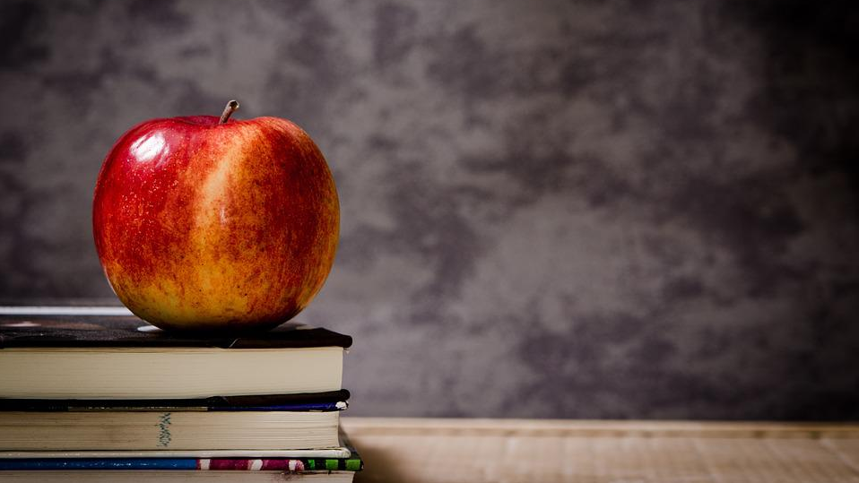
APPLE AND
BOOK
Free Template

Slide 2
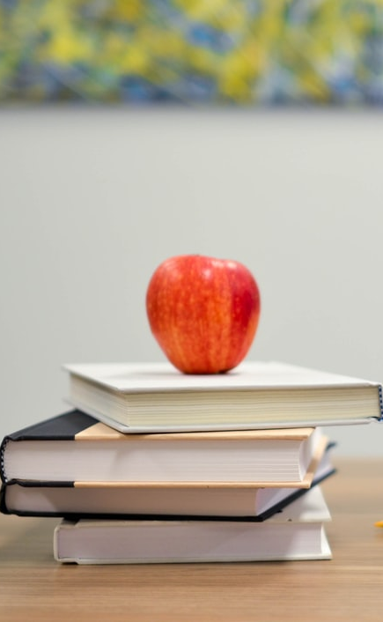
Table of contents
01.
02.
Books
Questions
04.
03.
To read
Exercises
You can describe the topic of the section here
You can describe the topic of the section here
You can describe the topic of the section here
You can describe the topic of the section here

Slide 3
Introduction
You can give a brief description of the topic you want to talk about here. For example, if you want to talk about Mercury, you can say that it’s the smallest planet in the entire Solar System

Slide 4
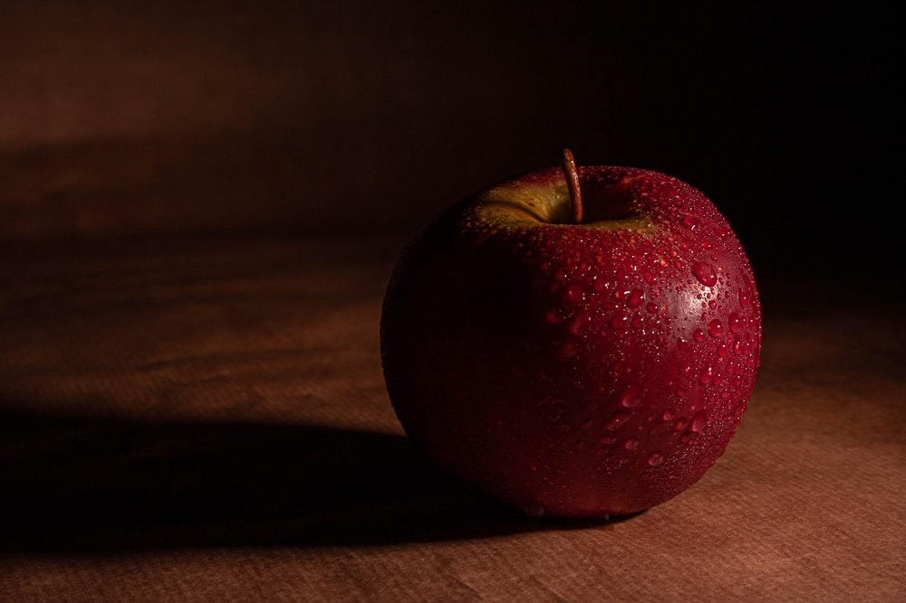
01.
Books
Books
You can enter a subtitle here if you need it

Slide 5
Questions to ask before reading
What do you think this book is about?
What do you think will happen?
Mercury is the closest planet to the Sun and the smallest one in the Solar System—it’s only a bit larger than the Moon
Venus has a beautiful name and is the second planet from the Sun. It’s hot and has a poisonous atmosphere

Slide 6
Questions to ask during reading
What do you think is going to happen next?
01.
02.
How do you think it is going to end?
How does the main character feel?
03.
Mercury is the closest planet to the Sun and the smallest of them all
Venus has a beautiful name and is the second planet from the Sun
Despite being red, it’s actually a cold place. It’s full of iron oxide dust

Slide 7
Questions to ask after reading
Like this book?
What happened?
Your favorite part
Tell me the story
Mercury is the smallest planet
Jupiter is the biggest planet
Despite being red, Mars is a cold place
Saturn is a gas giant and has rings

Slide 8
Traditional literary genres
Narrative
Lyrical
Didactic
Novel
Mercury is the smallest planet
Venus is the second planet from the Sun
Jupiter is the biggest planet of them all
Saturn is the only planet with rings

Slide 9
02.
Questions
You can enter a subtitle here if you need it

Slide 10
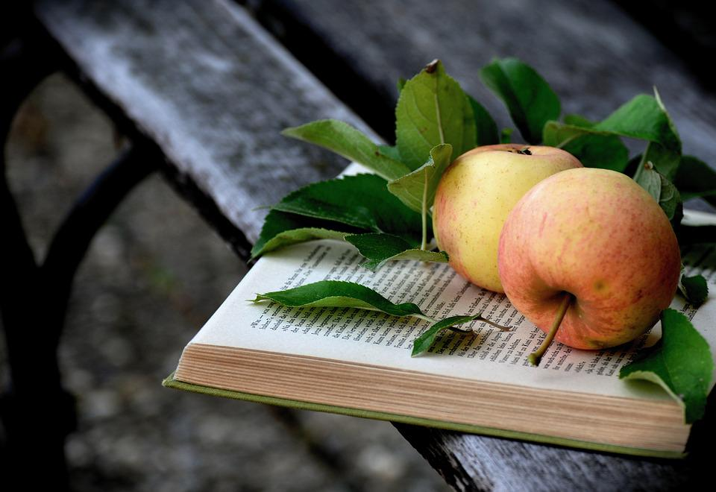
Awesome words
Awesome words

Slide 11
—Someone Famous
“This is a quote, words full of wisdom that someone important said and can make the reader get inspired.”

Slide 12
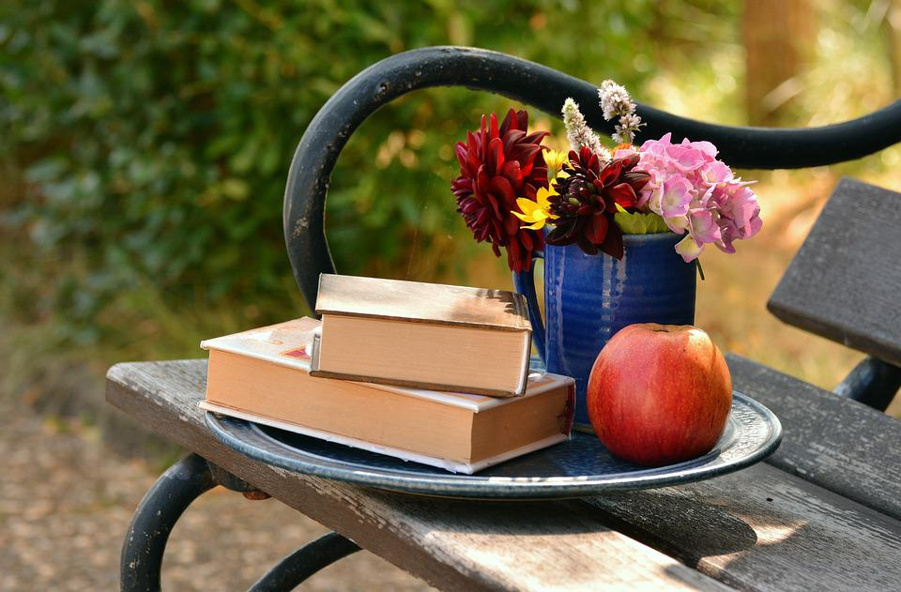
A picture is worth a thousand words

Slide 13
Literacy
Images reveal large amounts of data, so remember: use an image instead of a long text. Your audience will appreciate it
Images reveal large amounts of data, so remember: use an image instead of a long text. Your audience will appreciate it
Images reveal large amounts of data, so remember: use an image instead of a long text. Your audience will appreciate it

Slide 14
2,500
Big numbers catch your audience’s attention

Slide 15
5,000
500
25
Mercury is the smallest planet
Venus has very high temperatures
Saturn is the only planet with rings

Slide 16
Percentages
Read literature
75%
Mercury is the closest planet to the Sun and the smallest of them all
Heard literature
25%
Venus has a beautiful name and is the second planet from the Sun

Slide 17
03.
Exercises
You can enter a subtitle here if you need it

Slide 18
Most read books
Mercury
It’s the closest planet to the Sun
Jupiter
It’s the biggest planet of them all
Saturn
It’s composed of hydrogen and helium
Venus
It’s the second planet from the Sun

Slide 19
04.
To read
You can enter a subtitle here if you need it

Slide 20
Literature graph
60%
Mercury
It’s the closest planet to the Sun
40%
Jupiter
It’s the biggest planet of them all
Follow the link in the graph to modify its data and then paste the new one here. For more info, click here

Slide 21
Literature timeline
1984
Mercury is the smallest planet
1990
Venus has very high temperatures
2000
Earth is the planet where we all live
2021
Neptune is very far from the Sun

Slide 22
Literary genres
Lyrical subgenre |  |  | Dramatic subgenre
Venus is the second planet from the Sun |  |  | Saturn is a gas giant and has several rings
Despite being red, Mars is a cold place |  |  | Pluto is now considered a dwarf planet
Jupiter is the biggest planet of them all |  |  | The Sun is the star at the center of the Solar System

Slide 23
Our team
Lisa Doe
Tim Jones
Jean Dean
You can speak a bit about this person here
You can speak a bit about this person here
You can speak a bit about this person here

Slide 24
Literature Infographic
Venus
Mercury
It’s the second planet from the Sun
It’s the closest planet to the Sun
Saturn
Jupiter
It’s composed of hydrogen and helium
Jupiter is the biggest planet of them all

Slide 25
05.
Percentages
You can enter a subtitle here if you need it

Slide 26
Literacy bullet point
Mercury is the closest planet to the Sun
Venus is the second planet from the Sun
Despite being red, Mars is a cold place
Jupiter is the biggest planet of them all
Saturn is composed of hydrogen and helium
Neptune is the farthest planet from the Sun

Slide 27
Literature exercise
Indicate in the correct order to which literary genre each definition belongs
Definition 1
Narrative
Works that express feelings with a special language
Definition 2
Dramatic
Theater plays to be performed on stage
Definition 3
Lyrical
Works that tell stories and stories that are real or fantastic

Slide 28
06.
Mockup
You can enter a subtitle here if you need it

Slide 29
Thanks!
Do you have any questions?
Images reveal large amounts of data, so remember: use an image instead of a long text. Your audience will appreciate it

Slide 30
FUENTE
ELABORADO POR : plantillaspowerpoint.org
IMAGES :
unsplash.com
pixabay.com
FONTS :
Lemon
Comfortaa

Slide 31
RESOURCES

Slide 32
RESOURCES

Slide 33
RESOURCES

Slide 34
Fully Editable Icon Sets: A

Slide 35
Fully Editable Icon Sets: B

Slide 36
Fully Editable Icon Sets: C

