Slide 1


360 Degrees
Performance Appraisal
By
Deepak Bharara
LEVERAGING PEOPLE FOR TOMORROW...

Slide 2
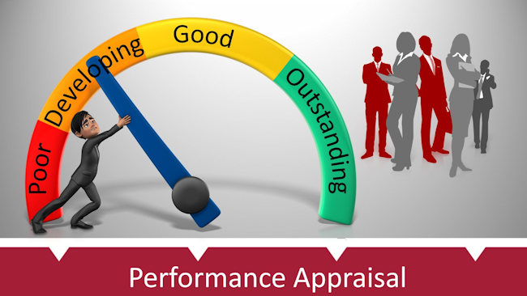
The most common Appraisal processes…
Straight Ranking Method
Grading Method
Management by Business Objectives Method
Competence/Trait Based Method
Behavior Based Method
Forced Distribution
Field Review Method
Critical Incident Method
Assessment Centers
360 Degree Review

Slide 3
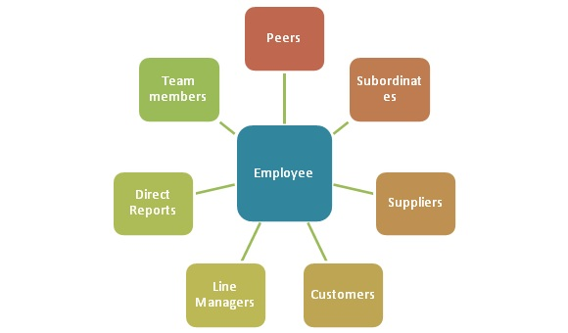
What is 360-Degree Appraisal ….
Unlike conventional appraisal techniques, a 360-degree appraisal is a management tool where the manager and an employee evaluate the latter's performance
It is also known as multi-rater feedback. 360-degree feedback also allows you to receive feedback from superiors, peers, clients, and other staff

Slide 4

What is 360-Degree Appraisal ….
A 360-degree appraisal can be defined as an anonymous employee performance review process in which an employee is collectively rated by subordinates, co-workers, and managers. It helps organizations gain valuable insights into organizational leadership, team functions, and overall company culture

Slide 5
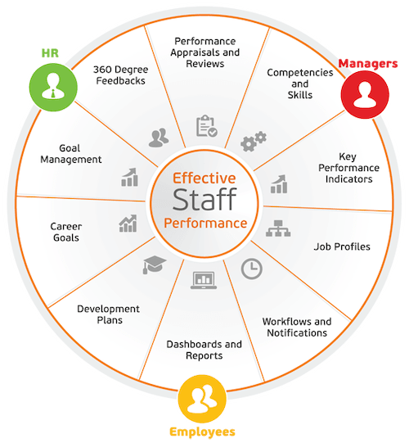
Why 360 Degree Appraisal ….
The purpose of 360-degree performance appraisal is to help each employee assess and understand their strengths and weaknesses for personal and organizational development. It aids in role clarity, potential appraisal, career planning, leadership, and team building

Slide 6
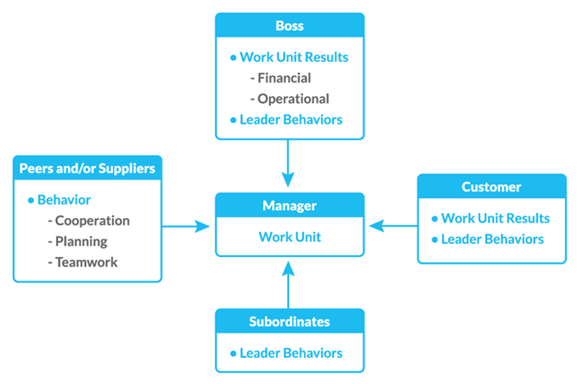
5 Important Components …
Self Appraisal
Superior Appraisal
Subordinate Appraisal
Peer Appraisal
Customer Appraisal

Slide 7
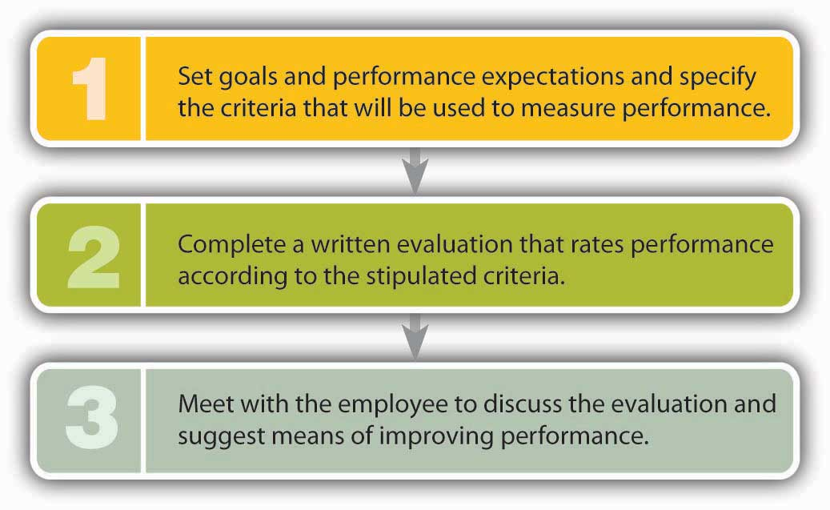
3 Steps to follow…

Slide 8
How to conduct 360 Degree Review…
Establish Criteria for rating each employee
Choose who will assess each employee
Train the assessors on evaluation process
Self Appraisal to start with
Send out appraisal/feedback form to rater to answer anonymously
Ensure the date & time-line to complete the process
Review the feedback/rating with the employees

Slide 9
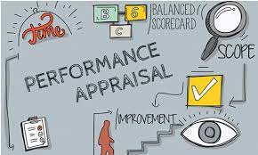
Factors to be looked at …
Punctuality
Accountability
Quality of Work
Quantity of Work
Time Management
Team-Work
Reliability
Effective Communication
Development Needs

Slide 10
Successful 360 Degree Appraisal…
Establish Criteria & Standards for rating each employee
Communicate the Standards
Choose who will assess each employee
Self Appraisal to start with
Send out appraisal/feedback form to rater to answer anonymously
Measure the Actual Performance – Compare Actual vs Desired performance
Ensure the date & time-line to complete the process
Review & provide the feedback/rating with the employees
Decision Making – List down disagreements, if any ?
Evaluate the raters/assessors as well

Slide 11
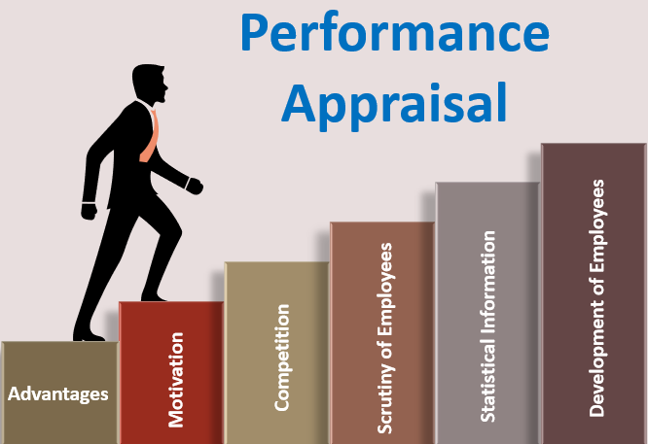
Advantage of 360 Degree Appraisal …

Slide 12
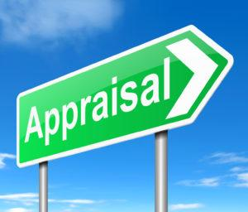
Advantage of 360 Degree Appraisal …
Provides complete assessment
Increase the Teamwork
Share Perception
Garners important feedback
Allows anonymity
Promotes Self Awareness
Identifies Development Gaps
Increase Productivity & Relationships

Slide 13
Disadvantage of 360 Degree…
Process is very lengthy, complex & take lot of time
High training efforts are required
Can create a suspicious environment in the organization
Leads to tension and trouble among employees, when the reviews are exchanged

Slide 14
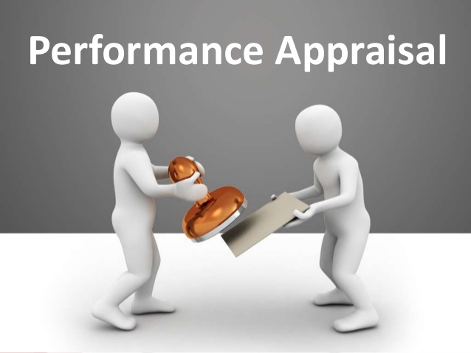
Problems in 360 Degree Appraisal …
Central Tendency error
Strictness or Leniency Approach error
Hallow Effect error
Recency error
Contrast error
Personal Biases error
Similar to me error

Slide 15
Pertinent Question to be put before ….
Is your organization committed to continuous learning?
Does your organization see the value of developing leaders in house?
Are you willing to make the changes necessary to do this?
What is the level of trust in your organization?
Will your culture support honest feedback?
Is the Top Management Committed & willing to lead the way & volunteer for 360 Degree Evolutions?

Slide 16

Let us get going ….
Ordinary people can deliver extraordinary performance

Slide 17

Open discussions

Slide 18

Email: contact@peoplea2z.com
Twitter:@peoplea2z
LinkedIn: https://in.linkedin.com/in/peoplea2z-advisory-n-solutions-a52837124
Facebook: @peoplea2z
Mobile: +91 9810048409

