Slide 1
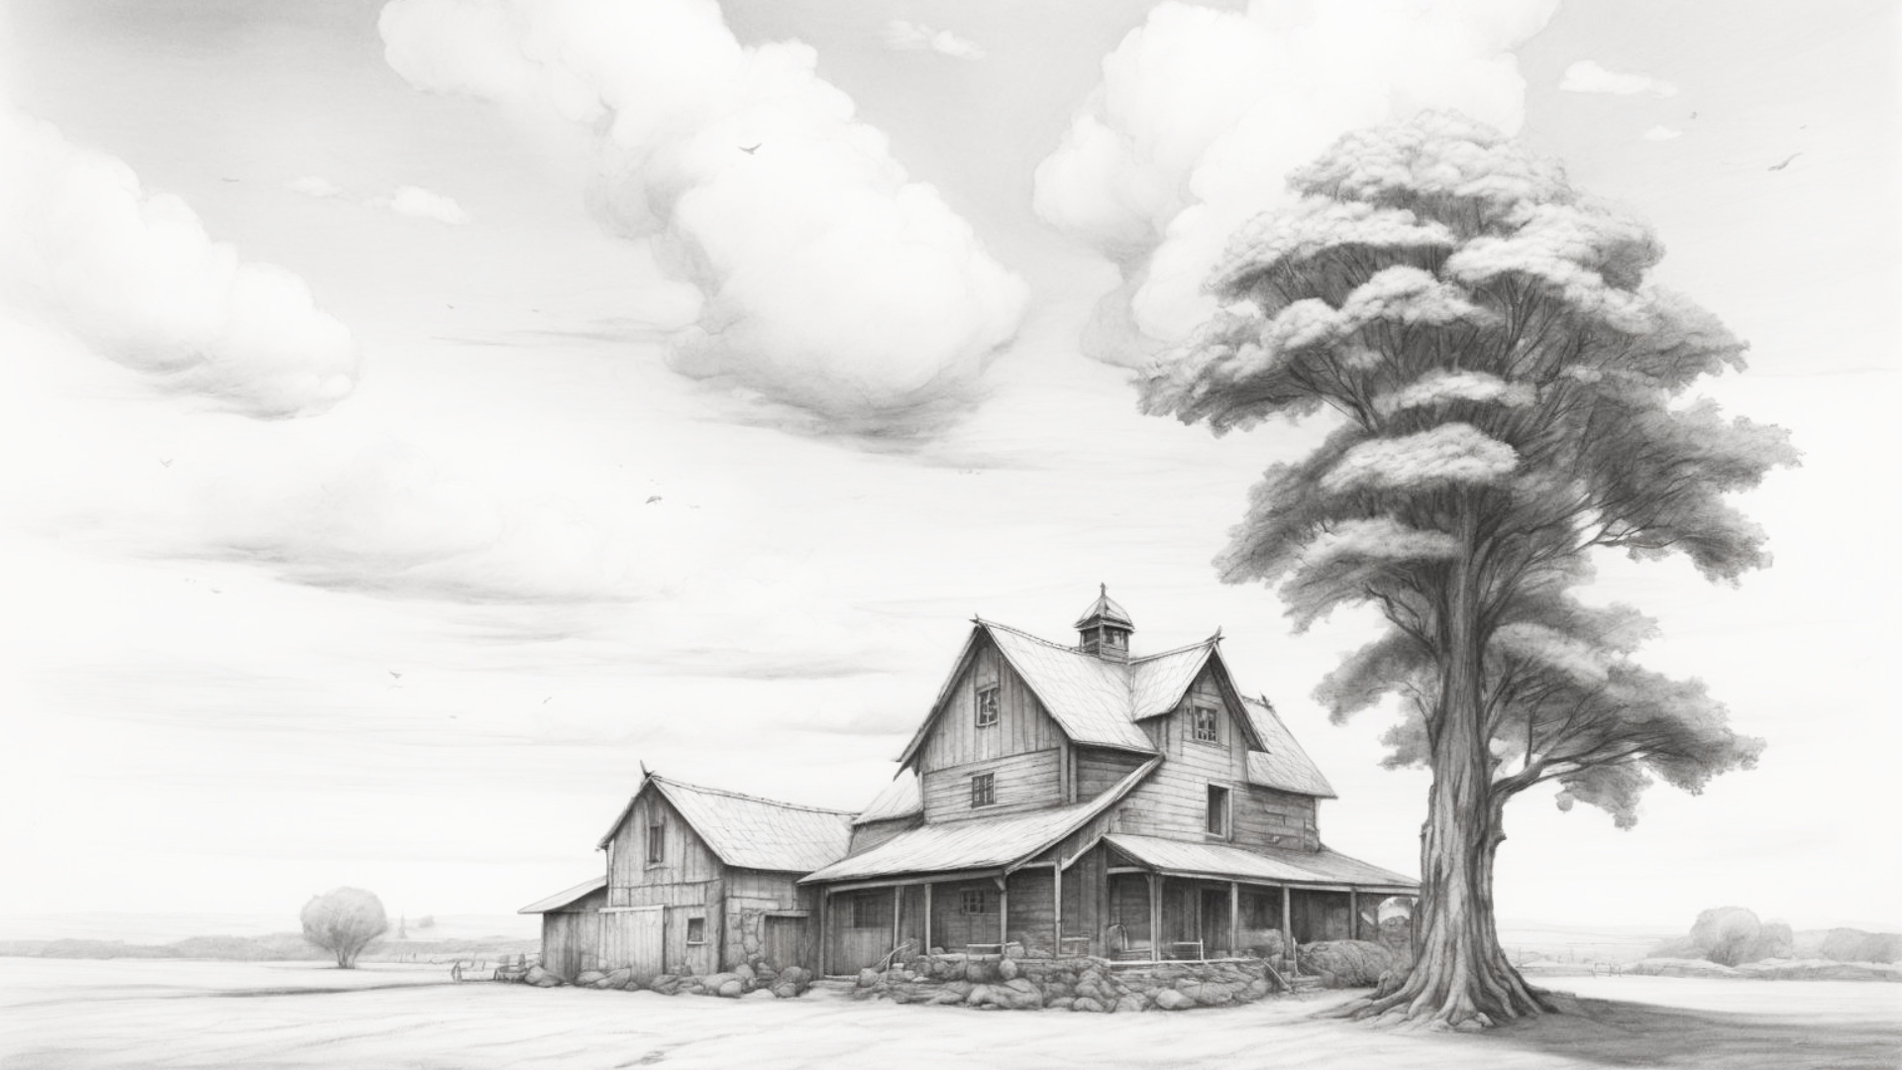


FREE PRESENTATION TEMPLATE
Organic Farming

Slide 2


Table of Contents
01
Introduction
02
Encounters
The Extraordinary Realm
Unicorn Sightings
03
Wonders
04
Magic
Wishes Granted
Spellcasting
05
Adventure
06
Conclusion
Happily Ever After
Embrace the Fantasy

Slide 3

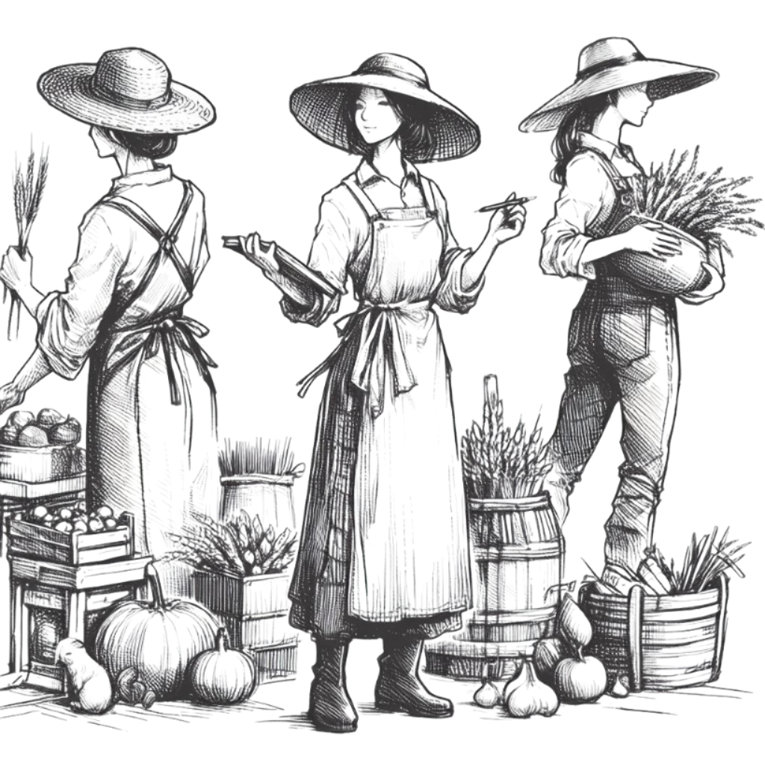

Introduction
The Fantasy Realm: Uncovering the Secrets of the Imagination and the Magic that Lies Within

Slide 4


The Realm of the Extraordinary
Welcome to the Fantasy World, a realm of wonder and enchantment where anything is possible. Here, dragons breathe fire, unicorns prance through meadows, and rainbows shine brightly. This world is a place where wishes come true, where potions can be cursed and spells are cast. It's a place of treasure and adventure, where the impossible becomes possible. But the greatest treasure of all is the one that lies within.
The world of fantasy is a reflection of our deepest desires, our fondest dreams, and our wildest imaginations. It's a place where we can let go of the constraints of reality and explore the boundless possibilities of the human mind. In this introduction, we will delve into the mysteries of this realm, uncovering the magic and wonder that lies within. So come with us and let's embark on a journey through the Fantasy World.

Slide 5
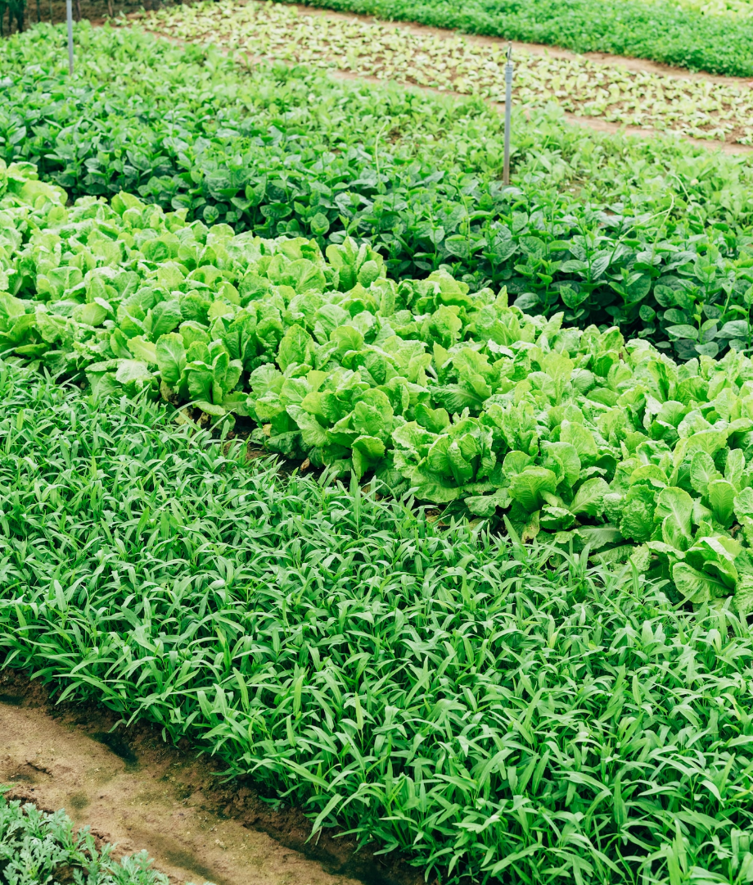



Unicorn Sightings
A record of the number of unicorns spotted in the fantasy realm and the beauty and mystery that surrounds these enchanting creatures.
Dragon Taming
A closer look at the art of taming dragons and the brave adventurers who dare to take on these fearsome creatures.

Slide 6


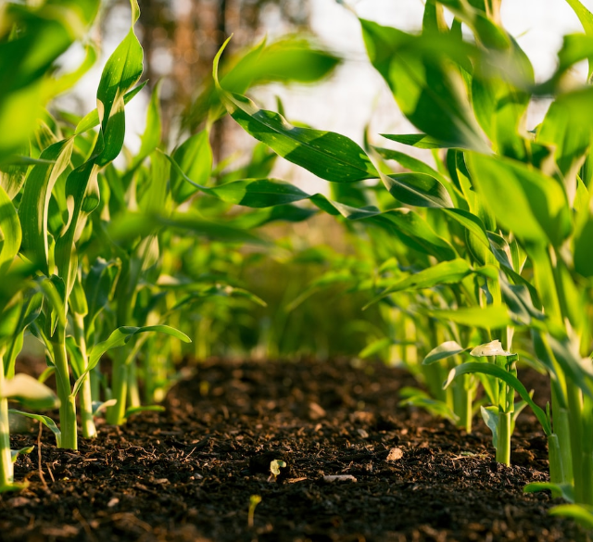
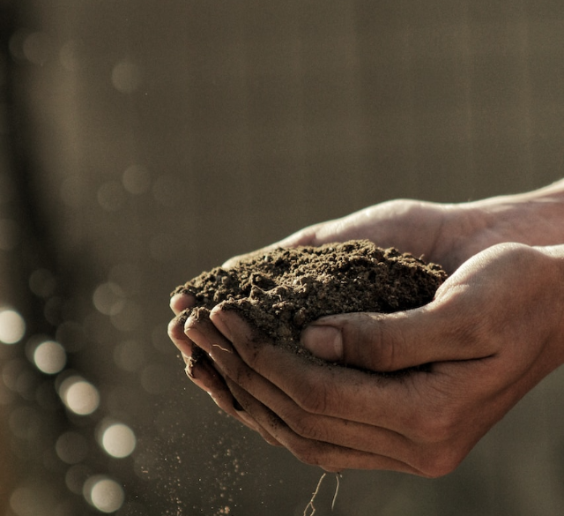

Unicorn Sightings
Dragon Taming
A record of the number of unicorns spotted in the fantasy realm and the beauty and mystery.
A closer look at the art of taming dragons and the brave adventurers who take on these creatures.

Slide 7


Fantasy is the gateway to the impossible, the land where the ordinary becomes extraordinary, and the impossible becomes possible. It is the realm of the imagination, where anything can happen and everything is possible.
The Dream Weaver

Slide 8
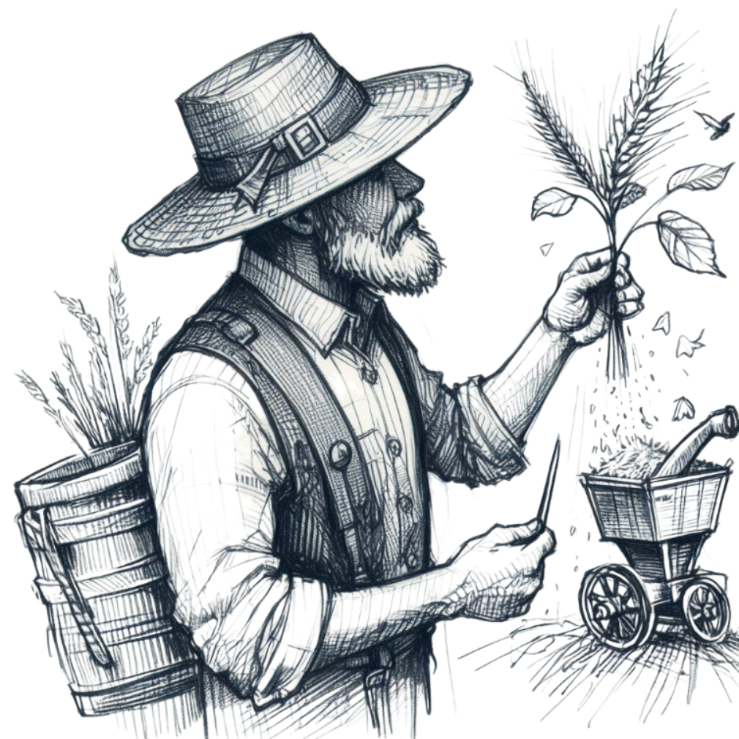

Dragon Taming Technique
The Art of Unicorn Sighting
A guide to taming and caring for dragons in the realm of magic.
Tips and tricks for spotting the elusive unicorns in their natural habitat.

Slide 9
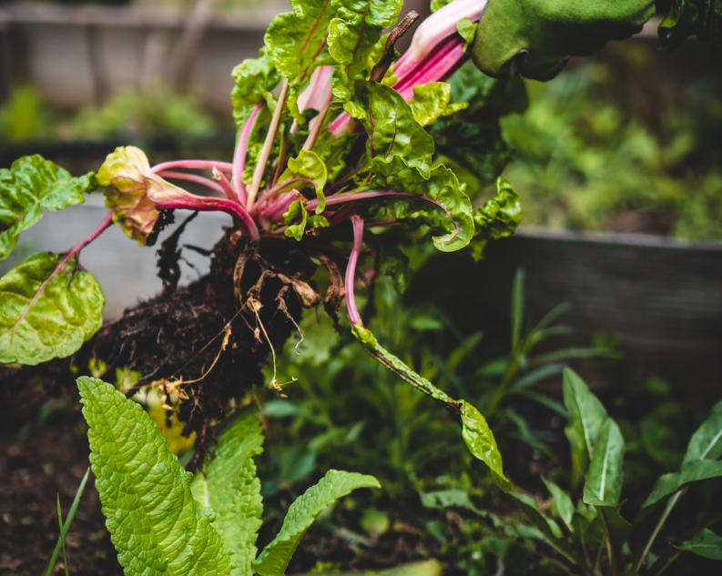
The Magic of Dragons:
A Research
6.7M
4.4M
2.3M

Slide 10
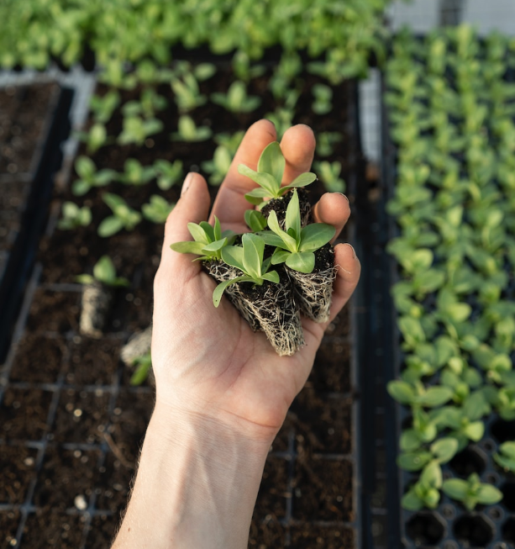



The Elves: A Glimpse into Their World
Elegant inhabitants of enchanted forests, known for their mastery of magic and their close connection to nature. They possess an innate sense of harmony and balance, making them protectors of the natural world.
"The Art of Archery": Discover the intricacies of the Art of Archery as practiced by the graceful and precise elves.
"The Music of the Elves": Immerse yourself in the enchanting music of the elves, whose songs have the power to heal.
"The Life of an Elf": Learn about the customs and daily life of the elves, from their familial structure to their religious beliefs.

Slide 11





S
Strengths
W
Weaknesses
Rare event causes unpredictable magic.
Rare event causes unpredictable magic.
O
Opportunities
T
Threats
Rare event causes unpredictable magic.
Rare event causes unpredictable magic.

Slide 12

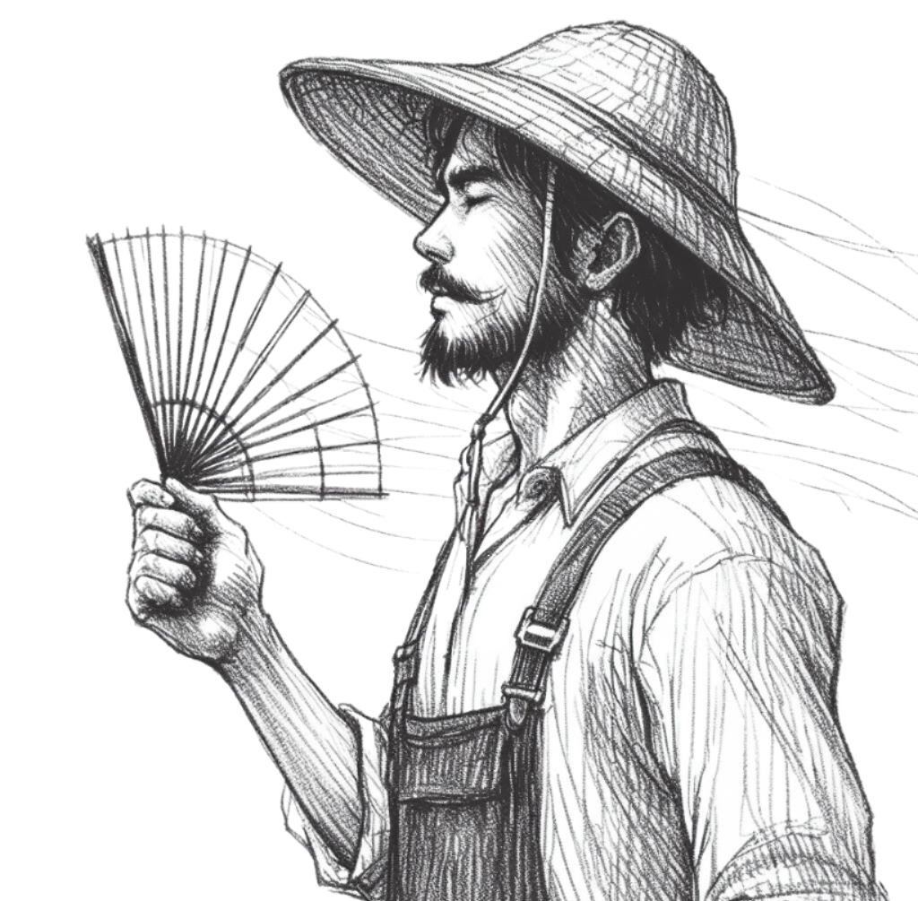

Some Data
75%
Enchanted Creatures
possess the ability to cast spells.
60%
Magic-Wielding Individuals
practice the art of illusions.
Spells Cast
90%
are dark magic, foretelling danger.

Slide 13
234,567
UNICORN SIGHTINGS
A tally of the number of unicorns spotted in the fantasy realm.

Slide 14
233 Coins
85%
Treasure Found
Wished Granted
456 Hours
535 Km
Duration of Spell Casting
Journey Distance

Slide 15

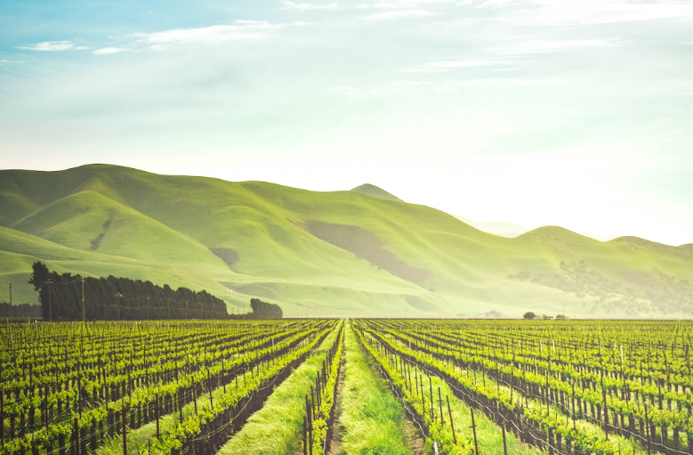
Portal to Adventure
A web application
A web application designed for discovering the world of fantasy

Slide 16



The Future of Fantasy
An mobile app
An app designed for exploring and experiencing the enchanting realm of fantasy

Slide 17

A Magic Picture

Slide 18

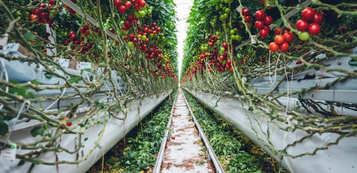
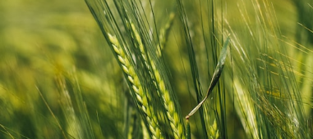
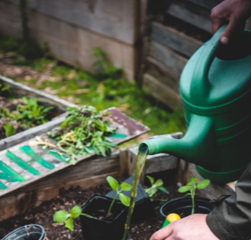
The Timeline
Eclipse
Quest
Obtain
Rare event causes unpredictable magic.
Adventurers seek immortal artifact.
Humans acquire Crystal
Invasion
Betrayal
Kingdom attacked by monsters.
Queen's advisor revealed as spy.

Slide 19



The Information
Spellcasting
Competition
Treasure
Hunt
Great
Adventure
A significant event in the history of the fantasy realm, in which the greatest spellcasters of the realm.
A significant event in the history of the fantasy realm, in which a massive and awesome treasure hunt was organized.
A notable year in the history of the fantasy realm, in which a large number of adventurers set out to explore.

Slide 20



Our Team
Eldruin
Elementalen
Lunaria
The Fire Mage
The Guardian
The Moon Priestess

Slide 21
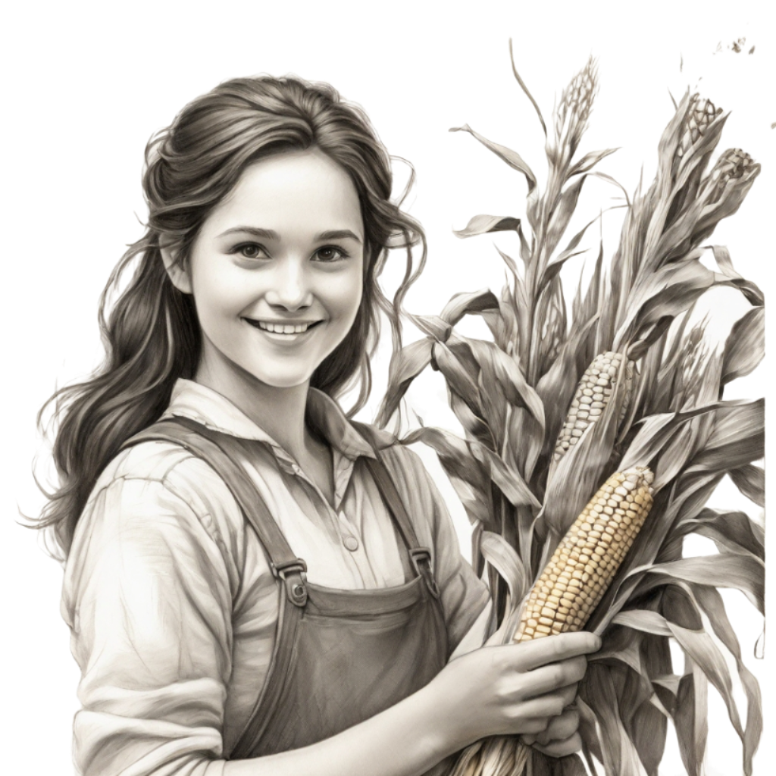

Thank you for choosing EaTemp
We offer free and high-quality slides templates for your presentations. We appreciate you choosing us and hope our templates have been helpful.
As a new website, we rely on your support to grow, so please help us by sharing our site with your friends and colleagues.
Credit | Image: Unsplash

