Slide 1
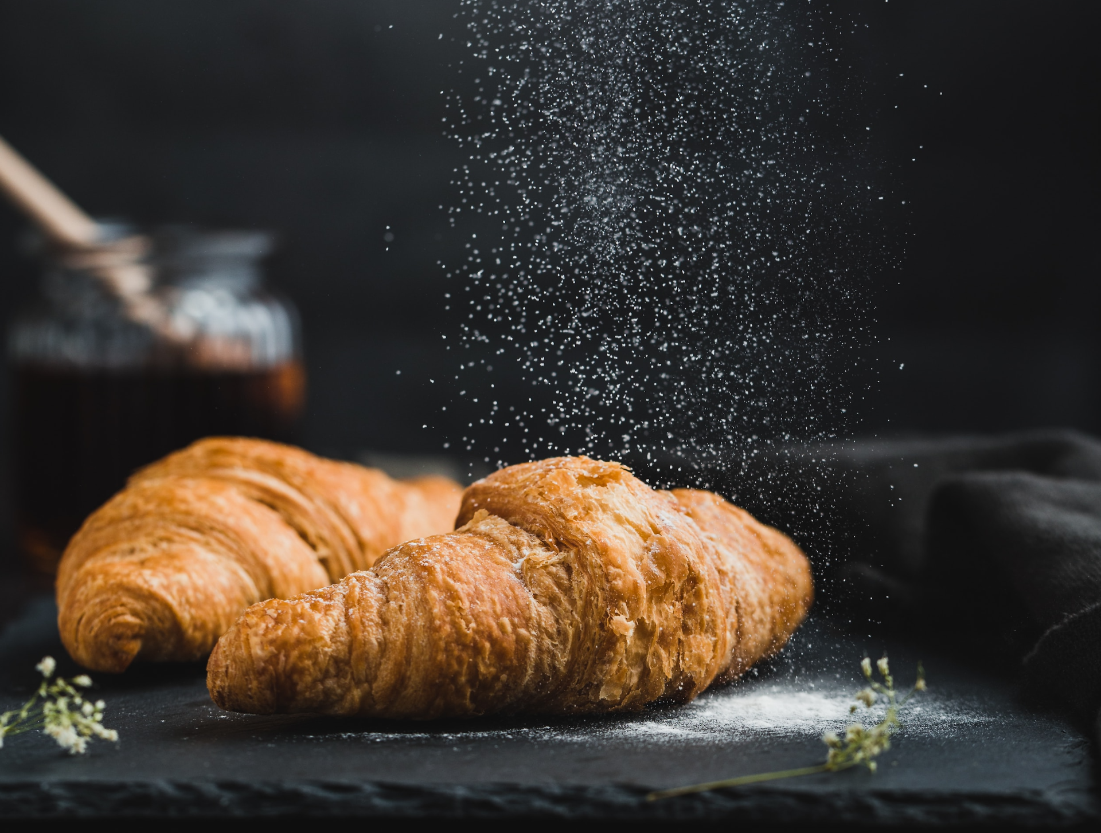

Bakery Workshop
Free Presentation Template

Slide 2

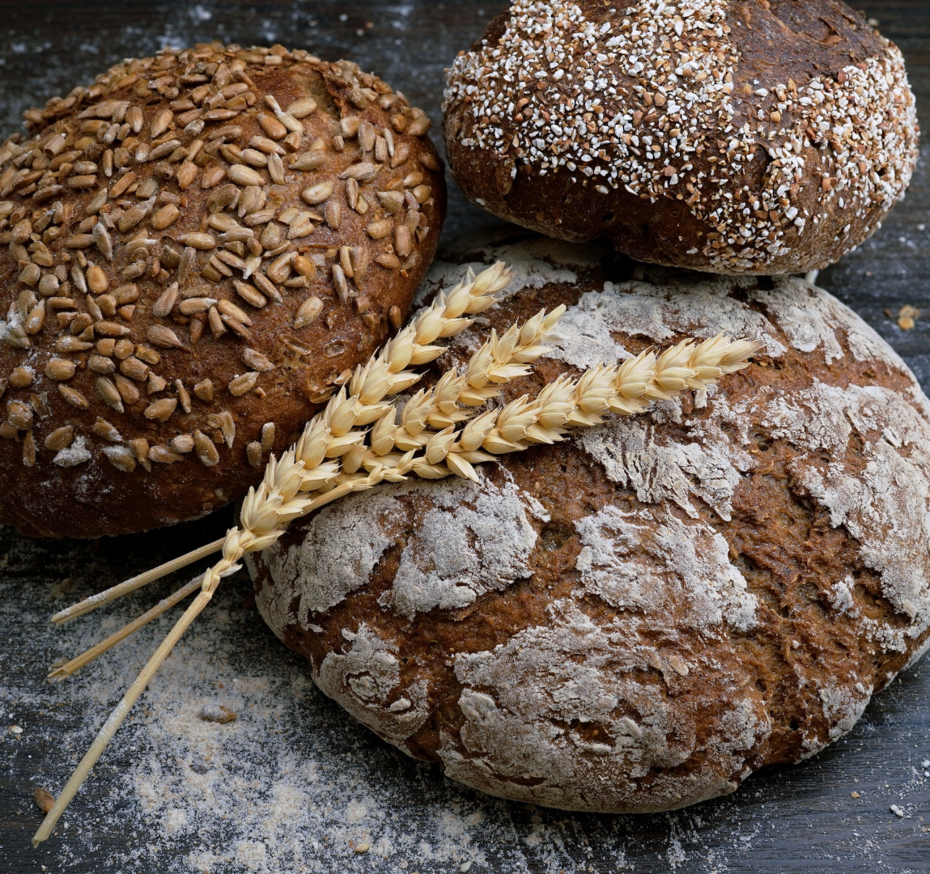

Welcome
Welcome to the world of fantasy! Join us on a journey to explore the mystical creatures, enchanted lands, and magical wonders that exist beyond our reality. Discover the wonders and secrets of this exciting realm and unlock the power of imagination.

Slide 3
table of content
Introduction
1
Specialty products
4
The basics of baking, ingredients, and equipment required for a bakery.
Gluten-free, vegan items, artisan bread, and custom cakes.
Techniques
2
Tips
5
Measuring ingredients, mixing, kneading, proofing, and baking.
Measuring ingredients, mixing, kneading, proofing, and baking.
Recipe
3
Safety and hygiene
6
Common bakery recipes, such as bread, cakes, pastries, and cookies.
Proper handling and storage of ingredients, cleaning of equipment.

Slide 4
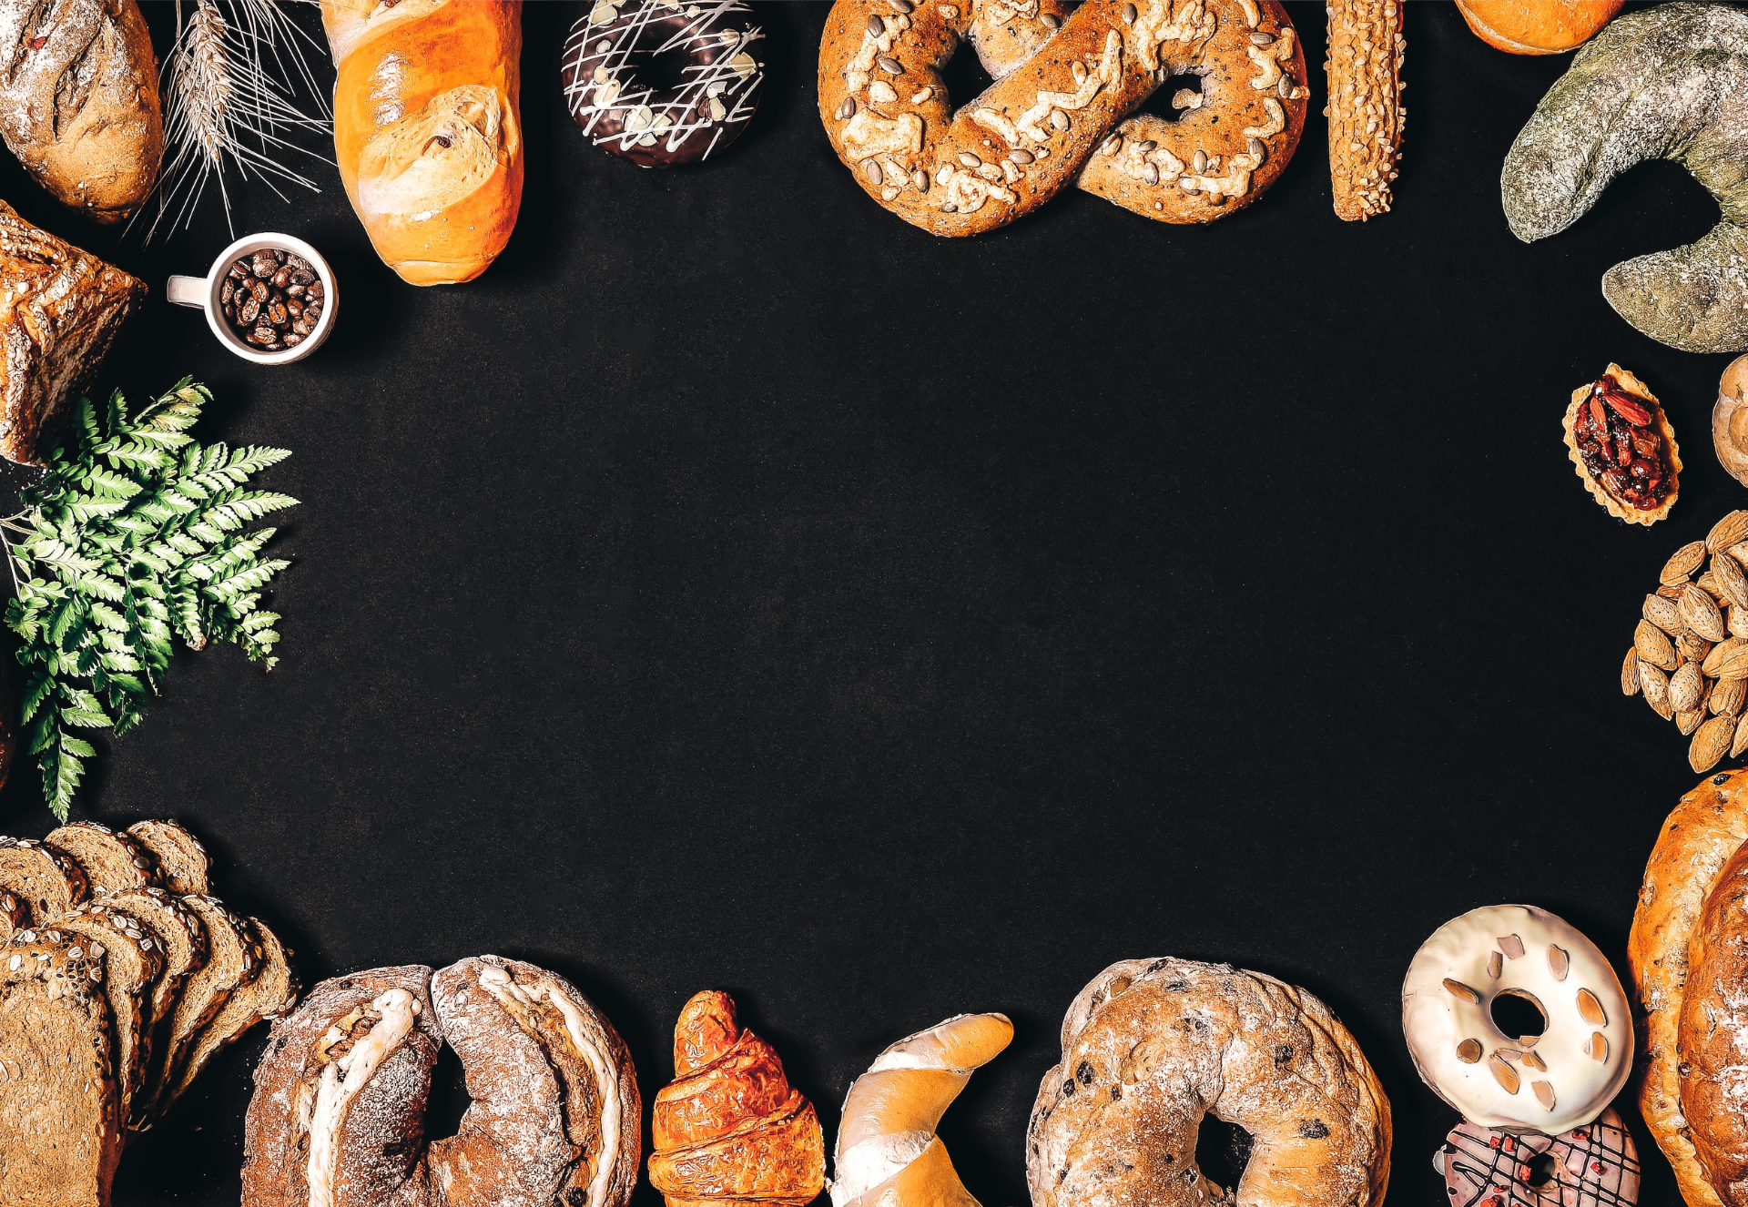
Introduction
The Fantasy Realm: Uncovering the Secrets of the Imagination and the Magic that Lies Within

Slide 5

the basics of baking
Welcome to the Fantasy World, a realm of wonder and enchantment where anything is possible. Here, dragons breathe fire, unicorns prance through meadows, and rainbows shine brightly. This world is a place where wishes come true, where potions can be cursed and spells are cast. It's a place of treasure and adventure, where the impossible becomes possible. But the greatest treasure of all is the one that lies within.
The world of fantasy is a reflection of our deepest desires, our fondest dreams, and our wildest imaginations. It's a place where we can let go of the constraints of reality and explore the boundless possibilities of the human mind. In this introduction, we will delve into the mysteries of this realm, uncovering the magic and wonder that lies within. So come with us and let's embark on a journey through the Fantasy World.

Slide 6
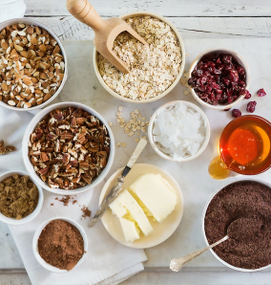
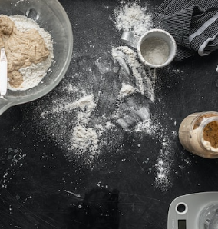
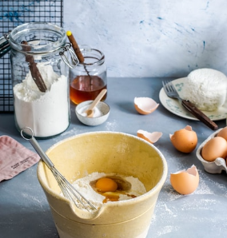
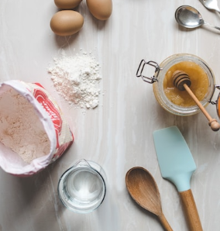
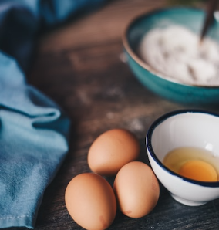
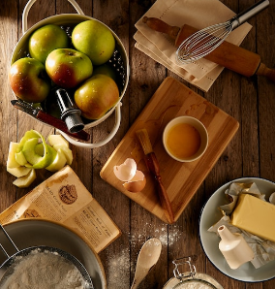
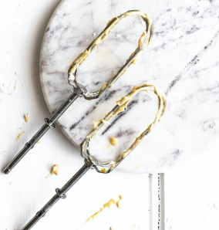
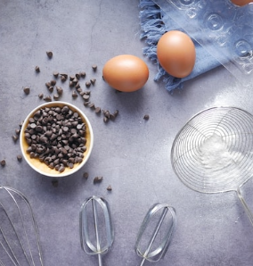
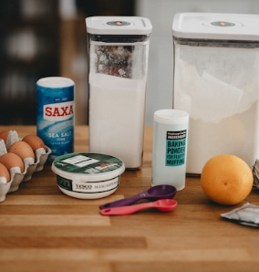
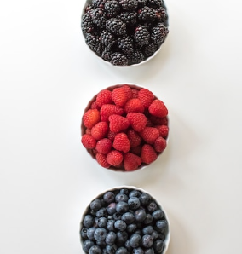
ingredients
Dragron
Unicorn
Spell
Elf
Egg
Sugar
Milk
Cheese
Rainbow
Love

Slide 7






equipment
Unicorn Sightings
Dragon Taming
Mermaid
A record of the number of unicorns spotted
A closer look at the art of taming dragons
A detailed account of mermaid sightings
Fairy
Mythical Creature
Ghost
A collection of stories and reports of fairy sightings
A journal of expeditions to remote locations
A collection of eerie tales and haunted locations

Slide 8
Techniques of baking
The Fantasy Realm: Uncovering the Secrets of the Imagination and the Magic that Lies Within

Slide 9



Fantasy is the gateway to the impossible, the land where the ordinary becomes extraordinary, and the impossible becomes possible. It is the realm of the imagination, where anything can happen and everything is possible.
The Dream Weaver

Slide 10
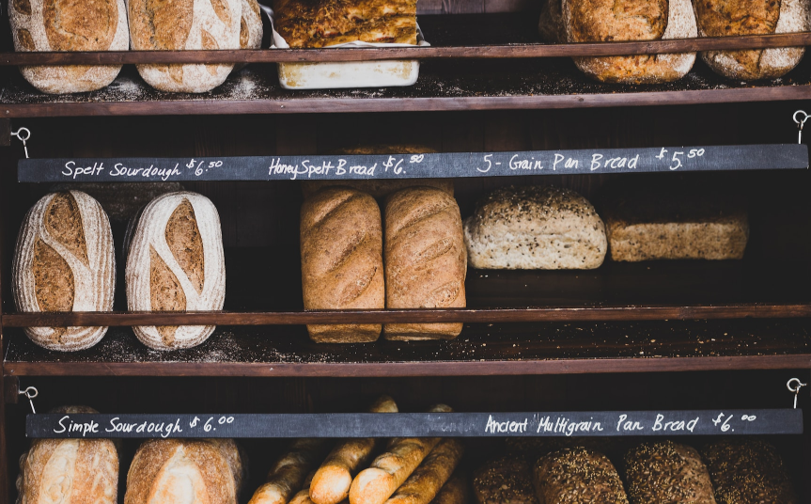
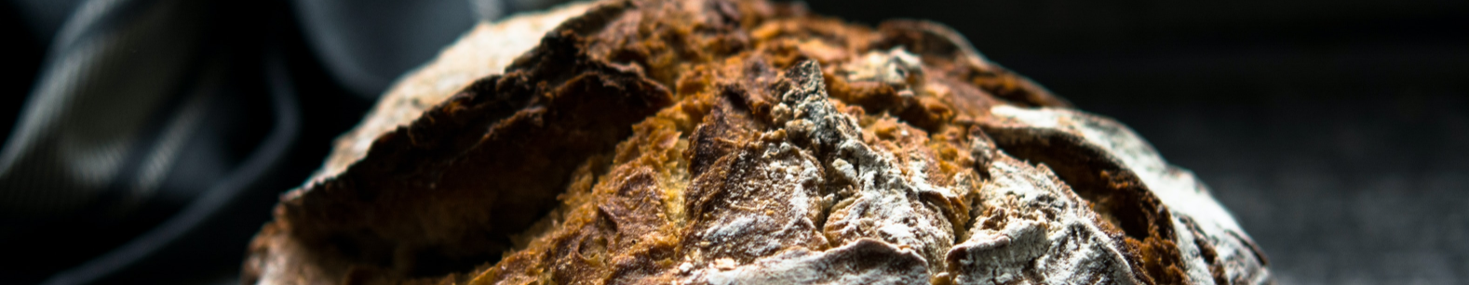
measuring ingredients
In the Realm of Magic and Adventure, dragons are no longer fearsome beasts to be feared. They can be tamed and even become loyal companions to those brave enough to venture into the unknown. Similarly, unicorns, long considered to be mythical creatures, can now be sighted in this fantastical realm.

Slide 11
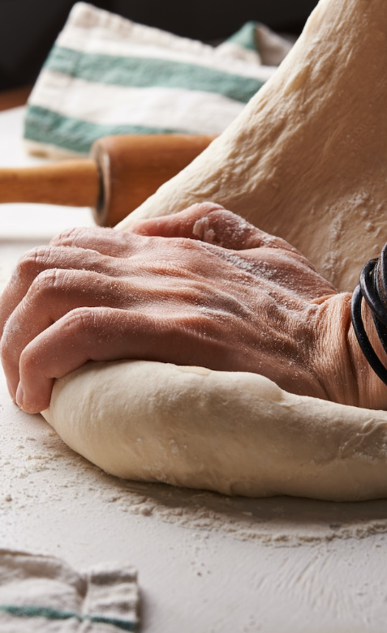
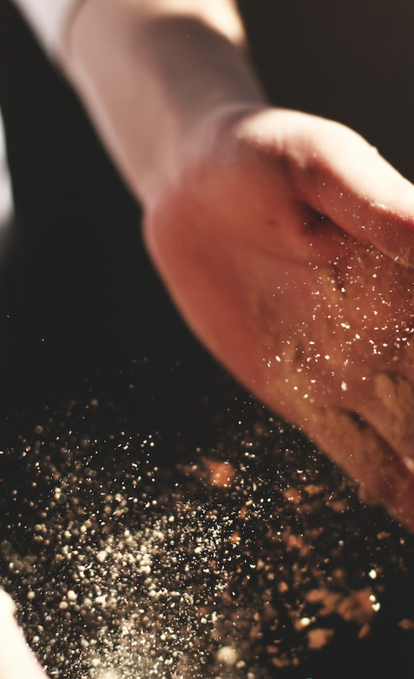




mixing, kneading, proofing, and baking
"The Art of Archery": Discover the intricacies of the Art of Archery as practiced by the graceful and precise elves.
"The Music of the Elves": Immerse yourself in the enchanting music of the elves, whose songs have the power to heal.
"The Life of an Elf": Learn about the customs and daily life of the elves, from their familial structure to their religious beliefs.
"The Art of Archery": Discover the intricacies of the Art of Archery as practiced by the graceful and precise elves.

Slide 12
Recipes
The Fantasy Realm: Uncovering the Secrets of the Imagination and the Magic that Lies Within

Slide 13
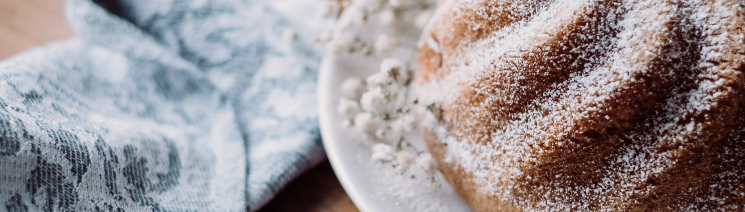
ingredients
Process
Dragon
20 g
The journey of self-discovery and the exploration of the human imagination are just as important as the creatures and wonders that populate this realm. Here, you can reflect on your deepest desires and fulfill your fondest dreams. The realm is a place where you can let go of the constraints of reality and explore the boundless possibilities of the mind.
Magic
500 ml
Spell
560 g
Unicorn
2 kg
Rainbow
245 ml

Slide 14
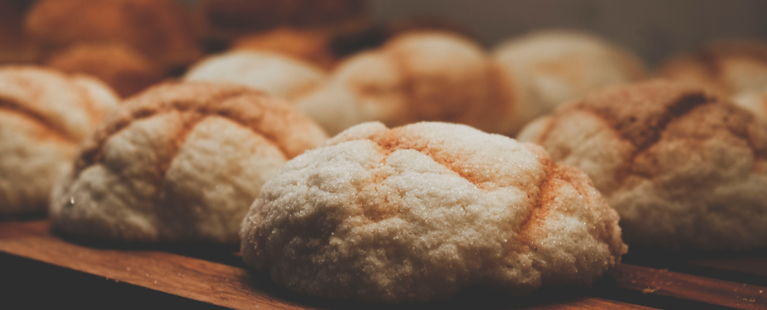
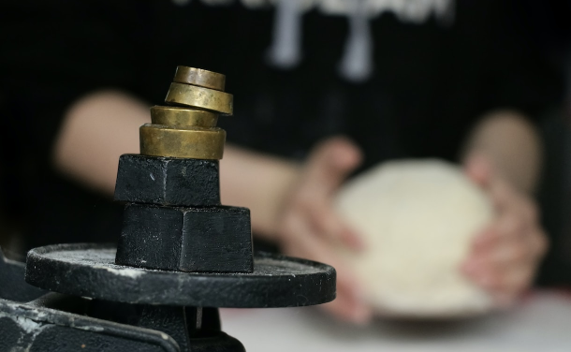
ingredients
Dragon
20 g
Magic
500 ml
Spell
560 g
Unicorn
2 kg
Rainbow
245 ml
Process
The journey of self-discovery and the exploration of the human imagination are just as important as the creatures and wonders that populate this realm. Here, you can reflect on your deepest desires and fulfill your fondest dreams. The realm is a place where you can let go of the constraints of reality and explore the boundless possibilities of the mind.

Slide 15
Specialty products
The Fantasy Realm: Uncovering the Secrets of the Imagination and the Magic that Lies Within

Slide 16
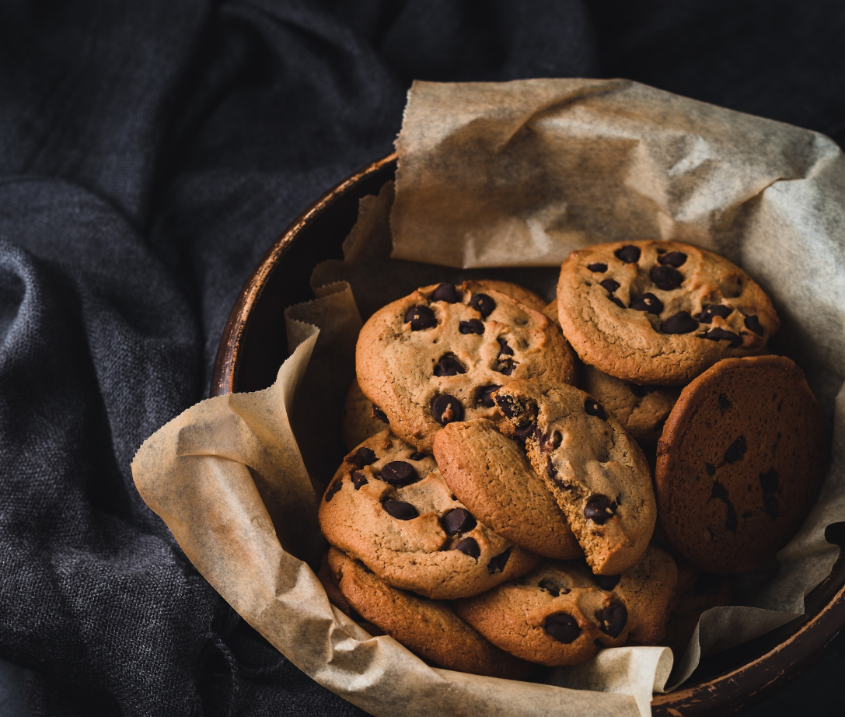
gluten-free or vegan items
"The Evolution of the Unicorn" is a study exploring the historical, cultural, and mythical development of the iconic fantasy creature. From its ancient roots in Mediterranean mythology to its modern-day representation in popular culture, this research delves into the various interpretations and beliefs surrounding the mystical horse with a single horn. The goal is to understand the evolution of this captivating creature and its enduring place in human imagination.

Slide 17
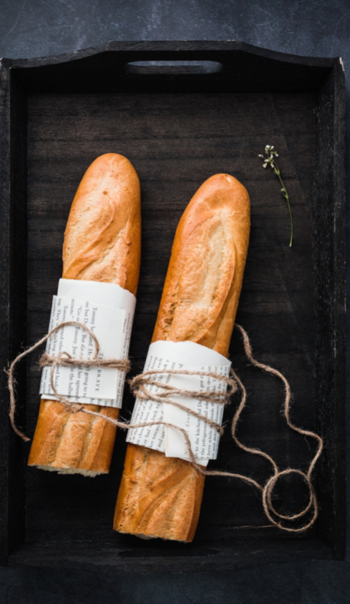
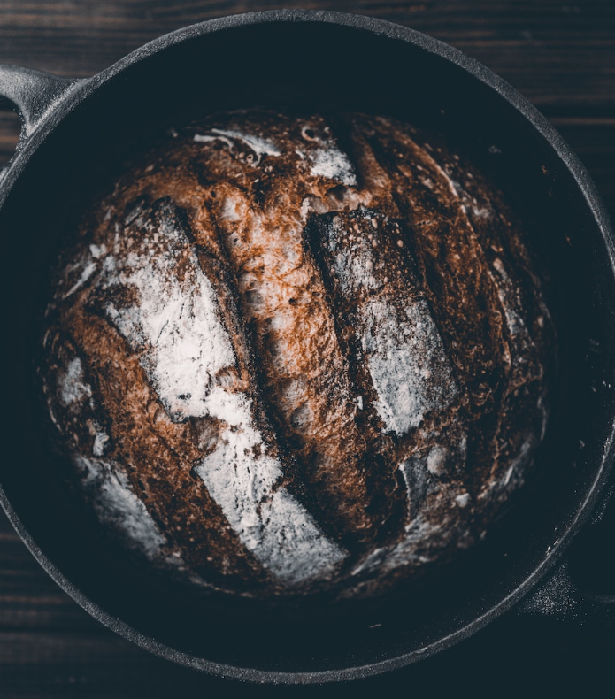
artisan bread
A magical being with the power to cast spells and create illusions, often sought for bringing wonder and magic into people's lives.

Slide 18




Tips for success
Unicorn Sightings
dragon taming
rainbow seeing
A record of the number of unicorns spotted in the fantasy realm and the beauty and mystery that surrounds these enchanting creatures.
A record of the number of unicorns spotted in the fantasy realm and the beauty and mystery that surrounds these enchanting creatures.
A record of the number of unicorns spotted in the fantasy realm and the beauty and mystery that surrounds these enchanting creatures.

Slide 19
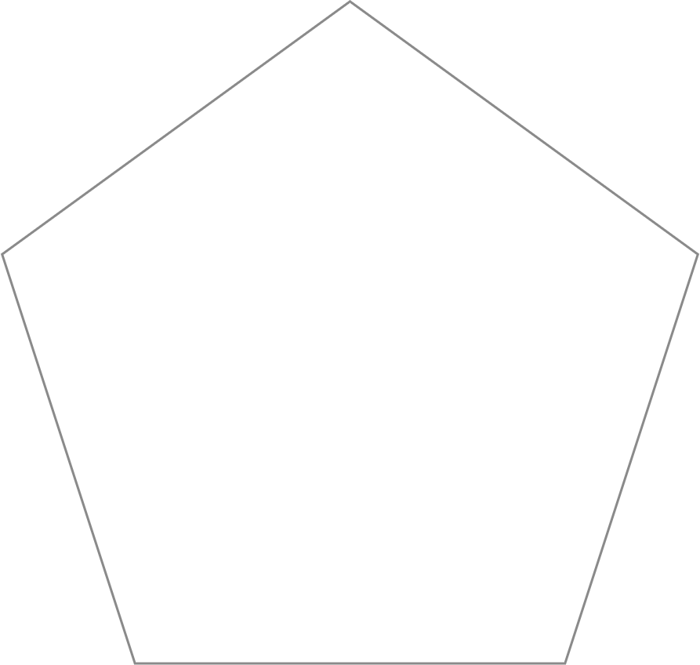
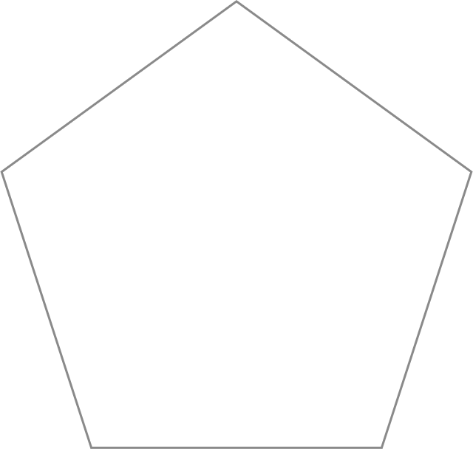

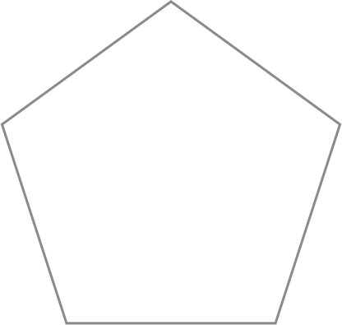
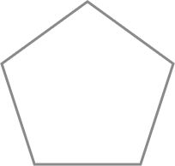
Adventure: 75%
"The Evolution of the Unicorn" is a study exploring the historical, cultural, and mythical development of the iconic fantasy creature.
Mystery: 85%
Magic: 90%
Danger: 50%
Wonder: 20%

Slide 20
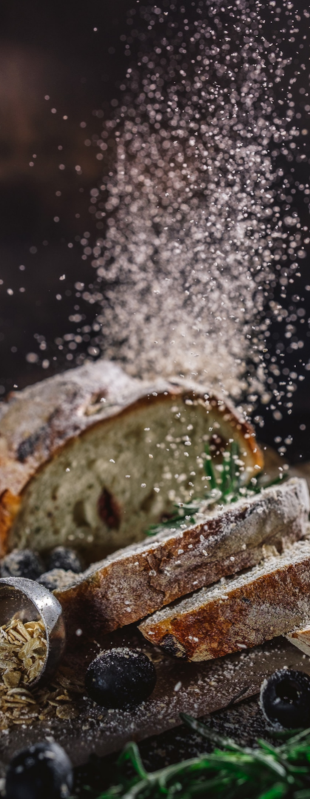
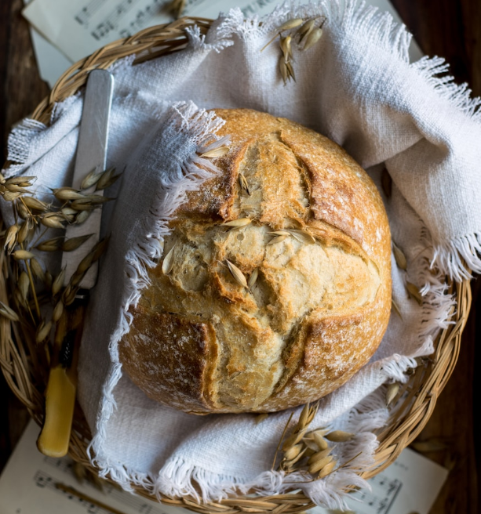
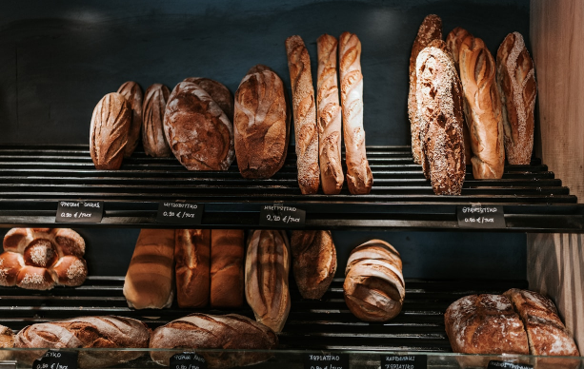
Safety and
hygiene
75%
Enchanted Creatures
possess the ability to cast spells.
60%
Magic Individuals
practice the art of illusions.
90%
Spells Cast
are dark magic, foretelling danger.

Slide 21









Thank you for choosing EaTemp
We offer free and high-quality slides templates for your presentations. We appreciate you choosing us and hope our templates have been helpful.
As a new website, we rely on your support to grow, so please help us by sharing our site with your friends and colleagues.
eatemp._
@eatemp
eatempofficial
@eatemp.official

