Slide 1

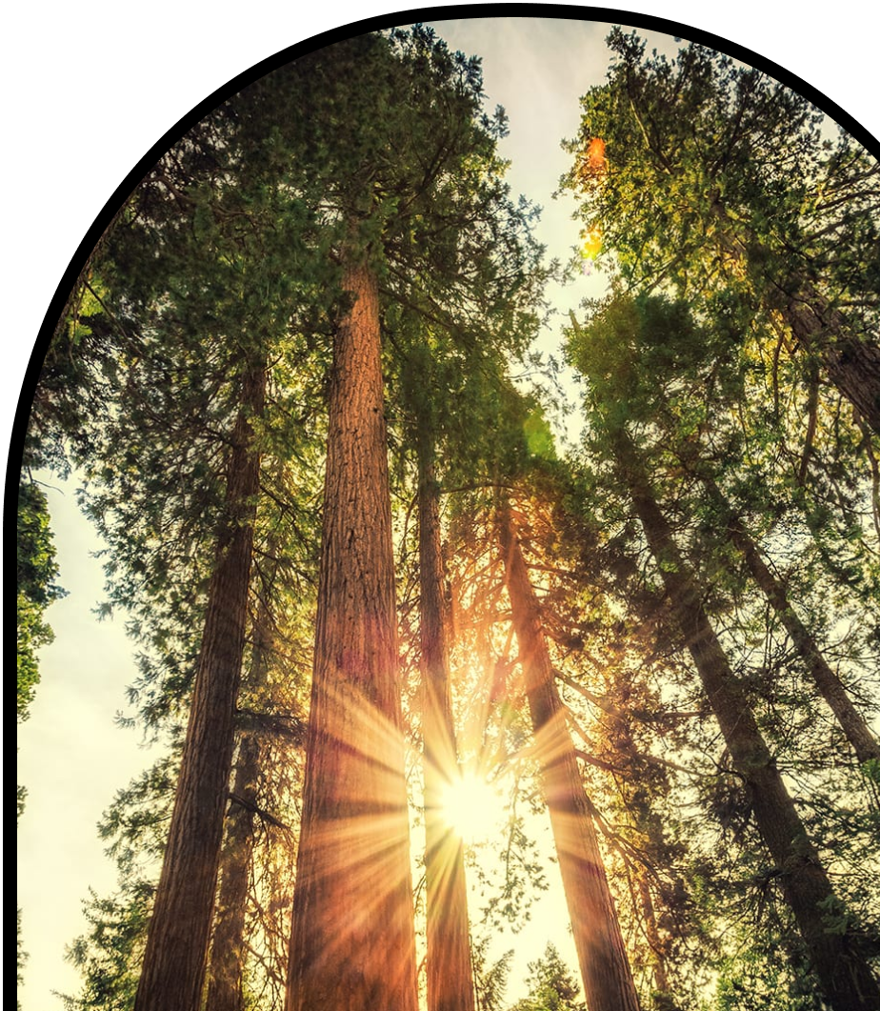
Anchor Layer Teacher Guide
A curriculum companion for Anchor Layer users
Grade 2
Plant Growth & Interactions
Unit Web Link • Pacing Guide • Other Units

Slide 2
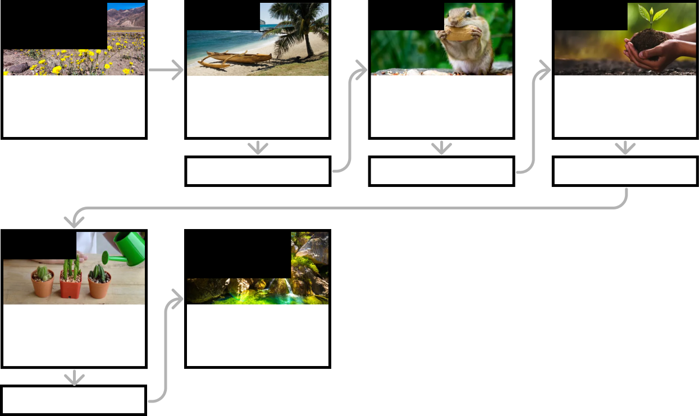
Plant Growth & Interactions • Grade 2
Anchor Layer Teacher Guide
Unit Summary
In this unit, students explore how plants interact with the environment to meet their needs. Students build models of seeds to explore how and why plants disperse their seeds. Students also conduct hands-on investigations to determine what those seeds need in order to grow, and what the adult plants need in order to survive and thrive. Assessments
Performance Expectations | Science & Engineering Practices | Disciplinary Core Ideas | Crosscutting Concepts
• K-2-ETS1-2. Develop a simple sketch, drawing, or physical model to illustrate how the shape of an object helps it function as needed to solve a given problem. • 2-LS2-1. Plan and conduct an investigation to determine if plants need sunlight and water to grow. • 2-LS2-2. Develop a simple model that mimics the function of an animal in dispersing seeds or pollinating plants. | • Developing and Using Models • Planning and Carrying Out Investigations • Analyzing and Interpreting Data | • LS2.A: Interdependent Relationships in Ecosystems | • Structure and Function • Cause and Effect
Anchor Phenomenon
Lesson 1
Lesson 2
Lesson 3
Plant Growth and Habitat
Superbloom
Seed Dispersal
How did a tree travel halfway around the world?
Animal Seed Dispersal
Why do seeds have so many different shapes?
Water, Sunlight, & Plant Growth
Could a plant survive without light?
Anchor Connection
Anchor Connection
Anchor Connection
Lesson 4
Performance Task
Plant Needs & Habitats
How much water should you give a plant?
Water, Plants, & Animals, & Habitats
How can anything live in Death Valley?
Anchor Connection
‹#›

Slide 3
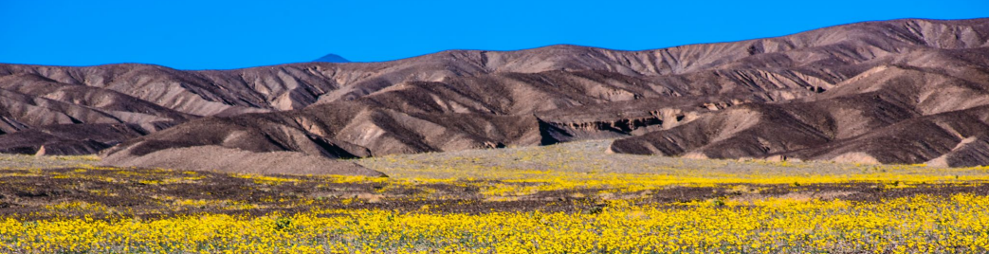
Plant Growth & Interactions • Grade 2
Anchor Layer Teacher Guide
Anchor Phenomenon Background
How can fields of flowers grow in one of the hottest, driest places on Earth?
Death Valley is an incredible place. Located in California, USA, it is a place of extremes. It is one of the hottest and driest places anywhere in the world. In the summer months, the average high temperature each day is a blistering 114°F (46°C), and the average annual rainfall is just 1.94 inches (4.9 cm).
Despite these harsh conditions, a wide variety of plants and animals inhabit the area. They have adapted to live in an environment with a scarcity of water and an overabundance of heat and light.
Approximately once every ten years, though, Death Valley experiences a slight reprieve. It is rare, but in some winters, Death Valley receives a series of multiple gentle rainstorms. These gentle rain storms soak into the dry earth, and millions of tiny wildflower seeds begin to germinate. This is the beginning of one of the most amazing phenomena seen in any desert: a superbloom!
The conditions that lead to a superbloom are very rare. There has to be enough water from winter rain storms for the seeds to begin to grow. They eventually begin growing in the spring, and the new plants are in a race to produce flowers and new seeds before the Sun builds in intensity and inevitably dries the flowers up. The flowers can suddenly appear, completely covering areas that were barren sand and rock just a few months prior, and then disappear within just a few weeks.
When the flowers dry up and disappear, however, they leave their seeds behind. Those seeds then lie dormant for years, until the conditions are just right for the superbloom cycle to repeat!
‹#›

Slide 4
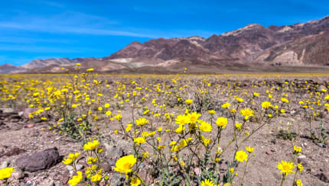
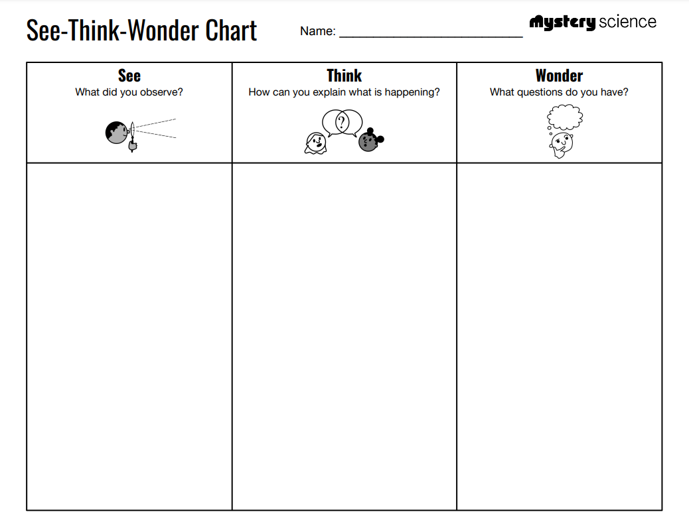
Plant Growth & Interactions • Grade 2
Anchor Layer Teacher Guide
Anchor Phenomenon: Superbloom
Plant Growth and Habitat
Anchor Phenomenon Lesson Overview
Note: This lesson is part of this unit’s Anchor Layer. If you have the Anchor Layer turned on, we recommend teaching all lessons in the remainder of this unit in order.
The anchor phenomenon for this unit is an amazing burst of life in a place called Death Valley. How can huge fields of flowers suddenly grow in one of the hottest, driest places on Earth?
During the introduction, students generate observations and questions about the phenomenon and create an initial conceptual model to explain the phenomenon. You can split this introduction into two parts with a break in between: complete everything up through the See-Think-Wonder, and then complete everything after that point. Students will use these initial ideas to track how their understanding grows throughout the unit.
Anchor Phenomenon 25 mins
Guided Inquiry 25 mins
Hands-On Activity 25 mins
Student Work Samples & Notes
Students will gather clues during and after each lesson in this unit to help them improve their understanding and explanations. It is important to encourage students to recognize that even if they don't know the perfect answer yet, they are going to learn a lot throughout the unit and will have an opportunity to revisit the phenomenon over time.
A hot, dry place
Sand and rocks
No clouds
Lots and lots of flowers
Mountains
I think it’s too hot for flowers to grow
I think the flowers get blown in by the wind
I think it might rain sometimes
Where do the flowers come from?
Why don’t the flowers grow every year?
‹#›

Slide 5
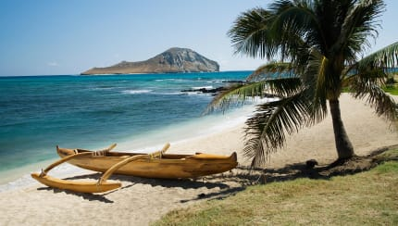
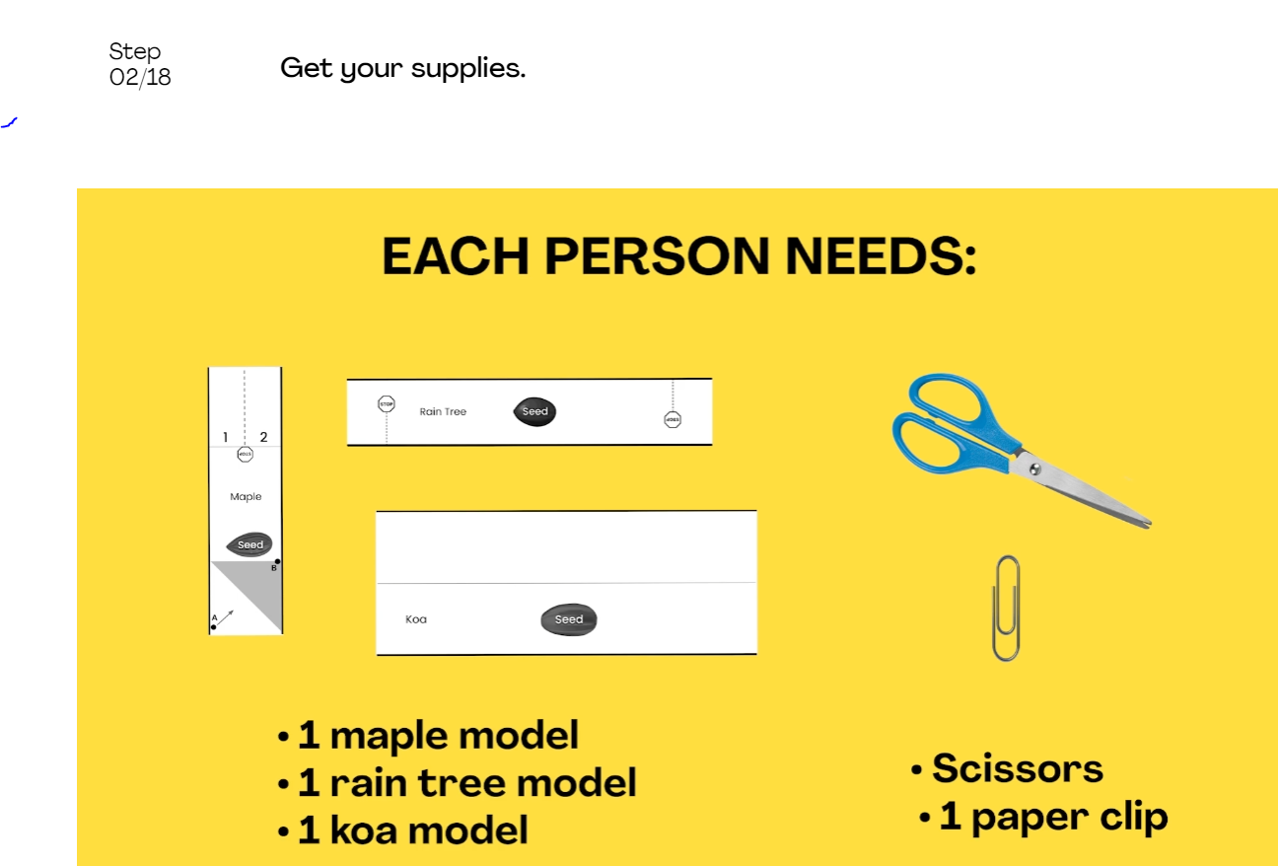
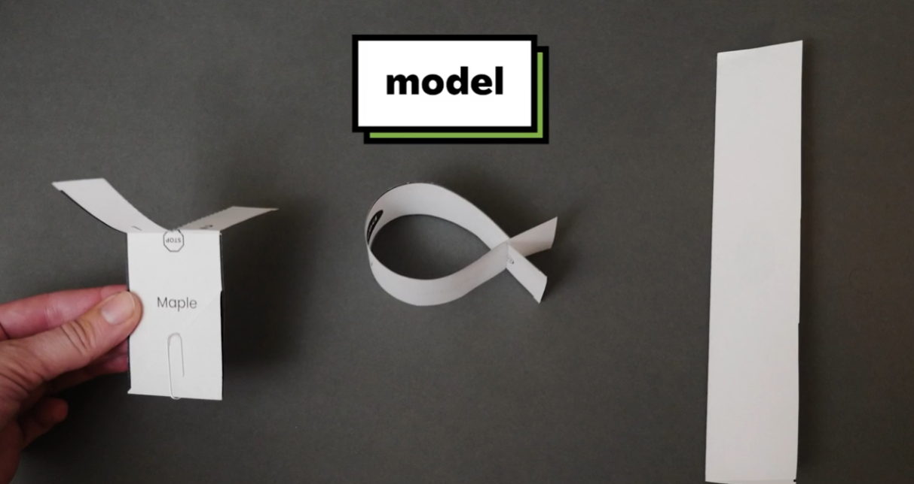
Plant Growth & Interactions • Grade 2
Anchor Layer Teacher Guide
Lesson 1: How did a tree travel halfway around the world?
Seed Dispersal (pg 1 of 2)
Overview
In this lesson, students investigate the mystery of the koa tree, a type of tree that grows in only two places—islands halfway across the world from one another.
In the activity, students develop three different physical models of seed structures. They observe how structure affects the seed’s function in dispersing away from the tree. Then, they use these observations to evaluate whether koa seeds are likely dispersed by wind, water, or animals.
Anchor Connection on Next Page
Exploration 10 mins
Hands-On Activity 35 mins
Wrap-Up 10 mins
Anchor Connection 20 mins
Activity Notes
You and your students may notice that the seed models don’t look exactly like the real seed structures. The models may look different than the real things, but they should mimic the function of how the real seeds fall and float to the ground.
We suggest students work in pairs. Each student will make their own seed models, but having a partner is useful for discussion and testing during the activity.
Each of the printouts has multiple seed models. We suggest cutting these seed models ahead of time for your students. Using a paper cutter can make this prep go quickly.
‹#›

Slide 6
Plant Growth & Interactions • Grade 2
Anchor Layer Teacher Guide
Lesson 1: How did a tree travel halfway around the world?
Seed Dispersal (pg 2 of 2)
Anchor Connection
Many plants produce seeds. Seeds can grow and produce new plants. The seeds in Death Valley are tiny, but they are important! Even though the seeds are too tiny to be seen in any of the images that students have viewed, they are there, waiting to grow and become superblooms. The plants that grow in a given superbloom continue the cycle: they produce new seeds that will eventually become the next superbloom.
Students revisit the worksheet that they worked on during the Anchor Phenomenon. They should understand that the flowers don’t come out of nowhere—they grow from seeds. The seeds for each superbloom come from the previous superbloom.
Students may add to their worksheet by drawing seeds on the ground in the non-superbloom image, drawing seeds falling from the flowers in the superbloom image, and by adding in words/labels as is applicable for their ability level.
Connecting Storyline Question
Why do the seeds sit for so long without growing?
Exploration 10 mins
Hands-On Activity 35 mins
Wrap-Up 10 mins
Anchor Connection 20 mins
‹#›

Slide 7
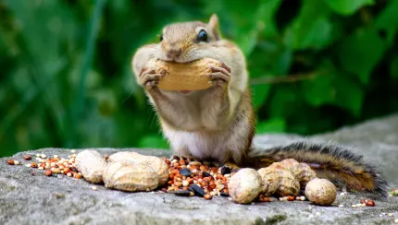
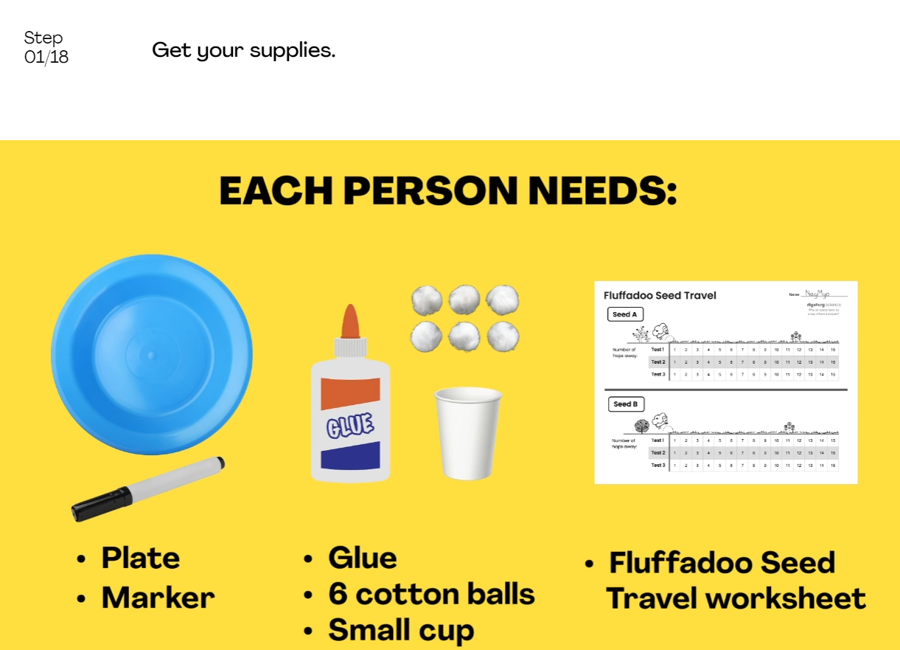
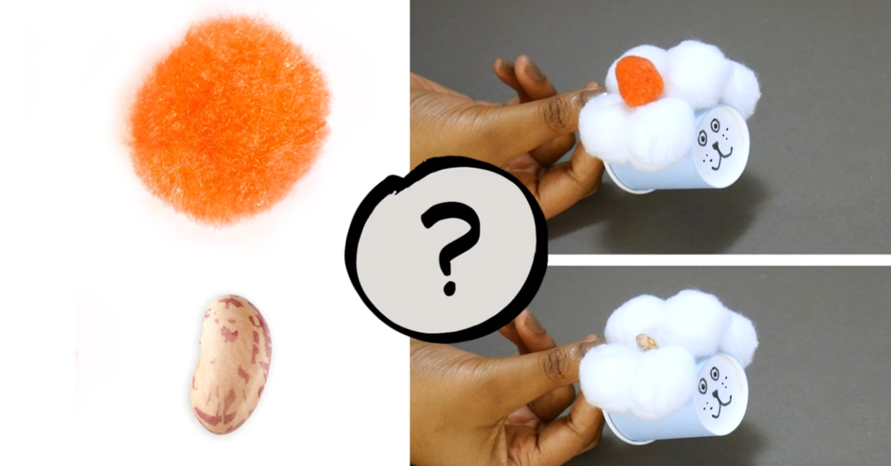
Plant Growth & Interactions • Grade 2
Anchor Layer Teacher Guide
Lesson 2: Why do seeds have so many different shapes?
Animal Seed Dispersal (pg 1 of 2)
Overview
In this lesson, students explore how the structures of seeds enable them to disperse, with a focus on seeds that utilize animal structures to aid in their dispersal.
In the activity, Seed Travelers, students develop a model of a furry animal (“fluffadoo”) and then use it to test how far seed models with different structures can travel.
Anchor Connection on Next Page
Exploration 15 mins
Hands-On Activity 30 mins
Wrap-Up 15 mins
Anchor Connection 20 mins
Activity Notes
We suggest students work in pairs for the activity. Separate materials for distribution. Seed A (pompom) is distributed in Step 7 and Seed B (bean) is distributed in Step 14.
Make sure students have space to hop up and down in place when doing fluffadoo + seed model tests. Seed A should stay on the fluffadoo the longest. Oftentimes, it can stay attached until the maximum of 15 hops. Seed B should fall off of the fluffadoo almost immediately- usually within 1 or 2 hops. See our lesson page for troubleshooting options.
As an accessibility accommodation, instead of hopping in place, students can test their fluffadoo + seed by raising and lowering their arms while seated (mimicking the motion of a hopping fluffadoo).
‹#›

Slide 8
Plant Growth & Interactions • Grade 2
Anchor Layer Teacher Guide
Lesson 2: Why do seeds have so many different shapes?
Animal Seed Dispersal (pg 2 of 2)
Anchor Connection
Seeds have plenty of room to grow in Death Valley, but seeds won’t begin to grow unless they are exposed to water. This explains why seeds can remain dormant in Death Valley for so many years. It is rare for there to be enough rain in Death Valley for the seeds to grow. When it does rain, the seeds spring to life!
Students revisit the worksheet that they worked on during the Anchor Phenomenon. They should understand that seeds begin growing when they are exposed to enough water. It is very, very rare for it to rain enough in Death Valley for a superbloom.
Students may add to their worksheet by drawing pictures and/or writing words to show that it must rain before a superbloom in order for the seeds to begin growing.
Connecting Storyline Question
What else do the plants need to be able to grow?
Exploration 15 mins
Hands-On Activity 30 mins
Wrap-Up 15 mins
Anchor Connection 20 mins
‹#›

Slide 9
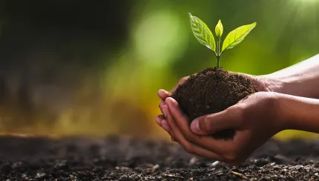
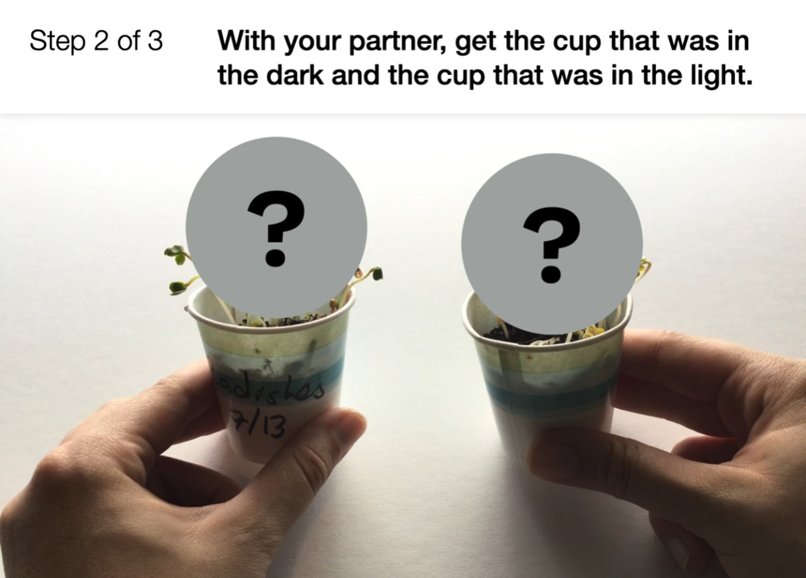
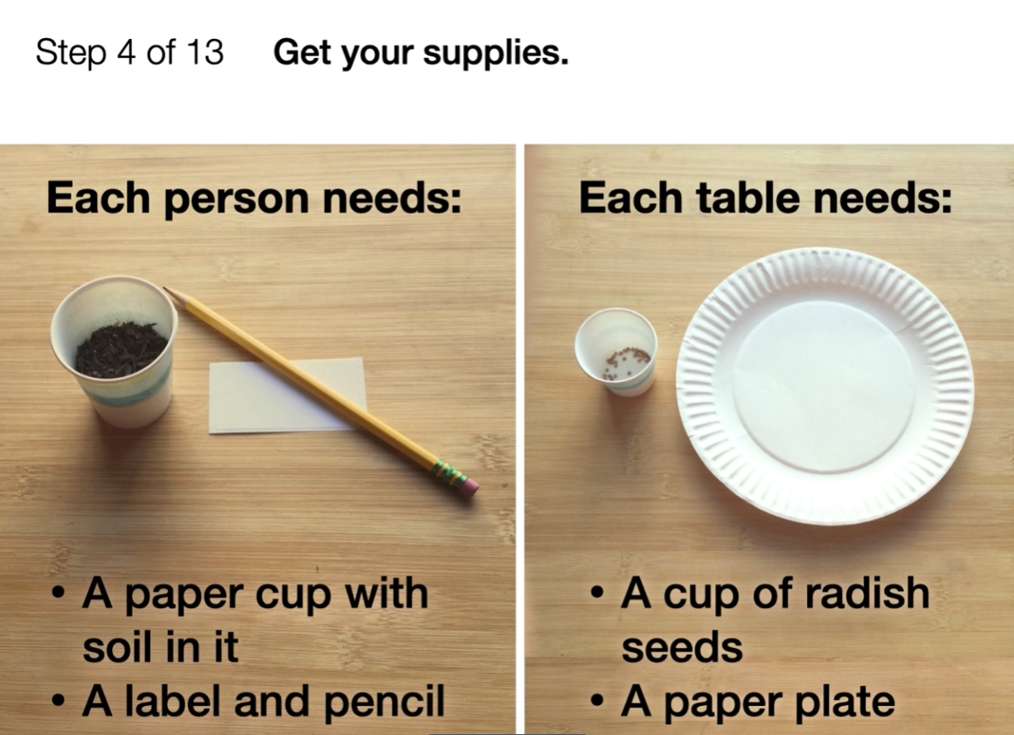
Plant Growth & Interactions • Grade 2
Anchor Layer Teacher Guide
Lesson 3: Could a plant survive without light? (pg 1 of 2)
Water, Sunlight, & Plant Growth
Overview
In this lesson, students investigate how plants need water and sunlight to grow.
In the two-part activity, Seeds — Light and Dark, students experiment with growing radish seeds in light and dark conditions. They plant them in cups, place half of the cups in sunlight, and put the other half in a dark container. Three to seven days later, students compare the seedlings and then watch what happens when all are placed in sunlight.
Anchor Connection on Next Page
Exploration 18 mins
Hands-On Activity 40 mins
Wrap-Up 7 mins
Anchor Connection 15 mins
Assessment 20 mins
Activity Notes
This is a two-part activity. We recommend that you allow at least three days (up to one week) in between Part One and Part Two of the experiment to give the radish seeds time to germinate.
You will need access to a sunny windowsill for radish seeds to grow in the light. You will also need access to water so that you can fill up the spray bottles.
We suggest students work in pairs. For more detailed instructions on how to prep your seeds, cups, and spray bottles, see our lesson page.
‹#›

Slide 10
Plant Growth & Interactions • Grade 2
Anchor Layer Teacher Guide
Lesson 3: Could a plant survive without light? (pg 2 of 2)
Water, Sunlight, & Plant Growth
Anchor Connection
While plants can grow in the dark, they can’t do it for long without becoming sick. Light is a requirement for plants to fully grow and be healthy. Fortunately for plants in Death Valley, there is an abundance of sunlight.
Students revisit the worksheet that they worked on during the Anchor Phenomenon. They should understand that the plants also require sunlight to grow and be healthy. Fortunately, Death Valley has an abundance of sunlight.
Students may add to their worksheet by drawing pictures and/or writing words to show that sunlight is an important part of the superbloom cycle.
Connecting Storyline Question
Why do the flowers eventually dry up and disappear?
Exploration 18 mins
Hands-On Activity 40 mins
Wrap-Up 7 mins
Anchor Connection 15 mins
Assessment 20 mins
‹#›

Slide 11
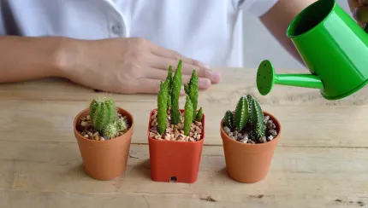
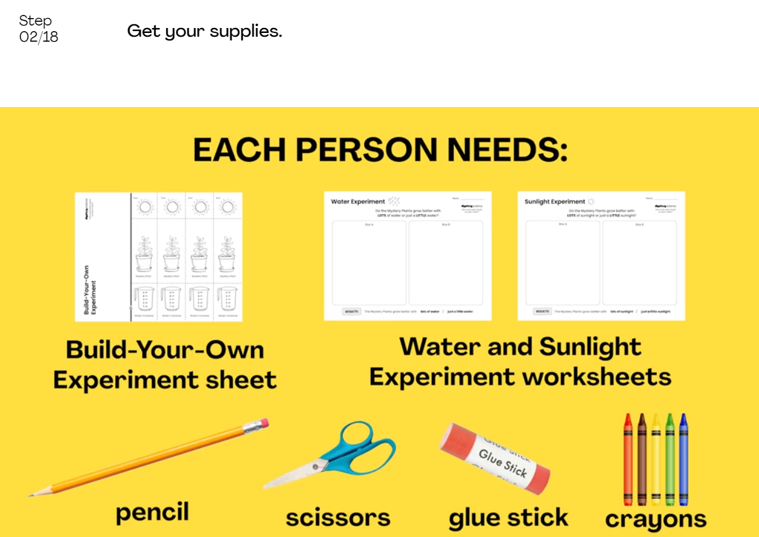
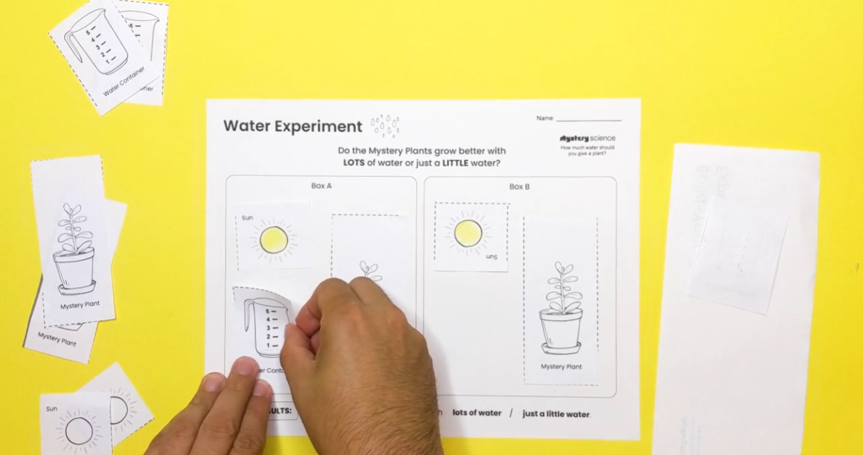
Plant Growth & Interactions • Grade 2
Anchor Layer Teacher Guide
Lesson 4: How much water should you give a plant? (pg 1 of 2)
Plant Needs & Habitats
Overview
In this lesson, students investigate how different plants grow best under very different conditions, ranging from deserts to tropical rainforests.
In the activity, Puzzling Plants, students plan and conduct virtual experiments in order to determine how much water and sunlight a set of mystery plants need to grow and stay healthy.
Anchor Connection on Next Page
Exploration 15 mins
Hands-On Activity 30 mins
Wrap-Up 10 mins
Anchor Connection 20 mins
Activity Notes
We suggest students work in pairs to share ideas. This activity walks students through virtual experiments to help reinforce the concept that an experiment should only change one part (variable), but keep all the other parts the same (controls).
We think it’s best to follow-up these learnings with a hands-on experiment that uses real plants! If you have radish plants leftover from the lesson “Could a plant survive without light?”, you can guide your students to plan and conduct a few classroom experiments.
‹#›

Slide 12
Plant Growth & Interactions • Grade 2
Anchor Layer Teacher Guide
Lesson 4: How much water should you give a plant? (pg 2 of 2)
Plant Needs & Habitats
Anchor Connection
All plants require water and light to grow and be healthy. Unfortunately, Death Valley is a place of extremes. No matter how good the conditions are for a superbloom, they don’t last for long. After blooming for just a few weeks, there is just too much sunlight (which causes too much heat) and not enough water for the flowers to survive. They eventually dry up and crumble. The seeds they produced, however, sit in wait for the next time that conditions are just right!
Students revisit the worksheet that they worked on during the Anchor Phenomenon. They should understand that the flowers eventually dry up from too much sunlight and not enough water. Their seeds are left behind, though, waiting for the next time the rains come.
Students may add to their worksheet by writing words to explain that the flowers dry up because of too much heat/light and not enough water.
Connecting Storyline Question
What other living things need water in Death Valley?
Exploration 15 mins
Hands-On Activity 30 mins
Wrap-Up 10 mins
Anchor Connection 20 mins
‹#›

Slide 13
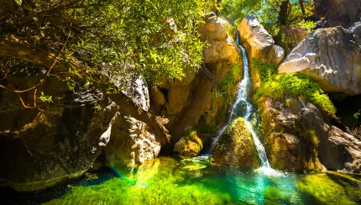
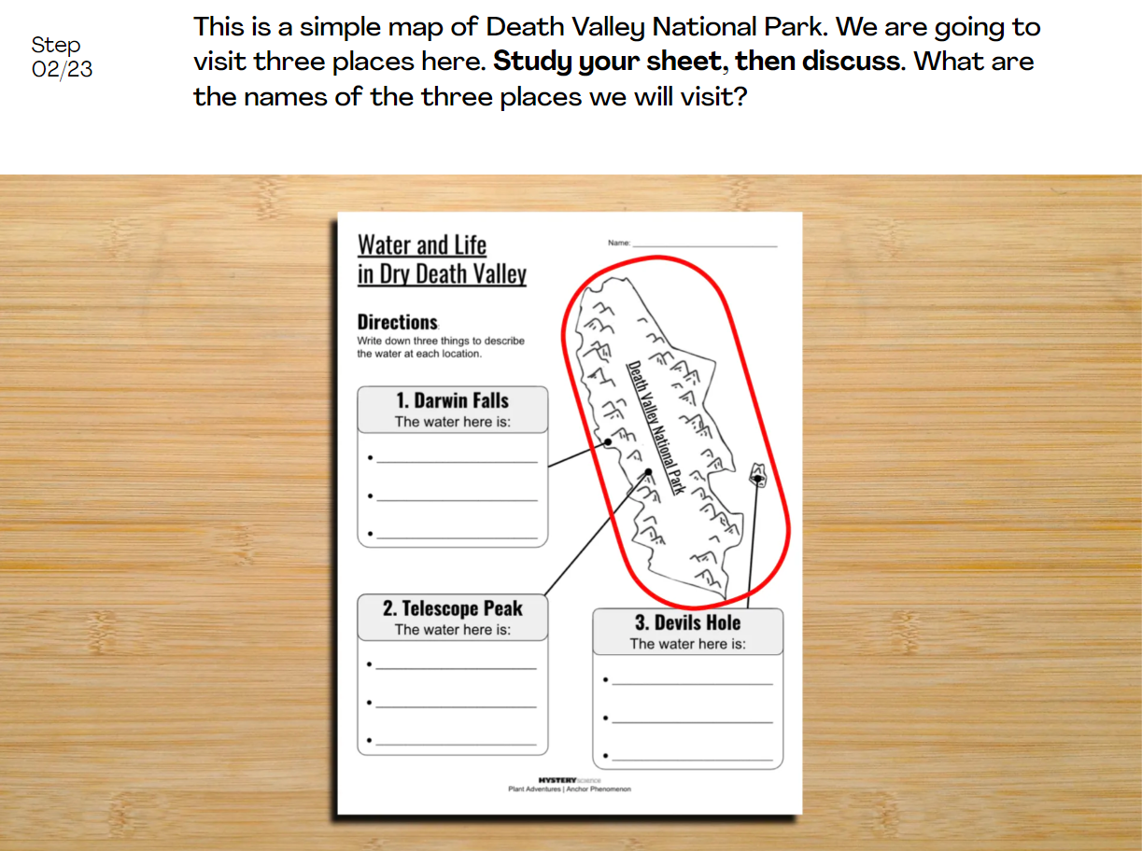
Plant Growth & Interactions • Grade 2
Anchor Layer Teacher Guide
Performance Task: How can anything live in Death Valley?
Water, Plants, & Animals, & Habitats
Overview
In this performance task, students will obtain information about Death Valley in order to see how different living things make use of water in different forms and in different places.
Unit Review 15 mins
Hands-On Activity 40 mins
Performance Task Notes
After a review of the Plant Adventures unit, students will virtually travel to different locations in Death Valley. They will make observations about how the water at each location supports a wide variety of incredible living things, ranging from one of the oldest living things on Earth to one of the rarest.
Crosscutting Concepts
Systems and System Models: A system is made up of a collection of interacting parts and processes. The extreme temperature and dryness in Death Valley ultimately control when and how many of the seeds can begin to grow and produce flowers. This interaction between the conditions in Death Valley and the living things that inhabit the area can be modeled as a cycle that is labeled with various words and drawings.
Cause and Effect: The environmental conditions in Death Valley are the causes that lead to the effects of huge numbers of flowers blooming—or not!
‹#›

