Slide 1
CPaaS
- CTI Integration -
Updated: August 2023

Slide 2
Release Notes (August 2023)
Item | Slide No. | Change Description
CPaaS Developer | 10 | Updated Screenshot for Programmable Flow

Slide 3
Problem Statement & Solution
Overview
Key Features
Value Propositions
Snapshot
Integration
Success Stories

Slide 4
Problem Statements & Solutions
Unified Work Tool
Data Retrieval
As the world of technology evolves at a breakneck pace, so does the consistent demand for service solutions that facilitate the simplification and ease of work. At present, many agents still use multiple platforms simultaneously to keep tabs on customer issues, a practice that is both inefficient and potentially detrimental to their productivity.
Some of the agents have trouble recording customer complaints while also collecting extensive information about their customers at the same time.
The call ticket detail function from CTI is very helpful in solving these problems, as agents no longer need to search one by one to see details of problems and information about customers. With CTI, customer's data information and the ticket number will be automatically retrieved when agents receive customers’ calls, which aids agents in tracking customers more efficiently.
CTI was developed to aid agents in efficiently managing tickets by requiring only a single page, which displays the ticket dashboard during both incoming and outgoing calls.

Slide 5

Overview
CTI is a technology that integrates information technology applications with telecommunications infrastructure. This technology is used as a call center agent who interacts with customers through web phone calls that generate tickets with complete customer call details to increase call agent productivity. With this CTI solution, you can save agents time in searching for customer information and you don't need to use many applications to handle phone calls from customers.

Slide 6
Key Features
Feature | Description
Ticket management | Create ticket automatically when doing outbound calls, auto-renew tickets after outbound and inbound calls end
Customer contact | Create contact automatically
Call notification | Incoming and outgoing call notifications sent to email
Auto attendant | Personalize customer journeys and offer self-service voice options with a graphic, flexible IVR solution
Queue management | A plethora of features to optimize queue management in your contact center. Service-level, skill attribution, personalized queues, automatic callback options, etc.
Advanced call routing | With this feature, you can make use of Ring All / Round Robin / Skill-based Routing / Sticky Agent
Dashboard | Custom dashboards turn a matrix of numbers into actionable insights that match the customer's unique needs. Organize data with custom dashboards and reports
Communication Hub | Monitor your call center data when the agents are on the call to make quick decisions and improve your operating efficiency
Supervisor tools | With special tools, supervisors have access to active call monitoring (call barge, call spy, whisper), queue management, with a detailed agent performance history

Slide 7





Value Propositions
Integrable with CRM software such as freshdesk, zendesk, salesforce or others based on customer requests.
Well-Organized Problems
CTI on the CPaaS platform can operate independently or in tandem with other integrations, such as a CRM software.
Increase Productivity
Problems can be handled more efficiently and effectively through the use of well-detailed tickets, which allow for easier tracking of open and closed tickets.
Cost Effective
Reduce the time it takes to resolve customer complaints by using a single, unified application
Integration
By consolidating your software needs into a single, streamlined program, you can save money while increasing efficiency.
Independence

Slide 8
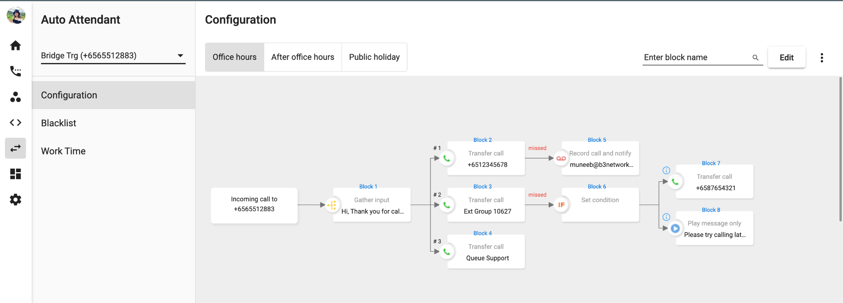
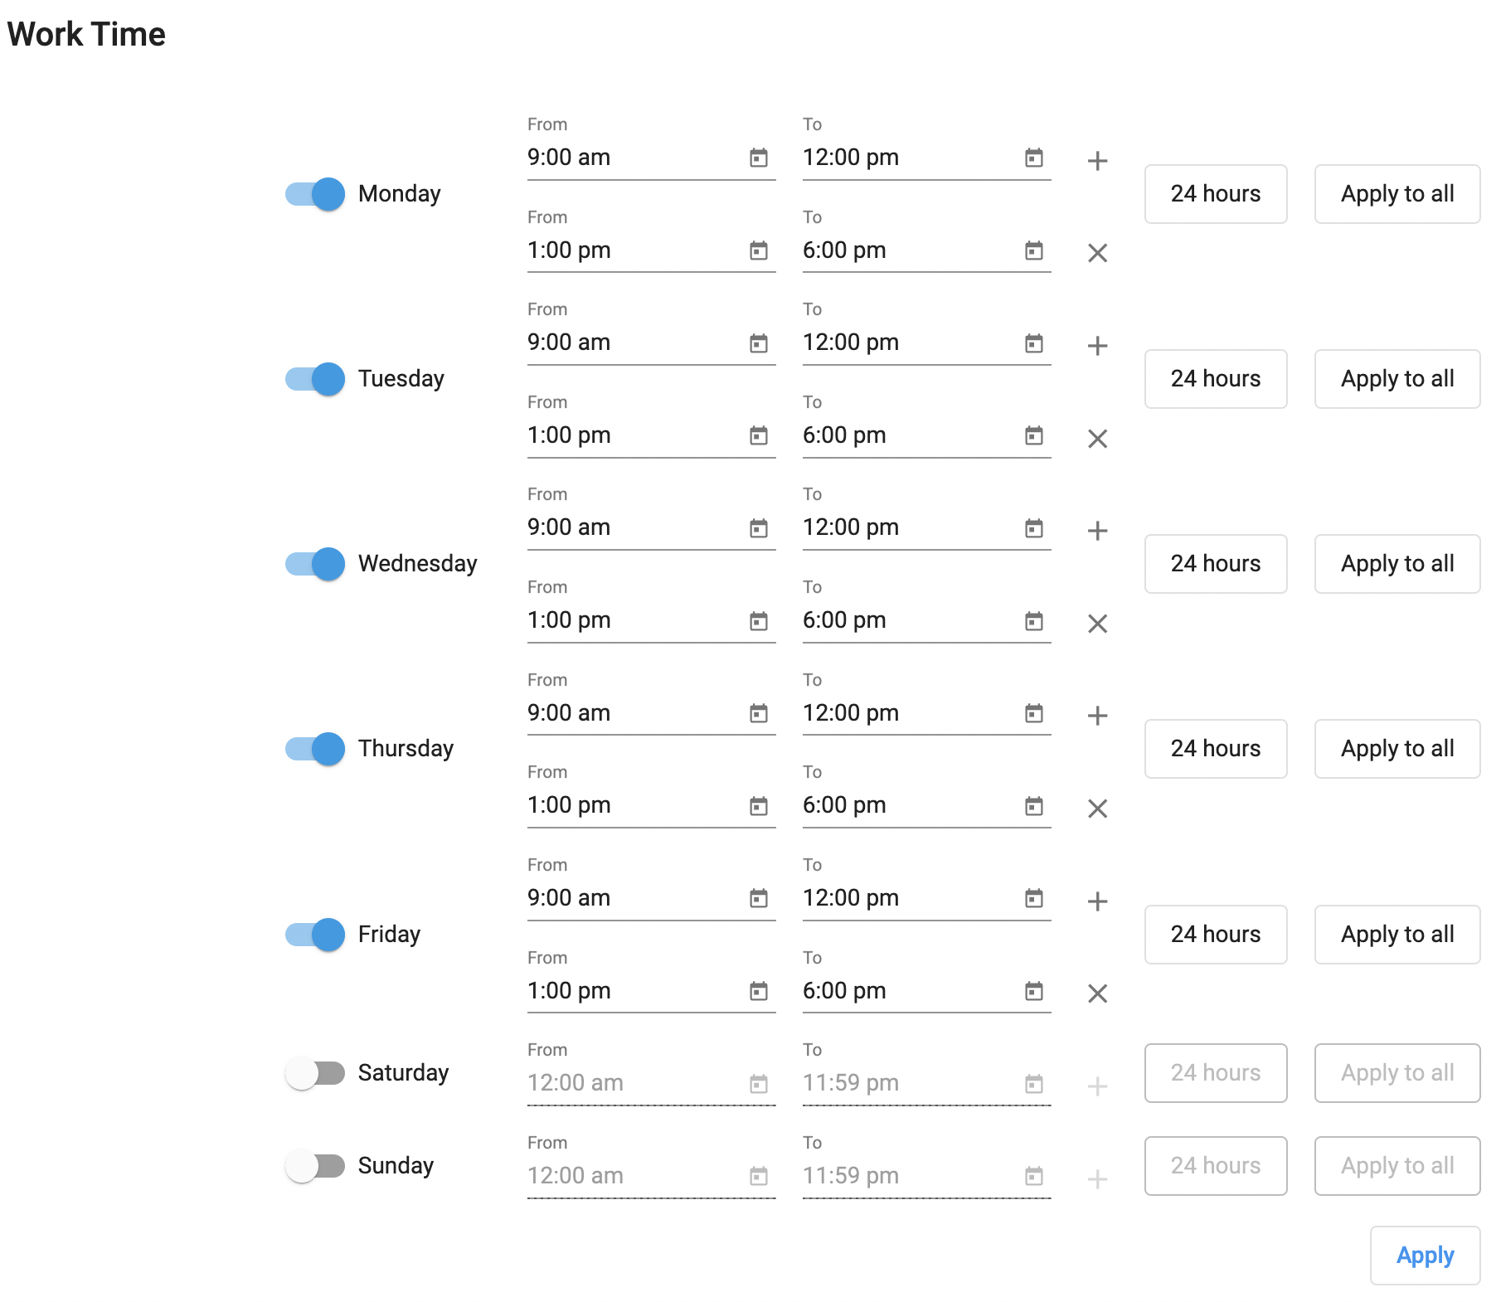
CPaaS Auto Attendant
Personalize customer journeys and offer self-service voice options with a graphic, flexible IVR solution. No coding or IT skills needed!

Slide 9
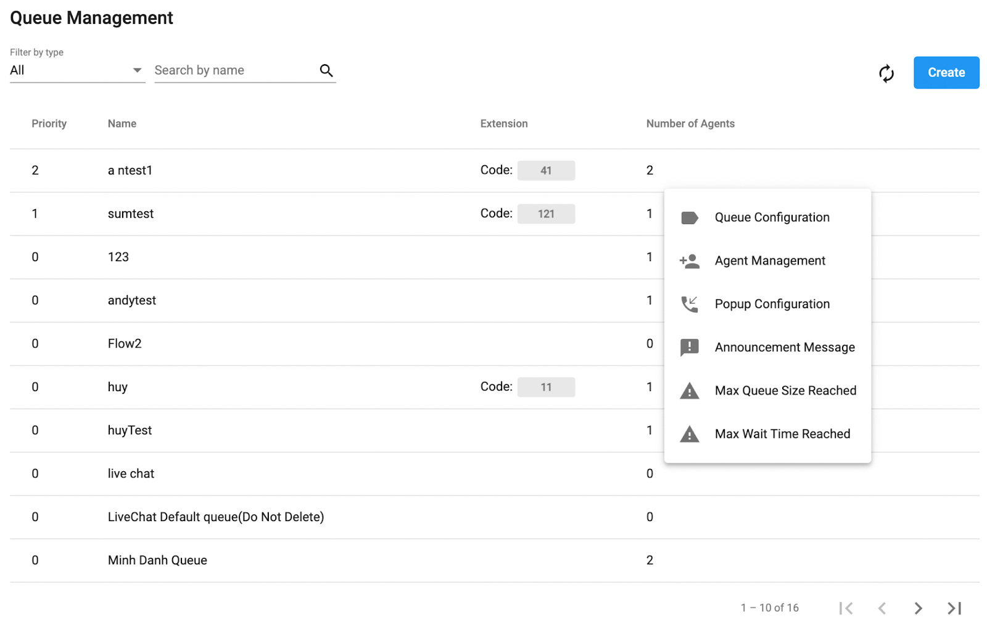
CPaaS Contact Center
Skill attribution, personalized queues, service-level, and many more options.
A wealth of features to optimize queue management of your contact center.

Slide 10
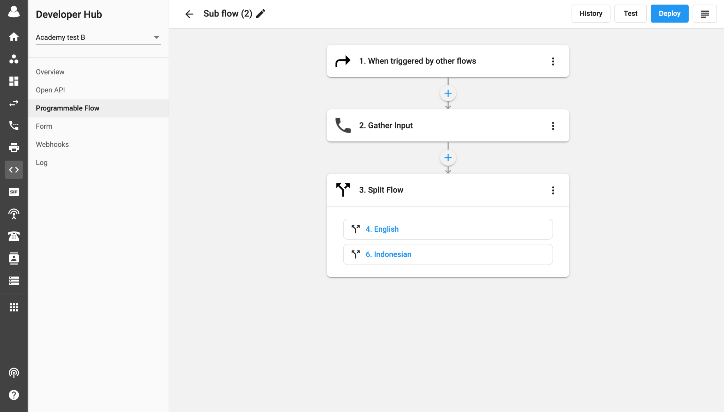
CPaaS Developer
Create automated workflows by gathering resources and performing actions on a diverse set of services. This flow is used to integrate with the required third-party system in order to update call details accordingly.

Slide 11
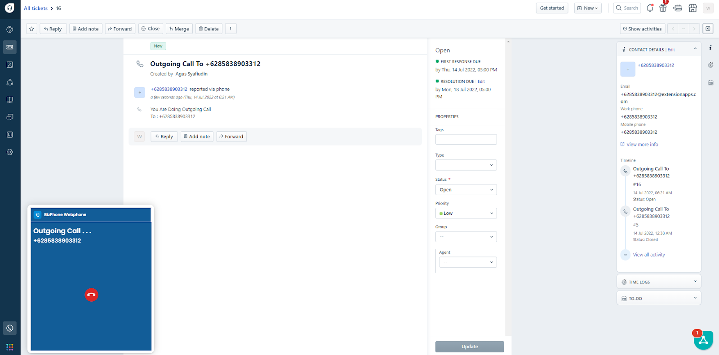
Freshdesk
Handle calls and manage customer’s tickets using the third-party platform

Slide 12

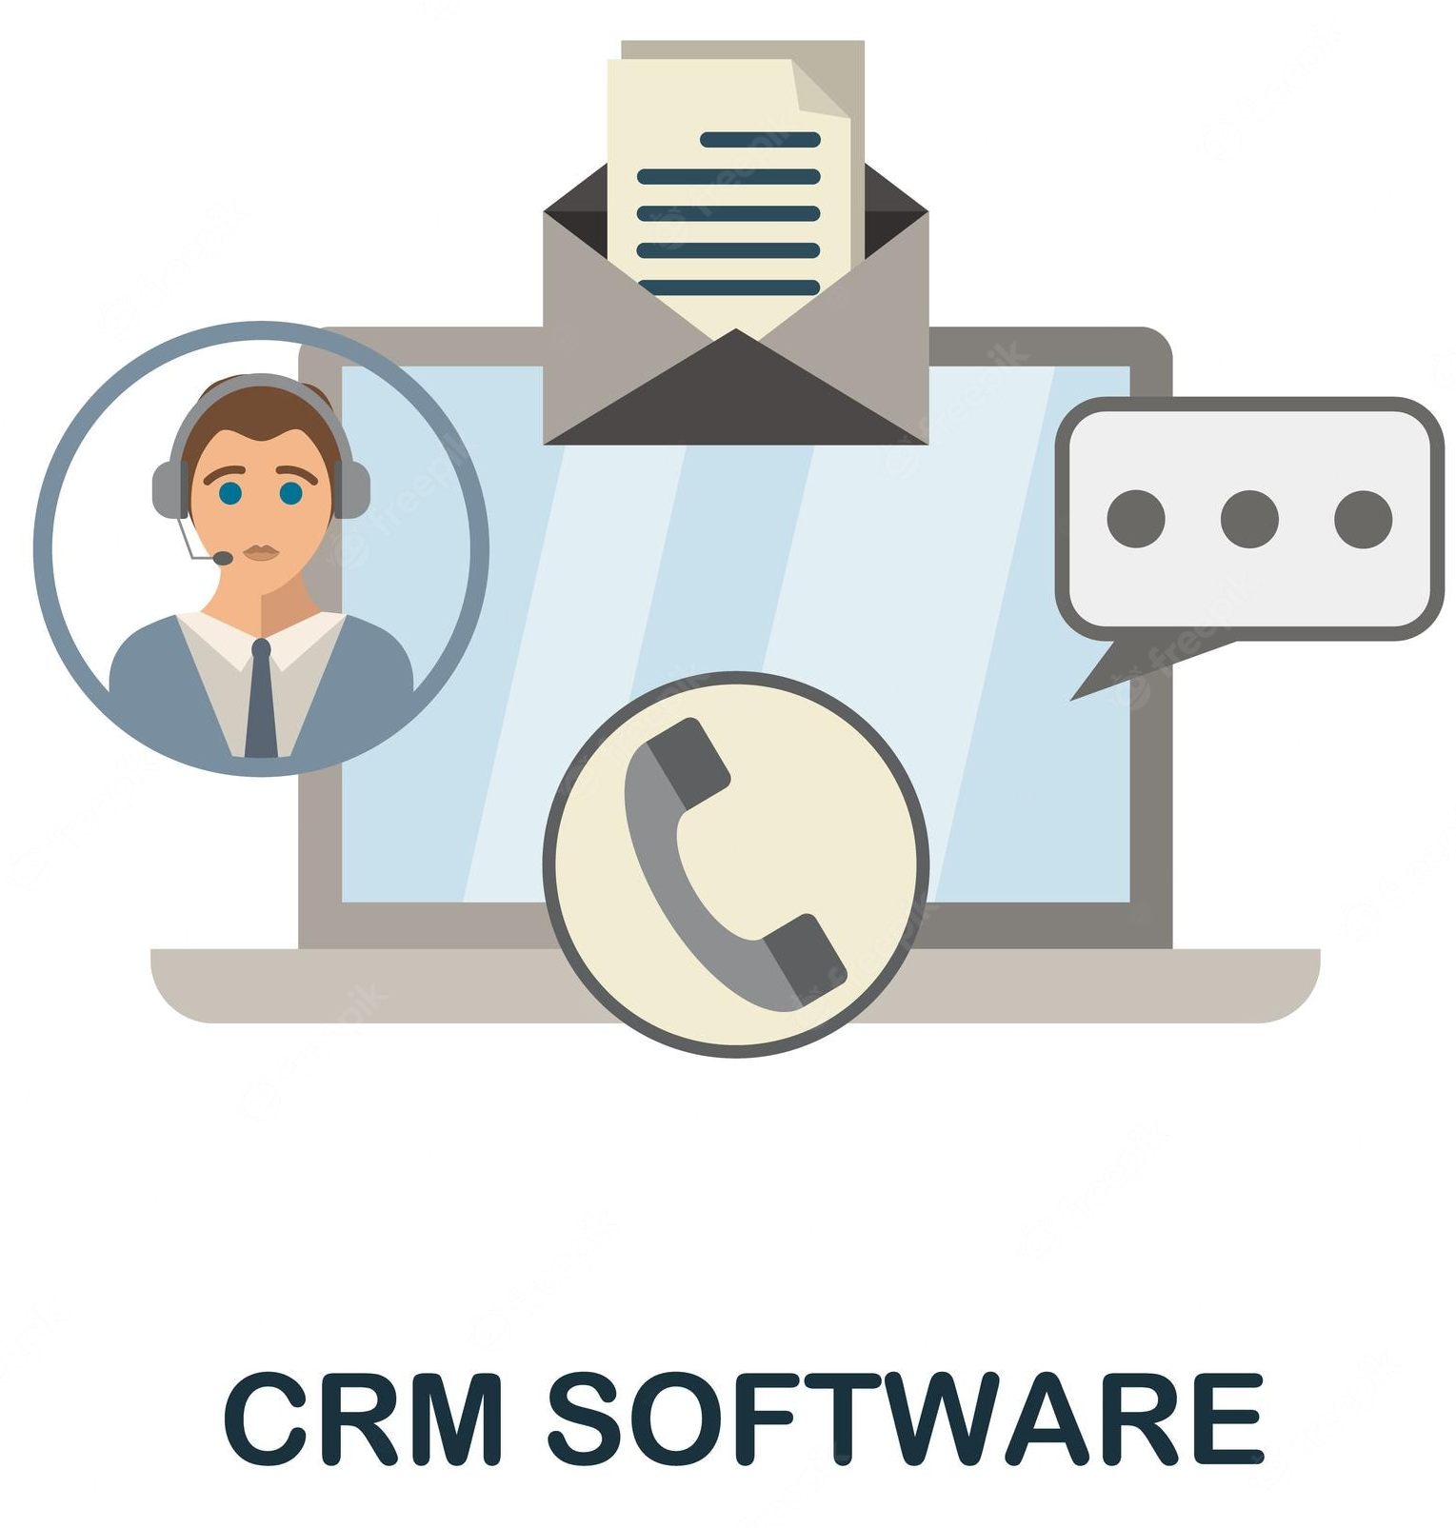
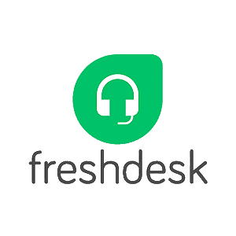

Integration
Using CTI of B3Networks, you can flexibly integrate webphone with applications such as Freshdesk, Zendesk, Salesforce or any CRM system according to your needs.

Slide 13

Success Stories
Customer Requirements:
Allow users to make outgoing call and receive incoming calls directly through Salesforce CRM.
Show call history on Salesforce platform.
Get the call recording files on Salesforce CRM.
Mask the callers’ information so agents will not know who or where the call comes from.
Notes:
-

Slide 14






Success Stories
Trigger Webphone
Our Solution (with CTI):
Integrate with Salesforce CRM using API.
Using Webphone so that it does not require desktop applications or IP Phone to make outgoing and incoming calls.
The call details will be converted to be a call history and ticket under CRM System.
Result:
Agents work more effectively by using CRM to carry out all activities including call activities and customer tickets.
Maintain the security of customer data because customers’ numbers can be masked.
Notify on Salesforce
Customer calls to agent
Show call details
Agent picks up call
Create ticket automatically
Call ended
Update ticket automatically with call recording

Slide 15

Success Stories
Customer Requirements:
Allow users to do telephony activities from Freshsales portal.
Able to integrate call log history and call recording details from CPaaS to Freshsales on a specific place.
Notes:
-

Slide 16


Success Stories
Agents use CPaaS Webphone
Our Solution (with CTI):
Integrate CPaaS Telephony System to Freshsales.
Result:
Users can perform phone activities on Freshsales portal using CPaaS Webphone.
User can check call history and call recording details from Freshsales portal.
: Outbound call
: Inbound call
CPaaS Telephony System
End-customer

