Slide 1

Culture Mapping: A Functional Analysis of
the Education Culture Landscape
Randy Keyworth
ABAI, 2014
Notes:
By way of introduction on why this is so important
we are extremely bad at school reform
one of the reasons is or failure to address the issue of culture
there are strategies we can use

Slide 2

Culture Mapping
or
Going Down the
Rabbit Hole
(an adventure into the unknown)
cognitive concepts: attitudes, beliefs, philosophies, ideologies
qualitative research: surveys, interviews, focus groups, media analysis
social sciences: anthropology, linguistics, cognitive psychology, sociology, political science, communications theory

Slide 3

How cultural constructs influence education policy at the national level.
Notes:
67% believe there is solid evidence for global warming
44% believe it is doe to human activity
29% believe it should be a top priority

Slide 4
Differing Views on the Influence of Evidence
RATIONAL ACTOR MODEL:
Reason is conscious, literal, logical, universal, unemotional, disembodied, and serves self interest.
If people are made aware of the fact and figures, they should naturally come to the right conclusions.
2. FRAME MODEL:
People evaluate information and make decisions in the context of their deeply held constructs—worldviews, beliefs, and assumptions—called “frames”.
Frames are a small sets of internalized concepts and values that allow people to attach meaning to new information.
Once a frame is established, it will “trump” numbers. If the facts don’t fit the frame, it’s the facts that are rejected, not the frame.
Frameworks, Framing Public Issues, 2002

Slide 5
Does evidence or cultural frames have a greater impact on education policy?

Slide 6
Culture Mapping: Patterns of Public Thinking
FRAMES REGARDING EDUCATION SOLUTIONS
1. Individual Frame
education “systems” are invisible, complex…focus goes to individual “actors”: parents, teachers, students
2. Blame Frame
assume problems are the result of motivation, character, discipline, effort and/or caring
“irresponsible parents”, “bad teachers”, “undisciplined students”
3. Visionary Leader Frame
tendency to reduce the complexity of a multi-actor system to the actions and characteristics of a single individual in a leadership role
Magic Bullets Hanging By a Thread”, O’Neil & Haydon, FrameWorks Institute, (2013)

Slide 7
Culture Mapping: Patterns of Public Thinking
FRAMES REGARDING EDUCATION SOLUTIONS
Magic Bullet Frame
  belief there is one reform or policy initiative that will “magically” address the country’s educational woes
Local Solutions Frame
  innovation, dynamism, and meaningful programmatic change can only occur at the local level; state and federal actors are inflexible, out of touch, and ineffective
Private Sector Frame
  private sector is the only place capable of innovation and efficiency, public schools too mired in bureaucracy,
“Magic Bullets Hanging By a Thread”, O’Neil & Haydon, FrameWorks Institute, (2013)

Slide 8
Culture Mapping: Patterns of Public Thinking
FRAMES REGARDING EDUCATION SOLUTIONS
Back to Basics Frame
      failure of education is due to reforms getting away from the basics: reading, writing and arithmetic
More Funding Frame
  assumption that any reforms would require that much more money, and that more money will improve education
Computers Frame
  belief that having more computers in the classroom is a universal panacea for improving education
“Magic Bullets Hanging By a Thread”, O’Neil & Haydon, FrameWorks Institute, (2013)

Slide 9
Culture Mapping: Impact of Cultural Beliefs
EDUCATION REFORM INITIATIVES
EVIDENCE vs. CULTURAL FRAMES
CHARTER SCHOOLS
SCHOOL IMPROVEMENT GRANTS
CLASS SIZE REDUCTION
ONE-TO-ONE COMPUTING

Slide 10
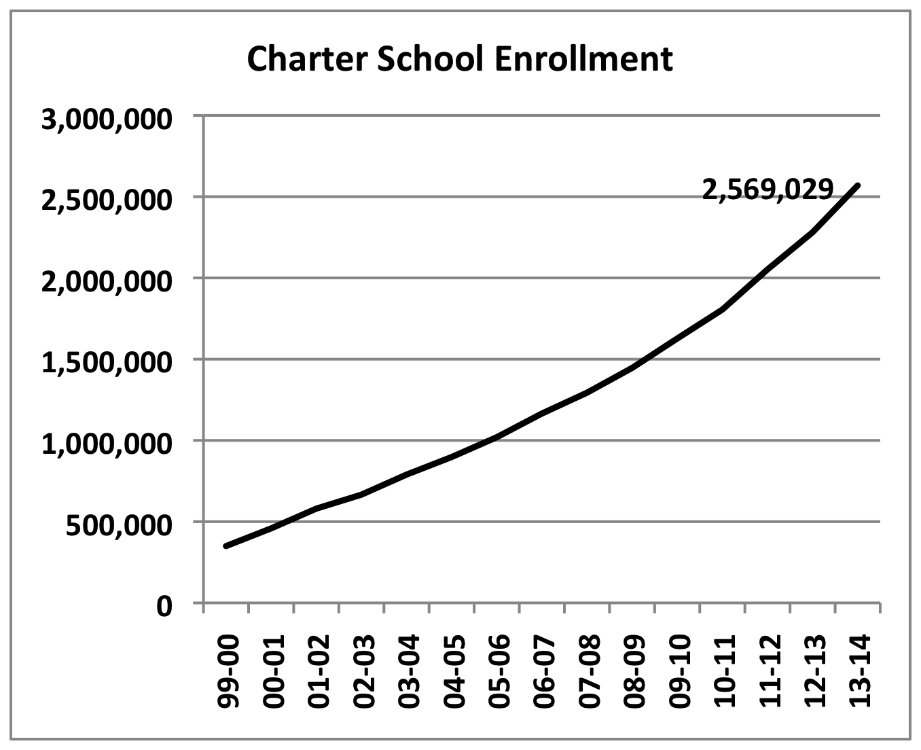
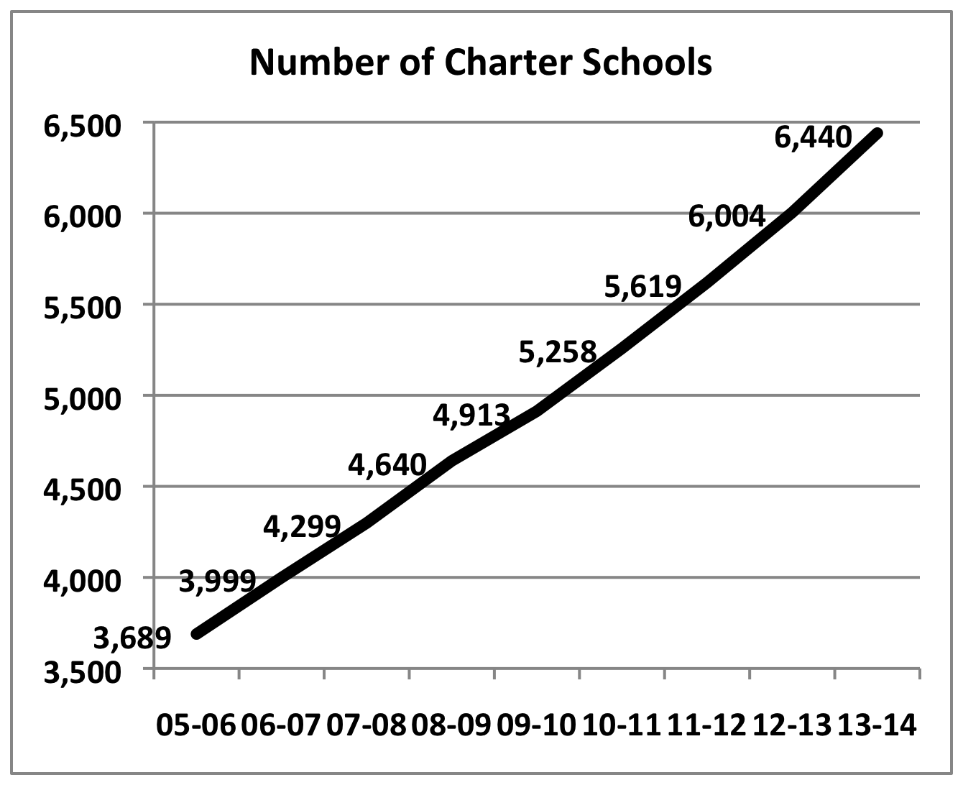
Culture Mapping: Impact of Cultural Beliefs
Charter Schools
Model: 1. independently contract with outside group to operate schools
2. no specific education model, curriculum, pedagogy
3. no unions
5.1% of K-12 students in charter schools
100% enrollment growth since 2007-08
Percentage of children in charter schools
New Orleans : 79% District of Columbia: 43%
Detroit: 51% Chicago: 19%
70% of Americans support charter schools

Slide 11
Culture Mapping: Impact of Cultural Beliefs
Charter Schools
EVIDENCE
CULTURAL FRAMES
Private Sector Frame
Visionary Leader Frame
Magic Bullet Frame
Local Solutions Frame
Charter School Performance in 16 States (2009), CREDO, Stanford
“academic growth was somewhat lower than their traditional public school peers…”
“tremendous variation in academic quality among charter schools …
The Evaluation of Charter Schools Final Report (June 2010), IES
“On average, charter middle schools are neither more nor less successful than traditional public schools in improving achievement, behavior, and school progress.”
“The impact of charter middle schools on student achievement varies significantly across schools”

Slide 12
Culture Mapping: Impact of Cultural Beliefs
School Improvement Grants
Model (funding and staff replacement)
1. funding over three years (2010-11, 2011-12, 2012-13 ) toward the goal of turning around the 1,200 of the nation’s lowest-performing schools
up to $ 2 million per school per year, $ 3.5 Billion total
3. must use one of the following four models for turnaround:
Turnaround model: replace the principal and no less than 50% of the staff; and introduce significant reforms (20% of schools)
Restart model: reopen the school under management of a charter school operator, or an ed. mgmt. organization (4% of schools)
School closure: close the school and reassign students to higher achieving schools (2% of schools)
Transformational model: replace the principal, introduce significant reforms
(74% of schools)
Hurlburt, et.al. 2011, Institute of Education Sciences

Slide 13
Culture Mapping: Impact of Cultural Beliefs
School Improvement Grants
EVIDENCE
Funding
Funding increased by 30% from 1995-2009
Disconnect between funding levels and performance at all levels
Staff Replacement
5 years NCLB data implementing staff replacment model
80% no change
8% small improvement
1% successful turnaround
11% closed
CULTURAL FRAMES
More Funding Frame
Individual Frame
Blame Frame
Magic Bullet Frame
Local Solutions Frame
Private Sector Frame

Slide 14
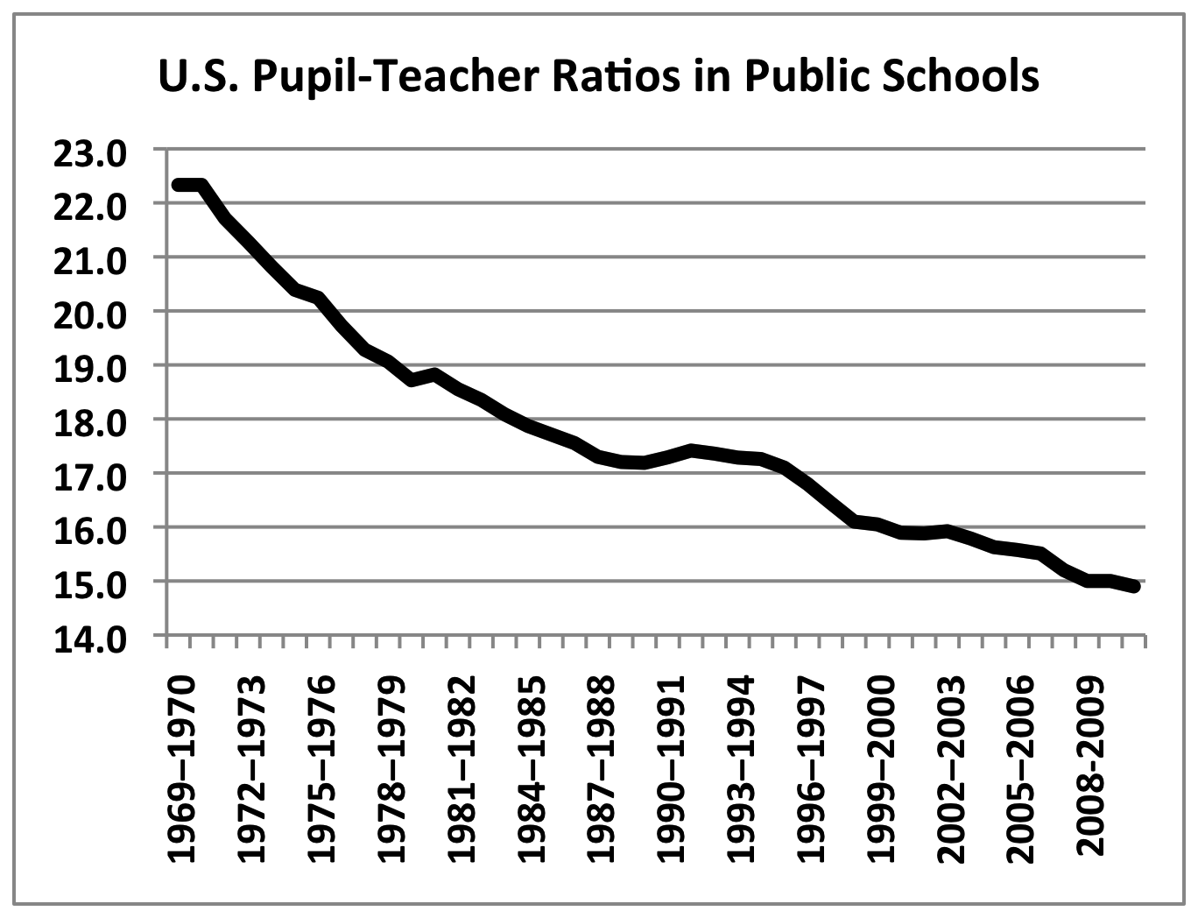
Culture Mapping: Impact of Cultural Beliefs
Class Size Reduction
Model: 1. legislatively mandated reductions in class size
2. no specific education model, curriculum, pedagogy
3. class size targets usually in the 20 student range
As or 2010, 36 states have laws restricting the number of children in K-12 Classrooms
77% of Americans think that additional dollars should be spent on smaller classes than higher teacher salaries.
CA spent over $20 billion from 1996–97 through 2009–10
on reduced K-3 class sizes,
averaging $ 1.75 billion per year for last five years.
Florida spent $ 20 billion from 2002-2011, projecting $ 4-5 billion per year going forward.

Slide 15
Culture Mapping: Impact of Cultural Beliefs
Class Size Reduction
EVIDENCE
CA Capstone Report (2002)
The relationship of CSR to student achievement was inconclusive… attribution to any gains in scores to CSR is unwarranted.
Students received more individual attention but similar instruction and curriculum…
Florida Research (2010)
The results indicated that the effects of mandated class size reduction on cognitive and non-cognitive outcomes were small at best and most likely close to zero.
CULTURAL FRAMES
Individual Frame
More Funding Frame
Magic Bullet Frame
Local Solutions Frame

Slide 16
Culture Mapping: Impact of Cultural Beliefs
One-to-One Computing
LAUSD $ 1 Billion to get iPADS to 650,000 students
cost over-runs (support, maintenance, WiFi, replacement, electricity)
inadequate, untested curriculum
poor planning, implementation
inadequate training for teachers
lack of integration with district
36% teacher support
Common Core Technology Project

Slide 17
Culture Mapping: Impact of Cultural Beliefs
One-to-One Computing
EVIDENCE
“one-to-one computer programs are only as effective as their teachers”
Bebell & Key, The Journal of
Technology, Learning & Assessment, (2010)
“Factors related to successful implemented reported in the research include extensive teacher professional development, technical support, and positive teacher attitudes toward student technology use.”
Penuel, SRI International, Journal of Research on Technology in Education, (2006)
CULTURAL FRAMES
Computers Frame
Magic Bullet Frame
Local Solutions Frame
Private Sector Frame

Slide 18
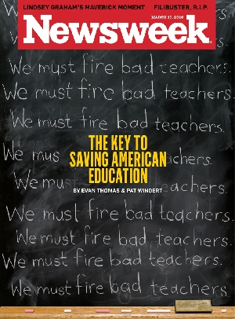

Slide 19
How do we get rid of bad teachers?
Make them good teachers.

Slide 20
In Summary
Does evidence or cultural frames have a greater impact on education policy?
Frames generally win
Systems change agents need to pay attention to this.

