Slide 1
From the Boutique to the Mainstream: The Role of Behavior Analysis in Education Reform
Ronnie Detrich
Wing Institute
MABA 2010, Lake Geneva, Wisconsin

Slide 2
Acknowledgments
Randy Keyworth
Jack States
Tom Critchfield
Hill Walker

Slide 3
Goals for Today
Describe the historical context for education reform and the outcomes of those reform efforts.
Describe the public health model of prevention and discuss where behavior analysts’ efforts have been focused in education.
Discuss the emerging science for disseminating innovations.

Slide 4
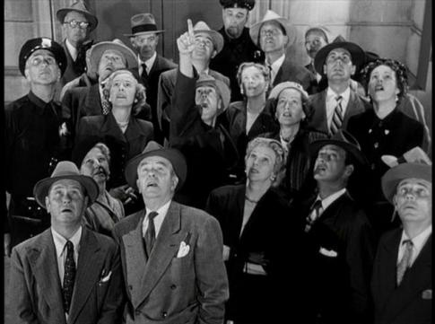
October 1957
USSR launched Sputnik.
U. S. Education quickly blamed.
Modern reform efforts began.

Slide 5

1983 A Nation at Risk
American students not performing well.
Education quickly blamed.
The Nations Report Card created.

Slide 6

1994 Goals 2000
All students will start school ready to learn.
High school graduation rate ≥ 90%.
All students in grades 4, 8, & 12 will demonstrate competency in challenging subjects.

Slide 7
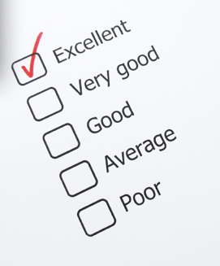
2001 No Child Left Behind
By 2014 every student will be at grade level.
Instructional methods will be scientifically based.
Educators will be held accountable for outcomes.

Slide 8
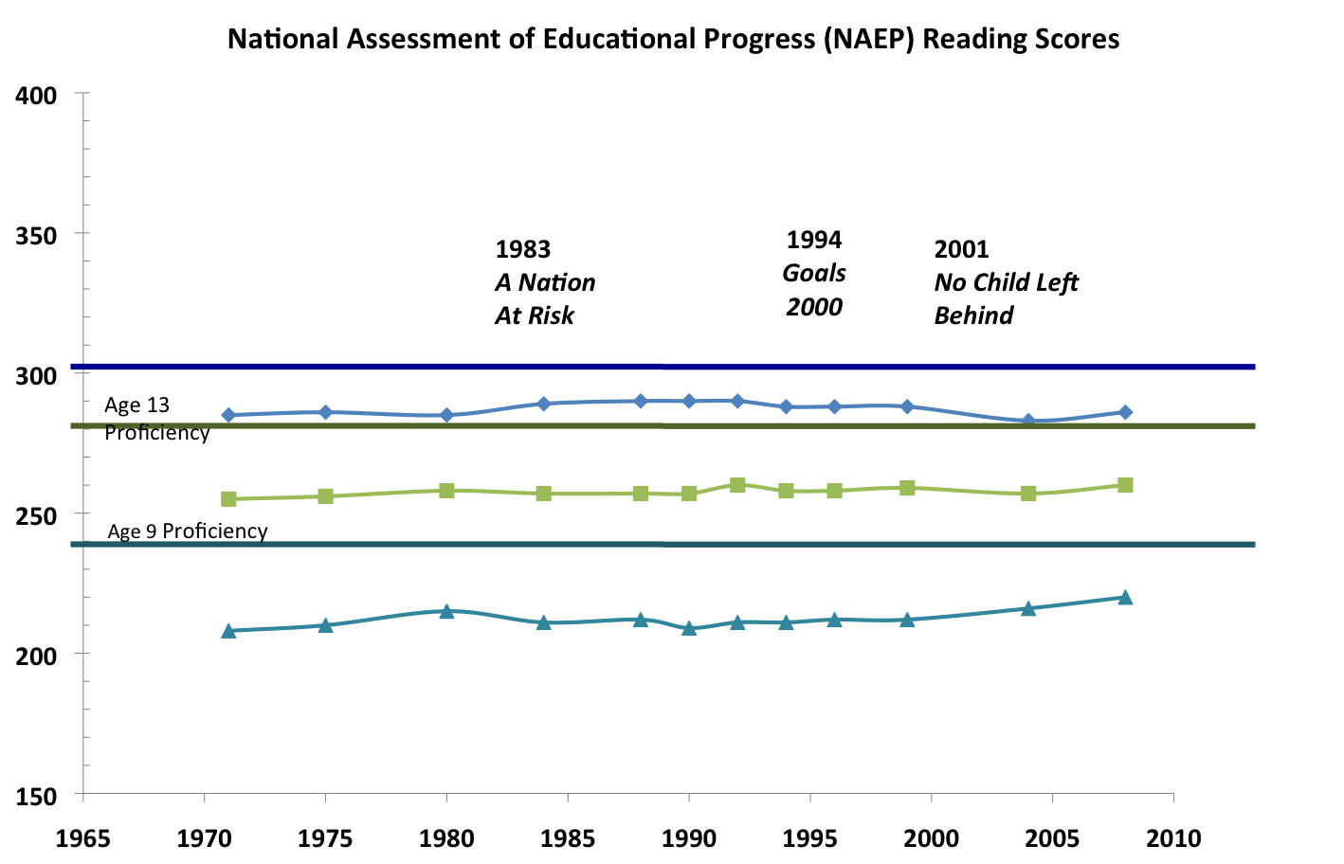
Age 17 Proficiency
Age 17
Score
Grade 8
Age 13
Score
Grade 4
Age 9
Score
SOURCE: U.S. Department of Education, Institute of Education Sciences, National Center for Education Statistics, National Assessment of Educational Progress (NAEP), 1992, 1994, 1998, 2000, 2002, 2003, 2005, and 2007 Reading Assessments.

Slide 9
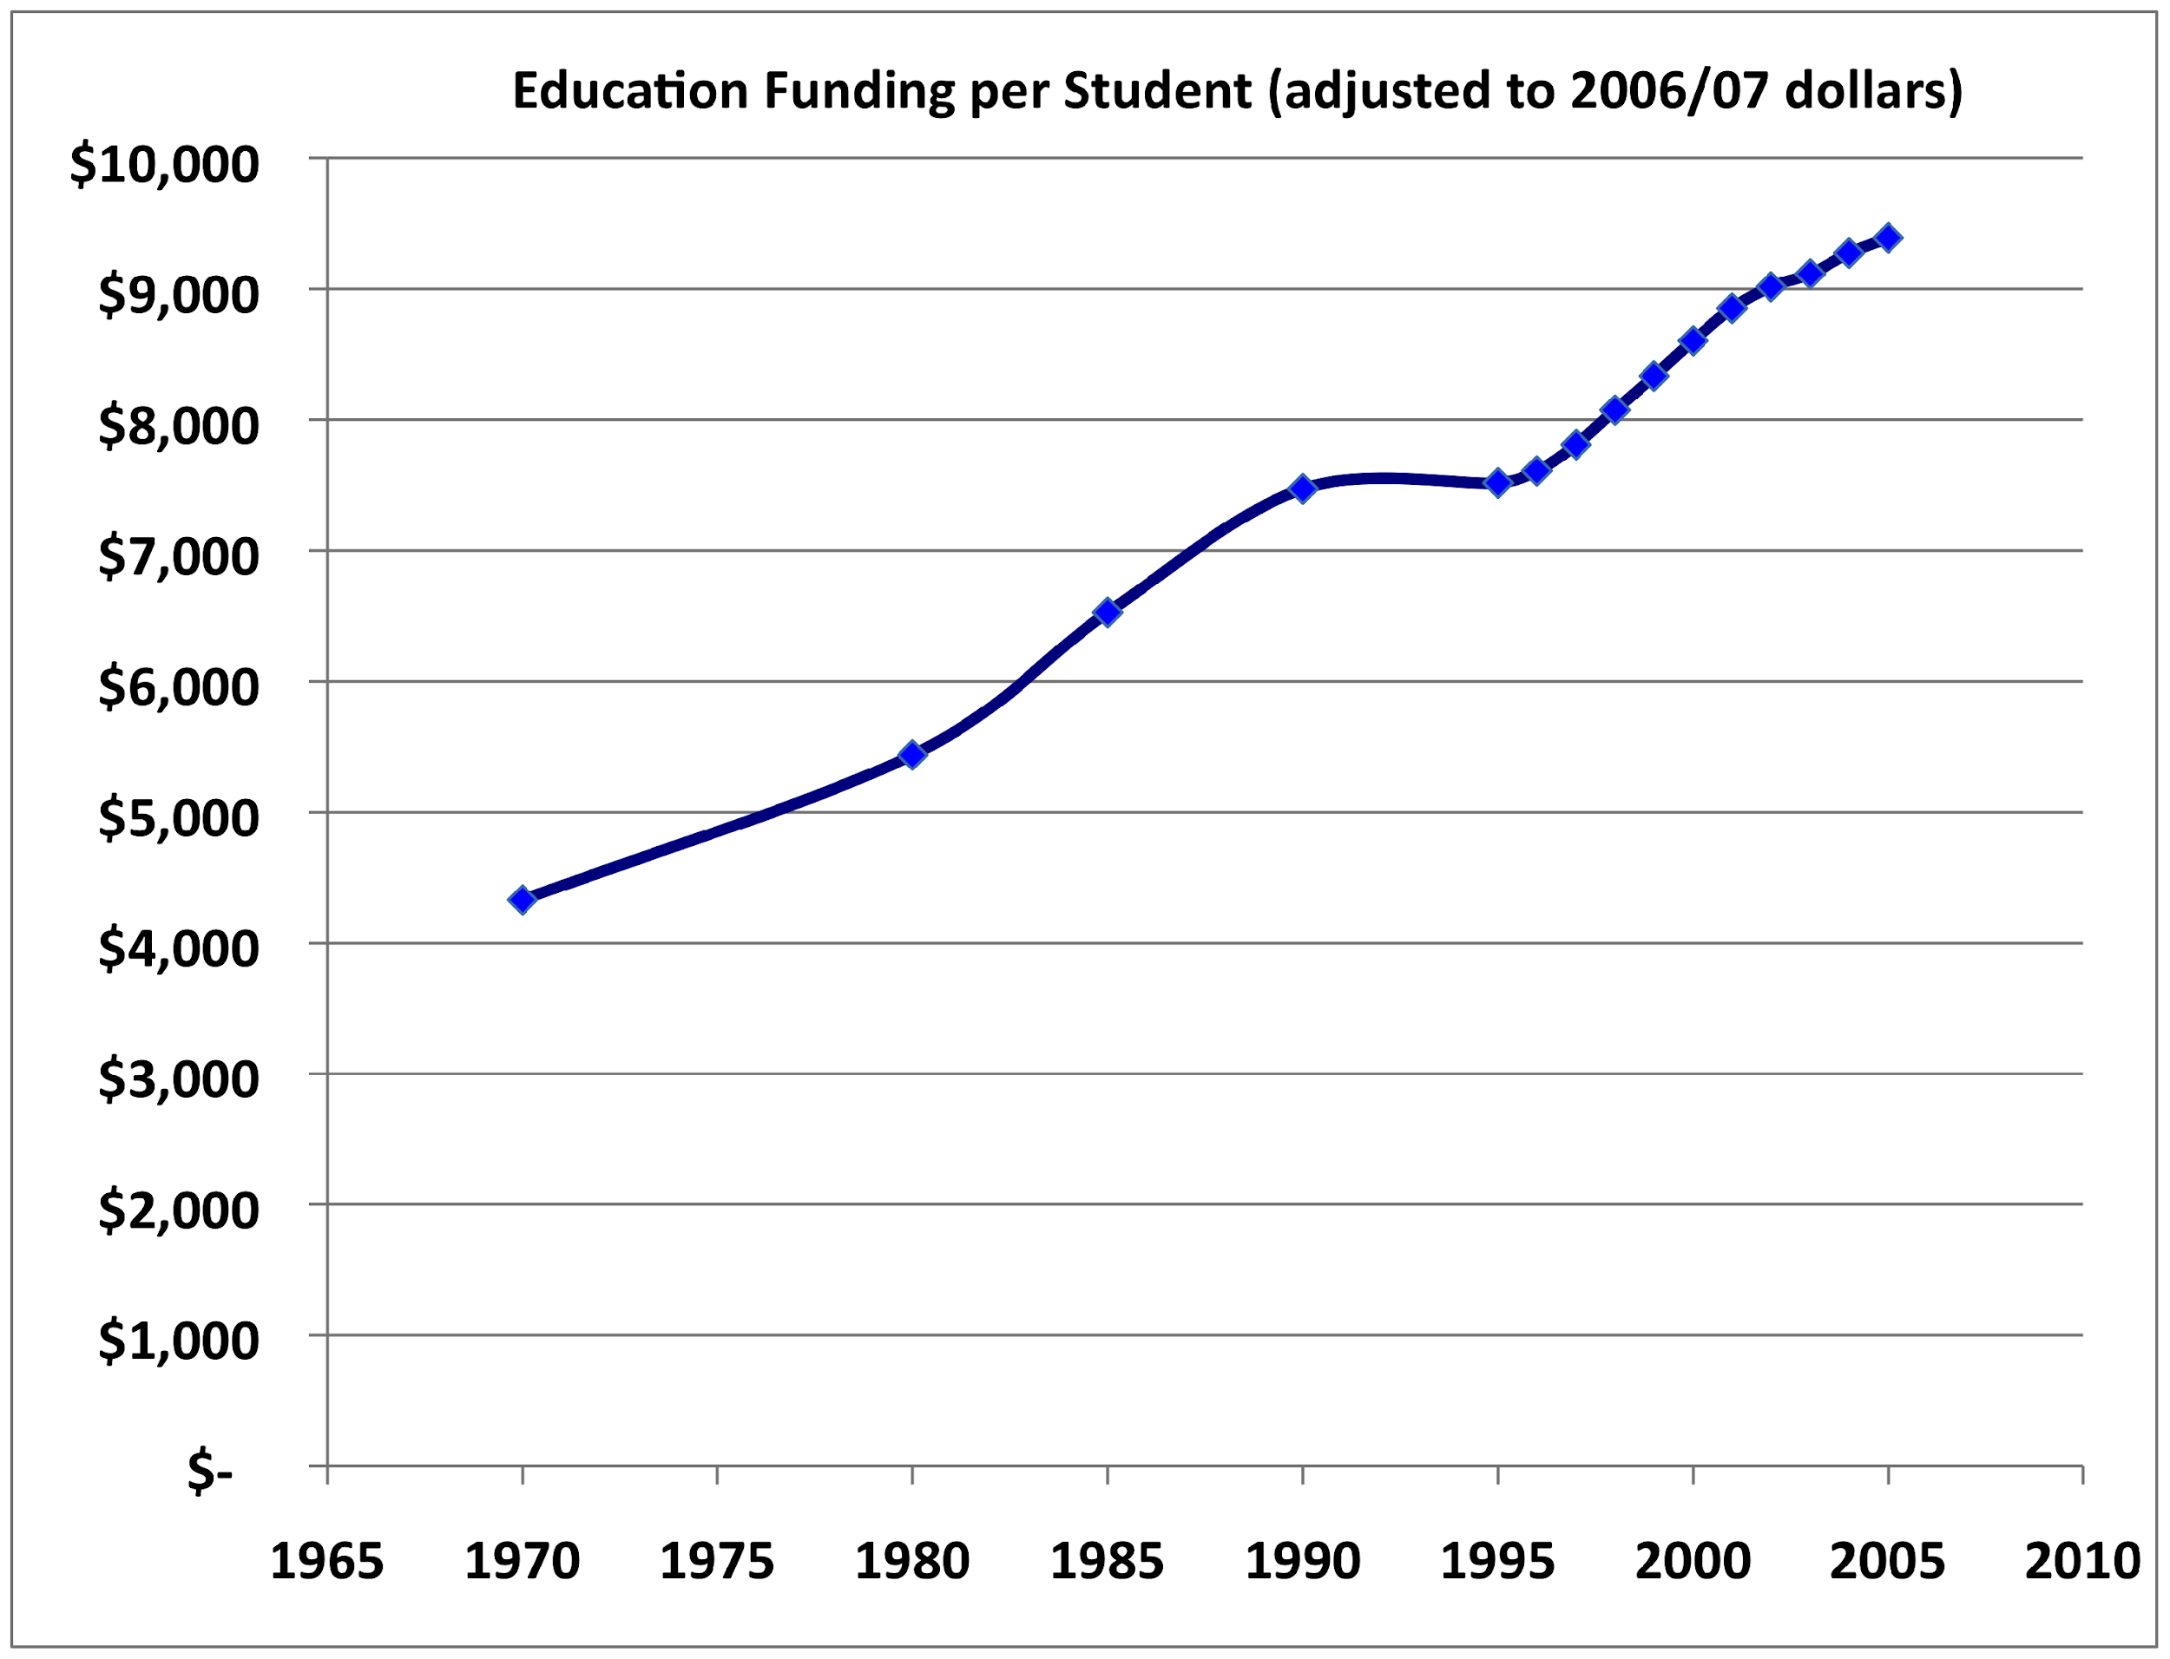
Are We Getting Our Money’s Worth?
We were doing better
in 1970 than 2009 because
we were getting same effect
for half the cost.
SOURCE: U.S. Department of Education, National Center for Education Statistics. (2009). Digest of Education Statistics, 2008 (NCES 2009-020), Chapter 2 and Table 179.

Slide 10
Scope of the Problem
55 million students enrolled in public schools.
6.7 million students in special education.
3.1 million public school teachers.

Slide 11
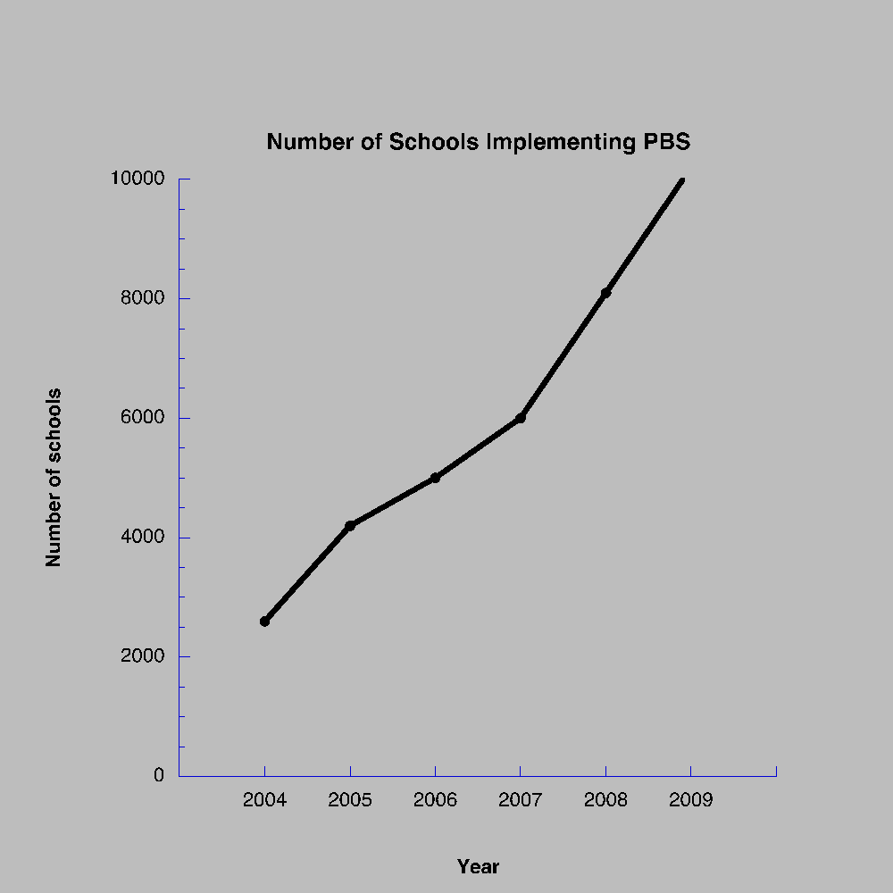

Slide 12
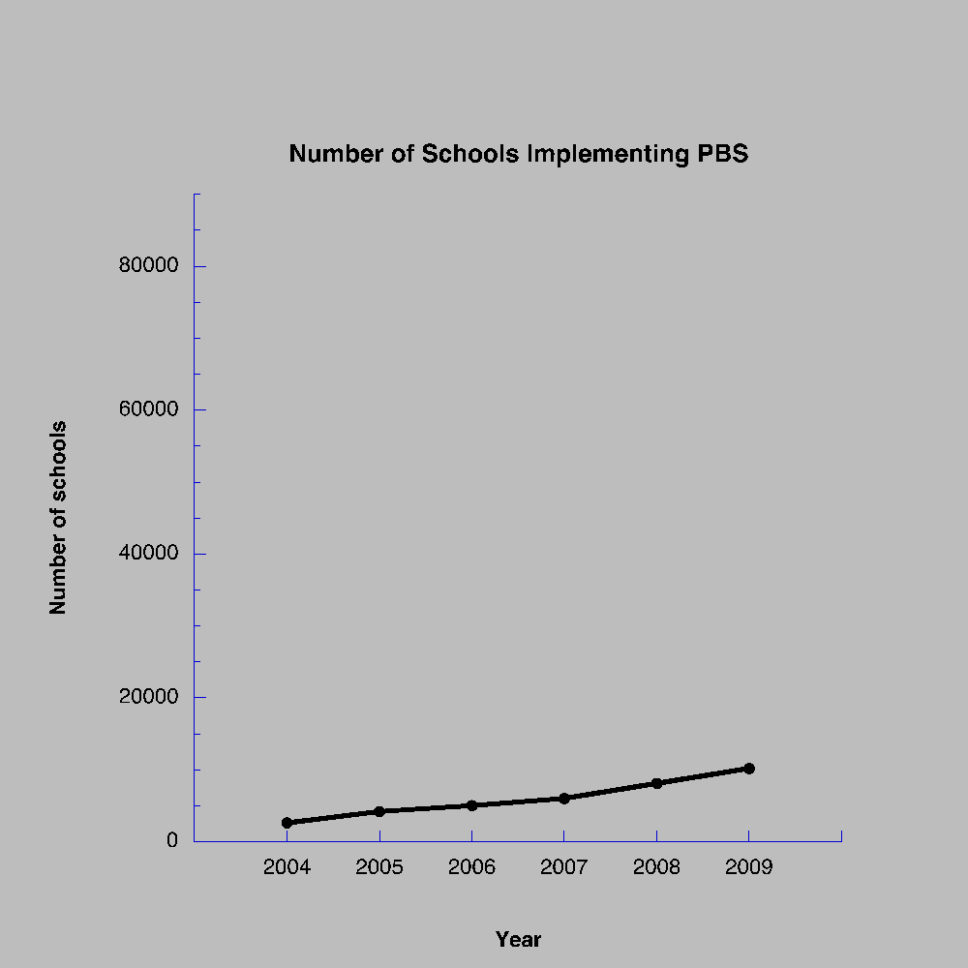

Slide 13
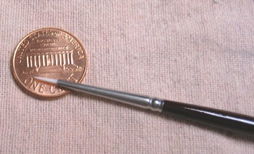

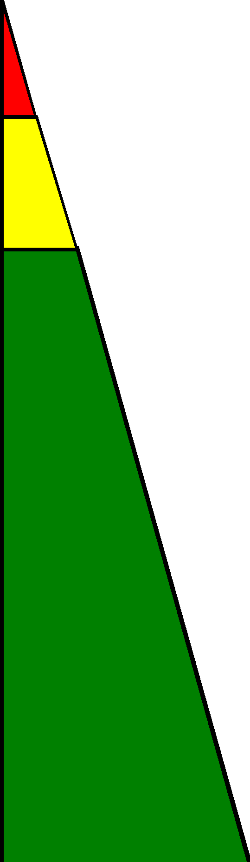

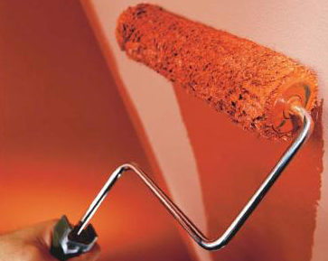
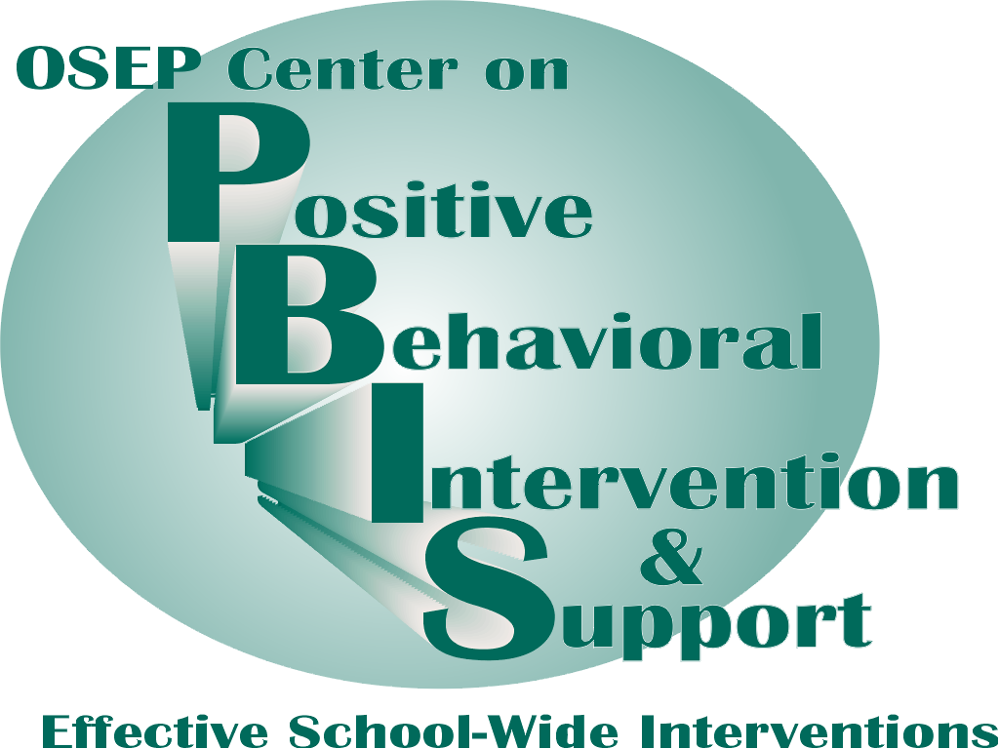
A Prevention Model for Evidence-based Education
Academic Systems
Behavioral Systems
Intensive, Individual Interventions
Individual Students
Assessment-based
High Intensity
Intensive, Individual Interventions
Individual Students
Assessment-based
Intense, durable procedures
1-5%
1-5%
Targeted Group Interventions
Some students (at-risk)
High efficiency
Rapid response
5-10%
5-10%
Targeted Group Interventions
Some students (at-risk)
High efficiency
Rapid response
Universal Interventions
All students
Preventive, proactive
80-90%
80-90%
Universal Interventions
All settings, all students
Preventive, proactive

Slide 14
What Are We Trying to Prevent?
It could be argued that quality of education is a public health issue.
Educational level has been correlated with many socially important outcomes.

Slide 15
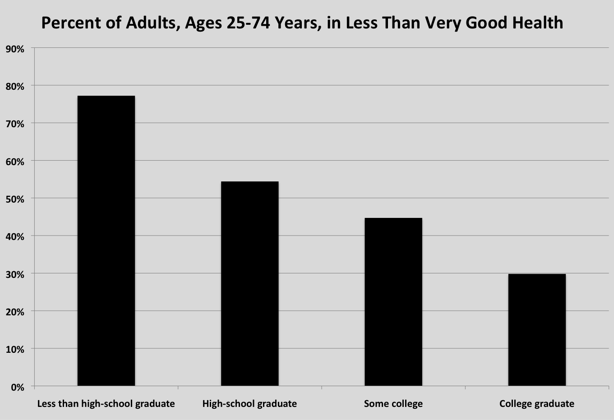
REACHING AMERICA'S HEALTH POTENTIAL: A STATE-BY-STATE LOOK AT ADULT HEALTH Commission to Build a Healthier America May 2009 U.S. Census Data: American Community Survey (2007) U.S. Census Data: Behavioral Risk Factor Surveillance System Survey Data (2005-2007)

Slide 16
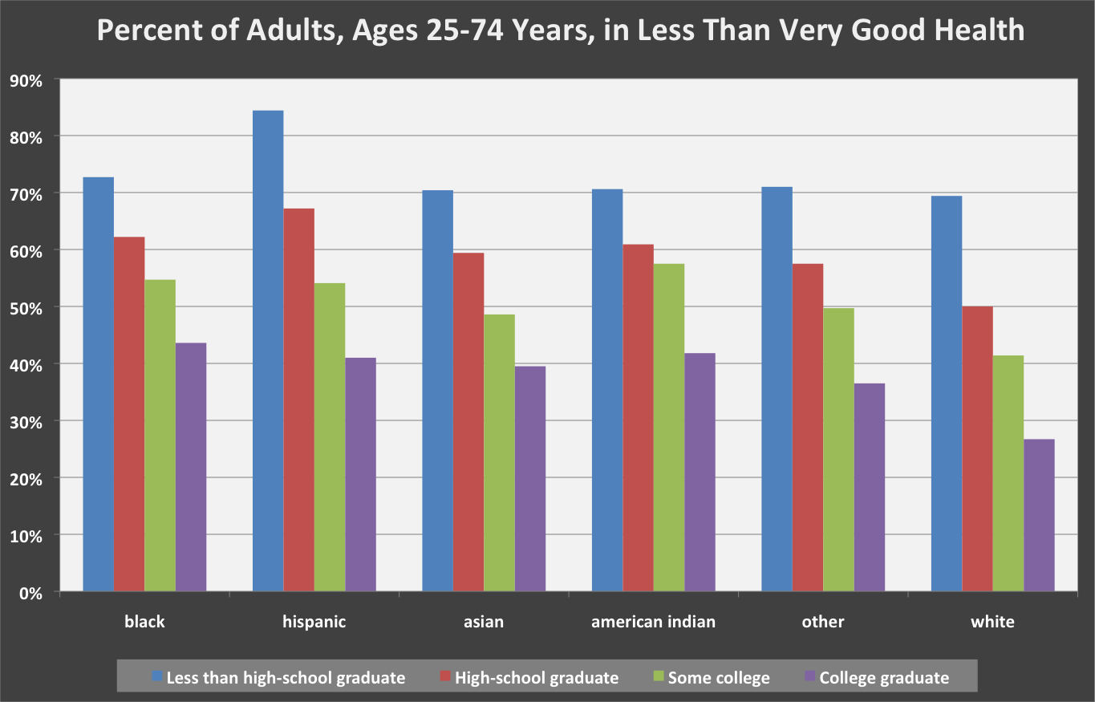
REACHING AMERICA'S HEALTH POTENTIAL: A STATE-BY-STATE LOOK AT ADULT HEALTH Commission to Build a Healthier America May 2009 U.S. Census Data: American Community Survey (2007) U.S. Census Data: Behavioral Risk Factor Surveillance System Survey Data (2005-2007)

Slide 17
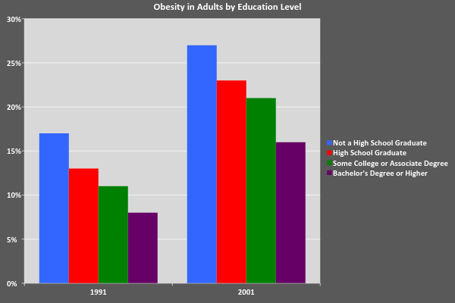
SOURCE:
Department of Health and Human Services (2003)
Notes:
Can’t find the linked file

Slide 18
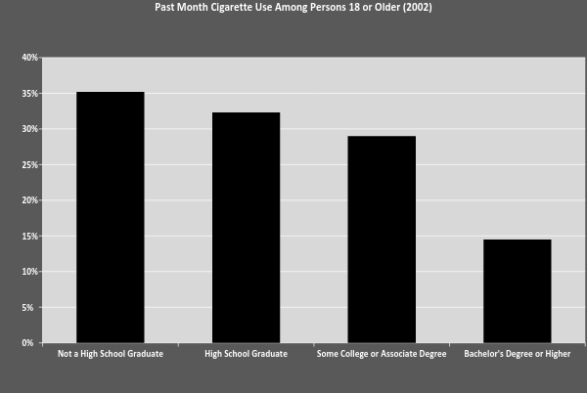
SOURCE:
Department of Health and Human Services (2003)
Notes:
Can’t find linked file

Slide 19
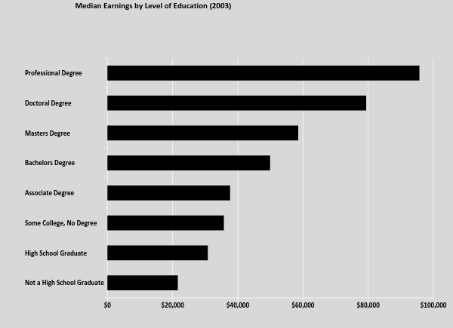
U.S. Census Bureau, 2004
Notes:
Can’t find linked file

Slide 20
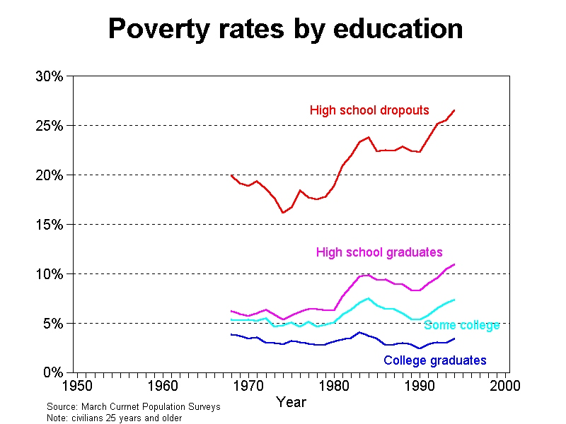
University of Maryland, Department of Sociology

Slide 21
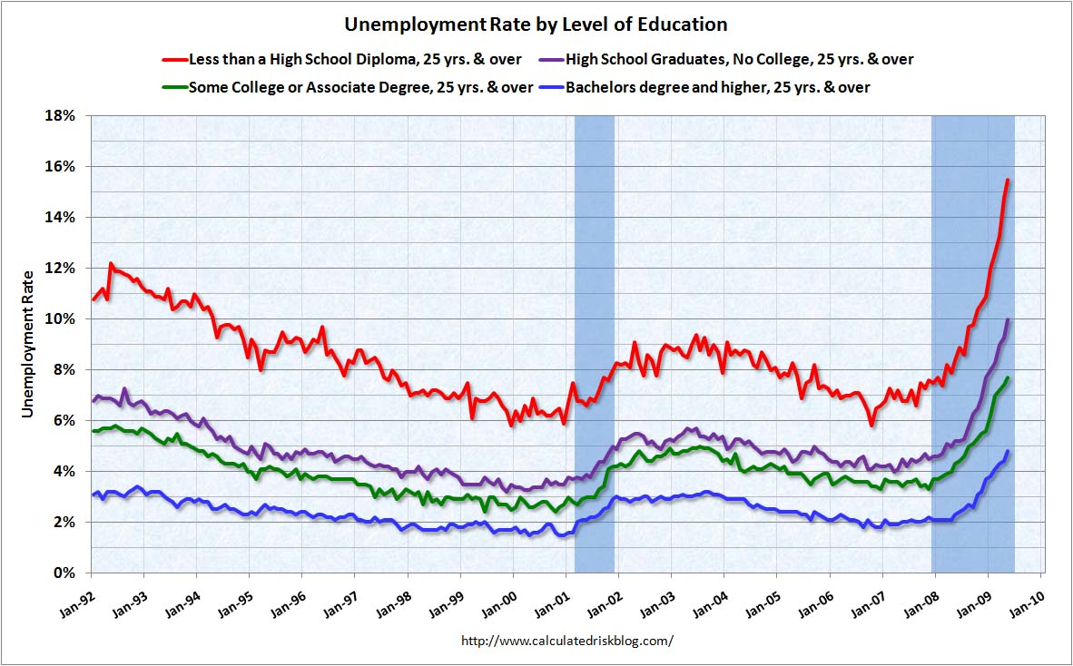

Slide 22
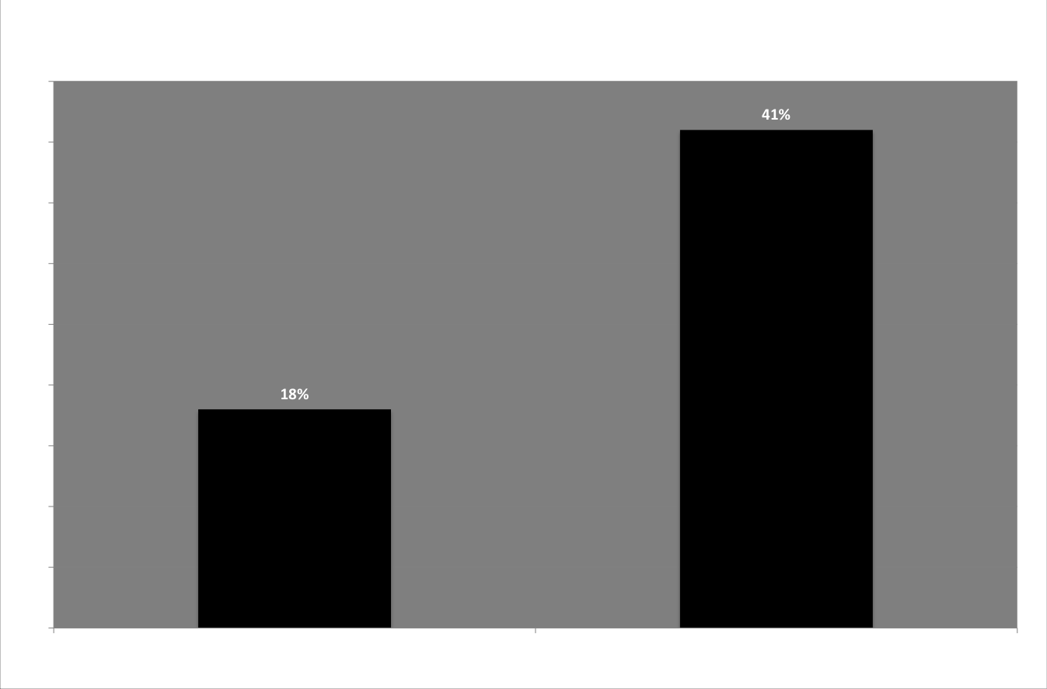
Source: U.S. Department of Justice (2003)

Slide 23
Applied Behavior Analysis as Agent for Change
Baer, Wolf, and Risley (1968)
“applied research is constrained to examining behaviors which are socially important, rather than convenient for study. It also implies, very frequently, the study of those behaviors is in their usual social settings, rather than in a "laboratory" setting.”

Slide 24
Is Behavior Analysis Ready for Education Reform?
Education is a gateway to improved socially important outcomes.
NCLB emphasis on scientifically based should be good news for behavior analysis.
Who is more scientifically based?
Is behavior analysis well positioned to inform public policy about education?

Slide 25
A Review of JABA Education Publications
Method
Searched JABA from 1968-2009.
Included all experimental studies that were in K-12 public schools.
Analog studies were included
Excluded all studies if not in public schools:
University lab schools
Pre-schools
University clinics
Developmental Centers

Slide 26
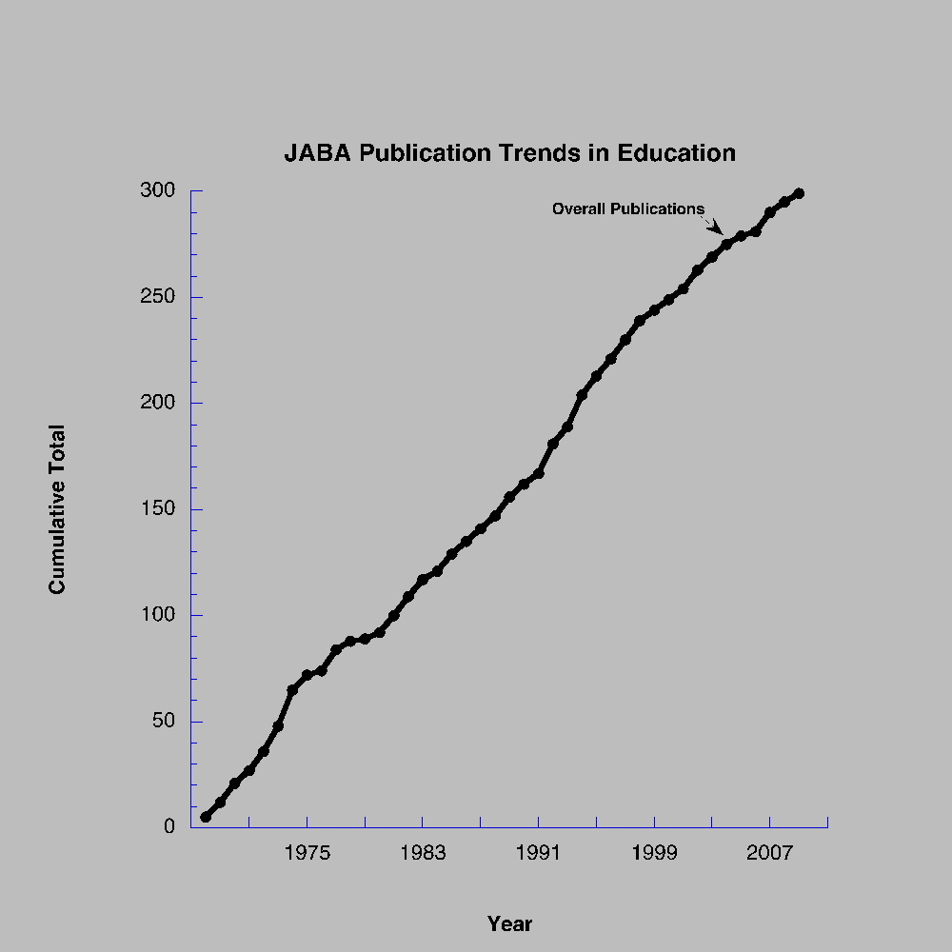

Slide 27
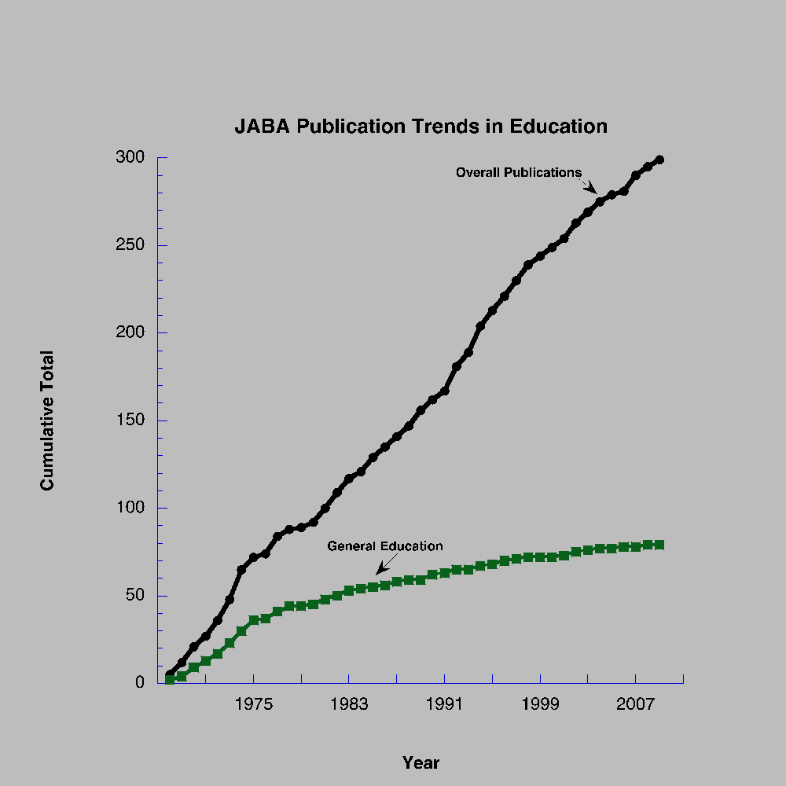

Slide 28
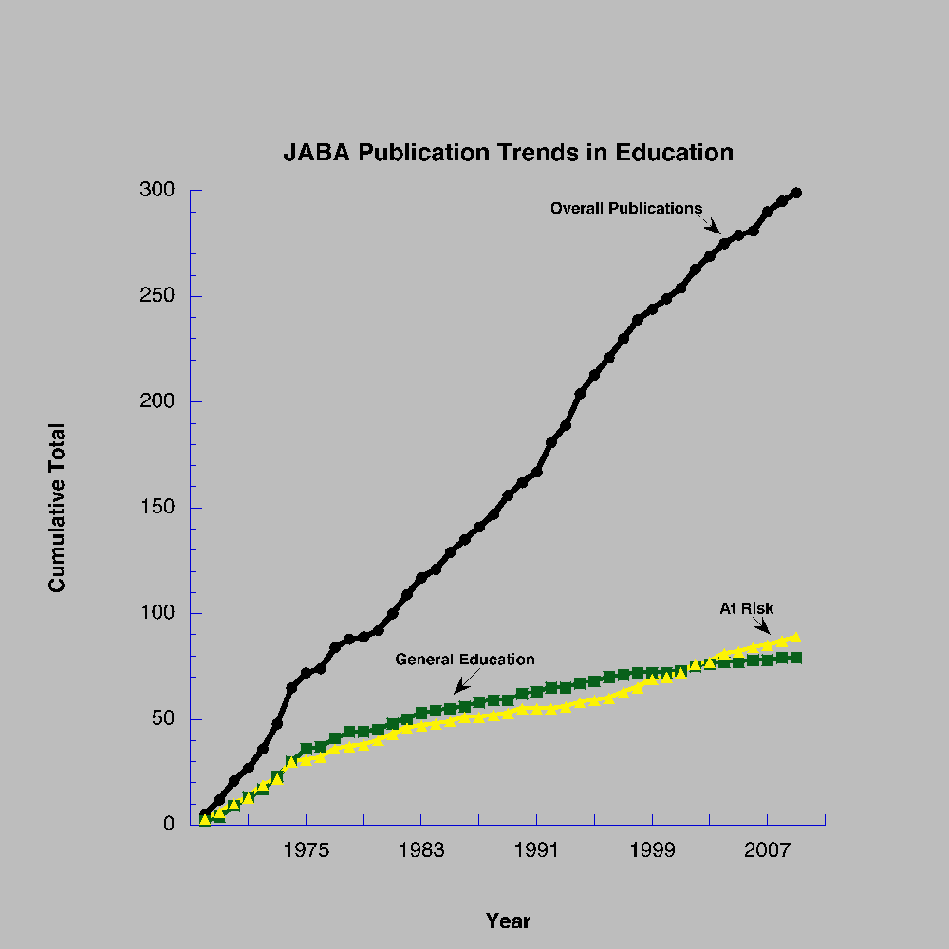

Slide 29
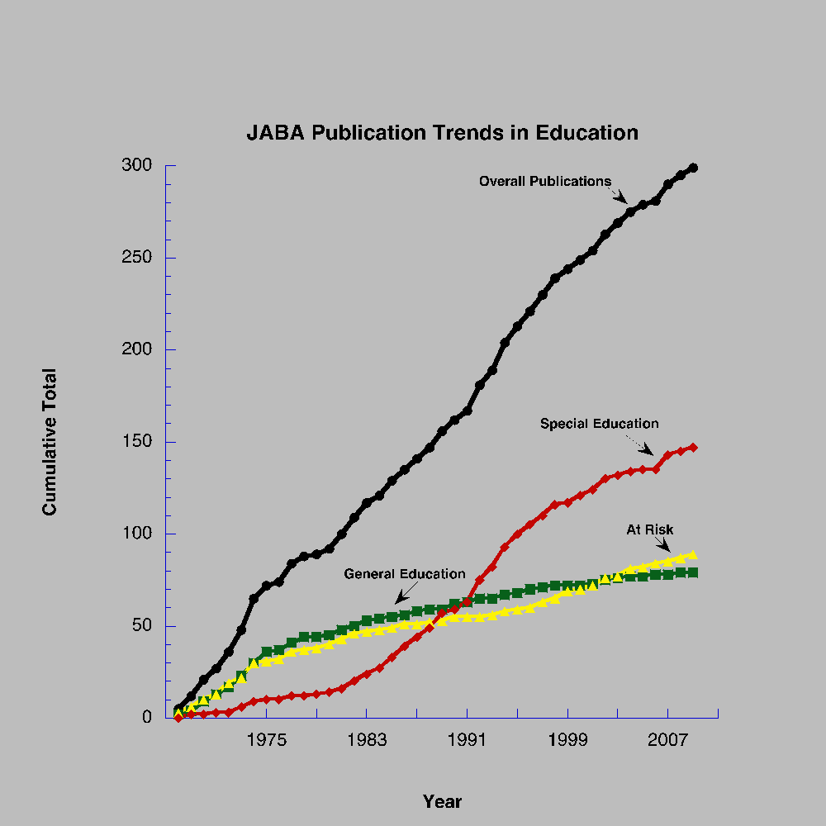
94-142 Passed
Special Ed Law

Slide 30
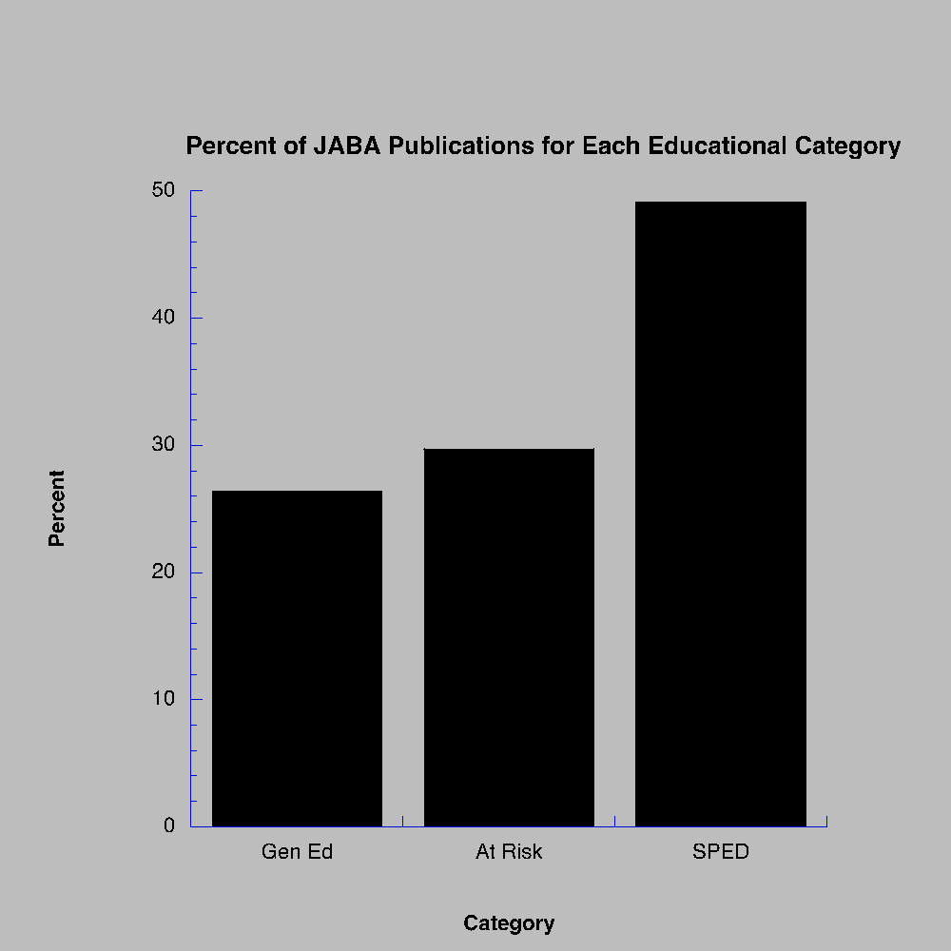

Slide 31
A Prevention Model for Evidence-based Education
Academic Systems
Behavioral Systems
Intensive, Individual Interventions
Individual Students
Assessment-based
High Intensity
Intensive, Individual Interventions
Individual Students
Assessment-based
Intense, durable procedures
1-5%
1-5%
Targeted Group Interventions
Some students (at-risk)
High efficiency
Rapid response
5-10%
5-10%
Targeted Group Interventions
Some students (at-risk)
High efficiency
Rapid response
Universal Interventions
All students
Preventive, proactive
80-90%
80-90%
Universal Interventions
All settings, all students
Preventive, proactive

Slide 32
Special
Special Education
50%
At Risk
29 %
General Education
26%

Slide 33
A Question of Face Validity: A Failure to Communicate
Much of our work is based on principles developed in settings other than public schools.
We may consider that an irrelevant issue but the “audience” of educators do not.
Work can be characterized as “boutique.”
With a few notable exceptions (PBS, Teaching Family Model) we have not taken our work to scale (mainstream).

Slide 34
A Question of Face Validity: A Failure to Communicate
Research methods are excellent for identifying functional relations.
Behavior analysis has not paid much attention to population or actuarial questions?
How big a bang for my buck from this intervention?
What percent of the population will benefit?
Who will benefit?
We have not built easily disseminated packages.

Slide 35
Good Behavior Game (GBG)
First efficacy study: fourth grade classroom
(Barrish, Saunders, Wolf, 1969)
Subsequent replications across:
Settings (Sudan, library, sheltered workshop).
Students (general education, special education, 2nd grade, 5th grade, 6th grade, adults with developmental disabilities ).
Behaviors (on-task, off, task, disruptive, work productivity).

Slide 36
Good Behavior Game (GBG): A Behavioral Vaccine
Developed manual for Good Behavior Game
www.jhsph.edu/prevention/publications/gbg.pd
Series of effectiveness studies by Kellam et al. examining it as a prevention program.
Special issue of Drug and Alcohol Dependence (2008).
If exposed to GBG in 1st and 2nd grade then reduced risk for young adults of:
drug/alcohol abuse
smoking
anti-social personality disorder
subsequent use of school-based services
suicidal ideation and attempts
All studies were RCTs.

Slide 37
First Step to Success Walker et. al.
Manualized intervention.
First Step has been in development since 1998.
Originally evaluated with SSDs.
Recently completed large scale, randomized trial in Albuquerque Public Schools.
Researchers worked at “arms length.”
Trained district coaches to train teachers.
Teachers implemented.
At Risk Population= 200 1st and 2nd grade students who were experiencing behavioral difficulties as identified by teachers.

Slide 38
First Step to Success
Benefits
Students who participated benefited relative to control group.
Effects did not maintain the following year.
Horner et. al. evaluated non-responders.
Often problem of treatment integrity.
As students improved teachers implementation “drifted.”
Approximately 2/3 of school districts continue to implement three years after adopting.
Suggests a sustainable intervention.

Slide 39
General Outcome Measures (GOMs)
The larger community is concerned with measures such as academic achievement, bullying, substance abuse.
These measures have not generally been the focus of behavior analysts.
Focus has been on more discrete units of behavior.
We have not demonstrated a link between our discrete units and the larger concerns of the culture.

Slide 40
General Outcome Measures
Baer, Wolf, Risley (1968) discussing effective as a dimension of applied behavior analysis:
“…an increase in those children from D- to C might well be judged an important success by an audience which thinks that C work is a great deal different than D work, especially if C students are much less likely to become drop-outs than D- students.”

Slide 41
General Outcome Measures (GOMs) An Example
Curriculum-based Measurement is the core of RtI.
Discrete measures of academic behavior.
words read correctly per minute
digits correct per minute
Facilitates decision making about intensity of intervention required.
Acknowledges debt to precision teaching.
Able to link discrete measures to broader outcomes.
Predicting reading outcomes years later.
Predicting performance on annual high stakes tests.

Slide 42
General Outcome Measures
Hart & Risley, Meaningful Differences, (1995): Language development by age 3 predicts performance at age 9 on a series of standardized tests.
No comparable CBM measures for social behavior.
Some behavioral colleagues developing measures for young children.

Slide 43
Is Behavior Analysis Ready for Education Reform?
We are a boutique and we have not found our way into the mainstream.
Well documented by behavior analysts for years:
Skinner, 1981
Stoltz, 1981
Foxx, 1996
Malott, 2000
Friman, 2010

Slide 44
Some Initial Recommendations
Increase research at the level of general education.
Develop packages for universal and at risk populations.
Important populations for the larger culture.
Manualize packages so can be implemented by general practitioners (teachers, school psychologists, etc.).
Consistent with Technological dimension of applied behavior analysis (Baer, Wolf, & Risley, 1968).
Explore methods for increasing treatment integrity when interventions are implemented at large scale.

Slide 45
Some Initial Recommendations
Expand research repertoire to include randomized trials.
If we have robust interventions, they will fare well with RCT.
RCTs are well suited to answer population questions.

Slide 46
Some Initial Recommendations
Sidman, The Behavior Analyst, 2006:
“To make the general contributions of which our science is capable, behavior analysts will have to use methods of wider generality, in the sense they affect many people at the same time- or within a short time, without our being concerned about any particular members of the relevant population.”

Slide 47
Some Initial Recommendations
Demonstrate a link between discrete measures of behavior and outcomes important to society.
We do not have to measure constructs but demonstrate a link between our measures and other, more molar units of behavior.

Slide 48
Bad News
Even if we did all recommendations tomorrow it would not be sufficient to assure influence in educational reform.
It will be necessary to understand the process by which some interventions are adopted and others are not.
“…it is at least a fair presumption that behavioral
applications, when effective, can sometimes
lead to social approval and adoption.”
(Baer, Wolf, & Risley, 1968)
Not often enough

Slide 49
Scurvy in the British Royal Navy:
An Example of Adoption
John Lind again experimentally demonstrated the effectiveness of citrus in preventing scurvy.
James Lancaster first experiment demonstrating how to prevent scurvy.
British Navy adopted policy to have citrus on all ships in the Royal Navy.
1601
1747
1795

Slide 50
Modern Dissemination
Lag time from efficacy research to dissemination is 10-20 years (Hoagwood, Burns & Weisz, 2002).
Journals very inefficient for dissemination.
Clearinghouse such as What Works in infancy.
Only 4 of 10 evidence-based Blueprint violence prevention programs had the organizational capacity to disseminate interventions to 10 or more sites in a year (Elliott & Mihalic, 2004).

Slide 51
Building a Better Mousetrap Will Not Save Us
550 named interventions for children and adolescents
Kazdin (2000)
Empirically evaluated
Cognitive-behavioral
Behavioral
Evidence-based interventions are less likely to be used than interventions for which there is no evidence or there is evidence about lack of impact.

Slide 52
Diffusion of Innovation Rogers, Diffusion of Innovation, 2003
Diffusion of innovation is a social process, even more than a technical matter.
The adoption rate of innovation is a function of its compatibility with the values, beliefs, and past experiences of the individuals in the social system.

Slide 53
Principles for Effective Diffusion: Improving the Odds (Rogers, 2003)
Innovation has to solve a problem that is important for the “client.”
Innovation must have relative advantage over current practice.
It is necessary to gain support of the opinion leaders if adoption is to reach critical mass and become self-sustaining.
Innovation must be compatible with existing values, experiences and needs of the community.

Slide 54
Principles of Effective Diffusion: Improving the Odds
Innovation is perceived as being simple to understand and implement.
Innovation can be implemented on a limited basis prior to broad scale adoption.
Results of the innovation are observable to others.

Slide 55
“If You’re Not at the Table then You’re On the Menu” Cathy Watkins
Behavior analysis has not been influential at the policy level of education.
PBS has demonstrated that it can be done.
The stakes are high for the culture.
Adapt our practices so that effective interventions are selected more often.

Slide 56
If You’re Not at the Table…
Become involved at the leadership levels of schools:
School board
Administration
requires different credentials than most of us have.
Organizational Behavior Management to schools
Learn the culture of schools:
valued outcomes
funding streams
language
values

Slide 57
If You’re Not at the Table
WWC has recently established standards for evaluating research based on single subject designs.
Indentify an intervention and review existing knowledge base using the standards.
Relying on scientific evidence is current policy but policy is transitory.
Establishing the evidence base for behavioral interventions may get us to the education table.

Slide 58
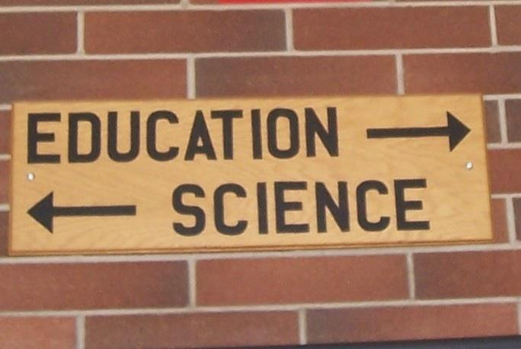
Why Do We Need to be at the Table?

Slide 59
Thank You
Copies of presentation may be downloaded:
winginstitute.org

