Slide 1


Campbell Collaboration Colloquium 2014
"Better Evidence for a Better World"
Why The U.S. Is So Bad At Knowledge Transfer and Implementation
Randy Keyworth
Jack States
Jack States and Randy Keyworth
Notes:
How many of you attended Knowledge transfer workshop” Good, We will not try in 20 minutes to cover the same material. They did a marvelous job of providing the critical content. Implementation: A tale of opportunities lost, misdirection, dead ends, and finally how we can do to change this picture

Slide 2
28 years studying “research to practice” issues…
from the “practice” side
10 years studying “research to practice” issues…
from the “research” side

Slide 3














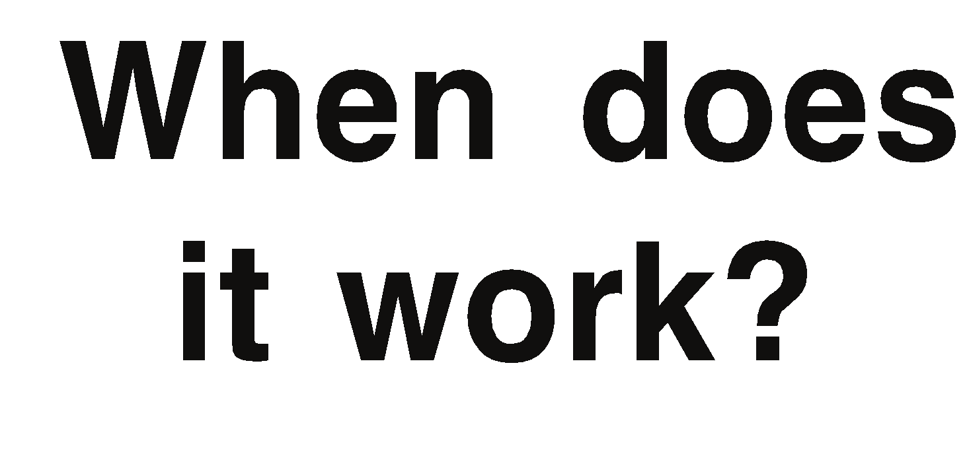





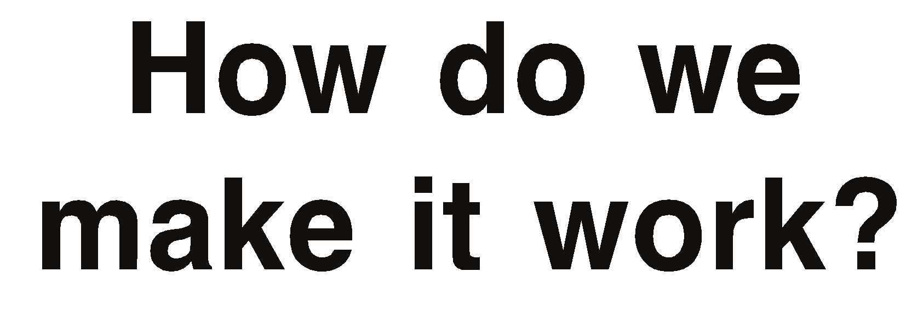
Road Map
Evidence-based Education
Research
Replicability
Sustainability
Practice
Notes:
Definition: a set of specific activities designed to put practices into action. Process not outcome. We are dealing with two types of activities: intervention and implementation. Like serum and syringe. Serum akin to the practice and implementation akin to syringe. Each has it’s place – each is essential if we are to achieve our goal inoculation or educating children
Provide an expanded model for bridging the gap between research and practice – sustainable implementation - Identify the key elements of sustainability

Slide 4




Efficacy Research (What Works?)
Research
What works?
What works?
Replicability
Research conducted to identify promising practices
Establishes a causal relationship between an intervention and its impact on behavior.
Often conducted in highly structured and controlled laboratory settings to clearly demonstrate impact and causation
When does it work?
How do we make it work?
Sustainability
Is it working?
Practice
Notes:
Why is this important? As scientist we want to understand the fundamental laws governing how humans learn. Causal relationships but is done in highly controlled setting to eliminate all possible relationships except the one we are studying.

Slide 5
Effectiveness Research (When Does it Work?)
Research
What works?
Replicability
Evaluates the robustness of an intervention when “taken to scale” and implemented in more typical practice settings.
Research conducted to answer questions about the impact and robustness of interventions when taken to scale in more typical practice settings
Primarily concerned with when an intervention works in the context of the following dimensions.
characteristics of students, setting
leadership and instructors
resources, training available
culture, level of commitment
When does it work?
When does it work?
How do we make it work?
Sustainability
Is it working?
Practice
Notes:
Why important? We are now out of the laboratory. We want to know if the practice will continue to work under the distractions and obstacles of real world settings and can we implement this broadly.

Slide 6
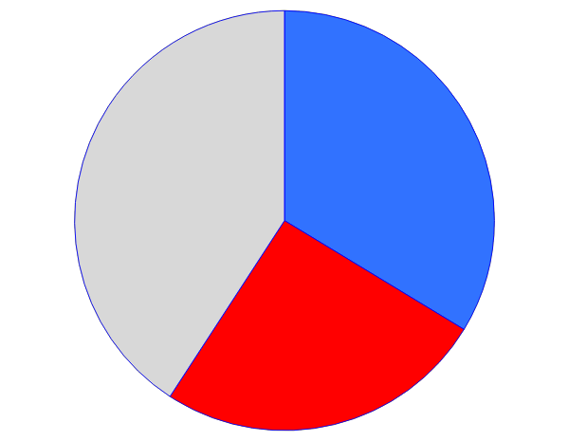
Who Makes a Difference On Student Achievement?
Factors Effecting
Achievement
33% Teacher
Impact
Other Factors
25% Principal
Impact
Marzano, Waters, and McNulty, 2005
Notes:
Principals rank 2nd to teachers in impact (Leithwood, 2007) – Principal effectiveness is tied to provide support, resources, standards, accountability, and training so teachers can teach effectively

Slide 7
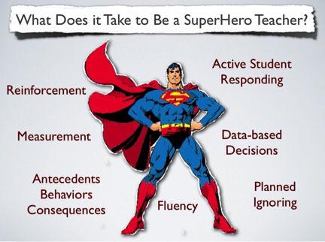
Janet Twyman, 2014
Notes:
We understand that there are four important skills areas that define effective teaching.

Slide 8
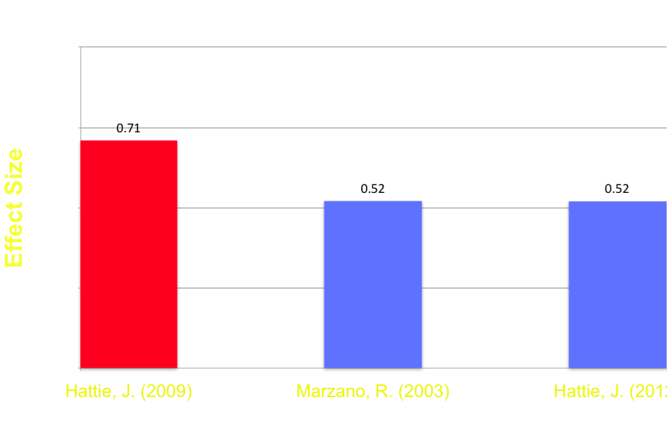
Classroom Management
Appropriate
Behavior
Classroom Management

Slide 9
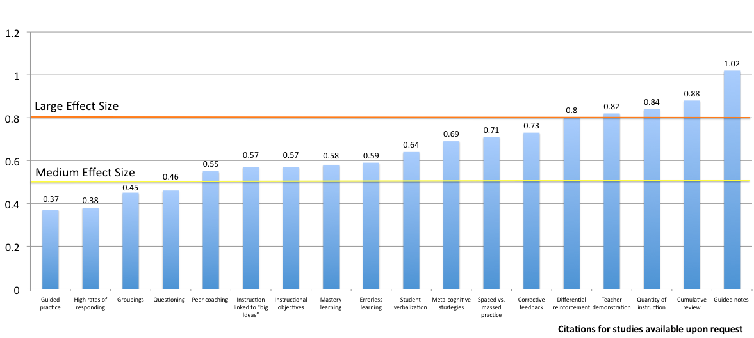
Instructional Delivery

Slide 10
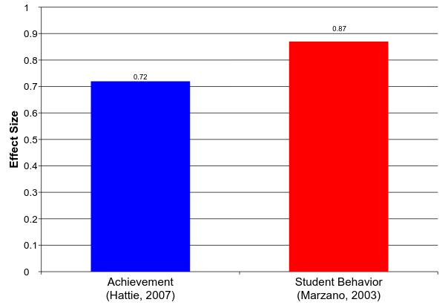
Soft Skills Teacher – Student Relations
Notes:
Ability to show empathy, warmth, encourage student learning, be adaptable to novel situations, exhibit cultural sensitivity and show respect for students

Slide 11
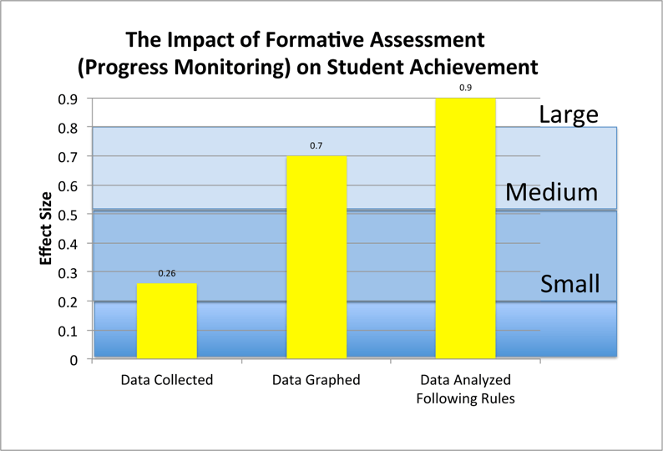
Formative Assessment
Fuchs and Fuchs, 1986
Notes:
High stakes as systems tool vs formative assessment as a diagnostic prescriptive tool

Slide 12
Progress Monitoring (Is it Working?)
Research
What works?
Replicability
Research guides us to interventions that are most likely to work.
Generalizing from a research base to a specific instance requires a leap of faith and confidence < 1.0
Assures that an intervention is actually effective in a setting (practice-based evidence).
When does it work?
How do we make it work?
Sustainability
Is it working?
Is it working?
Practice
Notes:
Why progress monitoring? As in formative assessment our interventions do not work for everyone, everywhere, every time. We need to know when we are not being successful so we can adapt. We want to implement practices with the greatest opportunity to make a difference for the greatest numbers of students

Slide 13
Treatment Integrity
Outcome
Positive
Negative
Positive
Negative
High
Continue Intervention
Change Intervention
High
Integrity
Low
Low
Unknown reason
Unknown reason
Other life changes?
Unknown intervention?
Intervention is effective?
Intervention problem?
Implementation problem?
Notes:
Progress Monitoring makes no sense without treatment integrity and the quality of implementation
Drug prevention programs are implemented with integrity only 19% of the time. (Hallfors & Godette, 2002) or
Gresham et al. (2000) found that only 18.5% of the articles measured the treatment integrity of academic interventions.
My own experience parent training toileting

Slide 14
Implementation (How do we make it work?)
Research
What works?
Replicability
“Identifying evidence-based interventions is one thing, implementing them is an entirely different thing.” (Dean Fixsen, 2008)
How do we make this intervention work in this particular setting?
• Translates effectiveness research to practice, from “general settings” to a “ particular setting”
• Explicit, systematic process for analyzing and addressing the critical variables necessary for an intervention to be successfully adopted, implemented and sustained in a particular setting.
Analyzes the contingencies operating on various stakeholders in a particular practice setting and how they influence adoption and sustainability of an intervention.
When does it work?
How do we make it work?
How do we make it work?
Sustainability
Is it working?
Practice
Notes:
Why is implementation important? Without effective implementation everything else is window dressing. It is the outcome the purpose of education to change children.

Slide 15
What Doesn’t Work
Diffusion and Dissemination
Training
Laws and Mandates
Funding and Financial Incentives
Ineffective
When Used Alone
Notes:
Studies in medicine guidelines on pain management only 12% change in behavior

Slide 16
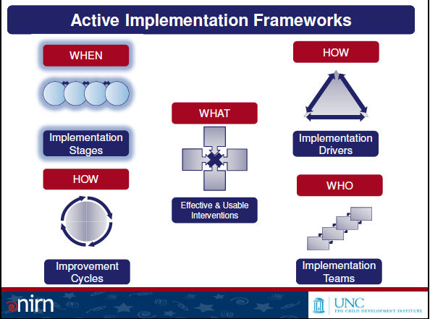
Implementation Framework
Notes:
Growing but nascent science of implementation - 2005 – 750 articles most of poor quality – now over 2500 National Implementation Research Network – Karen Blasé and Dean Fixsen

Slide 17
Implementation (How do we make it work?)
Research
What works?
Replicability
Practices maintained over time: generations of practitioners and decision-makers.
Becoming a part of the Culture: becomes institutionalized, routine…
“the way we do business”
Operating within existing resources (financial, staff, materials) and existing mandates
Continuous improvement is evolutionary not revolutionary
When does it work?
How do we make it work?
How do we make it work?
Sustainability
Is it working?
Practice
Notes:
2. The best way to kills a project is to fund it w/ a grant.

Slide 18

Implementation Takes Time To Get It Right
Notes:
* Implementation is where people have clear expectations are working toward a common end * NIRN research 5 years for an initiative to become mature. It takes persistence and building on the accomplishment of others and learning from your mistakes. The average life of an education innovation is 18-48 months (Latham, 1988). Worse each year a new initiative is added onto the last. These are not designed to work together, but to replace. There result is cynicism, skepticism, frustration, paper compliance, or worse

Slide 19
What Else Do We Know About
Implementation?
#1
It’s not happening enough

Slide 20
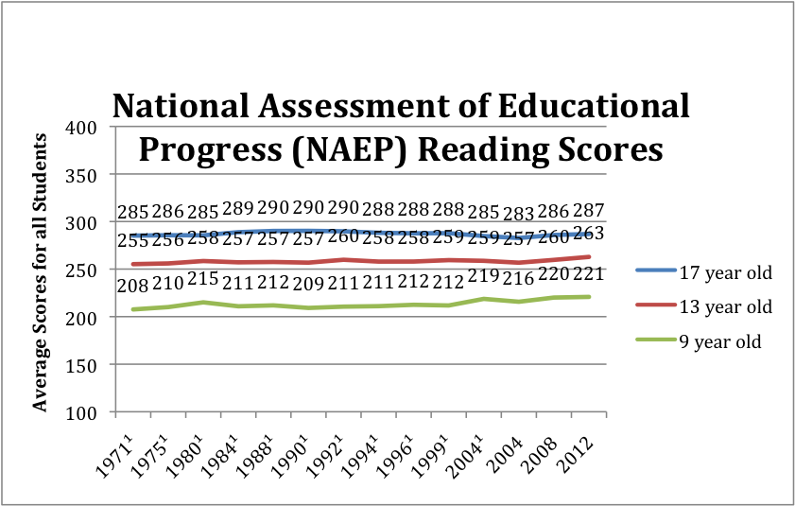
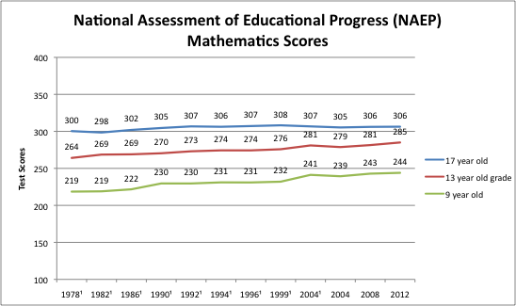
NAEP Scores
Notes:
1. Not reaching proficiency 2.. Graduation rates: Held at 75% forever, but recent improvement 80%

Slide 21
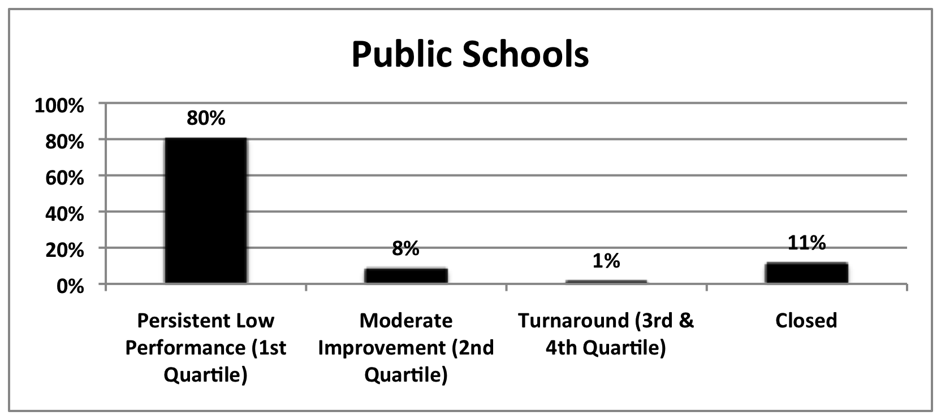
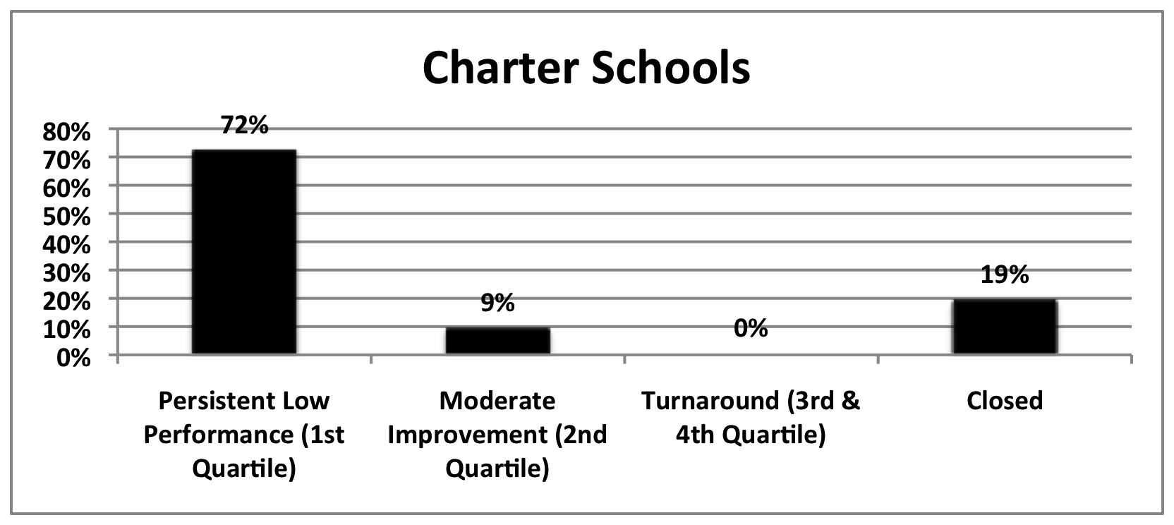
Education Structural Interventions No Child Left Behind
Tracked progress of
2,025 low-performing
charter & district schools
across 10 states
(2003-04 TO 2008-09)
Thomas B. Fordham Institute,
Are Bad Schools Immortal? (2010)
2005/06 was the first year
for “restructuring sanction”
Over the next three years
(2006-07, 2007-08, 2008-09 )
1521 more schools entered
restructuring than exited restructuring.
U.S. Department of Education
Notes:
Funding increased by 30% from 1995-2009
Waivers: Education Secretary Arne Duncan told Congress in 2011 that 82% of America's schools could fail to meet education goals set by No Child Left Behind this year.

Slide 22
School Improvement Grants (SIG)
A federal program pumped a record $3.5 billion into failing schools
SIG spent $2 million per school per year for 3 years on the lowest 10% of the nations schools (1228 schools)
After 4 years 1/3 of the schools showed no progress or actually gotten worse
What Went Wrong?
Notes:
Point: The nation threw money at a solution that didn’t require change in the teachers. Getting rid of bad teachers on the faith that the new teachers would be better. Get rid of the bad teachers Michelle Rhee

Slide 23
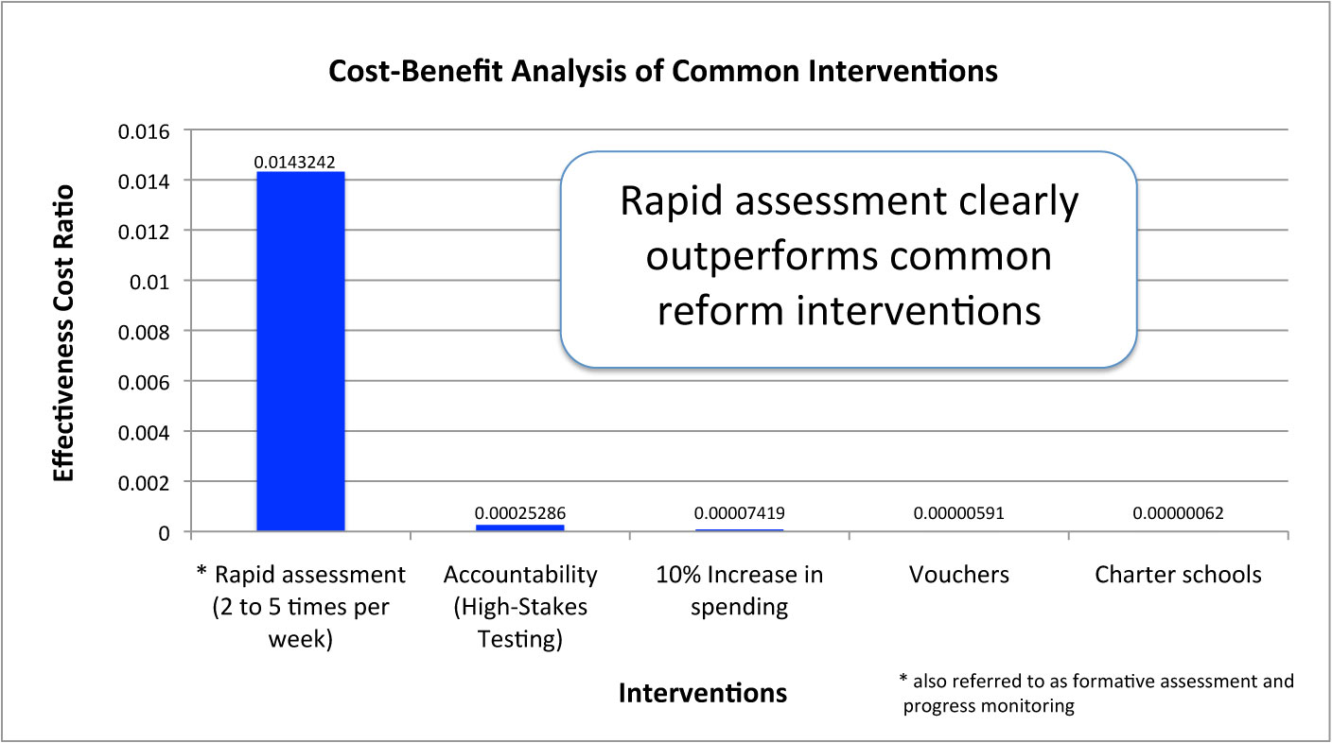
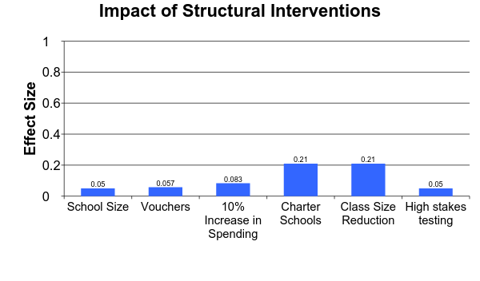
Why? Infatuation with Simple Solutions
Large Effect
Impact on student achievement has been small
Small Effect
Yeh, 2007 and Hattie, 2009
Notes:
Need a better return on our investment - California 20 Billion in 10 years - Being in a high performing schools is 2 ½ times more powerful than class size

Slide 24
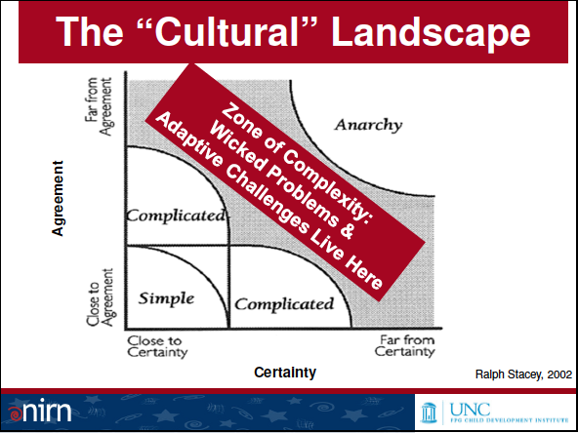
Our Problems Aren’t Simple They are “Wicked”
Notes:
2 variables Agreement and certainty of the solution

Slide 25
What We Know About The Problems We Face
Wicked Problems
Characterized by being messy, devious, and they fight back
Require confronting competing cultural beliefs and values
and/or
Competing contingencies
Require change in peoples behavior
Notes:
Wicked multifactorial involving many stakeholders at different levels of the system. The best way to get rid of the bad teachers is to make them good teachers.

Slide 26
Comparing The Two Dominant Approaches to Teaching
Explicit Instruction | Constructivism
The teacher and student share responsibility for learning | The student is self directed and responsible for their own learning
The role of the teacher is to teach concepts, skills, and knowledge | The role of the teacher is to provide a context and process for students to discover concepts, master skills, and acquire knowledge on their own
The role of the teacher is to provide systematic instruction tied to standards and goals | Students create knowledge of the world through personal experiences not tied to external standards and goals
Teachers master evidence-based teaching skills | Teachers develop their own philosophy of education and personal style of teaching
Formative assessment is key to ensuring student progress | Assessment of student progress is subjective
Higher order thinking is systematically taught and dependent on student mastery of foundation skills | Higher order thinking and foundation skills are learned as required to solve problems
Notes:
Clear distinction between the belief systems 1. Systematic vs random acts of exploration 2. The world is objective vs. subjective 3. Skills need to be taught vs. knowledge is already within us

Slide 27
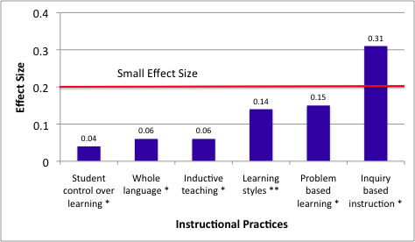
Less Effective Instructional Practices
* Hattie, 2009 ** Kavale, 1987
Notes:
Practices associated with constructivism do not hold up under scrutiny

Slide 28
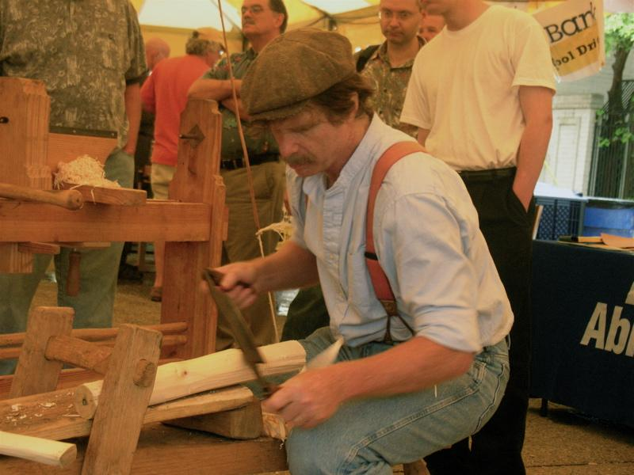
Effective Skills Must Be Taught And Nurtured
Notes:
Art vs. Science – it is more akin to bing a craft. Classroom teacher will make more than 800 - 1,500 educational decisions every school day.
Teachers must master a set of high level skills – Trained and coached: This takes time, effort, and money
Teacher Preparation doesn’t teacher the skills, Principals aren’t taught to do this, So why do we blame the teachers?

Slide 29
Take Away Message
Without effective Implementation the vast majority of reform efforts will fail
We know what it takes to improve student achievement, effective teaching
Past Implementation has missed the mark
There is a growing knowledge base of implementation
But, the solutions take time, required changing performance at all levels of the system, and patience.
Notes:
Being right, having the right practices isn’t enough if you can’t get your practices, adopted, incorporated into the culture, and sustained over time.

Slide 30
THE END

