Slide 1


Using District Instructional Tools and Resources based on Instructional Goals
Principal Professional Learning-Secondary
November, 2023
Notes:
Joan slides 1-18
Slides 1-12 should take about 6-min total

Slide 2

Shared Norms
Be on time and prepared
Stay engaged - Signal for coming back
Respect all voices
Assume best intent
Notes:
Under 1 min

Slide 3
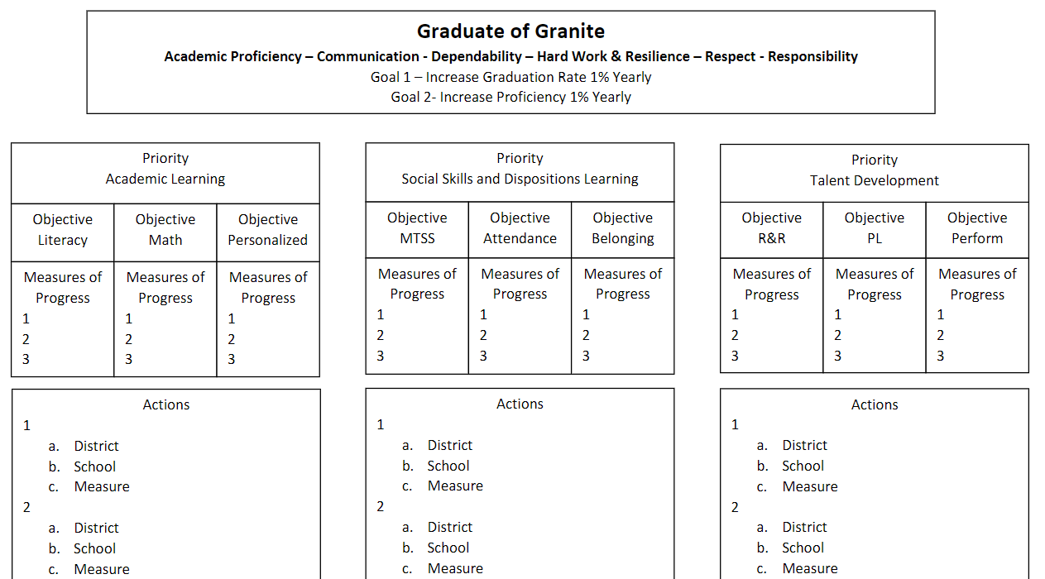
Notes:
Under 1 min

Slide 4

Quick Review of our Principal Professional Learning (PPL) 3-Year Cycle
Year 1- The “What” is good/great in Instruction
Year 2- The “What” is good/great in Learning Environment
Year 3- The “How” to Build Principal Capacity based on your
understanding of what is good/great
Notes:
Under 1 min

Slide 5
Domain 2: Collective Commitment to Learning
Domain 2: An educational leader promotes and is accountable for student success by advocating, nurturing, assessing and sustaining a school focused on teaching the Utah Core Curriculum. An educational leader provides a learning environment conducive to student, faculty, and staff growth through collaboration within a culture of learning.
2C. Instructional Practice
Works with individuals and a variety of groups to ensure the use of Utah Core Standards, the district provided tools, data in assessing student learning, collaborative problem solving, and adjustment to evidence-based instruction to meet student learning needs.
2D. Differentiated Instruction
Assists and monitors the effective use of the district’s framework for instruction and system of support for providing differentiated instructional strategies and appropriate resources to address a variety of student learning needs.
Leadership Standards
Click Here
Notes:
Under I min

Slide 6
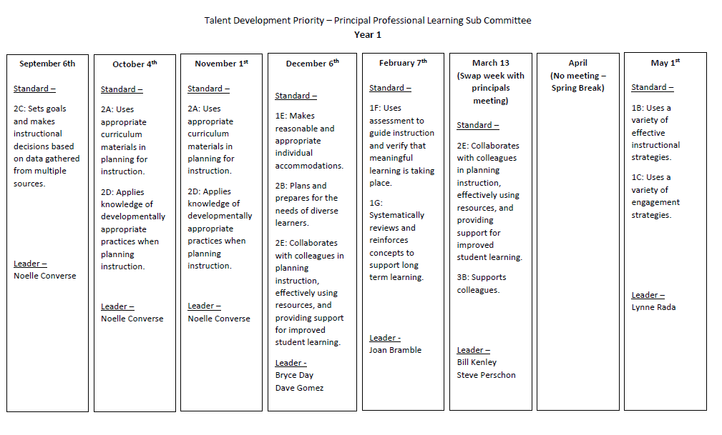
Notes:
-Under 1 min

Slide 7
Connection to Granite Educator Standards
Domain 2.D- Planning and Preparation
Educator Standard 2.D. November Focus
The educator applies knowledge of developmentally appropriate practices when planning instruction.
Includes, but not limited to:
Maximizing student time on task;
Establishing performance outcomes;
Using differentiated instructional strategies.
Notes:
-1 min

Slide 8
Connection to Granite Educator Standards
Domain 2.D- Planning and Preparation
Effective
Maximizes student time on task.
Establishes performance outcomes.
Uses differentiated instructional
strategies.
•
Highly Effective
Supports students in maximizing their
own time on task behavior.
Uses student input to establish
performance outcomes.
Incorporates differentiated instructional
strategies in response to student needs.
Notes:
-1 min

Slide 9


Objectives
Administrators will be able to self-assess where their teachers and PLCs are relative to Educator Standard 2D.
Administrators will increase their ability to support teachers in utilizing appropriate practices when planning instruction with an emphasis on
-Maximizing student time on task;
-Establishing performance outcomes
-Using differentiated instructional strategies
Notes:
-1 min

Slide 10
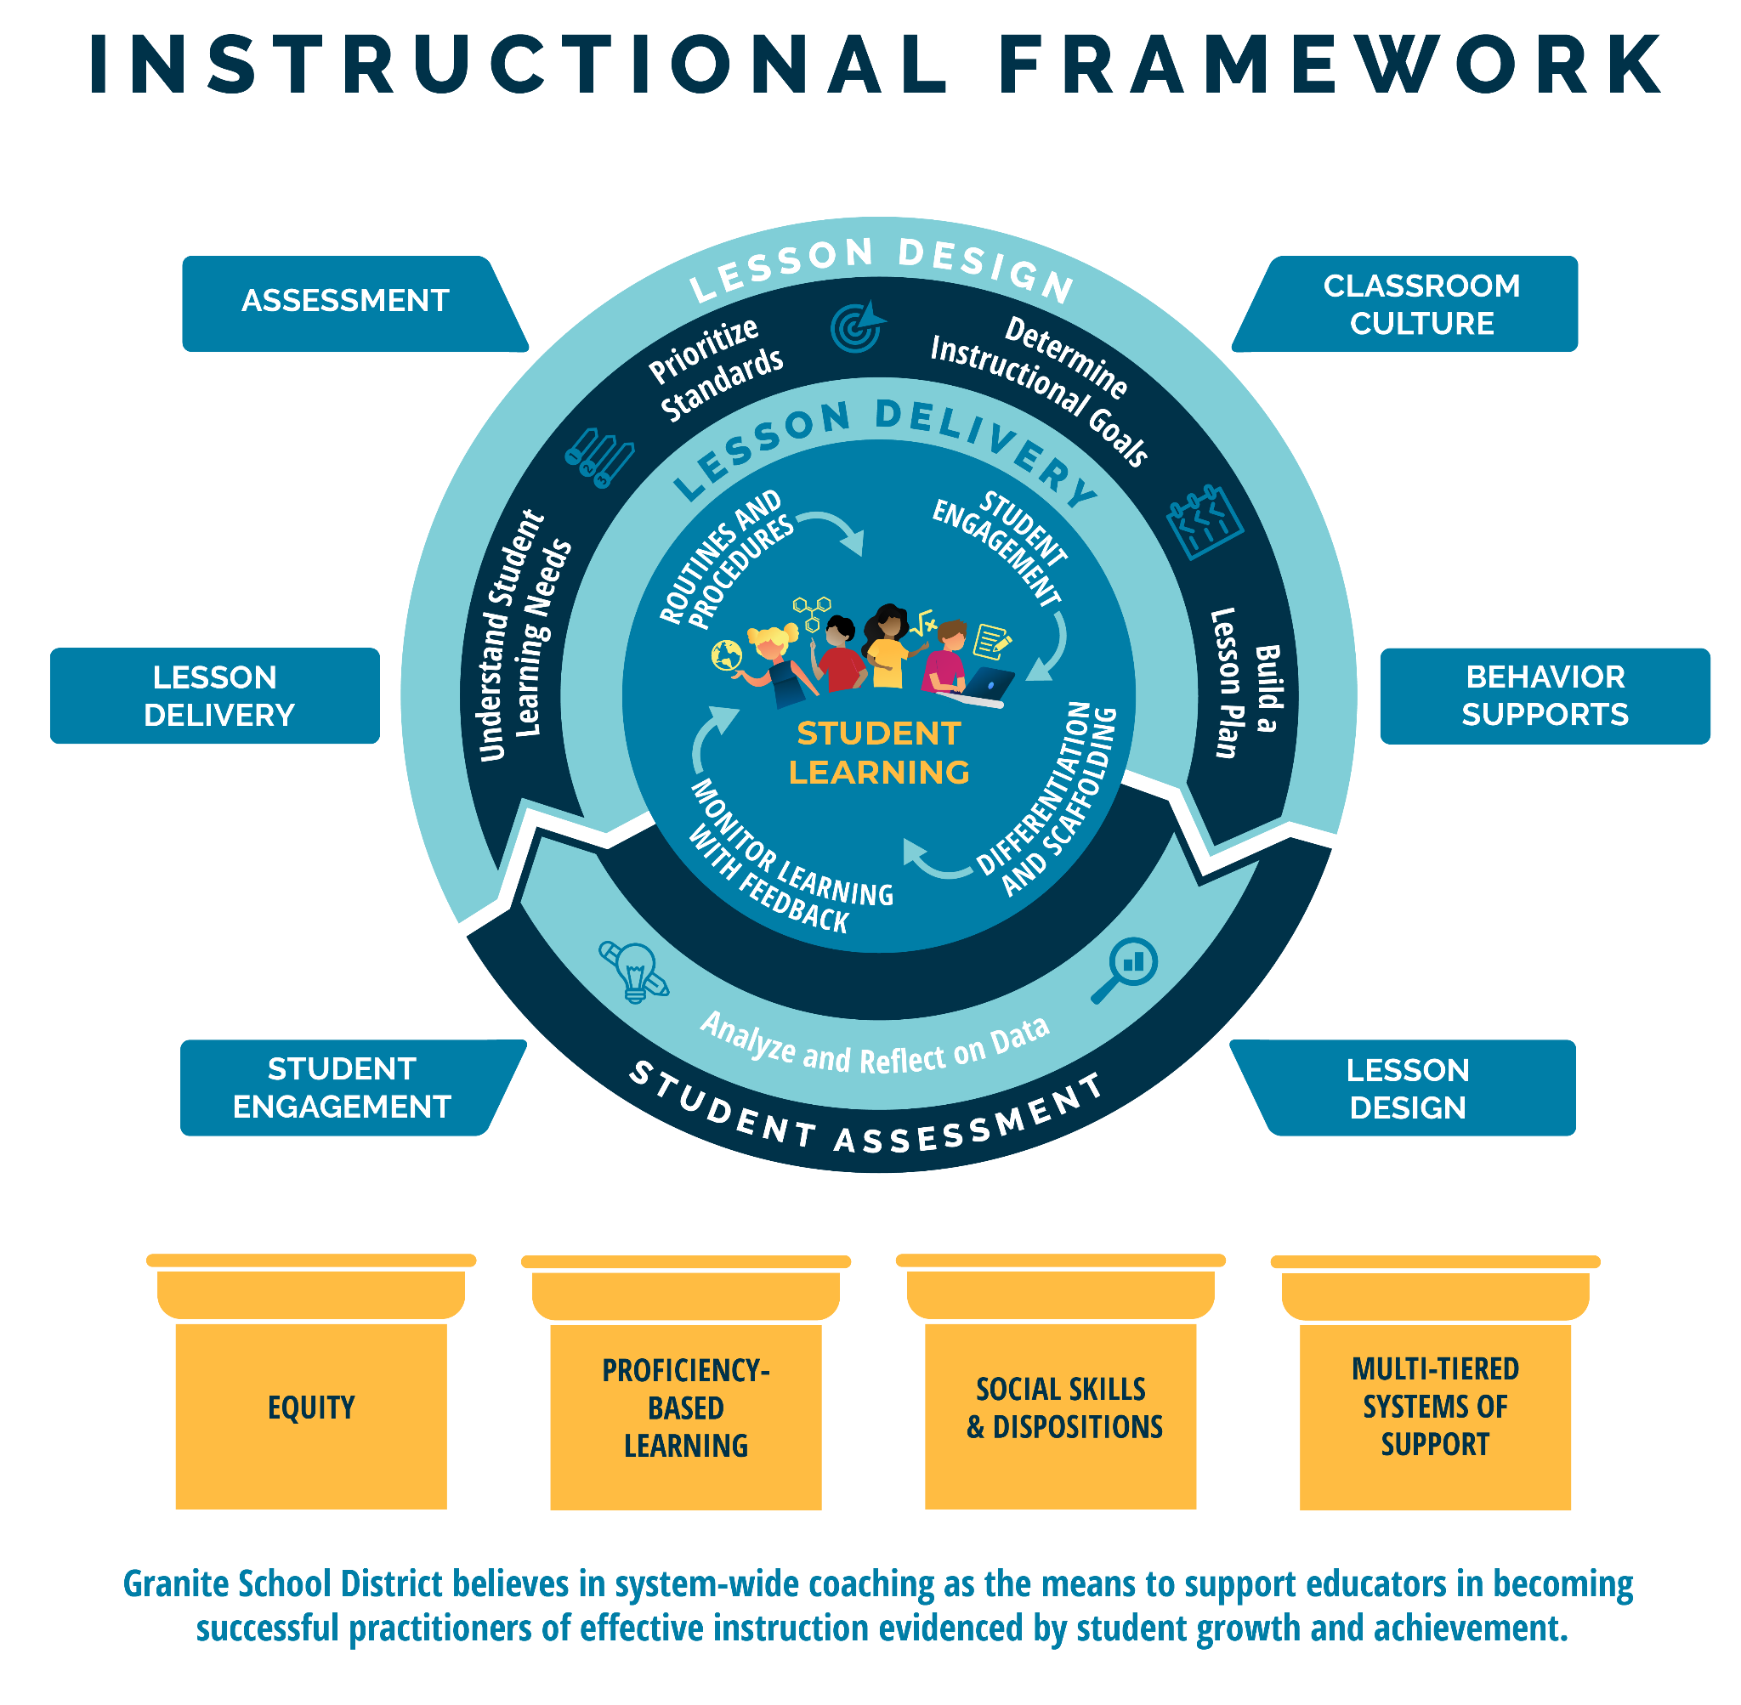
Notes:
-1 min. This is the Granite School District Instructional Framework. This framework is based on the evidence-based instructional practices embedded in the GSD Strategic Plan and represents all of Granite School District’s priorities. You will notice student learning is at the heart of the framework as it represents our commitment to student learning around which everything else is built. The framework features the basic elements of a high quality instructional cycle including Lesson Design, Lesson Delivery, and Student Assessment. You will notice the evidence-based practices at the lesson delivery level that we expect to see in what the teacher and the student are doing during the lesson. The high quality instructional cycle components are reinforced through ongoing, job-embedded coaching in: lesson design, student engagement, lesson delivery, assessment classroom culture and behavior supports, all of which contribute to meaningful learning and career and college readiness. The framework rests on the foundational pillars of Granite School District’s commitment to Equity, Proficiency-Based Learning, Social Skills and Dispositions and Multi-Tiered Systems of Support. Today we will be learning about the tools and resources in alignment with the instructional framework that will help you in your specific content areas.

Slide 11
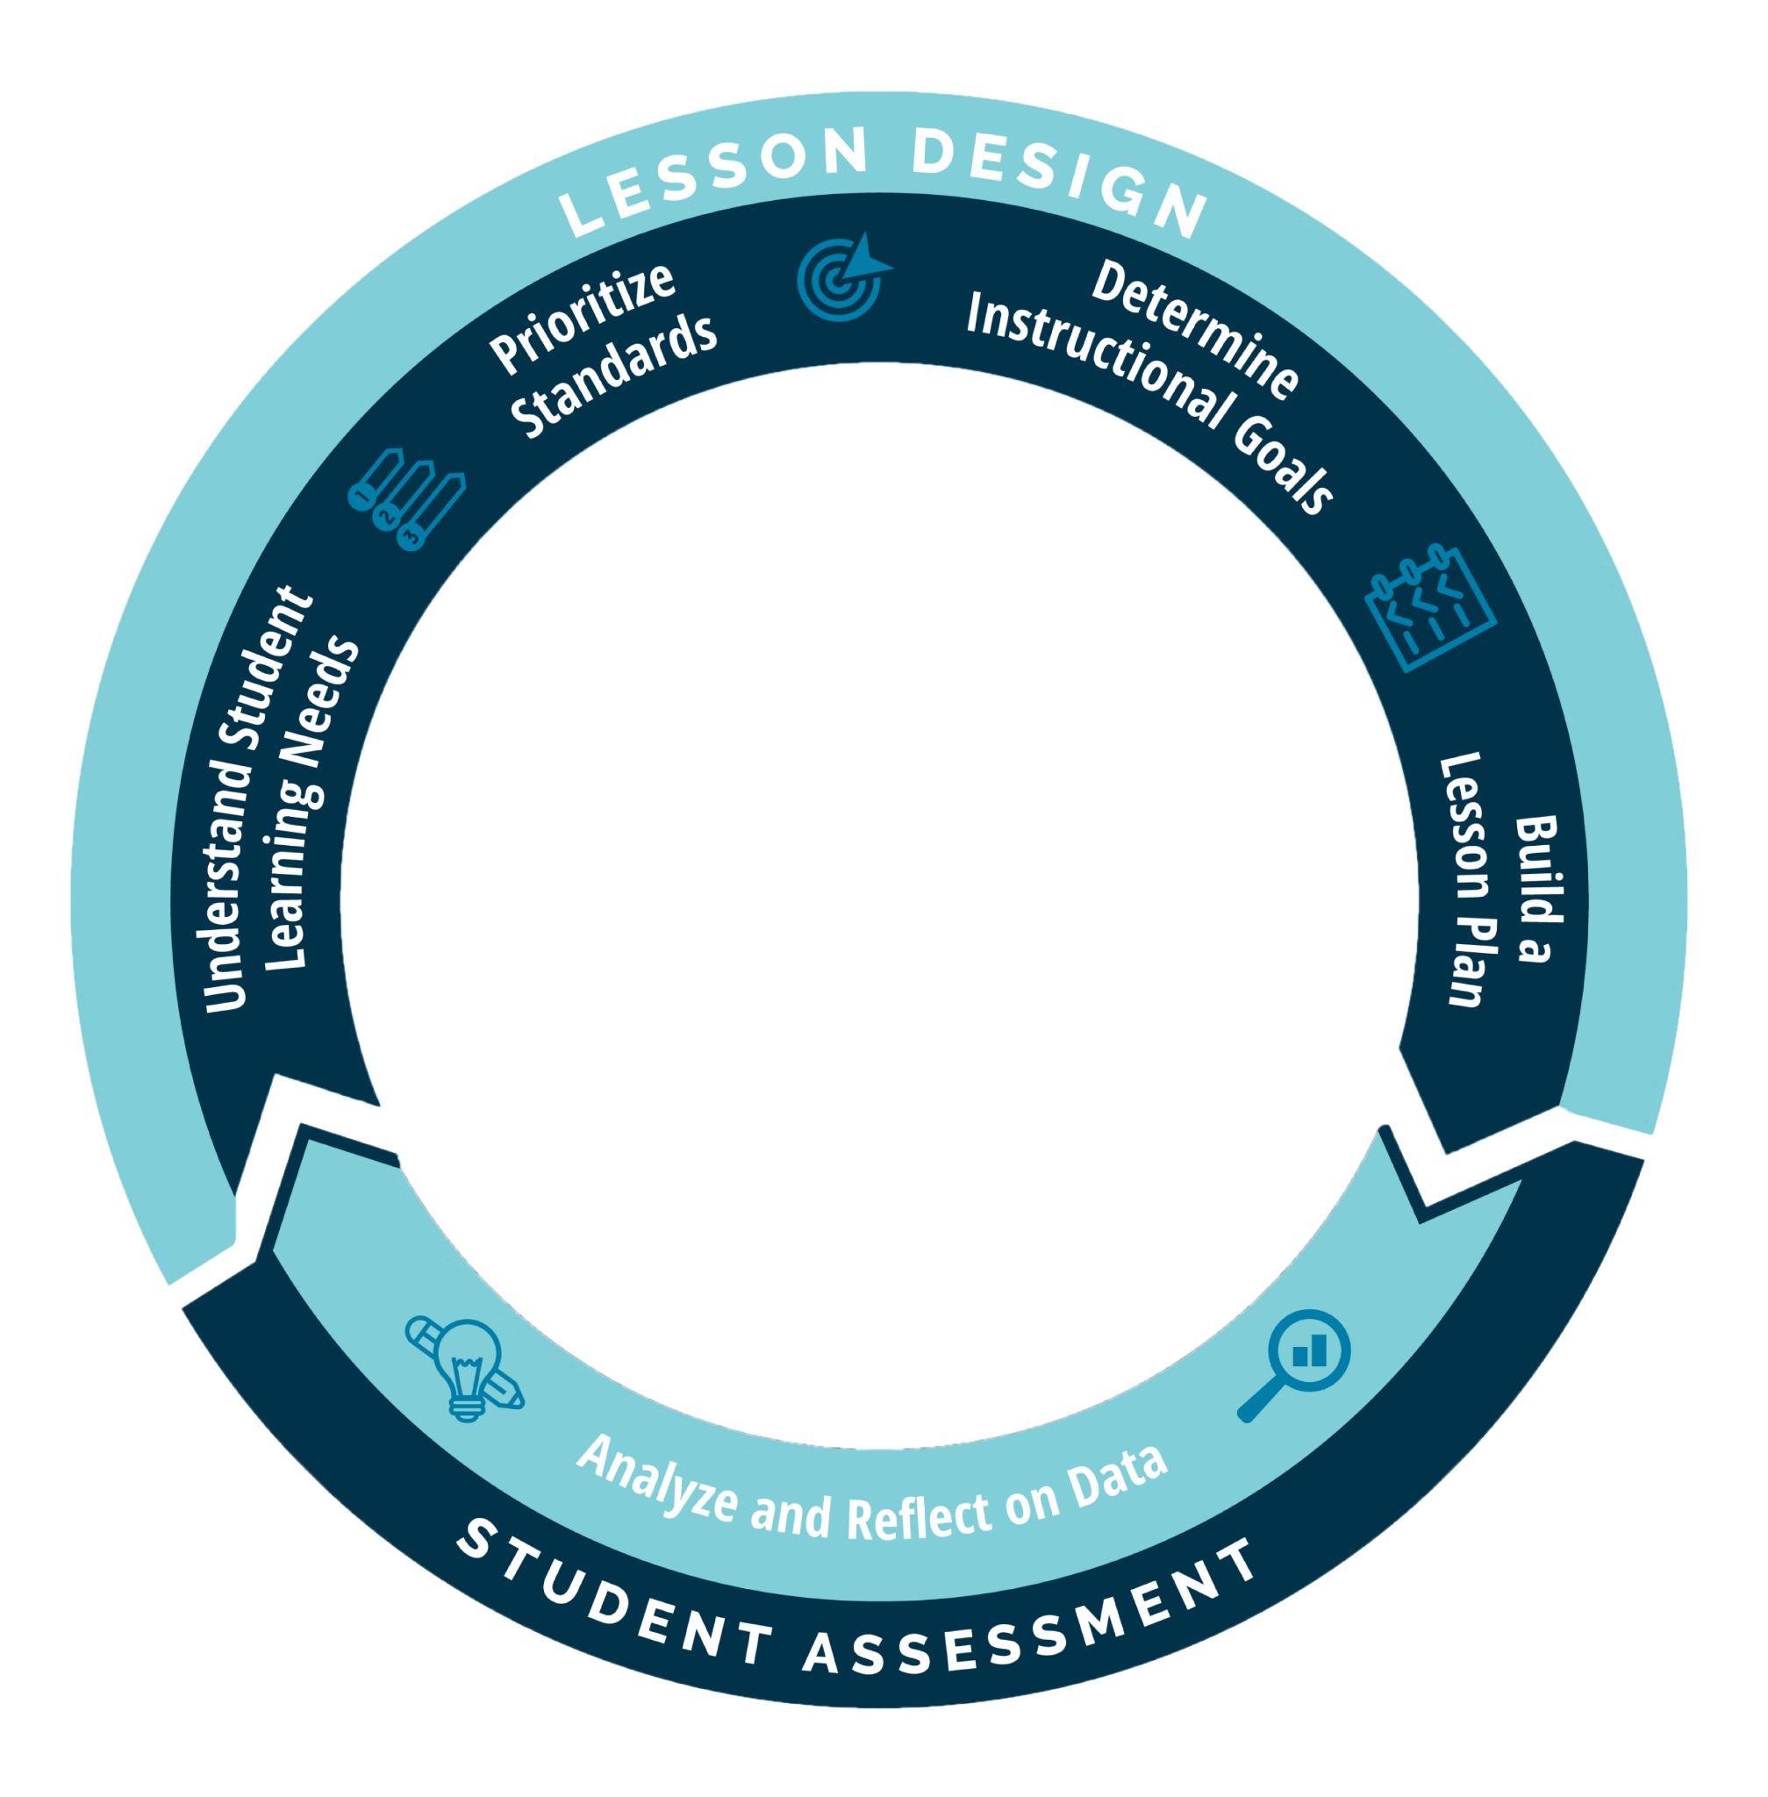
Notes:
-1 min. For the purpose of this presentation, we will be focusing primarily on the Lesson Design we will be focusing on the Build a Lesson Plan component

Slide 12




Determine
Instructional
Goals
Understand Student
Learning Needs
Prioritize
Standards
Build a
Lesson
Review student and school data
Scan the year’s curriculum maps to orient lesson(s) within the year’s scope and sequence
Review curricular resources from the learners’ perspective
Understand essential standards
Access proficiency scales
Organize concepts and skills from the standard into lesson(s)
Identify learning intentions
Identify success criteria
Identify the relevance of the learning
Determine design approach
Determine evidence to support learning
Develop learning tasks
Organize the components of the lesson
Lesson Design Guide
Curriculum and Instruction 2023
Notes:
-1 min. Here you see the components of lesson design. Today we focus on actually building a lesson. It is important to know that knowledge and skill of evidence based lesson design comes with time, practice, reflection and collaboration in PLCs.

Slide 13
Structured Reflection Journal
Click Here…Principal Reflection Journals
Click on the link and find your school folder
Click on the folder with your name.
Open the reflection journal and scroll to the October reflection.
Notes:
-1 min. Access your October reflection and take a second to remind yourself of what you wrote.

Slide 14
Turn and Talk- October Reflection Prompts
Discuss your reflections and any actions you took…
“What will I look for between now and next month’s PPL to determine what additional supports my teacher may need?
What will I look for between now and next month’s PPL to determine what additional supports my PLC may need?
What new data tool will I use or what existing tool will I use in a new way before next month’s Principal PL?”
Specifically…
What did I look for and do to support my teacher/PLC with establishing clear Learning Intentions, Success Criteria and/or deciding on a Lesson Approach
What new resource or tool did I use?
Notes:
-5 min
Talk with your table about your reflections and any actions.

Slide 15
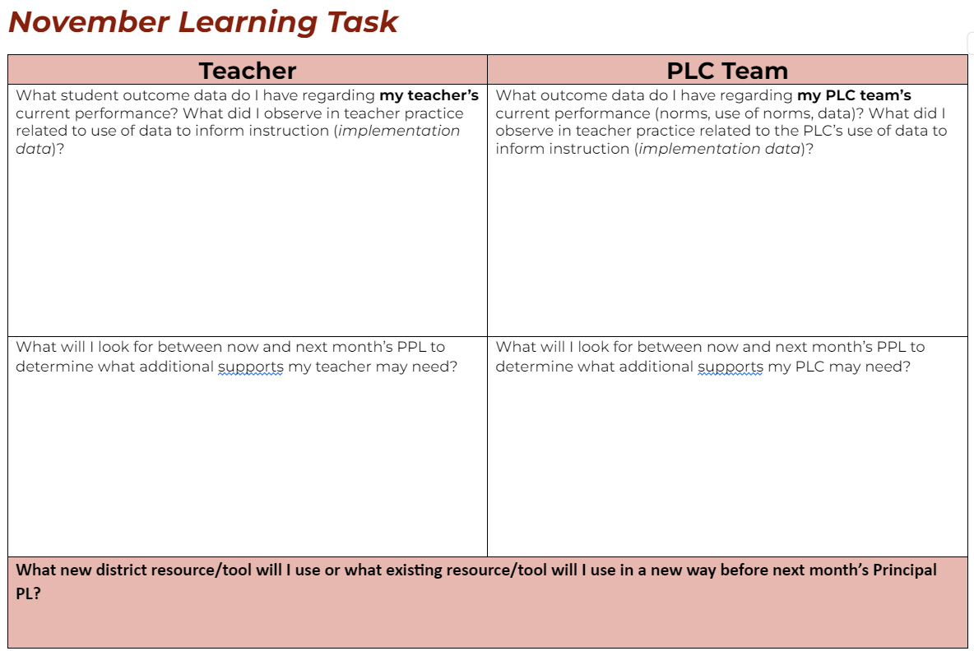
Reflection Journal Time-November
Notes:
-7 min. You will now have time to complete the top row in your November Reflection Journal. Remember for this, you are thinking about any data that you were able to gather to support the teacher or PLC you targeted. This could be student outcome data, written or observational data, or data that was shared during coaching or PLC discussions

Slide 16
Content Focus for 3 months
Math Content
SCI Content
OCT
SEPT
NOV
ELA Content
Notes:
-1 min.

Slide 17

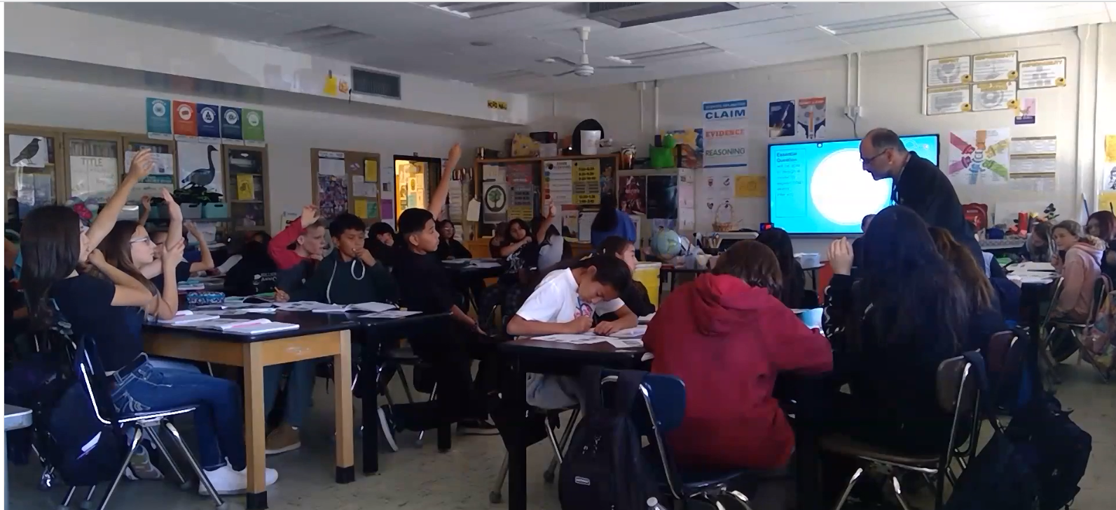
Watch this science lesson and
take notes on what you observe…
Notes:
5 minutes.We are going to show you this lesson now, and then after some learning about building a lesson, we will show you the lesson again to see how you might look for different things with a little more background knowledge on lesson design. To some extent we are modeling an inquiry based approach, starting with the you do and we do together.
NOTE: Stop video at minute 5:26 (the last part of the video is the teacher debrief)

Slide 18
Share your observations with your table partners
Notes:
3 min

Slide 19
The educator applies knowledge of developmentally appropriate practices when planning instruction.
Effective
Maximizes student time on task.
Establishes performance outcomes.
Uses differentiated instructional
strategies.
•
Highly Effective
Supports students in maximizing their
own time on task behavior.
Uses student input to establish
performance outcomes.
Incorporates differentiated instructional
strategies in response to student needs.
Notes:
Noelle/Stephanie slides 19-33 One component of Educator Standard 2.D you may have observed in the video is time on task. The teacher really had the student engaged 100% of the time. More naturally you tend to look at things like this -instructional delivery, but if you intentionally look for evidence of lesson design, you will be able to better understand the teacher’s current skill in lesson design and planning,

Slide 20
Connecting the Educator Standard 2.D to
the Lesson Design Elements
The educator applies knowledge of developmentally appropriate practices when planning instruction.
Educator Standard Component | Lesson Design Element
Establishing performance outcomes | Learning Intention, Success Criteria and Evidence of Student Learning
Maximizing Time On Task | Lesson Approach and Learning Tasks
Using Differentiated Instructional Strategies | Learning Tasks, What the Teacher Does, What the Student Does, Scaffolds
Notes:
2 min
Teachers who intentionally focus their planning on these lesson design elements are more likely to meet or exceed these components of the Ed Standard 2D

Slide 21
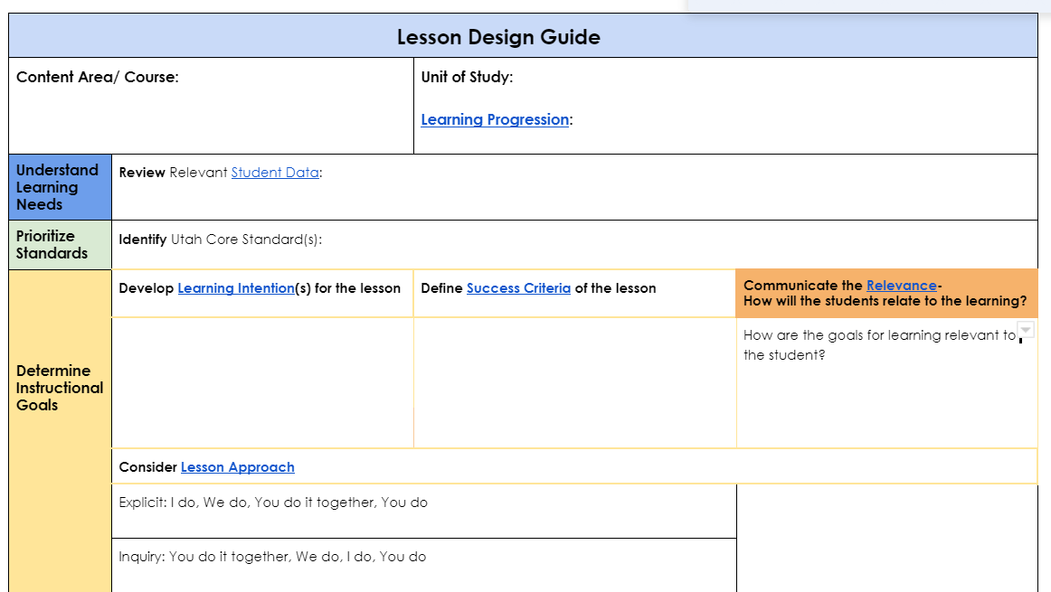
Granite School District Lesson Design Guide
October
Use of district instructional tools and resources based on instructional goals
Notes:
Last month we talked about Learning Intentions, Success criteria and Lesson Approach

Slide 22
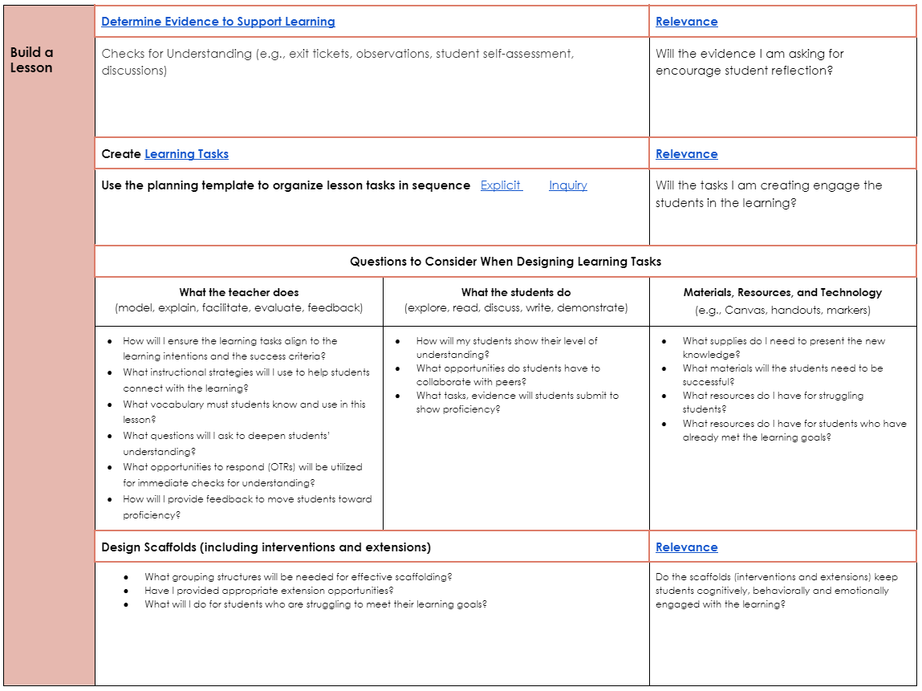
Granite School District Lesson Design Guide
November
Design of lesson using developmentally appropriate practices based on instructional goals
Notes:
This month we are heading into Determining Evidence of Student Learning and Creating Learning Tasks

Slide 23
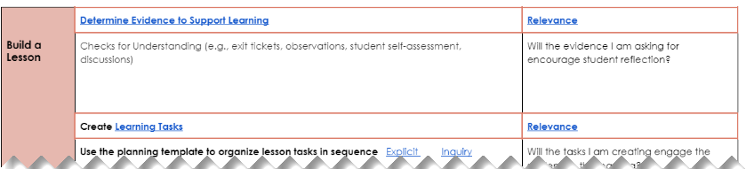
Building a lesson starts with determining Evidence of Learning
Notes:
1 min Before a teacher develops learning tasks, A teacher must first determine what it will look like for a student to demonstrate proficiency on the standard that is taught in the lesson.

Slide 24
Evidence of Learning
is directly tied to the
Success Criteria
Notes:
Under a min That evidence of learning is linked directly to the success criteria

Slide 25
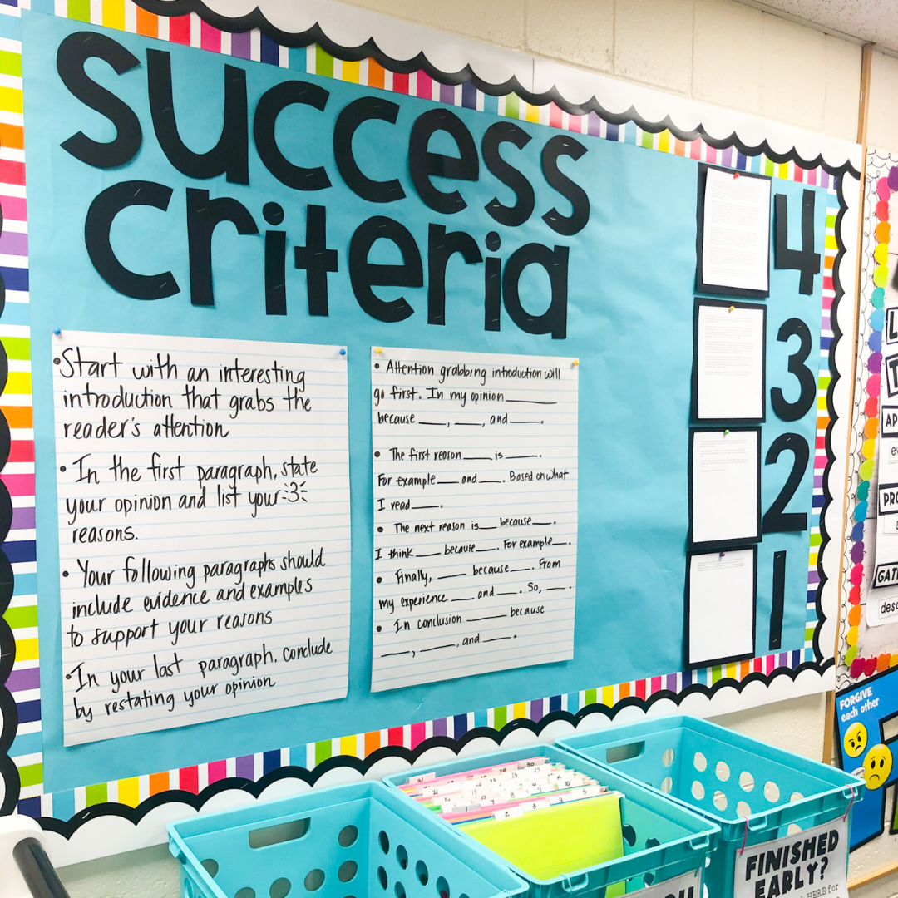
Success Criteria can include:
Common understanding developed from learning intentions by teacher and students
Teacher or student model
I can statement
Rubric
Exemplar
Developing Success Criteria
Notes:
1 min Recall that success criteria defines what it looks like for a student to be successful for a lesson, a standard, a task…

Slide 26
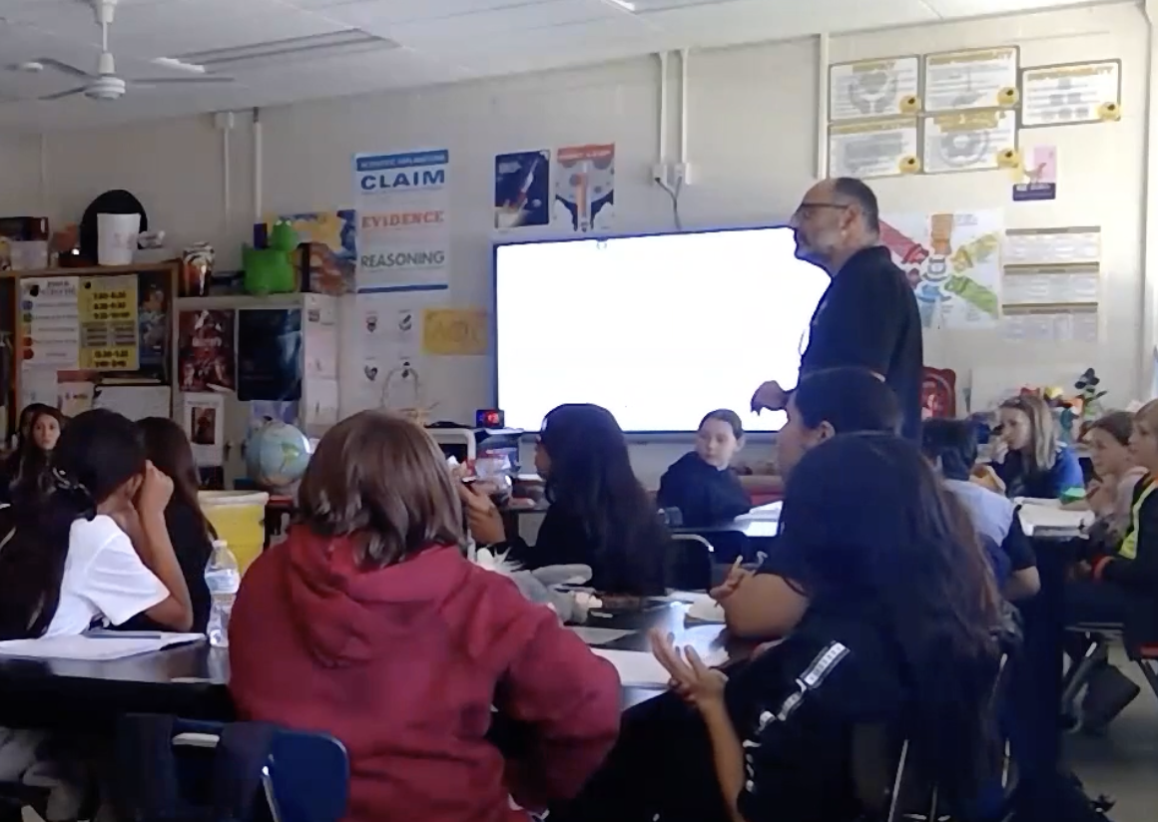
Notes:
Now let’s return to our teacher in the video.

Slide 27
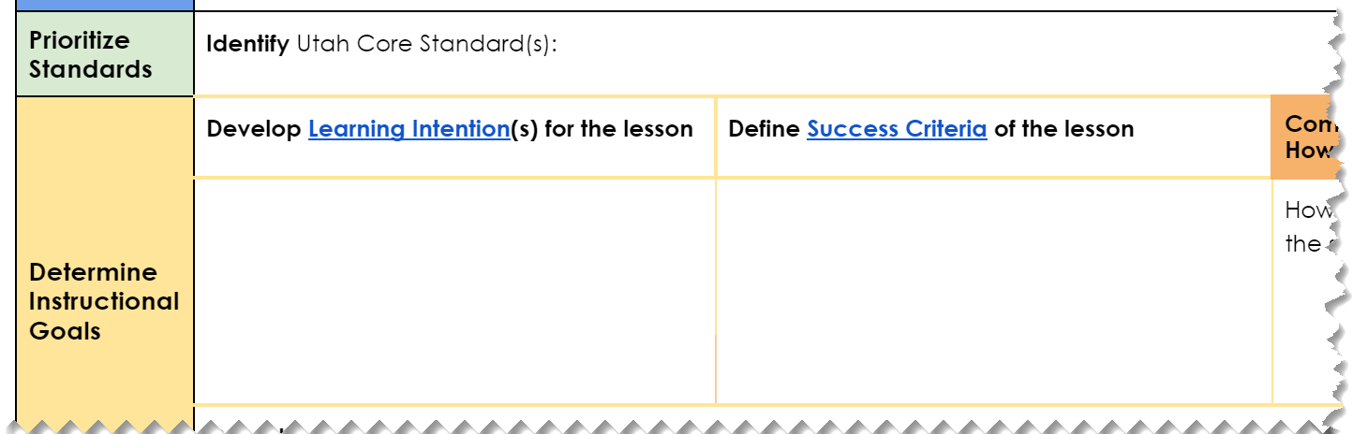
Observed Teacher’s Lesson
6.2.1 Develop models to show that molecules are made of different kinds, proportions and quantities of atoms. Emphasize understanding that there are differences between atoms and molecules, and that certain combinations of atoms form specific molecules. Examples of simple molecules could include water (H₂O), atmospheric oxygen (O₂), and carbon dioxide (CO₂).
I will be able to design a model. I will explain how atoms interact.
Notes:
3 min In our observed teacher’s lesson, the standard was 6.2.1. The success criteria was: I will be able to design a model to explain how atoms interact. Keep in mind that science standards include a lot of ways to think about “models” - these are essentially ways to visualize what is happening and help to explain science concepts.
Given this success criteria, the teacher determined the evidence of learning would include a model and written explanation.

Slide 28
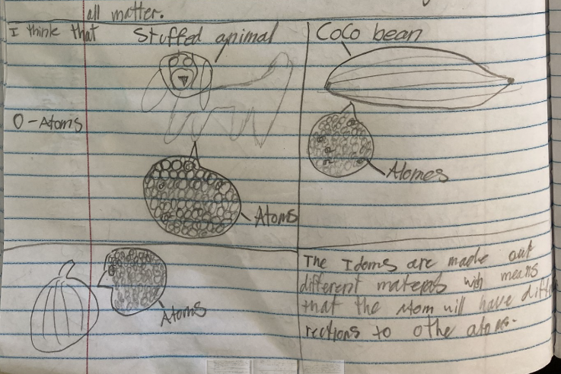
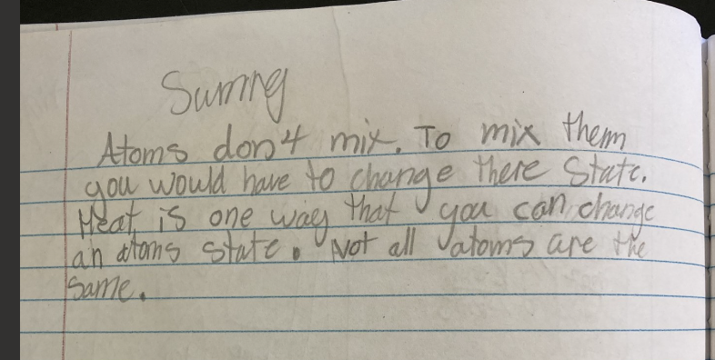
Evidence to support learning also includes the multiple ways teachers gather evidence to inform their instruction. Planning for these is an element of quality lesson design.
Examples:
In class discussions
Questioning
Low stakes group work
Reflection writing
Exit tickets
Concept maps
Self and peer-assessment
Success Criteria:
I will be able to design a model. I will explain how atoms interact.
Notes:
2 min Our example here shows the direct connection to the success criteria in the task students are asked to complete. As a teacher plans from this end point, the teachers should plan for additional formative ways for students to show evidence of learning relative to this standard. These include some examples listed here… These also serve as evidence of lesson design. This also supports our commitment to PBL as it represents multiple opportunities and multiple modalities.

Slide 29
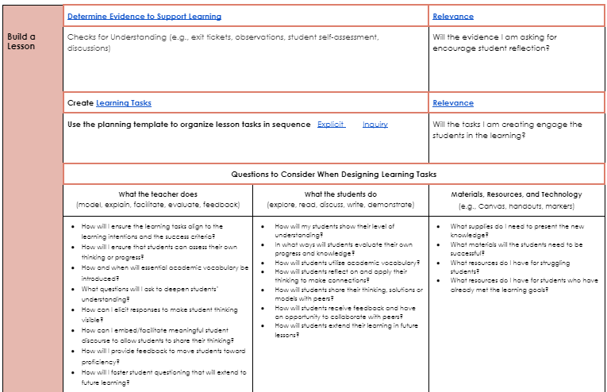
Building Meaningful Learning Tasks
Notes:
1 min Noelle-In order for the teacher to get to the student outcomes we just saw, the teacher had to intentionally plan out a lesson approach (explicit or inquiry) and sequence of meaningful learning tasks.

Slide 30
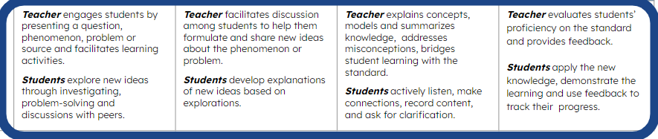
Explicit Instruction Delivery is characterized by clear descriptions and modeling of a skill, followed by practice with feedback. The teacher systematically withdraws support to move students to independent work. | I do Teacher models/explains | We do Teacher and students practice together | You do it together Students practice Teacher facilitates | You do Students demonstrate Teacher evaluates and gives feedback
 | Teacher establishes the purpose of learning, activates prior knowledge, models using think-alouds. Students actively listen, make connections, record content and ask for clarification. | Teacher prompts, questions and gives feedback to guide student practice; teacher firms up understanding. Students ask and respond to questions, work with the teacher and classmates to practice skills and concepts. | Teacher facilitates learning activities to help students practice and apply skills and concepts with each other. Students practice and apply skills and concepts through practice, problem-solving and discussions with peers. | Teacher evaluates students’ proficiency on the skills/standards and provides feedback. Students apply the new knowledge, demonstrate the learning and use feedback to track their progress.
Inquiry-Based Instruction Delivery is characterized by intentionally selected and organized tasks that create the opportunity for students to gain knowledge and skills through exploration. The teacher carefully scaffolds the learning to meet the standard(s). | You do it together Students explore Teacher facilitates | We do Students explain and elaborate Teacher facilitates | I do Teacher explains/models | You do Students demonstrate Teacher evaluates and gives feedback
 | Teacher engages students by presenting a question, phenomenon, problem or source and facilitates learning activities. Students explore new ideas through investigating, problem-solving and discussions with peers. | Teacher facilitates discussion among students to help them formulate and share new ideas about the phenomenon or problem. Students develop explanations of new ideas based on explorations. | Teacher explains concepts, models and summarizes knowledge, addresses misconceptions, bridges student learning with the standard. Students actively listen, make connections, record content, and ask for clarification. | Teacher evaluates students’ proficiency on the standard and provides feedback. Students apply the new knowledge, demonstrate the learning and use feedback to track their progress.
GSD C&I Revised February 2022
UBSE 2021 Instructional Approaches: Explicit and Inquiry-Based Instruction
Notes:
Stephanie-Remember last month we discussed Explicit and Inquiry based approaches and how some content areas rely more heavily on one or the other; yet there are elements of both built into good instruction at different phases. In the science lesson we watched the phase of the lesson, we saw the You Do, You Do it Together and We Do components.

Slide 31
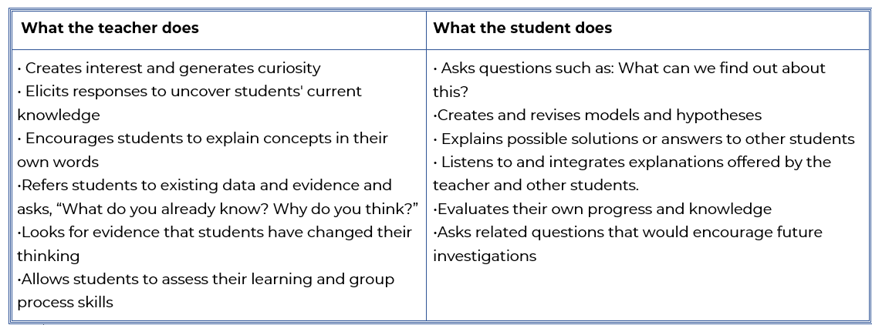
Learning Tasks
Notes:
I

Slide 32
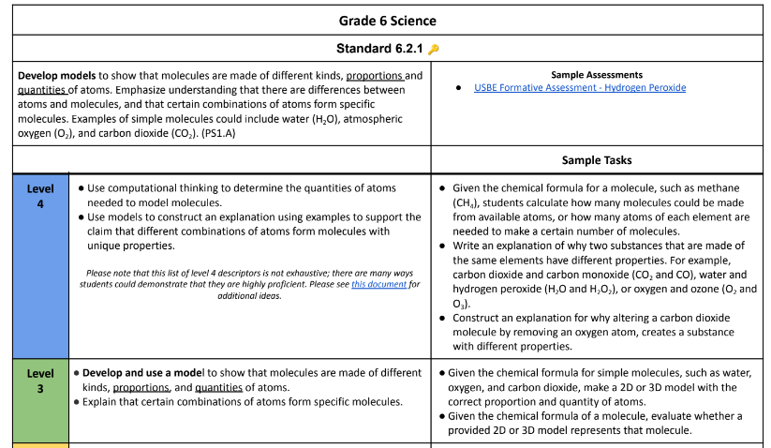
Learning Tasks
Sample Tasks are a part of the proficiency scales that might guide a teacher’s planning
Unit overview that includes what will come AFTER today’s lesson.
Day 1: Engage Atoms vs molecule models, chocolate chip/marshmallow activity
Day 2: Explore 1 with 2 glasses of liquid
Day 3: Explore 2 with investigating the liquids
Days 4-5: Explain with reading and two molecular models (legos and PhET)
Day 6: Elaborate with revising initial models
Day 7: Evaluate with atoms and molecules assessment

Slide 33
Science Curriculum Resources and Tools
Curriculum Maps
Learning Progressions
Sample units of instruction
OER Textbooks
Example assessments
All found on the Curriculum and Instruction Intranet Page
C&I Science Resources LInk
Notes:
3 min To support your teachers has they build lessons it is also important to know where to find some science (and other curriculum) resources will help you support your teachers as the refine their practice in determining evidence of learning and creating meaningful learning tasks based on success criteria. Toggle to a good example of evidence/task in the science resources

Slide 34
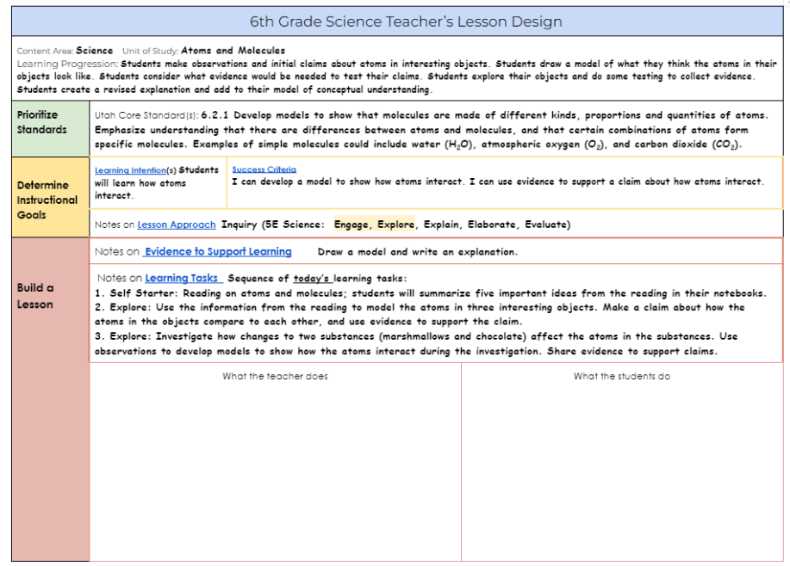
Notes:
Kyle/Joan slides 34-44 Take a look at your copy of our teacher’s lesson design document.

Slide 35
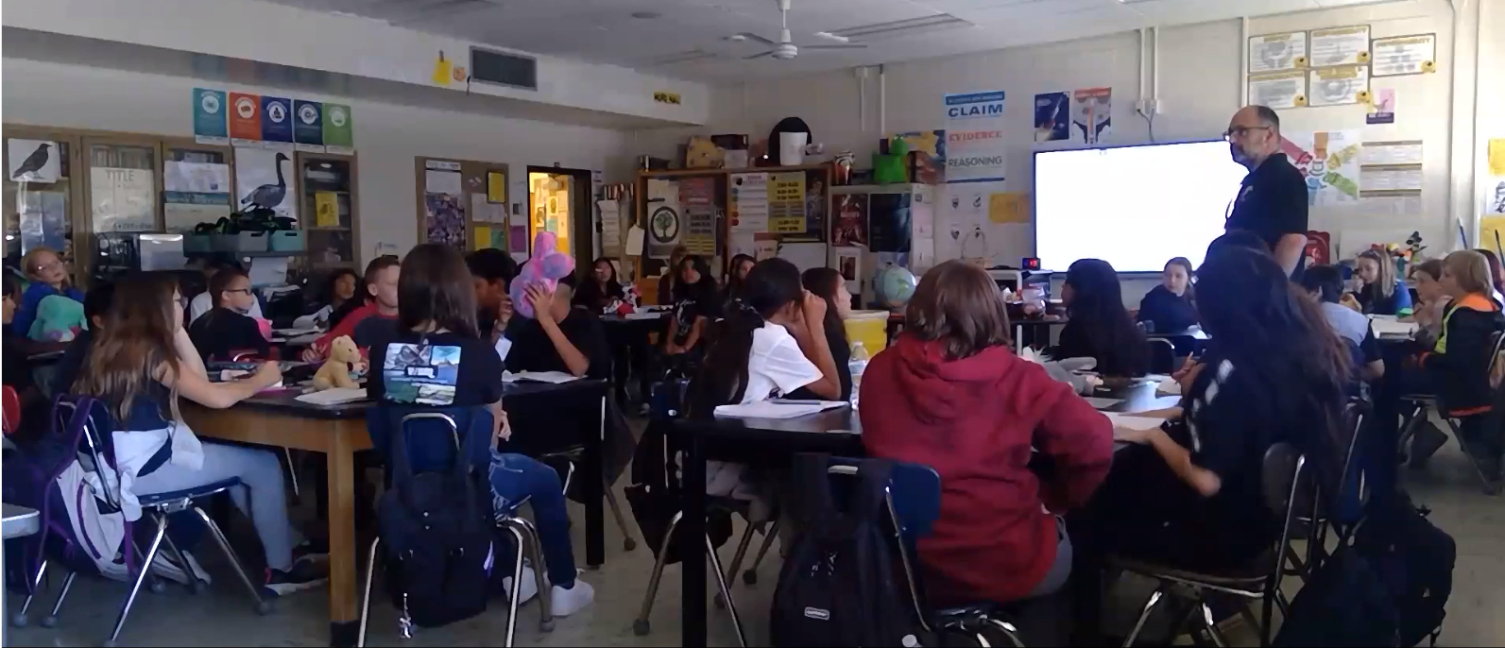
Second Video Take
Watch the sequence
of the learning tasks…
What is the teacher doing?
What are the students doing?
What evidence do you see of quality lesson design and planning?
What questions would you ask this teacher in a coaching debrief?
Notes:
His lesson design and planning is documented here in the lesson design guide including the standards, learning progressions, approach and sequence of tasks for the day’s learning. In the What the teacher does and the What the student does sections, we now want you to take a second look at the video. Now that we have done some additional learning on how to look for evidence of lesson design, we will watch the lesson again.

Slide 36
Notes:
Did you see evidence of any of these? What did you notice in what the teacher does and what the student does? None of this could happen without strong lesson planning.

Slide 37
Coaching Debrief Questions
What were your learning intentions/success criteria for today? What evidence of learning did you determine based on these?
Where did today’s lesson fit in the Unit learning progressions?
Why did you choose the Inquiry lesson approach?
How do you design learning tasks to maximize student time on task?
How do these compare with the questions you may have asked?
Notes:
Now we are going to watch a debrief with this teacher. These are the questions that were asked.
How do these compare with the questions you may have asked?

Slide 38
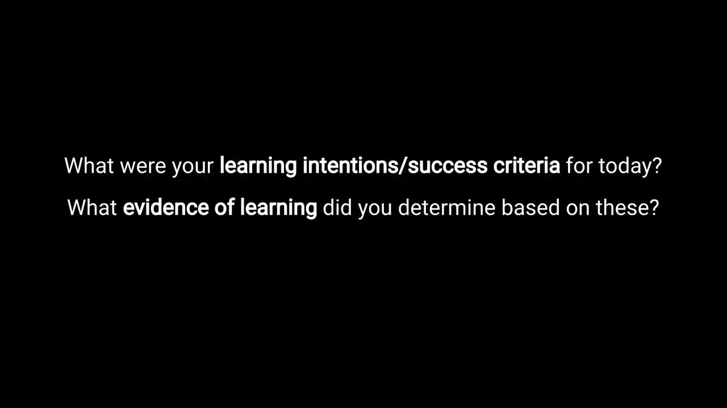
Coaching Debrief
Notes:
Recognize how many literacy skills are used in this lesson reading, writing, speaking and listening are all here. Used interesting materials to help students build content knowledge. Integration happens to support literacy skills and the background knowledge helps students engage with and comprehend complex text.

Slide 39
Turn and discuss…
How did the coaching debrief provide additional evidence of quality lesson design?
Notes:
min

Slide 40
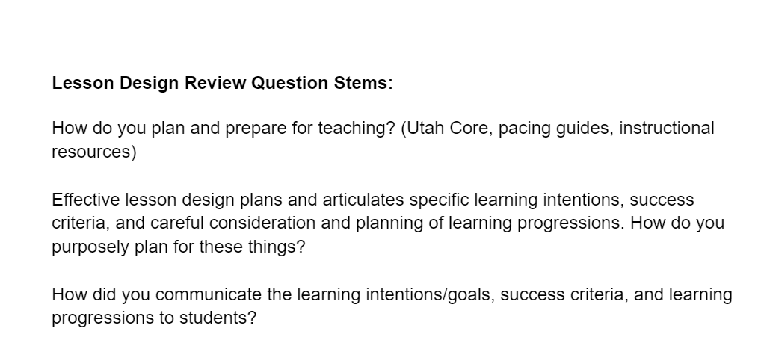
What other questions might be asked in a debrief about lesson design?
Notes:
These questions are part of a larger document put together by a principal.
It provides multiple ideas for questions you might ask a teacher

Slide 41
Structured Reflection Journal
Click Here…Principal Reflection Journals
Click on the link and find your school folder
Click on the folder with your name.
Open the reflection journal and scroll to the November reflection.
Notes:
1 min

Slide 42
Reflection Journal Time-November
Specifically…
What will I look for between now and next month to determine what additional support my teacher/PLC needs with determining Evidence of Learning and creating appropriate Learning Tasks based on the Success Criteria?
Notes:
10 min journal You will now have time to complete the top rows in your October Reflection Journal. Keep in mind we will be revisiting your reflections at the start of the November PPL

Slide 43
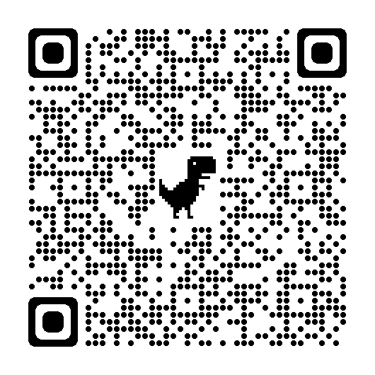
Principal Professional Learning Survey
Please give us your feedback:
Survey
Notes:
3 min

Slide 44

Links to Tools and Resources
Reflection Journal Link
Instructional Framework
Lesson Design Model
Lesson Design Website
Lesson Design Guide
Lesson Approaches
Student Learning Stages
Lesson Design Professional Learning Opportunities

