Slide 1
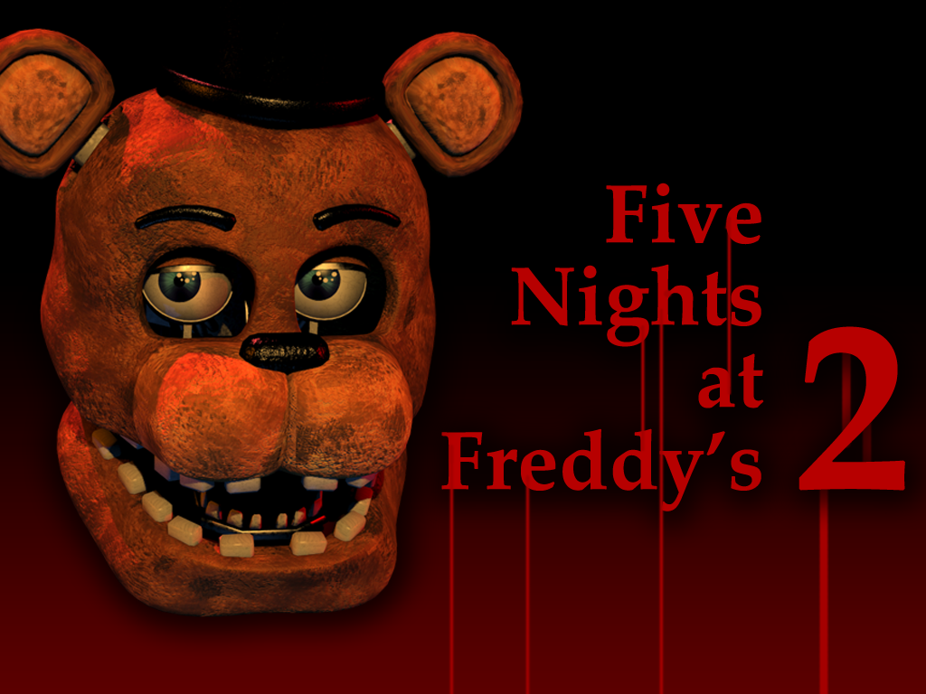
Welcome to
Click to go to the Main Menu to play this “little” game.
https://plantillaspowerpoint.org

Slide 2
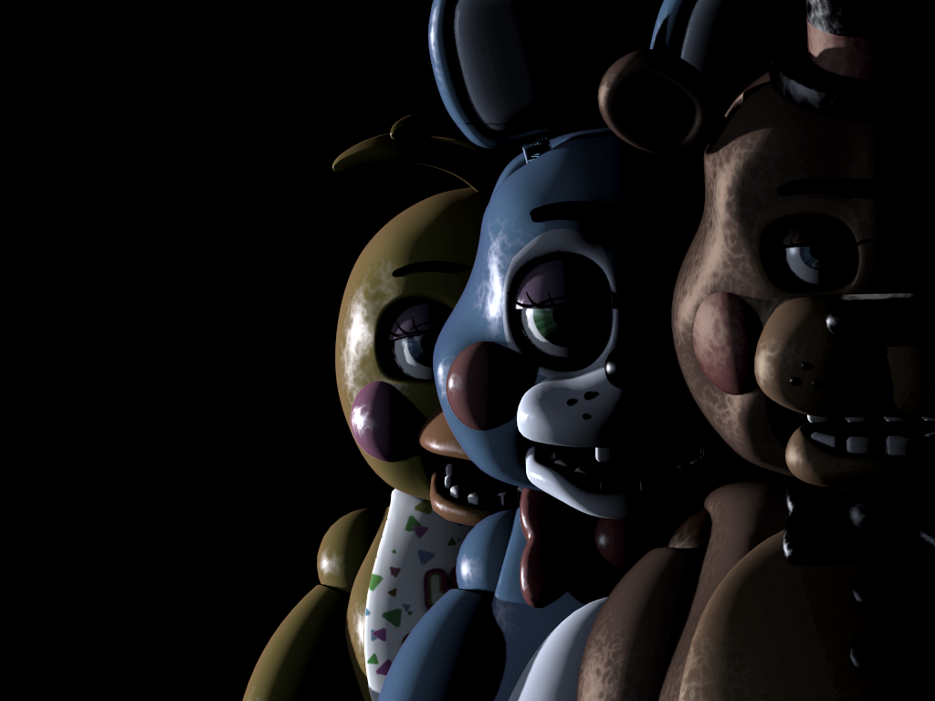

Five
Nights
at
Freddy’s
2: GSE
NOTE (MAKE SURE TO READ THIS!)
New Game
Continue
Infinite Night
Extra

Slide 3
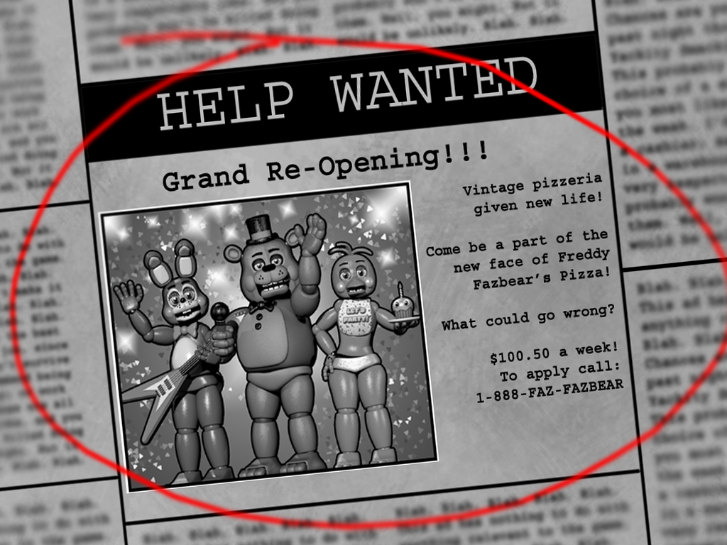

Slide 4
∞ AM
Infinite Night
Click here to begin the shift.

Slide 5
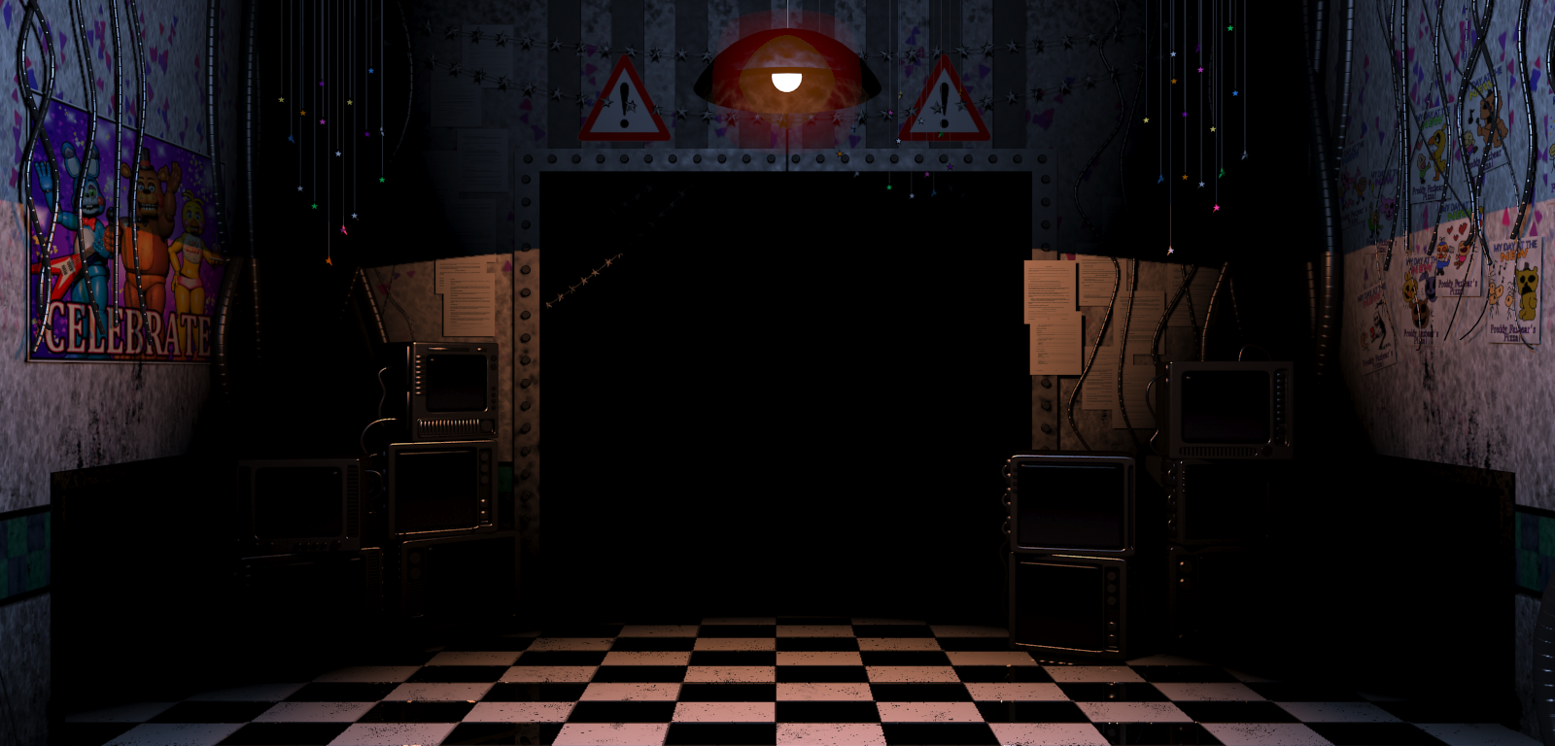



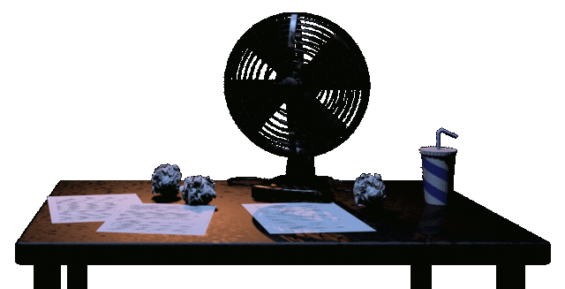

∞ AM
Would you like a spook? CLICK ME!
Night ???
Click here to use your flashlight!

Slide 6
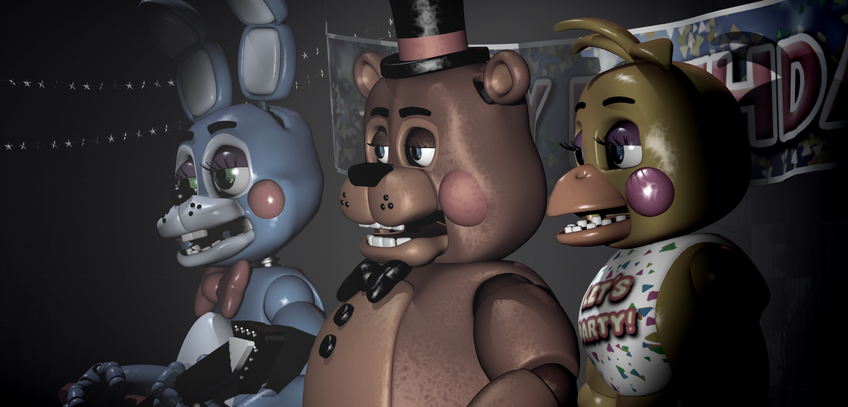
∞ AM
Night ???
Show Stage
CAM
08
CAM
09
CAM
07
CAM
03
CAM
04
CAM
11
CAM
10
CAM
02
CAM
01
CAM
12
YOU
CAM
05
CAM
06

Slide 7
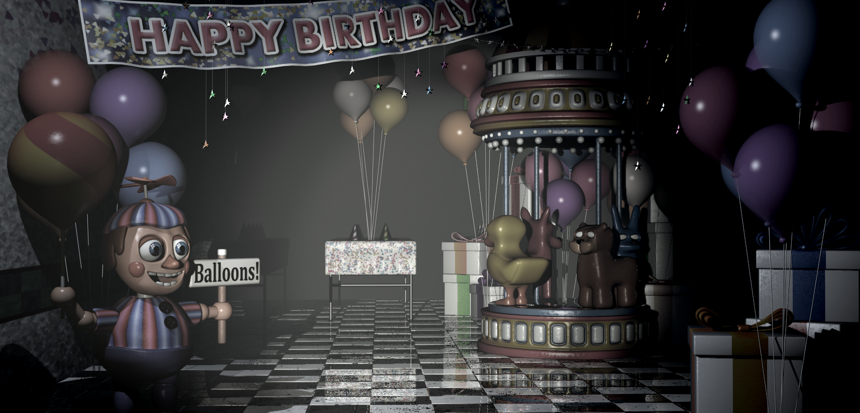

∞ AM
Night ???
Game Area
CAM
08
CAM
09
CAM
07
CAM
03
CAM
04
CAM
11
CAM
10
CAM
02
CAM
01
CAM
12
YOU
CAM
05
CAM
06

Slide 8
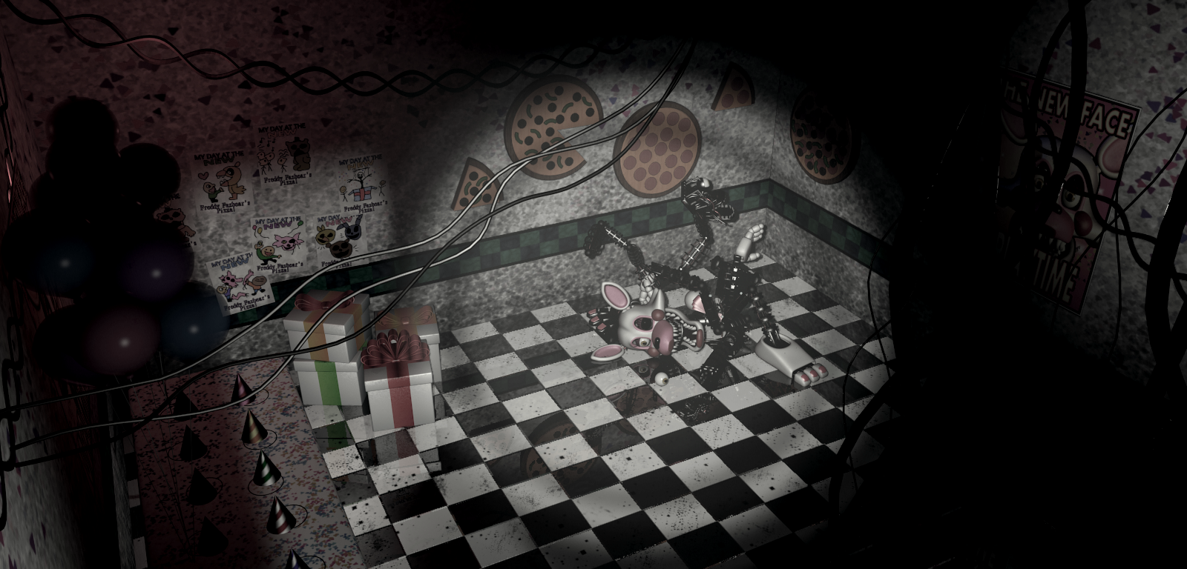
∞ AM
Night ???
Kid’s Cove
CAM
08
CAM
09
CAM
07
CAM
03
CAM
04
CAM
11
CAM
10
CAM
02
CAM
01
CAM
12
YOU
CAM
05
CAM
06

Slide 9
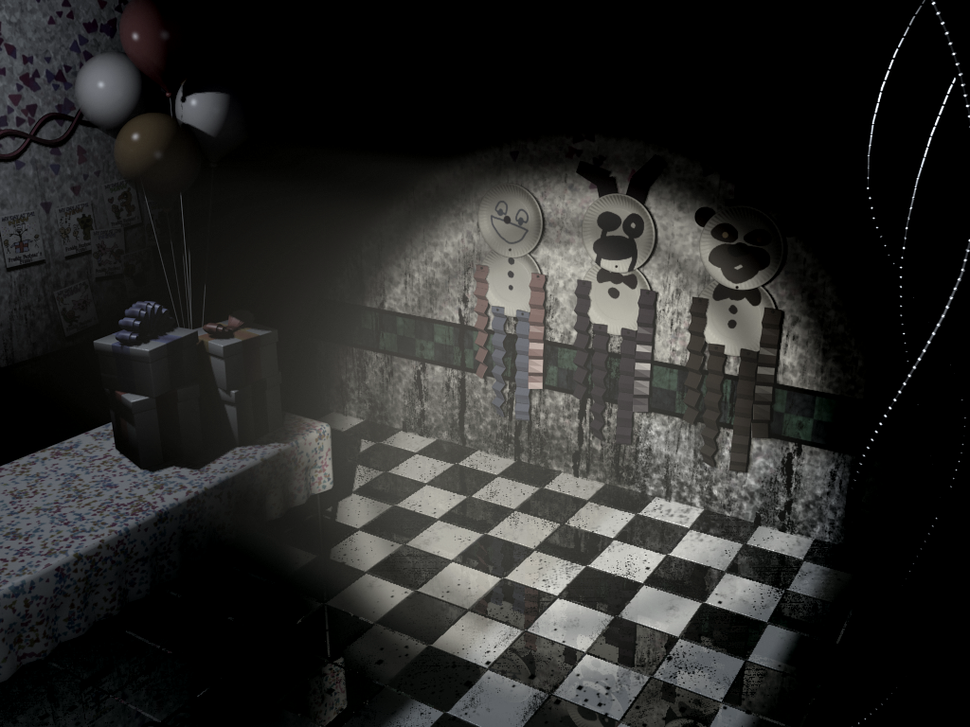

∞ AM
Night ???
Party Room 4
CAM
08
CAM
09
CAM
07
CAM
03
CAM
04
CAM
11
CAM
10
CAM
02
CAM
01
CAM
12
YOU
CAM
05
CAM
06

Slide 10
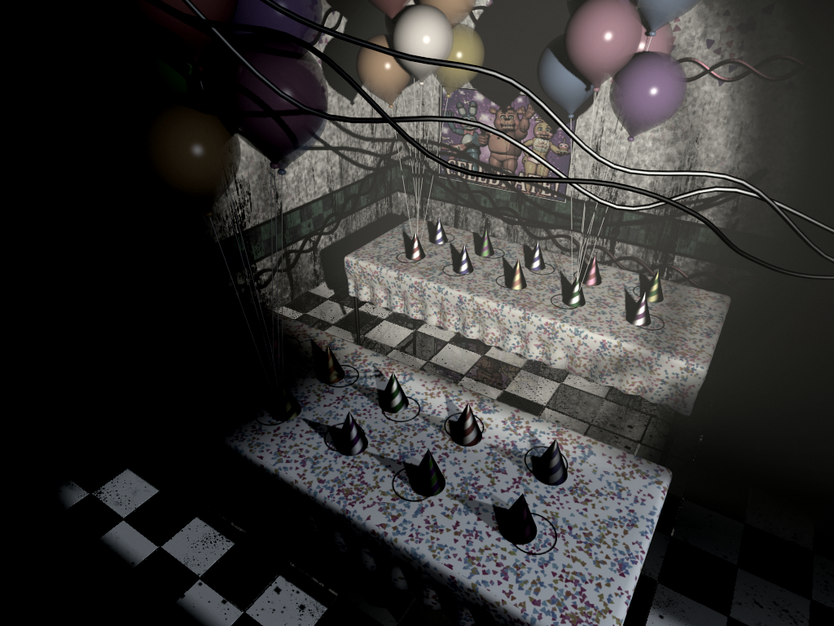
∞ AM
Night ???
Party Room 3
CAM
08
CAM
09
CAM
07
CAM
03
CAM
04
CAM
11
CAM
10
CAM
02
CAM
01
CAM
12
YOU
CAM
05
CAM
06

Slide 11
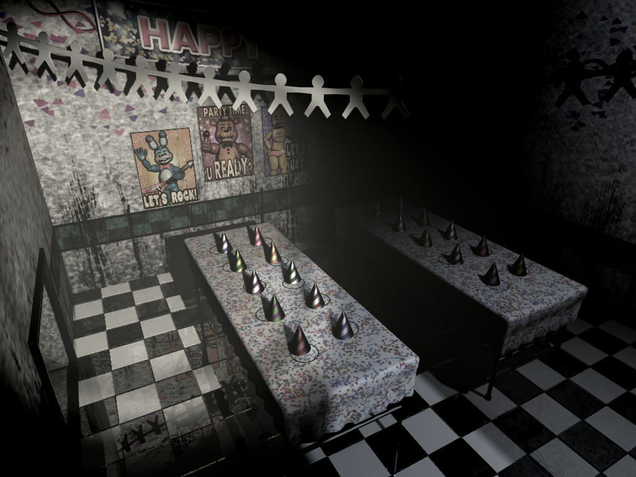
∞ AM
Night ???
Party Room 1
CAM
08
CAM
09
CAM
07
CAM
03
CAM
04
CAM
11
CAM
10
CAM
02
CAM
01
CAM
12
YOU
CAM
05
CAM
06

Slide 12
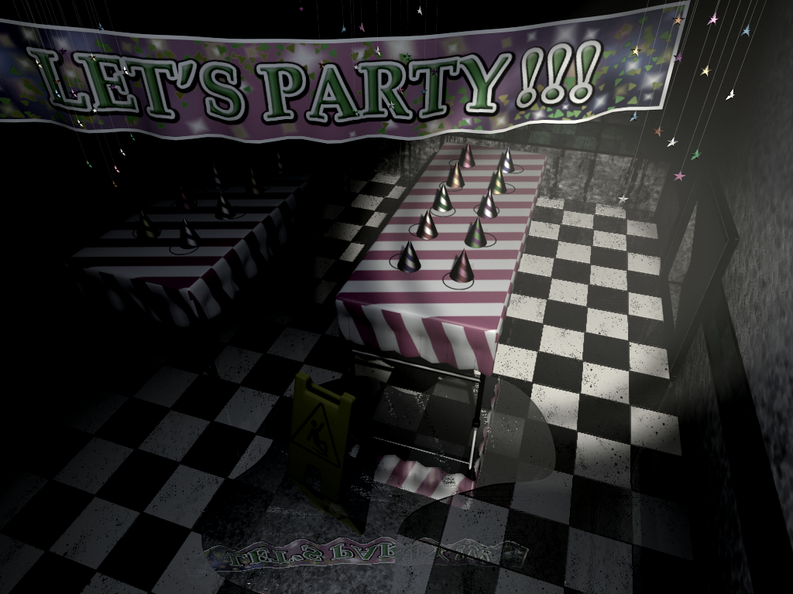

∞ AM
Night ???
Party Room 2
CAM
08
CAM
09
CAM
07
CAM
03
CAM
04
CAM
11
CAM
10
CAM
02
CAM
01
CAM
12
YOU
CAM
05
CAM
06

Slide 13
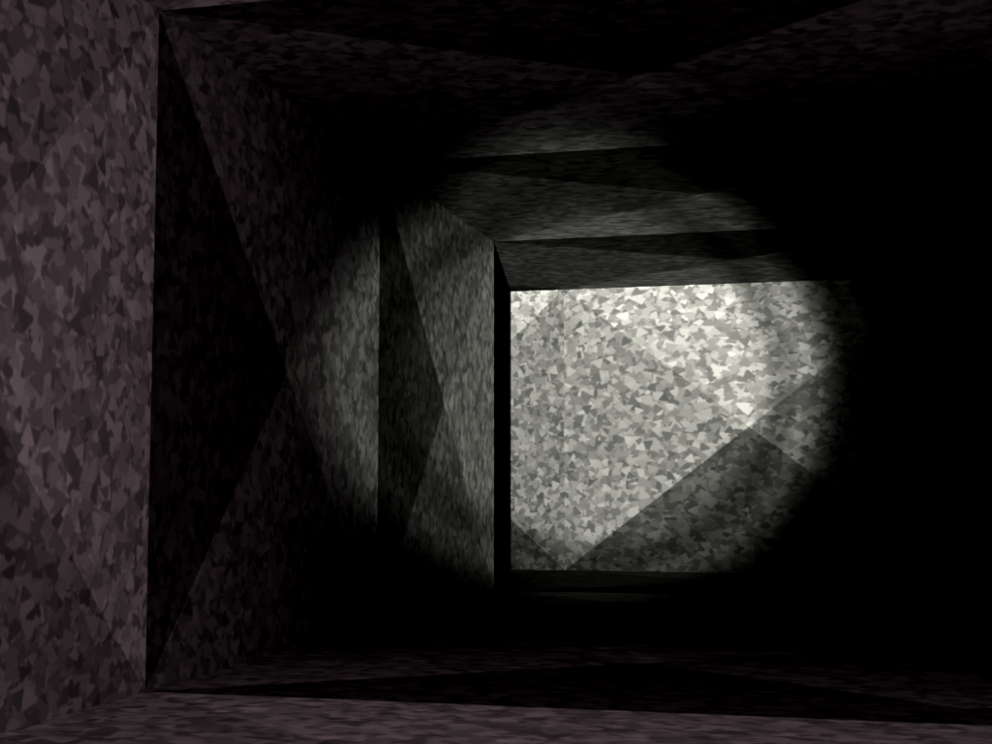
∞ AM
Night ???
Right Air Vent
CAM
08
CAM
09
CAM
07
CAM
03
CAM
04
CAM
11
CAM
10
CAM
02
CAM
01
CAM
12
YOU
CAM
05
CAM
06

Slide 14
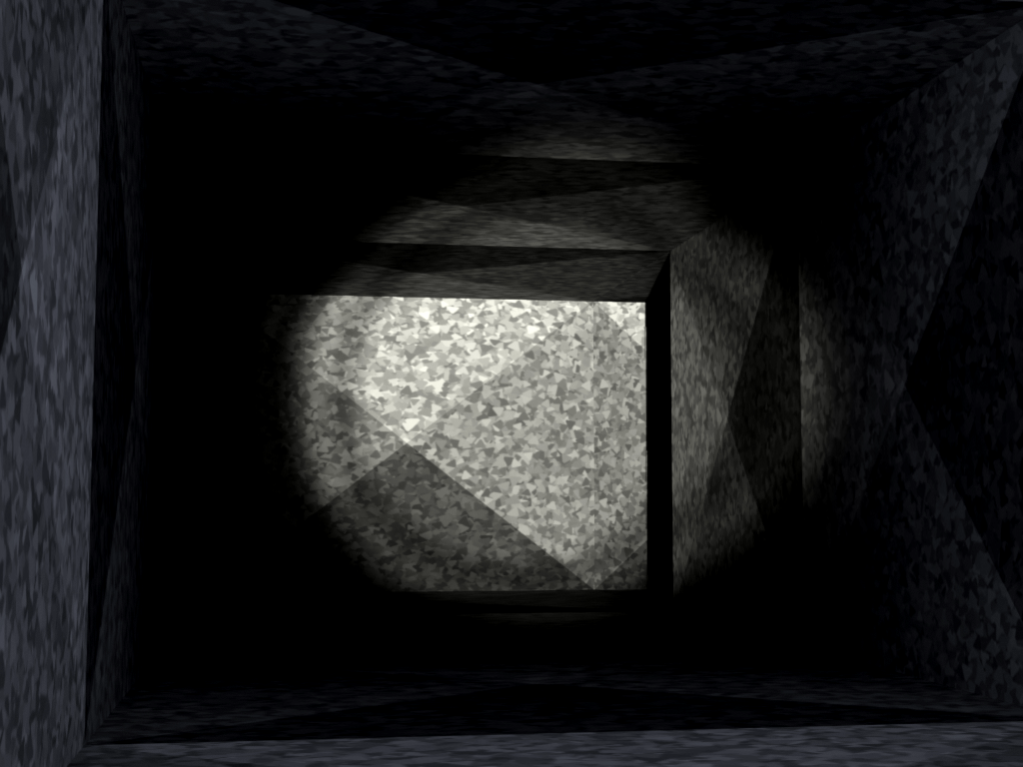
∞ AM
Night ???
Left Air Vent
CAM
08
CAM
09
CAM
07
CAM
03
CAM
04
CAM
11
CAM
10
CAM
02
CAM
01
CAM
12
YOU
CAM
05
CAM
06

Slide 15
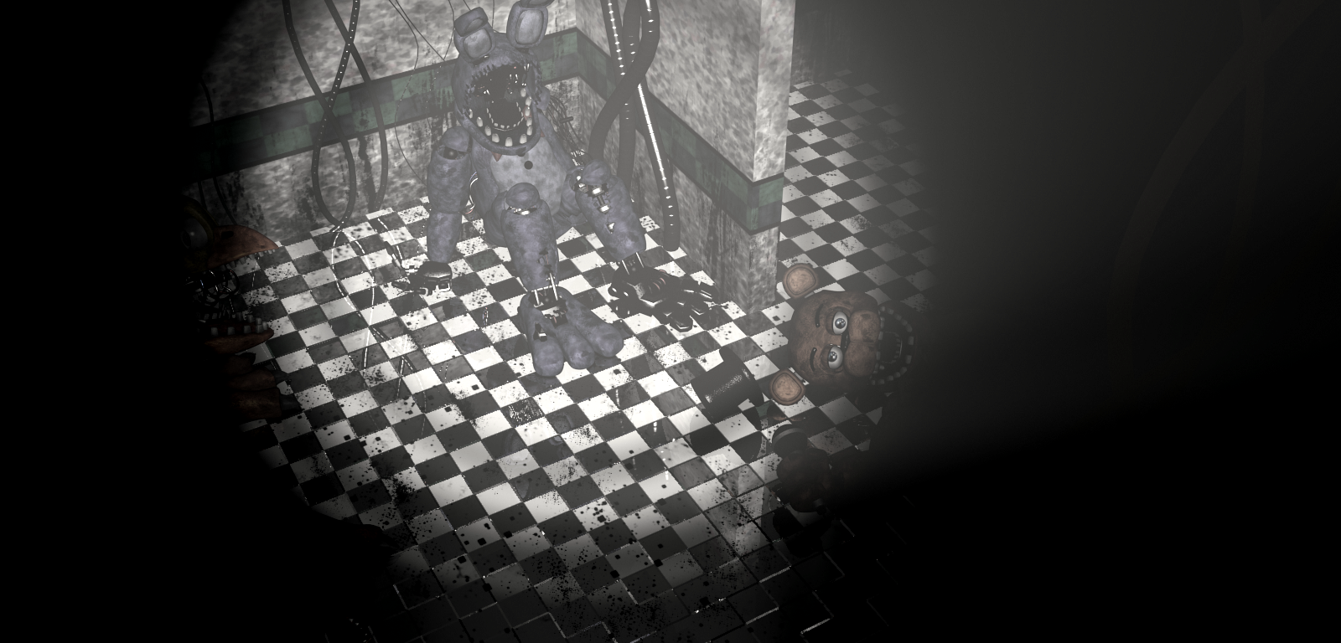

∞ AM
Night ???
Parts/Service
CAM
08
CAM
09
CAM
07
CAM
03
CAM
04
CAM
11
CAM
10
CAM
02
CAM
01
CAM
12
YOU
CAM
05
CAM
06

Slide 16
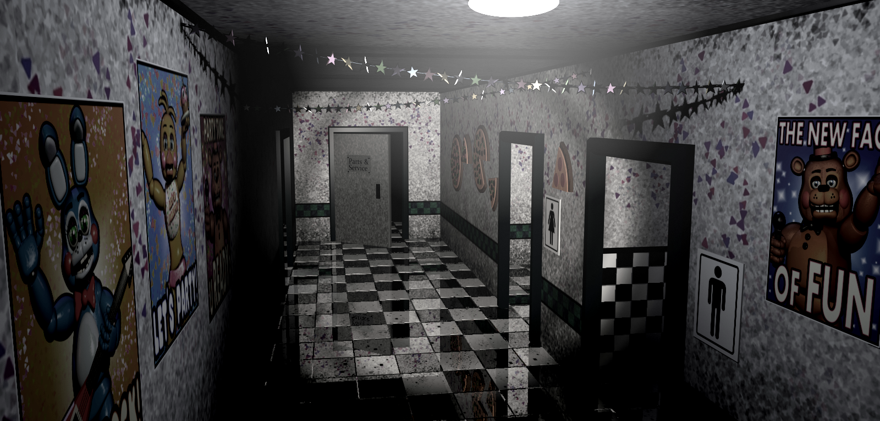

∞ AM
Night ???
Main Hall
CAM
08
CAM
09
CAM
07
CAM
03
CAM
04
CAM
11
CAM
10
CAM
02
CAM
01
CAM
12
YOU
CAM
05
CAM
06

Slide 17
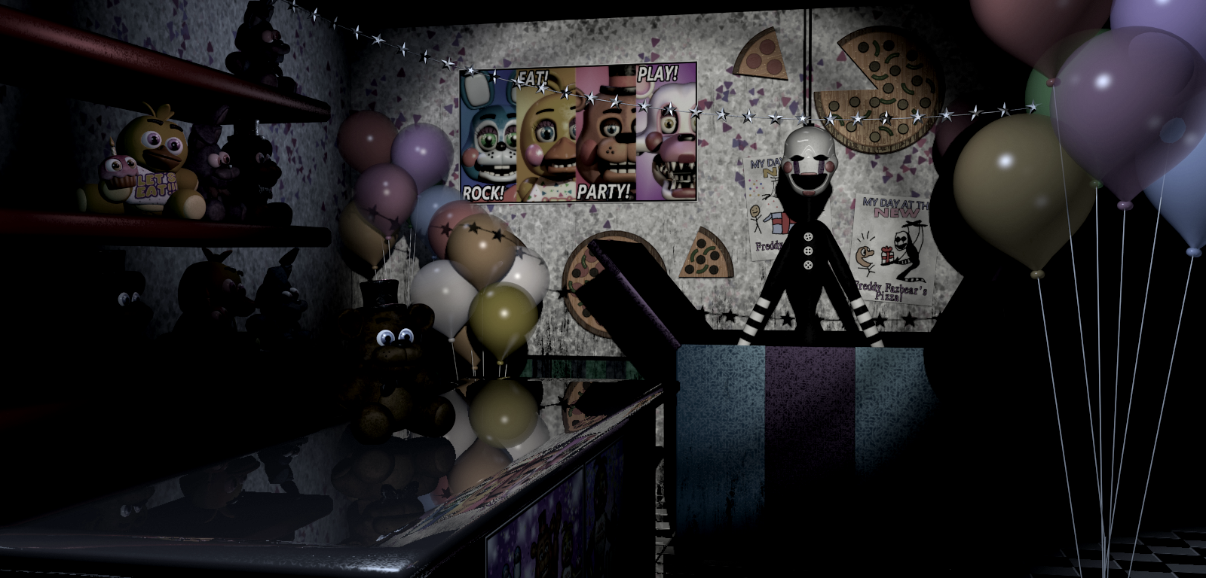


∞ AM
Night ???
Prize Corner
CAM
08
CAM
09
Wind Up
Music Box
CAM
07
CAM
03
CAM
04
CAM
11
CAM
10
CAM
02
CAM
01
CAM
12
YOU
CAM
05
CAM
06

Slide 18
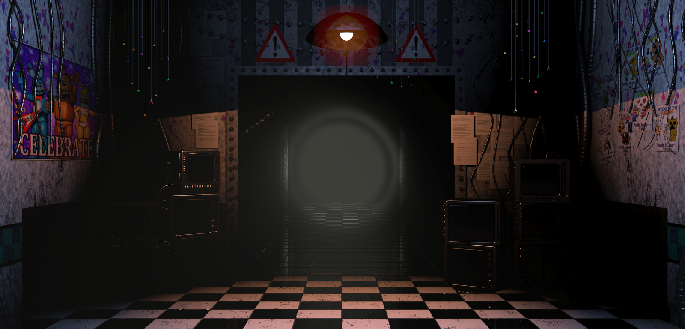
∞ AM
Night ???

Slide 19
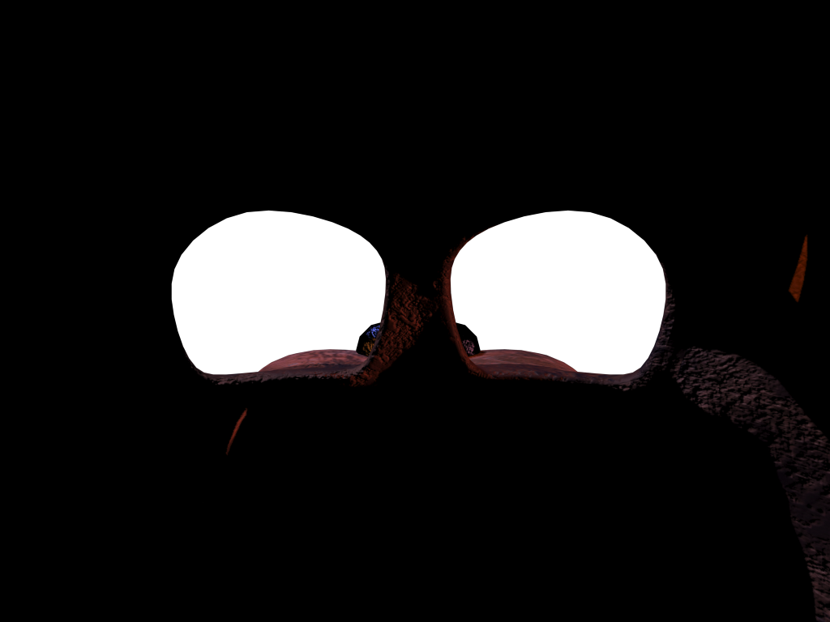

Slide 20
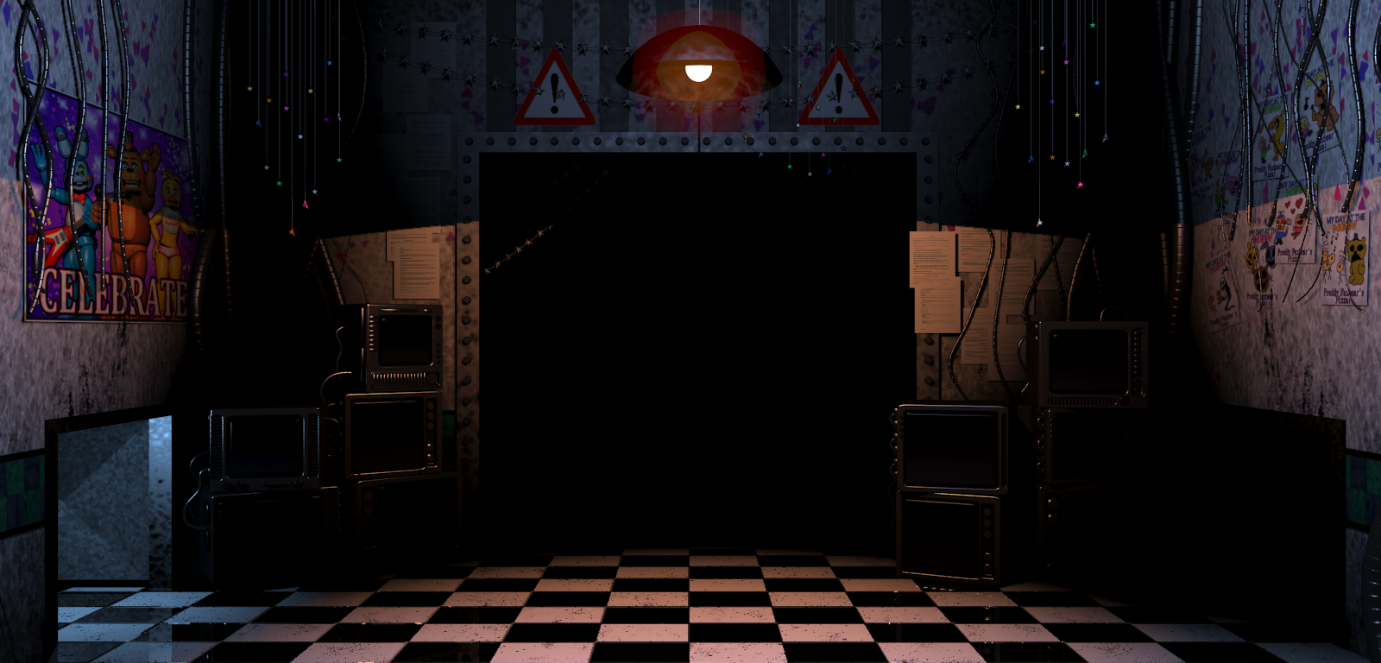
∞ AM
Night ???

Slide 21
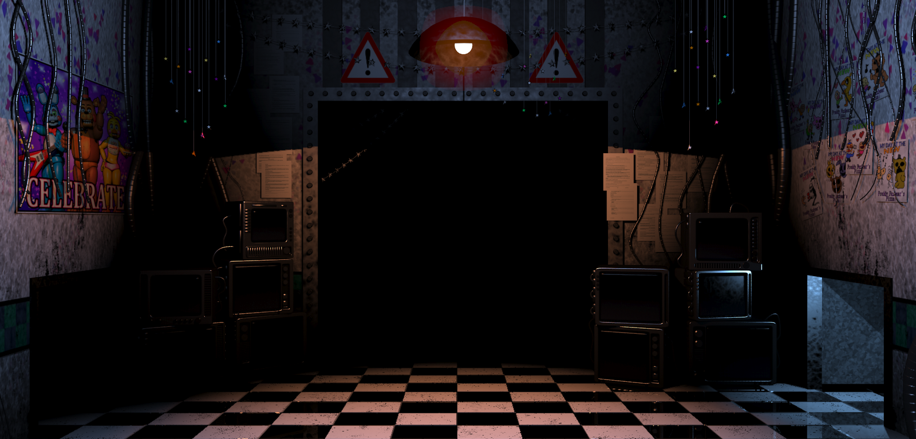

∞ AM
Night ???

Slide 22
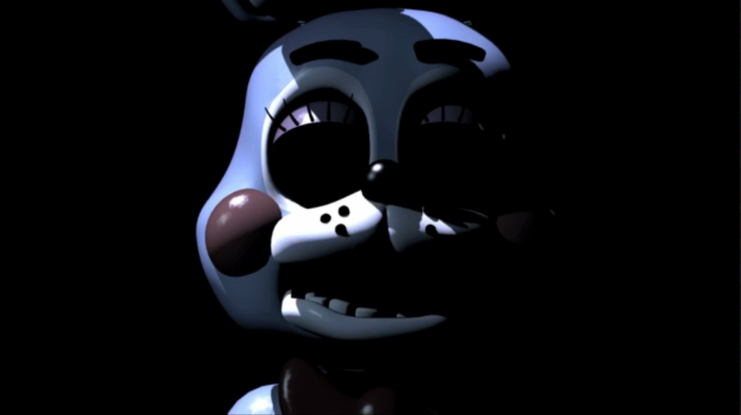

SPOOK

Slide 23

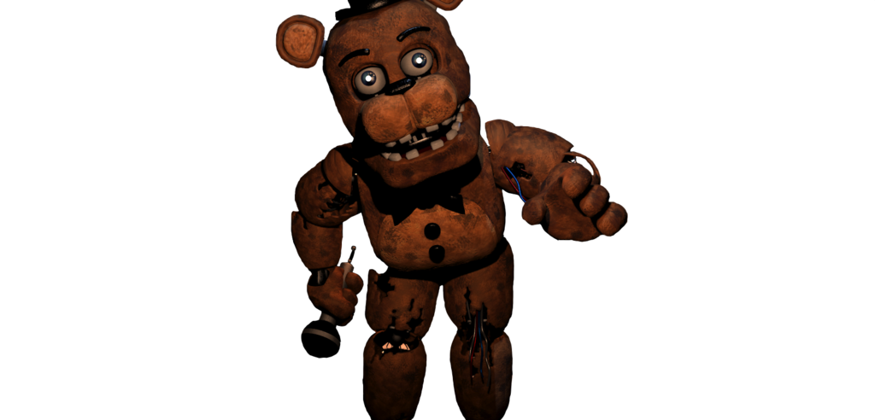
EXTRAS
Withered Freddy
1
2
3
Withered Freddy is the main man. He isn’t much of a problem, unlike the other Withered characters, but is the most unpredictable.
4
5
6
7
8
9
10
11
First Active: Night 3
BACK TO MENU

Slide 24
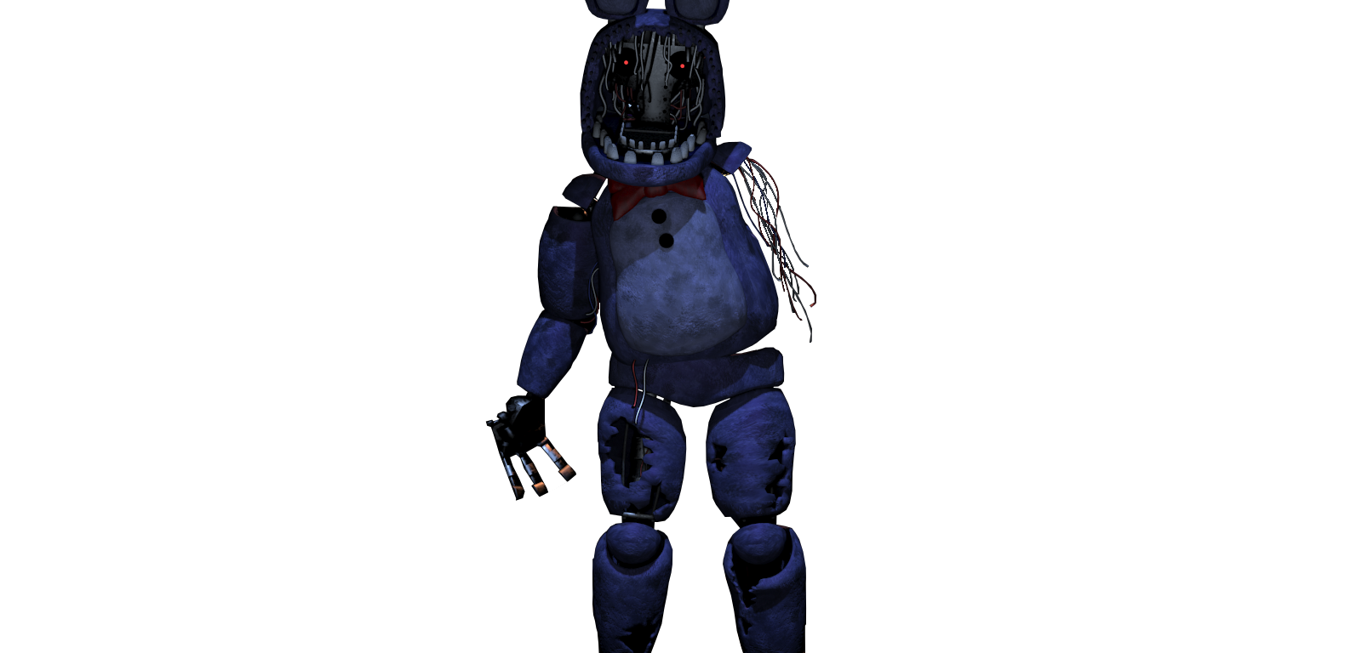
EXTRAS
Withered Bonnie
1
2
3
Withered Bonnie is considered the scariest character for many players. He isn’t a threat to fast players, however.
4
5
6
7
8
9
10
11
First Active: Night 3
BACK TO MENU

Slide 25
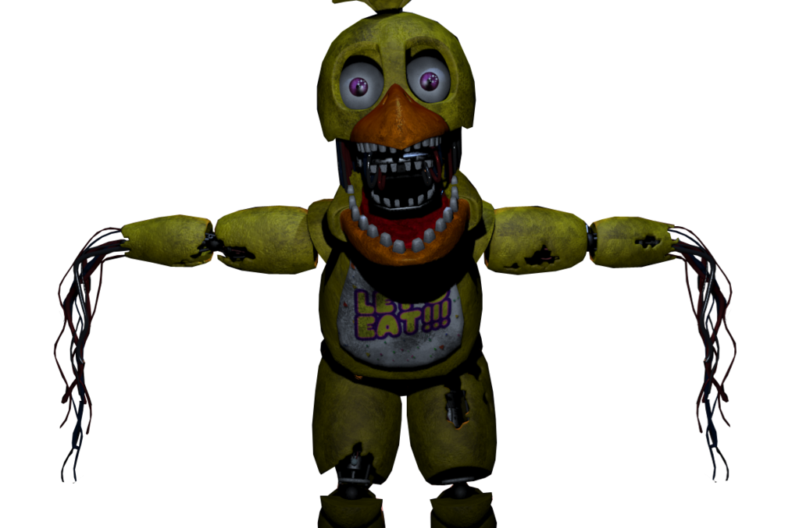
EXTRAS
Withered Chica
1
2
3
Withered Chica is a female chicken. She is a weird character but not considered a threat to players with fast reflexes.
4
5
6
7
8
9
10
11
First Active: Night 3
BACK TO MENU

Slide 26
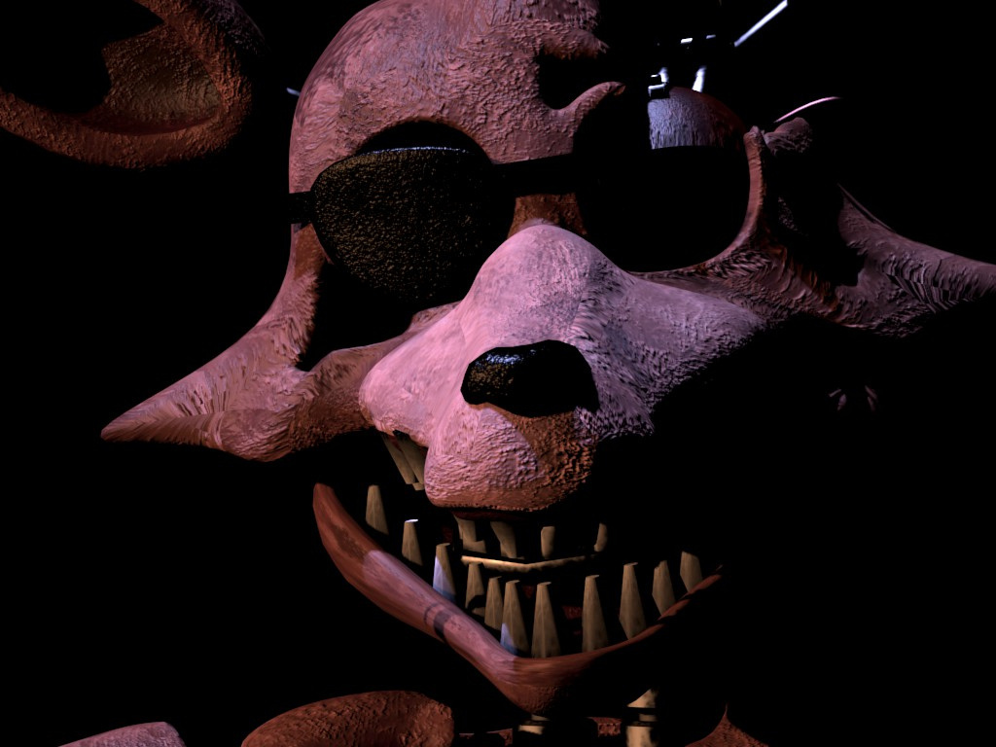
EXTRAS
Withered Foxy
1
2
3
Withered Foxy is the biggest threat out of all the other characters, as you must flash the light in the hallway from time to time to keep him away.
4
5
6
7
8
9
10
11
First Active: Night 2
BACK TO MENU

Slide 27
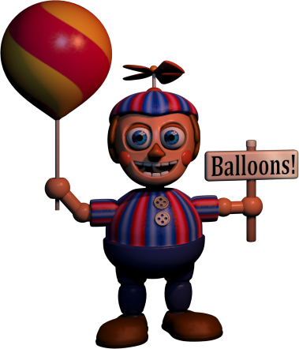
EXTRAS
Balloon Boy (BB)
Balloon Boy is the most hated character,. He signifies his movement via saying greetings, or laughing. He is the only character that doesn’t jumpscare you.
1
2
3
4
5
6
7
8
9
10
11
First Active: Night 2
BACK TO MENU

Slide 28
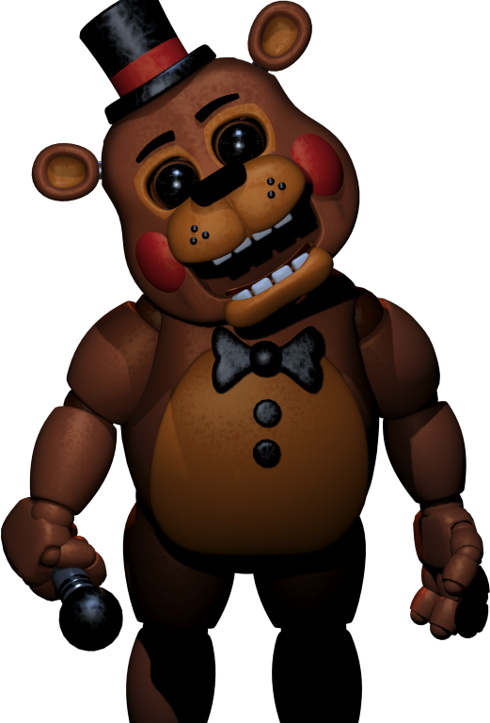
EXTRAS
Toy Freddy
1
2
3
Toy Freddy is a unique character, as he is the only Toy animatronic that is least threatening. However, you must have some fast reflexes, as he acts like the Withered animatronics.
4
5
6
7
8
9
10
11
First Active: Night 1
BACK TO MENU

Slide 29
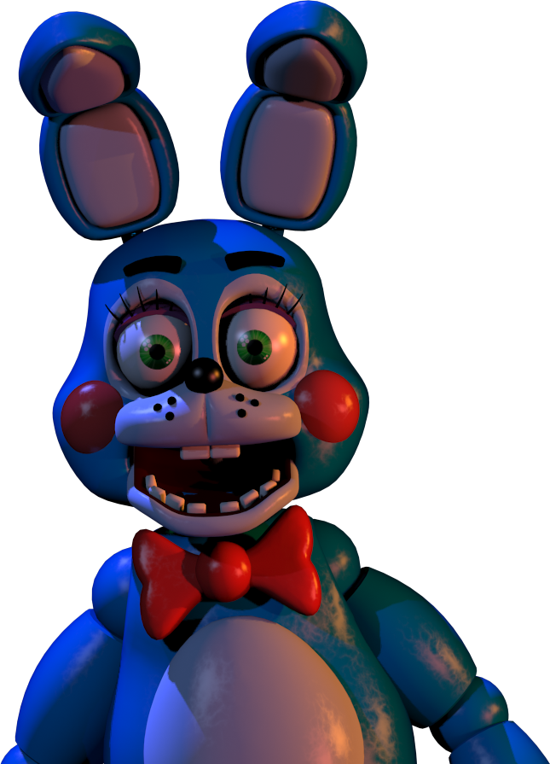
EXTRAS
Toy Bonnie
1
2
3
Toy Bonnie is the first character you interact with. Not necessarily considered a threat, but can be unpredictable at the worst moment possible.
4
5
6
7
8
9
10
11
First Active: Night 1
BACK TO MENU

Slide 30
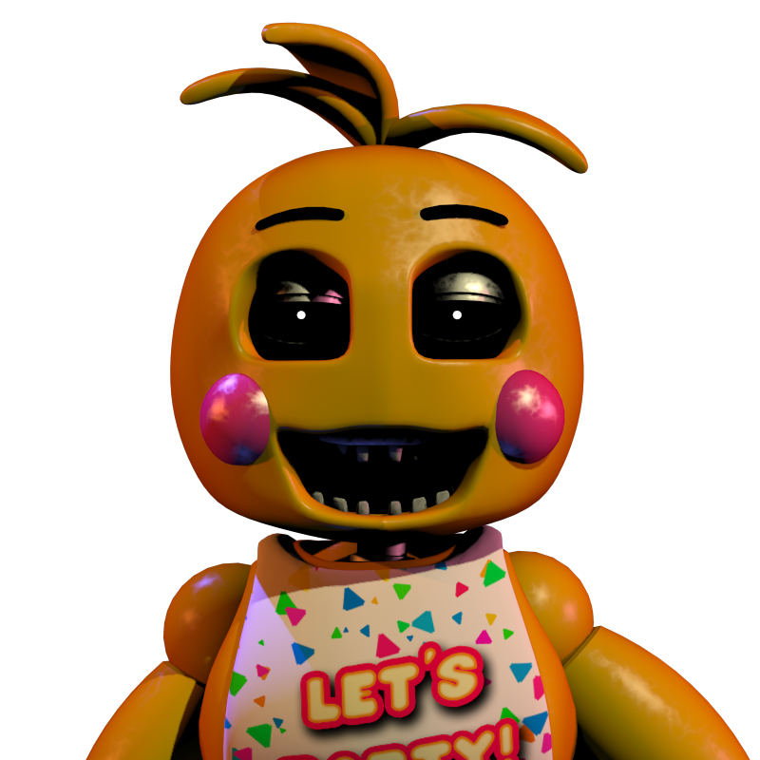
EXTRAS
Toy Chica
1
2
3
She is a definite threat to the player, however it is easy to avoid her by wearing the Freddy Fazbear Head. Toy Chica is also seen carrying her cupcake very often.
4
5
6
7
8
9
10
11
First Active: Night 1
BACK TO MENU

Slide 31
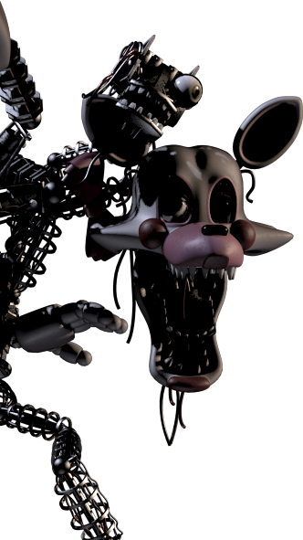
EXTRAS
Mangle/Funtime Foxy
1
2
3
The Mangle (formerly Funtime Foxy) is the result of when toddlers get a take-apart-&-put-back-together attraction and make it a mess of parts.
4
5
6
7
8
9
10
11
BACK TO MENU
First Active: Night 2

Slide 32
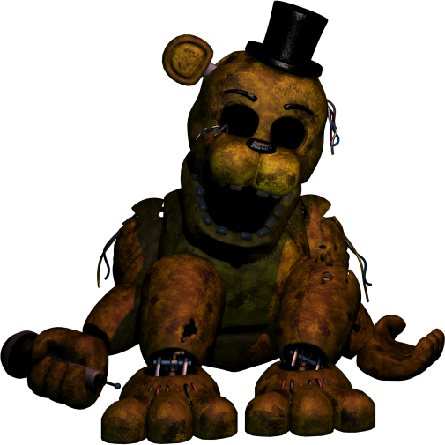
EXTRAS
Golden Freddy
1
2
3
Golden Freddy is a very mysterious character. He is a definite threat to players who haven’t encountered him before.
4
5
6
7
8
9
10
11
First Active: Night 6
BACK TO MENU

Slide 33
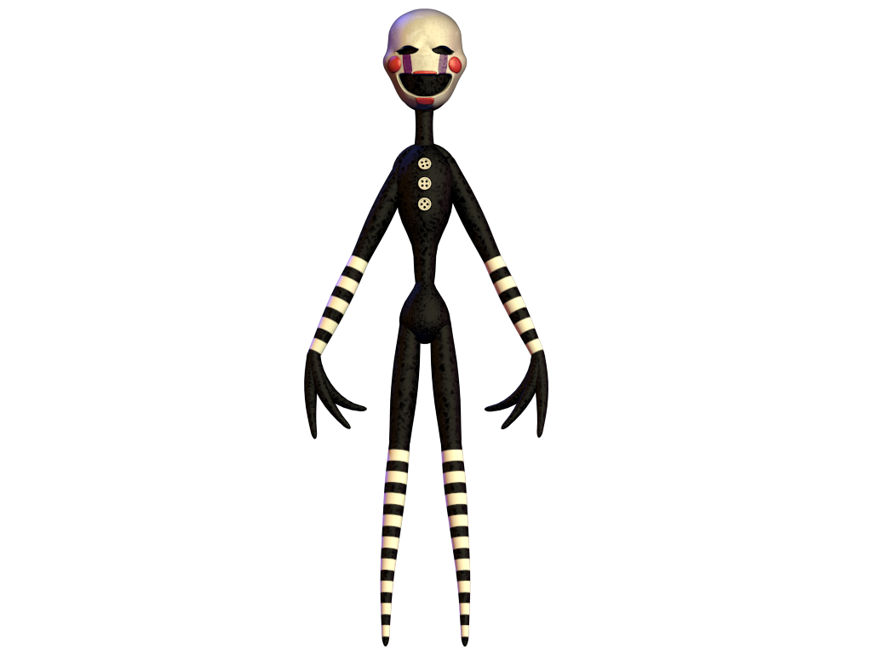
EXTRAS
The Puppet
1
2
3
The Puppet (aka The Marionette) is a character who loves calming music. It is vital to wind its music box, or you will have a bad time.
4
5
6
7
8
9
10
11
First Active: Night 1
BACK TO MENU

