Slide 1

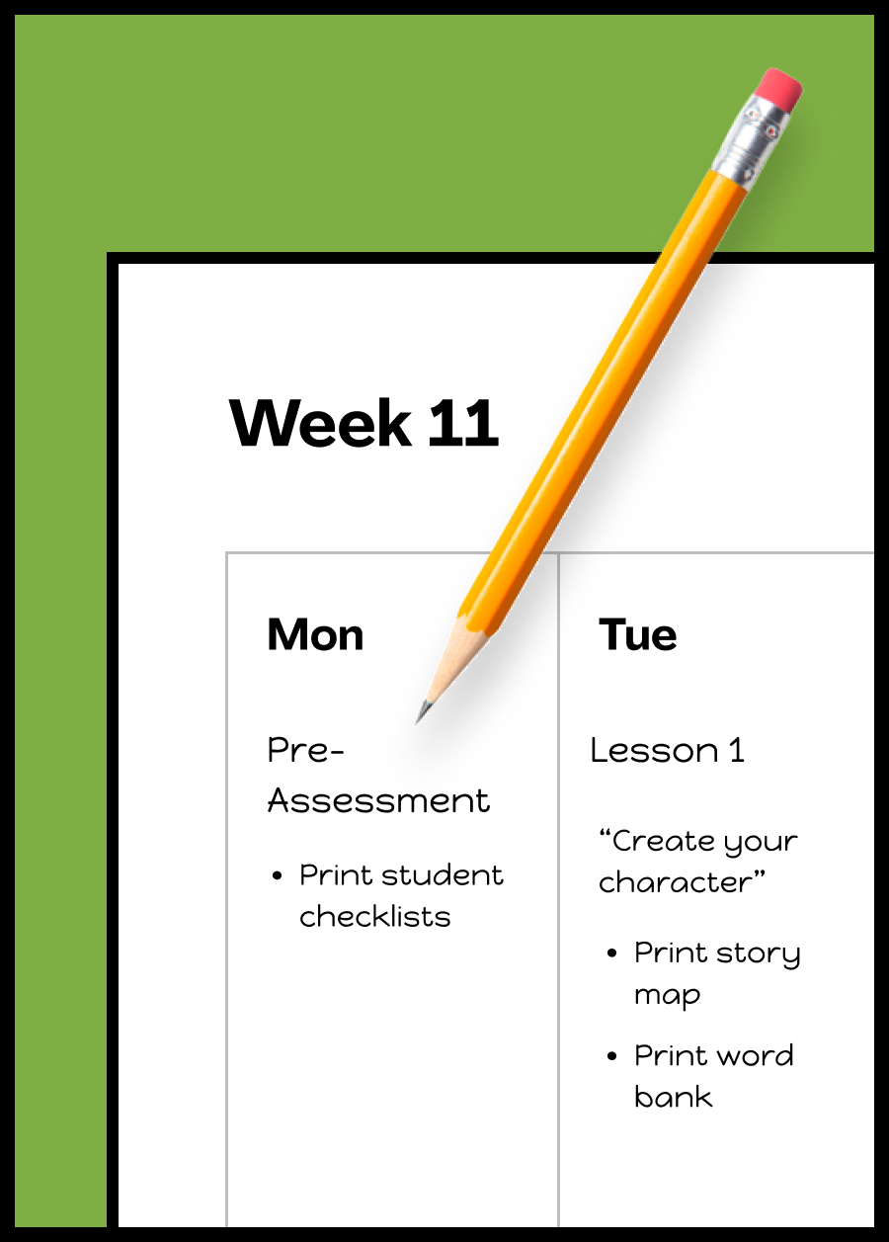
Sample Lesson Plans For Narrative Writing
Try a curated lesson plan to get a taste of how Mystery Writing builds students’ skills and confidence with engaging lessons & activities.
Sample Plans
5th Grade 4th Grade 3rd Grade 2nd Grade K-1 coming next year!
Standards & Lesson Details
Mystery Writing Standards Alignment Guide 2025-2026
Updated August 2025

Slide 2

5th Grade | Sample Plan for Narrative Writing
Click to open lesson
Similes
Essential Skill Lesson
Format: Introduction video & writing activity
Length: 30 min or 1-2 sessions
Character Traits
Essential Skill Lesson
Format: Introduction video & writing activity
Length: 30 min or 1-2 sessions
Unit Pre-Assessment
Assessment
Format: Writing prompt & independent writing
Length: 30 min or 1-2 sessions
Intro to Narrative Writing
Genre Intro Lesson
Format: Introduction video & writing activity
Length: 30 min or 1-2 sessions
Narrative Unit:
Australian Adventures
Genre Unit · 5 Lessons
Format: Introduction videos & writing activities
Length: About 45 min per lesson or 1 -2 weeks
Unit Post-Assessment
Assessment
Format: Writing prompt & independent writing
Length: 30 min or 1-2 sessions
Simile Practice
Practice Lesson
Format: Writing prompt & independent writing
Length: 15 min or 1 session
The Unexpected Guest
Independent Writing Prompt
Format: Writing prompt & independent writing
Length: 15 min or 1 session
Setting Writing Goals
Writing Community Lesson
Format: Introduction video & writing activity
Length: 30 min or 1-2 sessions

Slide 3
4th Grade | Sample Plan for Narrative Writing
Click to open lesson
Personification
Essential Skill Lesson
Format: Introduction video & writing activity
Length: 30 min or 1-2 sessions
Revising Words
Essential Skill Lesson
Format: Introduction video & writing activity
Length: 30 min or 1-2 sessions
Unit Pre-Assessment
Assessment
Format: Writing prompt & independent writing
Length: 30 min or 1-2 sessions
Intro to Narrative Writing
Genre Intro Lesson
Format: Introduction video & writing activity
Length: 30 min or 1-2 sessions
Narrative Unit:
Amusement Park
Genre Unit · 5 Lessons
Format: Introduction videos & writing activities
Length: About 45 min per lesson or 1 -2 weeks
Unit Post-Assessment
Assessment
Format: Writing prompt & independent writing
Length: 30 min or 1-2 sessions
Personification Practice
Practice Lesson
Format: Video prompt & independent writing
Length: 15 min or 1 session
Sensational Smells
Independent Writing Prompt
Format: Writing prompt & independent writing
Length: 15 min or 1 session
Setting Writing Goals
Writing Community Lesson
Format: Introduction video & writing activity
Length: 30 min or 1-2 sessions

Slide 4
3rd Grade | Sample Plan for Narrative Writing
Click to open lesson
Adding Details
Essential Skill Lesson
Format: Introduction video & writing activity
Length: 30 min or 1-2 sessions
Hyperbole
Essential Skill Lesson
Format: Introduction video & writing activity
Length: 30 min or 1-2 sessions
Elaborating with Feelings
Essential Skill Lesson
Format: Introduction video & writing activity
Length: 30 min or 1-2 sessions
Unit Pre-Assessment
Assessment
Format: Writing prompt & independent writing
Length: 30 min or 1-2 sessions
Intro to Narrative Writing
Genre Intro Lesson
Format: Introduction video & writing activity
Length: 30 min or 1-2 sessions
Narrative Unit:
Constellation Stories
Genre Unit · 5 Lessons
Format: Introduction videos & writing activities
Length: About 45 min per lesson or 1 -2 weeks
Unit Post-Assessment
Assessment
Format: Writing prompt & independent writing
Length: 30 min or 1-2 sessions
Adding Details Practice
Practice Lesson
Format: Video prompt & independent writing
Length: 15 min or 1 session
The Backpack Monster
Independent Writing Prompt
Format: Writing prompt & independent writing
Length: 15 min or 1 session

Slide 5
2nd Grade | Sample Plan for Narrative Writing
Click to open lesson
Partnering
Writing Community Lesson
Format: Introduction video & writing activity
Length: 30 min or 1-2 sessions
Onomatopoeia
Essential Skill Lesson
Format: Introduction video & writing activity
Length: 30 min or 1-2 sessions
Using And
Essential Skill Lesson
Format: Introduction video & writing activity
Length: 30 min or 1-2 sessions
Unit Pre-Assessment
Assessment
Format: Writing prompt & independent writing
Length: 30 min or 1-2 sessions
Narrative Unit:
Campsite Bandit
Genre Unit · 5 Lessons
Format: Introduction videos & writing activities
Length: About 40 min per lesson or 1-2 weeks
Unit Post-Assessment
Assessment
Format: Writing prompt & independent writing
Length: 30 min or 1-2 sessions
Onomatopoeia Practice
Practice Lesson
Format: Video prompt & independent writing
Length: 15 min or 1 session
Make a Monster!
Independent Writing Prompt
Format: Writing prompt & independent writing
Length: 15 min or 1 session
Setting Writing Goals
Writing Community Lesson
Format: Introduction video & writing activity
Length: 30 min or 1-2 sessions

