Slide 1
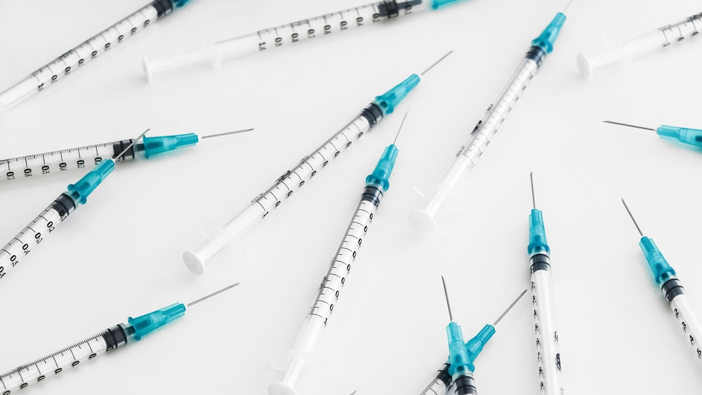
SYRINGE AND AMPOULE
Free Template
Here is where your presentation begins

Slide 2
TABLE OF CONTENTS
01
02
OBJECTIVES
METHODOLOGY
03
04
RESULTS ANALYSIS
CONCLUSIONS
Here you could describe the topic of the section
Here you could describe the topic of the section
Here you could describe the topic of the section
Here you could describe the topic of the section

Slide 3
Infographic Style
Content Here
Content Here
You can simply impress your audience and add a unique zing and appeal to your Presentations.
You can simply impress your audience and add a unique zing and appeal to your Presentations.
Add Text
Add Text
Simple PowerPoint Presentation
Simple PowerPoint Presentation
Content Here
Content Here
You can simply impress your audience and add a unique zing and appeal to your Presentations.
You can simply impress your audience and add a unique zing and appeal to your Presentations.

Slide 4
01
OBJECTIVES
You can enter a subtitle here if you need it

Slide 5
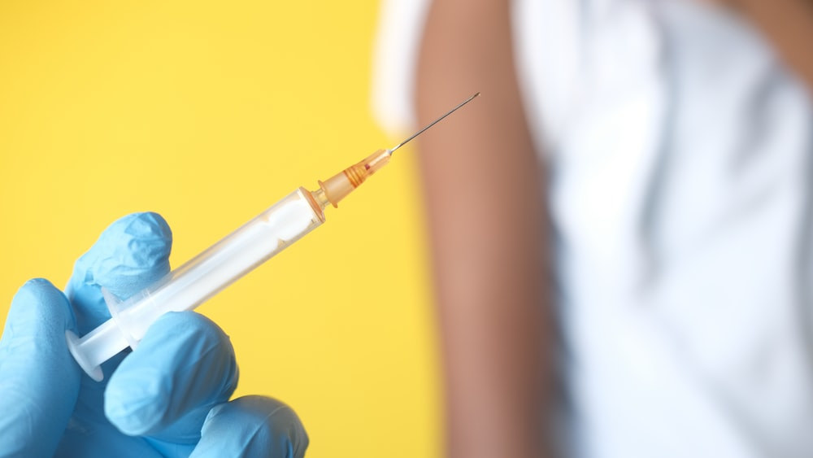
INTRODUCTION
Mercury is the closest planet to the Sun and the smallest one in the Solar System

Slide 6
BACKGROUND
01
02
03
MERCURY
MARS
JUPITER
04
05
06
VENUS
SATURN
NEPTUNE
Mercury is the closest planet to the Sun
Despite being red, Mars is actually a cold place
It’s the biggest planet in the Solar System
Venus has a beautiful name, but it’s terribly hot
Saturn is the ringed one and a gas giant
Neptune is the farthest planet from the Sun

Slide 7
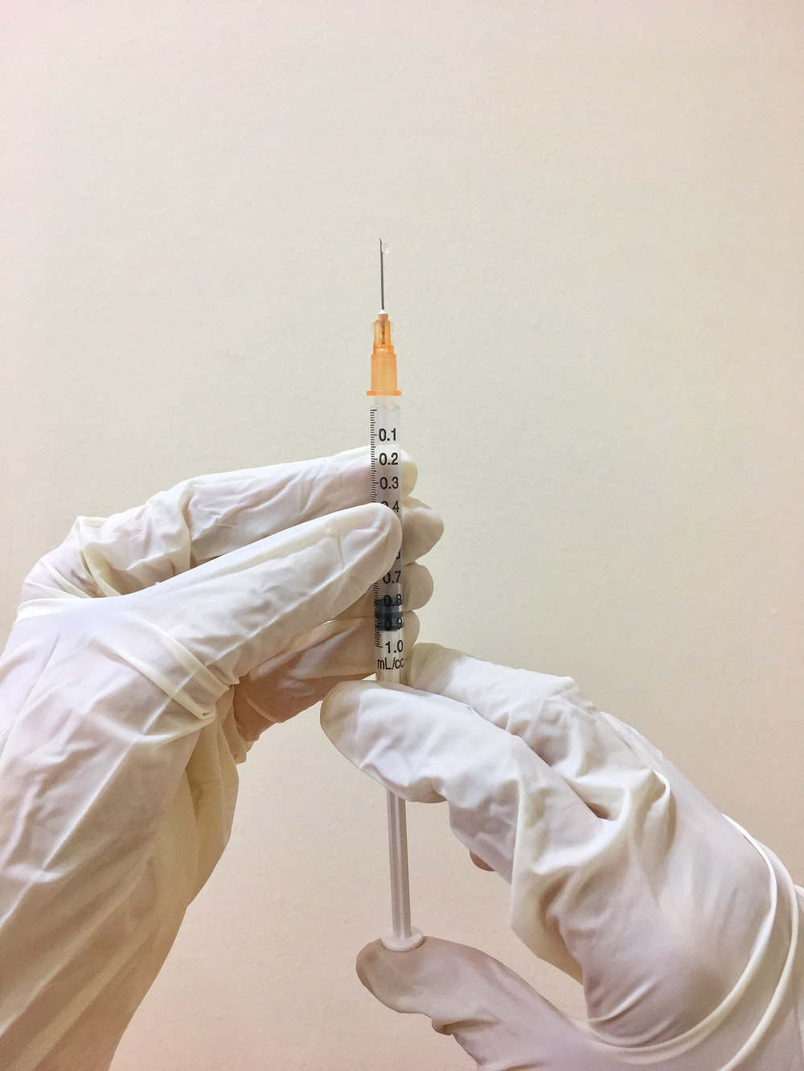
GOALS
MERCURY
VENUS
JUPITER
Mercury is the closest planet to the Sun and the smallest one in the Solar System
Venus has a beautiful name and is the second planet from the Sun. It’s terribly hot
Jupiter is a gas giant and also the biggest planet in the entire Solar System

Slide 8
METHODS
NEPTUNE
MERCURY
Neptune is the farthest planet from the Sun
Mercury is the closest planet to the Sun
SATURN
MARS
Saturn is the ringed one and a gas giant
Despite being red, Mars is a cold place
VENUS
JUPITER
Venus has a beautiful name, but it’s terribly hot
It’s the biggest planet in the Solar System

Slide 9
RESEARCH AND PUBLICATIONS
by VENUS
by MERCURY
by MARS
Venus has a beautiful name and is the second planet from the Sun
Mercury is the closest planet to the Sun and the smallest one in the Solar System
Mars is full of iron oxide dust, which gives the planet its reddish cast

Slide 10
Teddy bear story
Tell your classmates the story of your teddy bear
Step 01
Step 02
Step 03
Step 04
Neptune is the farthest planet from the Sun
The Moon is Earth’s only natural satellite
Despite being red, Mars is a cold place
Mercury is the closest object to the Sun

Slide 11
FACTORS TO CONSIDER
VENUS
MERCURY
Venus has a beautiful name and is the second planet from the Sun
Mercury is the closest planet to the Sun and the smallest one

Slide 12
CLINICAL TRIAL
PRECLINICAL | PHASE 1 | PHASE 2 | PHASE 3
Lab Studies | Human Safety | Expanded Safety | Efficacy & Safety

Slide 13
TRIAL TIMELINE
RESEARCH
EXPERIMENTATION
CONCLUSIONS
PRECLINICAL
RESULTS
Venus is the second planet from the Sun
Despite being red, Mars is a cold place
Mercury is the closest planet to the Sun
Jupiter is a gas giant and the biggest planet
Saturn is a gas giant and has several rings

Slide 14
PHASE 1
SAMPLE
SECONDARY EFFECTS
80%
Success rate
Young healthy people
20 - 80 Participants
Mercury is the closest planet to the Sun
RESULTS | GOAL | 6 MONTHS
Venus is the second planet from the Sun | Study the safety of medication | Experimentation time

Slide 15
A PICTURE IS WORTH A THOUSAND WORDS

Slide 16
Choose your bear adjectives
Drag the words that define your teddy bear to the circle
Soft
Brown
Yellow
Cute
Short
Friendly

Slide 17
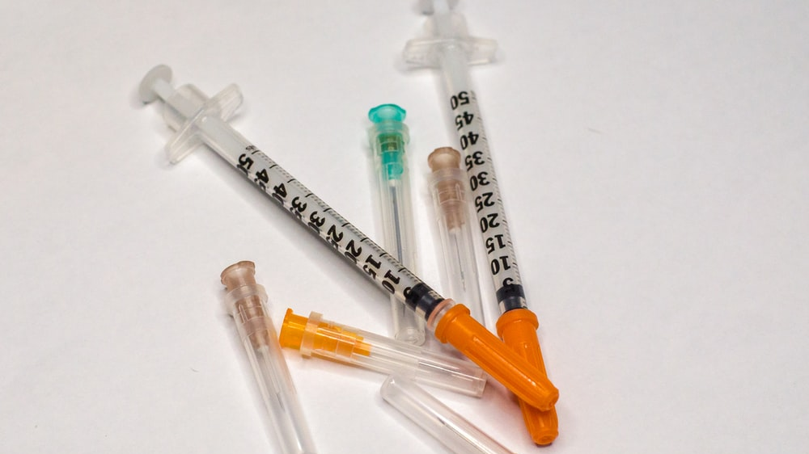
A picture is worth a thousand words
SECONDARY EFFECTS
80%
Mercury is the closest planet to the Sun

Slide 18
New words that we are going to learn
Mercury
Venus
Jupiter
Saturn
Mercury is the closest planet to the Sun
Venus is the second planet from the Sun
It’s the biggest planet in the Solar System
Saturn is a gas giant and has several rings

Slide 19
RESULTS
JUPITER
MARS
It’s the biggest planet in the Solar System
Despite being red, Mars is a cold place

Slide 20
Bring your teddy bear
Jupiter
Venus
Jupiter is a gas giant and the biggest planet in the entire Solar System
Venus has a beautiful name and is the second planet from the Sun

Slide 21
10,000,000
Big numbers catch your audience’s attention

Slide 22
SUCCESS RATE
75%
97%
Patients cured
Secondary effects

Slide 23
CONCLUSION
Mercury is the closest planet to the Sun and the smallest one in the Solar System—it’s only a bit larger than the Moon

Slide 24
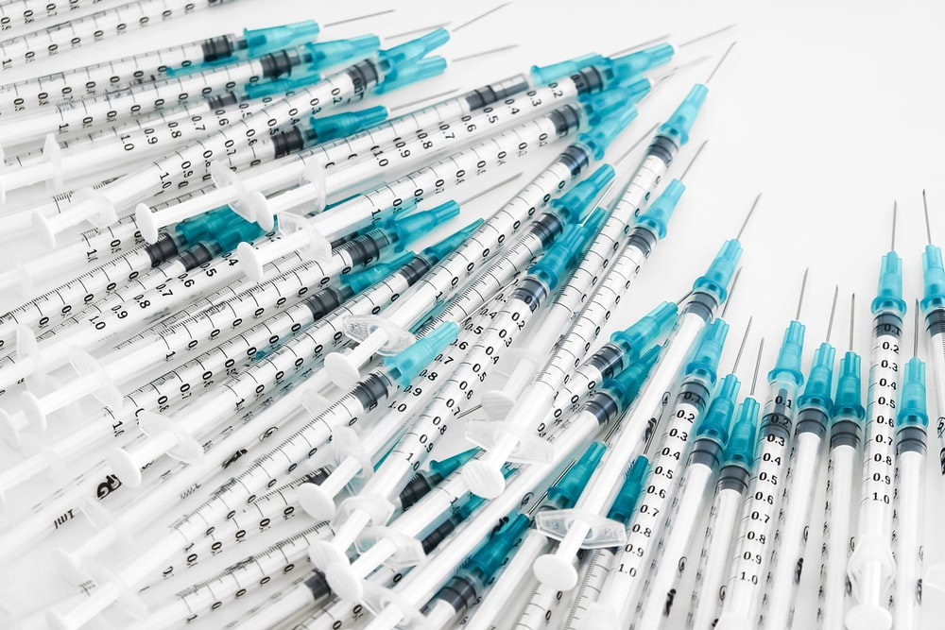
Infographic Style
ALLPPT Layout
Clean Text Slide for your Presentation
Get a modern PowerPoint Presentation that is beautifully designed. I hope and I believe that this Template will your Time.
80%
Text
Your Content Here
Get a modern PowerPoint Presentation that is beautifully designed. I hope and I believe that this Template will your Time, Money and Reputation. Easy to change colors, photos and Text. Get a modern PowerPoint Presentation that is beautifully designed.

Slide 25
A picture always reinforces the concept
Images reveal large amounts of data, so remember: use an image instead of a long text. Your audience will appreciate it for sure
Images reveal large amounts of data, so remember: use an image instead of a long text. Your audience will appreciate it for sure

Slide 26
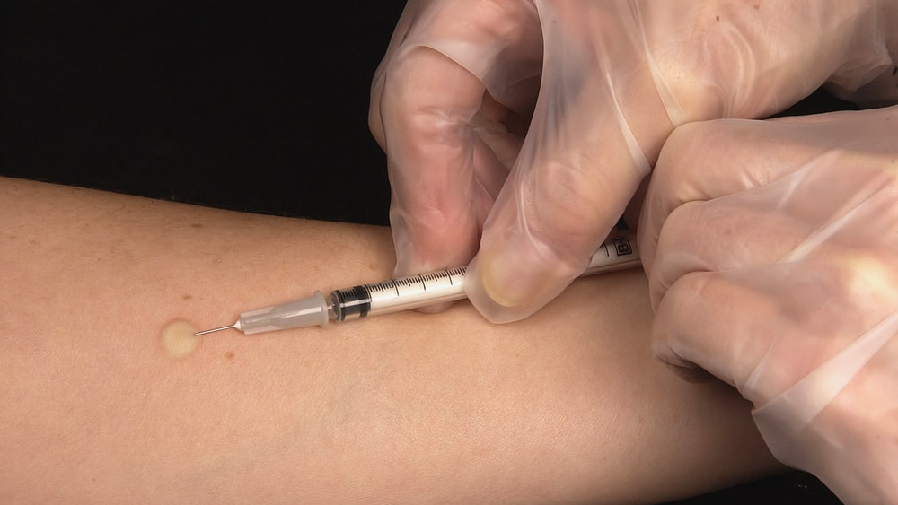
A picture is worth a thousand words
Free Template
Here is where your presentation begins

Slide 27
Parts of your teddy bear
Match each part of the teddy bear with its correct name
Venus
Jupiter
Mars
Venus is the second planet from the Sun
It’s the biggest planet in the Solar System
Despite being red, Mars is a very cold place

Slide 28
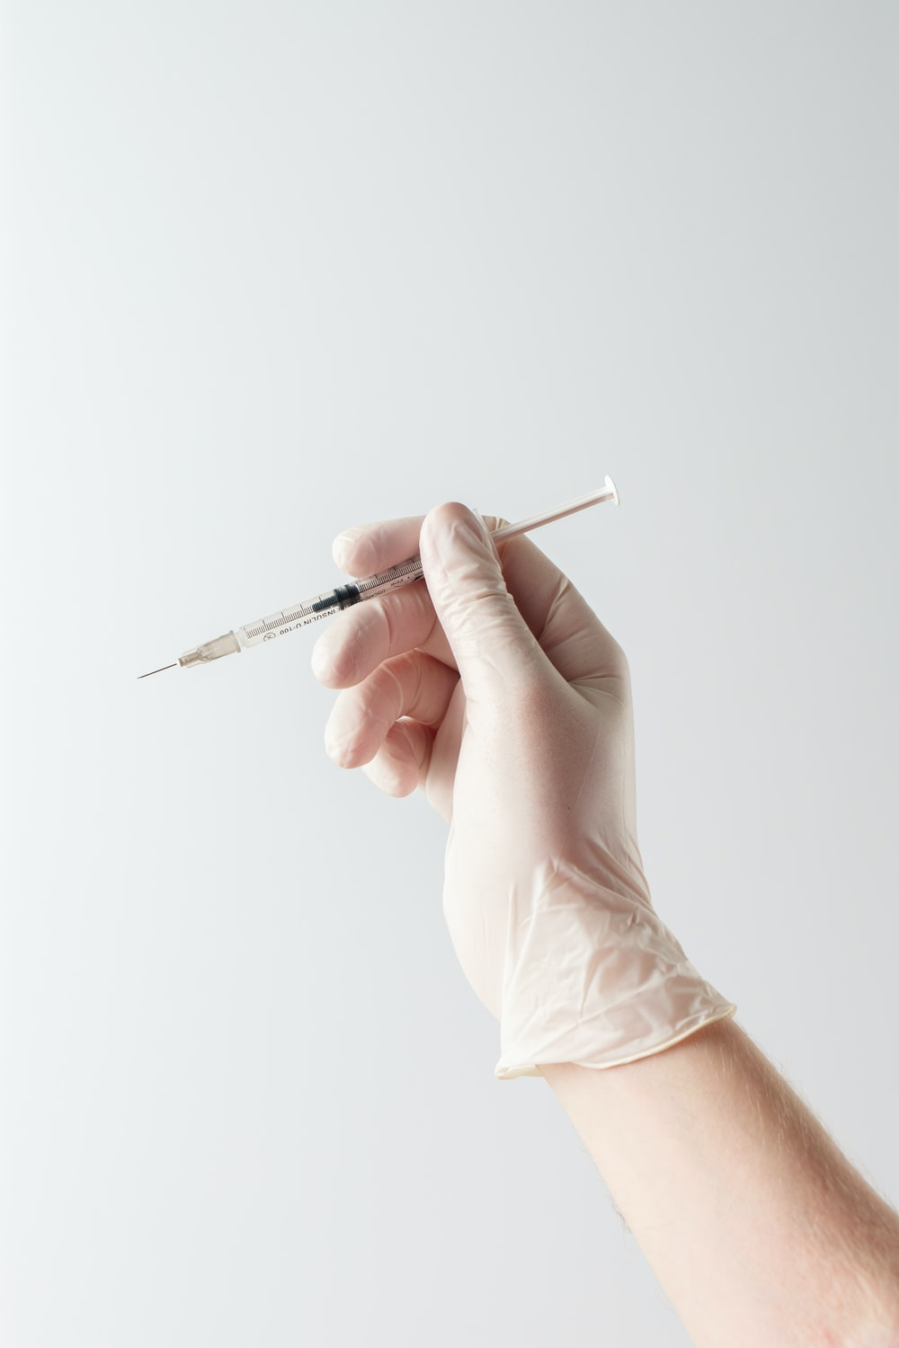
Roman empire
Latin language
Despite being red, Mars is actually a cold place. It’s full of iron oxide dust
Greek language
Mercury is the closest planet to the Sun and the smallest one

Slide 29
THANKS!
Do you have any questions?
addyouremail@example.com
+91 620 421 838
Domain.com
Free Template

Slide 30
FUENTE
ELABORADO POR :
plantillaspowerpoint.org
IMAGES :
unsplash.com
FONTS :
Mukta
Roboto

Slide 31
RESOURCES

Slide 32
RESOURCES

Slide 33
RESOURCES

Slide 34
Fully Editable Icon Sets: A

Slide 35
Fully Editable Icon Sets: B

Slide 36
Fully Editable Icon Sets: C

