Slide 1
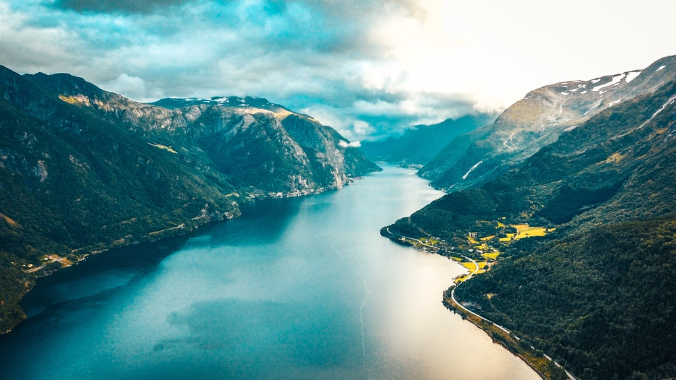
NATURAL LANDSCAPE
Free Template

Slide 2
FREE TEMAPLATE
01
About us
02
Our services
03
Our clients
04
Our team
You can describe the topic of the section here
You can describe the topic of the section here
You can describe the topic of the section here
You can describe the topic of the section here

Slide 3
FREE
TEAMPLATE
UNO
You can enter a subtitle here I
f you need it

Slide 4
TABLE OF CONTENTS
01
03
02
04
INTRODUCTION
CLINICAL TRIAL
Here you could describe the topic of the section
Here you could describe the topic of the section
METHODS
RESULTS
Here you could describe the topic of the section
Here you could describe the topic of the section

Slide 5
INTRODUCTION
Mercury is the closest planet to the Sun and the smallest one in our Solar System—it’s only a bit larger than our Moon. The planet’s name has nothing to do with the liquid metal, since Mercury was named after the Roman messenger god

Slide 6
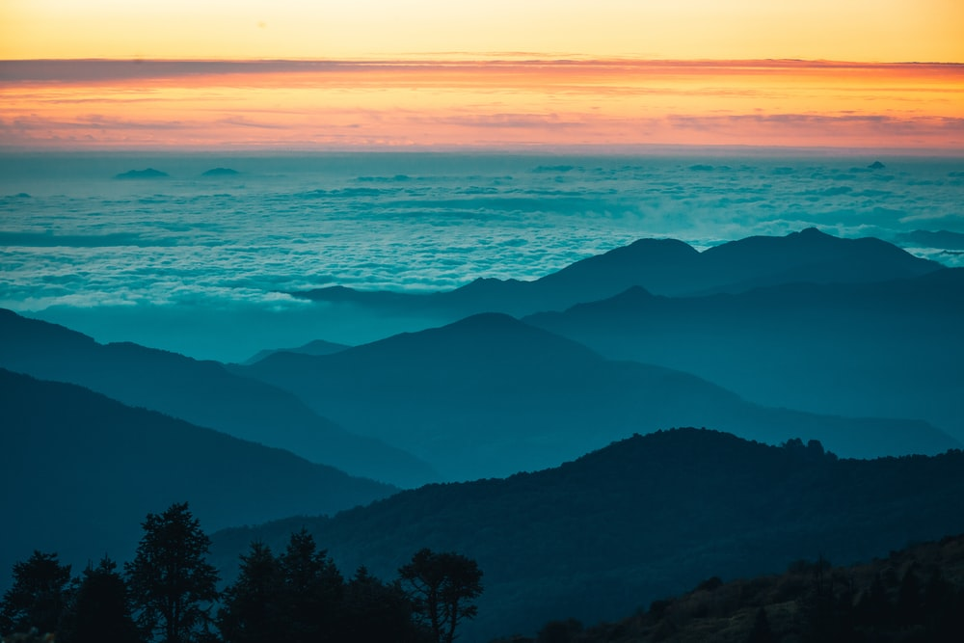
WOOW
This can be the part of the presentation where you introduce yourself, write your email…

Slide 7
TIME LINE FREE TEMPLATE
2019
2020
2021
Mars
Saturn
Jupiter
Despite being red, Mars is a cold place
It’s a gas giant and has several rings
It’s the biggest planet in the Solar System

Slide 8
FREE TEMPLATE LAYOUT
WOOW
VOOV
Despite being red, Mars is a cold place
Venus is the second planet from the Sun

Slide 9
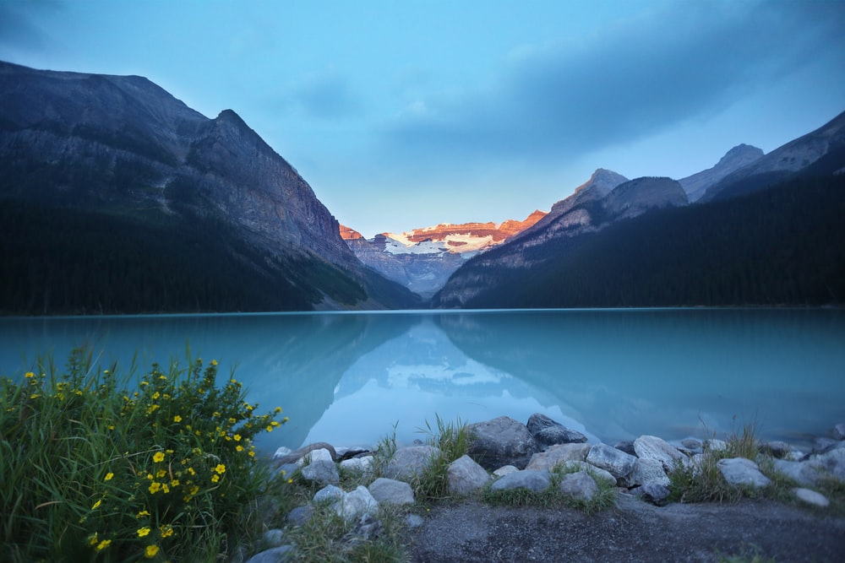
A PICTURE IS WORTH A THOUSAND WORDS

Slide 10
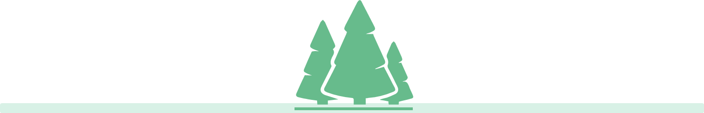
WAASDFHTUYOPhat do they say about us?
John Doe, 32
Senna Harry, 27
“Jupiter is a gas giant and the biggest
planet in the Solar System”
“Venus has a beautiful name and is the second planet from the Sun. It’s terribly hot”

Slide 11
BACKGROUND
FREE
MARS
VENUS
SATURN
FREE
FREE
Despite being red, Mars is actually a cold place. It’s full of iron oxide dust
Venus has a beautiful name and is the second planet from the Sun
This is the ringed planet. It’s a gas giant, composed mostly of hydrogen and helium

Slide 12
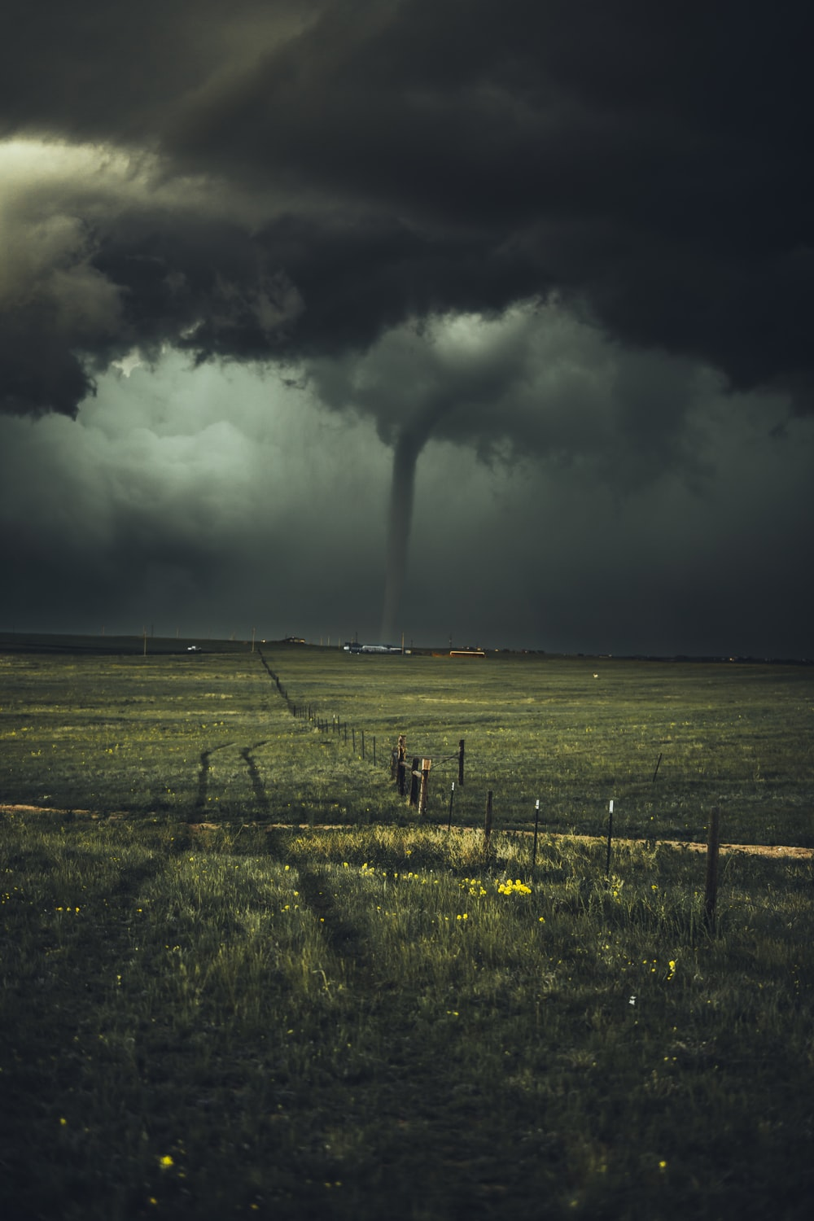
FREE TEAMPLATE POWERPOINT
VENUS
MERCURY
MARS
Venus has a beautiful name, but it’s terribly hot
Mercury is the closest planet to the Sun
Despite being red, Mars is actually a cold place

Slide 13
METHODS
VENUS
MERCURY
JUPITER
SATURN
Mercury is the closest planet to the Sun
Venus has a beautiful name, but it’s terribly hot
It’s the biggest planet in our Solar System
Saturn is the ringed one and a gas giant

Slide 14

RESEARCH AND PUBLICATIONS
A
B
Venus has a beautiful name and is the second planet from the Sun. It’s terribly hot, even hotter than Mercury
Mercury is the closest planet to the Sun and the smallest one in our Solar System—it’s only a bit larger than our Moon
by VENUS
by MERCURY

Slide 15
Venus
Saturn
Jupiter
Mars
FREE TEAMPLATE POWERPOINT
Venus is the second planet from the Sun
It’s a gas giant and has several rings
It’s the biggest planet in the Solar System
Despite being red, Mars is a cold place

Slide 16
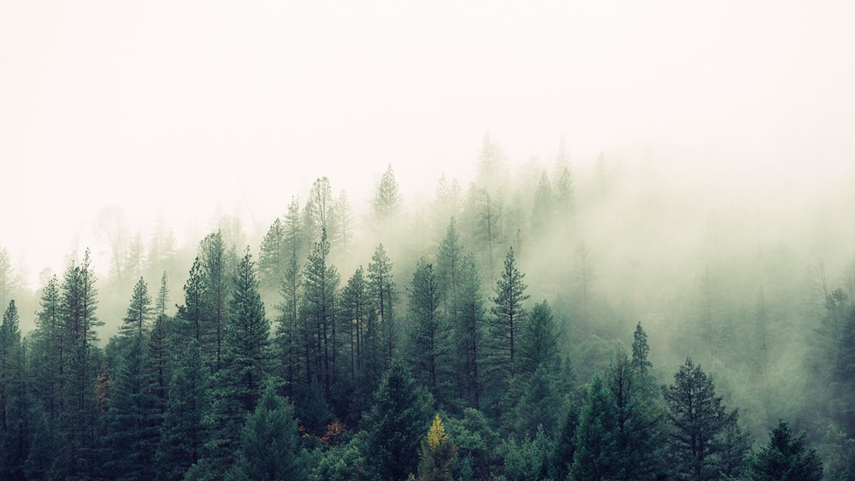
A PICTURE IS WORTH A THOUSAND WORDS

Slide 17
RESEARCH PUBLICATIONS
Here you can list your reference websites or publications.
Here you can list your reference websites or publications.
Here you can list your reference websites or publications.
Here you can list your reference websites or publications.
Here you can list your reference websites or publications.
Here you can list your reference websites or publications.

Slide 18
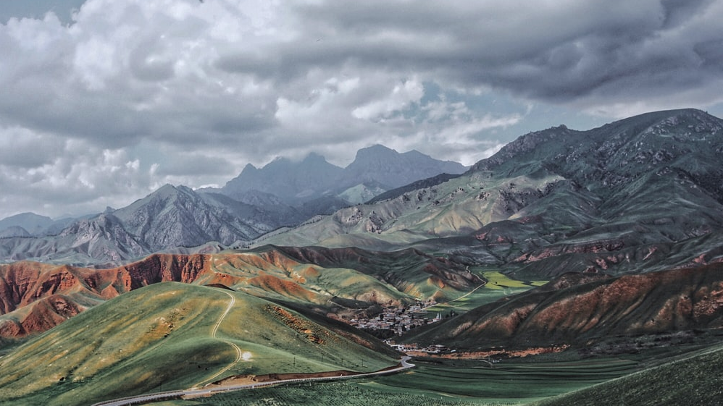
A PICTURE IS WORTH A THOUSAND WORDS

Slide 19
FACTORS TO CONSIDER
1-3 MONTHS
4-6 MONTHS
7-9 MONTHS
Venus is the second planet from the Sun
Venus is the second planet from the Sun
Venus is the second planet from the Sun
Mercury is the closest planet to the Sun
Neptune is the farthest planet from the Sun

Slide 20
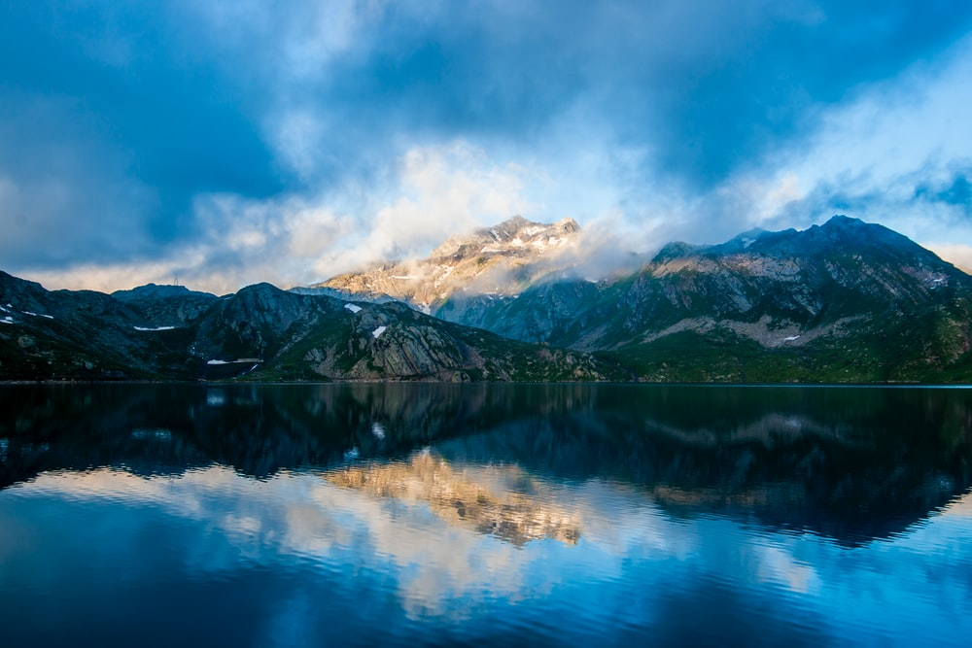
01
COMPANY
You could enter a subtitle here if you need it

Slide 21

CLINICAL TRIAL
PRECLINICAL
PHASE 1
PHASE 2
PHASE 3
Lab studies
Human safety
Expanded safety
Efficacy & safety
Venus has a beautiful name and is the second planet from the Sun. It’s terribly hot, even hotter than Mercury
Venus has a beautiful name and is the second It’s terribly hot, even hotter than Mercury
Venus has a beautiful name and is the second It’s terribly hot, even hotter than Mercury
Venus has a beautiful name and is the second planet from the Sun. It’s terribly hot, even hotter than Mercury

Slide 22

AWESOME WORDS

Slide 23
CLINICAL TIMELINE
CONCLUSIONS
Neptune is the farthest planet from the Sun
PRECLINICAL
Earth is the planet we live on
05
04
03
02
RESULTS
01
Mercury is the closest planet to the Sun
EXPERIMENTATION
Despite being red, Mars is actually a cold place
RESEARCH
Venus has a beautiful name, but it’s quite hot

Slide 24
CONCLUSIONS
JUPITER
01
03
02
MERCURY
VENUS
NEPTUNE
It’s the biggest planet in our Solar System
Mercury is the closest planet to the Sun
Venus has a beautiful name, but it’s terribly hot
Neptune is the farthest planet from the Sun

Slide 25
PHASE 1
SAMPLE
DURATION AND DOSAGE
100-150 people
20% healthy
25-30 years
0.1 ml
0.5 ml
0.9 ml
1 Month
5 Months
9 Months
90%
CONTROL GROUPS
Effectiveness
Group A
0.9ml
Ideal dose
Group B

Slide 26

A PICTURE ALWAYS REINFORCES THE CONCEPT
Images reveal large amounts of data, so remember: use an image instead of long texts. Your audience will appreciate that!

Slide 27
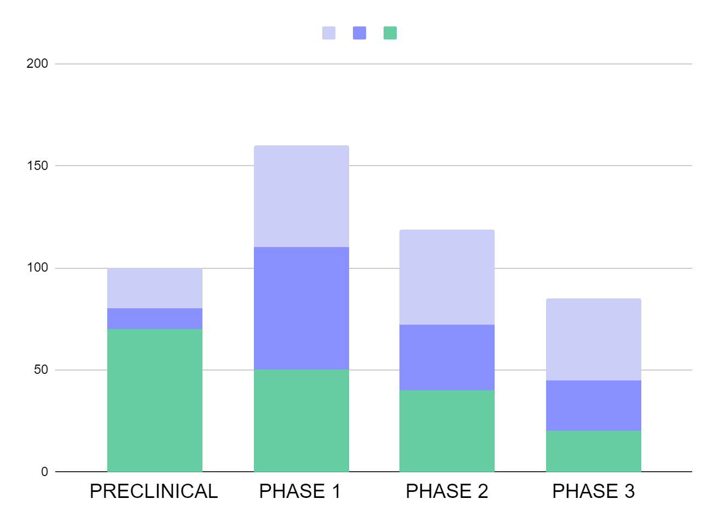

TENDENCY
Mercury is the closest planet to the Sun and the smallest one in our Solar System—it’s only a bit larger than our Moon
MERCURY
MARS
VENUS
If you want to modify this graph, click on it, follow the link, change the data and replace it here

Slide 28
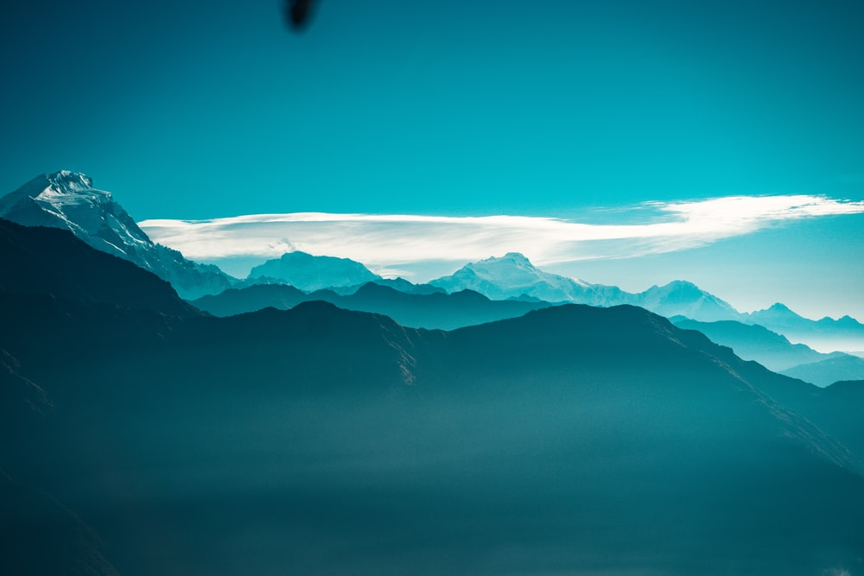
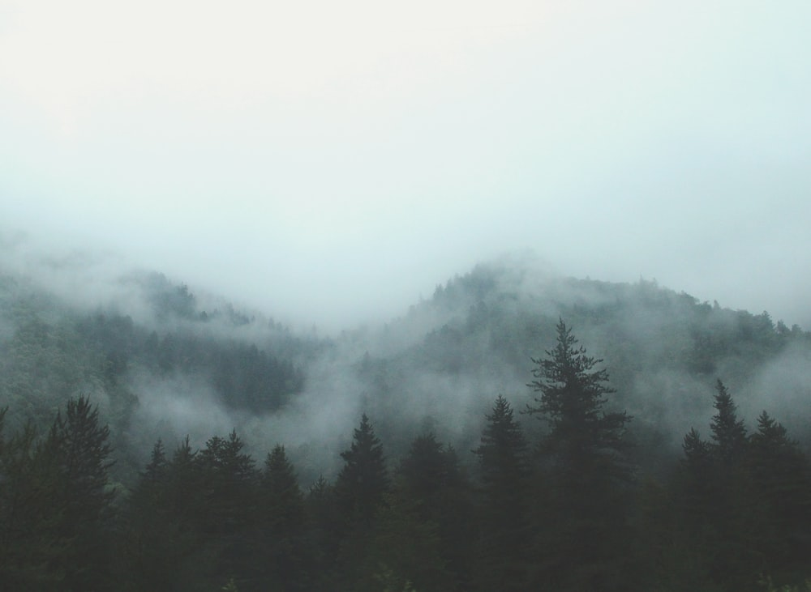
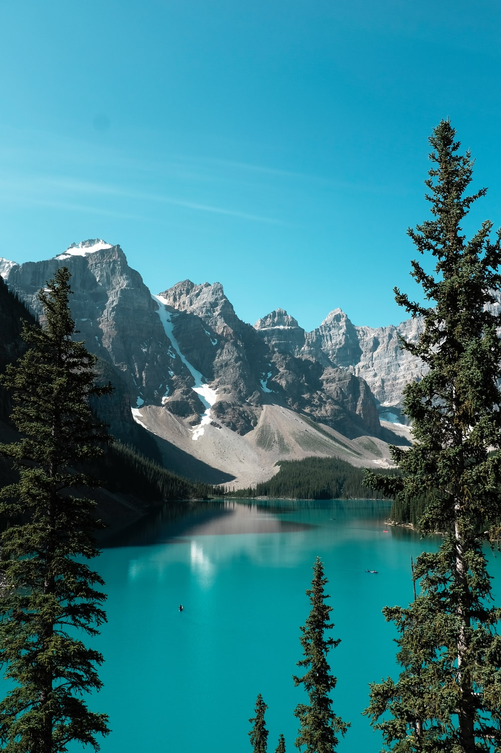
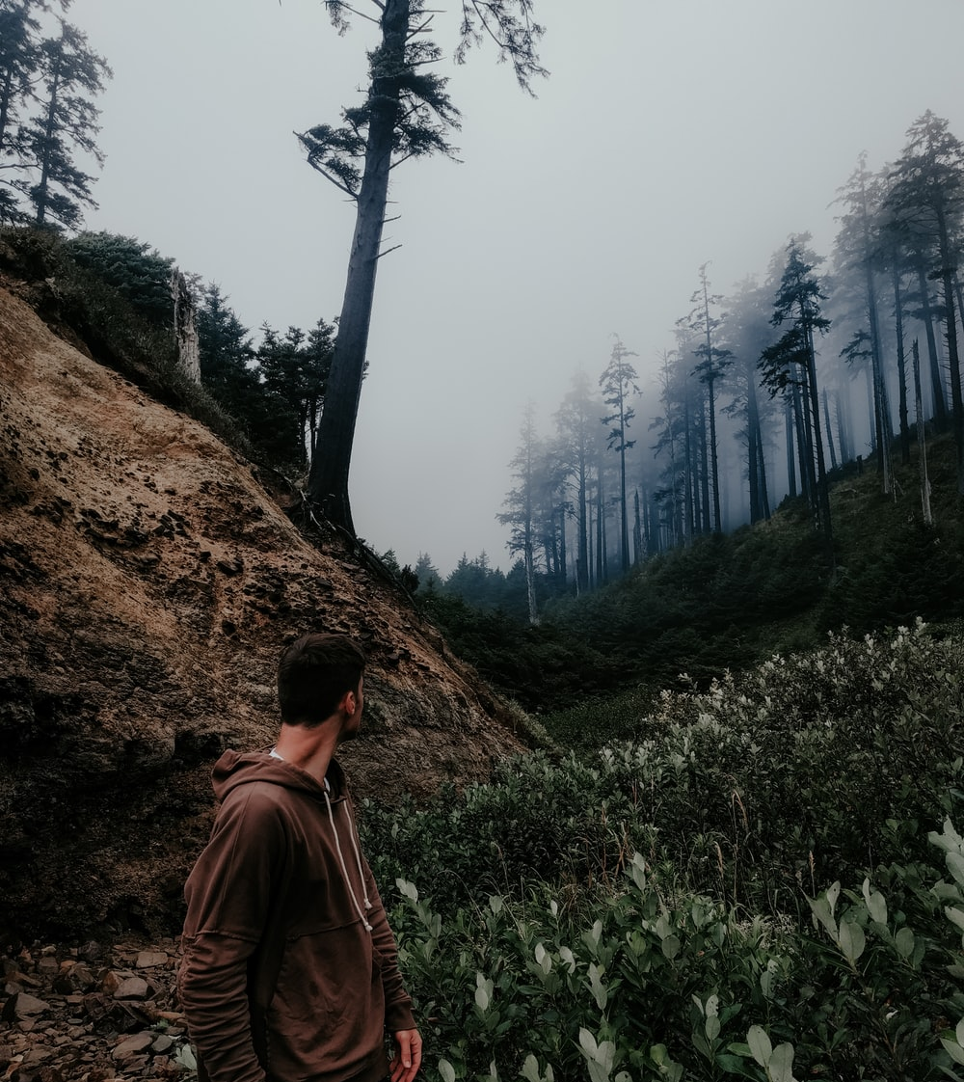
PROJECT 1
It’s the closest planet to the Sun and the smallest one in the Solar System—it’s only a bit larger than the Moon. The planet’s name has nothing to do with the liquid metal

Slide 29
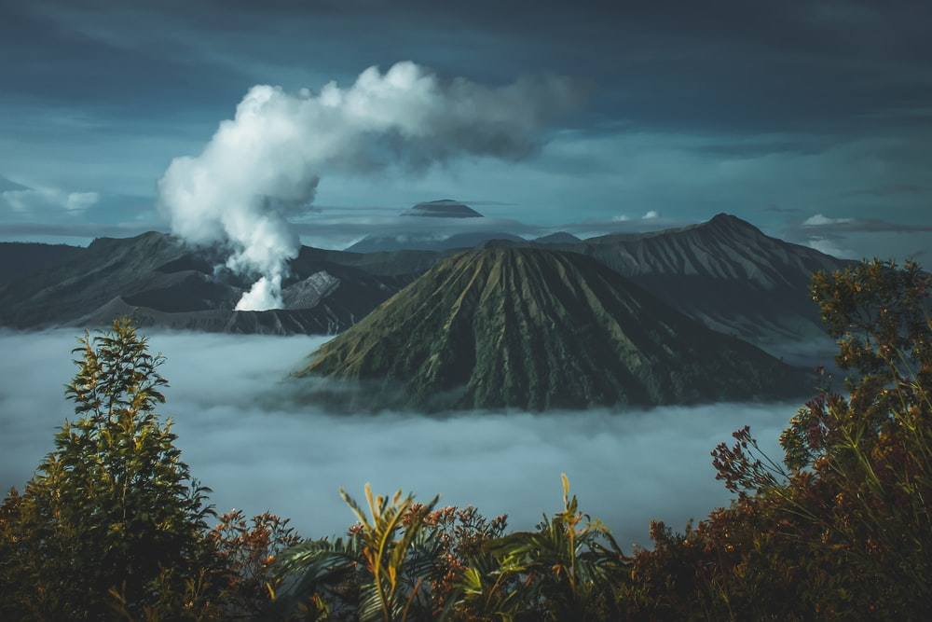
THANK YOU
Do you have any questions?
You can replace the images on the screens with your own work. Just delete these ones and add yours

Slide 30
FUENTE
ELABORADO POR : plantillaspowerpoint.org
IMAGES :
unsplash.com
FONTS :
Marvel
Assistant Light

Slide 31
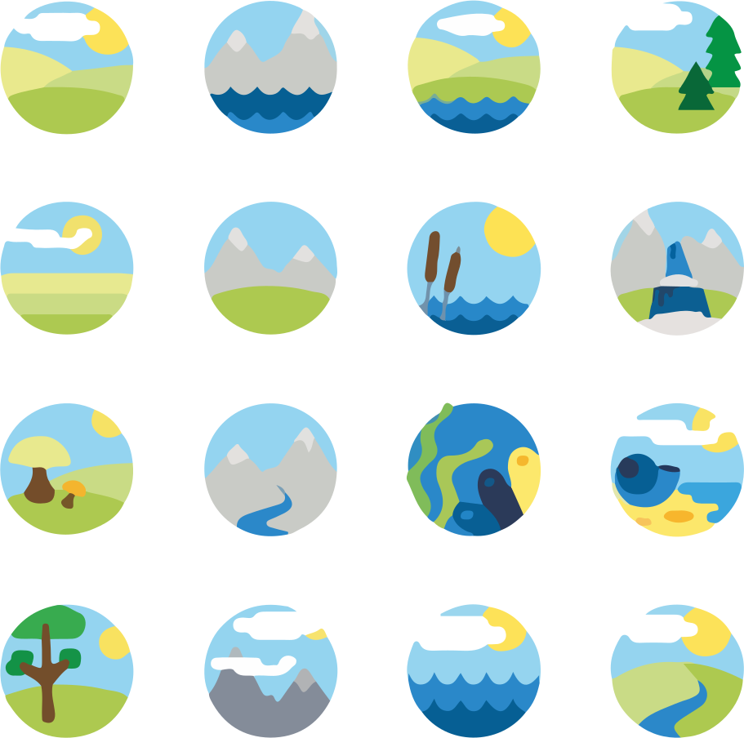
RESOURCES

Slide 32
RESOURCES

Slide 33
RESOURCES

Slide 34
Fully Editable Icon Sets: A

Slide 35
Fully Editable Icon Sets: B

Slide 36
Fully Editable Icon Sets: C

