Slide 1
Resume Breakdown

Slide 2
Disclaimer
This is an old and fake version of my resume made as an example, please do not distribute it outside of the class. You may freely use it as a reference for your own use.
These comments and tips are based on my experiences, online resources and comments from peers who are actively engaged in hiring

Slide 3
Lecture Goals
Go through a resume section by section
List the essential information expected in each section
Provide clear examples of how to frame achievements, skills and results

Slide 4
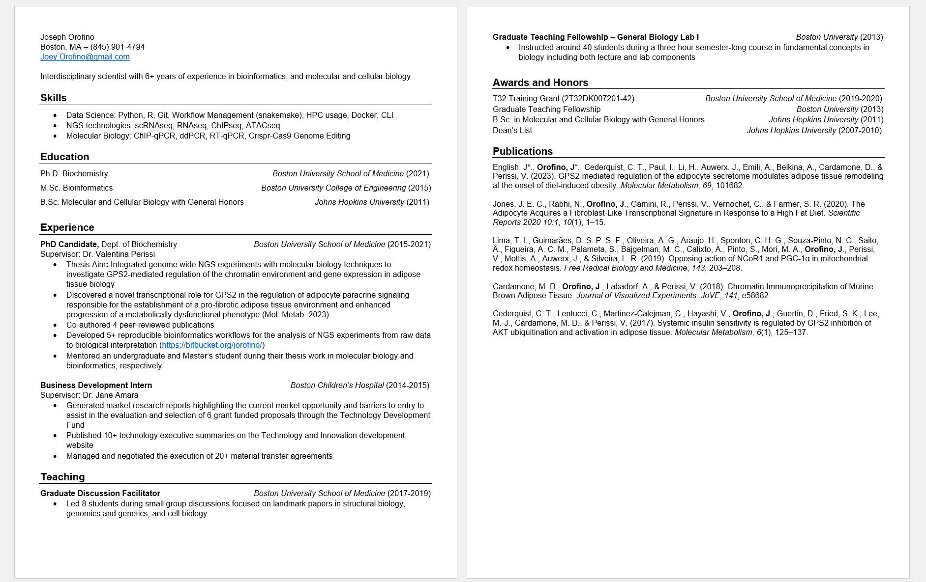

Slide 5
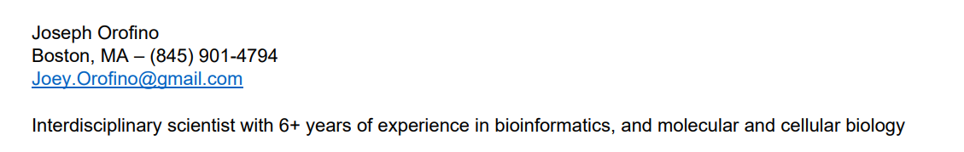
Required
Name
Location (general is fine, just so there are no questions about moving, etc.)
Contact Information (Phone and email)
Optional
Portfolios / Social Media (Github repos, LinkedIn)
Professional Summary / Objective Summary
  1-2 sentence statement encapsulating your most relevant experiences and immediate goals

Slide 6
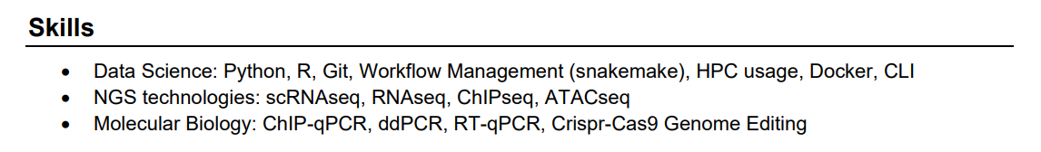
Make sure to include skills that are mentioned in the job description (spell them exactly the same)
Not meant to be exhaustive, choose the ones that you think are most likely to attract attention
Remove “assumed skills” like basic computer skills, soft skills, and languages (unless you’re at a conversational level or higher)

Slide 7
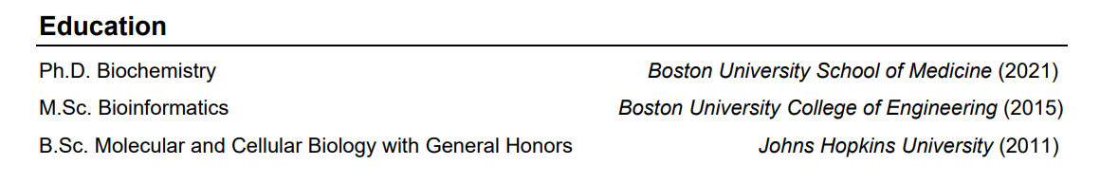
Degree name
University
Year of graduation
List in reverse chronological order
Include year of graduation or if still enrolled, expected graduation date
Early career you can list your GPAs, later on as you accumulate more work experience, it will not matter as much

Slide 8
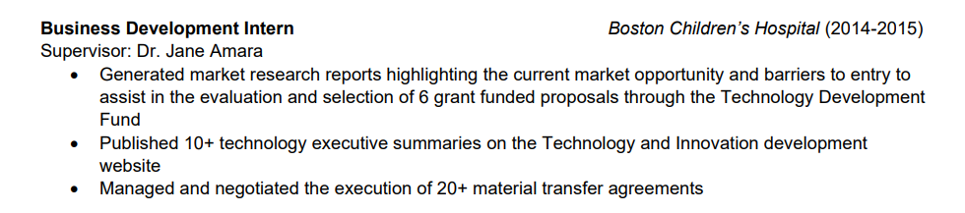
Quick formatting guide for research / work experience sections
Job / position title
Institution / Company and dates of employment
Name of PI / Supervisor
Bullet points with your main results / achievements. Use action verbs and quantify your results with numbers and real life examples when possible

Slide 9
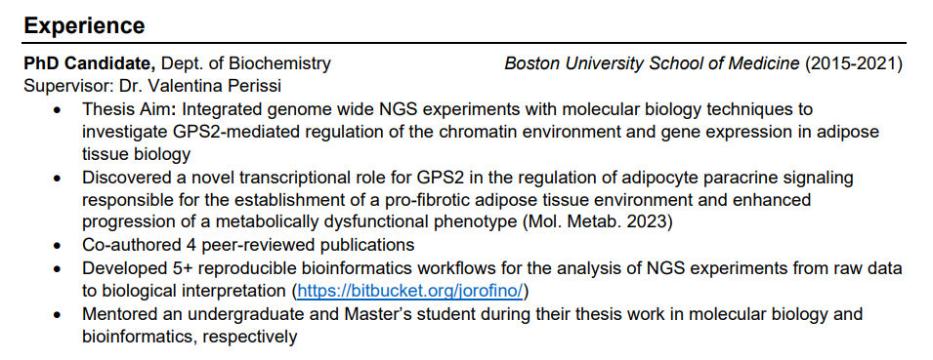
1
2
3
4
5
Consider using a summary statement of your project – a few sentences that quickly describe the high level goals of your work
Put your most important accomplishments first – in this case, I list my first author paper
Quantify your achievements – specific numbers seem more real and demonstrate your ability to produce tangible results
Provide real examples of your work – publications, code repositories, abstracts, etc.
Prove your soft skills using your accomplishments – mentoring students demonstrates management and leadership experience

Slide 10
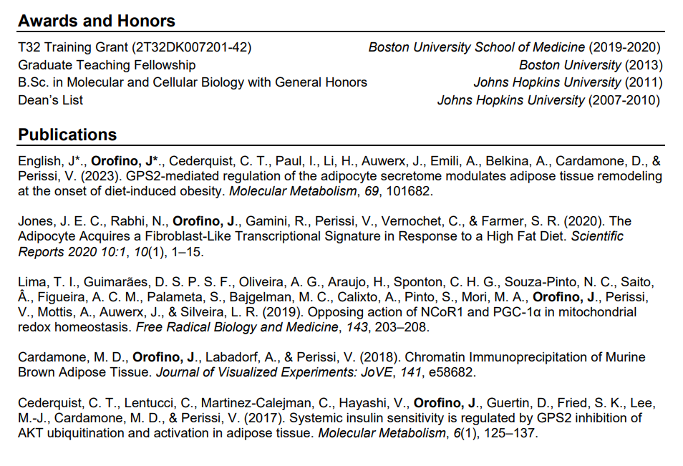
List in reverse chronological order
Highlight your important achievements

