Slide 1
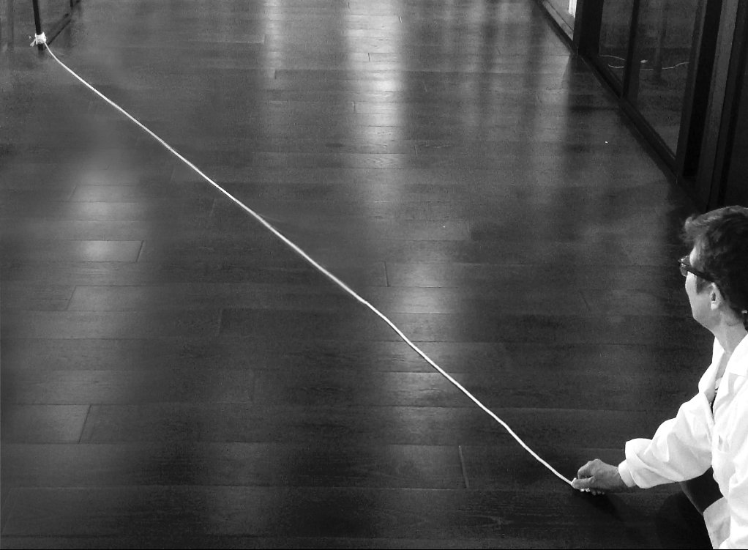
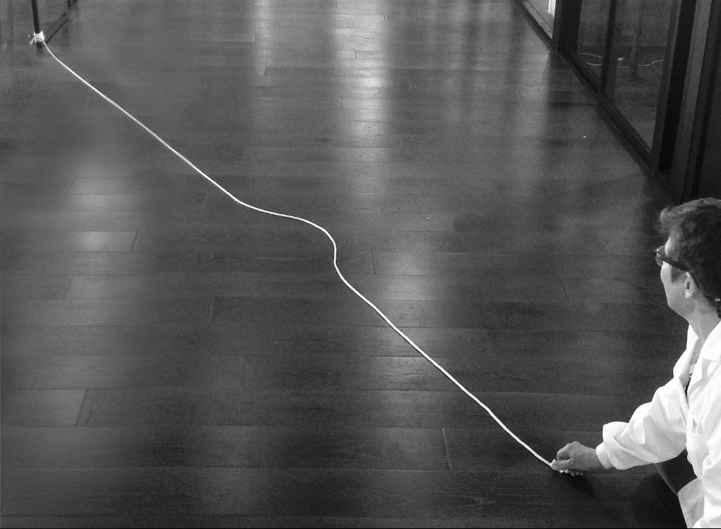

✎ Want to edit this or print? Go to File > Make a Copy, and edit away--or go to File > Print
Be the Vibration!
Name: ___________________
Step 1
Make sure you have all your supplies. Your experiment set-up should look like this:
1
Tie the rope at one end, or have someone hold it still.
Be sure you’re on a smooth, hard floor.
Get ready to vibrate!
Get ready to vibrate!
Step 2
Make a vibration by jerking your hand to the side and back. Try to make a wave that travels to the end of the rope.
2
Experiment with
how tight you pull the rope and how far you move your hand.
Take turns so everyone can try.
Why are some sounds high and some sounds low?

Slide 2
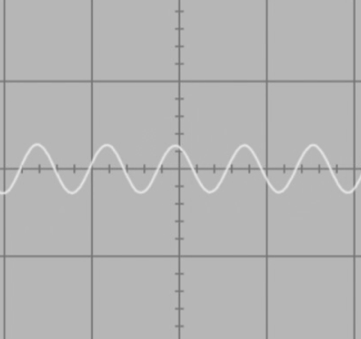
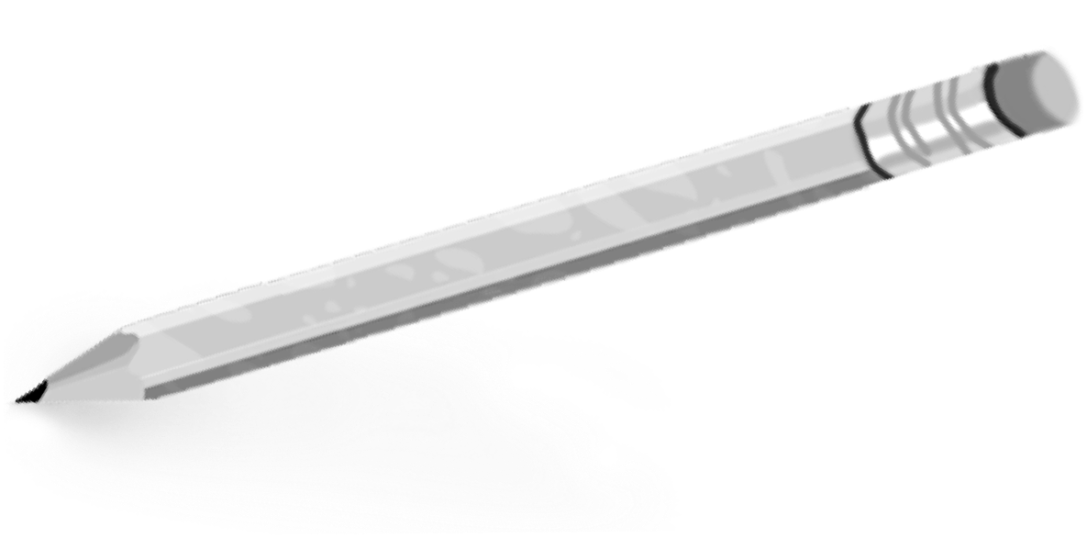
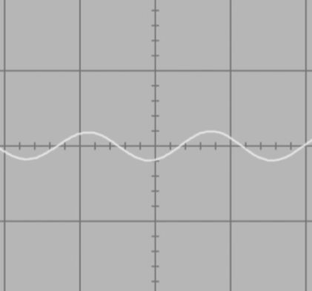
Challenge! Make waves that look like this oscilloscope picture of a high-pitched sound:
Step 3
3
How do you have to vibrate your hand to make waves that are squished together like this?
_______________________________________
Step 4
Challenge! Make waves that look like this oscilloscope picture of a low-pitched sound:
4
How do you have to vibrate your hand to make waves that are spread out like this?
________________________________________
Why are some sounds high and some sounds low?

