Slide 1
Instructional & Engagement Strategies
Principal Professional Learning
May 2024
Notes:
Presentation assignment:
Elementary- Lynne and Chris: Slides- Lynne-1-11, Chris 12-19, Lynne 20-23, Chris 24-28, Lynne 29-end
Secondary- Aaron and Craig
Afternoon- Lynne and Chris

Slide 2
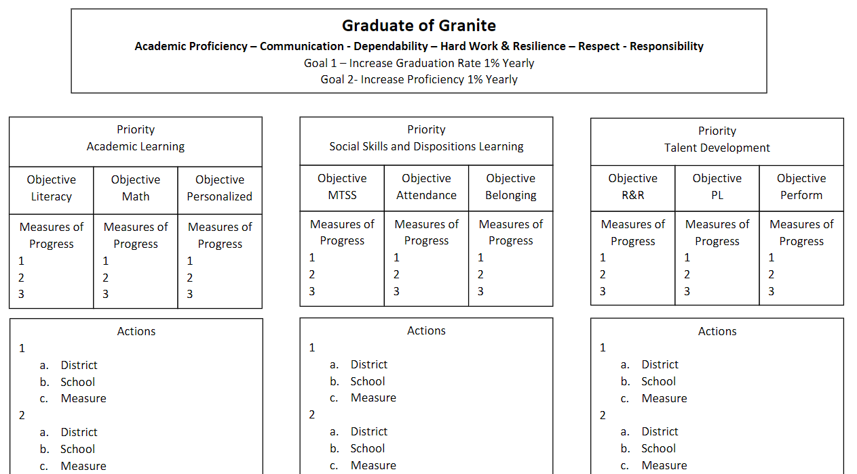
Notes:
Under 1 min

Slide 3
Quick Review of our Principal Professional Learning (PPL) 3-Year Cycle
Year 1- The “What” is good/great in Instruction
Year 2- The “What” is good/great in Learning Environment
Year 3- The “How” to Build Principal Capacity based on your
understanding of what is good/great
Notes:
Under 1 min

Slide 4
Domain 2: Collective Commitment to Learning
Domain 2: An educational leader promotes and is accountable for student success by advocating, nurturing, assessing and sustaining a school focused on teaching the Utah Core Curriculum. An educational leader provides a learning environment conducive to student, faculty, and staff growth through collaboration within a culture of learning.
2C. Instructional Practice
Works with individuals and a variety of groups to ensure the use of Utah Core Standards, the district provided tools, data in assessing student learning, collaborative problem solving, and adjustment to evidence-based instruction to meet student learning needs.
2D. Differentiated Instruction
Assists and monitors the effective use of the district’s framework for instruction and system of support for providing differentiated instructional strategies and appropriate resources to address a variety of student learning needs.
Leadership Standards
Click Here
Notes:
Under I min

Slide 5
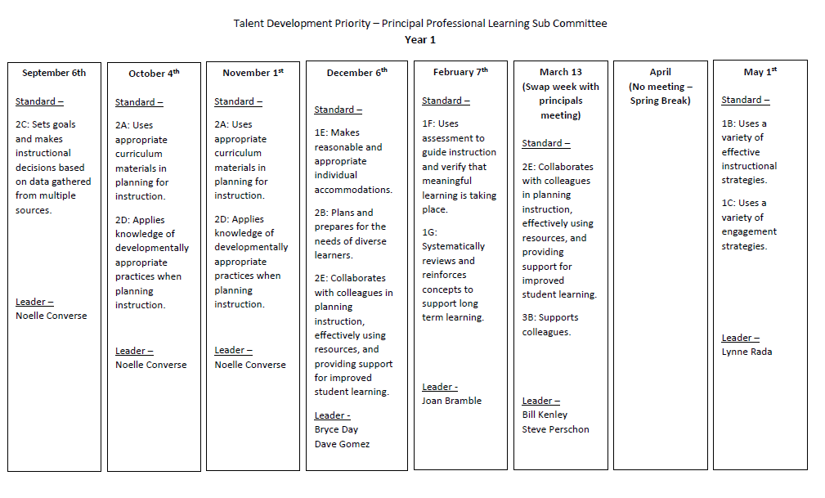
Notes:
-Under 1 min

Slide 6
Connection to Granite Educator Standards
Domain 1 - Instruction and Assessment
Educator Standard 1B. May Focus
The educator uses a variety of effective instructional strategies.
Includes, but not limited to:
Demonstrating proficiency in explicit instruction;
Selecting strategies that are developmentally and contextually appropriate (e.g. cooperative learning, teaming, and Sheltered English Strategies);
Enriching instruction through the proficient use of technology;
Assigning work and setting time limits; allowing sufficient time for mastery;
Using a variety of instructional materials and methods
Notes:
-1 min. Bullet 1- Add that in addition to explicit instruction, we also support an inquiry based model (not reflected in this standard) when appropriate.

Slide 7
Connection to Granite Educator Standards
Domain 1 - Instruction and Assessment
Educator Standard 1C. May Focus
The educator uses a variety of engagement strategies.
Includes, but not limited to:
Displaying enthusiastic, positive demeanor;
Modeling and encouraging positive interaction;
Eliciting confidence and respect;
Praising strengths and constructively addressing weaknesses;
Actively listening;
Connecting to cultural perspectives (e.g. gender,ethnicity, etc.)
Notes:
-1 min
What is the difference between instruction and engagement strategies? You will see during our presentation. Differences are: instructional strategies tend to be “inquiry-based versus explicit instruction.” Engagement strategies tend to be what the students are doing/focused on the students’ actions rather than the teachers’ actions.

Slide 8
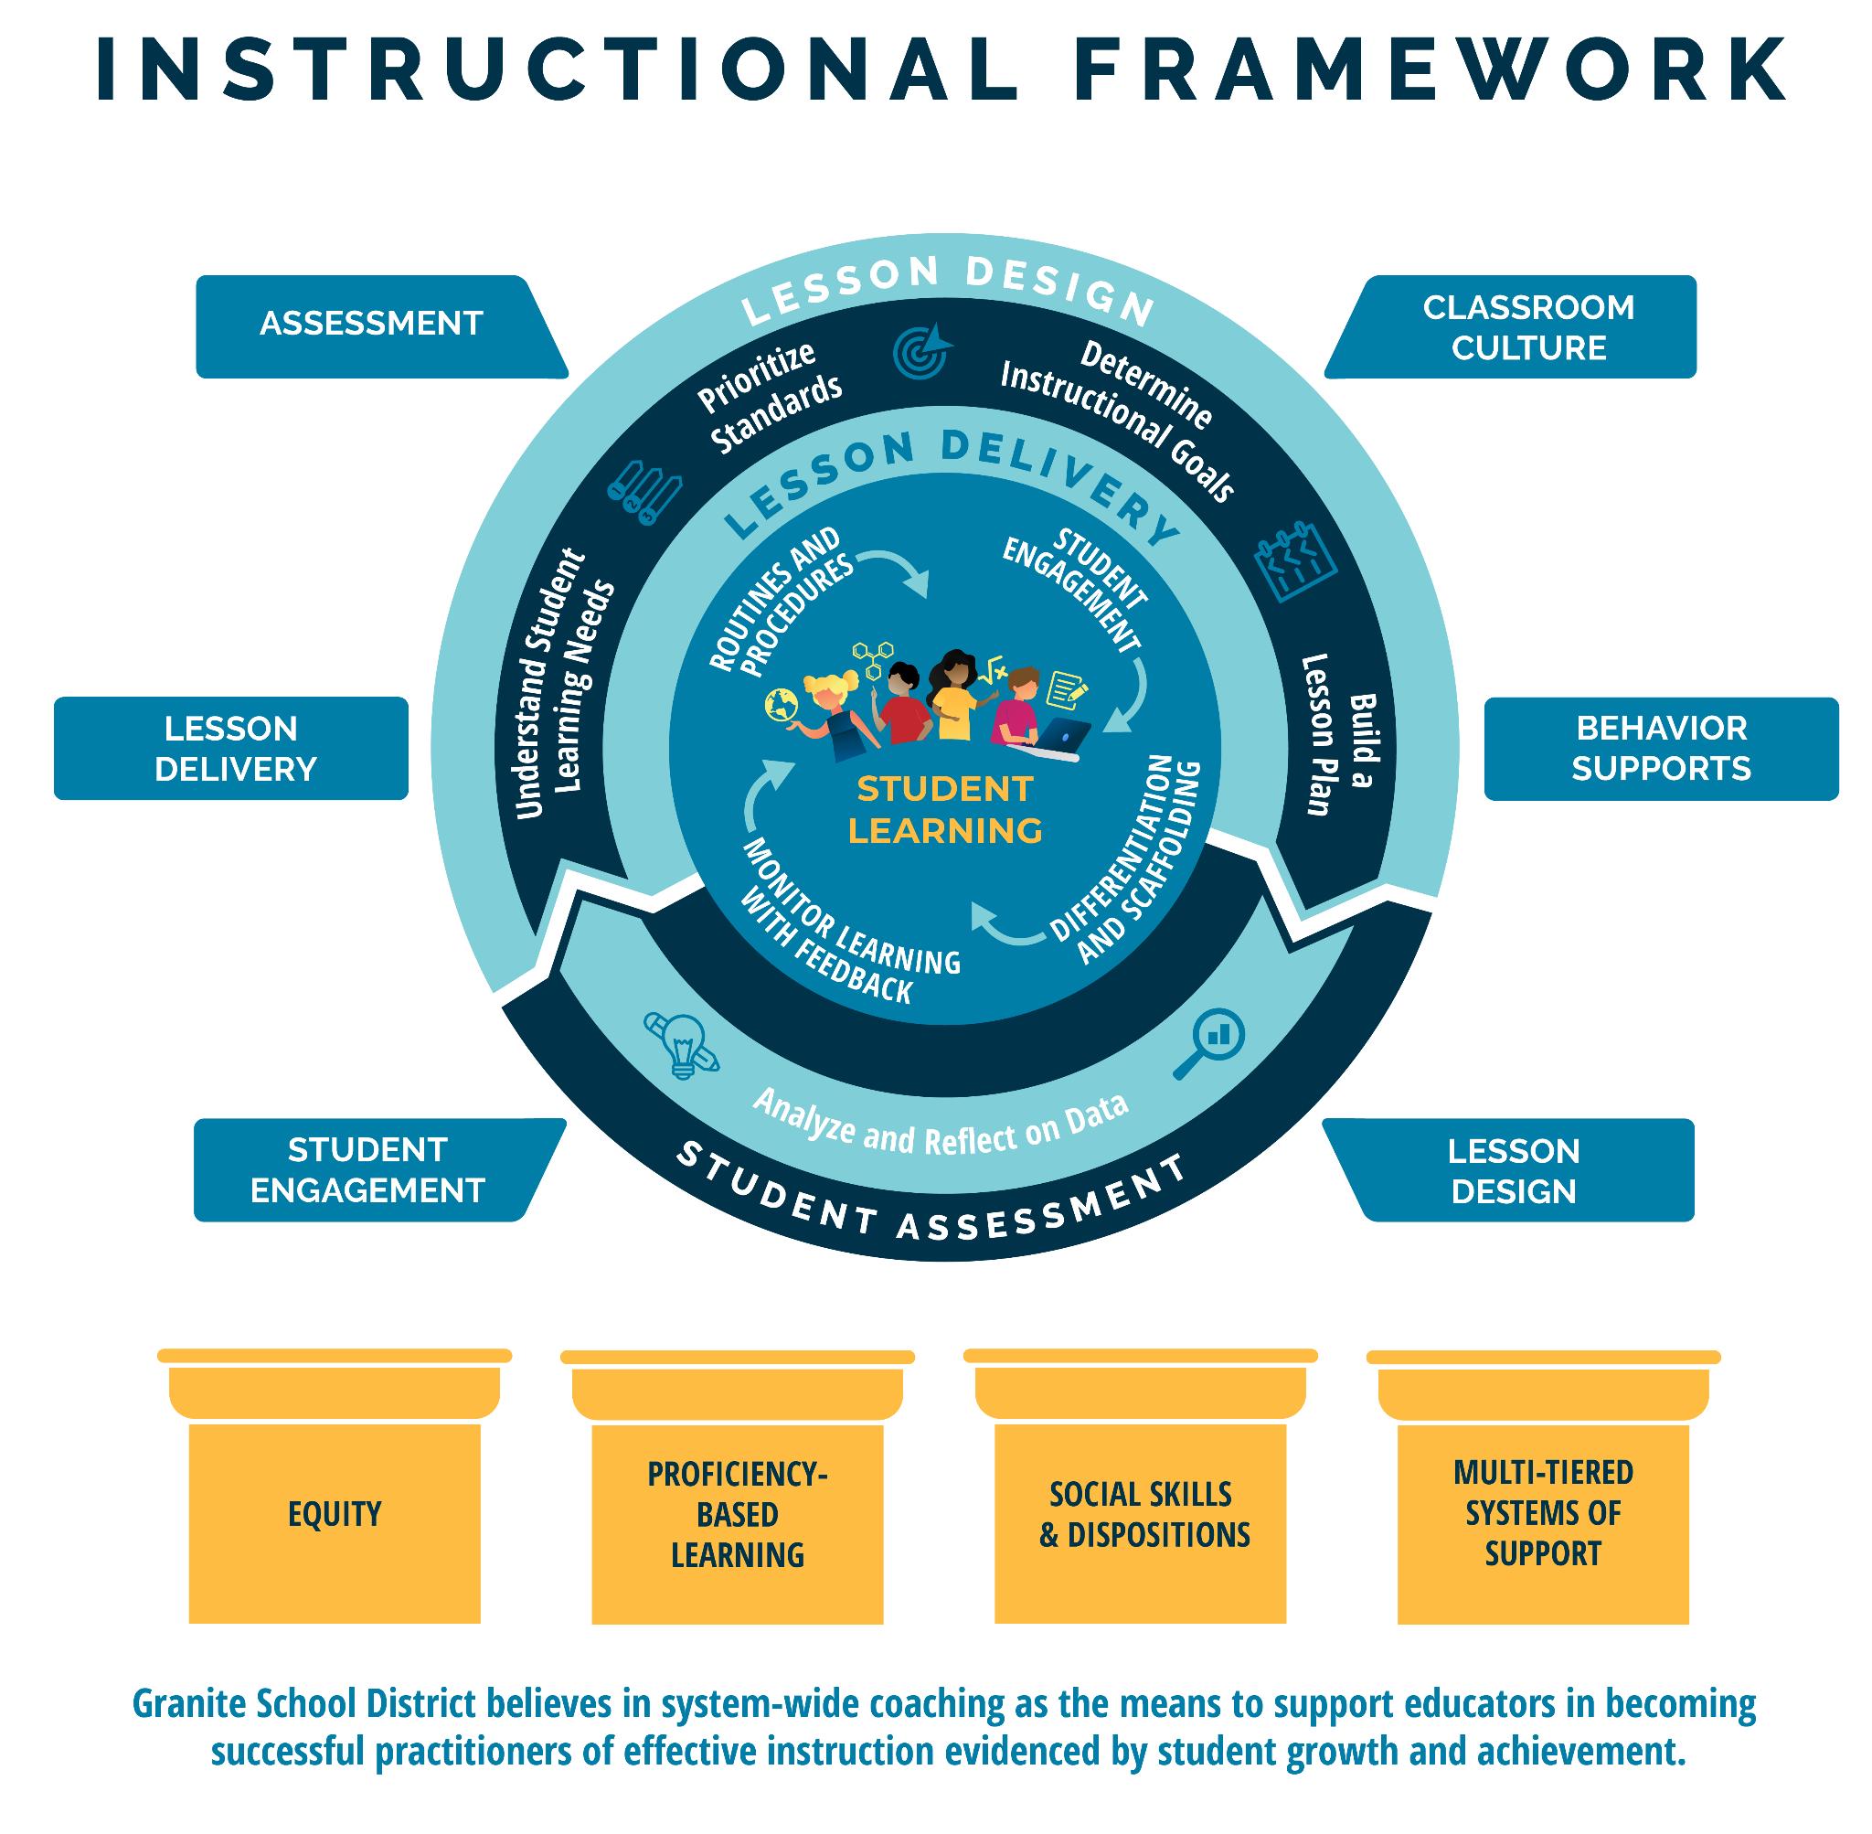
Notes:
-1 min. This is the Granite School District Instructional Framework. This framework is based on the evidence-based instructional practices embedded in the GSD Strategic Plan and represents all of Granite School District’s priorities. You will notice student learning is at the heart of the framework as it represents our commitment to student learning around which everything else is built. The framework features the basic elements of a high quality instructional cycle including Lesson Design, Lesson Delivery, and Student Assessment. You will notice the evidence-based practices at the lesson delivery level that we expect to see in what the teacher and the student are doing during the lesson. The high quality instructional cycle components are reinforced through ongoing, job-embedded coaching in: lesson design, student engagement, lesson delivery, assessment classroom culture and behavior supports, all of which contribute to meaningful learning and career and college readiness. The framework rests on the foundational pillars of Granite School District’s commitment to Equity, Proficiency-Based Learning, Social Skills and Dispositions and Multi-Tiered Systems of Support.

Slide 9
Notes:
-1 min.
As we zoom in, you will notice we are in the lesson design and lesson delivery area.
You will notice that central to Student Learning is the need to Monitor Learning with Feedback, Routines & Procedures and Student Engagement. Our Feb. PD focused on the monitoring of student learning. Today we will focus on Routines/Procedures & Student Engagement.

Slide 10
Sculpturades
This activity is well suited for vocabulary acquisition or review
Each person will have 2 minutes to create a sculpture that represents the given word.
When the time is up, each person will have 1 minute to share their sculpture with the group and explain why they chose this item to represent the word given.
Group then chooses the best sculpture to share with the class. The creator of this work is the spokesperson.
Notes:
12 min. Starter/Hook
(This activity is well suited for vocabulary acquisition)
Explain that we will modeling some engagement strategies throughout this presentation and they will be noted by the “engagement badge.”
Presenter explains activity and then gives the word.
Word is: Engagement

Slide 11
Objectives
Principals will be able to:
Understand how engagement is increased with high levels of student attention and commitment.
Identify and coach teachers in the selection of appropriate instruction and engagement strategies.
Notes:
-1 min
Goal : 1. Student engagement is high levels of Attention and Commitment 2. Intentional and thoughtful learning tasks/strategies is critical to achieve high attention and commitment.

Slide 12
join.nearpod.com
Code: je2ra
https://app.nearpod.com/?pin=je2ra
Notes:
5 minutes: Reminder of January 2022 PD where we introduced Schlechty’s Levels of Engagement.
Stop at 0:47 - How often was this your experience as a student? How often do you see this type of engagement at your school?
Stop at 3:29 - Multiple choice question: which level engagement do you see most often in classroom?

Slide 13
Notes:
5 minutes: Reminder of January 2022 PD where we introduced Schlechty’s Levels of Engagement.
Stop at 0:47 - How often was this your experience as a student? How often do you see this type of engagement at your school?
Stop at 3:29 - Multiple choice question: which level engagement do you see most often in classroom?

Slide 14
Notes:
2 minutes
When we go into classrooms, what level of engagement is most often seen? (Ritual or Strategic Compliance) How do we coach our teachers to move from this level to authentic engagement?

Slide 15
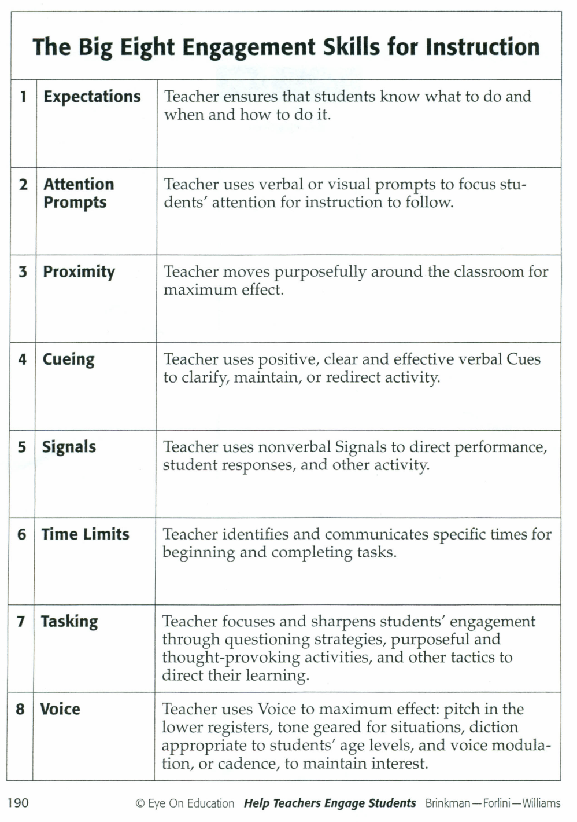
Does implementation of these strategies get us to the highest level of engagement?
Notes:
2 Min. Reminder of Big 8 Strategies-do these alone get us to the level of high engagement? While Big 8 strategies are good strategies (if you look through them, you will notice that…) they focus on increased compliance.
These strategies alone are not going to get us a truly engaged student that is committed. This is focused on attention in the classroom (not their commitment).

Slide 16
Vocabulary for Today
Attention: the idea that a student should be focused on a specific task, without getting distracted.
Commitment: the idea that a student should find the task intrinsically motivating and challenging and therefore work towards mastering it.
Notes:
1 min. -While the Big 8 strategies help with increasing a student’s attention, they don’t address the need for student commitment. Throughout today’s presentation, we will discuss different ways to address both of these important factors for authentic student engagement.
The rest of our presentation will be framed with these two constructs: garnering student attention and student commitment.

Slide 17
Strategies for Increasing Attention and Commitment
Ways to increase attention:
clear expectations
attention prompts
positive cueing
signals
time limits
tasking
voice
opportunities to respond
Ways to increase commitment:
student choice
relevancy
challenge/rigor
connecting to students’ background knowledge and lived experiences (meaning)
communicating value beyond the grade
Notes:
1 min. -Clarify that some of these strategies can increase both attention and commitment depending upon how they are implemented and utilized.
Left side: Big 8 strategies
Right side: (read list)

Slide 18
Student Engagement is the result of effective instruction and an effective learning environment.
Instruction consists of lesson design and delivery.
Learning environment includes classroom culture and behavior supports.
Notes:
1 min-Student Engagement is the result of effective instructions and an effective learning environment.
When both of these things are strong, we have true engagement.

Slide 19
Student Engagement is the result of effective instruction and an effective learning environment.
Instruction consists of lesson design and delivery.
Learning environment includes classroom culture and behavior supports.
Attention and Commitment can be built into both instruction and learning environment to lead to higher levels of engagement
Notes:
1 min-(read blue box)
This slide links the 5 foundational teaching skills to Schlechty’s model of Engagement and the need to address both the attention and commitment within Instruction and Learning Environment. How do we do this?
We need to build attention and commitment into all of these components

Slide 20
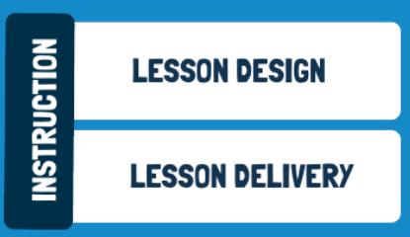
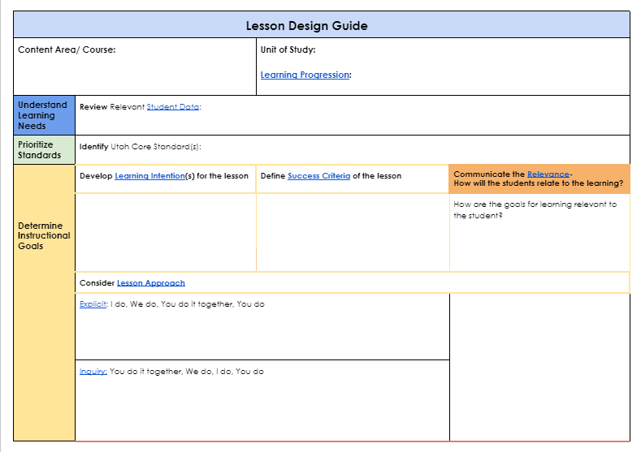
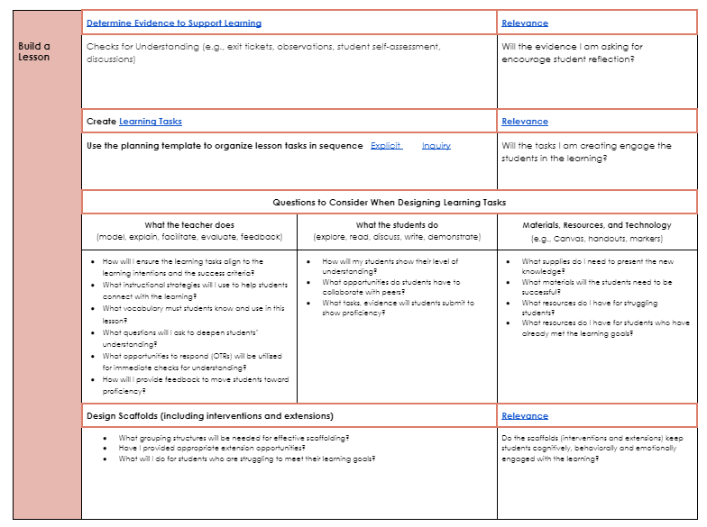
Teachers Plan the Learning Tasks
Notes:
-1 min.
Teacher should plan for the Learning Tasks/ engagement strategies that they will use during a lesson. This portion of the lesson design guide can be seen in the Create Learning Tasks. These documents are linked in the above graphics.

Slide 21
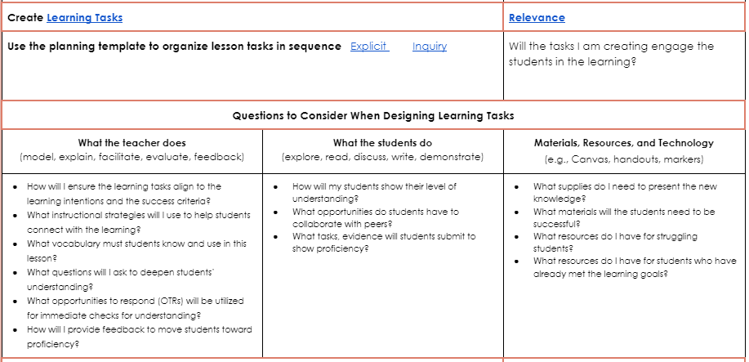
Notes:
1 min. Here you see pg. 2 of the Lesson Design Guide. There is an Explicit and Inquiry-Based Instruction Plan where teachers can plan for the instructional strategies they will use & learning tasks/ engagement strategies that will be part of their lesson. Teachers should select these tasks/strategies according to their desired learning intention and specified success criteria. The questions to consider when designing these learning tasks are: 1. What will the teacher be doing? 2. What will the students be doing? 3. What Materials.Resources and Technology will be used? They choose whether the lesson will be explicit or inquiry based. That takes them to the lesson templates on the next slide…
The learning tasks they choose are according to their learning objectives and success criteria. They help with the attention piece.
The relevance is how we add commitment (not yet defined). We have to start with one and we started with attention first.

Slide 22
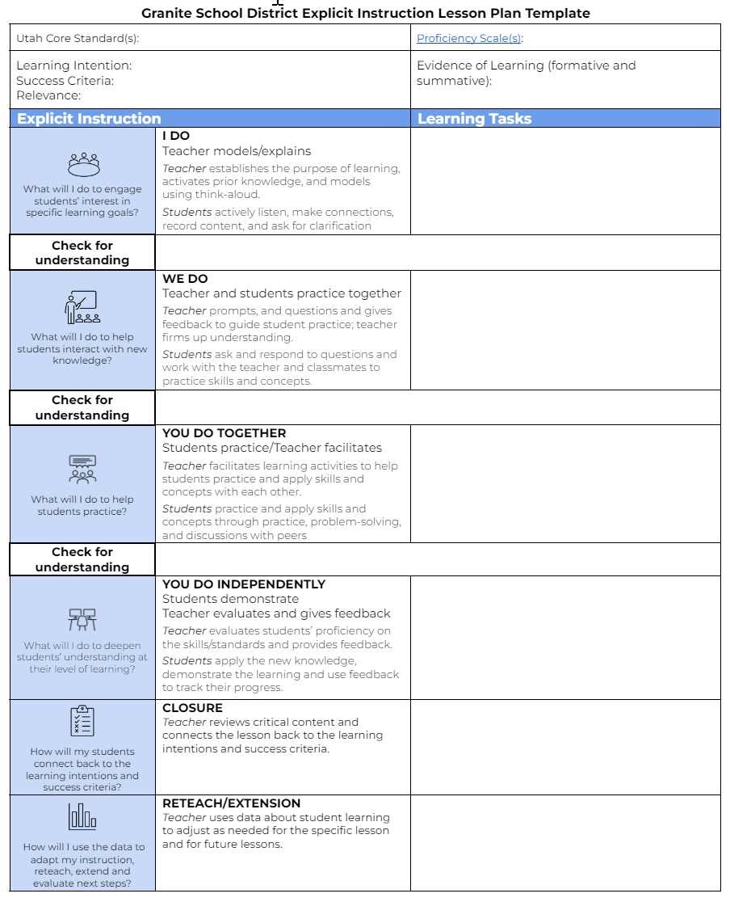
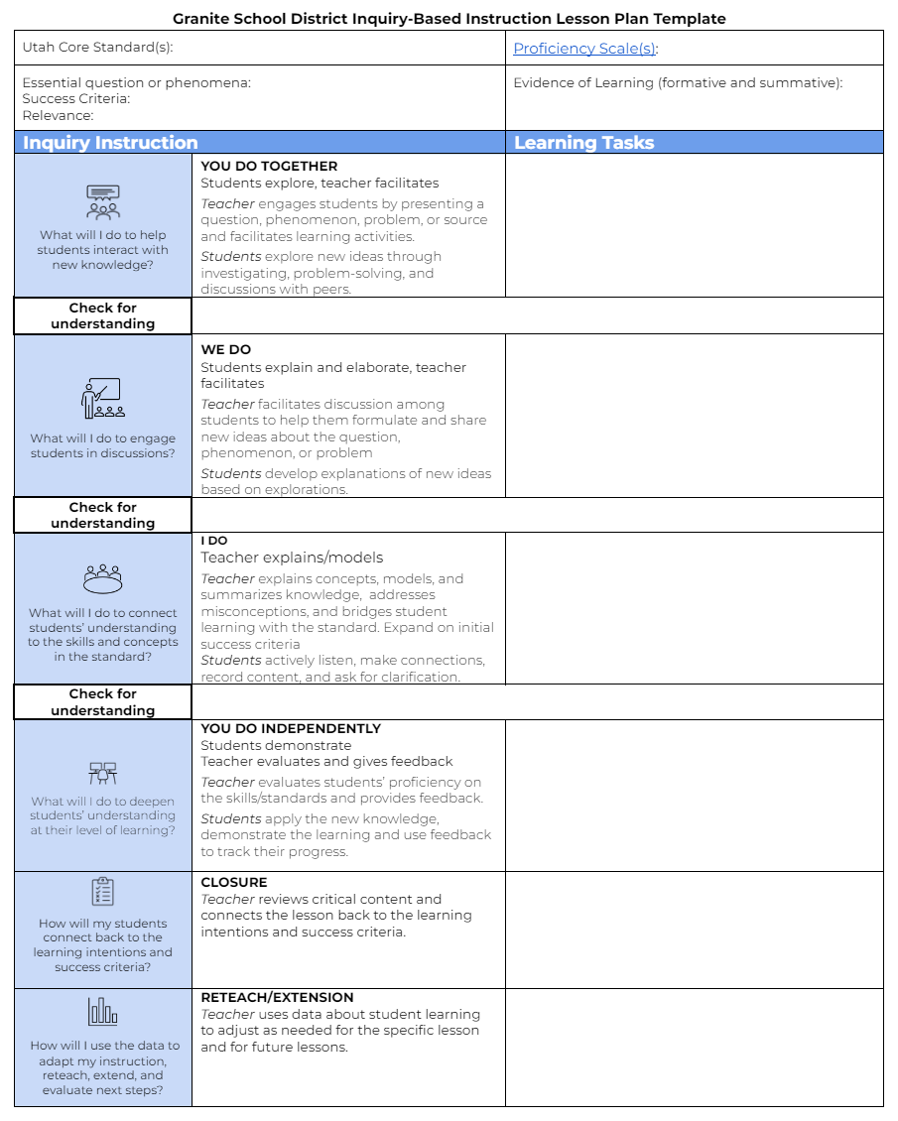
Lesson Design: Explicit and Inquiry-Based Instruction Plans
Explicit Instruction Plan
Inquiry-Based Instruction Plan
Reflective Questions
What learning tasks are used?
Is this an appropriate task(s) for the Learning Intention/Success Criteria?
What will the teacher be doing? What will the students be doing? What materials, resources & tech?
Notes:
2-3 min. There is an Explicit and Inquiry-Based Instruction Plan where teachers can plan for the instructional strategies they will use & learning tasks/ engagement strategies that will be part of their lesson. Learning tasks should be considered for each stage (throughout) of the lesson (gradual release) (there should not be one learning task for each stage of the lesson) Teacher should select these tasks/strategies according to their desired learning intention and specified success criteria.
The questions that should be considered by the teacher during lesson planning are:
What learning tasks are used?
Is the task appropriate for the learning intention and success criteria?
Will will the teacher be doing? What will the students be doing? What materials, resources etc.
Lesson Design month PD

Slide 23
What types of Learning Tasks increase students’ Attention?
Writing
taking notes
working out math equations
writing essays, research projects, stories
filling out graphic organizers
Physically Doing
using a total physical response
drawing
creating (i.e. artwork)
working on a Chromebook
creating slides
playing a game
Saying/Asking
inquiry-based learning
think-pair-share
interviewing a peer
group work
KWL
seeking help from a teacher
Notes:
2-3 min Now we are going to shift to the delivery piece.
Activities that an observer could see a student doing increase attention. Many schools refer to these strategies as Opportunities to Respond (OTR’s).
This list is not exhaustive. Here are some examples what we are talking about…

Slide 24
join.nearpod.com
Code: je2ra
https://app.nearpod.com/?pin=je2ra
Notes:
5 minutes: Reminder of January 2022 PD where we introduced Schlechty’s Levels of Engagement.
Stop at 0:47 - How often was this your experience as a student? How often do you see this type of engagement at your school?
Stop at 3:29 - Multiple choice question: which level engagement do you see most often in classroom?

Slide 25
Which strategies did the teacher utilize?
Notes:
10 minutes:. Play video of Albert Ferrons Font using student engagement strategies in the classroom. Nearpod Activity (Highlight strategies). Teacher shares responses in Nearpod.
Activity: identify what strategies they saw in the lesson.

Slide 26
The title of the specific strategy may differ depending on the brand…this doesn’t matter if the focus of the teacher is always reflecting upon:
What learning tasks did I choose to increase attention, commitment, and monitor learning?
Are students;
WRITING something?
SAYING something?
PHYSICALLY RESPONDING to something?
Are the learning tasks consistent
with the objective?
Notes:
2 min.-
Some examples (Branding): AVID, OTR’s.
There are lots of different strategies that are marketed or branded differently.
-Ex: turn and talk and think pair share are the same strategy
-Don’t get hung up on the title of the strategy. The focus should be on these things…

Slide 27
Attention and commitment are also components of a learning environment that is enhanced with:
clear expectations for behavior
focus on relevance
challenge/rigor
choice
Notes:
1 min-
(These are all ways we can increase both attention and commitment, but more so on commitment)

Slide 28
As an observer, when you have seen engagement strategies that have been ineffective, why?
It’s important to teach procedures/skills of the learning tasks.
Notes:
5 min total
Often called Turn & Talk OR Think, Pair, Share. Discuss with a partner. Choose 3 people to share with group. Hopefully this leads to the importance of teaching students expectations and procedures on how to engage/collaborate.

Slide 29
How do we explicitly teach students the skills and procedures needed to increase their commitment to the learning?
AVID Sentence Stems
Sentence Stems
Notes:
8 min.
This clip shows a teacher who established, taught and reinforced clear expectations for the group discussion. Watch video (4 min).
This is not just the procedures of the classroom (how to ask for a hall pass). These are academic procedures (i.e. for group discussion). These procedures will be sentence stems.
Having clear expectations will remove barriers for students being committed to the classroom.

Slide 30
Scenario Activity
How would you coach a teacher through the scenario on the card at your table?
Procedures
The person with the shortest hair at your table reads the scenario out loud to the group.
The person to the right of the reader plays the role of the principal in the scenario.
The person to the left of the reader plays the role of the teacher in the scenario.
The principal begins the conversation with the teacher by leading the discussion with an opening question.
The coaching sentence stems may be helpful for the principal.
Remaining group members provide feedback after the role play activity.
Guiding question: What questions might you ask a teacher that would help them increase opportunities for engagement?
Notes:
15 min.
Final activity: we understand strategies and how to increase attention and commitment through lesson design and delivery… now how do we coach a teacher?

Slide 31
SCENARIO 1
A teacher gives five minutes of instruction and then tasks the students with completing a 45-minute activity on their Chromebooks.
SCENARIO 4
Teacher shares a 30-minute video and instructs students to watch.
SCENARIO 2
Students are told to complete an assignment in a group for 20 minutes. Some of the students are working, while others are off task.
SCENARIO 3
The teacher tells the students that they have five minutes to complete a task independently. Two of the students put their heads down and three more begin acting out. The teacher signals for the activity to end after 15 minutes.
Notes:
What questions might you ask that would help a teacher to see what shifts could be made by increasing opportunities for engagement & teaching and clarifying expectations?

Slide 32
Plan for engaging learning tasks
Relevance - why?
Choice
Use various strategies
Clear expectations and procedures for engaging activities
Challenge / Rigor
Notes:
1 min.-
This slide links the 5 foundational teaching skills to Schlechty’s model of Engagement.

Slide 33
In your classroom observations, what will you look for regarding instructional strategies & efforts to increase student engagement?
Notes:
2 min.

Slide 34
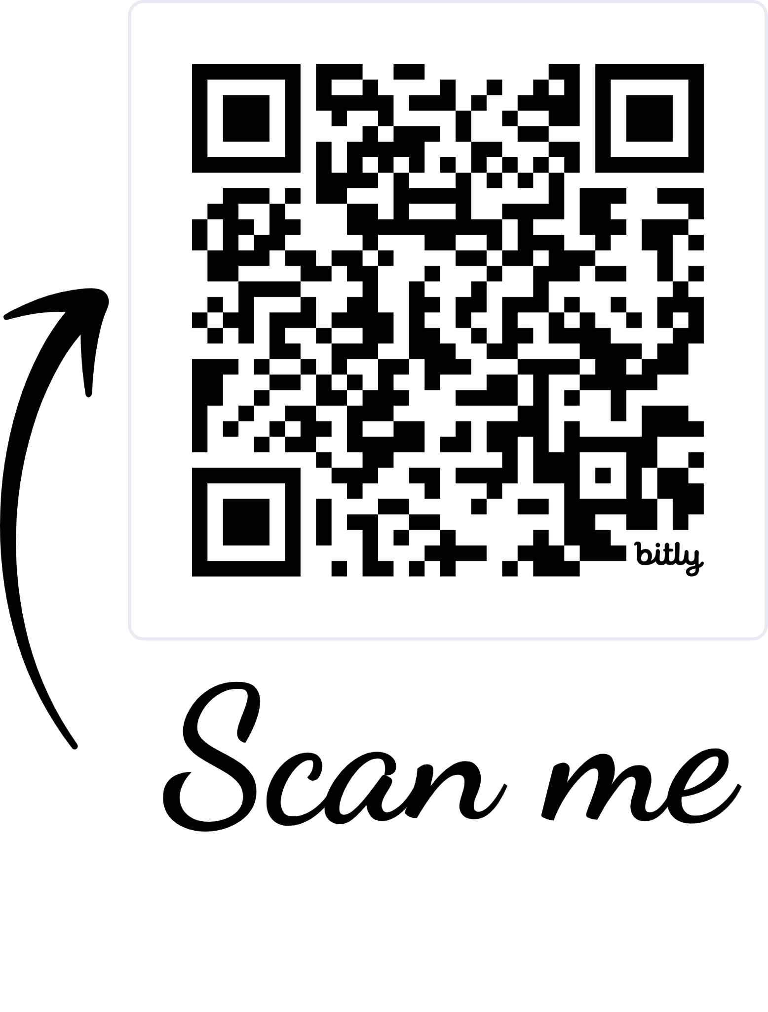
Principal Professional Learning Survey
Please give us your feedback:
Survey
Notes:
3 min
Is this the same qr code each month or do we need to update it?

Slide 35
Links to Tools and Resources
Reflection Journal Link
Instructional Framework
Lesson Design Website
Lesson Design Guide
Lesson Approaches
Granite Teacher Support
Checks for Understanding Idea List
Levels of Engagement
Opportunities to Respond
Engagement Strategies with Hyperlinks
Strategy Cards
Student Task Cards
Commitment in the Classroom Article

