Slide 1
How to manage
financial risk
This session is aimed at Year 9 and is also appropriate for KS4 and KS5

Slide 2
Unit outline
Session 1 | Session 2 | Session 3 | Session 4 | Session 5 | Session 6
Mobile phone products | Cryptocurrency | Financial exploitation | Online gaming | Online safety | Pocket money debate

Slide 3
Having a respectful learning environment
We will listen to each other respectfully
We will avoid making judgements or assumptions about others
We will comment on what has been said, not the person who has said it
We won’t put anyone on the spot and we have the right to pass
We will not share personal stories or ask personal questions
If there is a question that you do not wish to ask aloud, you can write it on a post-it note which will be collected throughout the session and answered at the end
Notes:
Teacher delivery
Students should be invited to ask questions and they should be provided with an opportunity to ask questions anonymously. It is useful to have a question box or allocated space on the whiteboard for students to share questions.
It is suggested that students are provided with post-its or slips to write their questions on and as the teacher circulates throughout the lesson these questions can be collected and answers throughout the session or using an allocated ‘question time’ at the end of the session.
Students can be invited to respond to questions asked by their peers. If responses to questions are based on personal preference or opinion, the teacher should be clear to preface any answers with this.

Slide 4
Session 3:
Financial exploitation

Slide 5
By the end of the session, I will be able to:
Identify situations where young people are vulnerable to exploitation
Explain the impact of financial exploitation
Rehearse strategies to respond to unwanted pressures

Slide 6
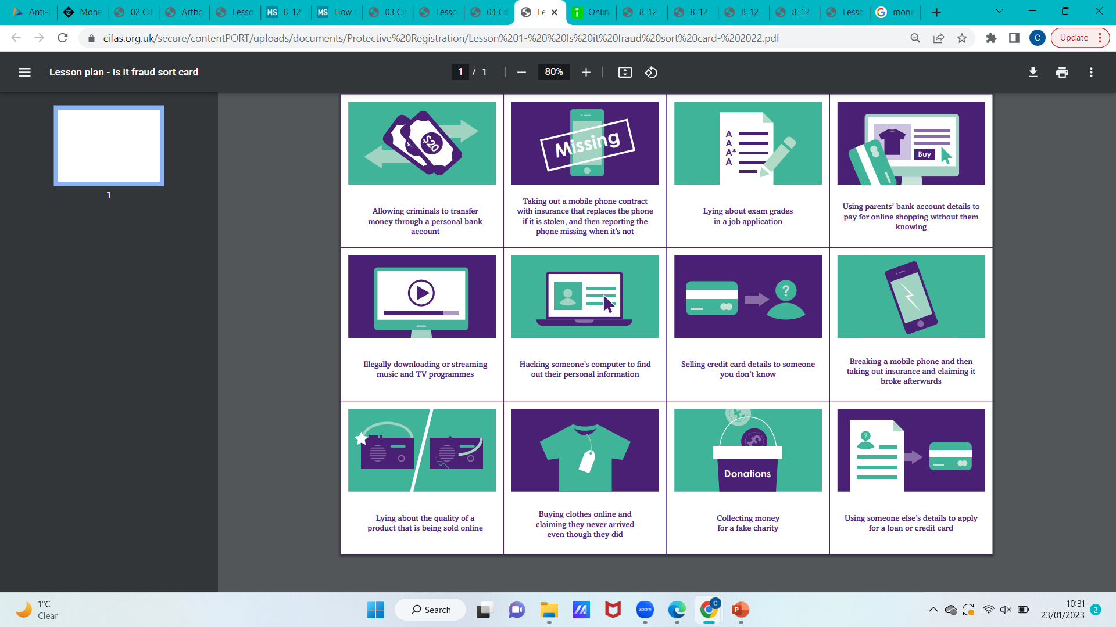
What is fraud?
Read the scenarios below
Discussion: Are there any problems with what is being described?
Using parents’ bank account details to pay for online shopping without them knowing
Allowing a stranger to transfer money through a personal bank account
Giving credit card details to someone you don’t know
Source: adapted from https://www.cifas.org.uk/
Notes:
Source here
NB:
If anything in students’ responses indicates risk / safeguarding concern, e.g. mention that they have been exposed to/invited to engage in similar activities, report to safeguarding

Slide 7
What is fraud?
Fraud is “wrongful or criminal deception intended to result in financial or personal gain.”
Using parents’ bank account details to pay for online shopping without them knowing
Allowing a stranger to transfer money through a personal bank account
Giving credit card details to someone you don’t know
The scenarios described are examples of making personal account details vulnerable to criminal activity.
Just borrowing card details from your parent or carer is technically a crime
Source: adapted from https://www.cifas.org.uk/
Notes:
Source here
NB:
If anything in students’ responses indicates risk / safeguarding concern, e.g. mention that they have been exposed to/invited to engage in similar activities, report to safeguarding

Slide 8

Young people and fraud
Financial troubles can arise quickly, especially if someone doesn’t recognize the warning signs or know how to protect themselves.
We'll follow two young people over five days to see what happens.
As you go through the information, note any signs of financial exploitation.

Slide 9

Young people and fraud
Yaz and Adnam are best friends.
They always meet at Adnam's house and then walk to school together.
After school they always meet in the playground and walk home together.

Slide 10
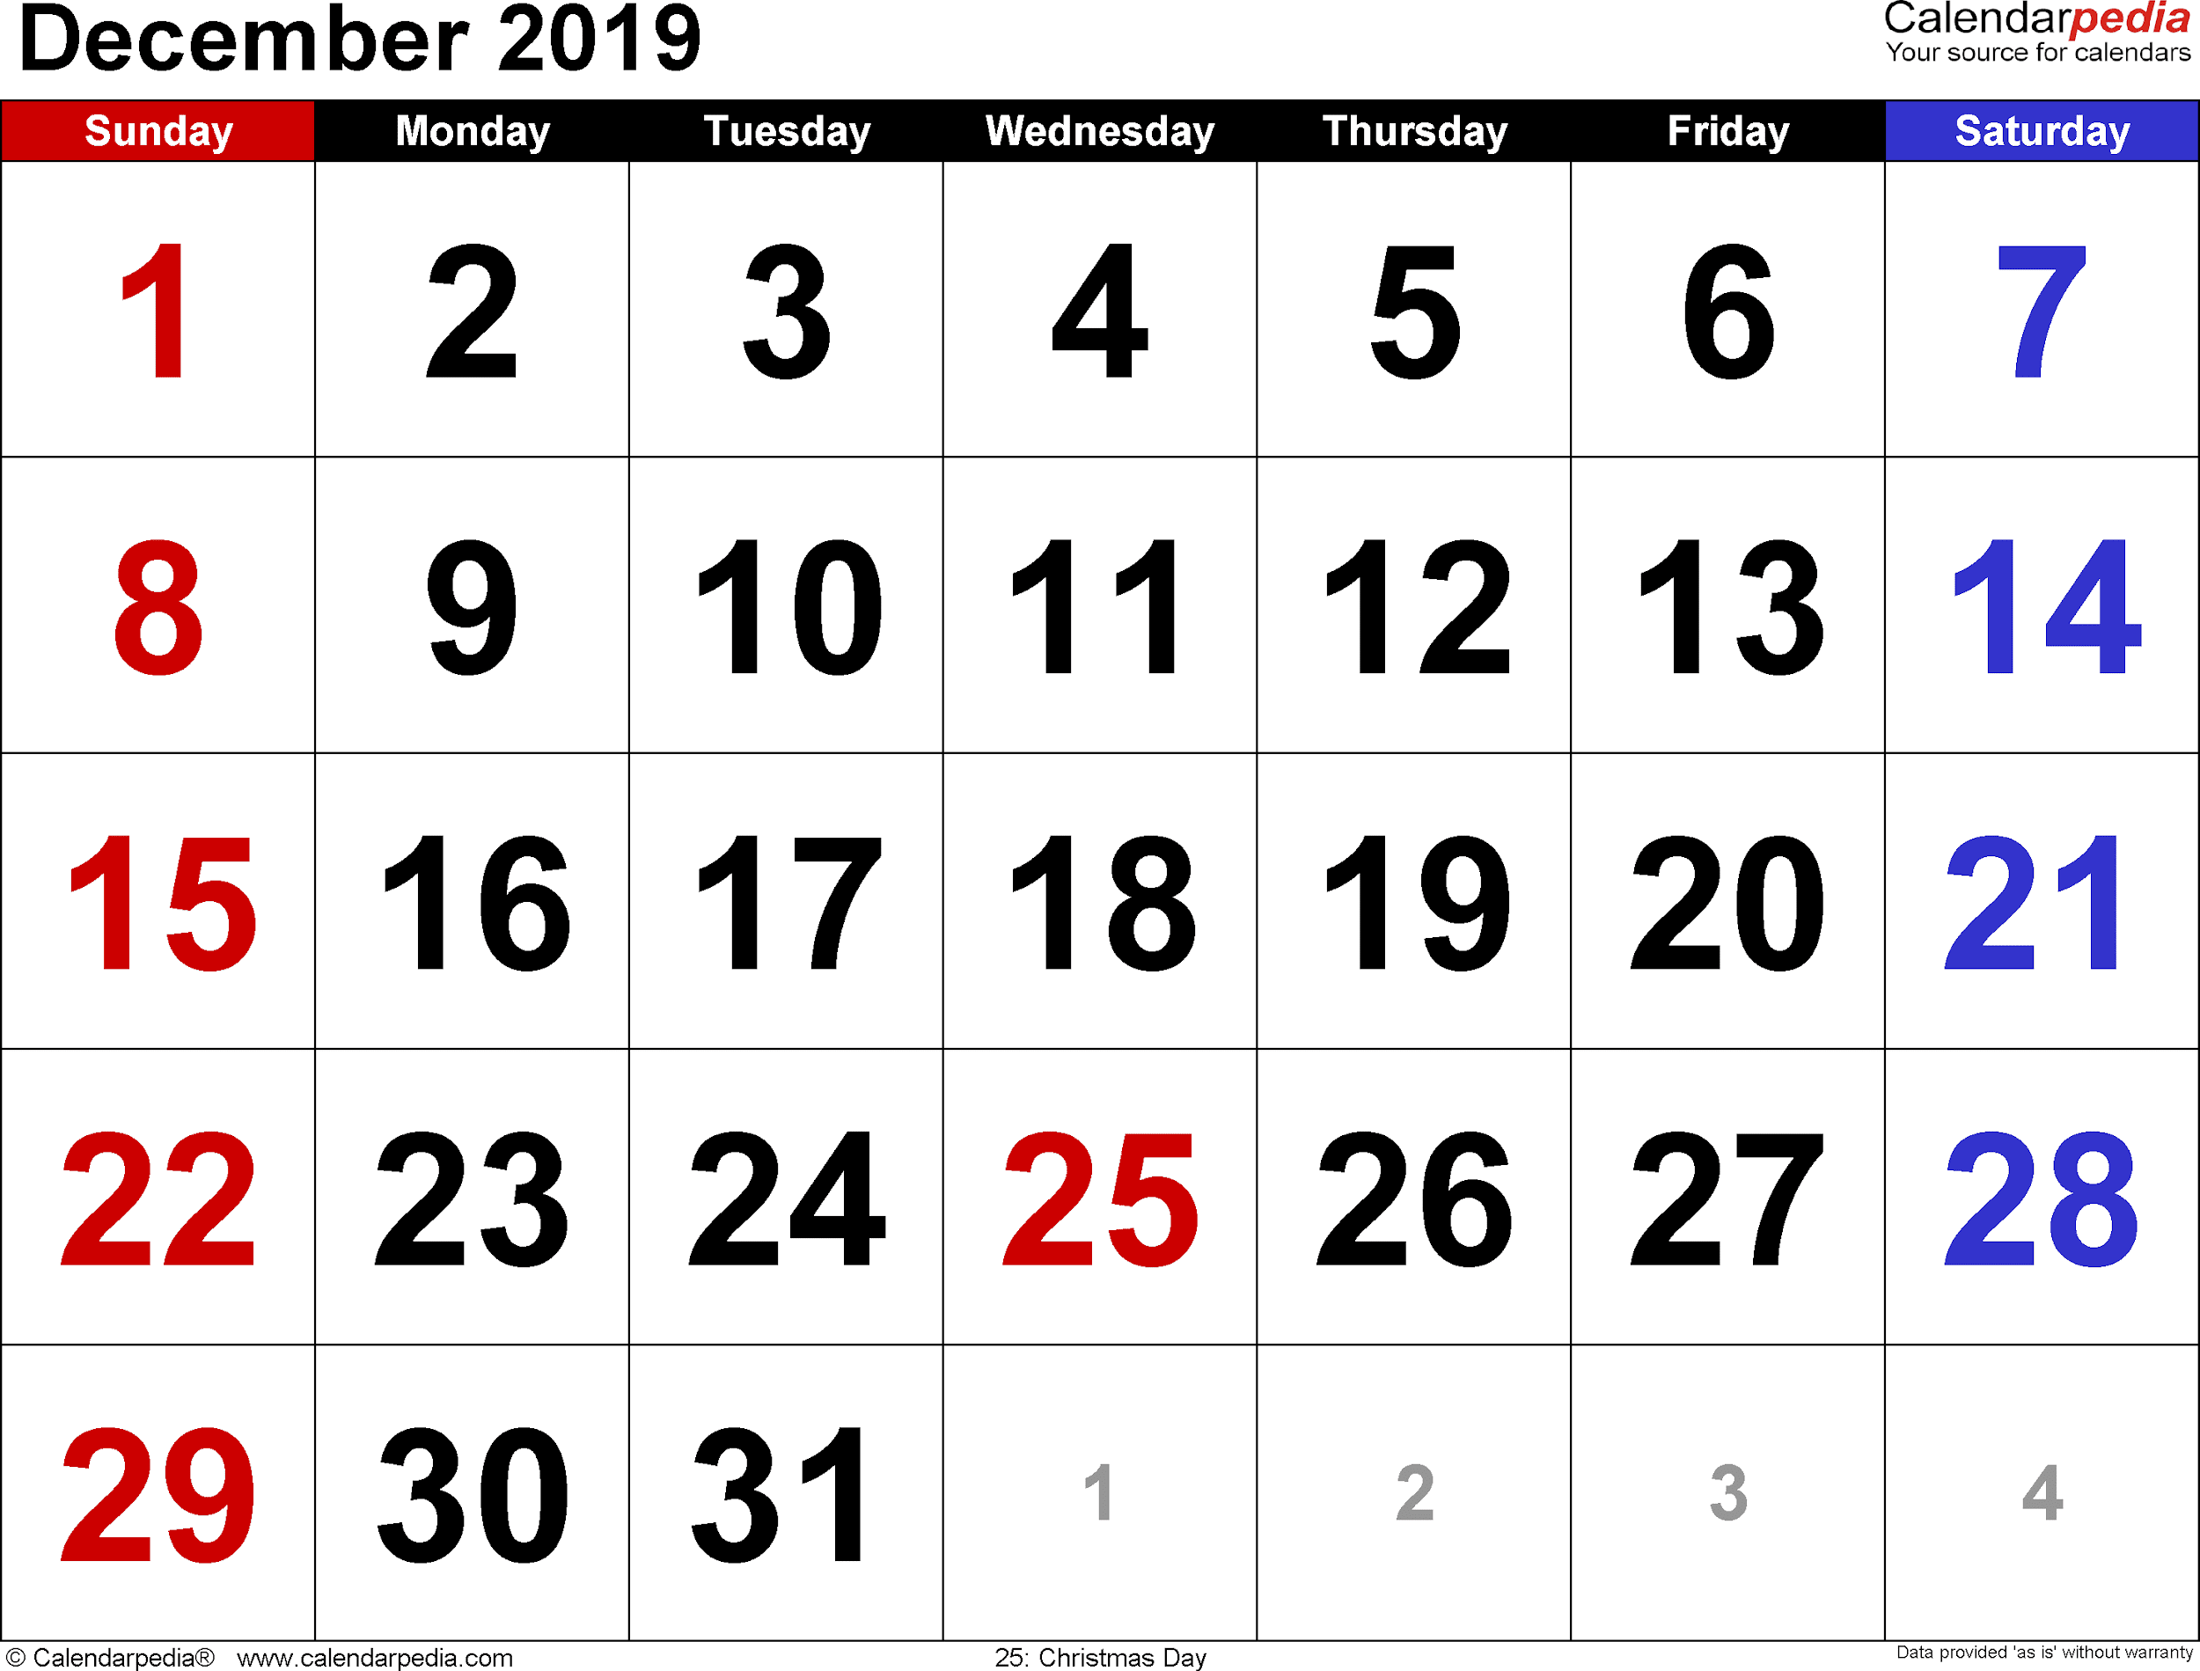
Young people and fraud
Monday
On Monday, Yaz arrives at Adnam’s house as normal.
As they walk to school they both tell each other about all the things they did at the weekend.

Slide 11
Young people and fraud
Tuesday
On their way to school Yaz and Adnam meet up with Mike.
Mike has two heavy bags full of energy drinks with him.
Mike asks Adnam to take one of the bags to school for him and offers to pay £2.
When they arrive at school Adnam gives Mike the bag back in the playground.

Slide 12
Young people and fraud
Wednesday
On Wednesday, Mike tells Yaz that he is having problems with his bank account and asks if he can pay some money into her bank and then she can take it out and give it to him.
Mike offers Yaz £20 if she does this for him.
On the way home they visit the bank and make the payments.

Slide 13
Young people and fraud
Thursday
On Thursday, Mike offers Yaz and Adnam a lift home in his brother’s car.
On the way home, Mike’s brother asks Adnam if he can use his bank account to pay the money into for some things that he is selling on eBay.
Adnam agrees and passes over his bank account details.

Slide 14
Young people and fraud
Friday
On Friday, Adnam shows Yaz an online advert which offers £10 for volunteers to help by taking wage payments for people without a bank account.
Yaz is interested; she signs up through the advert and provides her bank details.

Slide 15
Young people and fraud
What were the red flags?
Discuss with your partner where you have identified risks to financial exploitation.
Be prepared to feed back to the class.
As we go through the answers again, make a note of any warning signs you missed. These will be highlighted in orange and explained in a blue box like this.

Slide 16
Young people and fraud
Yaz and Adnam are best friends.
They always meet at Adnam's house and then walk to school together.
After school they always meet in the playground and walk home together.

Slide 17
Young people and fraud
Monday
On Monday, Yaz arrives at Adnam’s house as normal.
As they walk to school they both tell each other about all the things they did at the weekend.

Slide 18
Young people and fraud
Tuesday
On their way to school Yaz and Adnam meet up with Mike.
Mike has two heavy bags full of energy drinks with him.
Mike asks Adnam to take one of the bags to school for him and offers to pay £2.
When they arrive at school Adnam gives Mike the bag back in the playground.

Slide 19
Young people and fraud
Tuesday
On their way to school Yaz and Adnam meet up with Mike.
Mike has two heavy bags full of energy drinks with him.
Mike asks Adnam to take one of the bags to school for him and offers to pay £2.
When they arrive at school Adnam gives Mike the bag back in the playground.
This could be the beginning of a grooming process: checking if a young person is open to exchanging a request for money.

Slide 20
Young people and fraud
Wednesday
On Wednesday, Mike tells Yaz that he is having problems with his bank account and asks if he can pay some money into her bank and then she can take it out and give it to him.
Mike offers Yaz £20 if she does this for him.
On the way home they visit the bank and make the payments.

Slide 21
Young people and fraud
Wednesday
On Wednesday, Mike tells Yaz that he is having problems with his bank account and asks if he can pay some money into her bank and then she can take it out and give it to him.
Mike offers Yaz £20 if she does this for him.
On the way home they visit the bank and make the payments.
Again, this could be part of the grooming process. However, it has escalated from the previous request as the young person is now using their bank account.

Slide 22
Young people and fraud
Thursday
On Thursday, Mike offers Yaz and Adnam a lift home in his brother’s car.
On the way home, Mike’s brother asks Adnam if he can use his bank account to pay the money into from some things that he is selling on eBay.
Adnam agrees and passes over his bank account details.

Slide 23
Young people and fraud
Thursday
On Thursday, Mike offers Yaz and Adnam a lift home in his brother’s car.
On the way home, Mike’s brother asks Adnam if he can use his bank account to pay the money into from some things that he is selling on Ebay.
Adnam agrees and passes over his bank account details.
The young person has now shared their bank details with someone they are unfamiliar with. They cannot be certain where this transaction is coming from.

Slide 24
Young people and fraud
Friday
On Friday, Adnam shows Yaz an online advert which offers £10 for volunteers to help by taking wage payments for people without a bank account.
Yaz is interested; she signs up through the advert and provides her bank details.

Slide 25
Young people and fraud
Friday
On Friday, Adnam shows Yaz an online advert which offers £10 for volunteers to help by taking wage payments for people without a bank account.
Yaz is interested; she signs up through the advert and provides her bank details.
This can be considered as a ‘get-rich-quick’ scam.
They create the impression that users can obtain a rate of return with little skill, effort, or time, and with minimal risk.

Slide 26

Young people and fraud: money mules
A money mule is a person who transfers illegal money on behalf of others, usually through their bank account, and receives money for doing so.
Criminals contact people and offer them cash/commission to receive money into their bank account and transfer it to another account. The person who is moving money between criminals is called a ‘money mule.’
Notes:
Prompt questions
Who was the money mule?
Did you consider Mike to be a criminal?
When do people typically need to share their bank details

Slide 27

Young people and fraud: money mules
Write down your answers to the three questions:
Based on the previous activity;
Who was the money mule?
Did you consider Mike to be a criminal?
When do people typically need to share their bank details?
Notes:
Prompt questions
Who was the money mule?
Did you consider Mike to be a criminal?
When do people typically need to share their bank details

Slide 28

Money mules: what’s the point?
Why do criminals use money mules?
So their money is harder to trace
They might transfer money between lots of people, making it even harder for the police to track where it ends up
Their money may be from illegal sources
Notes:
Further information
More information here on e.g.:
Money mule networks
Risks involved: criminal record, access to services like credit cards, jobs

Slide 29
By the end of the session, I will be able to:
Identify situations where young people are vulnerable to exploitation
Explain the impact of financial exploitation
Rehearse strategies to respond to unwanted pressures

Slide 30
What is the impact of financial exploitation?
An alert has been raised on Adnam and Yaz’s bank account as they are receiving money from unfamiliar sources.
The bank start to investigate as they are suspicious of the unusual account activity.
What do you think might happen next?
2 minute discussion: Talk to your partner

Slide 31
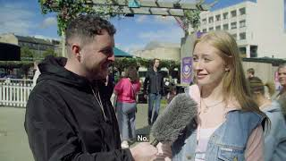
How easily can people spot a scam?
Write down the consequences of being a money mule
How do people react when asked to briefly have someone else’s money in their account? Would you have answered the same thing?
Source: Natwest - https://youtu.be/HX6PYjA_gfc
Notes:
Alternative video: https://natwest.mymoneysense.com/teachers/resources-16-18s/topic-9-how-can-my-money-choices-affect-my-mental-wellbeing/video/

Slide 32
What is the impact of financial exploitation?
SOCIAL
FINANCIAL
Feel isolated or disconnected from friends
Struggle to access banking or transfer money
Risk future credit issues (e.g., bank accounts, phone contracts, credit cards)
PERSONAL
LEGAL
Experience stress, anxiety, or strained relationships
Face legal consequences, including jail time
May unknowingly fund criminal activities

Slide 33


Unfortunately, even though they have been targeted by a criminal, the ‘money mule’ can also be convicted of a crime.
It is a crime to transfer criminal money.
Notes:
Transferring criminal money is a crime. If you let someone else use your bank account to transfer money, you could be funding serious organised crime. You may think it is easy money, but you could be landed with a criminal record.
Source: Money Mules - National Crime Agency

Slide 34
By the end of the session, I will be able to:
Identify situations where young people are vulnerable to exploitation
Explain the impact of financial exploitation
Rehearse strategies to respond to unwanted pressures

Slide 35
Keeping safe
Write down a few sentences that a young person could use if faced with a situation like Adnam.
On Thursday, Mike offers Yaz and Adnam a lift home in his brother’s car.
On the way home, Mike’s brother asks Adnam if he can use his bank account to pay the money into from some things that he is selling on Ebay.
Adnam agrees and passes over his bank account details.
What if Adnam is quite shy?
Rate your partner’s answer.
Ask these when assessing:
Keeps a young person safe?
Realistic response in this situation?
Highlights consequences?
What if Mike becomes threatening?
What if Mike is begging and pleading?

Slide 36
Keeping safe
Example responses
On Thursday, Mike offers Yaz and Adnam a lift home in his brother’s car.
On the way home, Mike’s brother asks Adnam if he can use his bank account to pay the money into from some things that he is selling on Ebay.
Adnam agrees and passes over his bank account details.
“Sorry, I don’t feel comfortable sharing bank details”
“My parent/ carer checks my bank account online, so I have to ask them first”
“I don’t have my own bank account”
If anyone threatens you, you should speak to an adult

Slide 37
Reporting Fraud
You can report fraud, scams, and cybercrime to Action Fraud by using their online tool or calling 0300 123 2040.
If you are in Scotland, you can call the police directly on 101.
If your bank account is involved, you can also call your bank using the number on your card, or call 159 to be connected to your bank’s fraud department.

Slide 38
By the end of the session, I will be able to:
Identify situations where young people are vulnerable to exploitation
Explain the impact of financial exploitation
Rehearse strategies to respond to unwanted pressures 0

Slide 39
Any questions?
?

Slide 40



Services available for people who have concerns about their personal finances
Citizens Advice – Debt and Money – This resource contains links to advice on a number of topics, including financial difficulties, cost of living and communicating with creditors.
Crimestoppers – an independent charity where information can be reported anonymously.
0800 555 111
Childline Helpline
0800 1111
At school, you can speak with an adult you trust.
This could be your form tutor, head of year or the school’s safeguarding officer.

Slide 41
Links to learn more!
ARTICLES TO EXTEND LEARNING
Please visit the FLIC learning hub for further resources: Learning Hub FT FLIC
Could your child be recruited as a money mule? (The Financial Times, 2023)
Take five to stop fraud
Tackling the financial exploitation of students
National crime agency - #DontBeUsed
Money Helper- Money mules – what are they and could you fall victim? (2021)

