Slide 1

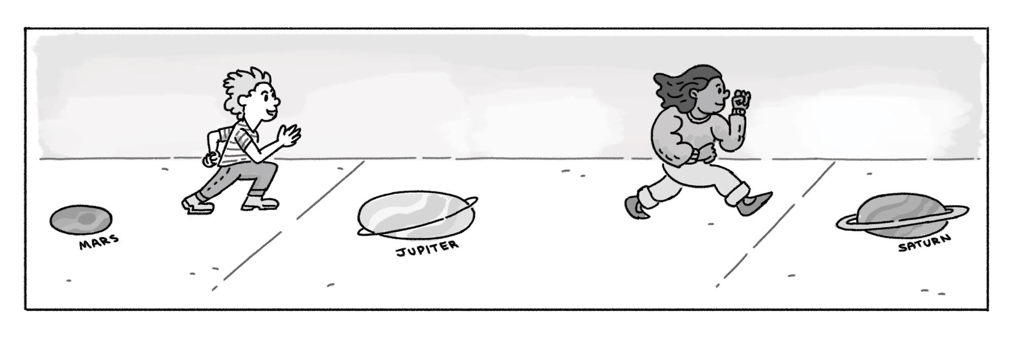
Running to Neptune
Type: Outdoor Activity
Time: 40 mins
How can the Sun help us explore other planets?
NGSS: (Foundational) 5-ESS1-1.Support an argument that differences in the apparent brightness of the sun compared to other stars is due to their relative distances from the Earth.
Focus: In this extension, students will participate in an outdoor activity to help them understand the relative distance between the planets by marking them out in chalk on the ground. This demonstration will help students better understand the order of the planets.
Materials (per class):
Ruler
Sidewalk chalk (several colors)
60-ft of string
Toilet paper tube
Permanent black marker
Scissors
Reference sheet (see next page)
Prep:
This video contains both preparation and instructions for the activity. They’re also listed below:
Take your string and ruler and measure out two feet of string by wrapping it to one end of the ruler and back.
With your marker, put a black mark to indicate two feet of distance. Be sure to color the front and the back of the string.
Now that you’ve made your first marking, repeat this step 29 times. You’ll need 30 markings total.
Double check that you have 30 markings exactly, then cut your string.
Take your toilet paper tube and cut a small slit on one side, then repeat on the other side.
Stick one end of the string in one of the slits, and wind it up. Tuck the other end of the string into the other slit.
Notes:
Double check that you have 30 markings

Slide 2
Running to Neptune Activity Instructions
You will need an outdoor area that is paved and at least 60 feet long for this activity.
Take everyone outside and unroll your string on the ground. Be sure you have your box of chalk and this sheet with you.
Divide your class into 9 groups. Each group will be in charge of drawing one of the planets or the Sun.
Note: if needed, there can be more students in the Sun group to make the drawing of the Sun extra big!
At the very start of the string, have the Sun group draw the Sun very large. It's hard to make it too big.
Decide which group is going to draw each planet on the ground using chalk and let them get creative with it. Guide each group as to where each planet should be drawn. For example: Earth should be drawn at the first black mark on the string (one astronomical unit).
Use the Planet Table for the location of the rest of the planets.
Once all the planets and the Sun have been drawn, have students
line up behind the Sun.
Call out a planet for the students to run to and stand on! At first, call
out the order of the planets and then switch it up and call planets
out randomly. For example: call out Neptune, then once they get
there, yell out Venus!
How can the Sun help us explore other planets?
 | How many astronomical units from the Sun? (approximately)
Sun | 0 a.u. Start of String
Mercury | ⅓ a.u.
Venus | ⅔ a.u.
Earth | 1 a.u. First marked line
Mars | 1½ a.u.
Jupiter | 5 a.u. Fifth marked line
Saturn | 10 a.u. Tenth marked line
Uranus | 20 a.u. Twentieth marked line
Neptune | 30 a.u. Last marked line
What’s going on?
Our solar system includes 8 planets: Mercury, Venus, Earth, Mars, Jupiter, Saturn, Uranus, and Neptune. These planets vary in size, appearance, and distance from the Sun, which affects their temperature, day length, and year length. Planets closer to the Sun are much hotter, while those farther away are colder. Each planet has its own unique characteristics, and their distance from the Sun plays a key role in shaping their environments.

