Slide 1

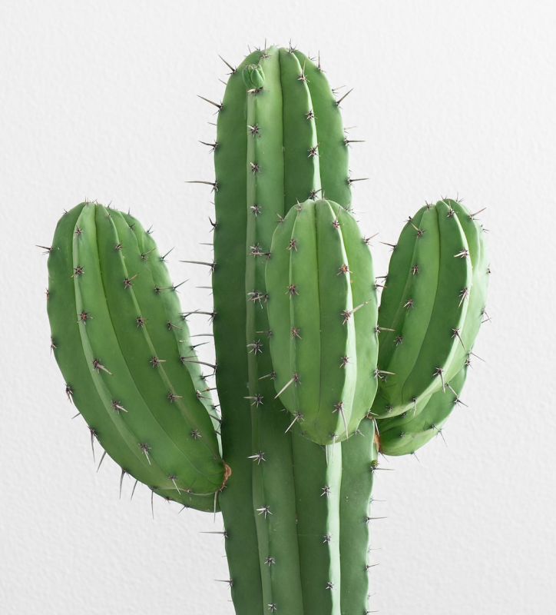

TABLE OF CONTENTS
INTRODUCTION
The Extraordinary Realm
ENCOUNTERS
NATURAL GREEN
Unicorn Sightings
WONDERS
Wishes Granted
MAGIC
Spellcasting
ADVENTURE
Happily Ever After
CONCLUSION
Embrace the Fantasy
FREE PRESENTATION TEMPLATE

Slide 2
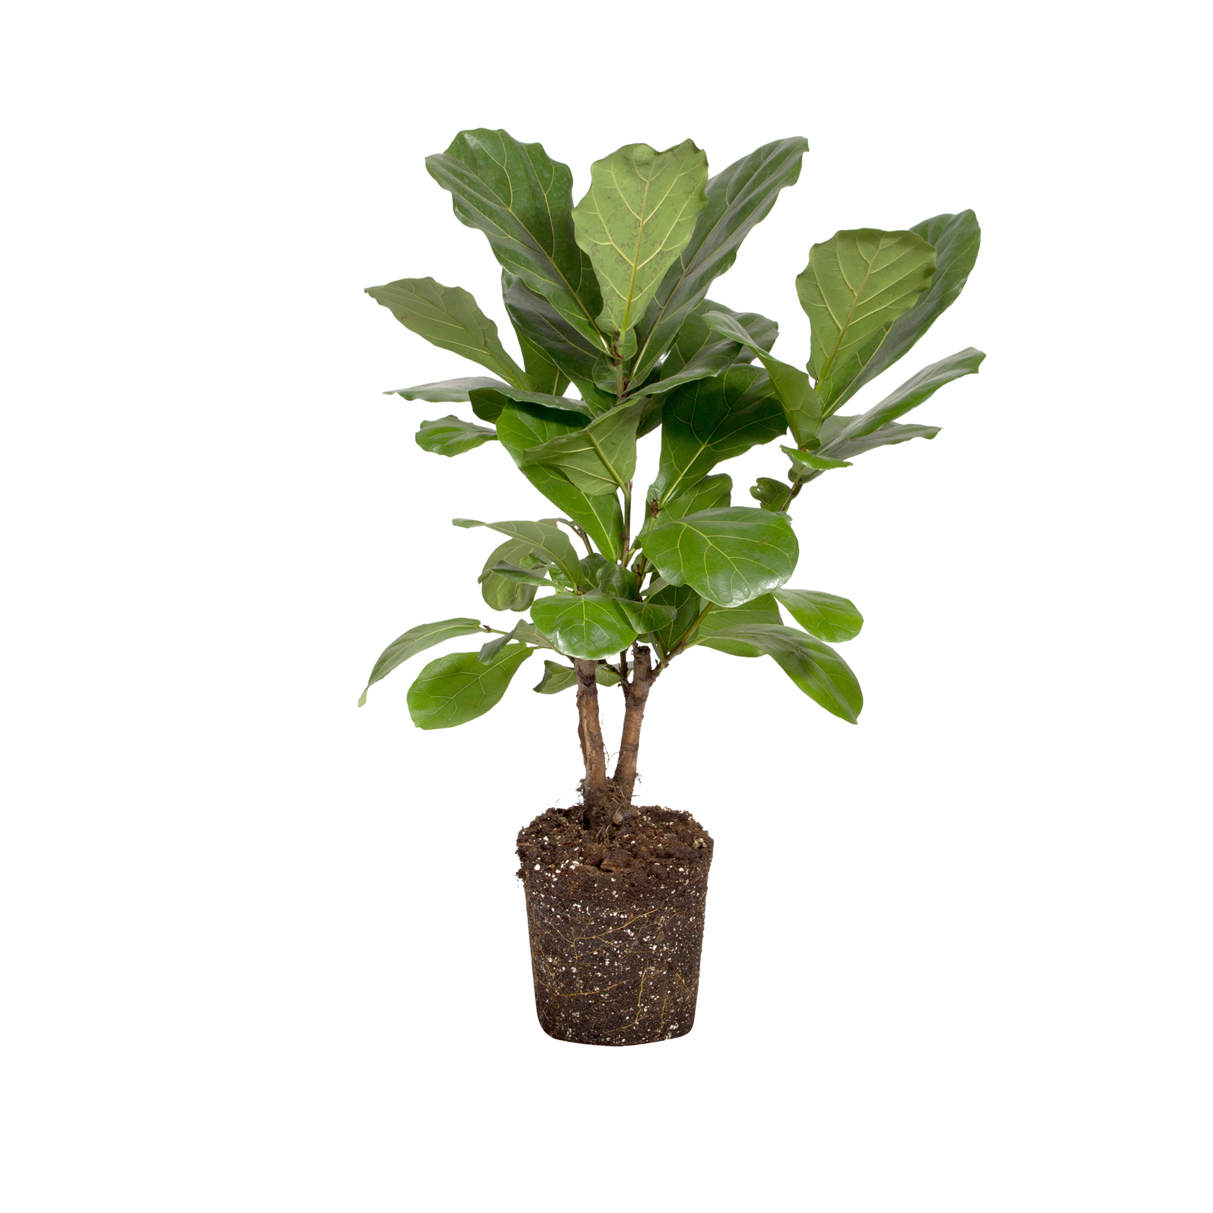
TABLE OF CONTENTS
WELCOME
INTRODUCTION
The Extraordinary Realm
Welcome to the world of fantasy! Join us on a journey to explore the mystical creatures, enchanted lands, and magical wonders that exist beyond our reality. Discover the wonders and secrets of this exciting realm and unlock the power of imagination.
ENCOUNTERS
Unicorn Sightings
WONDERS
Wishes Granted
MAGIC
Spellcasting
ADVENTURE
Happily Ever After
CONCLUSION
Embrace the Fantasy

Slide 3



UNICORN SIGHTINGS
A record of the number of unicorns spotted in the fantasy realm and the beauty and mystery that surrounds these enchanting creatures.
WELCOME
Welcome to the world of fantasy! Join us on a journey to explore the mystical creatures, enchanted lands, and magical wonders that exist beyond our reality. Discover the wonders and secrets of this exciting realm and unlock the power of imagination.
DRAGON TAMING
A closer look at the art of taming dragons and the brave adventurers who dare to take on these fearsome creatures.

Slide 4
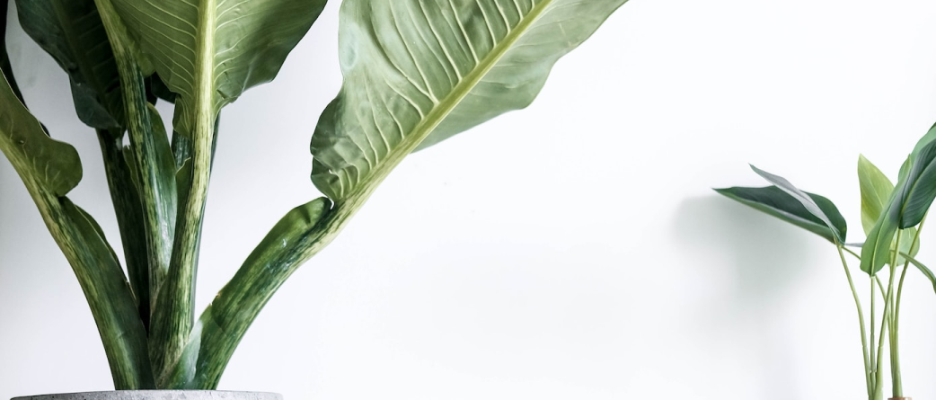
In the Realm of Magic and Adventure, dragons are no longer fearsome beasts to be feared. They can be tamed and even become loyal companions to those brave enough to venture into the unknown. Similarly, unicorns, long considered to be mythical creatures, can now be sighted in this fantastical realm. The world is filled with endless possibilities and endless adventures.
TAMING DRAGONS AND SIGHTING UNICORNS
UNICORN SIGHTINGS
A record of the number of unicorns spotted in the fantasy realm and the beauty and mystery that surrounds these enchanting creatures.
DRAGON TAMING
A closer look at the art of taming dragons and the brave adventurers who dare to take on these fearsome creatures.

Slide 5



In the Realm of Magic and Adventure, dragons are no longer fearsome beasts to be feared. They can be tamed and even become loyal companions to those brave enough to venture into the unknown. Similarly, unicorns, long considered to be mythical creatures, can now be sighted in this fantastical realm. The world is filled with endless possibilities and endless adventures.
FANTASY IS THE GATEWAY TO THE IMPOSSIBLE, THE LAND WHERE THE ORDINARY BECOMES EXTRAORDINARY, AND THE IMPOSSIBLE BECOMES POSSIBLE. IT IS THE REALM OF THE IMAGINATION, WHERE ANYTHING CAN HAPPEN AND EVERYTHING IS POSSIBLE.
TAMING DRAGONS AND SIGHTING UNICORNS
THE DREAM WEAVER

Slide 6




UNICORN SIGHTINGS
A record of the number of unicorns spotted in the fantasy realm and the beauty and mystery.
FANTASY IS THE GATEWAY TO THE IMPOSSIBLE, THE LAND WHERE THE ORDINARY BECOMES EXTRAORDINARY, AND THE IMPOSSIBLE BECOMES POSSIBLE. IT IS THE REALM OF THE IMAGINATION, WHERE ANYTHING CAN HAPPEN AND EVERYTHING IS POSSIBLE.
THE DREAM WEAVER
DRAGON TAMING
A closer look at the art of taming dragons and the brave adventurers who dare to take on these fearsome creatures.

Slide 7

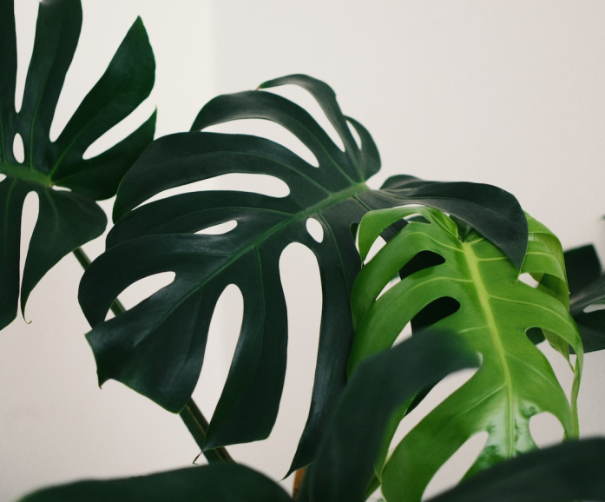
UNICORN SIGHTINGS
IMAGINATION AND FANTASY
A record of the number of unicorns spotted in the fantasy realm and the beauty and mystery.
DRAGON TAMING
  Embark on an adventure filled with magic and wonder
  Tame dragons, see unicorns and experience rainbows every day
  Discover yourself and unlock your imagination through exploration
  Experience the manifestation of your deepest desires and fondest dreams
  Leave reality behind and immerse yourself in a world of endless possibilities
A closer look at the art of taming dragons and the brave adventurers who dare to take on these fearsome creatures.

Slide 8

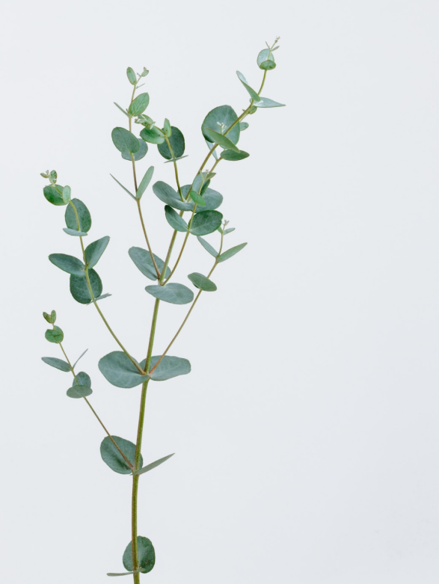
IMAGINATION AND FANTASY
  Embark on an adventure filled with magic and wonder
  Tame dragons, see unicorns and experience rainbows every day
  Discover yourself and unlock your imagination through exploration
  Experience the manifestation of your deepest desires and fondest dreams
  Leave reality behind and immerse yourself in a world of endless possibilities
EXPLORATION OF THE INNER SELF:
A JOURNEY OF SELF-DISCOVERY

Slide 9




"The Art of Archery": Discover the intricacies of the Art of Archery as practiced by the graceful and precise elves.
EXPLORATION OF THE INNER SELF:
A JOURNEY OF SELF-DISCOVERY
THE ELVES: A GLIMPSE INTO THEIR WORLD
Elegant inhabitants of enchanted forests, known for their mastery of magic and their close connection to nature. They possess an innate sense of harmony and balance, making them protectors of the natural world.
"The Music of the Elves": Immerse yourself in the enchanting music of the elves, whose songs have the power to heal.

Slide 10
THE ART OF UNICORN SIGHTING
Tips and tricks for spotting the elusive unicorns in their natural habitat.
THE ELVES: A GLIMPSE INTO THEIR WORLD
"The Art of Archery": Discover the intricacies of the Art of Archery as practiced by the graceful and precise elves.
Elegant inhabitants of enchanted forests, known for their mastery of magic and their close connection to nature. They possess an innate sense of harmony and balance, making them protectors of the natural world.
"The Music of the Elves": Immerse yourself in the enchanting music of the elves, whose songs have the power to heal.
DRAGON TAMING TECHNIQUE
A guide to taming and caring for dragons in the realm of magic.

Slide 11
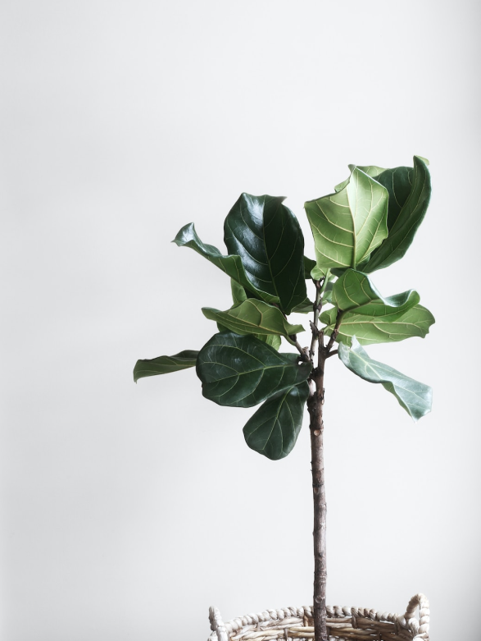
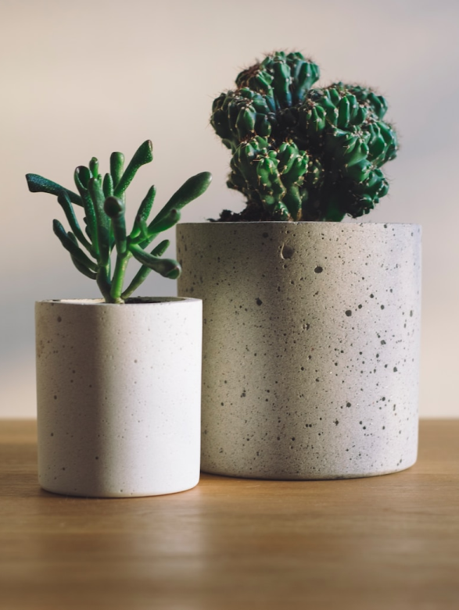
THE ART OF ENCHANTMENT
DRAGON TAMING TECHNIQUE
A guide to taming and caring for dragons in the realm of magic.
THE ART OF UNICORN SIGHTING
Tips and tricks for spotting the elusive unicorns in their natural habitat.
20%
55%
30%

Slide 12



THE ART OF ENCHANTMENT
20%
A magical being with the power to cast spells and create illusions, often sought for bringing wonder and magic into people's lives.
55%
30%

Slide 13

1
DISCOVER THE SECRETS
2
FIND YOUR OWN PATH
Explore the lush, vibrant forest and uncover the mysteries that lie within.
Choose your own path through the forest, and see where it takes you.
A magical being with the power to cast spells and create illusions, often sought for bringing wonder and magic into people's lives.
4
UNCOVER THE MAGIC
3
MEET THE CREATURES
Learn about the powerful magic that pervades the forest and how it affects.
Encounter the mythical creatures that call the forest home.

Slide 14

The Evolution of the Unicorn" is a study exploring the historical, cultural, and mythical development of the iconic fantasy creature. From its ancient roots in Mediterranean mythology to its modern-day representation in popular culture, this research delves into the various interpretations and beliefs surrounding the mystical horse with a single horn. The goal is to understand the evolution of this captivating creature and its enduring place in human imagination.
1
DISCOVER THE SECRETS
2
FIND YOUR OWN PATH
Explore the lush, vibrant forest and uncover the mysteries that lie within.
Choose your own path through the forest, and see where it takes you.
4
UNCOVER THE MAGIC
3
MEET THE CREATURES
Learn about the powerful magic that pervades the forest and how it affects.
Encounter the mythical creatures that call the forest home.
THE EVOLUTION OF THE UNICORN

Slide 15



ELDRUIN
The Fire Mage
THE ELVES: A GLIMPSE
The Evolution of the Unicorn" is a study exploring the historical, cultural, and mythical development of the iconic fantasy creature. From its ancient roots in Mediterranean mythology to its modern-day representation in popular culture, this research delves into the various interpretations and beliefs surrounding the mystical horse with a single horn. The goal is to understand the evolution of this captivating creature and its enduring place in human imagination.
ELDRUIN
THE EVOLUTION OF THE UNICORN
The Fire Mage
ELDRUIN
The Fire Mage

Slide 16

FANTASY REALM
THE ELVES: A GLIMPSE
ELDRUIN
THE ENCHANTED FOREST
The Fire Mage
ELDRUIN
A magical forest filled with talking animals and enchanted creatures.
The Fire Mage
ELDRUIN
The Fire Mage
THE CRYSTAL CAVES
A network of underground caves filled with precious gems and crystals.

Slide 17
THE TIMELINE
UNICORN MIGRATION
DRAGON TAMING
First dragon was successfully tamed
Large herd of unicorns migrated to the realm
FANTASY REALM
THE ENCHANTED FOREST
A magical forest filled with talking animals and enchanted creatures.
2022
2023
2024
2025
THE CRYSTAL CAVES
A network of underground caves filled with precious gems and crystals.
RAINBOW SIGHTINGS
ENCHANTED POOL
A magical pool with power to grant wishes
Unusually large number of rainbows were sighted

Slide 18

THE TABLE
THE TIMELINE
UNICORN MIGRATION
DRAGON TAMING
First dragon was successfully tamed
Large herd of unicorns migrated to the realm
2022
2023
2024
2025
RAINBOW SIGHTINGS
ENCHANTED POOL
A magical pool with power to grant wishes
Unusually large number of rainbows were sighted
ITEM NAME
PRICE
Enchanted Sword
500 Gold Coins
Spellbook of the Elders
700 Gold Coins
Staff of the Archmage
643 Gold Coins
Phoenix Feather Cloak
875 Gold Coins
Amulet of Invisibility
124 Gold Coins
Cursed Mirror
673 Gold Coins
Dragon's Hoard Chest
908 Gold Coins
Mermaid's Tear Necklace
569 Gold Coins

Slide 19

THANK YOU
Help us keep bringing free content by spreading the word about EaTemp.
THE TABLE
ITEM NAME
PRICE
Enchanted Sword
500 Gold Coins
Spellbook of the Elders
700 Gold Coins
Staff of the Archmage
643 Gold Coins
Phoenix Feather Cloak
875 Gold Coins
Amulet of Invisibility
124 Gold Coins
Cursed Mirror
673 Gold Coins
Dragon's Hoard Chest
908 Gold Coins
Mermaid's Tear Necklace
569 Gold Coins

Slide 20





THANK YOU
Help us keep bringing free content by spreading the word about EaTemp.
THANK YOU FOR CHOOSING EATEMP
We offer free and high-quality slides templates for your presentations. We appreciate you choosing us and hope our templates have been helpful.
As a new website, we rely on your support to grow, so please help us by sharing our site with your friends and colleagues.
eatemp._
@eatemp
eatempofficial
@eatemp.official

Slide 21
THANK YOU FOR CHOOSING EATEMP
We offer free and high-quality slides templates for your presentations. We appreciate you choosing us and hope our templates have been helpful.
As a new website, we rely on your support to grow, so please help us by sharing our site with your friends and colleagues.
eatemp._
@eatemp
eatempofficial
@eatemp.official

