Slide 1
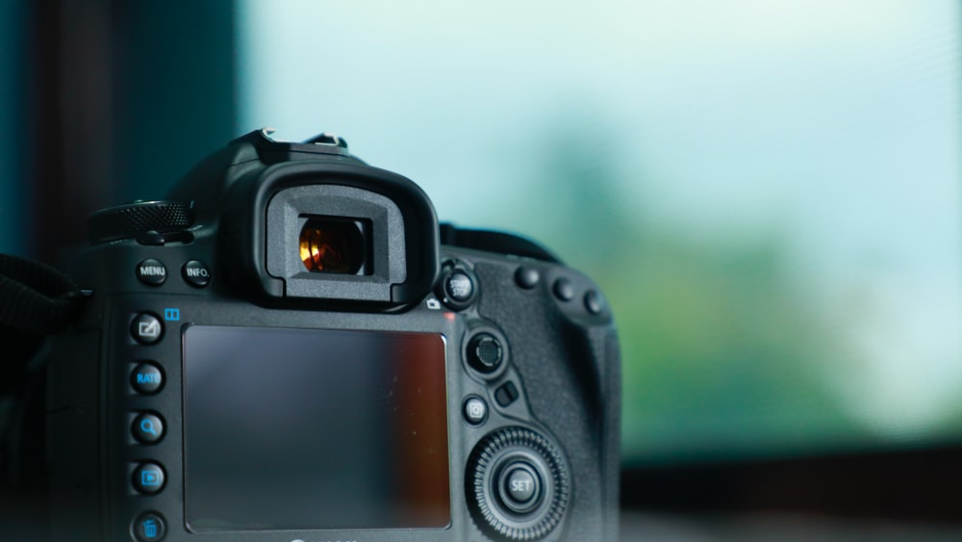
DIGITAL CAMERA
Free Template

Slide 2
ABOUT ME
Venus has a beautiful name and is the second planet from the Sun. It’s terribly hot—even hotter than Mercury—and its atmosphere is extremely poisonous. It’s the second-brightest natural object in the night sky after the Moon

Slide 3
TABLE OF CONTENTS
ABOUT ME
EXPERIENCE
WHAT I DO
MY WORK
Describe here the topic of the section
Describe here the topic of the section
Describe here the topic of the section
Describe here the topic of the section

Slide 4
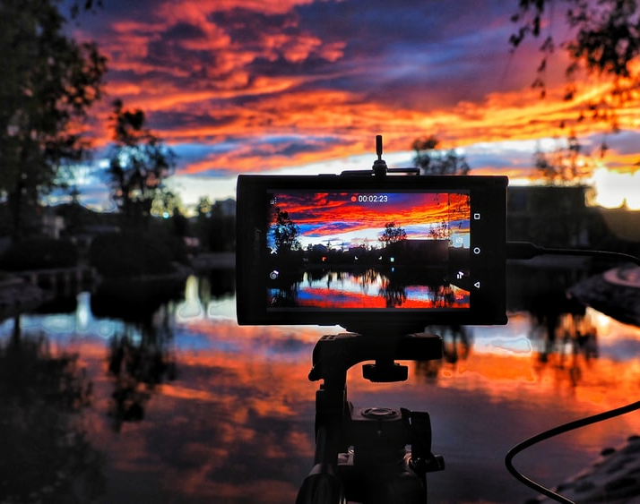
01
BUSINESS OVERVIEW

Slide 5
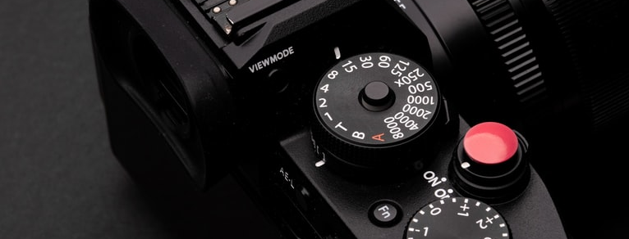
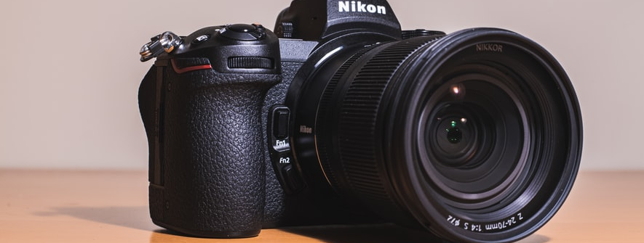
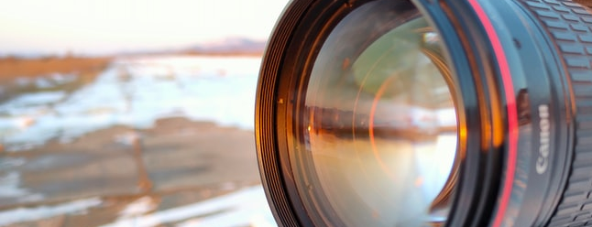
VALUES
MERCURY
VENUS
MARS
Mercury is the closest to the Sun and the smallest one in the Solar System
Venus has a beautiful name and is the second planet from the Sun
Despite being red, Mars is a very cold place. It’s full of iron oxide dust

Slide 6
DIGITAL CAMERA
Here you can describe the company’s mission. A clear message is a good way to get down to business

Slide 7
—SOMEONE FAMOUS
“This is a quote, words full of wisdom that someone important said and can make the reader get inspired.”

Slide 8
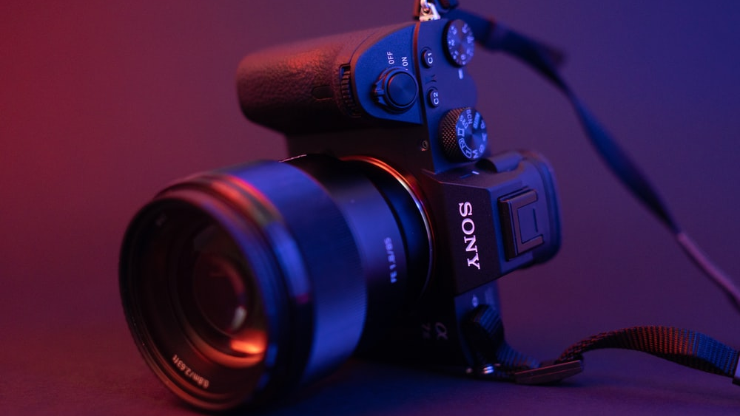
A PICTURE IS WORTH A THOUSAND WORDS

Slide 9
MY RESUME
EDUCATION
EXPERIENCES
2015-2019
Mercury is the closest planet to the Sun
2015-2019
It’s the biggest planet in the Solar System
2015-2019
Venus has a beautiful name, but it’s terribly hot
2015-2019
Saturn is the ringed one and a gas giant
2015-2019
Despite being red, Mars is a very cold place
2015-2019
Neptune is the farthest planet from the Sun
SKILLS

Slide 10
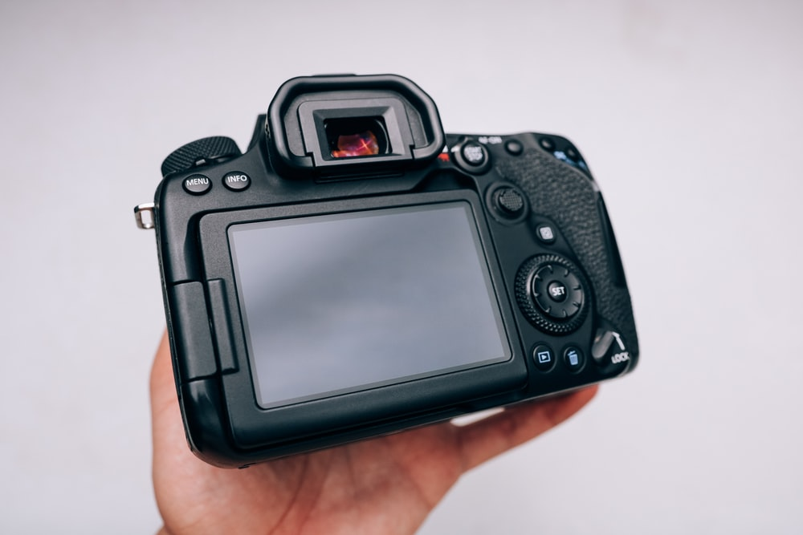
02
MARKET ANALYSIS

Slide 11
PROJECT
2
Venus has a beautiful name and is the second planet from the Sun. It’s terribly hot—even hotter than Mercury—and its atmosphere is extremely poisonous

Slide 12
HOW TO CELEBRATE THIS DAY
Try bringing a blanket to the park so that you can lay down on it and look at the sky for some time
Watch birds go about their lives as if nothing of importance was going on down below
You might be motivated to take a trip to other places if you watch planes soaring high above

Slide 13
A TIMELINE ALWAYS WORKS WELL
MERCURY
JUPITER
Mercury is the closest planet to the Sun
It is the biggest planet in the Solar System
01
02
03
04
MARS
VENUS
Despite being red, Mars is a cold place
Venus is the second planet from the Sun

Slide 14
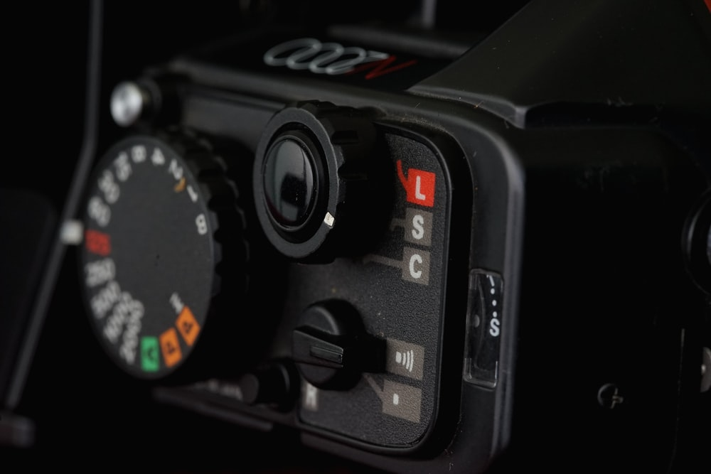
03
MARKETING PLAN

Slide 15
EXHIBITIONS
2016
2017
2018
2020
MARS
VENUS
MERCURY
JUPITER
Despite being red, Mars is actually a cold place
Venus has a beautiful name, but it’s terribly hot
Mercury is the closest planet to the Sun
It’s a gas giant and the biggest in the Solar System

Slide 16
PROJECTS
MARS
MERCURY
Despite being red, Mars is actually a cold place
Mercury is the closest planet to the Sun
VENUS
JUPITER
Venus has a beautiful name, but it’s terribly hot
It’s a gas giant and the biggest in the Solar System

Slide 17
BREAK-EVEN ANALYSIS
BREAK-EVEN POINT
It’s the biggest planet in the Solar System
LOSS

Slide 18
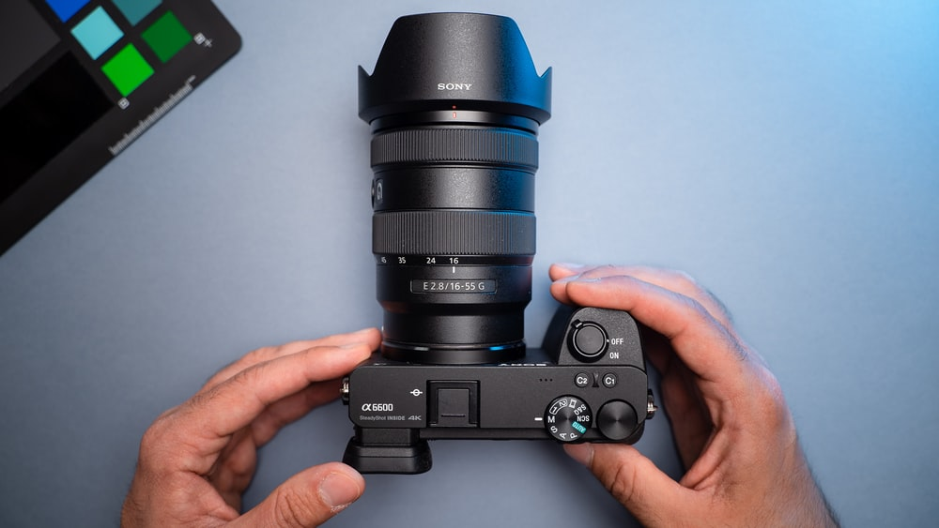
A PICTURE IS WORTH A THOUSAND WORDS

Slide 19
ONLINE FREE TEMPLATE
You can replace the images on the screens with your own work. Just delete these ones and add yours

Slide 20
4,498,3000
Big numbers catch your audience’s attention

Slide 21
GRAPH
MARS
VENUS
MERCURY
JUPITER
12%
36%
Despite being red, Mars is cold
Venus is the second planet from the Sun
28%
24%
Mercury is the closest to the Sun
It’s a gas giant and the biggest planet
To modify this graph, click on it, follow the link, change the data and paste the new graph here

Slide 22
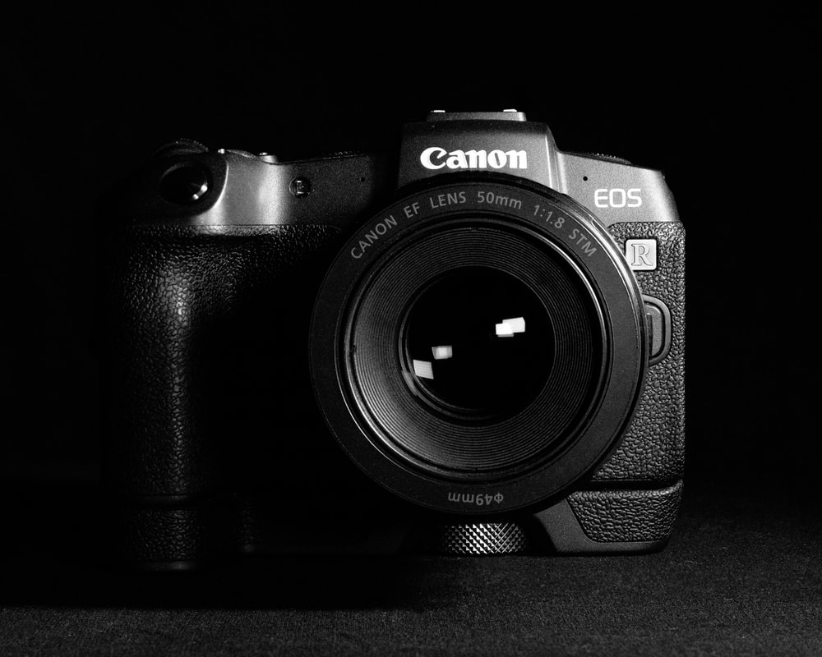
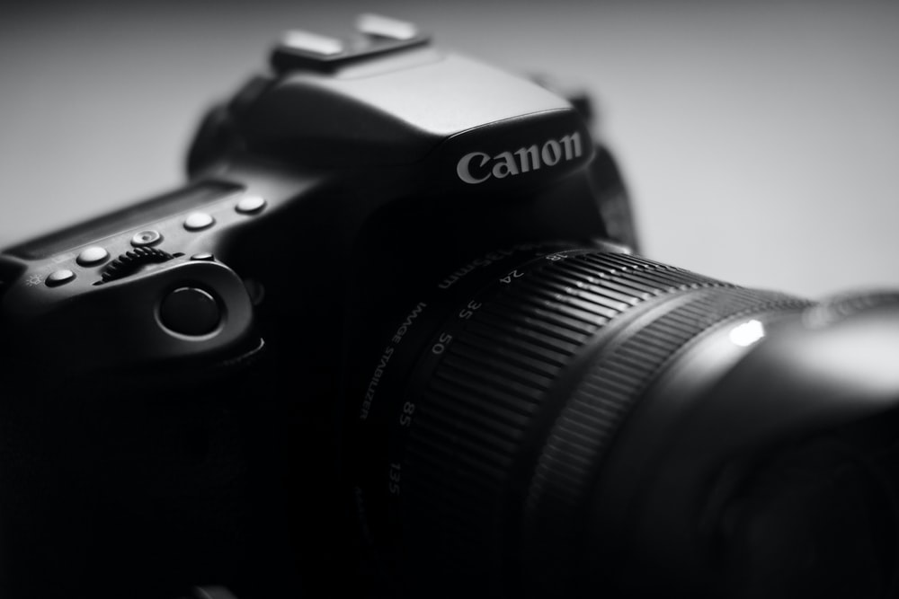
PROJECT 1
It’s the closest planet to the Sun and the smallest one in the Solar System—it’s only a bit larger than the Moon. The planet’s name has nothing to do with the liquid metal

Slide 23
BREAK-EVEN ANALYSIS
PROFIT
HIGH PROFIT
It’s the ringed one and a is gas giant
It’s the farthest planet from the Sun

Slide 24
INFOGRAPHIC
MERCURY
Mercury is the closest planet to the Sun
VENUS
JUPITER
Venus has a beautiful name, but it’s terribly hot
It’s a gas giant and the biggest of them all

Slide 25
STATE YOUR POINTS
Do you know what helps you make your point clear? Lists like this one:
They’re simple
You can organize your ideas clearly
And because you’ll never forget to buy milk!
And the most important thing: the audience won’t miss the point of your presentation

Slide 26
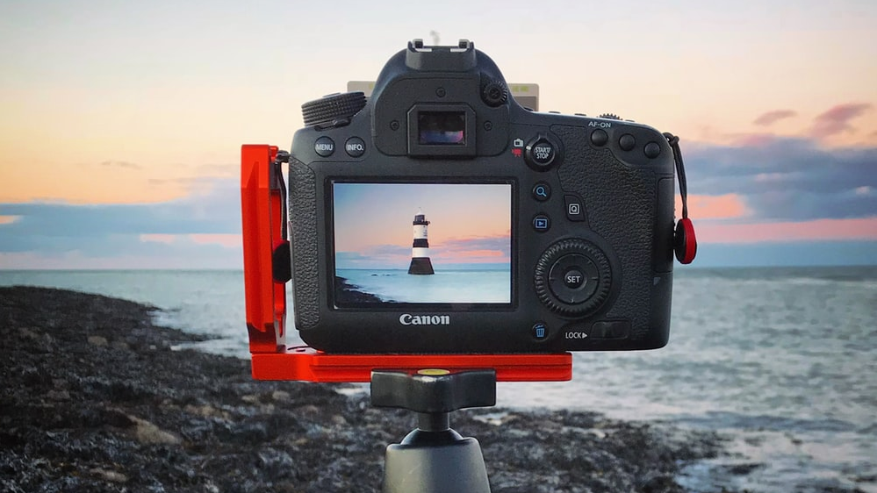
AWESOME WORDS

Slide 27
REVIEWING
MARS
JUPITER
VENUS
SATURN
Despite being red, Mars is a cold place
It’s the biggest planet in the Solar System
Venus has a beautiful name, but it’s hot
Saturn is the ringed one and a gas giant

Slide 28
1,300
12
20
REVIEWING
Despite being red, Mars is cold
Mercury is the closest to the Sun
It’s the biggest in the Solar System

Slide 29
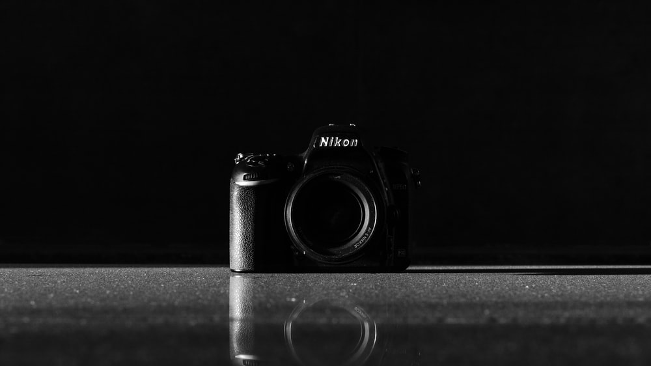
THANK YOU
Do you have any questions?
You can replace the images on the screens with your own work. Just delete these ones and add yours

Slide 30
Fuentes
ELABORADO POR :
plantillaspowerpoint.org
IMAGES :
unsplash.com
FONTS :
Lexend Peta
Didact Gothic

Slide 31
RESOURCES

Slide 32
RESOURCES

Slide 33
RESOURCES

Slide 34
Fully Editable Icon Sets: A

Slide 35
Fully Editable Icon Sets: B

Slide 36
Fully Editable Icon Sets: C

