Slide 1


Slide 2
Proceedings of the 100th Day Celebrations
Agenda and the Presentation Team
- Ms.Padmavati Joshi : Welcome and Why Sahakar Vidya
- Mr Srikanth P : Journey & Reflection on the First 100 Days.
- Ms. Indu Sinha : Strategic Proposal: State-wise Cooperative Pathway.
- Mr Sunil Sood : Action Plan for the next 100 Days.
Open House Discussions: Members’ Consultation, Strategic Direction & State Core Groups.-
Dr. Bala Venkata Subbarayudu Chilukuri : Concluding Remarks.

Slide 3



SAHAKAR VIDYA Towards a Cooperative Education Movement
(Education-of the People, by the People, for the People)
WELCOMES ONE & ALL!
www.sahakarvidya.org

Slide 4
Welcome and “Why Sahakar Vidya” ?
Presentation by Ms. Padmavati Joshi

Slide 5

Welcome and Why “sahakar Vidya Presentation by Ms. Padmavati Joshi

Slide 6


Slide 7
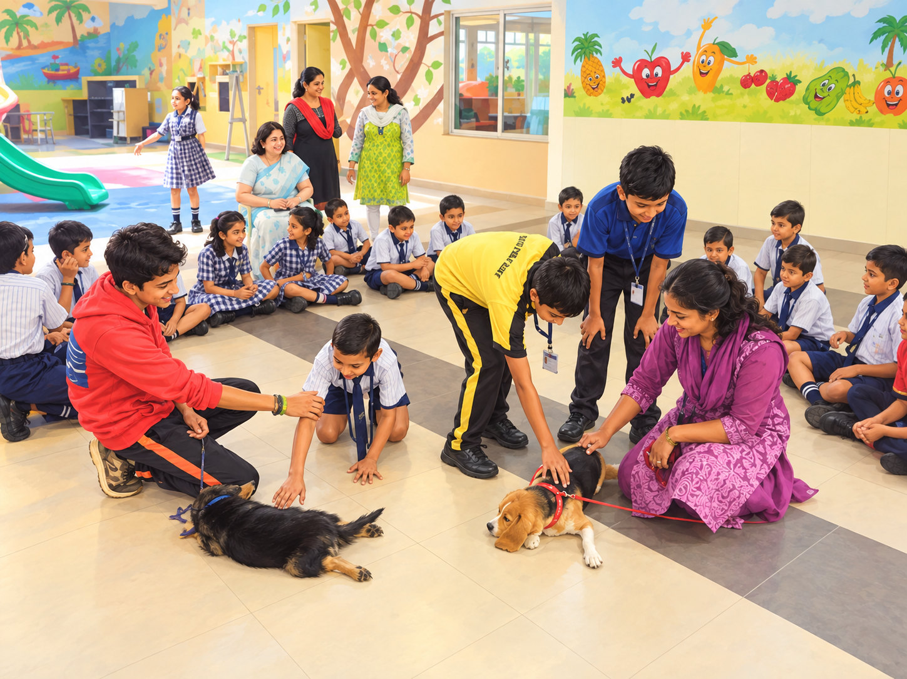
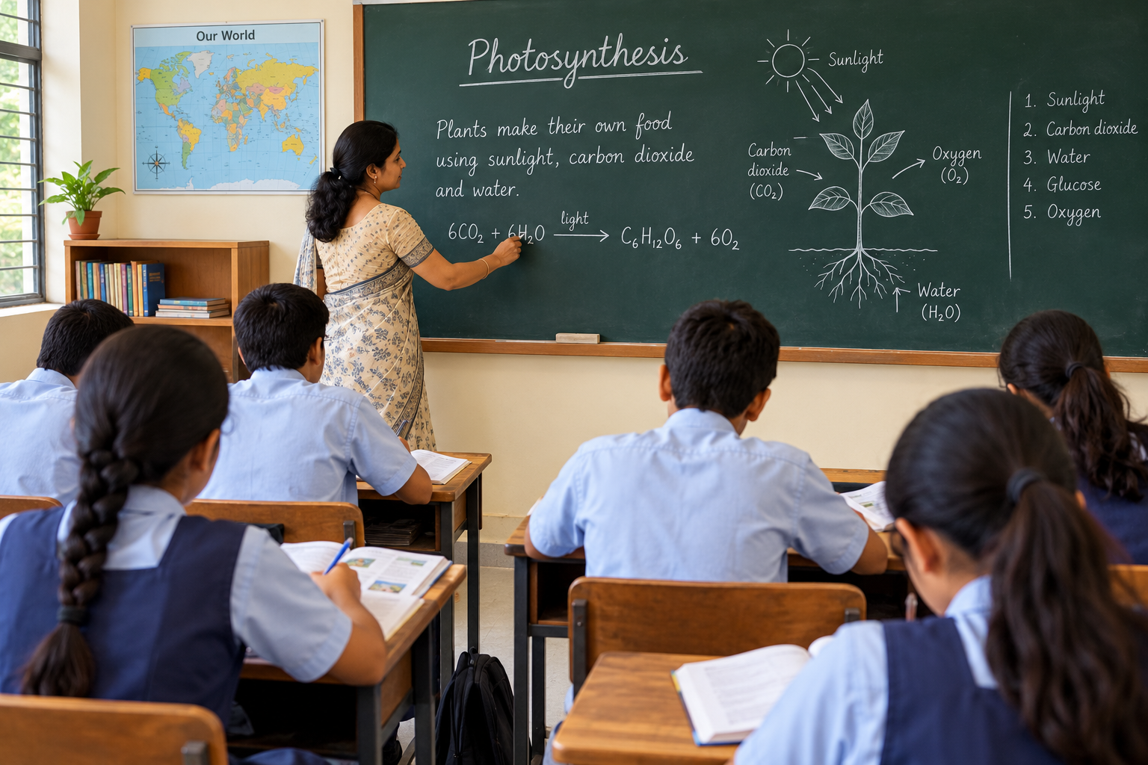
LIMITATIONS OF THE FORMAL SYSTEM.
Formal + Non-Formal+ Informal = Holistic Education

Slide 8
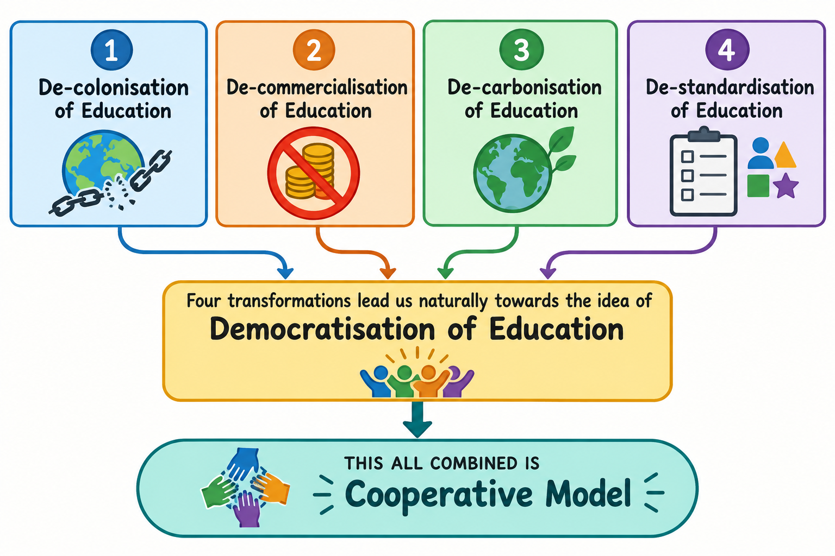

Slide 9


Slide 10
“Journey & Reflections on the first 100 Days” ?
Presentation by Mr. Srikanth P.

Slide 11
Adhoc Organisation Structure - Sahakar Vidya
National Committee
Shri Sunil Sood, Bhopal – National Convener
Smt. Ketika Kasetwar, Pune- Chairperson,
National Advisory Committee
Smt Shweta Singh – Zonal Convener (North)
Smt Meenakshi -Zonal Convener (South)
Shri Ajay Sharma- Zonal Convener (East)
Shri Suraj Kasera – Zonal Convener (West)
Executive Committee Members
Shri Vinay Hoyasala, Chickmanagkuru
Smt Varsha Shrikanth, Mysore
Smt Florine Rodrigues, Mumbai
Shri Vipul Pradhan
Smt Rashi Sharma
Smt Suyash Shrivastava
Shri Anoop Errakil, Keralam
Dr Anish , Keralam
State Conveners
Smt Indira – Karnataka
Smt Thiripurasunadri – Tamilnadu
Dr. Bala Venkata Subbarayudu Chilukuri, Telangana
Smt. Indu Sinha , NCR
Smt. Risha Sheikh, Keralam
Shri Sandeep Nisal, Maharashtra
Shri Tarit Mohan, Uttarakhand
IT Core Team
Shri Ajay Sharma, Ranchi
Shri Srikanth Pemmaraju, Bengaluru
Shri Manik Lohar, Ranchi
Shri Hitesh Kumar. Delhi
Shri Durgesh Bugade
Shri Aaradhy Kasera, Pune
Shri Rakesh Rajak,Bhopal
Online Learning Sessions Committee
Smt. Shubha Joshi, Chairperson
Smt. Padmavati Joshi, Member
Smt. Shrutee Pandarangi, Member
Shri Ramanathan S, Member
Shri Viru Kulkarni, Member

Slide 12


Slide 13
Strategic Proposal: State-wise Cooperative Pathway.
Presentation by Ms. Indu Sinha

Slide 14
Over the past 100 days, we have Created a platform, Brought people into conversation and Begun to imagine what is possible. But launching a platform is not the same as building an institution. An institution must enable broad participation, - shared responsibility and continuity beyond any one individual.
That is the purpose of the proposal before us.(From local participation to national collaboration)*The pathway we are proposing is:
1) Local Communities →to
2) State Cooperatives →to
2) Inter-State Collaboration → to
3) National Federation / Cooperative of Cooperatives.
This is a pathway for exploration and consultation--, NOT a decision to be accepted without discussion.

Slide 15
These State-level structures will create Active communities which could develop initiatives in –
Learning *homeschooling support, Community- learning centres, skills such as vocational education in Nature, agriculture, health, arts and traditional IKS indigenous knowledge System. Every State need not do the same thing; Our strength may lie in our diversity.
What we need is a COMMON FRAMEWORK of Values and purpose, combined with freedom for communities to innovate according to local circumstances. We do not want uniformity imposed from above.
We want UNITY strengthened from below through Shared purpose, local ownership and collective learning..

Slide 16


Slide 17
Next 100 Days Action Plan
Presentation by Mr Sunil Sood

Slide 18


Slide 19
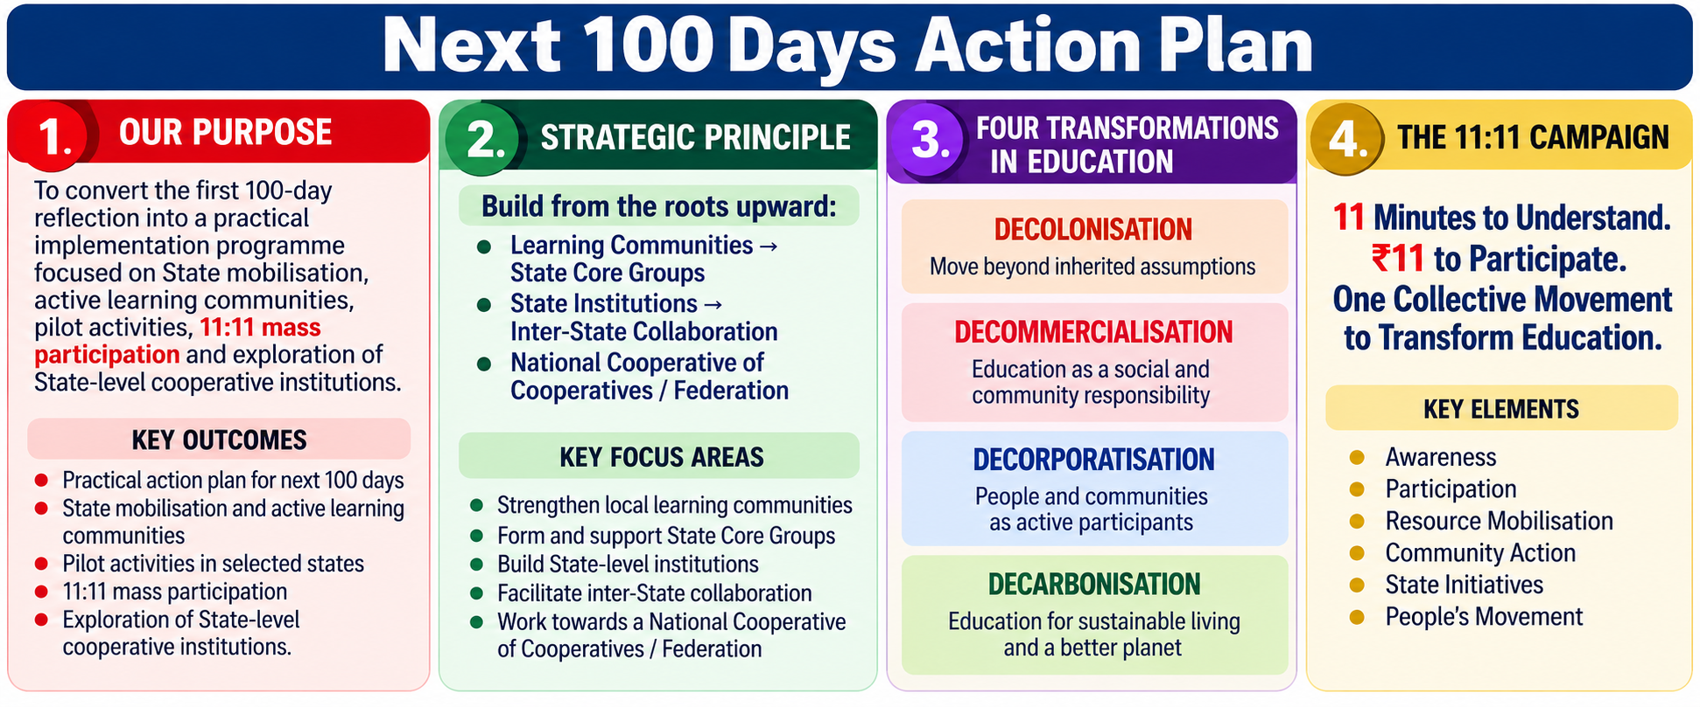

Slide 20
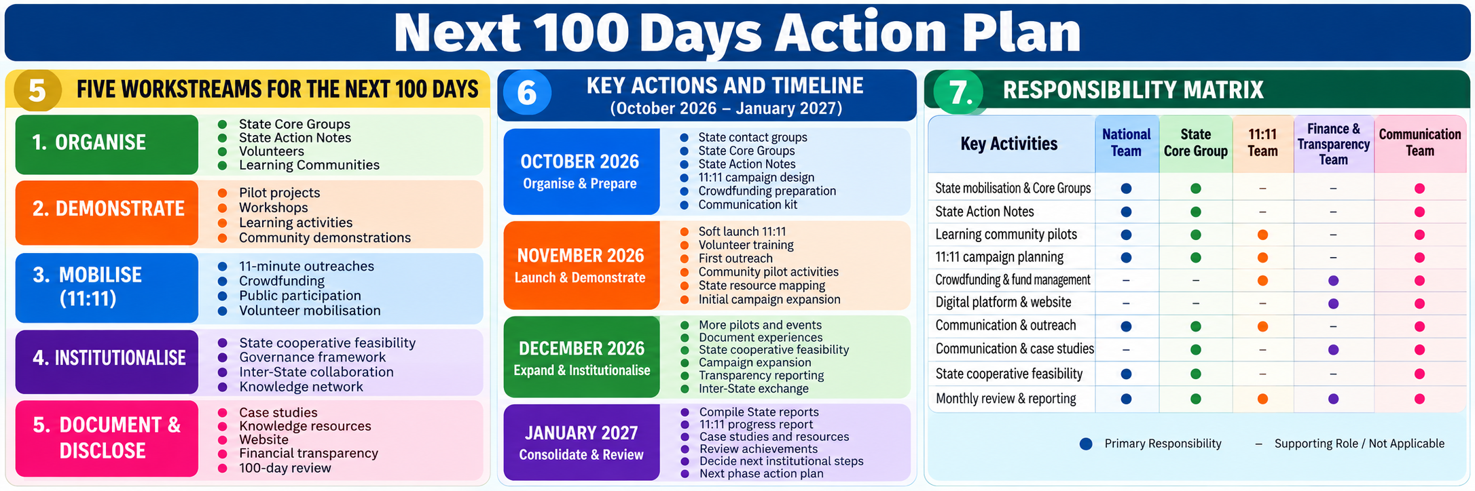

Slide 21
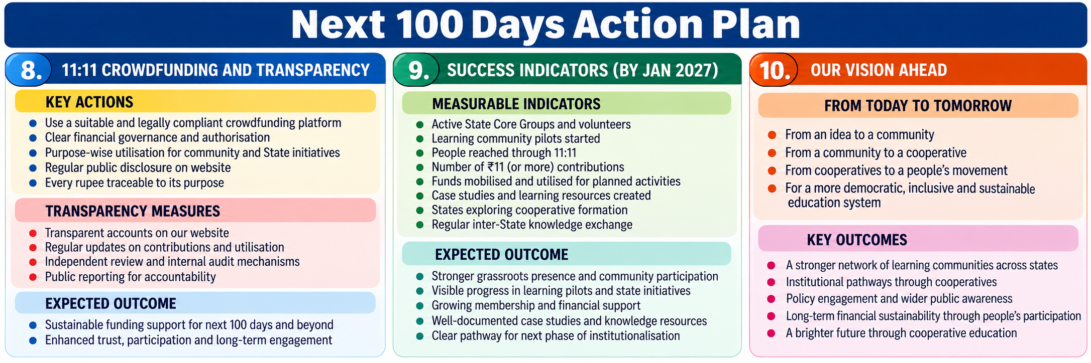

Slide 22
Concluding Remarks:
Dr. Bala Venkata Subbarayudu Chilukuri

Slide 23
Thank you very much for your participation….
Please visit our web site www.sahakarvidya.org
To join our WhatsApp group, please contact 9039308929

