Slide 1
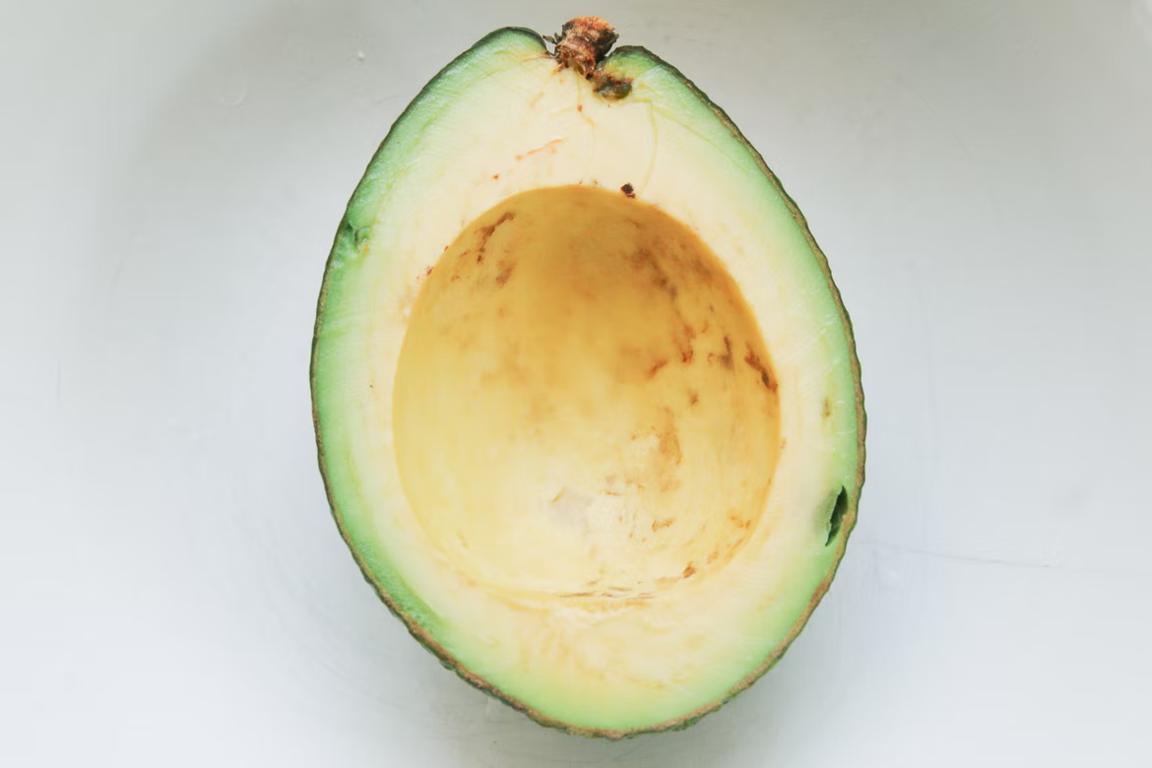
AVOCADO
Free Template

Slide 2
Introduction
From history and teenage romance to futuristic science fiction and profound themes of life, manga became an important, almost inevitable aspect of Japan’s identity and they helped spread knowledge and understanding of it across the planet.

Slide 3
Table of Contents
01
03
02
04
Introduction
How does benchmarking work?
Ways to use benchmarking
Defining a Benchmarking Initiative

Slide 4
How to prepare your bike
1
2
Saddle area
Mercury is the closest planet to the Sun
Wheels
Venus has a beautiful name, but it’s very hot

Slide 5
Equity, diversity & inclusion
Diversity
Despite being red, Mars is cold
Equity
Venus has a beautiful name
Inclusion
Diversity
Jupiter is the biggest planet
Despite being red, Mars is cold

Slide 6
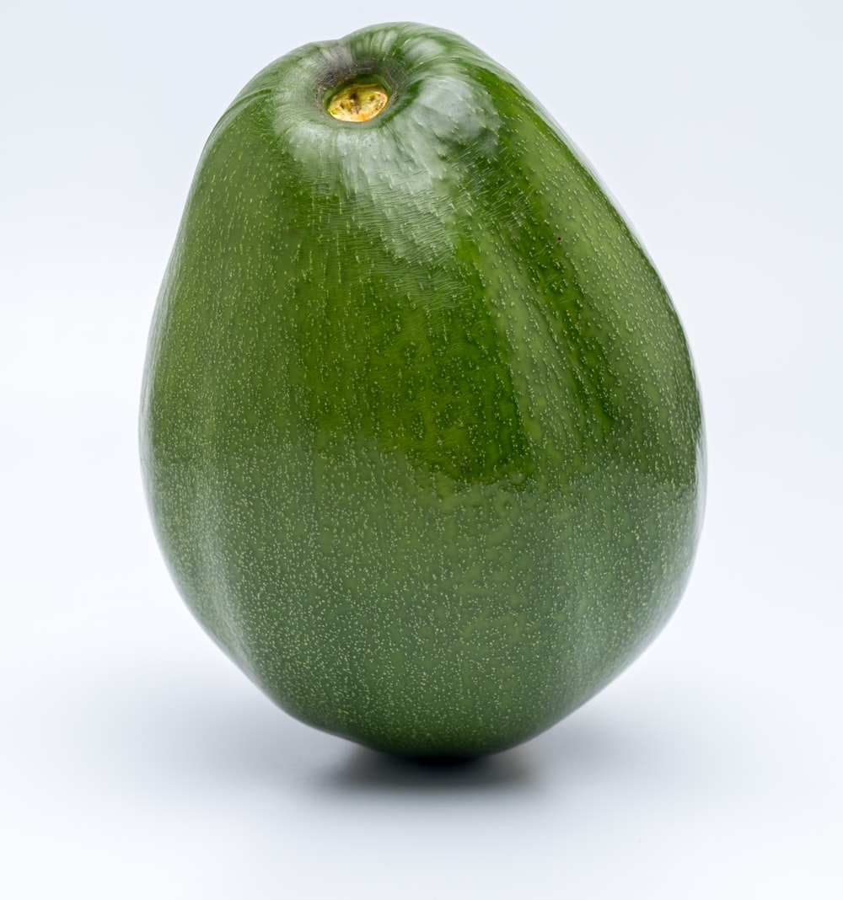
Introduction
01
You can give a brief description of the topic you want to talk about here. For example, if you want to talk about Mercury, you can say that it’s the smallest planet in the entire Solar System

Slide 7
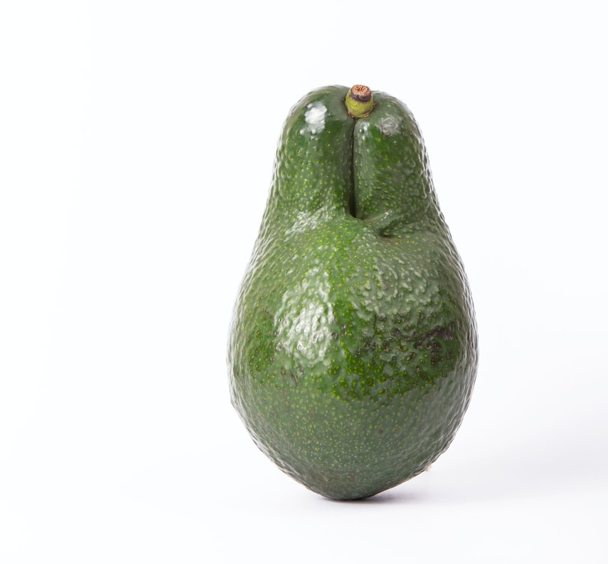
What is benchamrking?
Benchmarking – i.e.
Comparing your business performance against certain reference points – is a popular and potentially powerful way to glean insights that can lead to improved performance. We’ll explore the various types of benchmarking and how these approaches can benefit your business.

Slide 8
What’s the difference between benchmarks and KPIs?
Benchmark
KPI
Benchmarks are reference points that you use to compare your performance against the performance of others. These benchmarks can be comparing processes, products or operations, and the comparisons can be against other parts of the business, external companies (such as competitors) or industry best practises. Benchmarking is commonly used to compare customer satisfaction, costs and quality.
KPIs, on the other hand, are decision-making and monitoring tools, used to track performance in relation to strategic goals. In other words, KPIs chart whether an individual, project, team, business unit or entire company is on track to achieve its objectives. KPIs are a bit like an early warning system, flagging up where things might be heading off-course and where action might be needed.

Slide 9
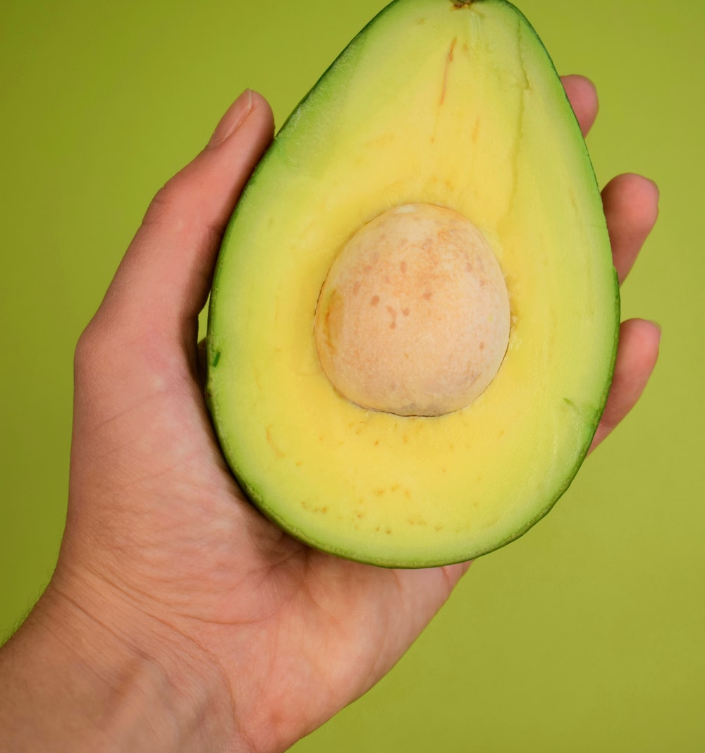
Ways to use benchmarking
02
Process benchmarking
Strategic benchmarking
Performance benchmarking

Slide 10
Three ways to use benchmarking
Process benchmarking
Performance benchmarking
Strategic benchmarking

Slide 11
AWARDS
Saturn
Mercury
Neptune
Saturn is a gas giant and has rings
It’s the closest planet to the Sun
Neptune is very far away from us

Slide 12
Three ways to use benchmarking
This is all about better understanding your processes, comparing performance against internal and external benchmarks, and finding ways to optimise and improve your processes. The idea is that, by understanding how top performers complete a process, you can find ways to make your own processes more efficient, faster and more effective.
This is all about better understanding your processes, comparing performance against internal and external benchmarks, and finding ways to optimise and improve your processes. The idea is that, by understanding how top performers complete a process, you can find ways to make your own processes more efficient, faster and more effective.
Process benchmarking

Slide 13
ABOUT OUR SERVICES
Jupiter
Mercury
70%
30%
It’s the biggest planet of them all
It’s the closest planet to the Sun

Slide 14
Three ways to use benchmarking
This compares strategies, business approaches and business models in order to strengthen your own strategic planning and determine your strategic priorities. The idea is to understand what strategies underpin successful companies (or teams or business units) and then compare these strategies with your own to identify ways you can be more competitive.
This compares strategies, business approaches and business models in order to strengthen your own strategic planning and determine your strategic priorities. The idea is to understand what strategies underpin successful companies (or teams or business units) and then compare these strategies with your own to identify ways you can be more competitive.
Strategic benchmarking

Slide 15
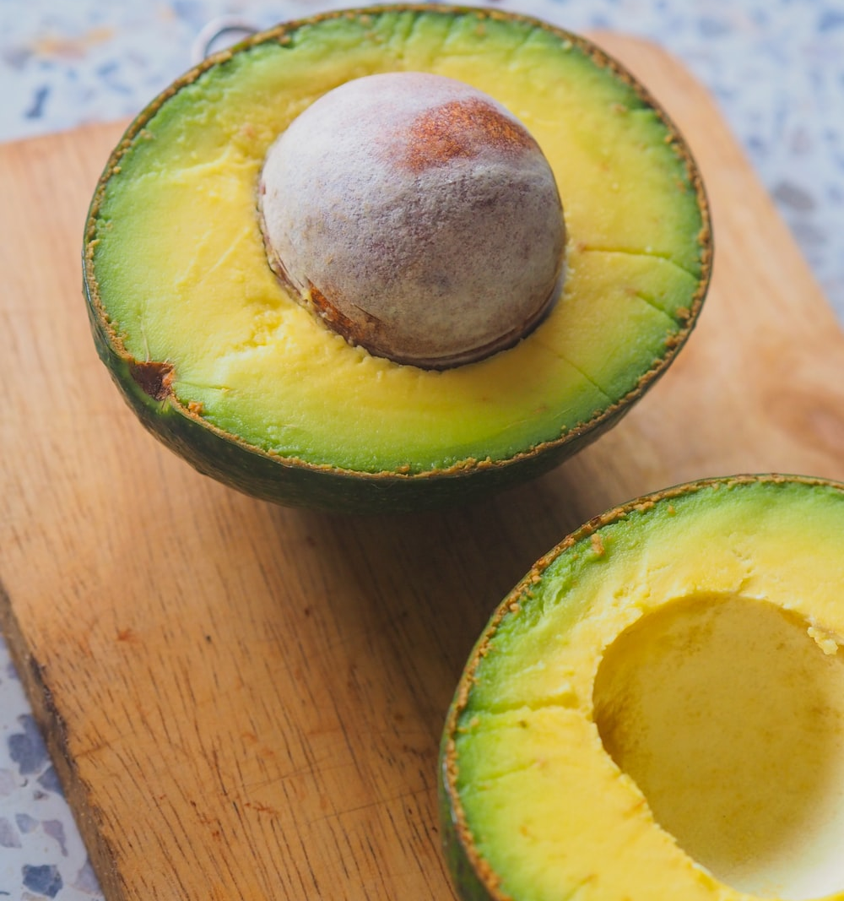
How does benchmarking work?
03

Slide 16

ABOUT US
You can give a brief description of the topic you want to talk about here. For example, if you want to talk about Mercury, you can say that it’s the smallest planet in the entire Solar System
You can give a brief description of the topic you want to talk about here. For example, if you want to talk about Mercury, you can say that it’s the smallest planet in the entire Solar System

Slide 17
OUR SERVICES
You can enter a subtitle here if you need it

Slide 18
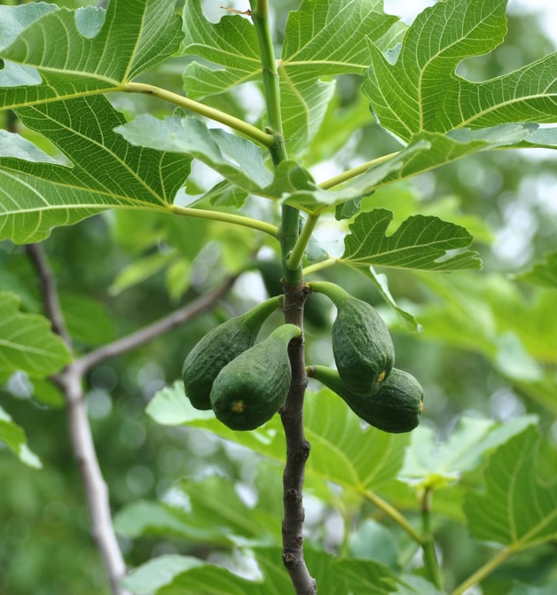
Defining a Benchmarking Initiative
04

Slide 19
Defining a Benchmarking Initiative
Because any process, product, or function in a business is eligible for benchmarking, methodologies vary. Typically, the benchmarking process involves:
Defining the subject of the benchmarking study
Defining the process or attribute to be studied in detail
Selecting the comparison set
Assessing the data and identifying differences and gaps

Slide 20
Benchmarking Examples
A firm interested in improving their customer service practices may compare its own processes and metrics against those of its most successful competitor. If it identifies negative discrepancies or differences in measures, it may start improving its processes to strengthen its performance. The firm will observe and measure the competitor's operations, and in some industries, it will send in employees as customers to gain direct experience.

Slide 21
Benchmarking Examples
One of the best examples that has been carried out in recent years is Starbucks.
Economic instability and the commitment to boost coffee sales by fast food companies such as McDonalds, have led Starbucks to initiate a benchmarking process.

Slide 22
Benchmarking
Examples
What did they decide to improve to alleviate this situation? One of the vital aspects for its business model is the time of preparation of its coffees. As we have seen before, they needed a leading company to look at to later implement the improvements. The chosen company: the Japanese car manufacturer Toyota. Without a doubt a great example to follow in optimizing the manufacturing time of their products.

Slide 23
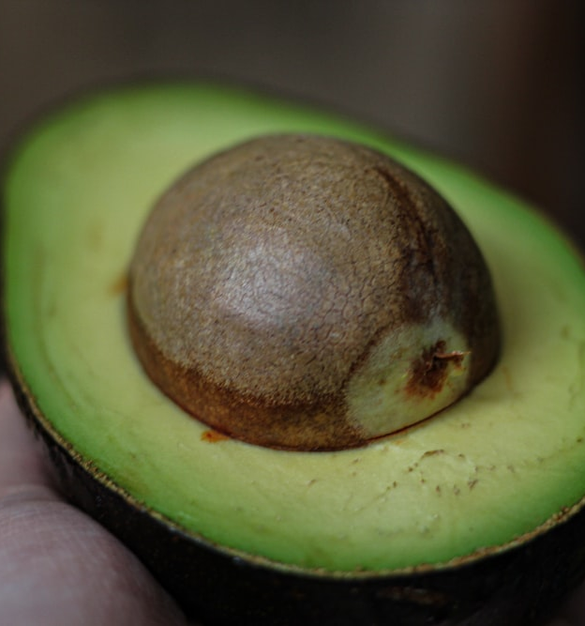
Extra Slides and Infographics
05

Slide 24
The Bottom Line
Apparently 30% of the time spent preparing the famous Starbucks coffees was wasted on the time spent by employees bending, walking or choosing ingredients. After conducting an analysis of the benchmarks, they implemented an action plan based on the optimization of the processes to prepare their coffees, a redesign of the workspace, along with a new arrangement of the utensils and machines necessary for the preparation of their products. This led to an improvement in the production time of their products by almost 20%.

Slide 25

A PICTURE IS WORTH A THOUSAND WORDS

Slide 26
OUR LOCATIONS
Neptune
Mercury
Neptune is very far away from us
It’s the closest planet to the Sun
Mars
Jupiter
Mars is actually a very cold place
It’s the biggest planet of them all

Slide 27
9h 55m 23s
333,000.000
386,000 km
is Jupiter's rotation period
earths is the Sun’s mass
separate Earth from the Moon

Slide 28
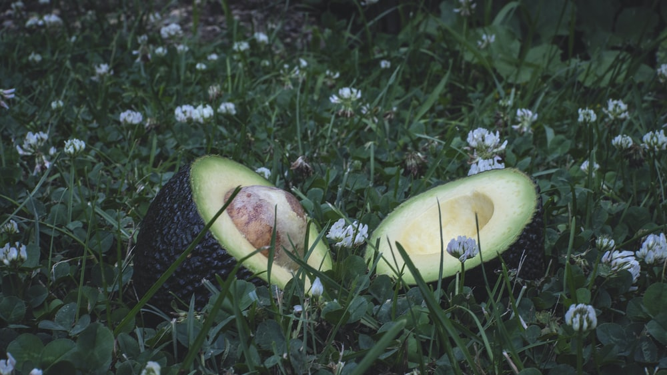
AWESOME WORDS

Slide 29
Free Template
Thank you!

Slide 30
FUENTE
ELABORADO POR : plantillaspowerpoint.org
IMAGES :
unsplash.com
FONTS :
Quicksand

Slide 31
RESOURCES

Slide 32
RESOURCES

Slide 33
RESOURCES

Slide 34
Fully Editable Icon Sets: A

Slide 35
Fully Editable Icon Sets: B

Slide 36
Fully Editable Icon Sets: C

