Slide 1

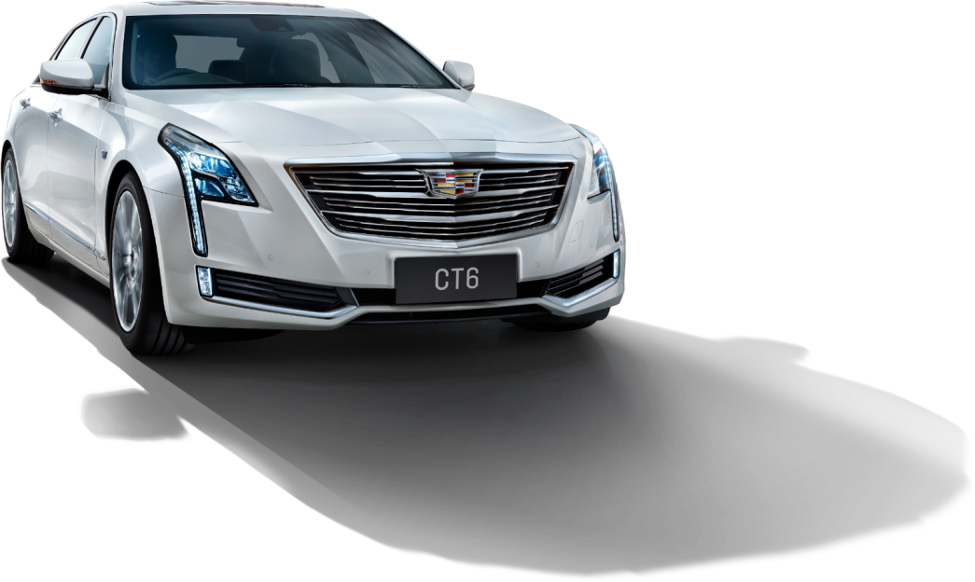
AUTO TRANSFER
Powerpoint Template
www.freepptbackgrounds.net

Slide 2

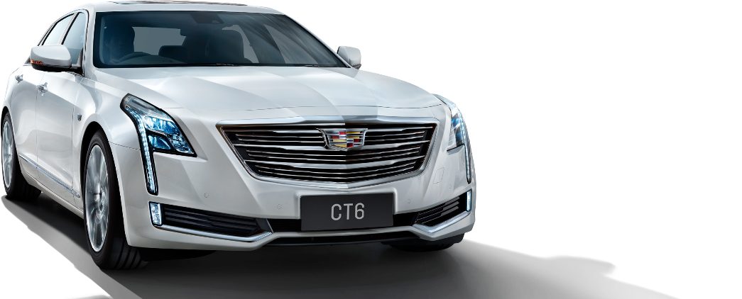
CONTENT
Public
1
Education
2
Finance
3
Fashion
4

Slide 3
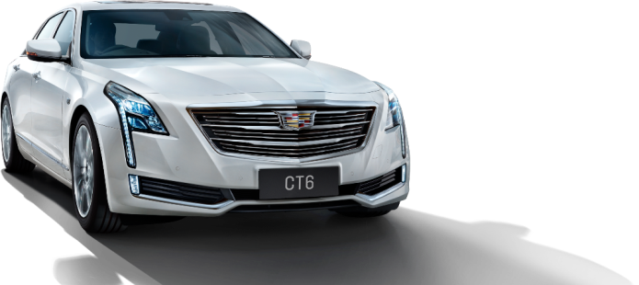
PUBLIC
1

Slide 4
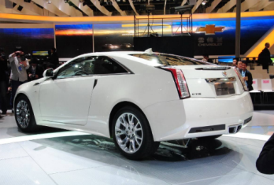
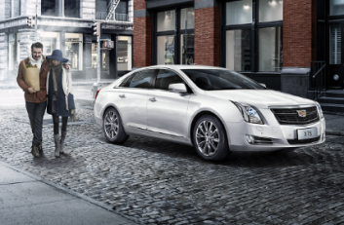

Arts
Culture
Real
Easy to change colors, photos and Text. Get a modern PowerPoint Presentation that is beautifully designed.Far far away, behind the word mountains, far from the countries Vokalia and Consonantia, there live the blind texts.

Slide 5
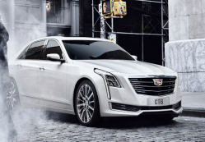
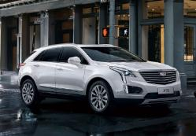
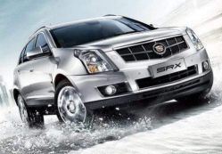
Get a modern PowerPoint Presentation that is beautifully designed.
Easy to change colors, photos and Text.
Easy to change colors, photos and Text.
Get a modern PowerPoint Presentation that is beautifully designed.

Slide 6
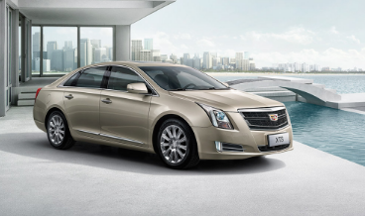



Click on the button under the presentation preview that says "Use as Google Slides Theme.
You have to be signed in to your Google account.
You have to be signed in to your Google account.

Slide 7
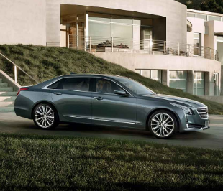
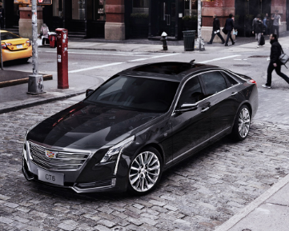
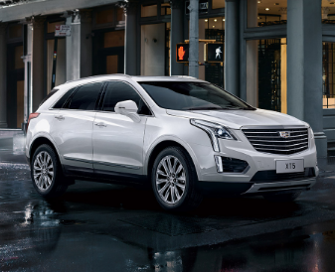
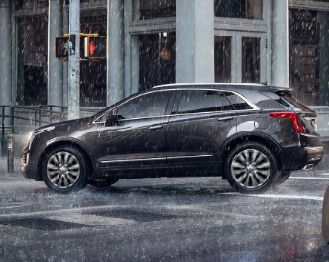

Slide 8

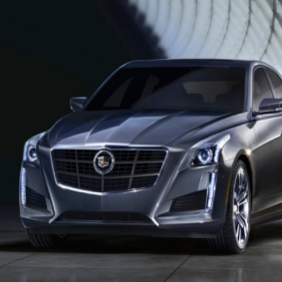
Is the color of gold, butter and ripe lemons. In the spectrum of visible light, yellow is found between green and orange.
We use well-known development methodologies to create a customized approach for each of the projects.
Is the color of gold, butter and ripe lemons. In the spectrum of visible light, yellow is found between green and orange.

Slide 9
EDUCATION
2

Slide 10
This allows us to achieve high quality outcomes and full transparency towards.
A
G
1
7
B
F
C
D
E
2
6
3
4
5

Slide 11





We press play on your digital story. Using conceptual
This allows us to achieve high quality outcomes and full transparency towards.
This allows us to achieve high quality outcomes and full transparency towards.
We press play on your digital story. Using conceptual

Slide 12
100
We press play on your digital story. Using conceptual, digital design, we work with you to build experiences that feel 'right' for your users. We create a solid user-product relationship, one that's long and fruitful.
80
60
40
20
0
1
2
3
4
5
6
7
8
9

Slide 13



60%
30%
80%
Moving from creative ideas to solid strategy
60%
30%
We leverage digital tools, design and words, to become even more relevant.
80%
We leverage digital tools, design and words, to become even more relevant.

Slide 14
We align with your users need to build and evolve a flowing shopping interface, one that slots easily into
Simple & Smooth, exactly how purchasing experiences should be.
Simple & Smooth, exactly how purchasing experiences should be.
We align with your users need to build and evolve a flowing shopping interface, one that slots easily into

Slide 15
FINANCE
3

Slide 16


01 Workshops
02 Briefing
The user can demonstrate on a projector or computer
Your audience relate and absorb information on different sensory
Your audience relate and absorb information on different sensory
Design
The user can demonstrate on a projector or computer
04 Evaluation
03 E-commerce

Slide 17








The user can make a presentation on a projector
The user can make a presentation on a projector or computer
The user can make a presentation on a projector or computer
Enter the comprehensive description of the above chart here
Enter the comprehensive description of the above chart here
The user can make a presentation on a projector

Slide 18




Design
Quality
01
We certainly do not forget you as soon as you forget us.
It is a very sad thing that nowadays there is so little useless information.
02
Assurance
Quality
04
It is a very sad thing that nowadays there is so little useless information.
We certainly do not forget you as soon as you forget us.
03

Slide 19
95%
40%
95%
40%
You have always a profession, pursuits, business of some sort or other
You have always a profession, pursuits, business of some sort or other

Slide 20




The time is now, the place is here. Stay in the present. You can do nothing to change the
I believe that people would be alive today if there were a death penalty. Nancy Reagan
I believe that people would be alive today if there were a death penalty. Nancy Reagan
The time is now, the place is here. Stay in the present. You can do nothing to change the

Slide 21
FASHION
4

Slide 22




The time is now, the place is here. Stay in the present. You can do nothing to change the past, and the future will never
01
Genius hath electric power which earth can never tame. Lydia M. Child
03
The time is now, the place is here. Stay in the present. You can do nothing to change the past, and the future will never
Genius hath electric power which earth can never tame. Lydia M. Child
02
04

Slide 23





Solution
Direction
Editable
Content
Layouts

Slide 24

I feel very strongly that change is good because it
2020
A large income is the best recipe for
2019
I feel very strongly that change is good because it
2012

Slide 25
Be an encourager, the world has enough critics already.
Woe be to him that reads but one book. George Herbert
Be an encourager, the world has enough critics already.
Woe be to him that reads but one book. George Herbert
Always give your best never worry for results.

Slide 26
01
02
03
Money
Invectors
Impress
Everyone wants, happiness. No one wants pain. But you can’t have a rainbow without a little rain.
Enjoy the little things in life, because one day you will look back and realize they were the big things.
God sometimes removes people from your life to protect you. Do not run after them.

Slide 27
THANK YOU !
Auto Transfer
Powerpoint Template
www.freepptbackgrounds.net

