Slide 1



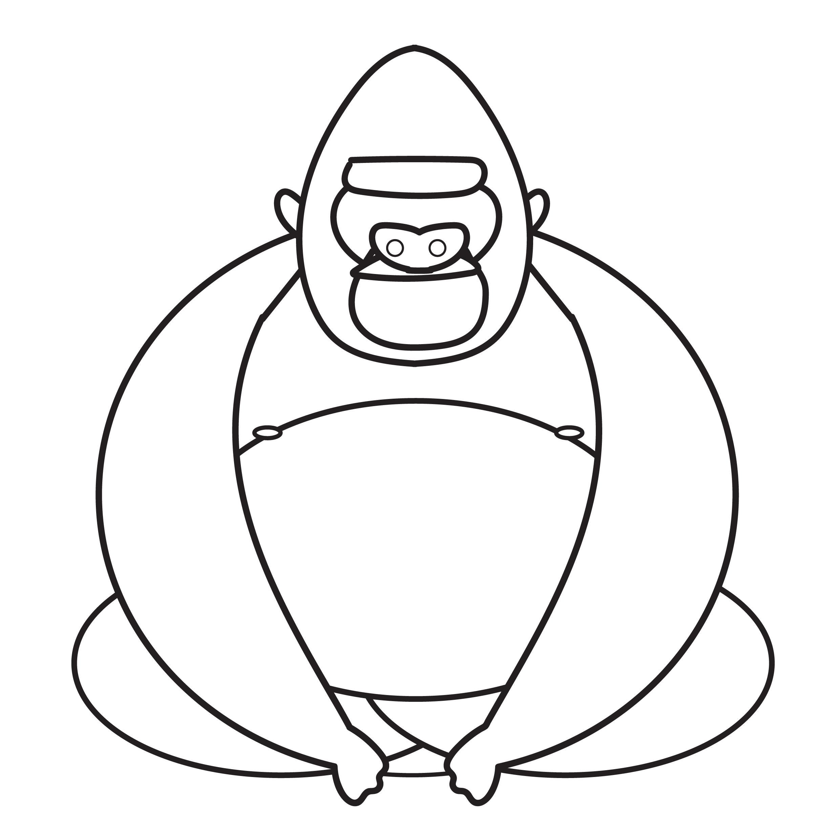

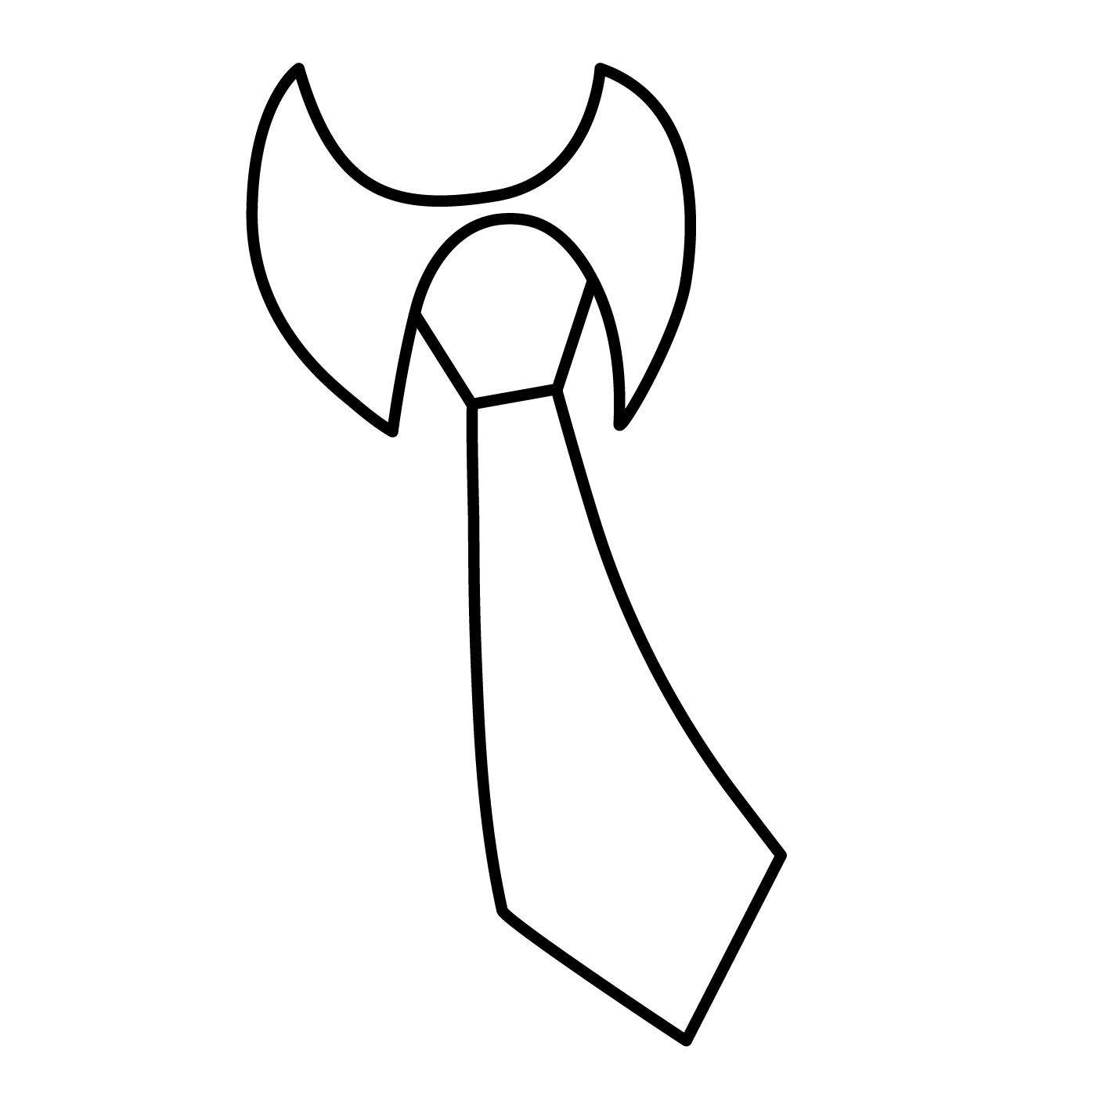

Phonics: g as in gas
What sound does each object start with? Colour the letter that matches the sound.
g
m
d
t
s
i
g
n
p
t
a
g
© State of New South Wales (Department of Education), 2023. Except for the Department of Education logo, other logos and trademark-protected material, this resource is licensed under the Creative Commons Attribution 4.0 International Licence

Slide 2

Phonics: g as in gas
Colour the boxes that have the letter g and practise making the sound.
d
m
g
g
n
a
g
s
t
g
© State of New South Wales (Department of Education), 2023. Except for the Department of Education logo, other logos and trademark-protected material, this resource is licensed under the Creative Commons Attribution 4.0 International Licence

Slide 3







Phonics: g as in gas
g
Colour the pictures that begin with the g sound.
Draw your own pictures that start with the g sound.
© State of New South Wales (Department of Education), 2023. Except for the Department of Education logo, other logos and trademark-protected material, this resource is licensed under the Creative Commons Attribution 4.0 International Licence

