Slide 1
Stream flow generation
NOTE: Slides for each module are numbered for easier cross-referencing with class notes
1
NOTE: My slides have TONS of animations and building graphics. These do not translate well to D2L, so it is best to download the power point to work through the logic behind the animations

Slide 2
Stream flow response: Source water separation
2
Mixture of water from different sources
Where did the new water come from?
Where did the old water come from?
New water
Energy moves faster than water through hydrologic systems.
Old water

Slide 3
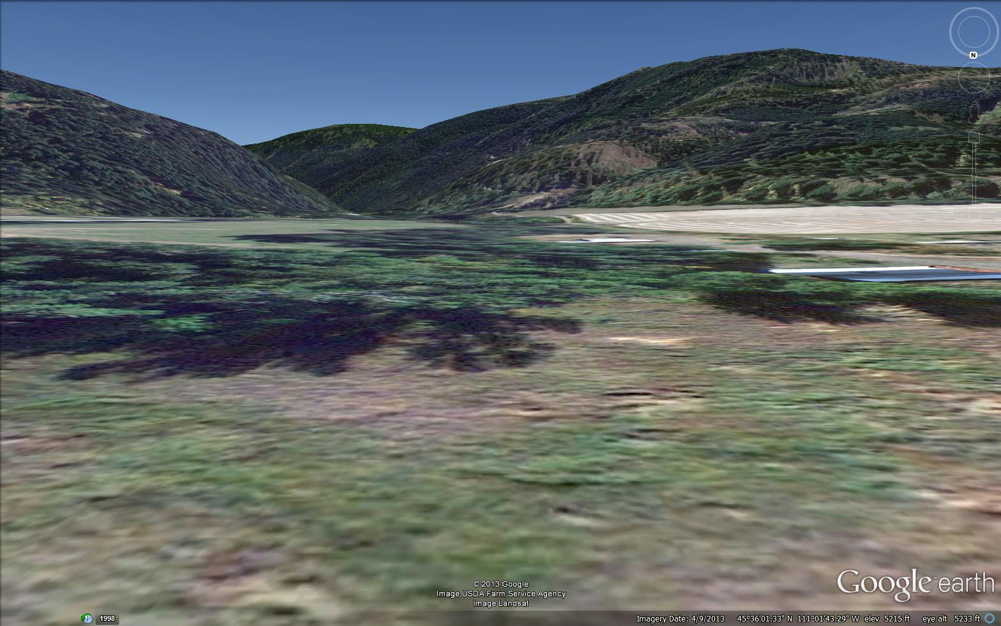
Stream flow generation: hillslope hydrology
3
Bozeman (Sourdough) Creek

Slide 4
Stream flow generation: hillslope hydrology
4
Precipitation = P
Evaporation (and Transpiration) = E_{ET}
Infiltration /
Recharge
Groundwater flow
Runoff = Q_{OUT}

Slide 5
Stream flow generation: hillslope hydrology
5
Precipitation = P
Evaporation (and Transpiration) = E_{ET}
Infiltration /
Recharge
Groundwater flow
Runoff = Q_{OUT}

Slide 6



Stream flow generation: hillslope hydrology
6
Precipitation = P
Interception ($∆S$)
Total interception loss (evaporation)
Net precipitation (throughfall)
Surface detention ($∆S$)
Infiltration excess overland flow
Infiltration
Soil water ($∆S$)

Slide 7

Stream flow generation: Infiltration excess
7
Infiltration excess overland flow = Hortonian overland flow
Foundational concept for decades (including the basis for rational and SCS curve methods)
What if event flow is driven by rainfall rates in excess of soil infiltration capacity?
Peak flow
Rising limb
or
hydrograph rise
Falling limb
or
hydrograph recession
Quick flow or Event flow
Delayed flow or Base flow
Robert Elmer Horton
Base flow

Slide 8
Stream flow generation: Infiltration excess
8
?
New water
Old water
Robert Elmer Horton

Slide 9

Stream flow generation: hillslope hydrology
9
Precipitation = P
Interception ($∆S$)
Total interception loss (evaporation)
+ Evapotranspiration
Net precipitation (throughfall)
Surface detention ($∆S$)
Infiltration excess overland flow
Infiltration
Soil water ($∆S$)
Percolation (recharge)
Saturation excess overland flow
Groundwater ($∆S$)
Groundwater (aquifer) flow

Slide 10
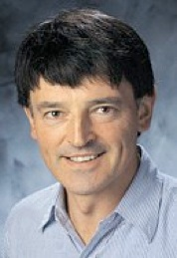
Stream flow generation: Saturation excess
10
Saturation excess overland flow = Dunnian overland flow
Led to the current foundational idea known as the Variable Source Area Concept
Saturated areas where groundwater meets the surface must be important to stream flow generation
New water
Old water
Thomas Dunne

Slide 11
Stream flow generation: Variable source areas
11
Contours
Streams
Variable source area
Ephemeral or intermittent stream

Slide 12
Stream flow generation: Variable source areas
12
Capillary
fringe
Water
table

Slide 13


Stream flow generation: Variable source areas
13
Transmissivity feedback
Kevin Bishop
Hydraulic conductivity (K)
$$\frac{Q}{A}=−K\frac{∆h}{∆l}$$
In many systems, conductivity tends to decrease with depth

Slide 14

Stream flow generation: topographic controls
14
Contours
Topography must be important in controlling the extent of variable source areas
Streams
“Wetness” is directly related to contributing area and inversely related to the slope
Variable source area
Ephemeral or intermittent stream
Keith Beven

Slide 15
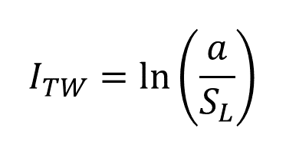


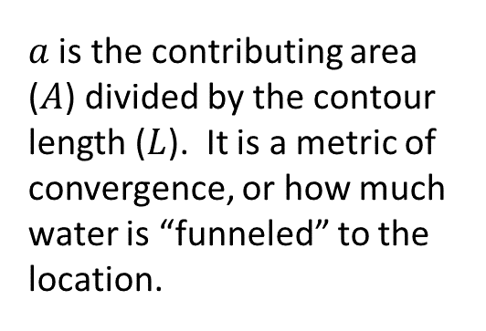
Stream flow generation: topographic controls
15
Topographic Wetness Index
$a$ is the contributing area ($A$) divided by the contour length ($L$). It is a metric of convergence, or how much water is “funneled” to the location.
$$I_{TW}=\ln\left(\frac{a}{S_{L}}\right)$$
$$a=\frac{A}{L}$$
“Wetness” is directly related to contributing area and inversely related to the slope
A
A
$$a_{left}<a_{right}$$
Keith Beven
L
L

Slide 16

Stream flow generation: topographic controls
16
Topographic Wetness Index
$a$ is the contributing area ($A$) divided by the contour length ($L$). It is a metric of convergence, or how much water is “funneled” to the location.
$$I_{TW}=\ln\left(\frac{a}{S_{L}}\right)$$
$$a=\frac{A}{L}$$
“Wetness” is directly related to contributing area and inversely related to the slope
A
A
$$a_{left}>a_{right}$$
Keith Beven
L
L

Slide 17

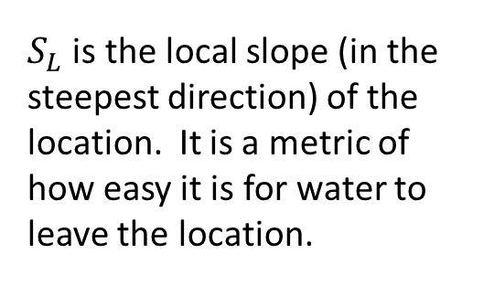
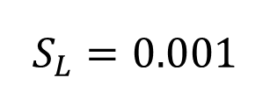
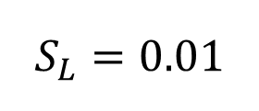
Stream flow generation: topographic controls
17
Topographic Wetness Index
$$I_{TW}=\ln\left(\frac{a}{S_{L}}\right)$$
a
a
$$a=\frac{A}{L}$$
$$I_{TW,left}<$$
$$I_{TW,right}$$
$$S_{L}=0.01$$
$$S_{L}=0.001$$
“Wetness” is directly related to contributing area and inversely related to the slope
$S_{L}$ is the local slope (in the steepest direction) of the location. It is a metric of how easy it is for water to leave the location.
Keith Beven

Slide 18
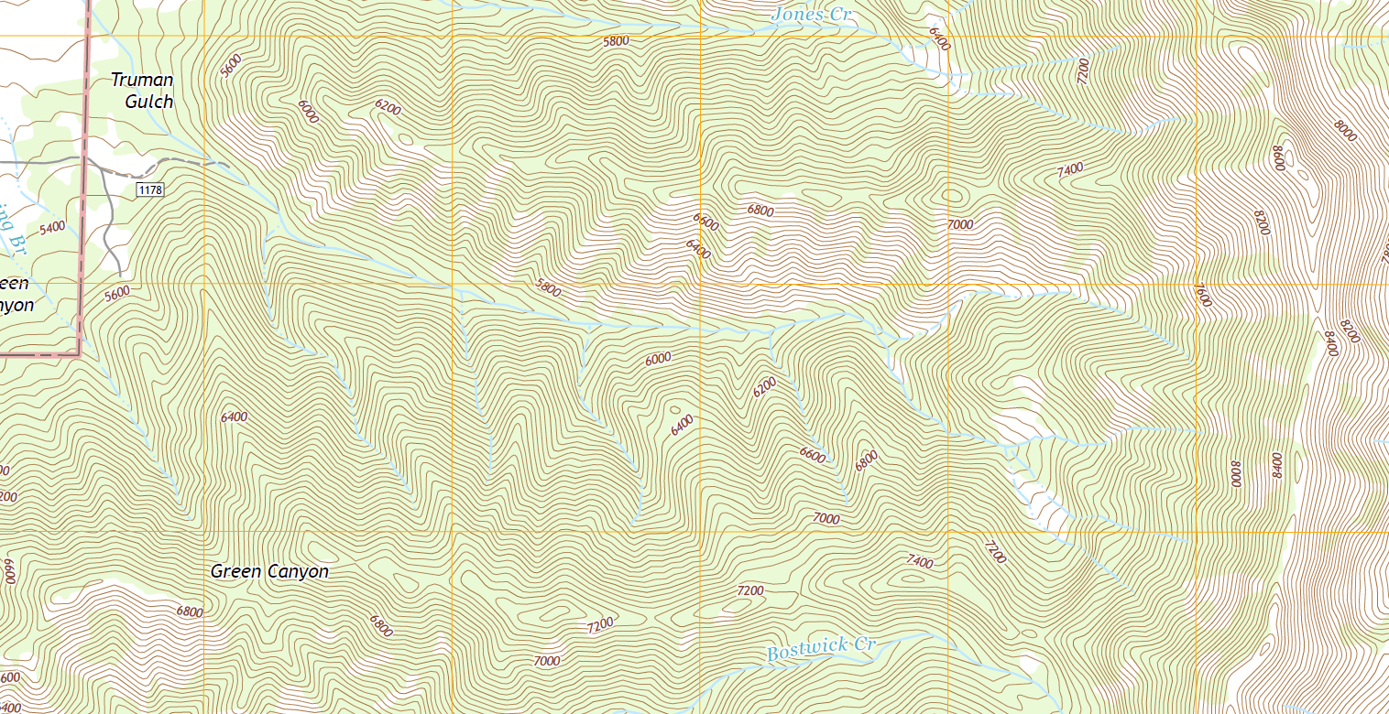
18
Stream flow generation: topographic wetness

Slide 19

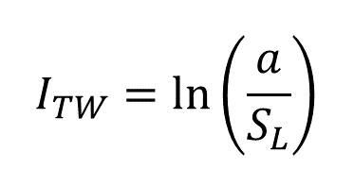
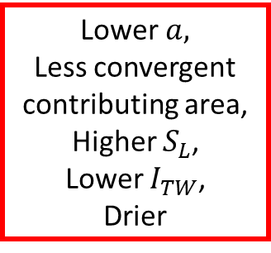
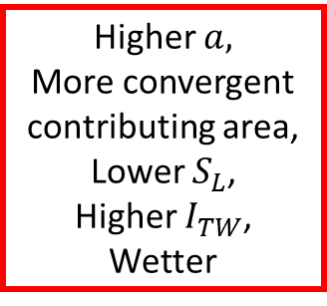
19
Stream flow generation: topographic wetness
$$I_{TW}=\ln\left(\frac{a}{S_{L}}\right)$$
Lower$a,$
Less convergent contributing area,
Higher $S_{L}$,
Lower $I_{TW}$,
Drier
$$a=\frac{A}{L}$$
Higher $a,$
More convergent contributing area,
Lower $S_{L}$,
Higher $I_{TW}$,
Wetter

Slide 20
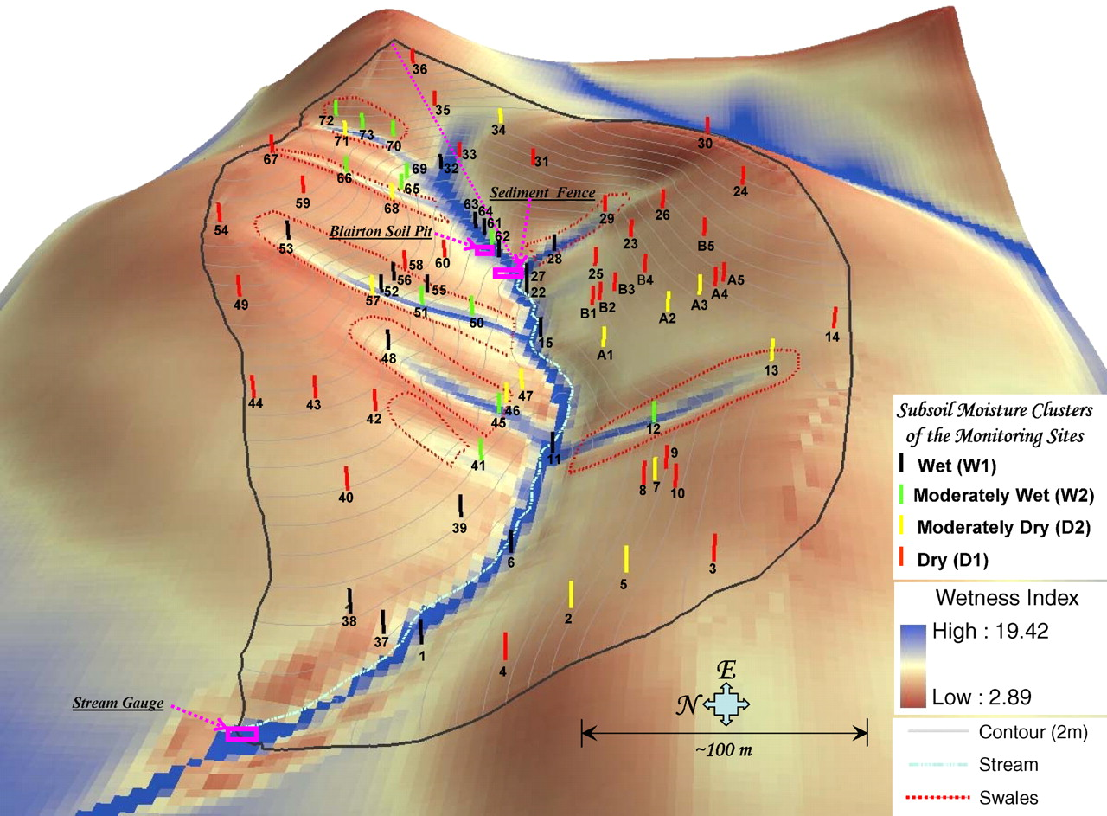
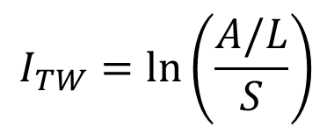
Contributing area and local slope: The topographic wetness index
20
$$I_{TW}=\ln\left(\frac{A/L}{S}\right)$$
From Lin (2006) Vadose Zone Journal 5(1): 317-340

Slide 21
Contributing area and local slope: The topographic wetness index
21
The topographic wetness index is a simplification:
When is it more likely to work?
Uniform soil depth in high relief topography
Confining layer below soil more likely to reflect surface topography
When is it less likely to work?
Variable soil depth in low relief topography
Subsurface topography less likely to match surface topography
From Lin (2006) Vadose Zone Journal 5(1): 317-340

Slide 22
Stream flow generation: Variable source areas
22
Contours
Streams
Variable source area
Ephemeral or intermittent stream

Slide 23
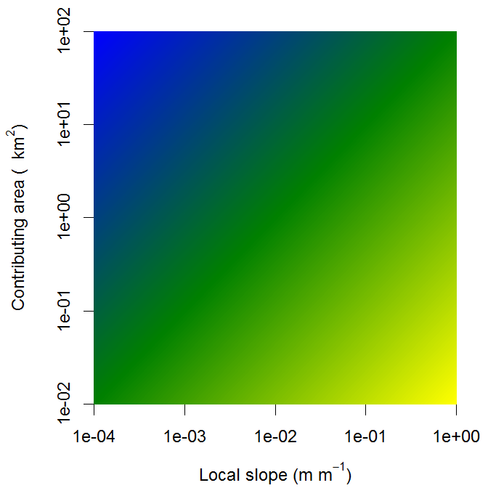
Contributing area and local slope: Concepts behind TOPMODEL
23
Stream flow generating area
Variable Source Area
Non-stream flow generating area
$$I_{TW}=\ln\left(\frac{A/L}{S}\right)$$
Blue is wettest
Green is middling
Yellow is driest

Slide 24
Stream flow generation: hillslope hydrology
24
Precipitation = P
Interception ($∆S$)
Total interception loss (evaporation) + Evapotranspiration
Net precipitation (throughfall)
Surface detention ($∆S$)
Infiltration excess overland flow
Infiltration
Soil water ($∆S$)
Interflow (throughflow)
Percolation (recharge)
Return flow
Saturation excess overland flow
Groundwater ($∆S$)
Groundwater (aquifer) flow

Slide 25
Stream flow generation: interflow
25
Perched water tables
Local impermeable layer

Slide 26
Stream flow generation: interflow
26
Hydraulic conductivity (K)
$$\frac{Q}{A}=−K\frac{∆h}{∆l}$$
Water will be backed up by the decrease in hydraulic conductivity with depth. This will create hydraulic gradients that will effectively “bend” the flow path to create lateral flow toward the stream

Slide 27
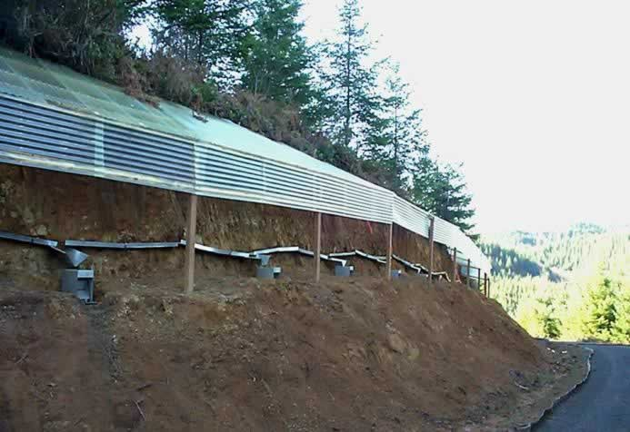
Stream flow generation: measuring interflow
27
A trenched hillslope for measuring lateral flow in soil

Slide 28
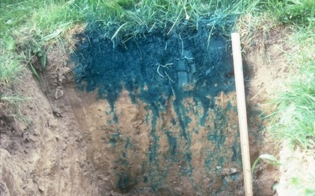
Stream flow generation: macroporosity
28

Slide 29
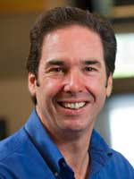
Stream flow generation: macroporosity
29
Disequilibrium flow in macropores
Jeff McDonnell
Infiltration excess
Saturation excess

Slide 30








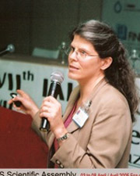
30
Diversity in hydrology needs to grow…
Doerthe Tetzlaff
Ryan Emanuel
Laura Lautz
Effi Foufoula-Georgiou
Mary Anderson
Diego Riveros-Iregui
Murugesu Sivapalan
Mary Hill
Bridget Scanlon

Slide 31
Stream flow generation: hillslope hydrology
31
Precipitation = P
Interception ($∆S$)
Total interception loss (evaporation) + Evapotranspiration
Net precipitation (throughfall)
Surface detention ($∆S$)
Infiltration excess overland flow
Infiltration
Soil water ($∆S$)
Interflow (throughflow)
Percolation (recharge)
Return flow
Saturation excess overland flow
Groundwater ($∆S$)
Groundwater (aquifer) flow
Groundwater (aquifer) flow
Vertical water movement and storage
Lateral water movement
= Stream flow generation

Slide 32
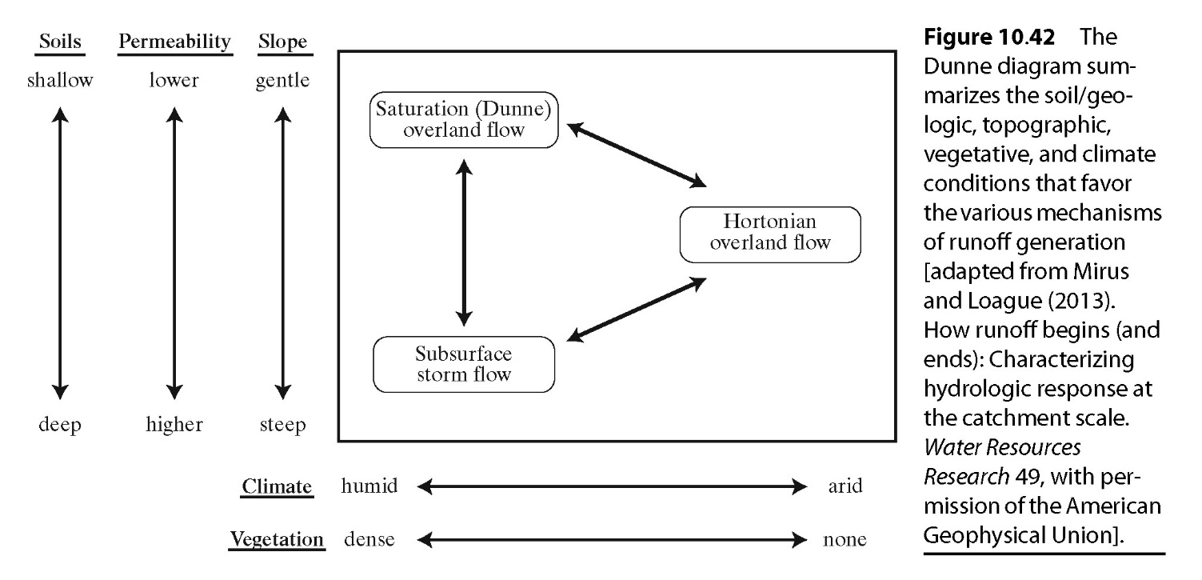
Stream flow generation: basic controls
32
Soil
(a.k.a. Interflow)
Surface Permeability
higher
lower

Slide 33
Stream flow generation: source water
33
Precipitation = P
Interception ($∆S$)
Total interception loss (evaporation) + Evapotranspiration
Net precipitation (throughfall)
Surface detention ($∆S$)
Infiltration excess overland flow
Infiltration
Soil water ($∆S$)
Interflow (throughflow)
Percolation (recharge)
Return flow
Saturation excess overland flow
Groundwater ($∆S$)
Groundwater (aquifer) flow
Groundwater (aquifer) flow
Vertical water movement and storage
Lateral water movement
= Stream flow generation

Slide 34
Stream flow generation: source water
34
Discharge
New
+ Evapotranspiration
Old
Time

Slide 35
Stream flow generation: source water
35
Discharge
Infiltration excess
Precipitation on variable source area
+ Evapotranspiration
Old
Time

Slide 36
Stream flow generation: source water
36
Discharge
Infiltration excess
Precipitation on variable source area
+ Evapotranspiration
Interflow
Groundwater from variable source area
Deep groundwater
Time

