Slide 1
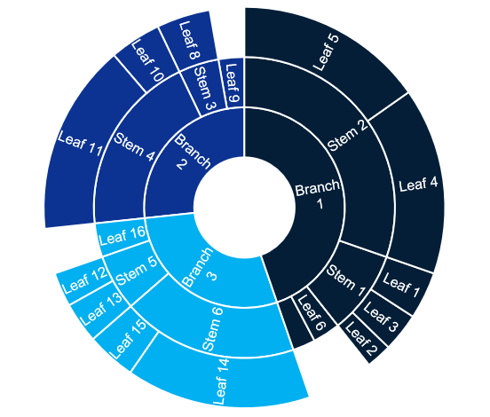
2-Sunburst Charts
Click to edit Header text styles
Click to edit Header text styles
Source: Complete if required

