Slide 1












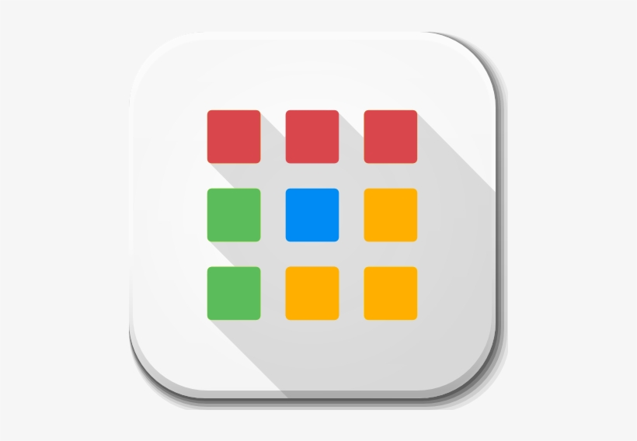







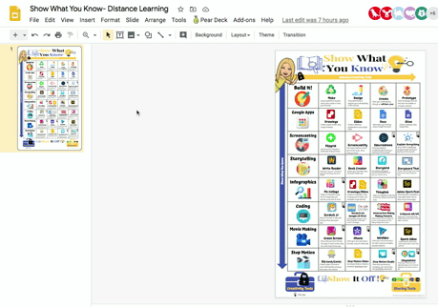









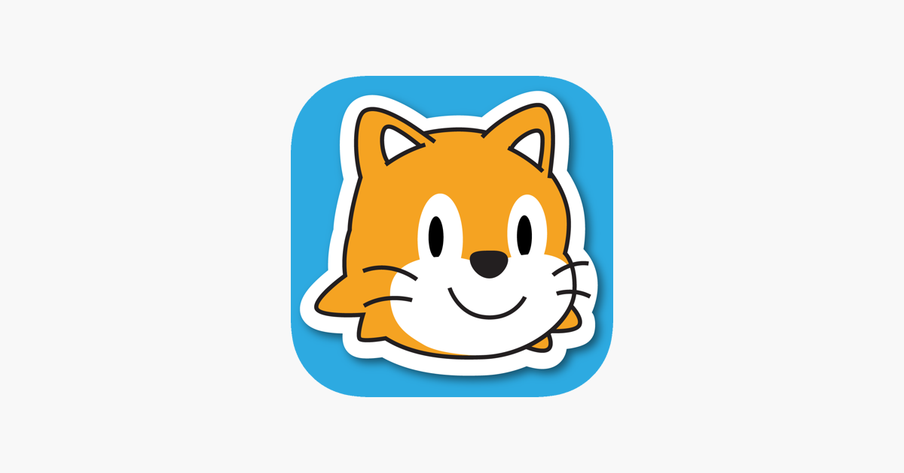


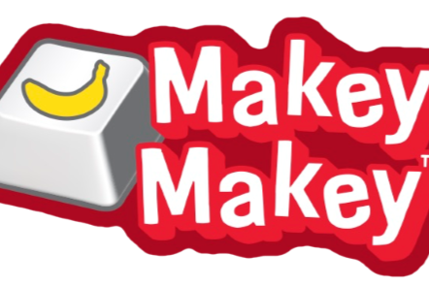


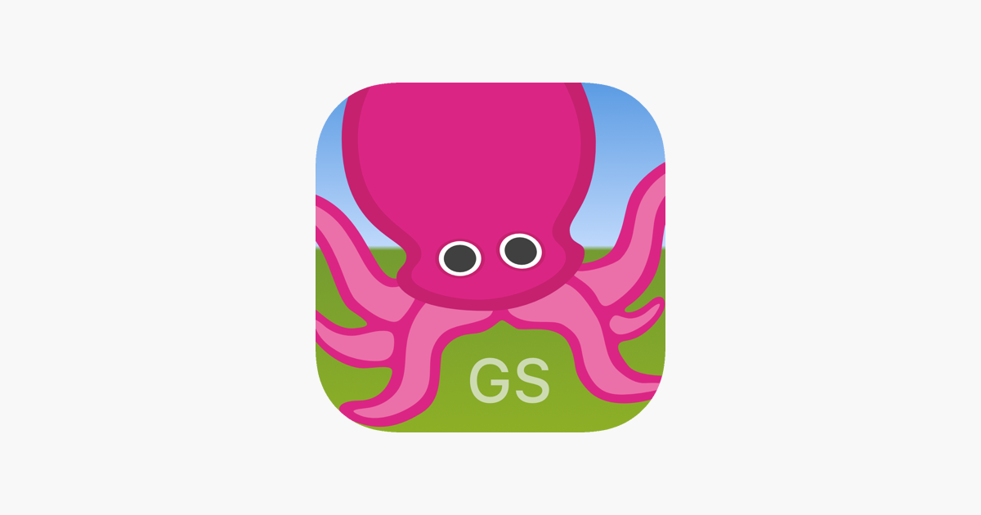



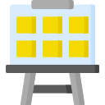











Unlocked Creativity Tools
Build It!
Google Apps
Screencasting
Storytelling
Infographics
Coding
Movie Making
Stop Motion
Make
Using household & recycled items, build a model of what you’ve learned.
Design
Draw, sketchnote, or diagram your understanding of the concept.
Create
Show your understanding through an ARTistic Lens!
Prototype
Build a prototype that will help solve the problem or innovate a solution.
Drawings
Create a digital poster using Google Drawings.
Slides
Create a slideshow presentation using Google Slides.
Docs
Write about your learning using a Google Document.
Sites
Create a webpage using Google Sites.
For Your Viewing Pleasure: Zoom 100%
Flipgrid
Use the tools in Flipgrid to screencast what you know!
Screencastify
Use screencastify to record your screen as you show what you know!
Educreations
Using Educreation’s whiteboard app, record your teaching of the concept.
Explain Everything
Using Explain Everything’s whiteboard app, record your teaching of the concept.
TEACHERS: Using the Lock Feature
See here for explanation, Delete this before sharing with students
Show What You Know
Write Reader
Create your very own story about what you’re learning using Write Reader.
Book Creator
Author your own book using the Book Creator app.
Storybird
Get inspired by Storybird’s beautiful illustrations & write your own creative story.
Storyboard That
Tell your story through a fun comic book format using Storyboard That!
Pic Collage
Design an infographic using the Pic Collage app with pictures, icons, text & more!
Drawings/Slides
Create an infographic using Drawings and/or Slides. Use templates to get started!
Thinglink
Make an infographic that links to pictures, videos, resources & more. .
Adobe Spark Post
Create beautiful infographics
using Adobe Spark Post to
show off your knowledge.
Scratch Jr
Using the Scratch Jr app, code what you know about your topic.
Scratch via Google CS First
After learning through CS First, code a program to show your content knowledge.
Interactive Makey Makey Posters
Create a poster, code a program, & connect it all together with the Makey Makey circuit board.
CoSpaces AR/VR
Design your virtual reality space using CoSpaces & use your coding skills to impress!
Green Screen
Show what you know through the magic of green screen using the DoInk Green Screen app.
iMovie
Direct your own movie about the topic using the iMovie app
WeVideo
Direct your own movie about the topic using the incredible WeVideo platform.
Spark Video
Create beautiful videos using Adobe Spark Video’s robust web platform.
Flip book/Comic
Create a paper flip book or comic strip teaching what you know about the concept.
Stop Motion Slides
Use Google Slides to create an animation StopMotion style!
Stop Motion Studio
Show what you know by animating your movie using the StopMotion Studio app.
Claymation
Create your characters with clay/play dough, set the scene & make your stop motion come to life!
Creativity Tools
Sharing Tools
=iPad App
Notes:
THIS IS A WORK IN PROGRESS: I’ll be adding student tutorials to each choice option and will link as I go. 🌟🌟Please see blog for description/idea and stay tuned! 🌟🌟 For Version #1 WITHOUT tutorials click here. 🌟🌟
Christine Dixon makedesigninnovate@weebly.com

Slide 2
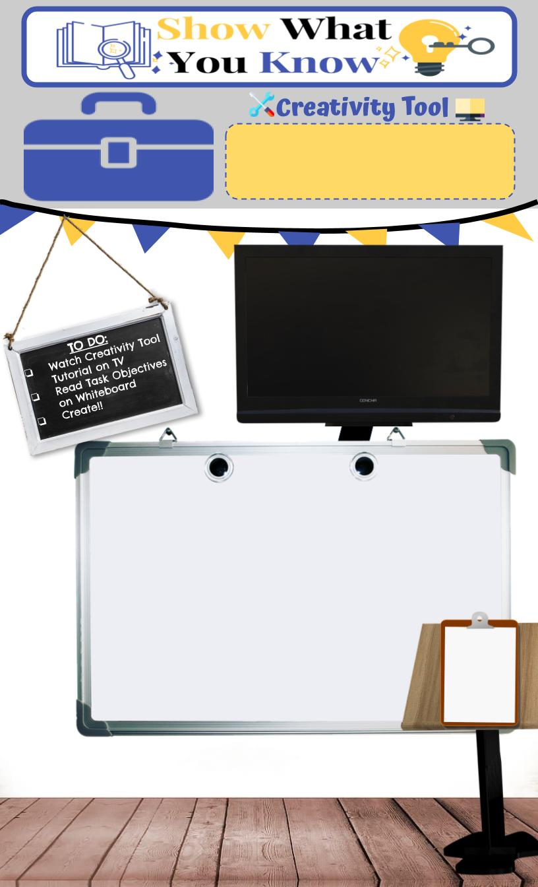


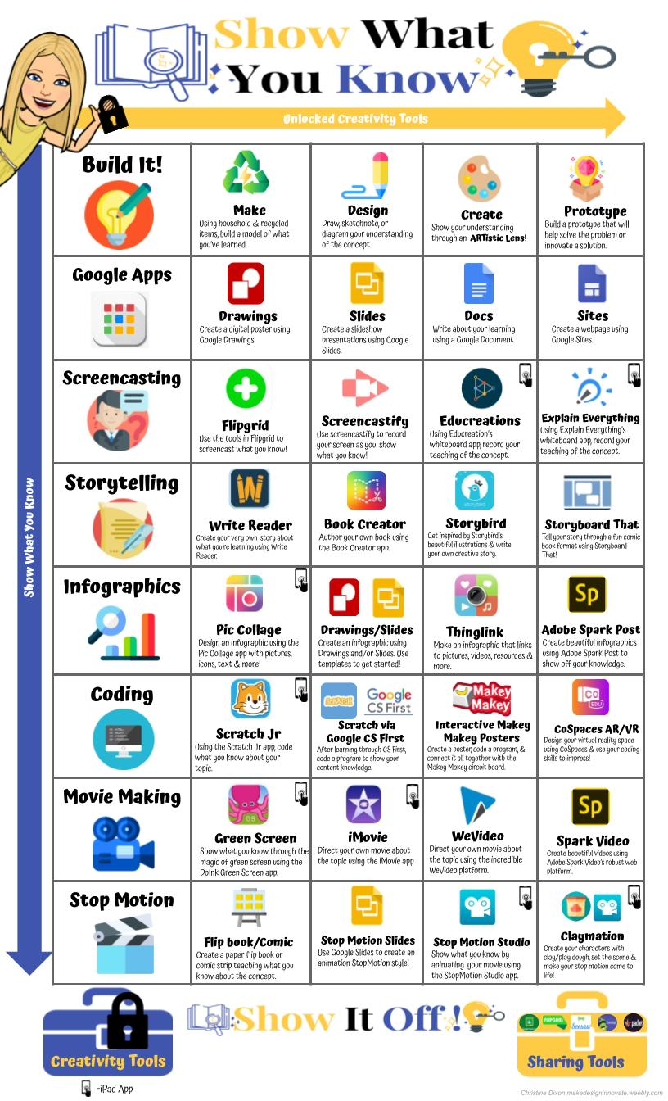


Build It!
Make
Using household & recycled items, build a model of what you’ve learned.
Pick something you’re learning about in one of your classes
Using various recycled materials (paper, buttons, paper clips, straws, toothpicks, toilet paper/ paper towel roll, newspaper, paper bag, cardboard box, etc.)
build a model

Slide 3
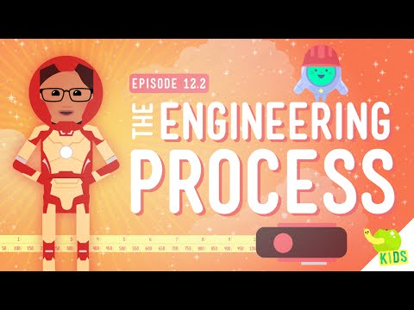
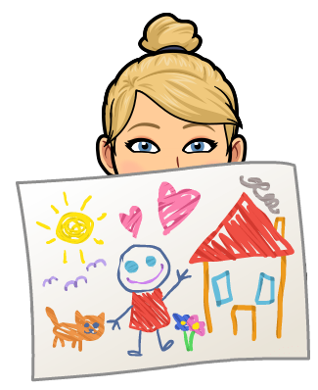

Build It!
Design
Draw, sketchnote, or diagram your understanding of the concept.
What is the design process?
Click the link up above, review the poster listing the design process steps.
Draw, create a sketchnote or a diagram listing and explaining the 6 steps in the design process

Slide 4

Build It!
Create
Show your understanding through an ARTistic Lens!

Slide 5

Build It!
Prototype
Build a prototype that will help solve a problem or innovate a solution.

Slide 6
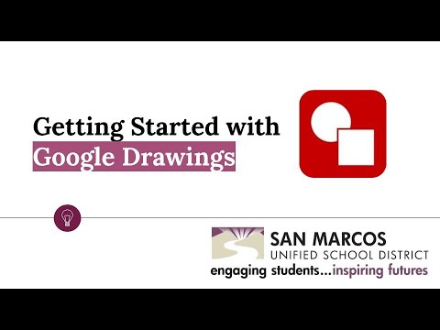

Google Apps
Drawings
Create a digital poster using Google Drawings.

Slide 7
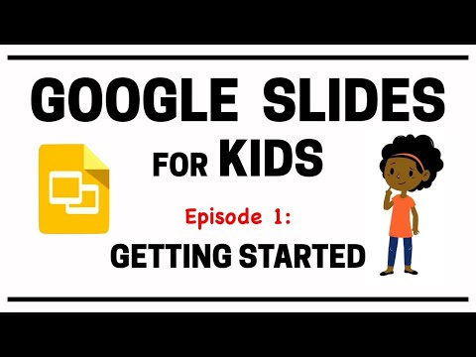
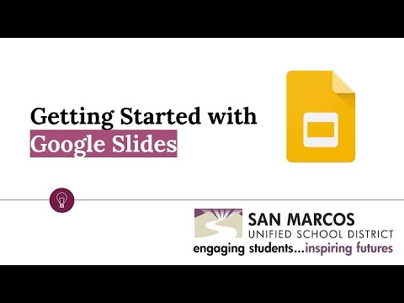

Google Apps
Slides
Create a slideshow presentation using Google Slides.

Slide 8
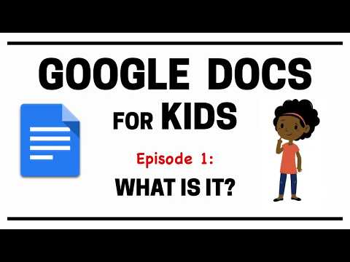
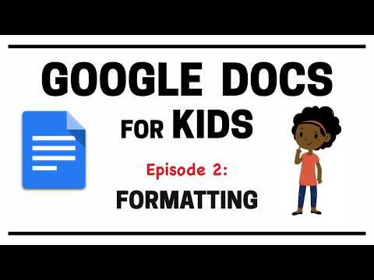
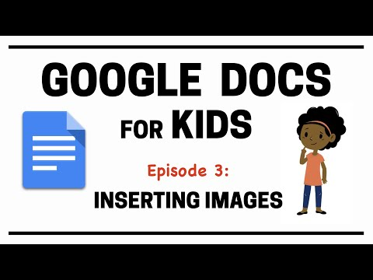

Google Apps
Docs
Write about your learning using a Google Document.

Slide 9

Google Apps
Sites
Create a webpage using Google Sites.

Slide 10

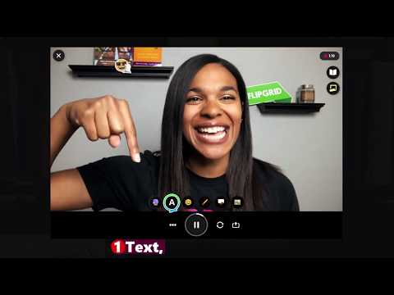
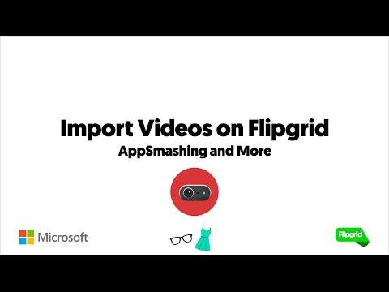
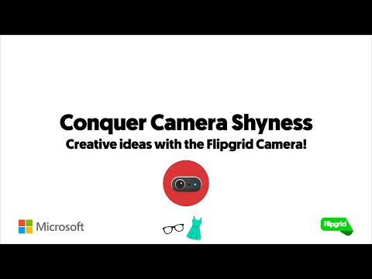


Screencasting
Flipgrid
Use the tools in Flipgrid to screencast what you know!
Notes:
Want to learn more? Learn from InterACTIVE with TheMerrils Flipgrid Playlist

Slide 11
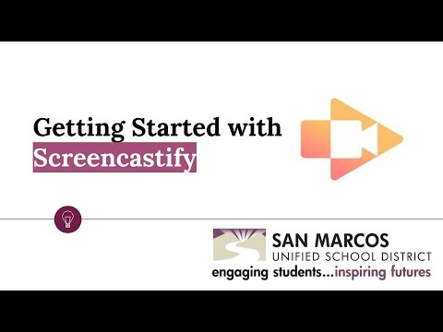


Screencasting
Screencastify
Use screencastify to record your screen as you show what you know!

Slide 12
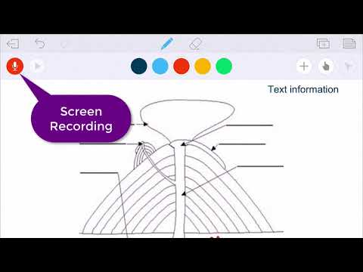

Screencasting
Educreations
Using Educreation’s whiteboard app, record your teaching of the concept.

Slide 13
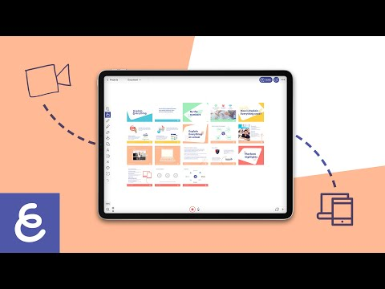

Screencasting
Explain Everything
Using Explain Everything’s whiteboard app, record your teaching of the concept.

Slide 14



Storytelling
Write Reader
Create your very own story about what you’re learning using
Write Reader.
Notes:
Teacher set up Instructions: ABCS of Write Reader with Google Classroom

Slide 15
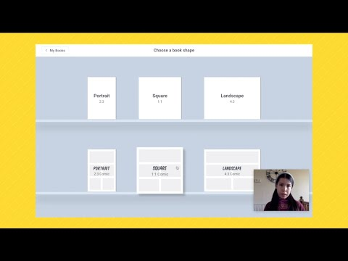


Storytelling
Book Creator
Author your own book using the Book Creator app.
Notes:
Teacher set up Instructions: Book Creator Tutorial for teachers

Slide 16
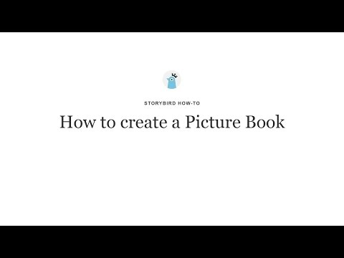

Storytelling
Story Bird
Become inspired by Storybird’s beautiful illustrations & then write your own creative story.
Notes:
Teacher set up Instructions: How to Create a Class on Storybird

Slide 17
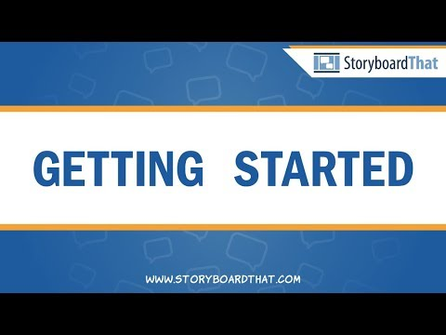

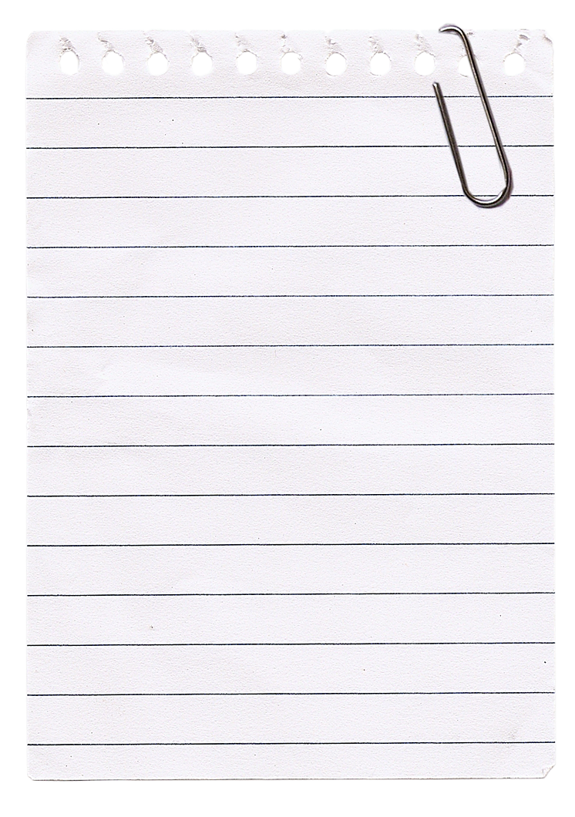
Storytelling
Storyboard That!
Tell your story through a fun comic book format using Storyboard That!
Notes:
Teacher set up Instructions: Storyboard Teacher Account Set Up

Slide 18
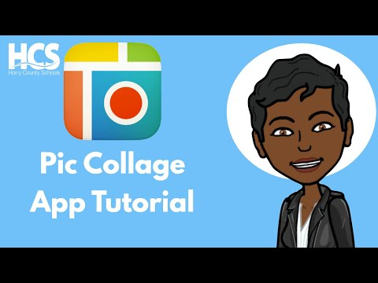

Infographics
Pic Collage
Design an infographic using the Pic Collage app with pictures, icons, text & more!

Slide 19
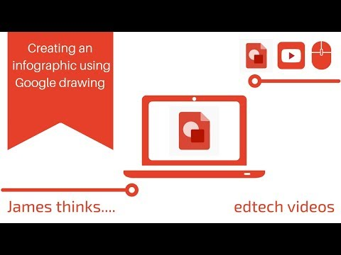


Infographics
Drawings/ Slides
Create an infographic using Drawings and/or Slides.
Use templates to get started!
Slides Tutorials Playlist
Templates

Slide 20
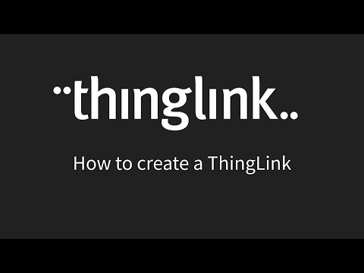

Infographics
Thinglink
Make an infographic using Thinglink that links to pictures, videos, resources & more. .
Notes:
About Thinglink for Educators
Teacher set up Instructions: Thinglink Teacher Account Set Up

Slide 21
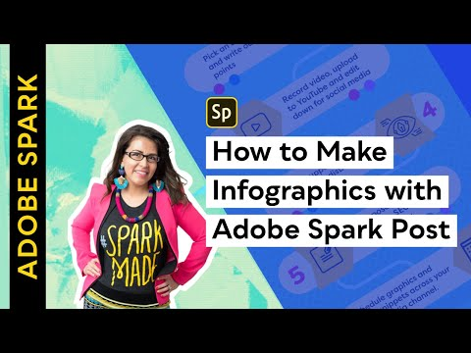


Infographics
Adobe Spark Post
Create beautiful infographics using Adobe Spark Post to show off your knowledge.
Notes:
Teacher set up Instructions: Adobe Spark Education Teacher Account Set Up

Slide 22
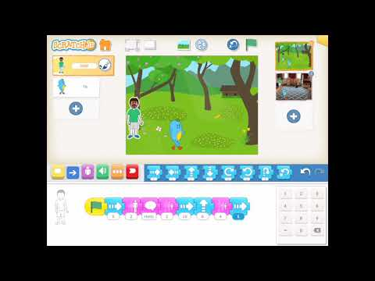

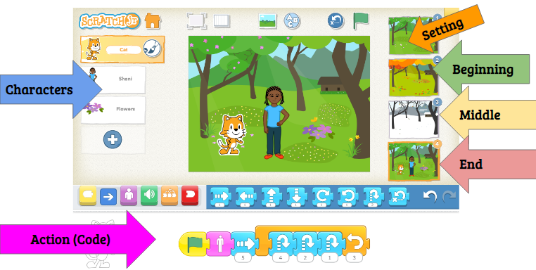
Coding
Scratch Jr
Using the Scratch Jr app, code what you know about your topic.
Scratch Jr Coding Task:

Slide 23

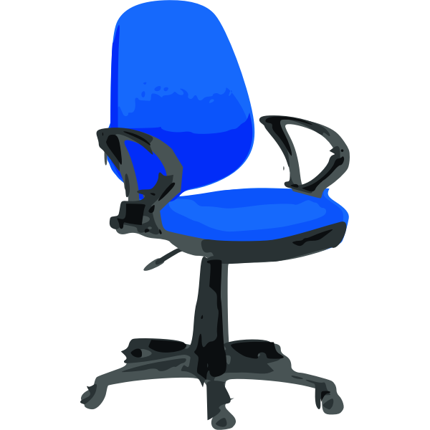
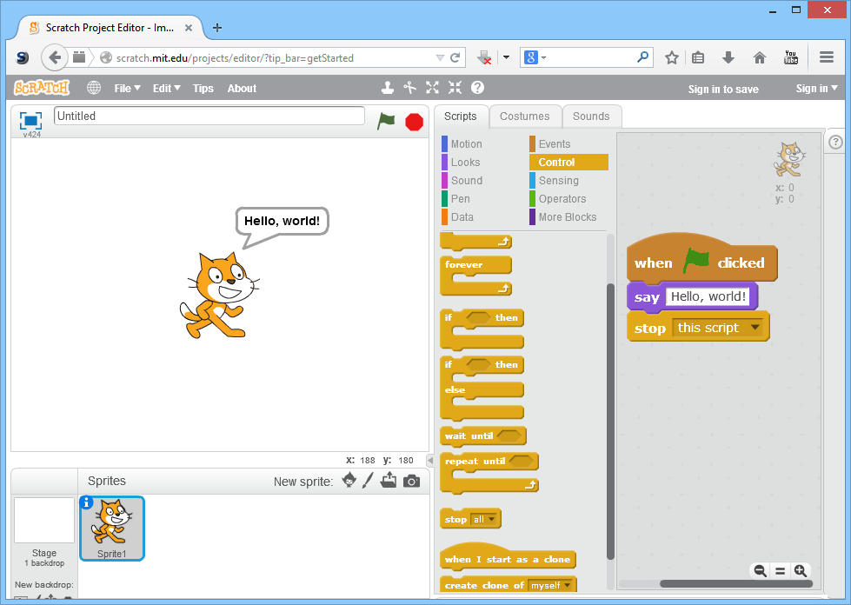
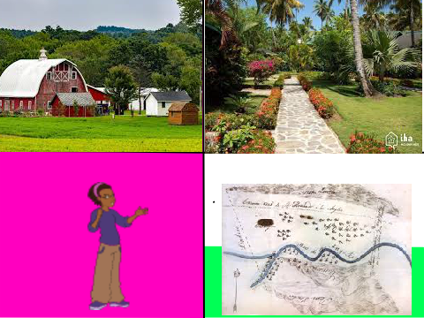
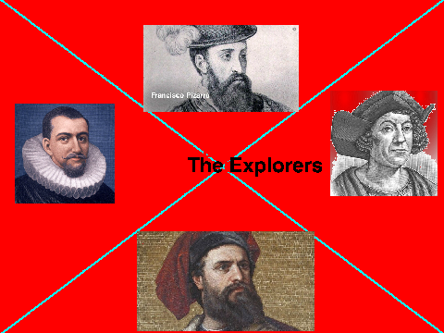
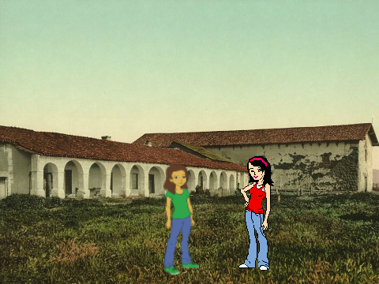
Coding
Scratch & Google CS
After learning through CS First,
code a program in Scratch to show your content knowledge.
Your Scratch Project should teach the content clearly & in detail and include:
2- 3 Stage/backgrounds (setting)
2 Sprites (characters)
Movement
Sound
Dialogue (speech bubbles)
Check out some student examples:

Slide 24

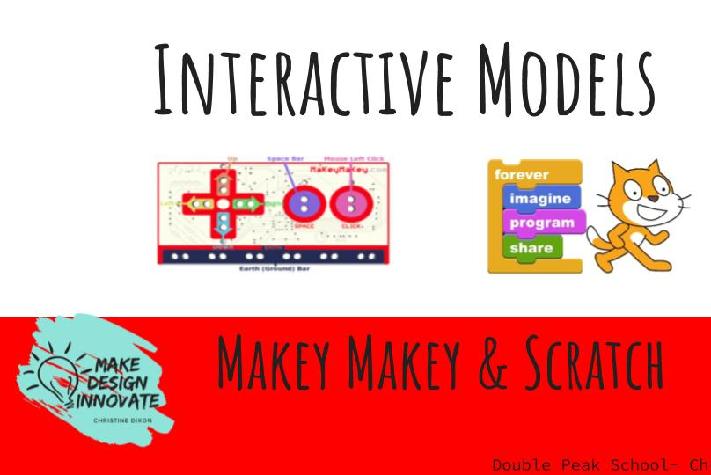
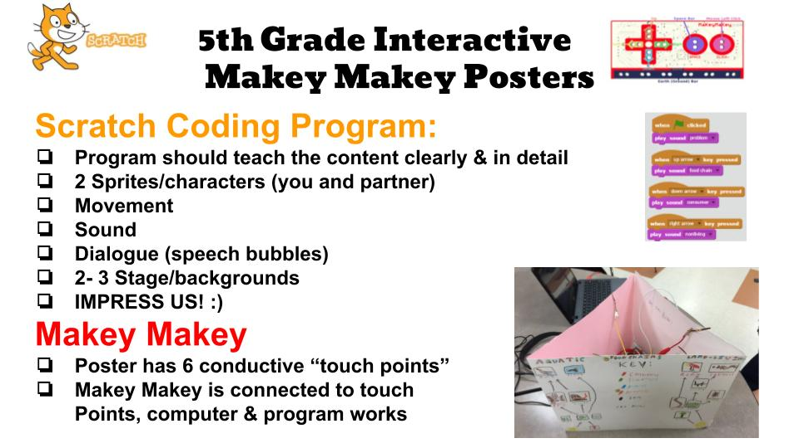

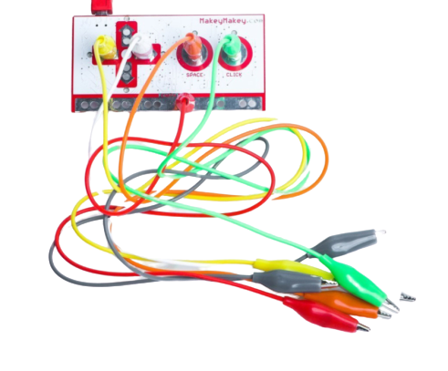
Coding
Makey Makey
Interactive Makey Makey Posters
Create a poster, code a program in Scratch, & connect it all together with the Makey Makey circuit board.
Lesson Here:

Slide 25
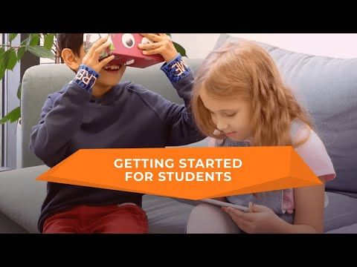

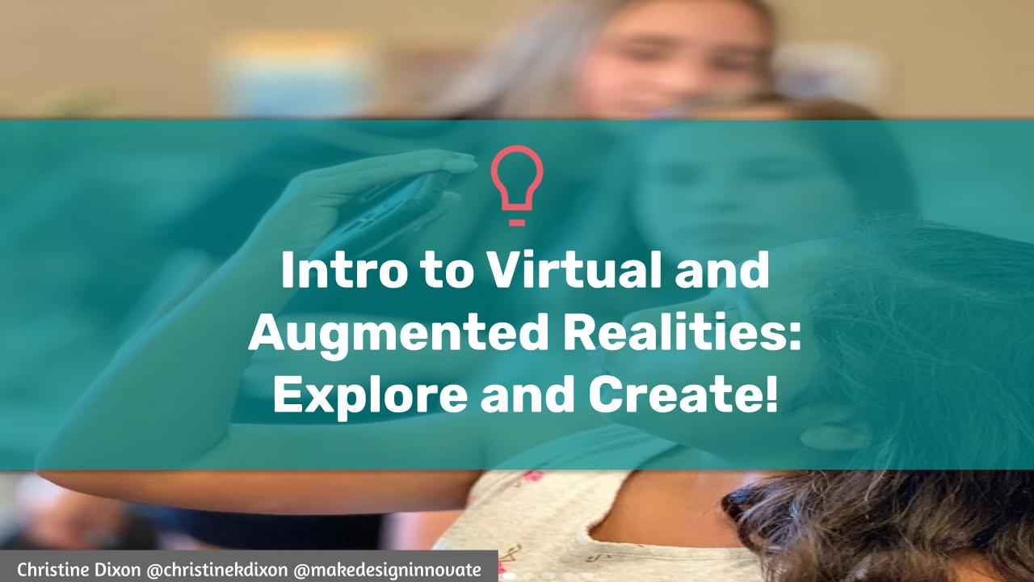

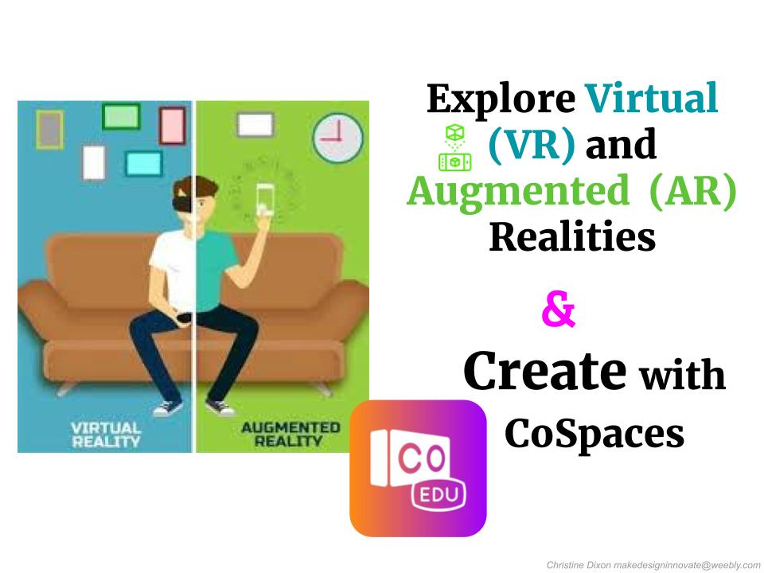
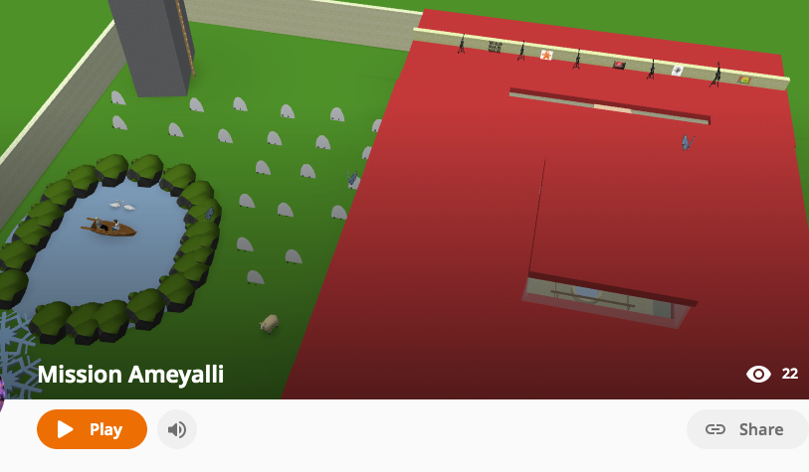
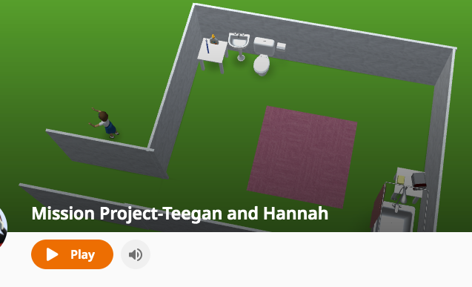
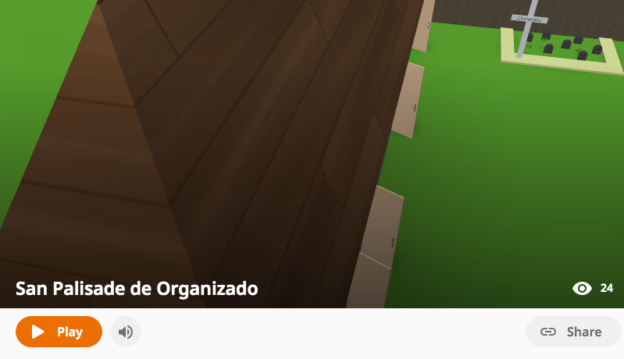
Coding
CoSpaces
Design your virtual reality space using CoSpaces & use your coding skills to impress!
For Teachers:
Check out some student examples:
Notes:
Teacher set up Instructions: CoSpaces EDU Teacher Account Set Up

Slide 26
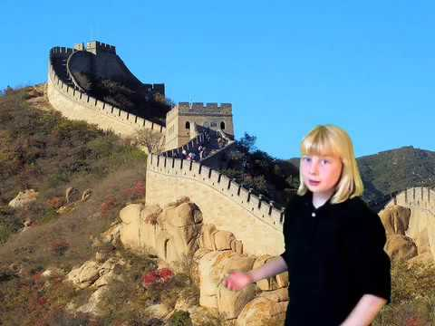


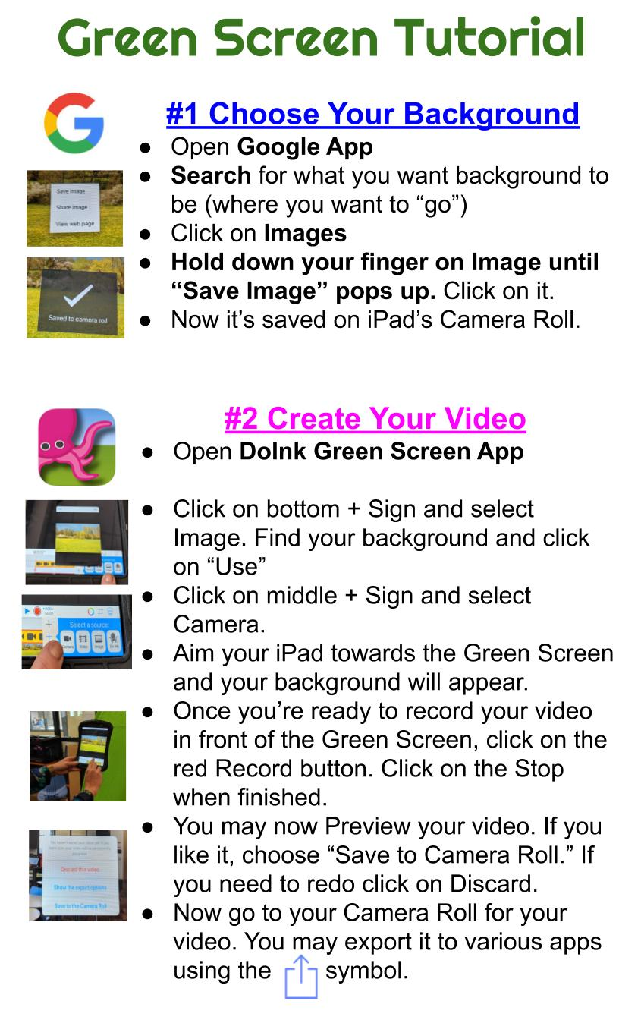

Movie Making
Green Screen
Show what you know through the magic of green screen using the DoInk Green Screen app.

Slide 27
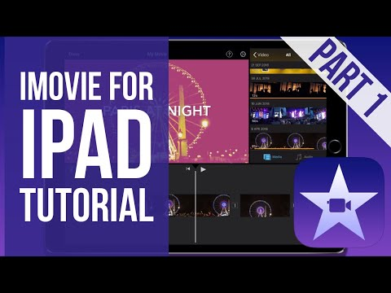

Movie Making
iMovie
Direct your own movie about the topic using the iMovie app.

Slide 28
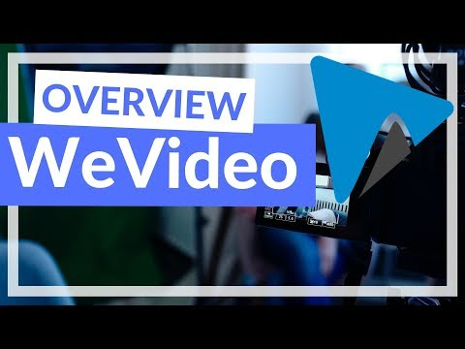


Movie Making
WeVideo
Direct your own movie about the topic using the incredible WeVideo platform.

Slide 29


Movie Making
Adobe Spark Video
Create beautiful videos using Adobe Spark Video’s web platform.
Notes:
Teacher set up Instructions: Adobe Spark Education Teacher Account Set Up

Slide 30





Stop Motion
Flipbook/ Comic
Create a paper flip book or comic strip teaching what you know about the concept.

Slide 31



Stop Motion
Google Slides
Use Google Slides to create an animation StopMotion style!

Slide 32


Stop Motion
StopMotion Studio
Show what you know by animating your movie using the StopMotion Studio app.

Slide 33






Stop Motion
Claymation
Create your characters with clay/play dough, set the scene & make your stop motion come to life!
Check out some student examples:

