Slide 1


ANGER MANGEMENT
by
Deepak Bharara
LEVERAGING PEOPLE FOR TOMORROW...
LEVERAGING PEOPLE FOR TOMORROW...

Slide 2

Anger Management
ANGER IS A BASIC HUMAN EMOTION THAT IS EXPERIENCED BY ALL OF US…

Slide 3
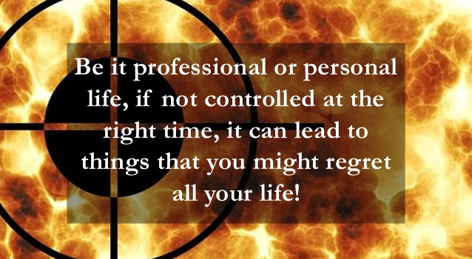
Anger

Slide 4

Anger
Anger is an emotion characterized by antagonism towards someone or something you feel has deliberately done you wrong.
Anger can be good also. It opens a way to express negative feelings but excessive anger can cause problems

Slide 5

Anger leads to discomfort…
“To be angry with the right person to the right extent at the right moment with the right object and in the right way – that is not easy” … Aristotle

Slide 6
Anger
Triggered by an emotional hurt, anger is usually experienced as an unpleasant feeling that occurs.
It happens when…
We have been injured – physically and emotionally
Mistreated
Opposed in our long held views
Forced with obstacles in achieving our personal goals
It is a normal healthy human emotion but when it gets out of control turns destructive.. can lead to problems at work, home, personal, social relationships, legal ramification, health issues, cynical behavior, anxieties and impact overall quality of life

Slide 7
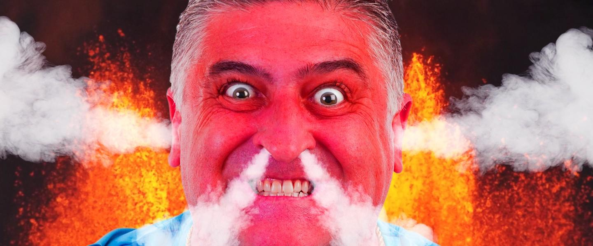
Range of Feelings
Embarrassment
Excitement
Disappointment
Jealousy
Fear
Helplessness
Sadness
Left out

Slide 8
Myths of Anger
You can express your anger whenever and however you wish
You can repress your anger and never have to feel it yourself
Anger Styles:
Anger Out – No choice, Appear Powerful, uncomfortable
Anger In – Fear of hurt/offended, disliked, rejected, loosing relationship, losing of control
Expressing Anger Assertively - Being positive in expressing emotions – taking responsibility of actions

Slide 9

Causes of Anger
Anger can be caused by both external & internal events
While you are dealing with …
Coworkers or Supervisor
Event – Traffic Jam, Cancelling of Flight
Personal problems
Going through traumatic or enraging event
ANGER IS DOUBLE EDGED SWORD – it is an emotional state that varies in intensity from mild irritation to intense fury and rage
CAN LEAD TO AGRESSION, RAGE, HOSTILITY, FRUSTRATION, DEPRESSION, VIOLENCE

Slide 10

How does body reacts to Anger
Red Face
Red eyes
Faster pumping of heart
High Blood Pressure
Blood flow quickens
Muscle tension
Clinching of Fists
Rages and Shouts
Failing to deal with anger may lead to Health Problem, Tension, Accident or Interpersonal Problems
Uncontrollable Anger can be dangerous and can lead to abusive and violent behavior resulting in committing Crime

Slide 11
Effects of Anger
Anger can be helpful &/or harmful…it depends on how you express it.
Can result in domestic violence
Hurt feelings of Others
Others tend to shut down
Others become defiant, indifferent, avoid and have very little or no respect for the angry person
lead to disrupt thinking and aggressiveness
Put label as ANGRY MAN/WOMEN
Anger Management helps in using anger in a positive way though this doesn’t support in getting rid of it
Anger has positive aspect also - it can increase energy to communicate feelings, to be able to solve problems and allows to take charge of situation

Slide 12
Anger Management
Know yourself & Organize your mind
Identify the emotional baggage
Identify stressor and learn stress management & relaxation
State your true feeling
Communicate effectively – Listen
Learn & recognize body reaction to anger – never get angry with a person who has nothing to lose
See things from other perspective
Learn from mistakes instead reacting, learn to say Sorry
Do important things now before they become urgent
Avoid unnecessary criticism, condemn or complain – don’t argue
Say No, if required
Choose a passionate job & be decisive
Think ahead, anticipate .. do it or get it done – Engage
Accept things and also commit to change yourself

Slide 13
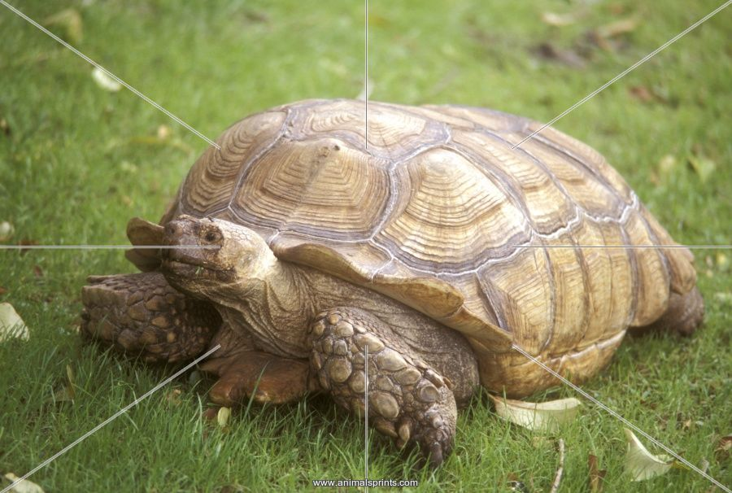
Anger Management
Follow 1,2 & 3 of Turtle…
Go inside your shell
Think before you act
Take a time out
Take a deep Breath
Time to relax
Calm yourself down
Walkaway
Think of Good Solution

Slide 14

Anger – Rational Emotive Therapy
Situation
Belief
Feeling and action
Dispute
Realistic Goal
Constructive Options
Put best option into Practice
Anger is one letter short of DANGER so be careful…

Slide 15
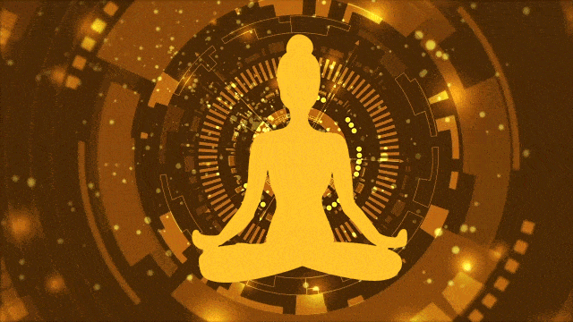
Tips to Manage Anger
Take a deep breath and count till 50
Drink water
Stay Happy
Listen to Music
Talk to yourself
Step out of situation
Practice Yoga/Meditation
Read something interesting
Think of a person who makes you smile

Slide 16

The Journey must Continues…... to transform People, Communities & Organization

Slide 17

Email: contact@peoplea2z.com
Twitter:@peoplea2z
LinkedIn: https://in.linkedin.com/in/peoplea2z-advisory-n-solutions-a52837124
Facebook: @peoplea2z
Mobile: +91 9810048409

