Slide 1
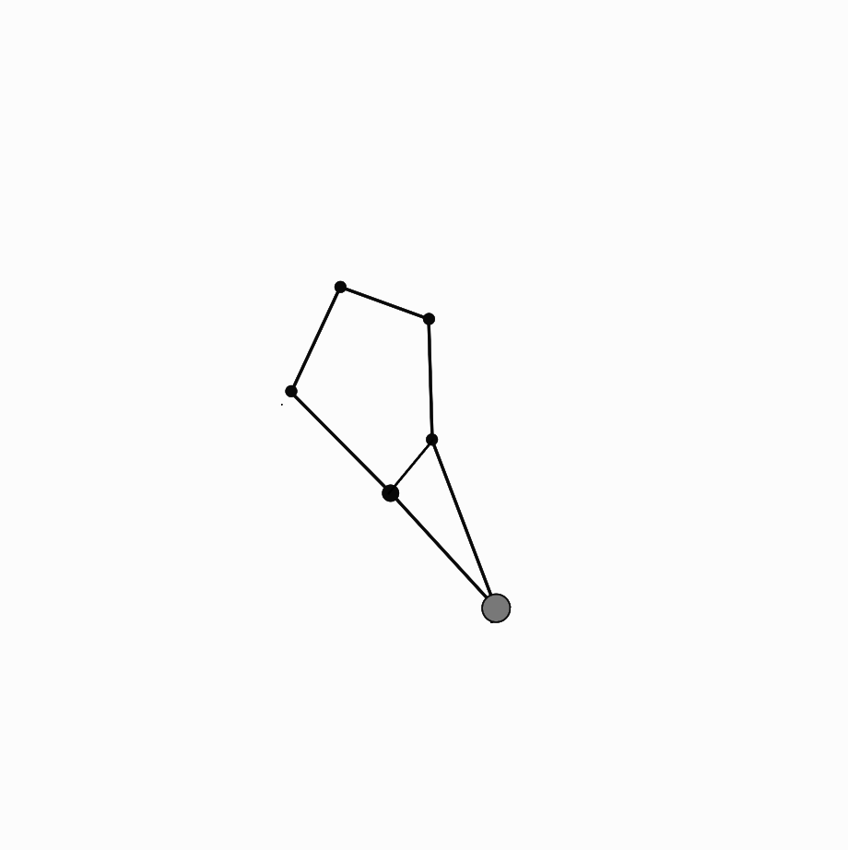
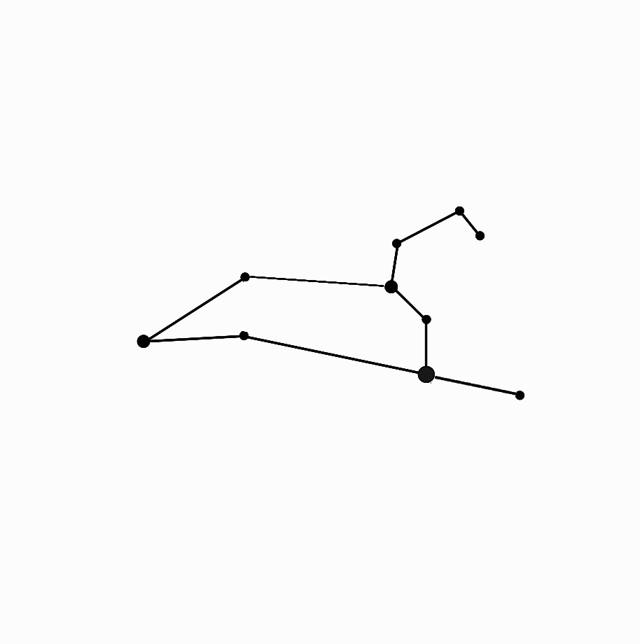
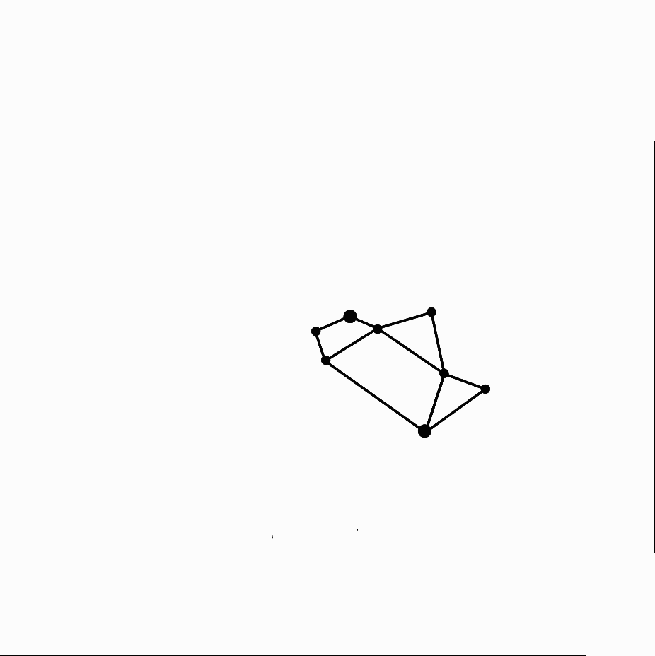

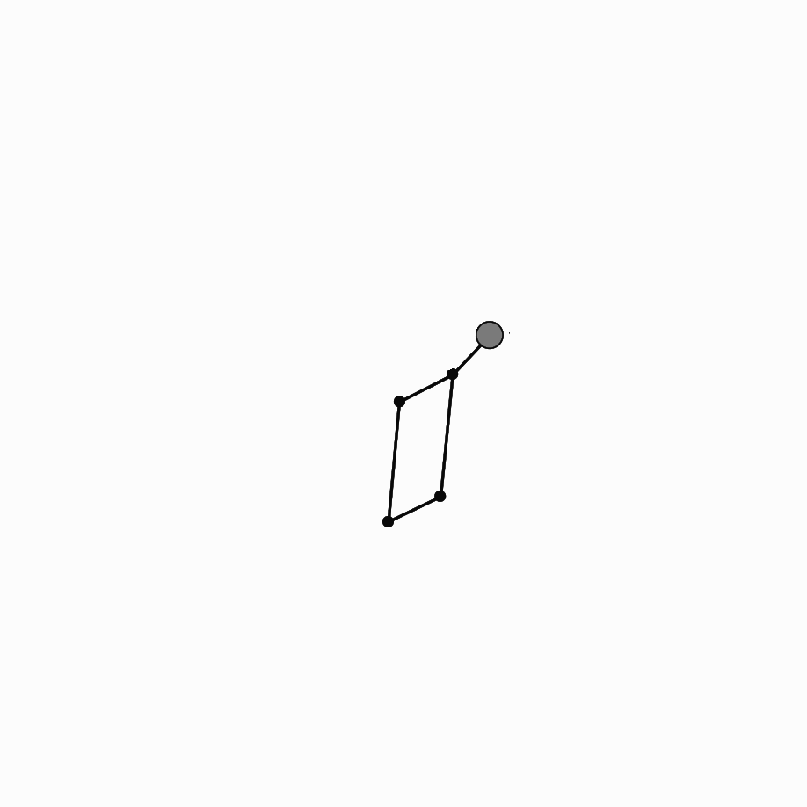
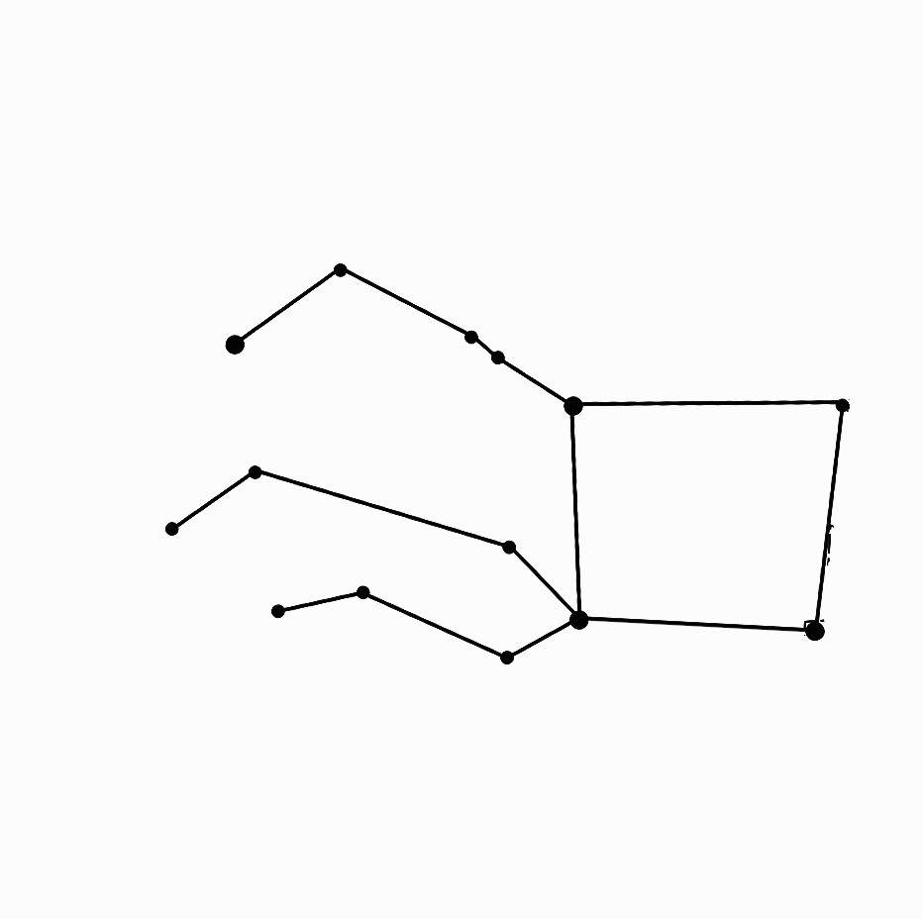
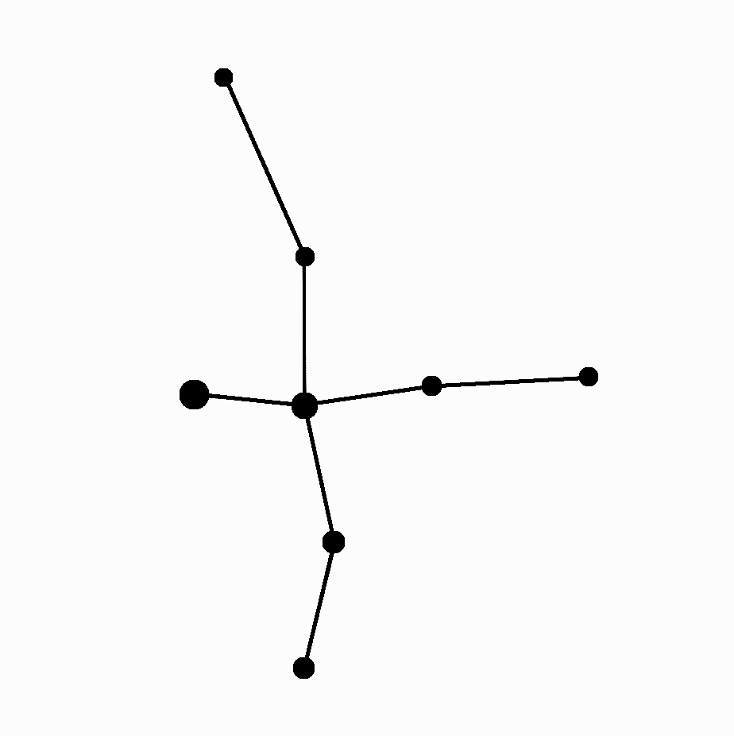
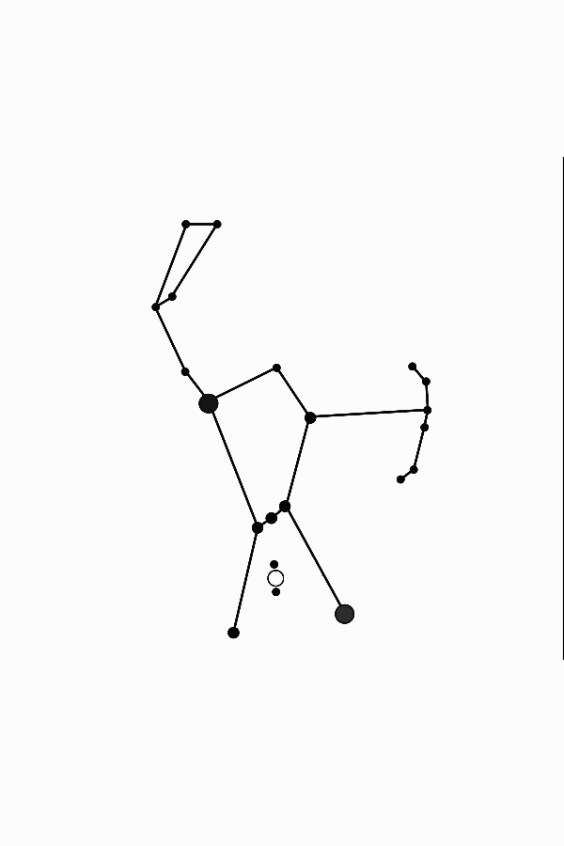
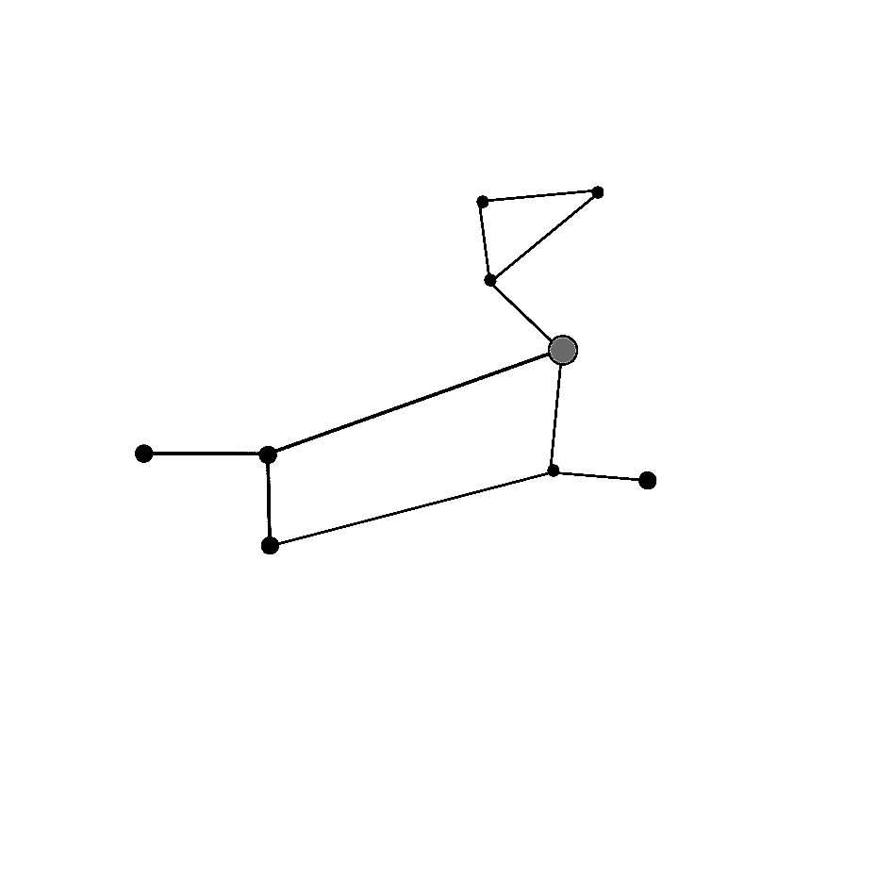
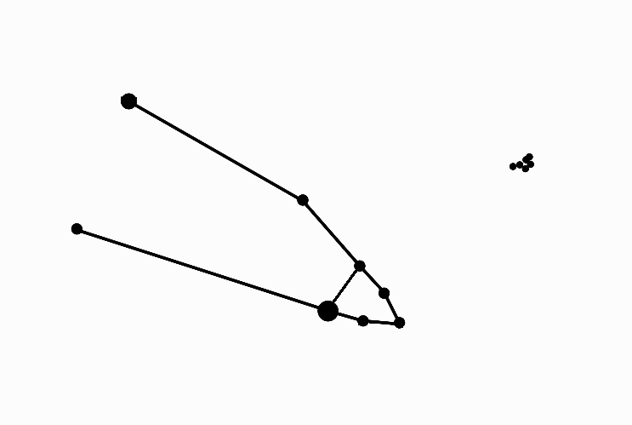

(SOUTHERN HEMISPHERE VERSION)
Constellation Guide
Some constellations that you can see in the sky each season:
fall
Bootes,
the Ice Cream Cone
Leo,
the Lion
winter
Lyra,
the Harp
Sagittarius,
the Teapot
Scorpius,
the Scorpion
spring
Pegasus,
the Horse
(head and front legs)
Cygnus, the flying Swan
(only partially visible from Southern Hemisphere)
summer
Canis Major, the Big Dog
Orion,
the Hunter
Taurus,
the Bull’s horns
Why do the stars change with the seasons?

Slide 2
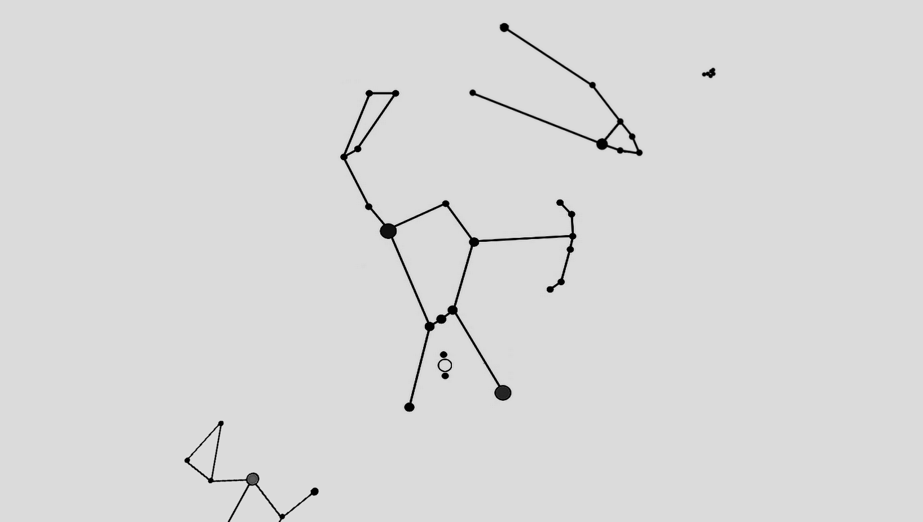
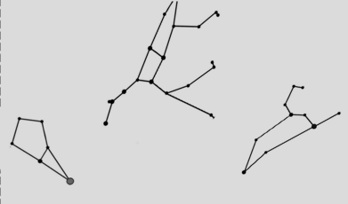
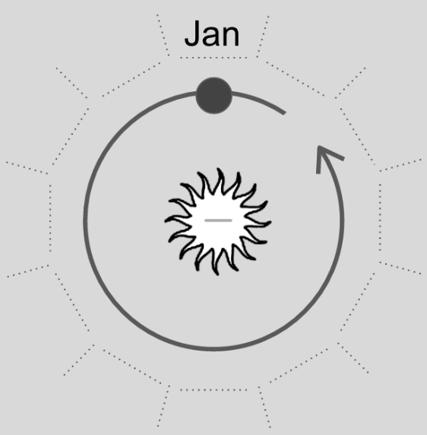
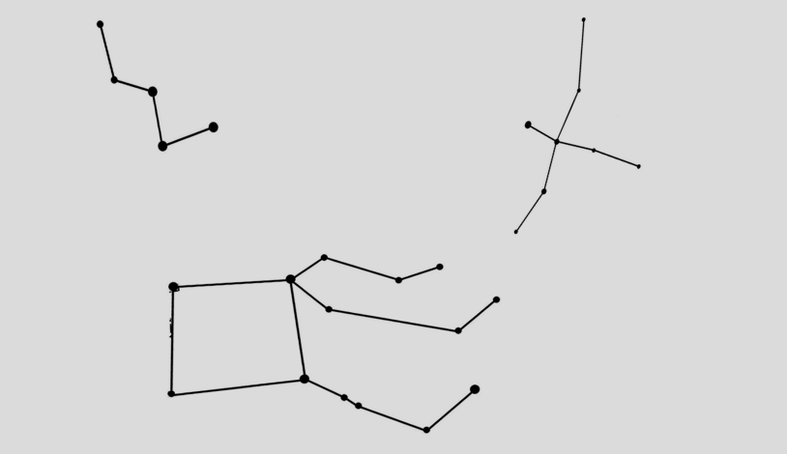
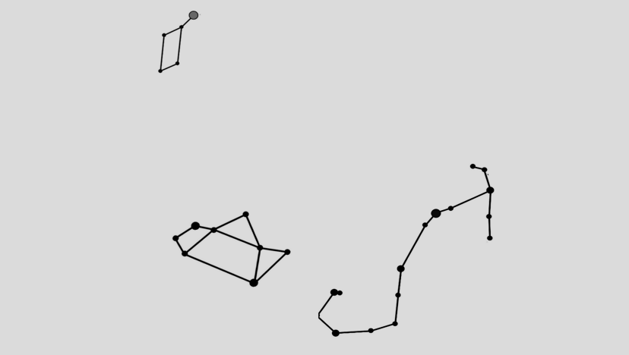
(SOUTHERN HEMISPHERE VERSION)
A
Universe
in a Box
A
FOLDx
FOLDx
FOLDx
FOLDx
STOP
STOP
FOLDx
FOLDx
FOLDx
STOP
FOLDx
STOP
FOLDx
FOLDx
B
B
Why do the stars change with the seasons?

Slide 3

(SOUTHERN HEMISPHERE VERSION)
Universe
in a Box
Why do the stars change with the seasons?

