Slide 1


BANK TRANSACTIONS

Slide 2
In this chapter we will study
• Meaning of Banks
• Banks and post offices in financial transactions.
• Characteristics of Banks.
• Different accounts that can be opened in a Bank.
• Methods to open accounts in Banks.
• Advantages of Bank accounts.

Slide 3

❖ Banks are developed 200 years ago the term of bank related to financial transactions
❖ The term bank is derived from Italian word and French word. Italian word Banco , French word Banque . It means money exchange table

Slide 4

❖ The company which transacts the business with Finance is called Bank.
❖ It accepts deposits, lends money and saves customers money.
❖ The services of bank is called banking

Slide 5
Characteristics:
❖ Dealing with money
❖ Individual/ firm/ company
❖ Acceptance of deposits
❖ Lending loans
❖ Payment and withdrawal
❖ Agency and utility services

Slide 6
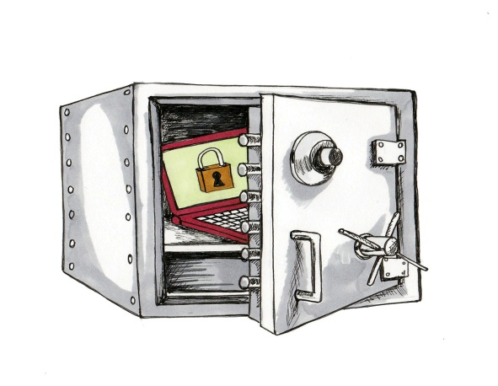


❖ Profit and service oriented
❖ Ever increasing functions
❖ Connecting link between depositor and borrower
❖ Banking business
❖ Name identity

Slide 7
Functions of bank
❖ Accepting deposits from public and others
❖ Lending money to public and institutions
❖ Transferring money from place to place
❖ Collecting money on cheque, draft and bills
❖ Discounting of bills

Slide 8


❖ Hiring safe deposit locker
❖ Conducting foreign exchange transaction
❖ Keeping valuable materials in custody
❖ Issue of letters of credit and guarantee
❖ Conducting government transactions centre and state

Slide 9
Relationship between bankers and customers
❖ General relationship.
❖ Primary relation is debtor and creditor.
❖ Subsidiary relation is Trustee and beneficiary.
❖ Agent and principal relation.
❖ Special relationship. Obligations to honor cheques. Obligation to maintain secrecy of accounts.

Slide 10

Services offered by bank
❖ Debit Card and Credit Cards
❖ Personal loans
❖ Home and vehicle loans
❖ Mutual funds
❖ Safe deposit lockers
❖ Trust services
❖ Signature guarantee
❖ E- Banking

Slide 11
Banking transactions
❖ Any sort of activity involving in money exchange then and account is viewed as bank transaction
❖ All the banking transactions in India are controlled by the Reserve Bank of India that's why it is called the mother of banks or bankers Bank.

Slide 12

Postal Bank of India
❖ Post office savings bank
❖ It issues national saving certificate
❖ Kisan Vikas Patra
❖ Monthly recurring deposits
❖ Postal life insurance and Pension Payment
❖ Money transfer
❖ Promoting a capital investment of thousand crores.

Slide 13
Types of bank
❖ Central Bank or RBI
❖ Commercial banks
❖ Industrial Development Banks
❖ Land Development Banks
❖ Indigenous banks

Slide 14
Types of bank accounts
❖ Savings bank account
❖ Current account
❖ Recurring deposit account
❖ Term of fixed deposit account

Slide 15
Savings bank account:
❖ Generally opened by salaried persons
❖ This facility is given to students senior citizens and pensioners
❖ This type of accounts are open to encourage people to save money
❖ There is no restrictions on deposition of money
❖ Money can be withdrawn either by cheque or withdrawal slip

Slide 16
Current account
❖ It is opened by Businessman who have a large number of transactions
❖ Amount can be deposited or withdrawal any number of times
❖ Banks do not give any interest on deposits
❖ Banks collect service charge on such amount

Slide 17
Recurring deposit
❖ Generally it is open for a purpose to be saved for future
❖ Deposits are made regularly on monthly basis for wedding, land And car purchase
❖ After the period is over amount is repaid with interest

Slide 18
Fixed deposit account
❖ Account is opened for a fixed period by depositing the money
❖ The deposit amount cannot be withdrawn before expiry date
❖ The rate of interest is both depending on the term of deposit

Slide 19

Procedure to open a bank account
❖ Decide the type of account which you want to open
❖ Approach the bank of your choice
❖ Fill up the bank account form or proposal form
❖ Give reference for opening new account
❖ Submit the form duly filled
❖ Verification by the office
❖ Initial deposit.

Slide 20
Advantages of opening bank account
❖ Bank account facilitate safe custody of money
❖ It helps in making of payments
❖ It helps in collection of money
❖ Account holders get advances and loans
❖ Bank account helps in smooth financial transaction
❖ Account holders can get a safe deposit locker facility.

Slide 21

Thank you
Prepared by:
Praveen Banakar

