Slide 1
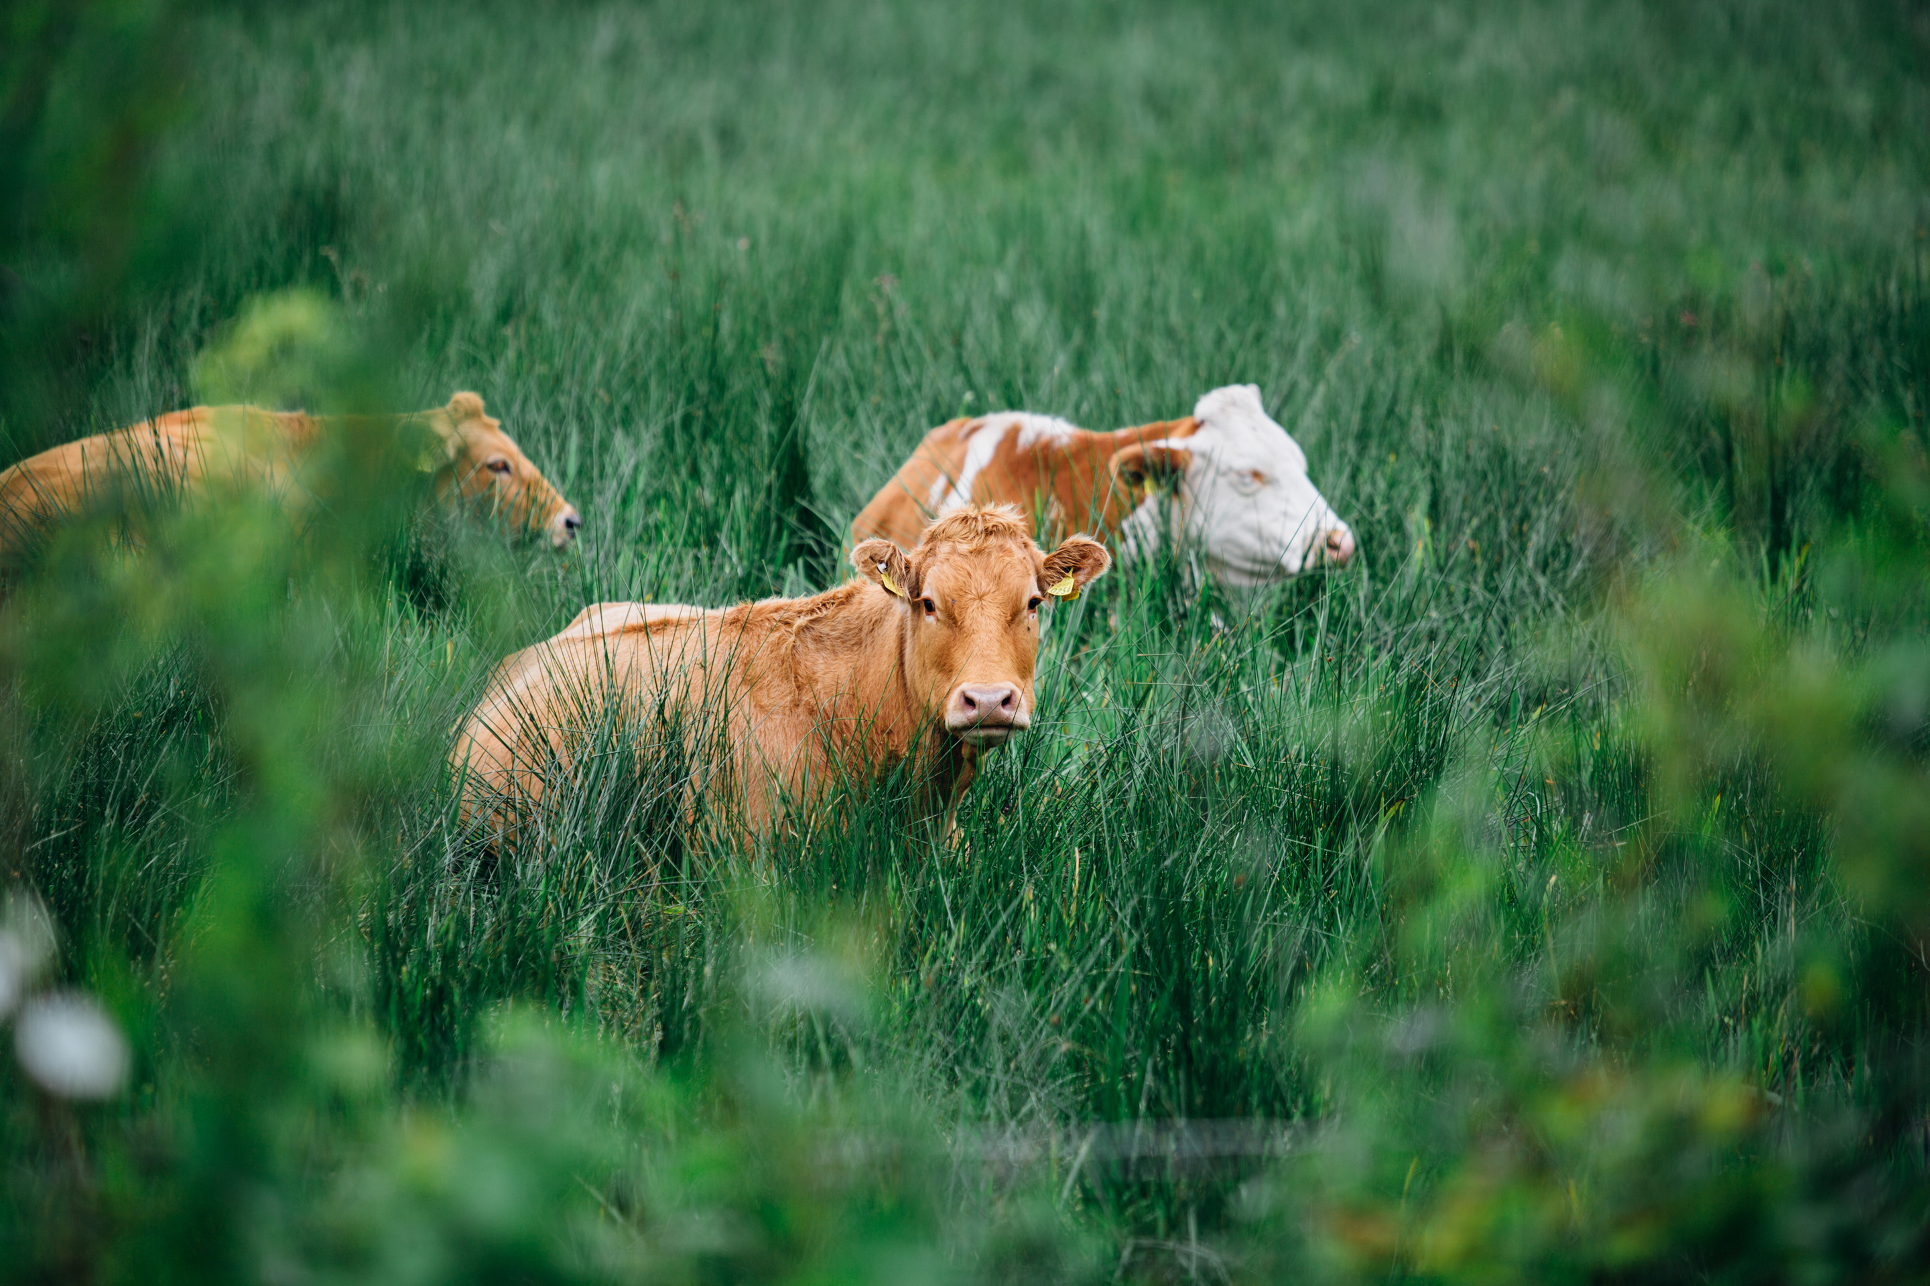

LIVESTOCK
FEEDING THE WORLD, SUSTAINING COMMUNITIES

Slide 2
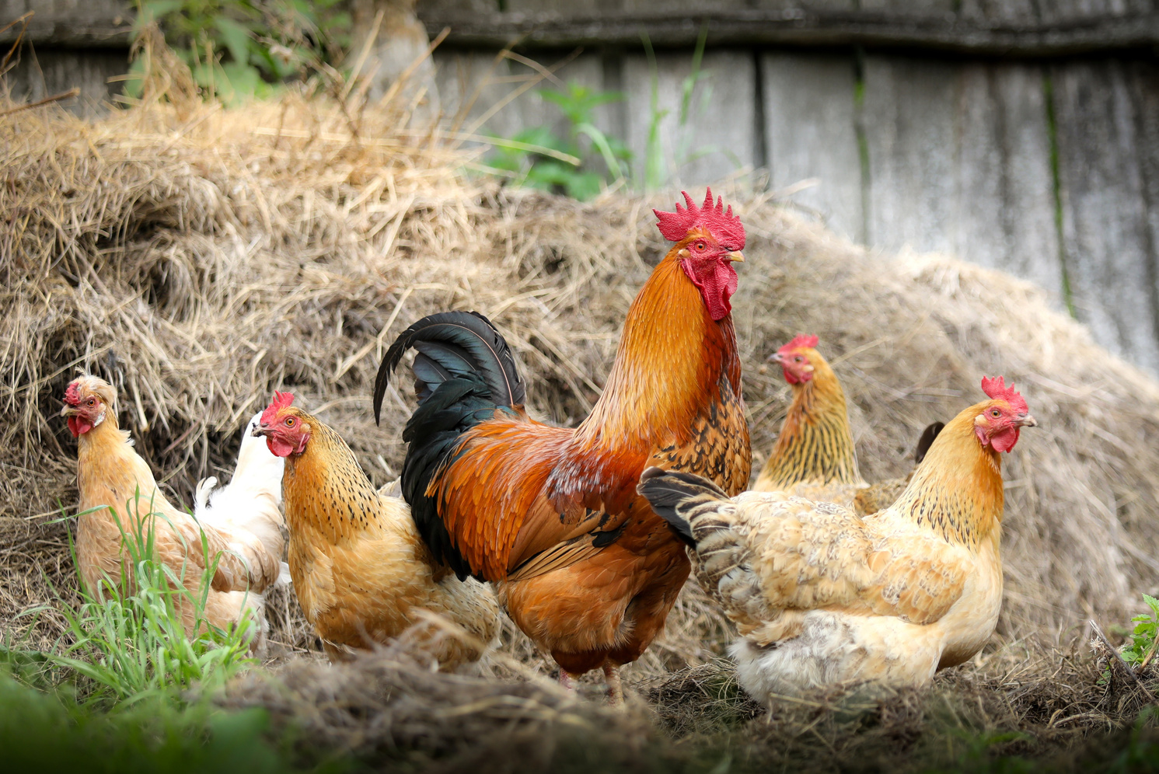
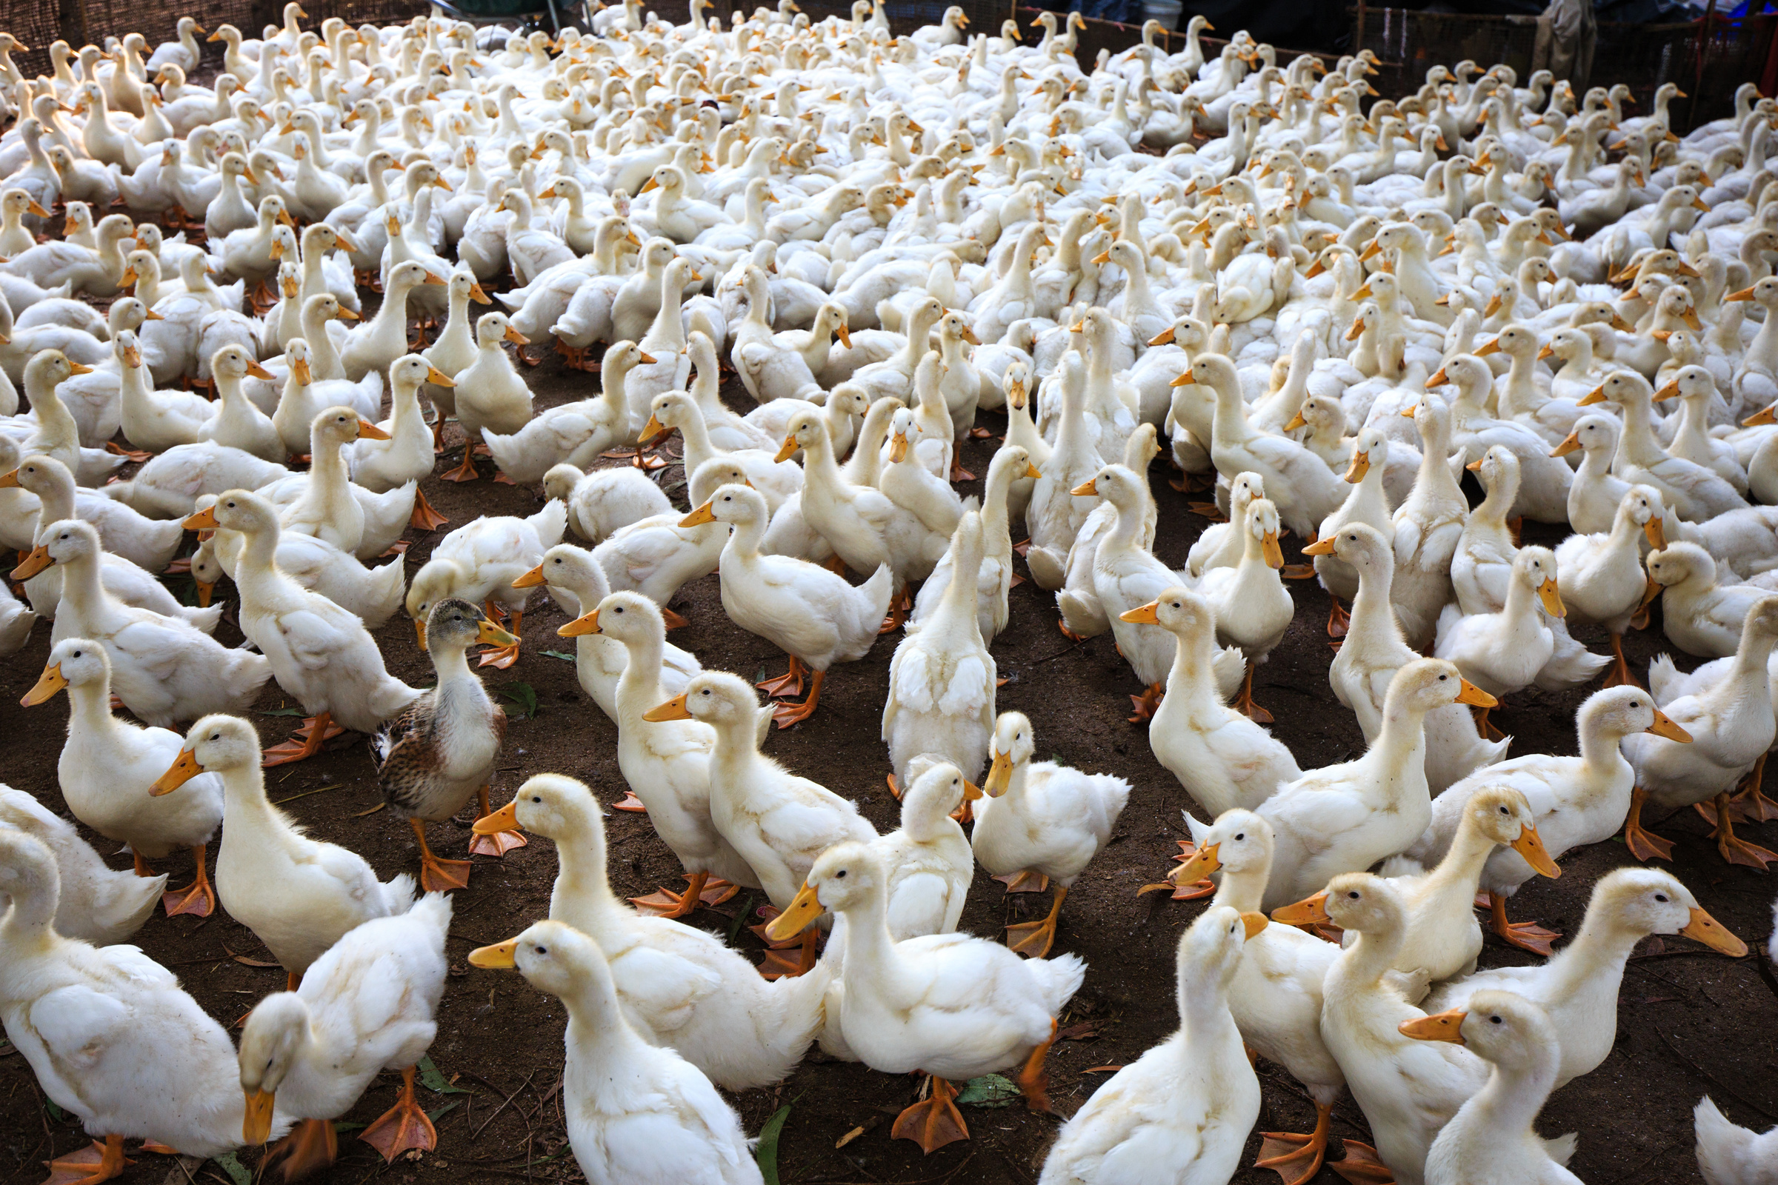
GLOBAL FOOD SECURITY
LIVESTOCK IMPACT ON FOOD SYSTEMS
Livestock supplies meat, milk, and eggs, all vital to human nutrition. These foods provide irreplaceable nutrients, especially in regions lacking alternative protein sources. Sustainable livestock systems ensure consistent food supply, resilience against climate change, and economic stability. By improving efficiency and reducing waste, livestock farming contributes directly to achieving global food security, making it essential for nourishing future generations worldwide.

Slide 3
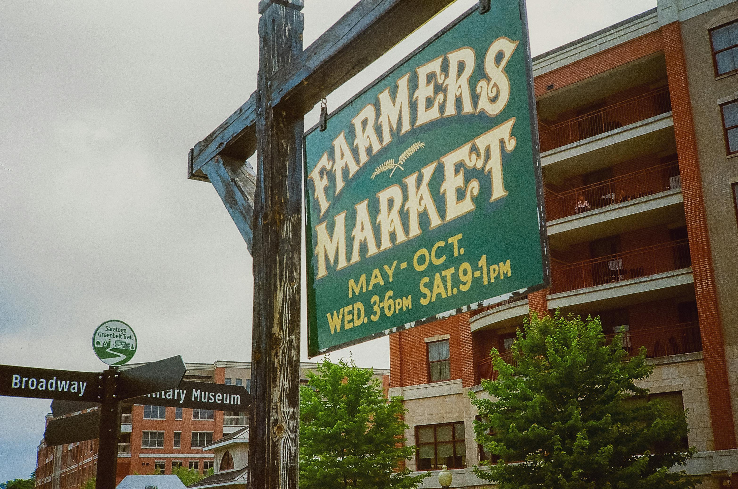
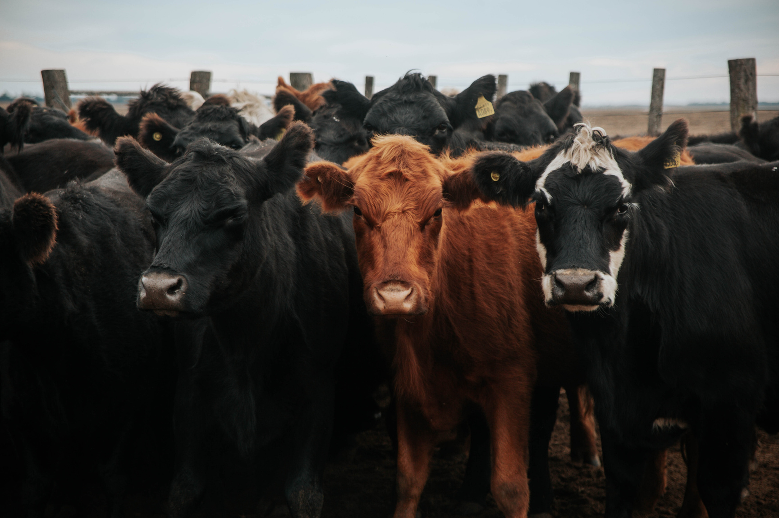
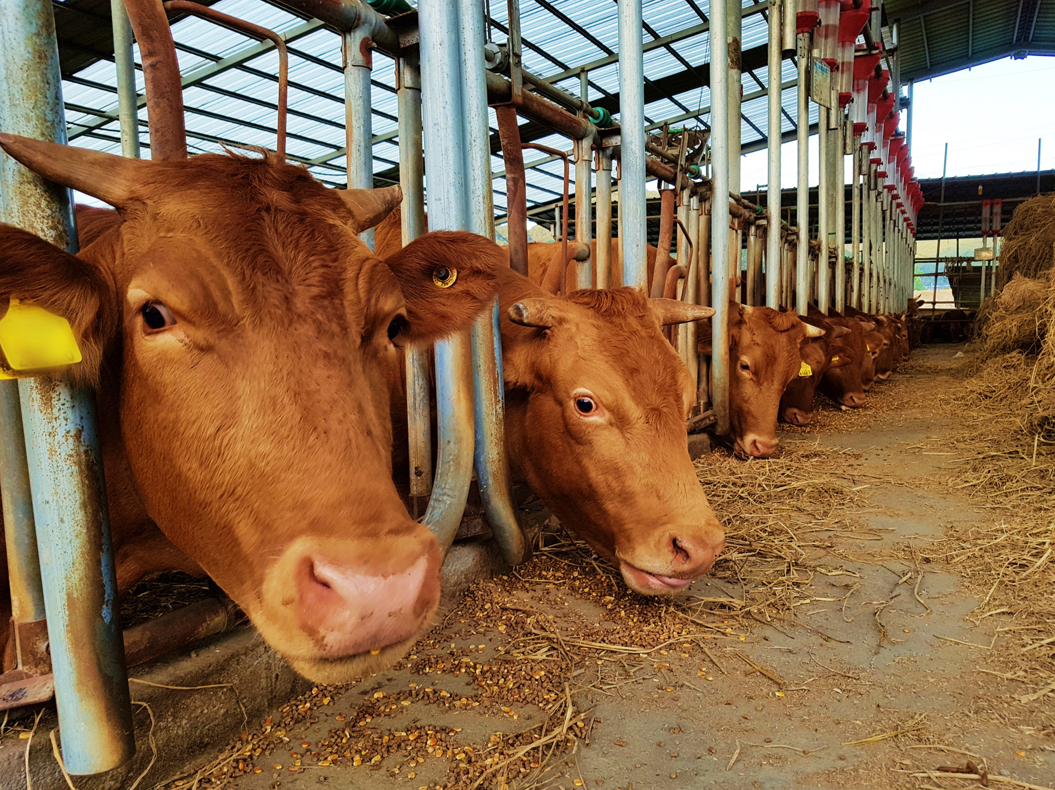
DRIVING LIVELIHOODS AND RURAL ECONOMIES
CORE CONTRIBUTION
NUTRITION
LIVELIHOODS
Livestock offers essential protein, vitamins, and minerals that combat malnutrition, ensuring healthy diets and improving well-being for millions of people across diverse global communities.
Livestock production creates employment, strengthens trade, and empowers rural farmers, boosting economic opportunities while sustaining local and national markets in both developed and developing countries worldwide.

Slide 4
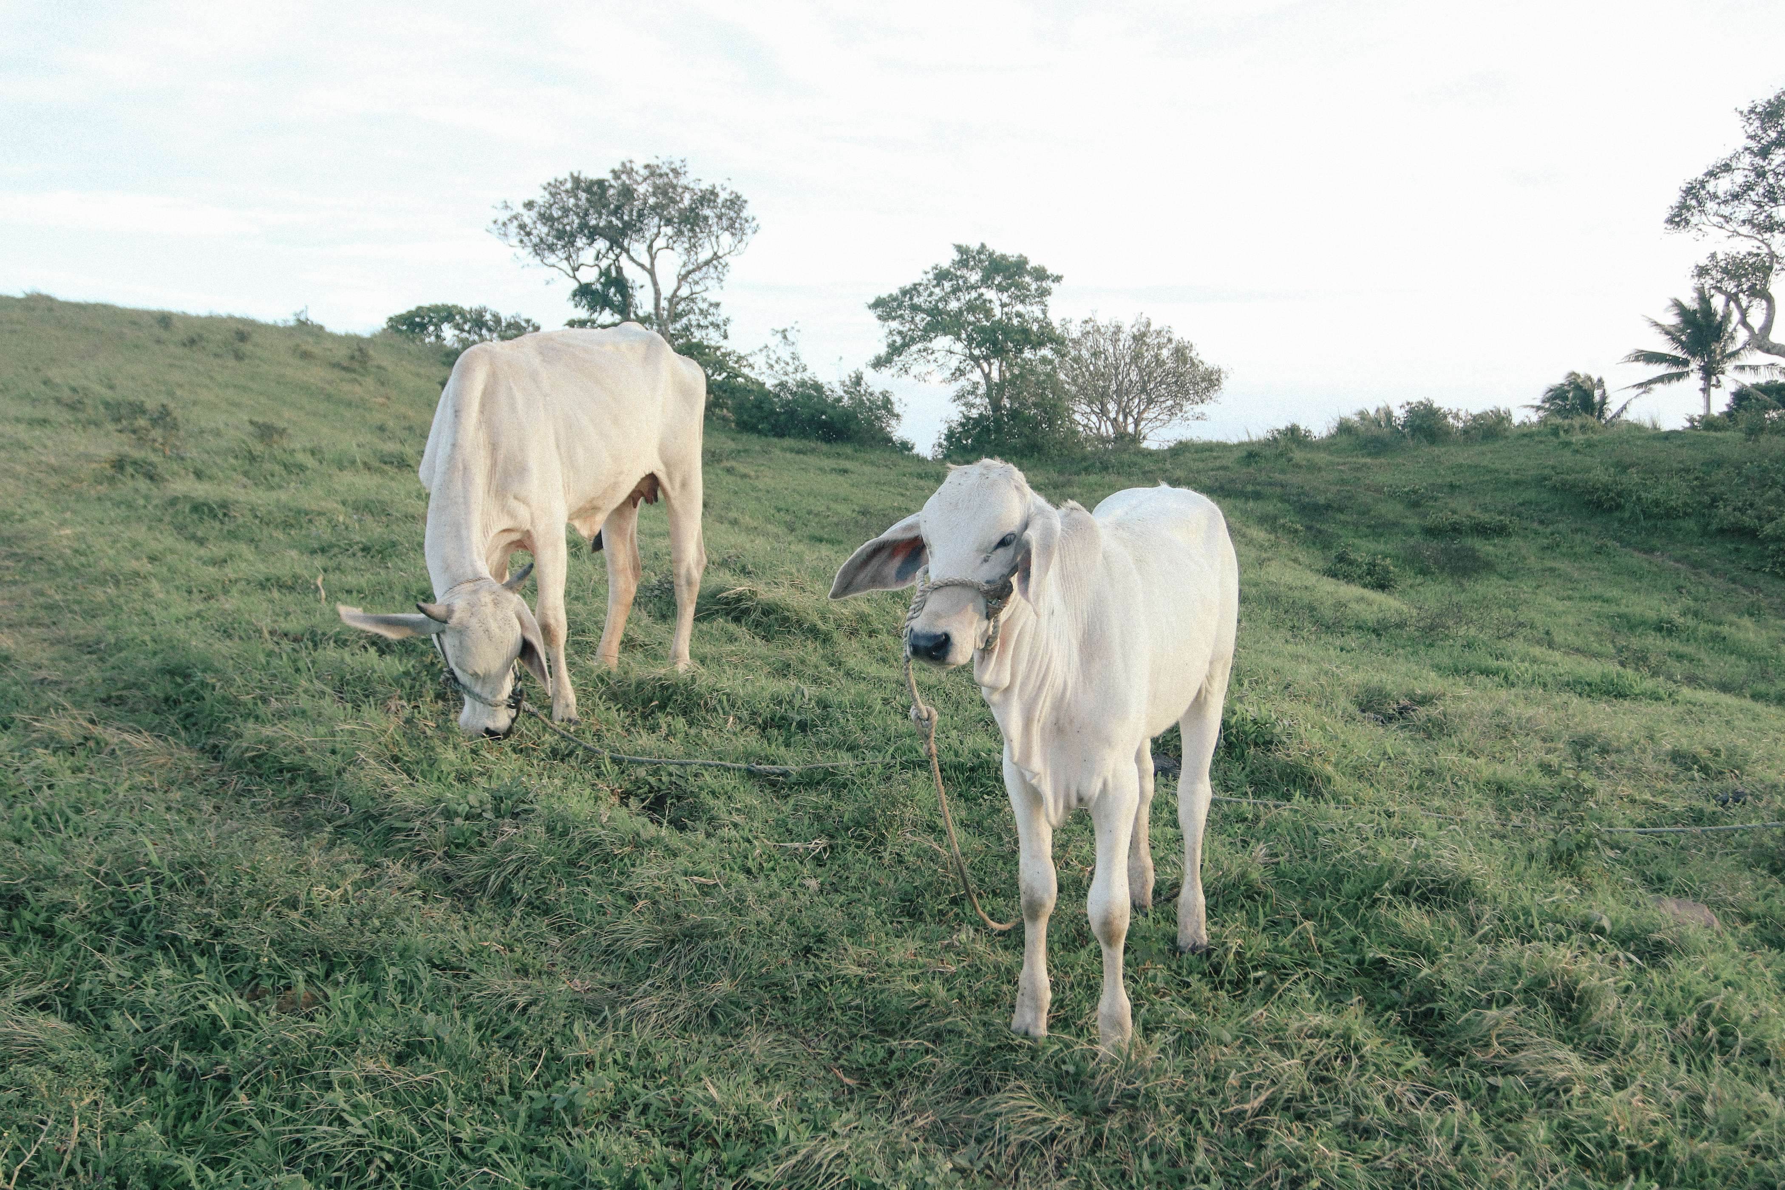
ENVIRONMENTAL CHALLENGES
ADDRESSING CHALLENGES AND SOLUTIONS
Livestock contributes to greenhouse emissions, water use, and soil degradation. Innovative strategies like rotational grazing, improved feeding, and recycling methods reduce harmful impacts. Sustainable systems are vital to balance food demand with ecological preservation.
Farmers, researchers, and communities must collaborate on long-term solutions. Protecting biodiversity and ecosystems ensures future generations inherit healthy environments while maintaining secure, abundant food supplies globally.

Slide 5
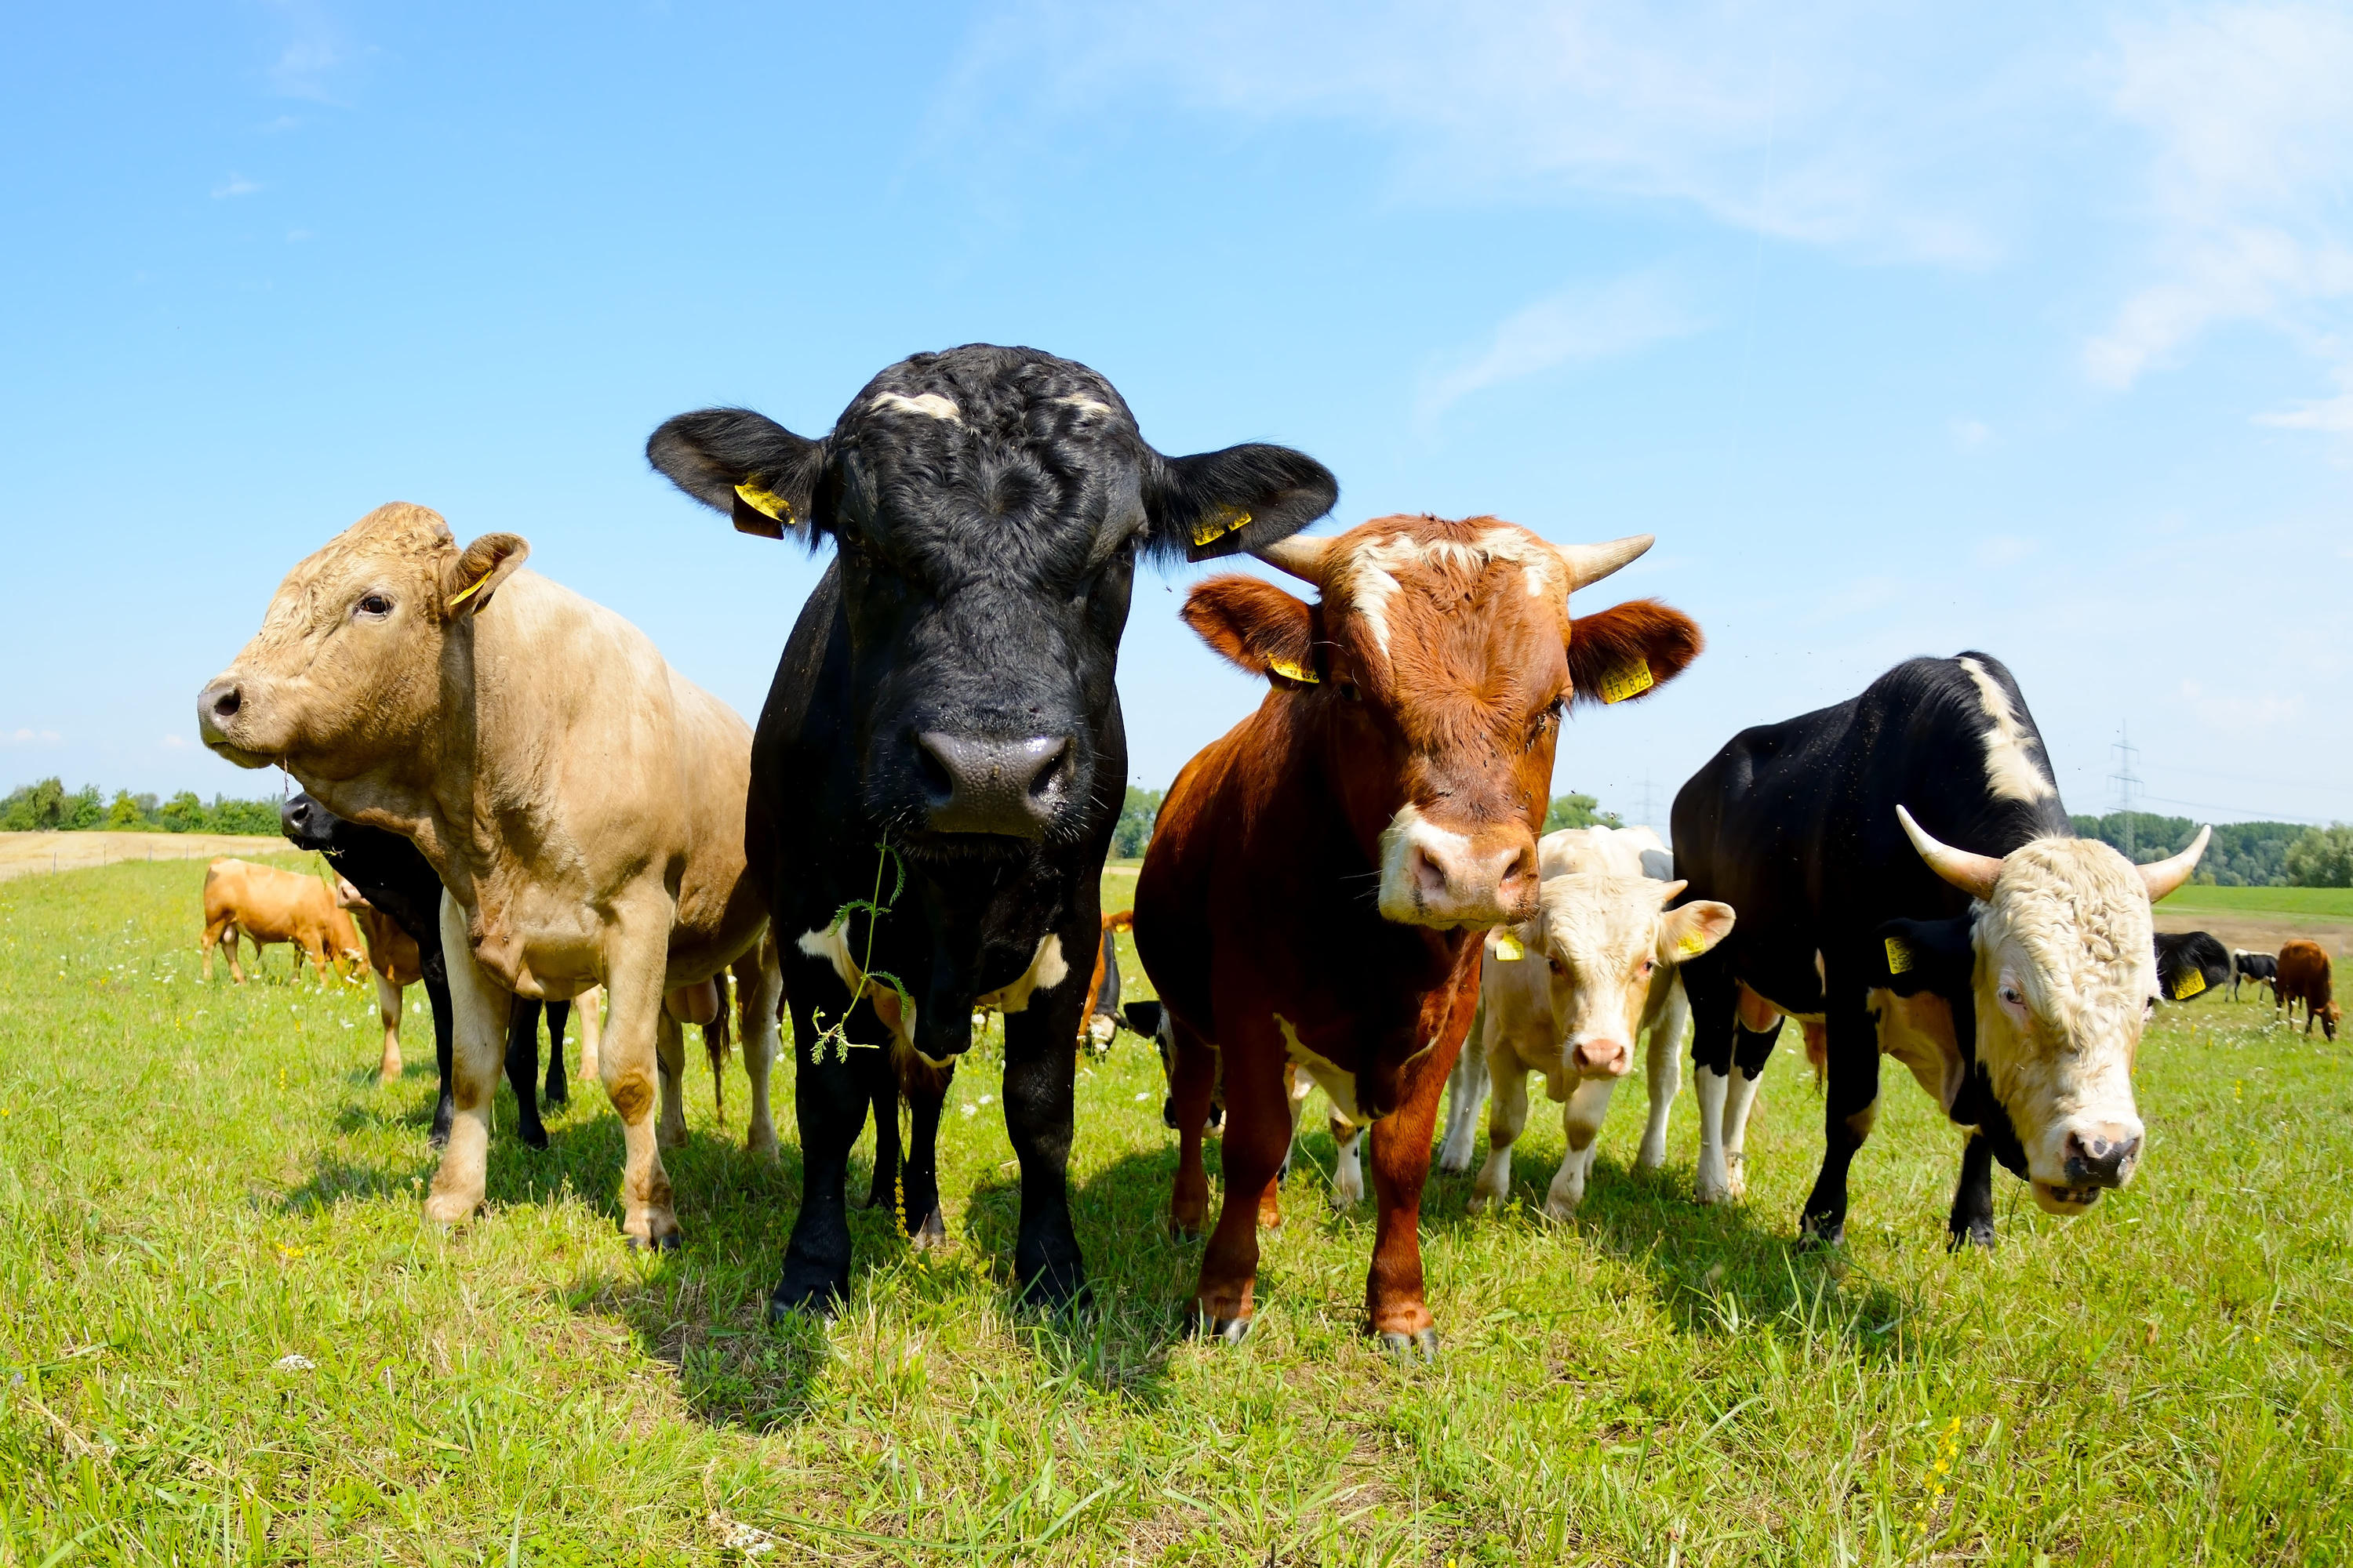
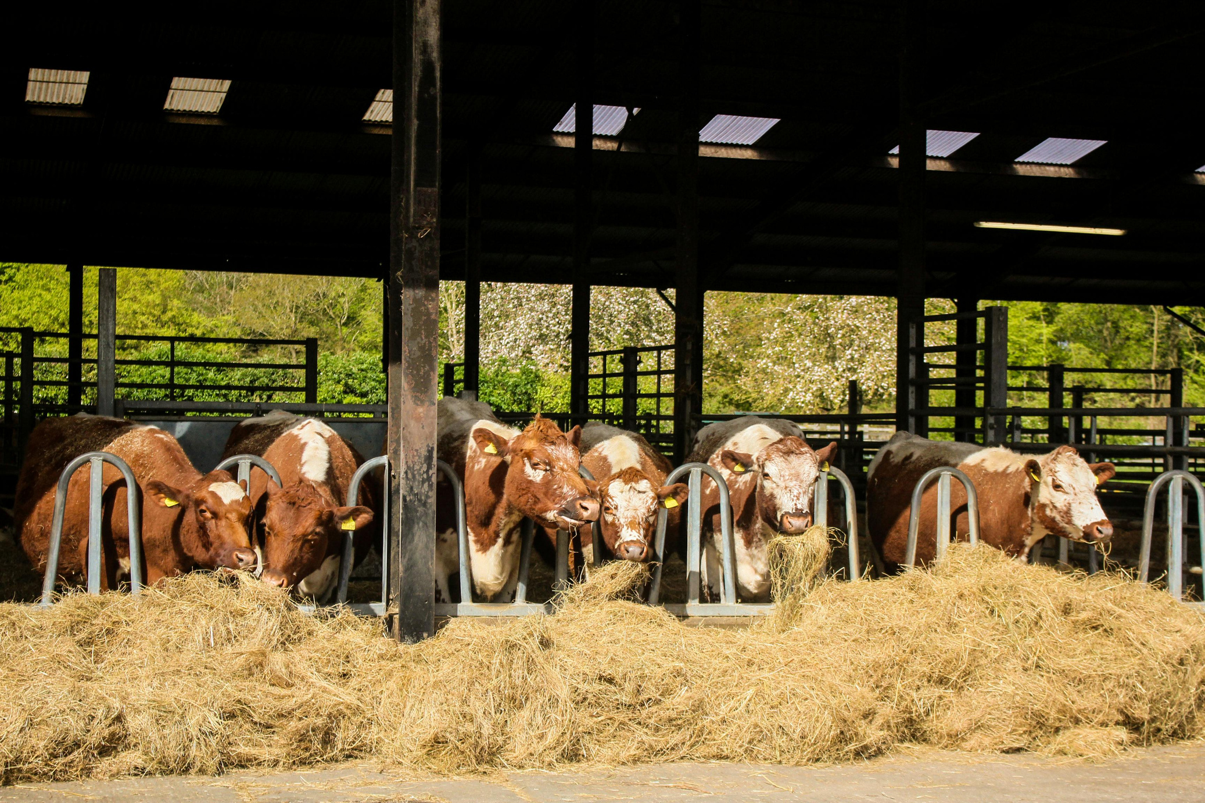
RURAL LIVELIHOODS
ESSENTIAL ROLE IN HUMAN HEALTH
Millions of families rely on livestock for food and income. It sustains both smallholder farmers and larger agricultural enterprises, driving local economies. Beyond nutrition, livestock fosters cultural values, education opportunities, and community stability. Supporting sustainable livestock practices strengthens resilience, helping communities overcome poverty, face economic challenges, and achieve long-term growth. Livestock remains essential for improving livelihoods worldwide.

Slide 6
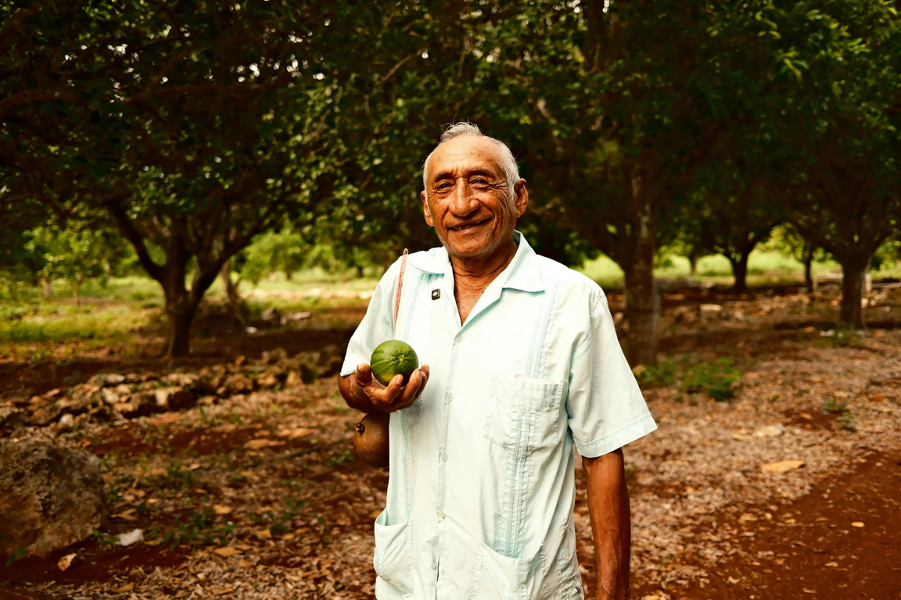
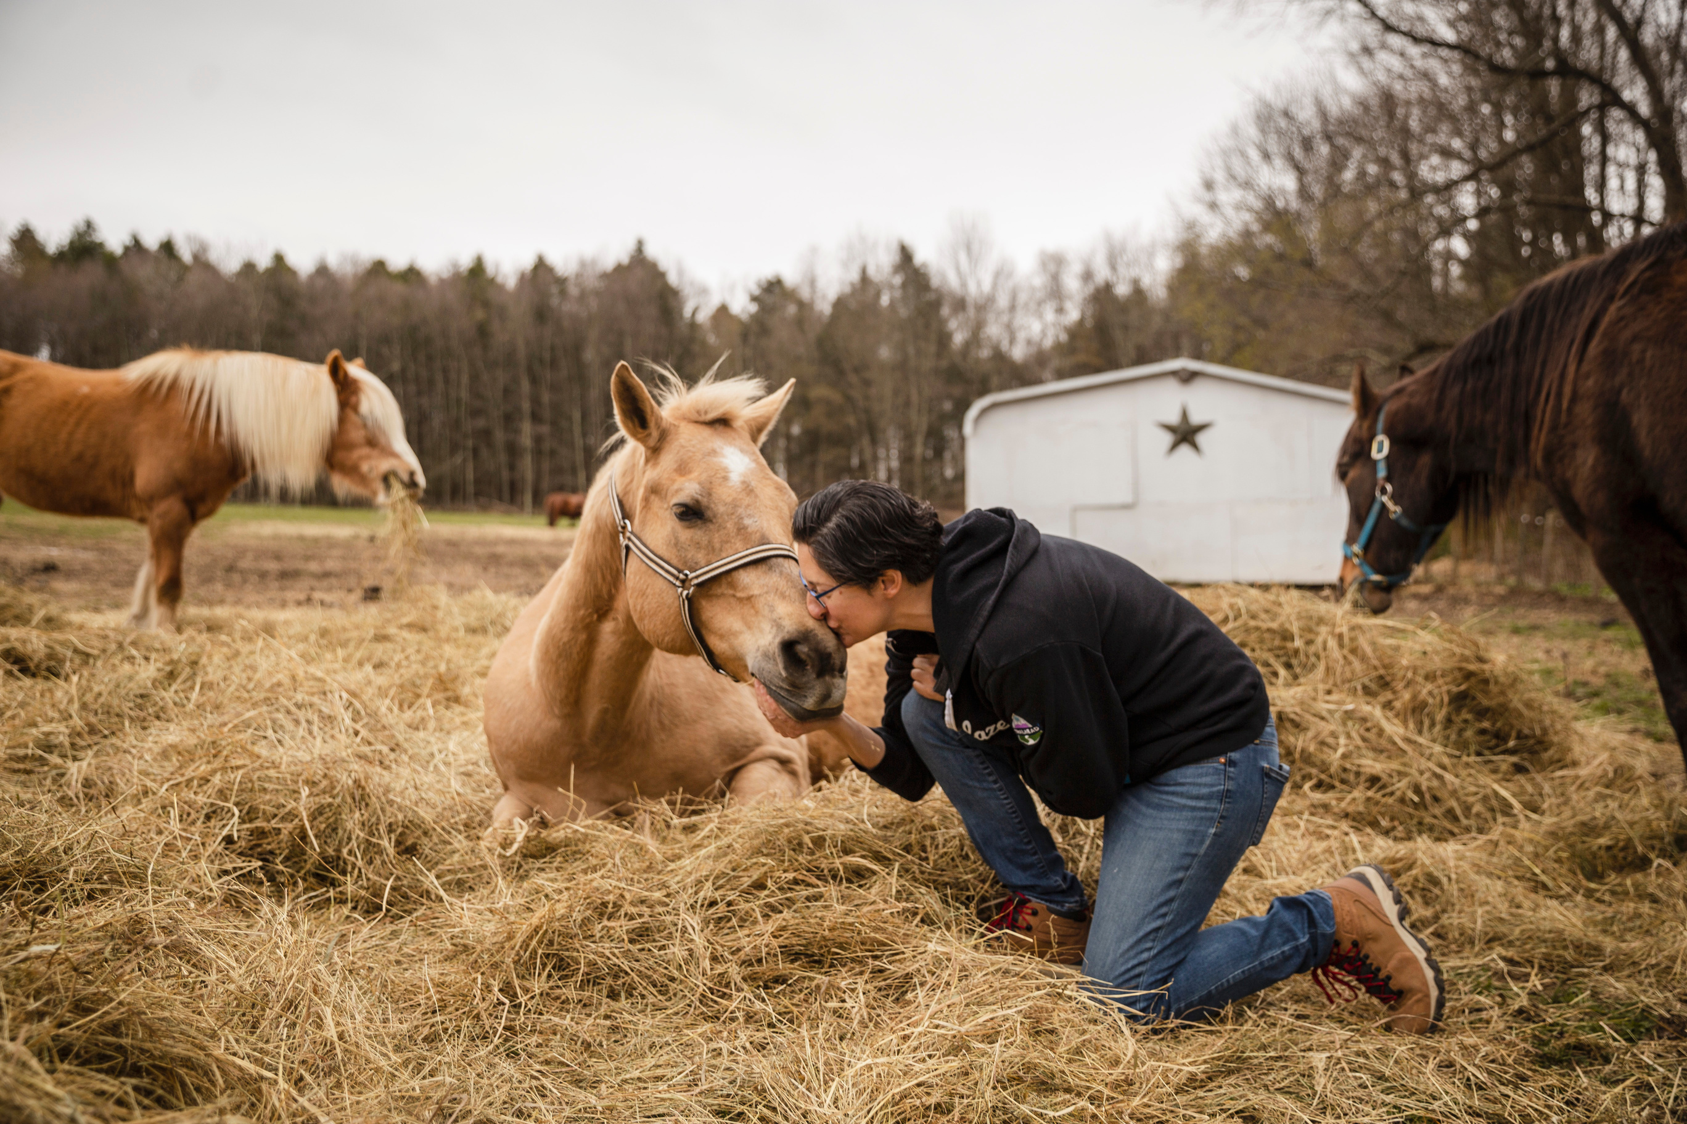
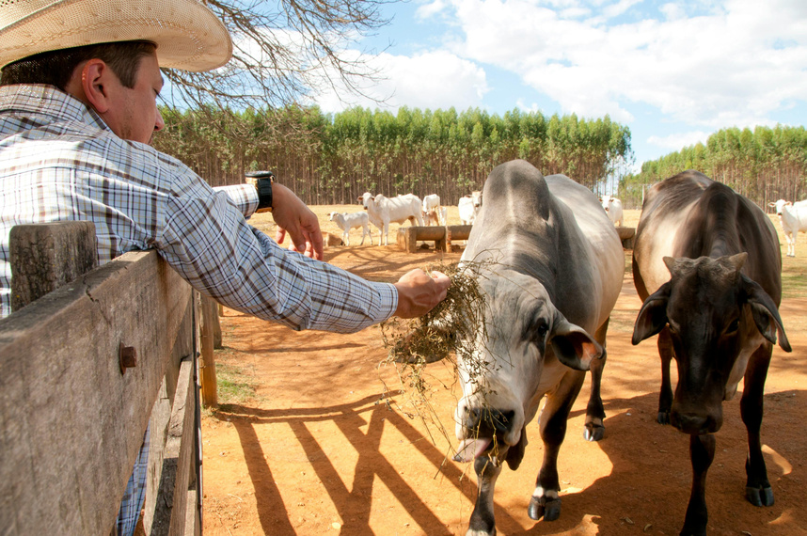
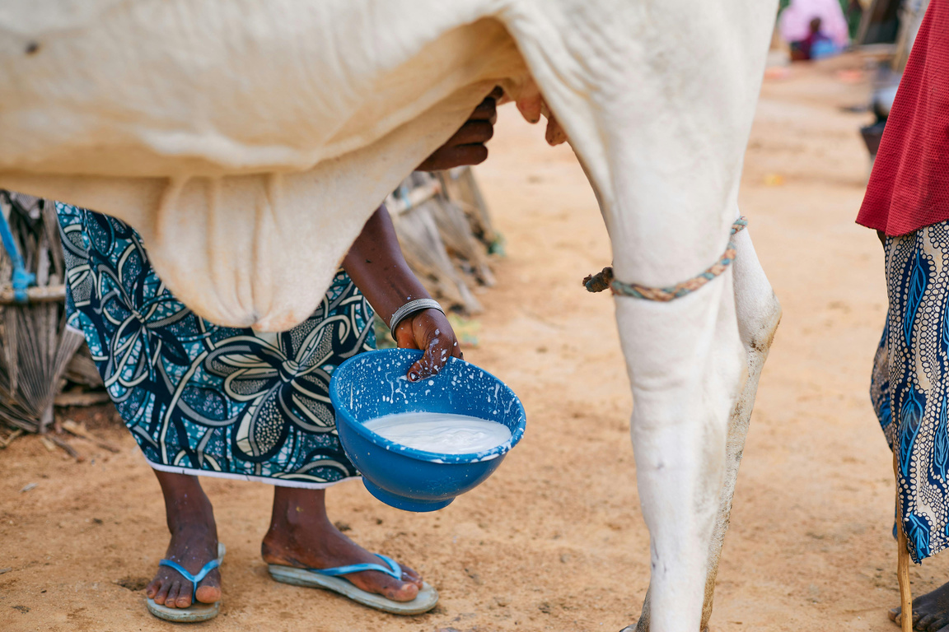
SOCIAL DIMENSIONS
TRADITIONS SHAPED BY ANIMAL KEEPING
TRADITIONS
Livestock is central to festivals, ceremonies, and shared practices, strengthening community identity while preserving cultural heritage that connects generations and ensures continuity across different societies worldwide.
KNOWLEDGE
Families pass farming expertise, animal care, and survival strategies, enabling resilience. Skills provide communities with sustainable resources and adaptability to meet evolving environmental and economic challenges.
INCLUSION
Women play essential roles in livestock care, management, and production. Their involvement promotes empowerment, enhances gender equality, and supports stronger communities with inclusive opportunities for development and progress.

Slide 7
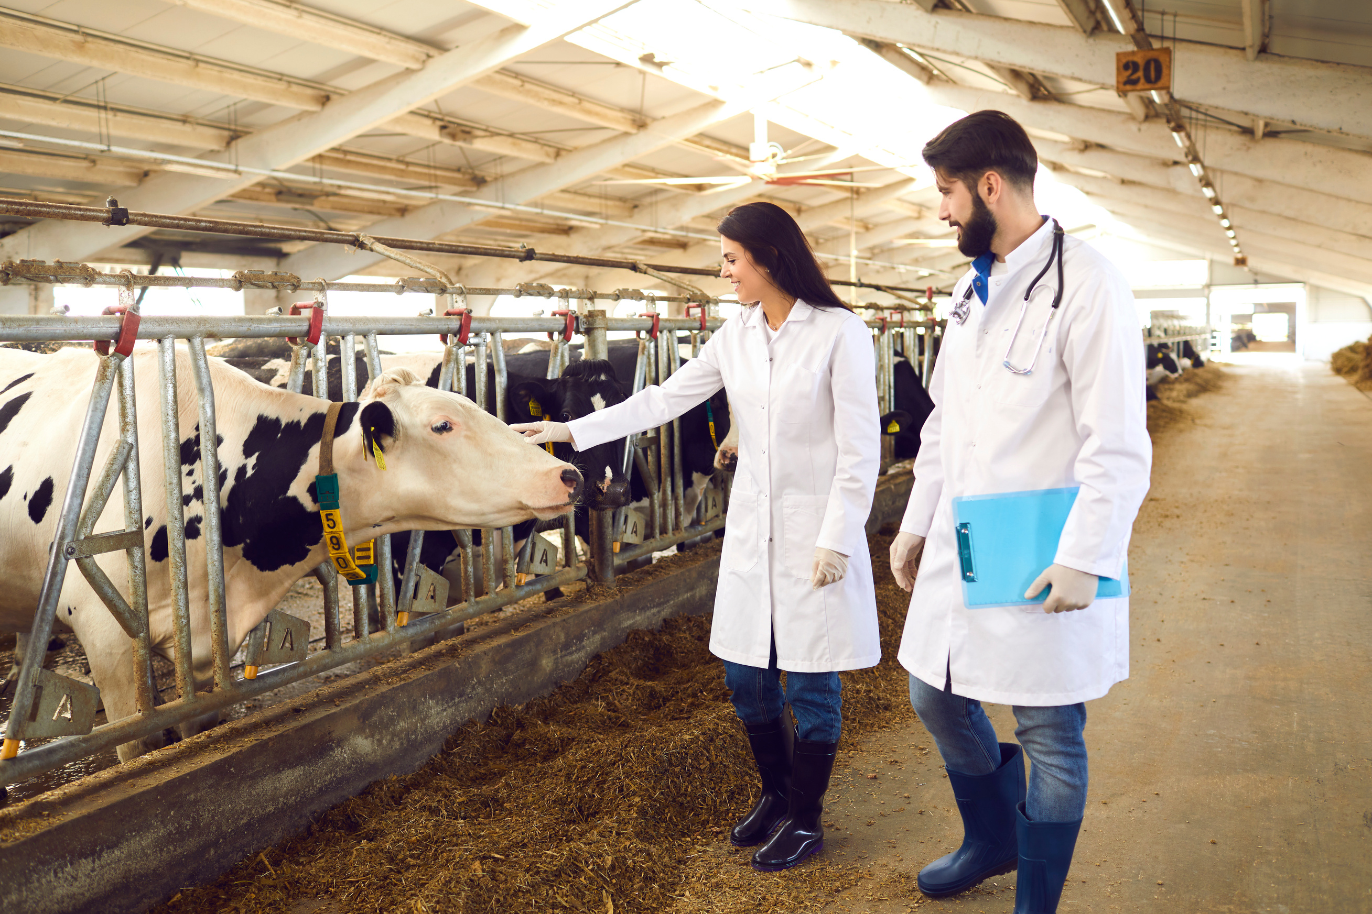
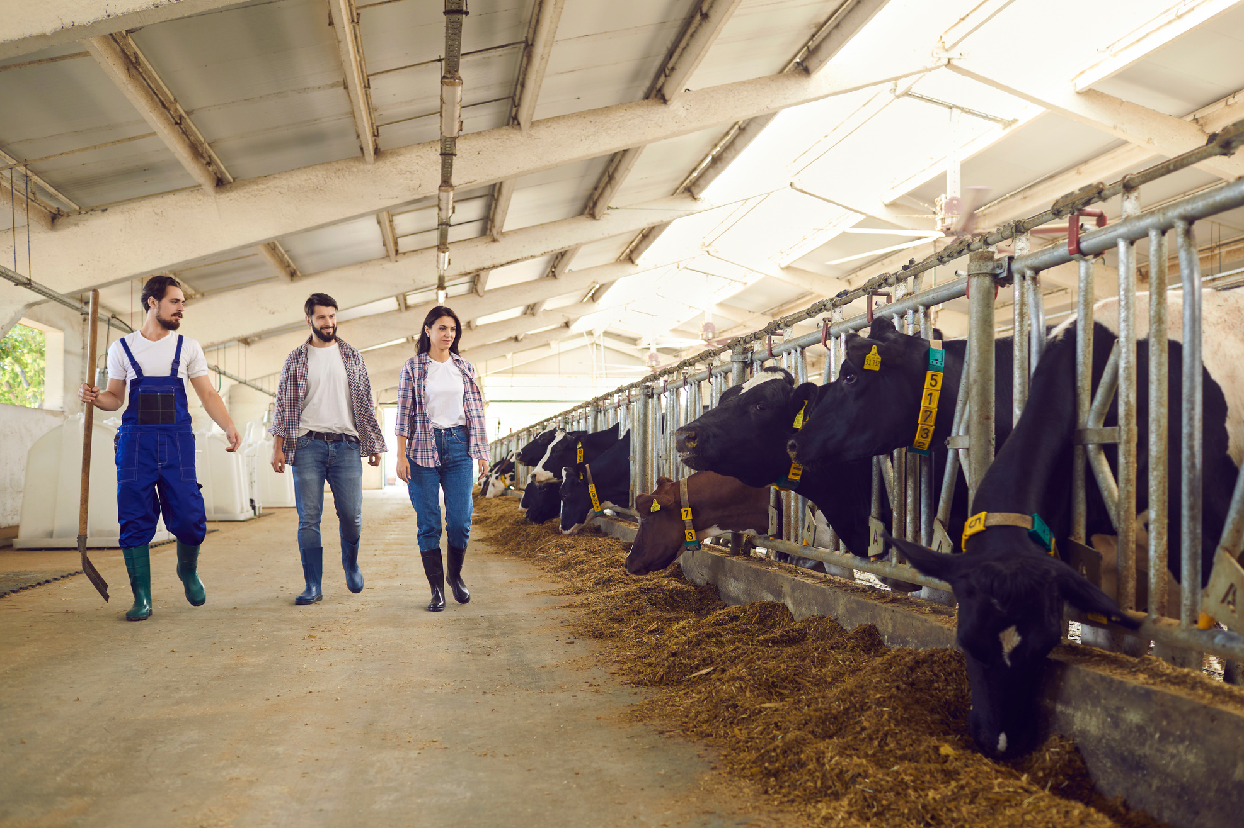
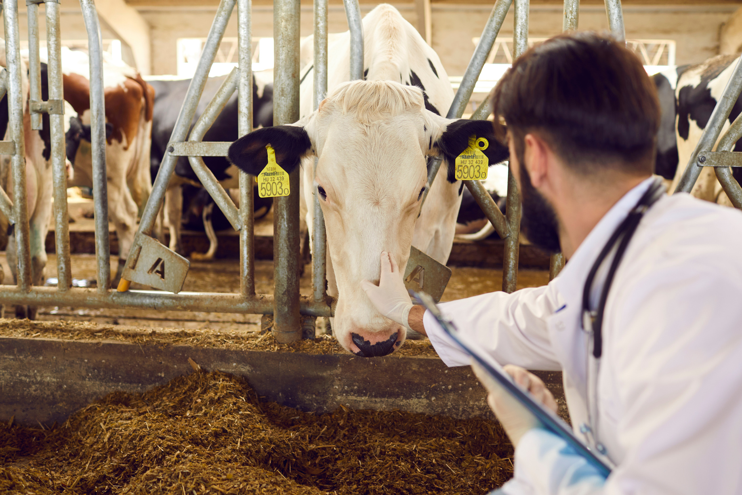
INNOVATIONS SHAPING FUTURE PRACTICES
INNOVATION IN LIVESTOCK
TECHNOLOGY
SUSTAINABILITY
Sensors, monitoring, and artificial intelligence improve animal health, enhance productivity, and ensure efficiency, supporting sustainable livestock practices for global food security.
Climate-smart farming, waste recycling, and improved feeding methods minimize ecological impact while sustaining productivity and food supplies for future generations.

Slide 8
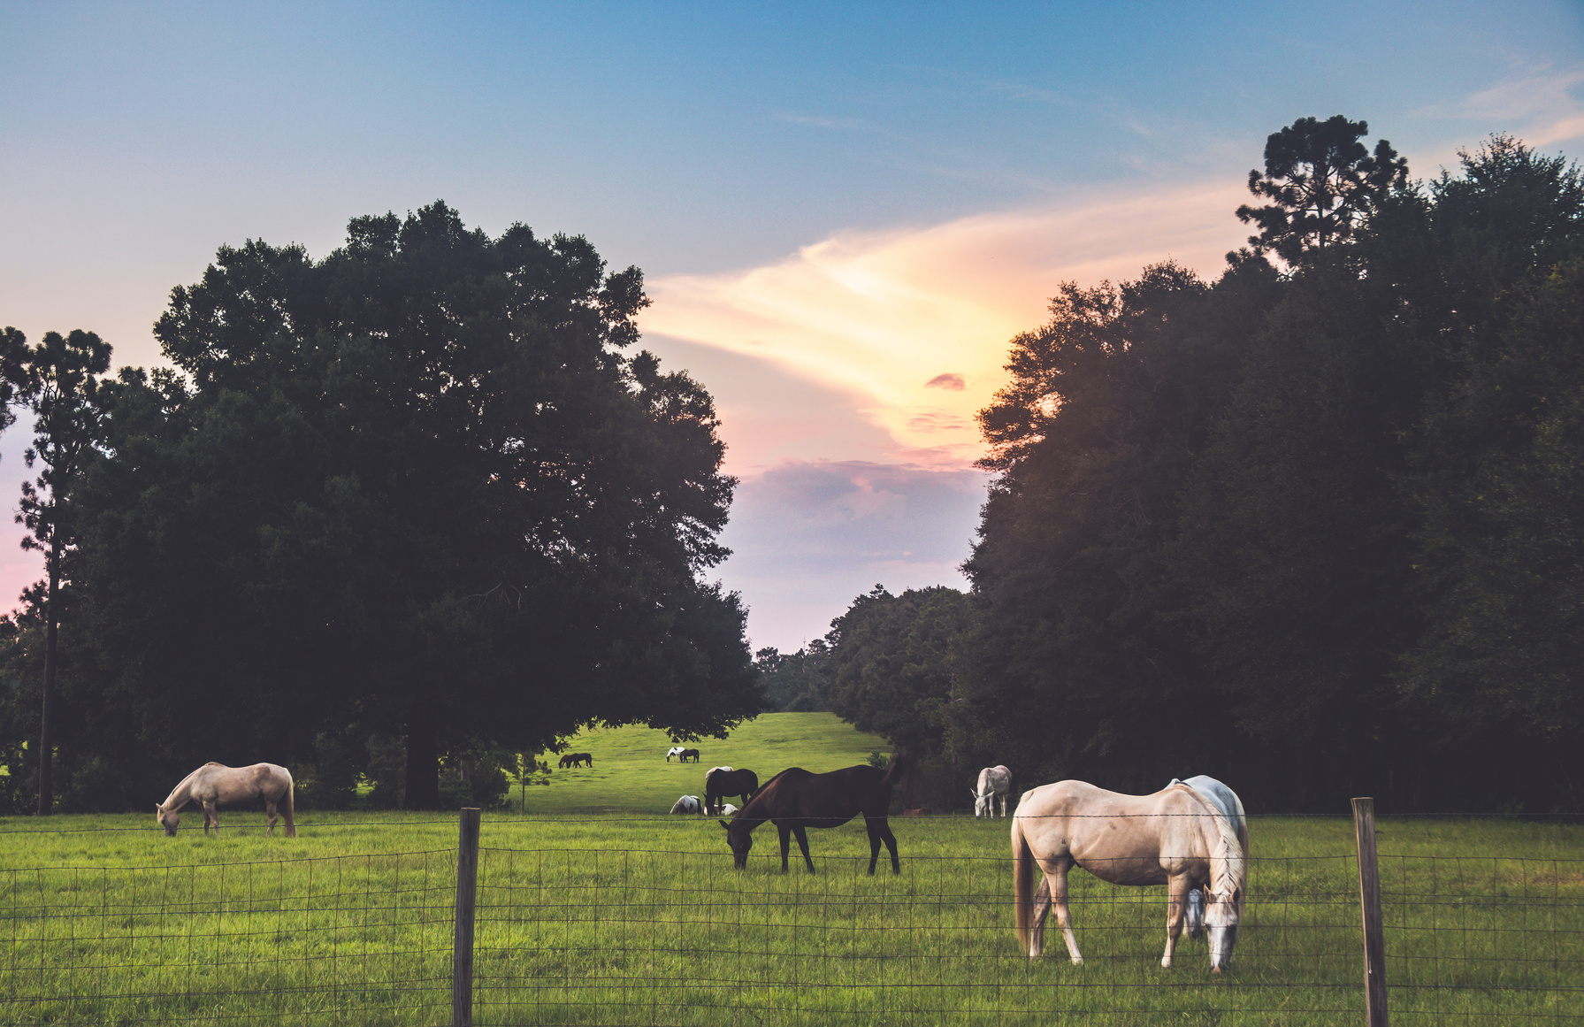
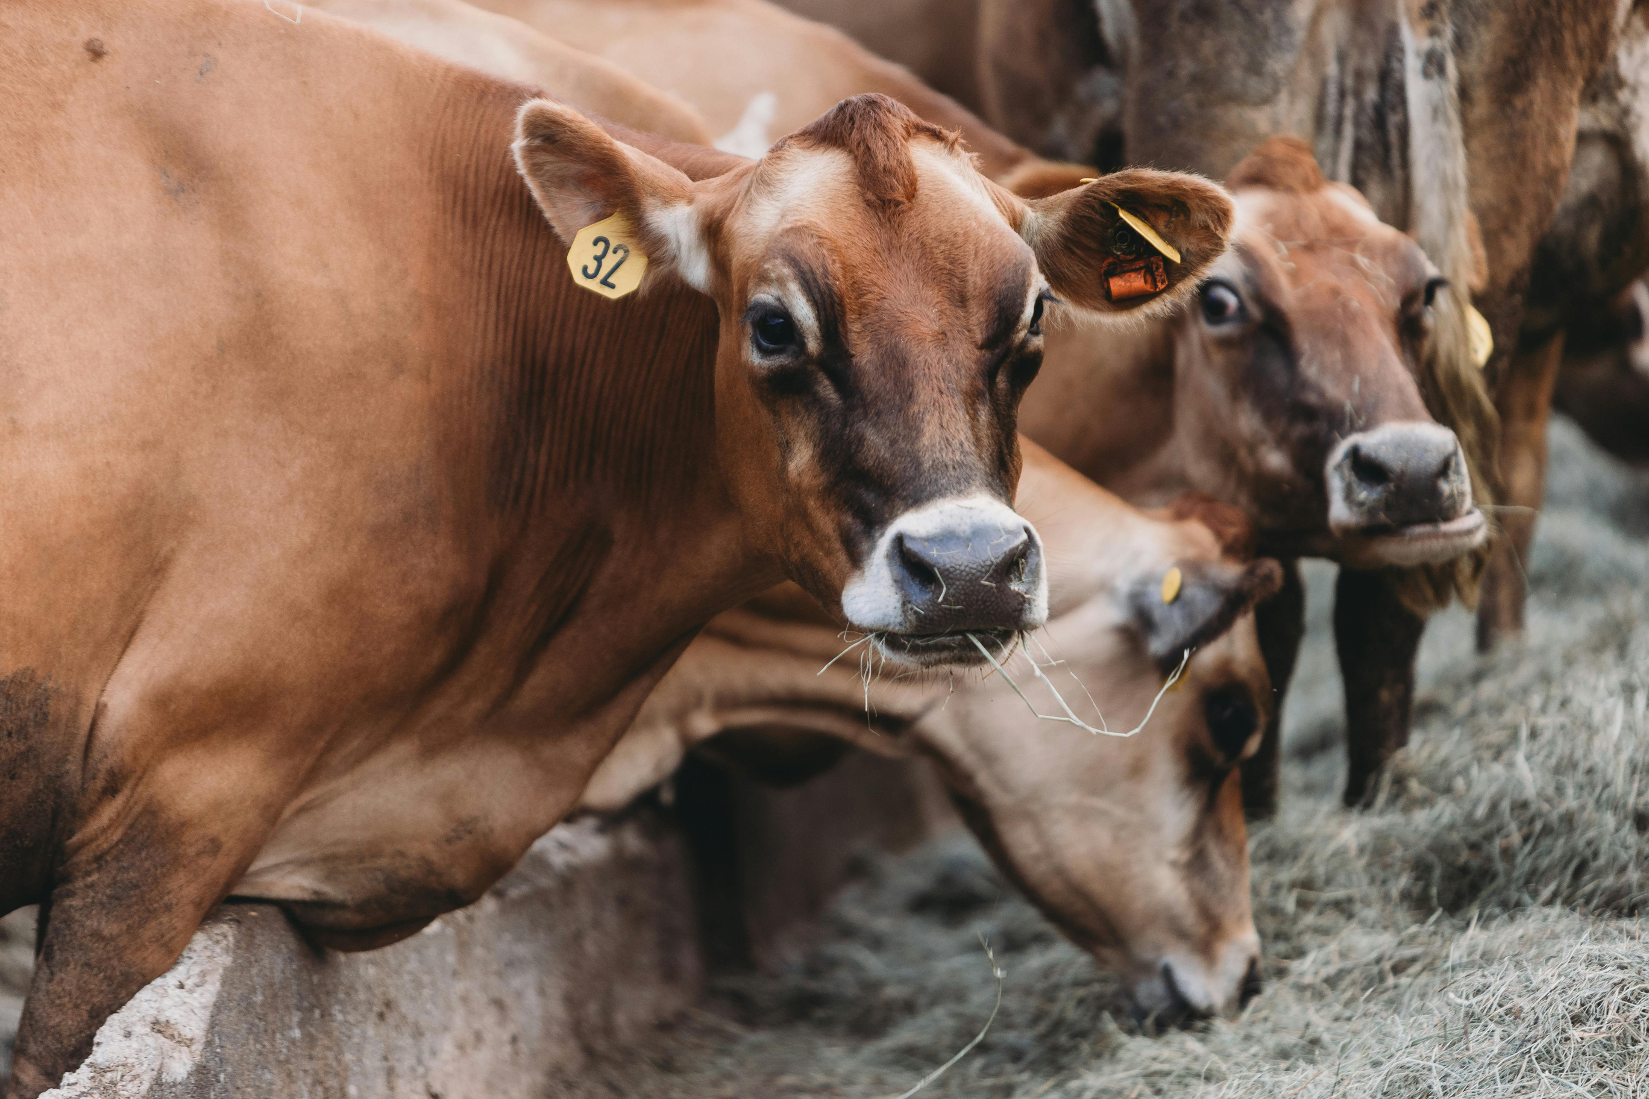
NUTRITION AND HEALTH
BUILDING STRONGER LOCAL FOUNDATIONS
Animal products deliver protein, iron, and vitamins essential for human health. For vulnerable communities, livestock prevents malnutrition and ensures balanced diets, highlighting its irreplaceable role in global nutrition and well-being.
Overconsumption can raise health risks. Balanced diets that integrate livestock with plant-based foods allow people to maximize nutritional benefits while reducing disease risks, promoting wellness and sustainable lifestyles worldwide.

Slide 9
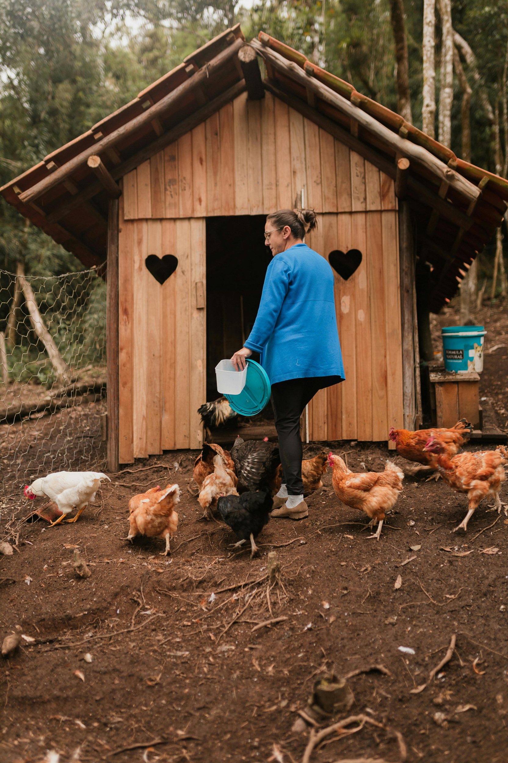
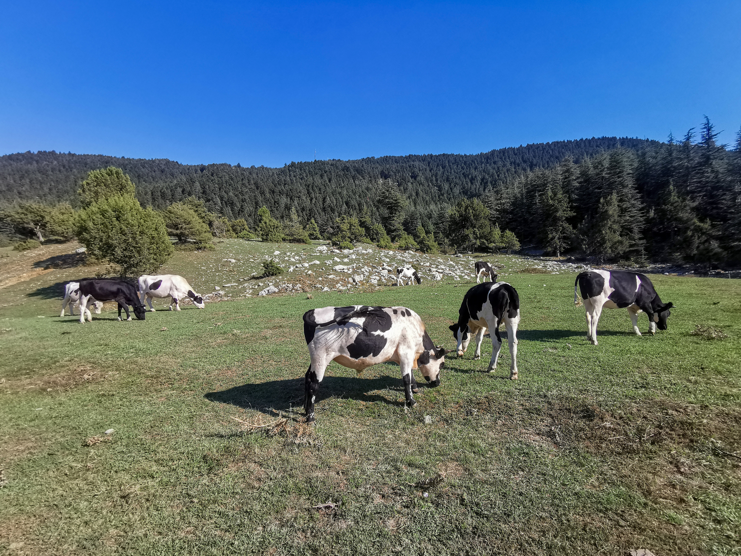
CULTURAL IMPORTANCE
BALANCING DEMANDS WITH SUSTAINABILITY
Livestock symbolizes wealth, respect, and belonging in many cultures. Animals play a role in festivals and rituals, reflecting deep community values. Farming traditions reinforce identity and connect generations, building stronger social ties. These cultural practices highlight livestock’s significance beyond economics, preserving heritage while sustaining communities. Livestock therefore supports both nutritional needs and long-standing traditions worldwide.

Slide 10
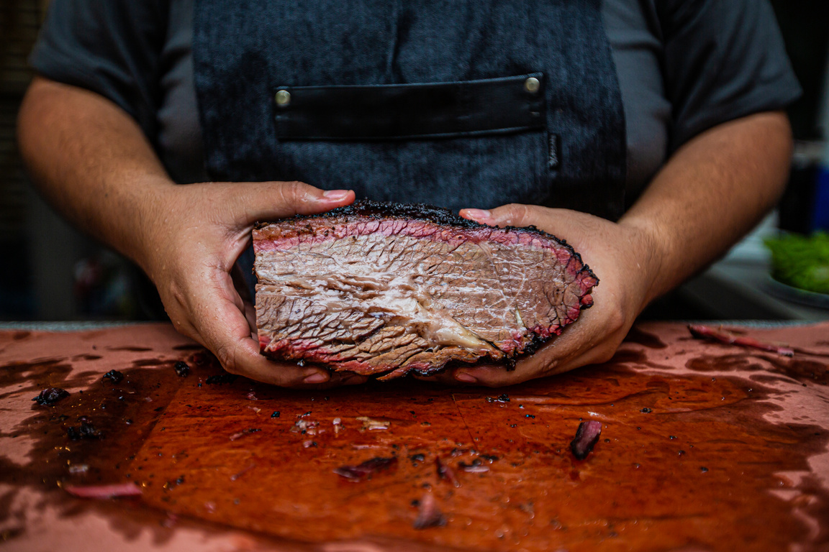


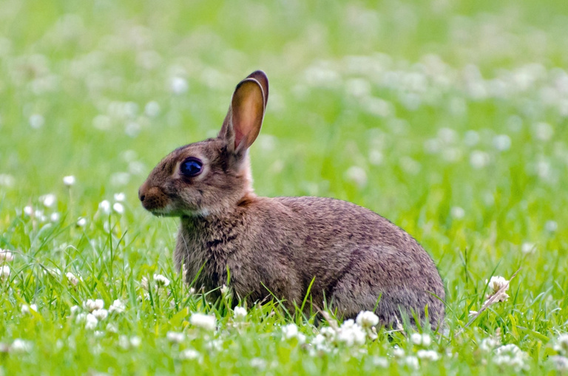
FUTURE DIRECTIONS
ALTERNATIVE PROTEINS
POLICY SUPPORT
Plant-based and lab-grown meat complement livestock, reducing pressure on ecosystems.
Regulations and programs promote sustainable practices across regions.
GLOBAL PARTNERSHIPS
RESILIENT PRACTICES
INNOVATION FOR SUSTAINABLE LIVESTOCK SYSTEMS
Collaboration enhances knowledge sharing and resource distribution worldwide.
Climate-smart innovations protect biodiversity and secure food security.

Slide 11
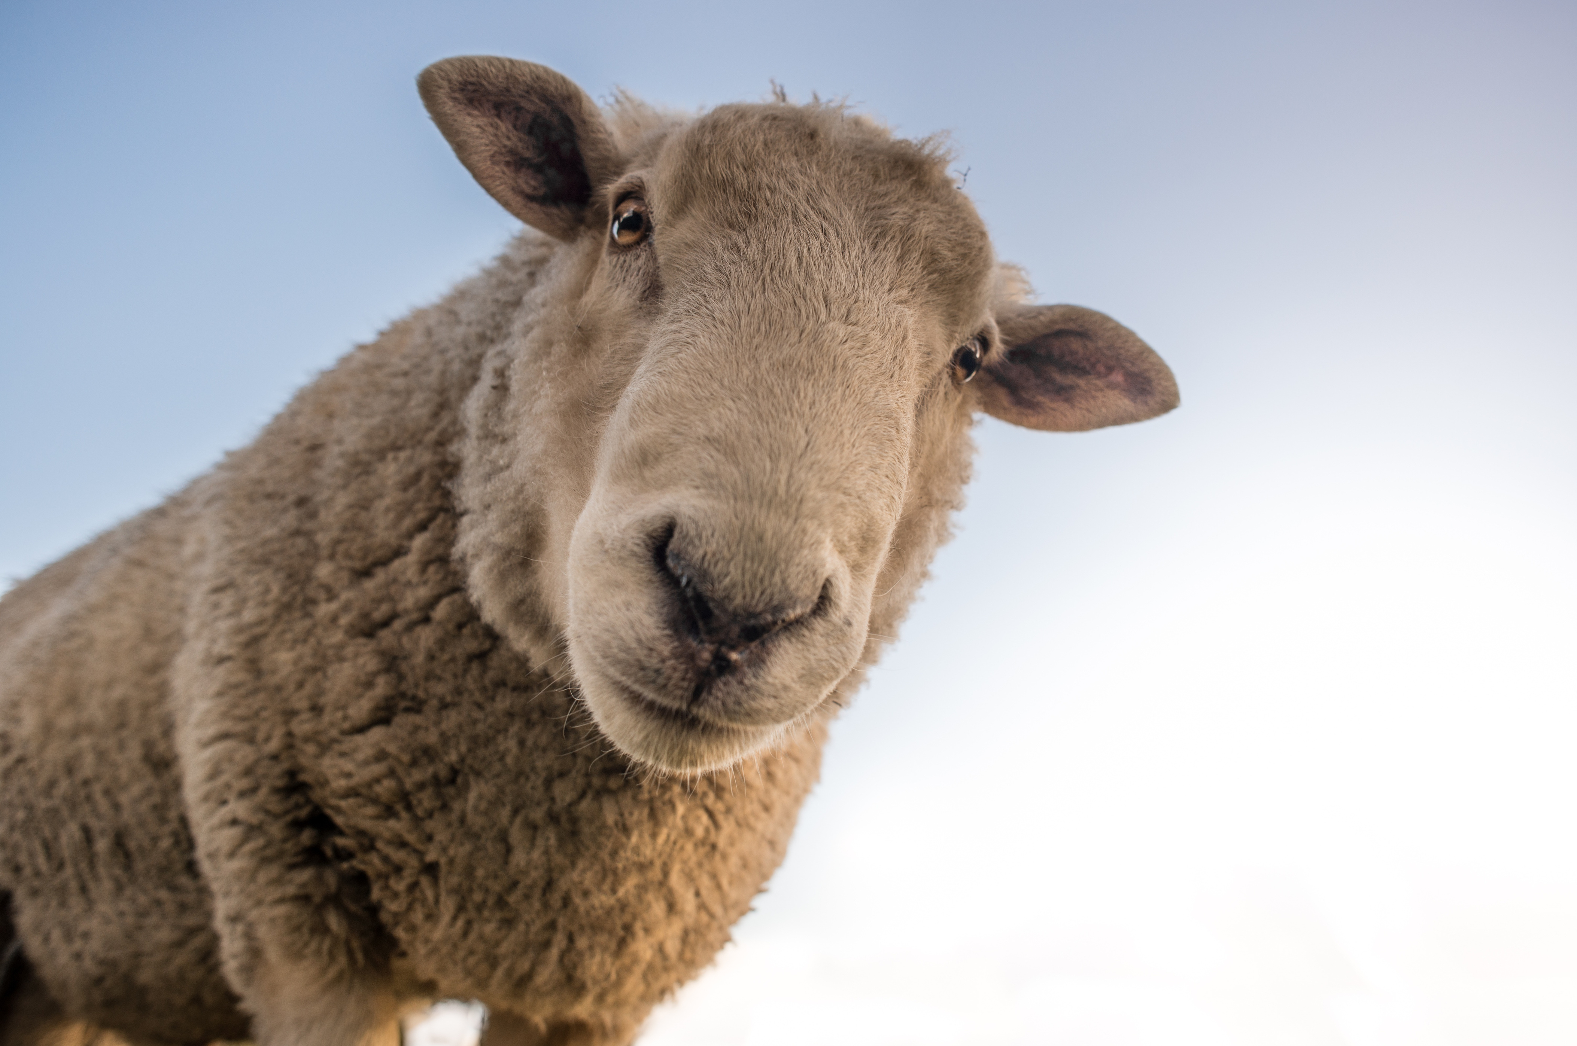
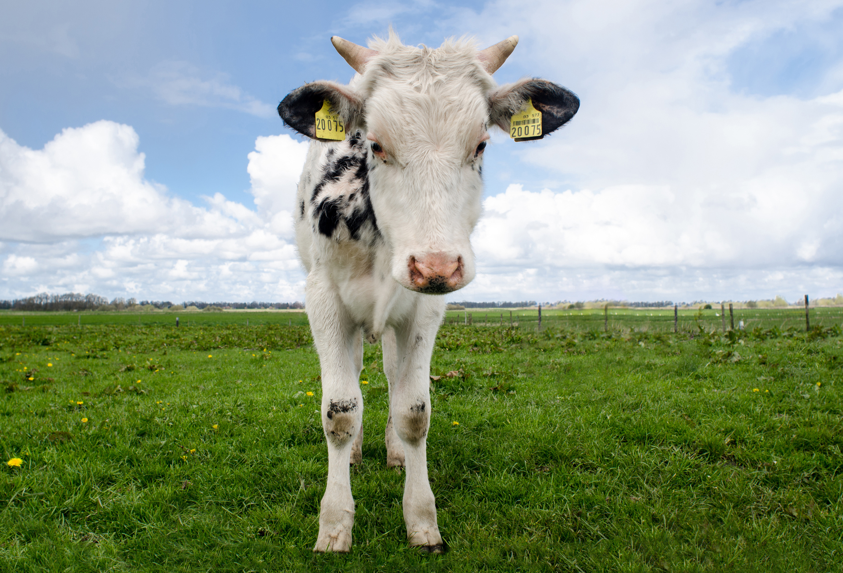




THANK YOU
GET IN TOUCH
Thank you for exploring livestock’s vital role. For collaboration and inquiries, reach us anytime—let’s shape a sustainable future together.
+123-456-7890
www.reallygreatsite.com
hello@reallygreatsite.com
123 Anywhere St., Any City, ST 12345

