Slide 1






Christmas
Wish List
Free Slides Template by EaTemp

Slide 2





Dragon
Socks
Tiramiru
Cat
PS5
A House

Slide 3




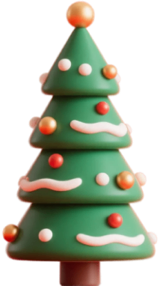
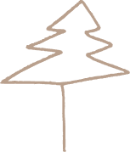
Dragon
Socks
Tiramiru
Cat
PS5
A House

Slide 4





Dragon
Socks
Tiramiru
Cat
PS5
A House

Slide 5



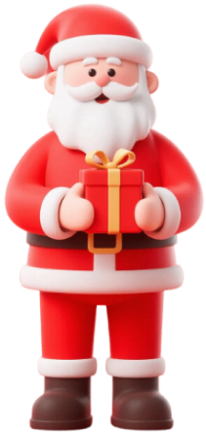

Dragon
Socks
Tiramiru
Cat
PS5
A House

Slide 6
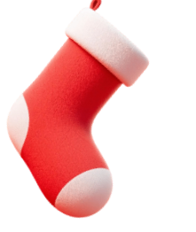




Thank you for choosing EaTemp
• Yes, you can use this for both personal and commercial projects.
• No, you don't have to credit us.
• No, you can't resell or redistribute it, including uploading this template online.
• And you can support us by sharing our site, EaTemp.com, with others.

