Slide 1
SCIENCE AND THE EDUCATION OF TEACHERS James M. Kauffman University of Virginia
Teachers at the Crossroads:
The State of Teacher Preparation

Slide 2
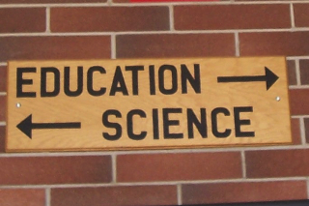
THE PROBLEM

Slide 3
Three “Take-Away” Points
1. Some things just aren’t possible, and we should recognize them. Some things are inevitable, and we should get used to them. Both kinds are just functions of basic math and science.
2. To make education a science, we have to understand what science is and isn’t.
3. If education becomes an applied science, then we’ll have manuals and checklists, and we ought to start working on them.

Slide 4
IMPOSSIBILITIES
Measurement without a distribution
A distribution without “moments” (e.g., mean, standard deviation, skew, kurtosis)
Elite education for everyone (unless “elite” doesn’t mean elite)
All students becoming proficient (unless “all” excludes those who don’t)

Slide 5
INEVITABILITIES
Prevention resulting in identification of more individuals and a higher risk of false positives
A line (criterion, qualification) required for selection for a special program
Margins of a line (false positives and false negatives) resulting in ambiguities and errors

Slide 6
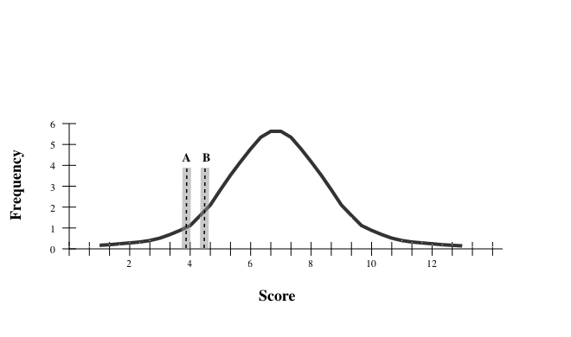
Prevention A v. Prevention B for Reading Failure

Slide 7
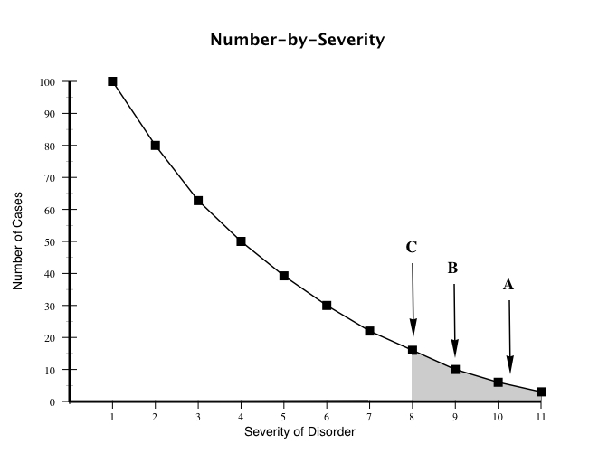
Prevention A, B, & C for EBD

Slide 8
COMMON MISUNDERSTANDINGS OF SCIENCE

Slide 9
Judgment versus Certainty
Direct Instruction (DI) may be selected or embraced as an approach to reading because it has more research support than whole language, not because scientific support for DI is unassailable.

Slide 10
Disproof versus Proof
For example, the technique known as facilitated communication (FC) might be disproved as a means of communication more readily than it can be proven to work.

Slide 11
Contingent versus Noncontingent Statements
The claim that rewarding consequences work has to be qualified.

Slide 12
Replication versus Idiosyncratic Data
Finding an effect that can be replicated by other teachers in other locations is particularly important.

Slide 13
Observation, Measurement, Reason, and Experiment versus Philosophy or Ideology
Consider this: “We must understand that ‘ready means never.’ If we wait until students are ready to work on challenging standards by virtue of having mastered basic skills, they will never work on challenging standards.”

Slide 14
Gradual Change versus Paradigm Shift
Many education reformers are particularly fond of the “break the mold” or “breakthrough” idea of educational reform. However, in education as in other scientific endeavors, paradigm shifts are extremely rare.

Slide 15
Theory versus Fact
“Theory” in education must become what it is in better-established sciences, not a euphemism for ideology or mere guesswork.

Slide 16
PREPARING TEACHERS TO USE A SCIENCE OF EDUCATION
∫Requires a science of education
∫Common suggestions of questionable merit:
* Get smarter teachers!
* Teachers must know their subject!

Slide 17
Essential characteristics of good teachers?
How intelligent?
Subject-matter knowledge?
Knowledge of child development?
Skill in pedagogy (instruction)?
Skill in behavior management?

Slide 18
Philosophy v. Science
Look at other professions.
Other professions apply science:
Prepare manuals--step-by-step instructions on how to do it, based on field trials
Use checklists that help practitioners remember, avoiding errors
The more complex the task, the greater the need for a manual and a checklist.
We don’t need teachers who “wing” it!

Slide 19
Will a Checklist Work?
√ Checklist must be linked to specific outcomes.
√ Checklist requires that we know whether what’s checked off has been done.
√ Checklist allows art and craft; just prevents stupid mistakes.
√ Checklist must be simple and straightforward; must focus on big mistakes that most commonly cause failure; should mean, “If you don’t do this, then you’re running the risk of failing because you forgot something.”
√ Checklist should distribute power and increase communication among team members.

Slide 20
Why people may hate manuals and checklists
Checklists are painstaking.
Checklists seem beneath our dignity, to force rigidity, to make us automatons.
We want to believe we can handle situations of high stakes and complexity.
We want to be among the truly great, who are daring and creative, who improvise and don’t follow protocols and checklists.

Slide 21
Best Example of Manual in Education
Direct Instruction Reading
We need manuals in many or all aspects of teaching.

Slide 22
Example of Possible Checklist in Teaching
For giving instructions (after Kauffman, Pullen, Mostert, & Trent, 2011):

Slide 23
When giving instructions, be sure to: [] Make the instruction as simple and clear as possible. [] Give the instruction in a clear, firm, nontentative, but polite and nonangry way. [] Obtain students’ full attention before giving the instruction. [] Be careful not to give too many different instructions. [] Give one instruction at a time. [] Wait a reasonable time for compliance. [] Monitor compliance. [] Provide appropriate consequences for compliance or noncompliance.

