Slide 1
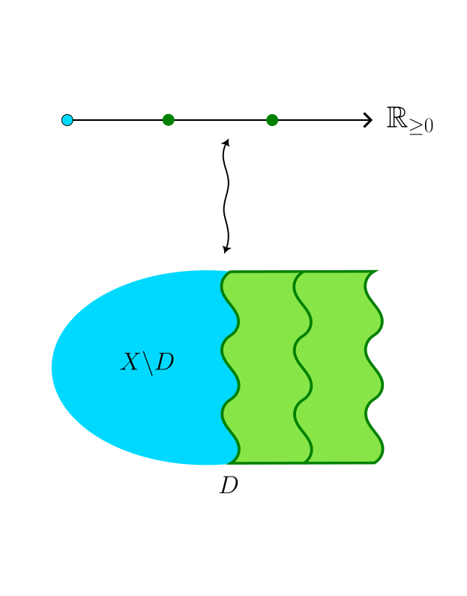
From doodles to exploding shapes: Recipe for making geometry from discrete mathematics
Siao Chi Mok
Newnham College Pudding Seminar, 08/11/2024

Slide 2
What would a team of mathematicians do when they are stuck on a problem?

Slide 3
Connections in mathematics
Langlands programme: a connection between number theory, geometry, and analysis
Furstenberg’s proof of Szemerédi’s theorem: “rewording a problem about sets of integers, into a question about points moving around in space!” (quoted from Quanta magazine, 05/12/2022)
Themes in common: gaining new perspectives, connecting the discrete and the continuous!

Slide 4
The magical recipe
Discrete
Continuous
Problem in tropical geometry
Problem in algebraic geometry
Constructions in tropical geometry
Constructions in algebraic geometry

Slide 5

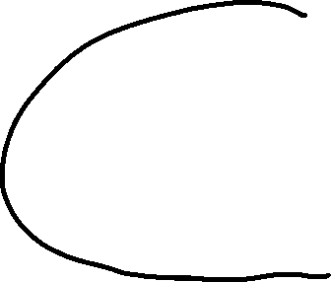





An adventure…
Problem: Study distributions of a number (n) of points on a space X, lying away from the boundary D. Imagine D is a cliff!
(ignore!)
$$↑y$$
$$→x$$
$$x=0$$

Slide 6

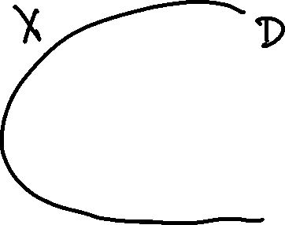


The adventure continues…
$$x=0$$
$$→x$$

Slide 7



The adventure continues…
$$p_{1}\left(s\right)=s+s^{2}+…$$
$$p_{2}\left(s\right)=s^{2}+2s^{3}+…$$
(Look at the behaviour as $s→0$.)
$$x=0$$
$$→x$$

Slide 8







What happens at the boundary?
$$p_{1}\left(s\right)=s^{1}+s^{2}+…$$
$$p_{2}\left(s\right)=s^{2}+2s^{3}+…$$
A ‘doodle’
The ‘exploded shape’

Slide 9
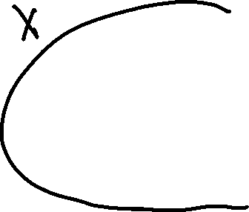
Problem solved!

Slide 10
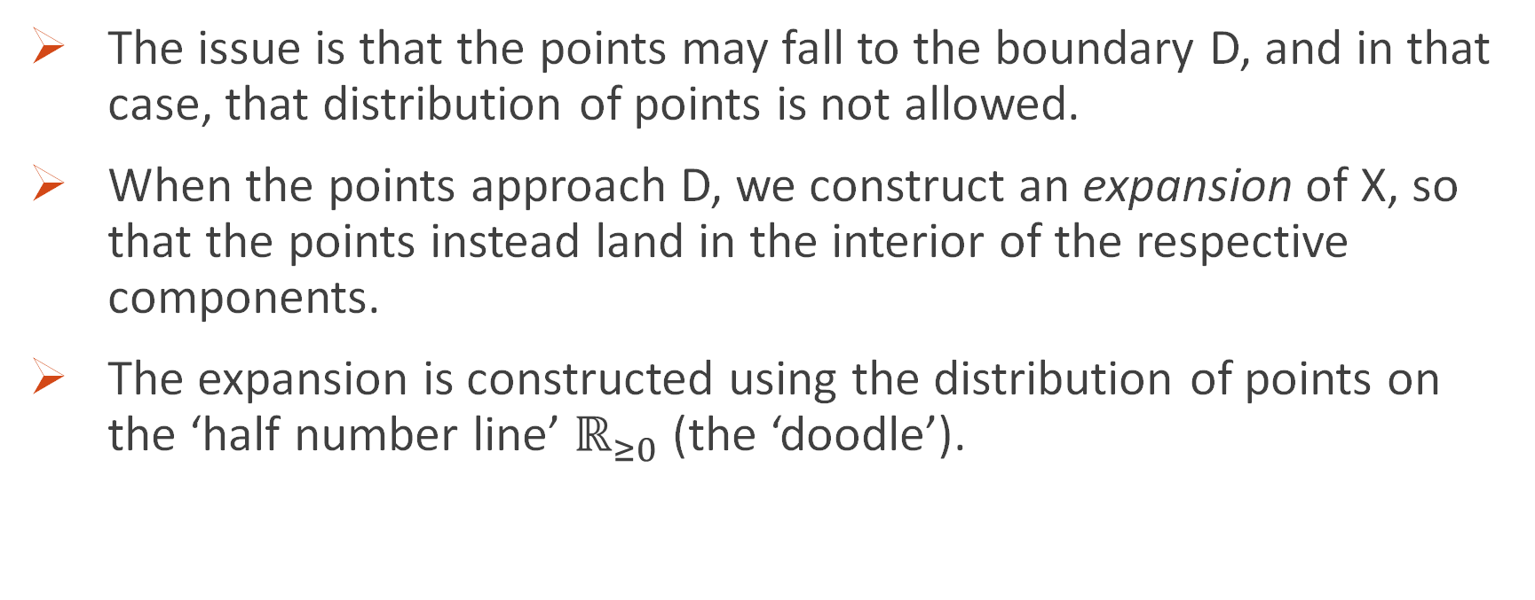
Great, in more precise terms?
The issue is that the points may fall to the boundary D, and in that case, that distribution of points is not allowed.
When the points approach D, we construct an expansion of X, so that the points instead land in the interior of the respective components.
The expansion is constructed using the distribution of points on the ‘half number line’ $ℝ_{≥0}$ (the ‘doodle’).
Notes:
Story behind the name of expansions

Slide 11
The magical recipe
Discrete
Continuous
Problem in tropical geometry
Problem in algebraic geometry
Constructions in tropical geometry
Constructions in algebraic geometry

Slide 12
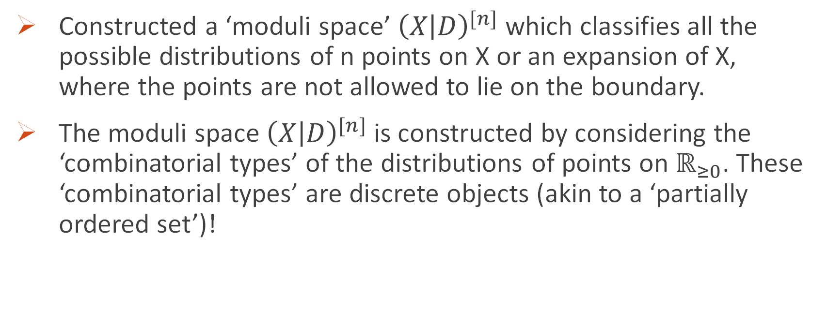
My research
Constructed a ‘moduli space’ ${\left(X | D\right)}^{[n]}$ which classifies all the possible distributions of n points on X or an expansion of X, where the points are not allowed to lie on the boundary.
The moduli space ${\left(X | D\right)}^{[n]}$ is constructed by considering the ‘combinatorial types’ of the distributions of points on $ℝ_{≥0}$. These ‘combinatorial types’ are discrete objects (akin to a ‘partially ordered set’)!

Slide 13





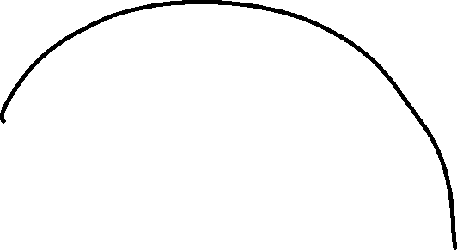









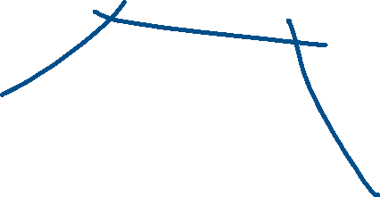







A schematic picture of ${\left(X | D\right)}^{[2]}$

Slide 14
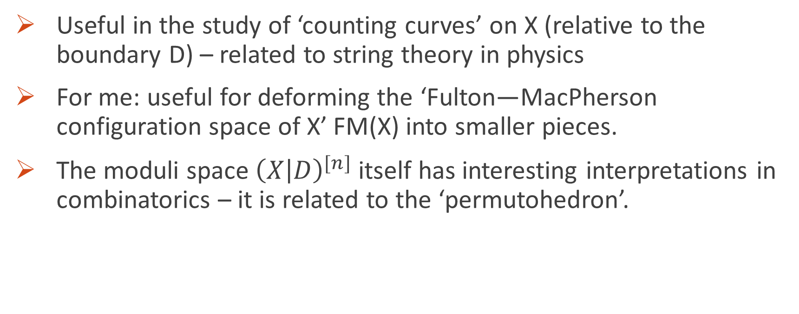
Why is it useful?
Useful in the study of ‘counting curves’ on X (relative to the boundary D) – related to string theory in physics
For me: useful for deforming the ‘Fulton—MacPherson configuration space of X’ FM(X) into smaller pieces.
The moduli space ${\left(X | D\right)}^{[n]}$ itself has interesting interpretations in combinatorics – it is related to the ‘permutohedron’.

Slide 15
The joy of mathematics
My own experience: beautiful and accessible!
Related to a summer research project by another Newnham student Maria Osmova
Humanity in mathematics: collaboration between different areas, bridging gaps
More conversations about appreciating mathematics, and women participation in mathematics

Slide 16
Acknowledgements
Newnham College, DPMMS and Cambridge Trust
My supervisor Prof. Dhruv Ranganathan
Thank you for listening!

