Slide 1
RESEARCH and DEVELOPMENT
www.freepptbackgrounds.net
Presentation Template

Slide 2
01
Powerpoint
02
Web Design
CONTENTS
03
Keynote
04
Development

Slide 3
PART 01
Powerpoint

Slide 4
2020
Powerpoint
Check
We certainly do not forget you as soon
as you forget us.
Think
It is a very sad thing that nowadays there is so
little useless information.
01
02
03
04
Infographic
It is, perhaps, our fate rather than
our merit. We cannot help ourselves.
We live at home, quiet, confined,
and our feelings prey upon us
. You are forced on exertion.
Make
It is a very sad thing that
It is a very sad thing that

Slide 5
2020
Powerpoint
01
I believe that people would be alive today I
f there were a death penalty.
02
The time is now, the place is here. Stay in the present.
You can do nothing to change the past, and the future will
never come exactly as you plan or hope for.Dan Millman
03
I feel very strongly that change is
good because it stirs up the system.
04
A large income is the best recipe for
happiness I ever heard of.

Slide 6
2020
Powerpoint
1998
2002
Opening
Speakers
2009
2012
Design
Overview
Solutions
2019
When you feel in your gut what you are and then dynamically pursue it - don't back down and don't give up - then you're going to mystify a lot of folks.
2014
Devices
Cerenomy

Slide 7
2020
Powerpoint
People
I'm convinced that about half of what separates the successful entrepreneurs
Like
From the non-successful ones is pure perseverance.
Coin
When you feel in your gut what you are and then
Opening
Skiing consists of wearing $3,000 worth of clothes and equipment
Break Time
When you feel in your gut what you are and then
01
02
03
04
05

Slide 8
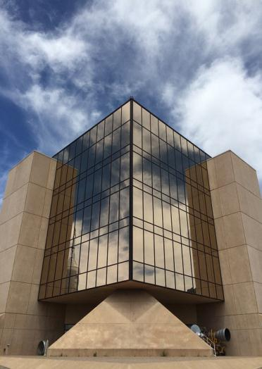
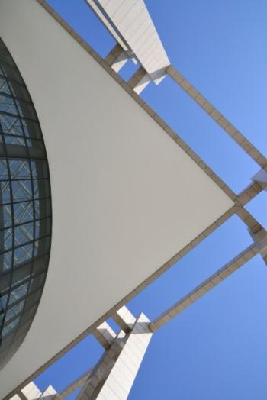
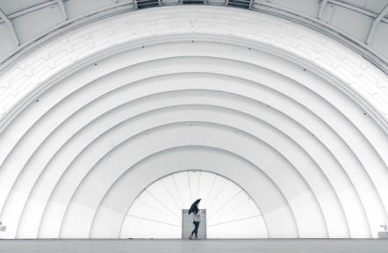
2020
Powerpoint
Speakers
When you feel in your gut what you are and then dynamically pursue it - don't back down and don't give up - then you're going to mystify a lot of folks.
Free Time
Skiing consists of wearing $3,000 worth of clothes and equipment and driving 200 miles in the snow in order to stand around at a bar and drink.

Slide 9
PART 02
Web Design

Slide 10
2020
Web Design
01
02
03
04
Forum
To see what is in front of one's nose
needs a constant struggle.
Vision
There is only one difference between a madman
and me.I am not mad.
Our Values
To see what is in front of one's nose needs a constant
struggle.
Mission
Take calculated risks. That is quite
different from being rash.

Slide 11
2020
Web Design
02
Annual Meeting
The time is now, the place is here.
Stay in the present.
Future
I believe that people would be alive today
if there were a death penalty.
01
03
What we do?
I feel very strongly that change
is good because it stirs up the system.
Services
Genius hath electric power which
earth can never tame.
06
04
Pricing
I believe that people would
be alive today if there were a death penalty.
05
Timeline
The time is now, the place is here. Stay in the
present. You can do nothing to change the past,
and the future will never come exactly as you plan
or hope for.

Slide 12
2020
Web Design
Peoples
A torn jacket is soon mended; but hard words bruise the heart of a child.
Like
When you feel in your gut what you are and then dynamically pursue it - don't back down and don't give up - then you're going to mystify a lot of folks.
Social Media
A large income is the best recipe for happiness I ever heard of.

Slide 13


2020
Web Design
2011
Skiing consists of wearing $3,000 worth of clothes and equipment
2013
When you feel in your gut what you are and then dynamically
2014
When you feel in your gut what you are and then dynamically
2019
Skiing consists of wearing $3,000 worth of clothes and equipment

Slide 14
2020
Web Design
Conferences
There is only one difference between a
madman and me. I am not mad.
01
Tech Startup
There is only one difference between
a madman and me. I am not mad.
02
Public & NGO
I'm convinced that about half of what
separates
03
Education
I'm convinced that about half of what s
eparates the successful entrepreneur
s from the non-successful ones is pure
perseverance.
04

Slide 15
PART 03
Keynote

Slide 16

2020
Keynote
Tick
Take calculated risks. That is quite different from being rash.
Take calculated risks. That is quite different from being rash.
Edu
To see what is in front of one's nose needs a constant struggle.George Orwell
Raise
I'm convinced that about half of what separates the successful entrepreneurs from the non-successful ones is pure perseverance

Slide 17
2020
Keynote
Briefing
Arts & Culture
Real
A large income is the best recipe for happiness I ever heard of.
A large income is the best recipe for happiness I ever heard of. A large income is the best recipe for happiness I ever heard of.
E-commerce
Estate
Energy

Slide 18
2020
Keynote
Design
I feel very strongly that change is
good because it stirs up the system.
01
02
Evaluation
I feel very strongly that change is good because
it stirs up the system.
03
Workshops
Genius hath electric power which
earth can never tame.

Slide 19
2020
Keynote
03
Social
Money
01
Quality
Grow
02
04

Slide 20
PART 04
Development

Slide 21


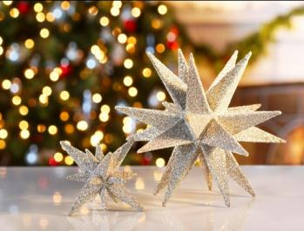
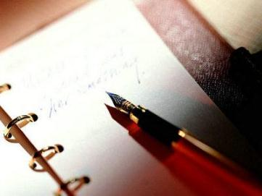
2020
Development
Builds
Fly
Gift
Write
The time is now, the place is here. Stay in the present. You can do nothing to change the past, and the future will never come exactly as you plan or hope for.

Slide 22
2020
Development
01
06
02
Thinks
05
03
04
I believe that people would be alive today if there were a death penalty. I believe that people would be alive today if there were a death penalty.I believe that people would be alive today if there were a death penalty. I believe that people would be alive today if there were a death penalty. I believe that people would be alive today if there were a death penalty. I believe that people would be alive today if there were a death penalty.

Slide 23
2020
Development
02
04
It is, perhaps, our fate rather than
our merit. We cannot help ourselves.
We live at home
We certainly do not forget you
as soon as you forget us.
It is, perhaps, our fate rather than our merit.
We cannot help ourselves. We live at home
Direction
Content
Layouts
Visual
The Solution
01
All the privilege I claim for my own
sex (it is not a very enviable one; you
need not covet it)
03
We certainly do not forget you as
soon as you forget us.
05

Slide 24
2020
Development
Money
It is a very sad thing that nowadays there is
so little useless information.
Invectors
Enter the comprehensive description
of the above chart here
01
02
03
04
Company
Enter the comprehensive description
of the above chart here
Raise
It is a very sad thing that nowadays
there is so little useless information.

Slide 25
2020
Development
The user can demonstrate on a
projector or computer,
01
Your
02
The user can make a presentation on a
projector or computer
Grow
The user can make a presentation
on a projector or computer
03
Company
04
Your audience relate and absorb
information on different sensory levels
Base

Slide 26
Thanks for Presentation
www.freepptbackgrounds.net
Research and Development Slides

