Slide 1
21st Century Community
Learning Centers
Cohort 13 Request for Proposal and EUNA Demo
July 2026

Slide 2
Timeline
RFP Release/Euna Grants Open: July 24th, 2026
TA Webinar and EUNA Demo: July 31, 2026
Questions due to OST inbox: August 7, 2026
Application Due: September 4, 2026: 11:59 p.m. ET (via Euna, linked in the RFP)
Anticipated Award Notifications: October 1, 2026
Awarded funds available: After October 1, 2026

Slide 3
Technical assistance
This is a virtual info session for potential grantees—allowing you to learn more about the application from the lens of a first time applicant.
IDOE 21st Century Community Learning Center (CCLC) staff are able to answer questions about application clarity, however, we are not able to answer questions regarding or make suggestions on application narrative content.
More TA opportunities to come for awarded applicants.

Slide 4
Overview
21st CCLC is a federally-funded program for public school districts, charter schools, community-based organizations, public/private organizations, faith-based organizations, or a consortium of these organizations, in order to provide youth a safe environment during non-school hours. This program supports the creation of community learning centers that provide academic enrichment opportunities for youth, particularly those who attend high-poverty and low-performing schools. The program helps students meet state and local academic standards in core academic subjects, such as reading and math, offers students a broad array of enrichment activities that can complement their regular academic programs, and offers literacy and other educational services to the families of participating children.

Slide 5
Who is eligible to apply?
Any public or private organization is eligible to apply. This includes: School corporations and charter schools through an local educational agency (LEA) or community-based organization (CBO), educational consortia (of charter schools or LEAs), non-profit agencies, city or county government agencies and education service centers, faith-based organizations, institutions of higher education.
*Individual schools may not submit a proposal—must be through the district or another eligible entity.
      To qualify for funding, applicants must have one of the following:
  40% or higher Free and Reduced Lunch program student participation
  Title I eligible in SY25-26

Slide 6
What can 21st CCLC Funds be used for?
21st CCLC programs must provide safe environments for youth during non-school hours. All sites must provide a range of high-quality services to support student learning and development that may include, but are not limited to: academic enrichment, mentoring, service learning, physical wellness, career and technical programs, internships or apprenticeship programs, etc.
Funds may be used to begin a new 21st CCLC program site and expand current 21st CCLC programming. If the application is for expansion of a current 21st CCLC program site, the application must describe how additional funds will be used for enhanced and/or expanded programming and will not replace current or past 21st CCLC funding.
Ex: If a 21st CCLC program currently serves K-5th grade at School A, another 21st CCLC program (or current 21st CCLC program) can apply to serve 6th-8th grade at School A.

Slide 7
What can 21st CCLC Funds be used for? continued
Program areas of focus can be, but are not limited to:
Academic enrichment
Well-rounded education
Literacy education
Physical wellness
Technology education
Expanded library service hours
Parenting skills
Financial Literacy
Drug and violence prevention
Services for individuals with disabilities
Programs that serve English Language Learners with activities that emphasize language skills and academic achievement
Programs that serve youth who have been truant, suspended, or expelled
STEM education teaching methods
Programs that partner with in-demand fields of the local workforce or build career competencies and career readiness

Slide 8
Priority Points (up to 9 pts)
To qualify you must address the following in your application narrative:
Application identifies Literacy as a Focus Area and grounds literacy activities in Science of Reading principles. (2 points)
Application identifies Mathematics as a Focus Area and demonstrates how instruction in mathematics will build proficiency and/or acceleration, aligned to Indiana Academic Standards. (2 points)
The proposed program serves high school youth and contributes to students earning work-based learning hours. (2 points)

Slide 9
Priority Points (up to 9 pts) continued
To qualify you must address the following in your application narrative:
Application is jointly submitted by eligible entities consisting of not less than one LEA receiving funds under Title I, Part A and another eligible entity, or the LEA demonstrates that it is unable to partner with a community-based organization in reasonable geographic proximity and of sufficient quality. (1 point)
Application demonstrates that proposed activities are, as of the date of the submission of the application, not accessible to students who would be served or would expand accessibility to high-quality services that may be available in the community. (1 point)
Application targets services to students who primarily attend schools that are implementing comprehensive support and improvement activities or targeted support and improvement activities under section 1111(d) or other schools the LEA has determined to be in need of intervention and support to improve student academic achievement and other outcomes, and enroll students who may be at risk for academic failure, dropping out of school, involvement in criminal or delinquent activities, or who lack strong positive role models, and the families of these students. (1 point)
Notes:
To be reviewed by specialist - Federal requirements

Slide 10
What can 21st CCLC Funds be used for?
Allowable Expenses
Personnel | Equipment | Supplies
Fringe Benefits | Travel within guidance | Transportation costs for students
Contractual support | Indirect costs within guidance | Professional development
Remedial education activities and academic enrichment programs. | Arts and music education activities | Mathematics and science education activities
Programs that provide assistance to students who have been truant, suspended, or expelled. | Drug and violence prevention and character education programs. | Field trips with academic support
Recreational activities | Programs for limited English proficient students. | Tutoring services and mentoring programs
Programs that promote parental involvement and family literacy. | Expanded library service hours | Telecommunications and technology education programs

Slide 11
What can 21st CCLC Funds be used for? continued
Allowable Expenses with pre-approval by IDOE
Promotional or Marketing Items with the 21st CCLC logo (e.g., Flags, banners). | Purchase of equipment, such as computers, laptops, DVD players, projectors, printers, scanners, fax machines, telephones, cell phones, televisions, digital cameras, or similar items.
Staff events that include retreats, lock-ins, or other events of a similar nature. | Out of state or overnight field trips with approved academic support.

Slide 12
What can 21st CCLC Funds be used for? continued
Unallowable Expenses
Entertainment: field trip without approved academic support | Preparation of the Proposal | Pre-Award Costs (incurred before the grant effective date of October 1st)
Un-approved out-of-state or overnight field trips, including retreats, lock-ins, etc. | Decorative Items | Purchase of facilities or vehicles
Land acquisition | Capital Improvements, Permanent Renovations | Refreshments/Snacks
Supplanting federal, state or local funds | Direct charges for items/services that the indirect cost rate covers. | Membership dues to organizations, federations, or societies.

Slide 13
How do i determine my funding amount?
Utilize the following equation: Number of youth X $2,500 X 3 (years) = total youth funding amount. The equation should include a total number of youth served across program site(s), including youth served in summer programming. Grantees must serve at least 40 youth annually.
Total Number of Youth | Per Pupil Amount | Yearly Base Funding Amount | Total Award Amount
75 youth total Site 1: 35 elementary Site 2: 40 middle school | $2,500/youth | $187,500 | $187,500 X 3 = $562,500
IDOE does not allow grantees to carryover unused funds from year to year.

Slide 14
Hours of operation Requirements
Sites are required to provide services to youth a minimum of 100 days in SY 26-27 during:
Before school (at least one hour per day, ends just before school begins) AND/OR;
Afterschool (at least two hours per day, begins when school dismisses) AND/OR;
Both before and after school (at least one hour before and two hours after) AND/OR;
Non-school weekdays and Saturdays (at least 4 hours per day) AND/OR;
During school breaks at least 2 days per week and/or at least 4 hours per day
Note: Sites will be required to provide services to youth a minimum of 130 days in Years 2 and 3.

Slide 15
Hours of operation Requirements continued
Elementary programs are required to operate at least 12 hours/week. Middle School programs are required to operate at least 10 hours/week. High School programs are required to operate at least 8 hours/week. If a program site has a mixed-grade group, hours/week should reflect the earliest age group. Ex: If the program site serves 40 elementary youth and 15 middle school youth, the site should operate 12 hours/week.
Summer programs must provide services for at least four (4) hours per day for four (4) days per week, with a minimum of four (4) weeks.*

Slide 16
Program requirements
In order for youth in the program to count toward program outcomes, they must be Regularly Attending Participants (RAPs).
RAPs are youth that attend 45 days or more through the school year.
Grantees are given a RAP target goal that aligns with their annual allocation amount.
Example: If the application is awarded for $200,000/year, the grantee will be required to serve 80 youth/year.

Slide 17
program requirements continued
Grantees are required to:
Employ a 21st CCLC Program Director who is dedicated to the 21st CCLC program at least half time (.5 FTE). In addition, grantees are required to have a Site Coordinator at every site. Grantees who only operate one 21st CCLC site may utilize their Program Director as their lead Site Coordinator if desired.
Maintain appropriate staff-to-youths; one staff person to fifteen youth if there are youth who are five years of age in the group, and one staff person to twenty youth for groups containing only children who are six years of age or older.

Slide 18
Program requirements continued
IDOE 21st CCLC considers professional development for all grantee staff key to program quality and continuous improvement.
Awarded grantees are required to submit a comprehensive annual professional development plan. Professional Development plans will be discussed more following award notices.
Grantees are encouraged to design and customize their professional development plan to meet the needs and capacity of their program, including training relevant to all levels of staff (direct service, site coordinator(s), program director, etc.).
Grantees may allocate approximately 2% of their total annual allocation toward professional development needs, which should be reflected in the budget.

Slide 19
program requirements continued
All applicants must assure that eligible youth are able to attend and participate.
Transportation and access to the building site cannot be a barrier for youth participating in the 21st CCLC program. Grantees must provide youth access to transportation as needed; transportation options can include school buses (ex., working with the sports program’s buses), carpools, parent pick-up agreements, public transportation, etc. Requiring parents to provide transportation as a condition of student participation is not allowed.

Slide 20
program requirements continued
Programs must be accessible to all youth targeted for services, regardless of their ability to pay. Charging fees (one-time fee, monthly fee, etc.) is strongly discouraged and unallowable unless prior approval is granted from the U.S. Department of Education (see policy manual for more information). Participation in 21st CCLC programming can’t be prohibited due to a families’ inability to pay a fee. Program marketing materials should ensure families understand the 21st CCLC program is available free of charge.

Slide 21
program requirements continued
Grantees are required to engage a local evaluator.
Grantees may use no more than six (6) percent of the funding award (minus indirect costs) for local program evaluation throughout the three (3) year grant period.
IDOE cannot recommend a local evaluator for grantees to contract with unless we as a State provide one for all.
Important note: Local evaluators are not required to be external to the organization. However, the responsibilities as set forth in the policy manual must still be met.

Slide 22
program requirements continued
Required information includes:
Grantee contact information
Community Partners and Subcontractors information
Feeder school(s) information
Operational information
Staffing
Activities by category and subject area
Intensity of service provision and participation
Characteristics of feeder schools
Participation/Number of regular attendees
Program Partner Information
Youth demographics
Measure 1: Growth in reading and language arts and mathematics on state assessments (Grades 4-8)
Measure 2: Grade point average improvement (Grades 7, 8, 10-12)
Measure 3: School day attendance rate improvement (Grades 1-12)
Measure 4: Decrease of in-school suspensions (Grades 1-12)
Measure 5: Teacher-reported engagement improvement in learning (Grades 1-5)
Notes:
Grades (math and reading/English/language arts); number of attendees whose grades have increased, decreased, or remained the same from fall to spring
Performance on State & Local Assessment Proficiency Test (math and reading/language arts): number of attendees who performed at below proficiency, approaching proficiency, at proficiency, and above proficiency levels
Teacher Surveys (survey format is provided) Scaled survey to be administered to teachers of attendees who attended 30 days or more throughout the school year on behaviors such as improvement of behavior, academic performance, etc. - this is if you were a previous 21st CCLC grantee.

Slide 23
program requirements continued
Grantees must submit an three-year budget to IDOE using the approved template. Expenses in the budget should reflect all program expenses and align with allowable costs, found on slides 8-10.
Grantees must utilize the restricted indirect cost rate agreement with IDOE. For entities that do not currently have a restricted indirect cost rate agreement, an agreement must be negotiated in order to utilize or claim indirect costs on this grant. See 2027 LEA Indirect Cost Rate.
You should only fill out the Details tabs for each year. Do not edit cells on the Summary tab or the DO NOT EDIT tab.

Slide 24
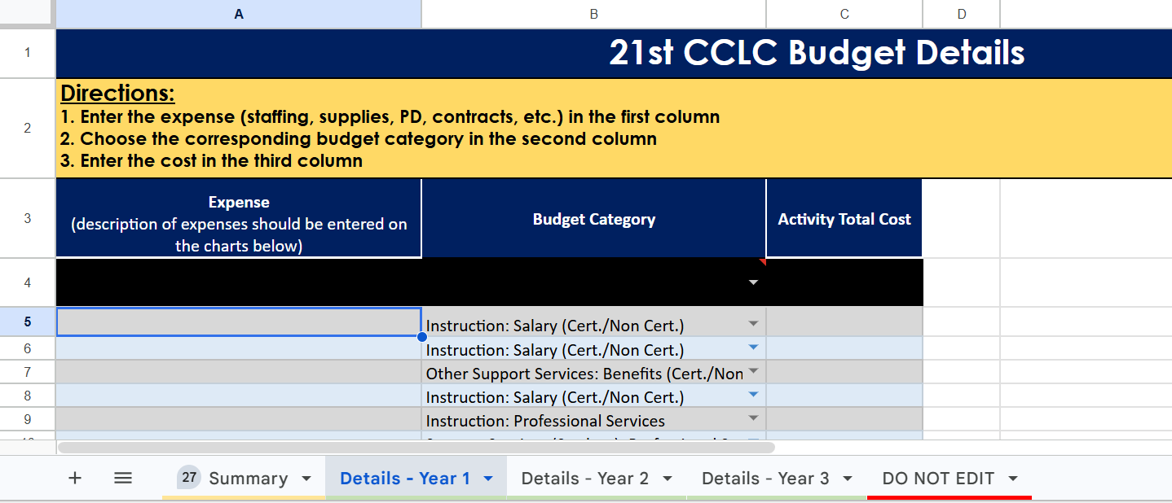
Budget template

Slide 25
What should my application include?
The application must be submitted via Euna. Applicants will be unable to submit unless all the required fields are addressed. Be sure to review all required file uploads (Weekly Schedule, Budget, Grantee/School/Site information & Assurances)
Note: If IDOE cannot view these materials the application will be eliminated from review.
Guidance on navigating Euna is provided later in this webinar, including a full demo video on slide 47. Accessibility questions can be directed to OSTprogram@doe.in.gov.

Slide 26
What happens after submission?
A panel of IDOE staff with expertise in providing effective academic, enrichment, youth development, and related services to children will review applications.
Reviewers will review and rate the applications to determine the extent to which the applications meet the program requirements.
IDOE will rank applications by final application scores. Using the total amount of funding available and the total funding amount of application requests, IDOE will determine a cut score for funding. IDOE will attempt (but does not guarantee) to fully fund all application requests within the determined score range. IDOE reserves the right to determine individual awarded amounts based on application content and funding availability.
Note: IDOE 21st CCLC staff will score two sections: Priority Points and Budget. All other sections will be scored by a peer reviewer.

Slide 27
Dates to remember
Release/Euna Grants Open: July 24, 2026
Questions Due: August 7, 2026
Application Due: September 4, 2026; 11:59 p.m. ET (via Euna, linked in the RFP)
Anticipated Announcement: October 1, 2026
Awarded funds available: After October 1
As a reminder, IDOE 21st CCLC staff are able to answer questions about application clarity, however, we are not able to answer questions regarding or make suggestions on application narrative content.
Notes:
October 1 is when we plan to start making contracts but some applicants, particularly new grantees, may experience a delay in gaining access to the funds as we work to establish contracts.

Slide 28
21st CCLC- Cohort 13
Euna Guidance
This guide serves as a walkthrough of the 21st CCLC Application through the new grants management system, Euna.

Slide 29
Locating the 21st CCLC Euna Application
In order to apply for the 21st CCLC grant through Euna, you must use the provided solicitation link. Click on the link listed below to access the solicitation.
Cohort 13 Solicitation
Prior to applying, please download all the supplemental ﬁles you will need to attach to your submission. Click on the “Files” tab to ﬁnd these documents.

Slide 30
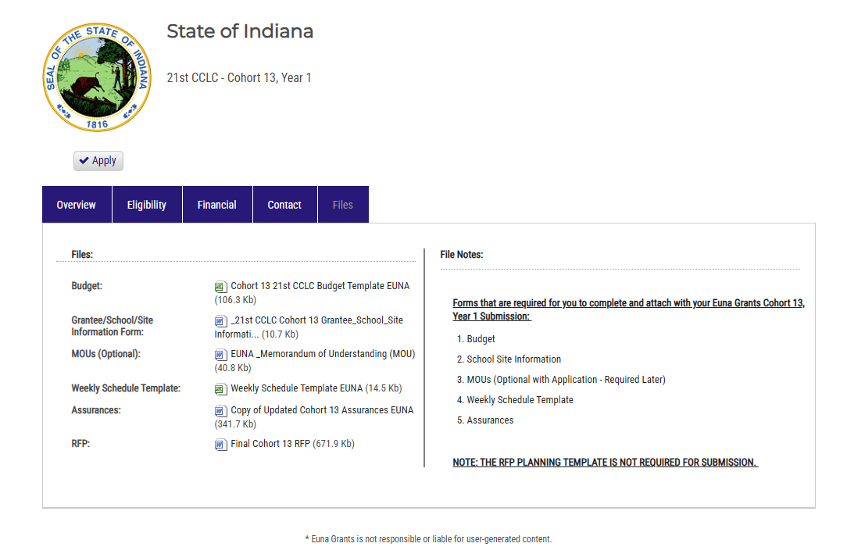
Application Page
Once you click on the ﬁles tab, multiple documents will appear. Please download the required forms you will need to complete and attach with your Euna Cohort 13 Submission.

Slide 31
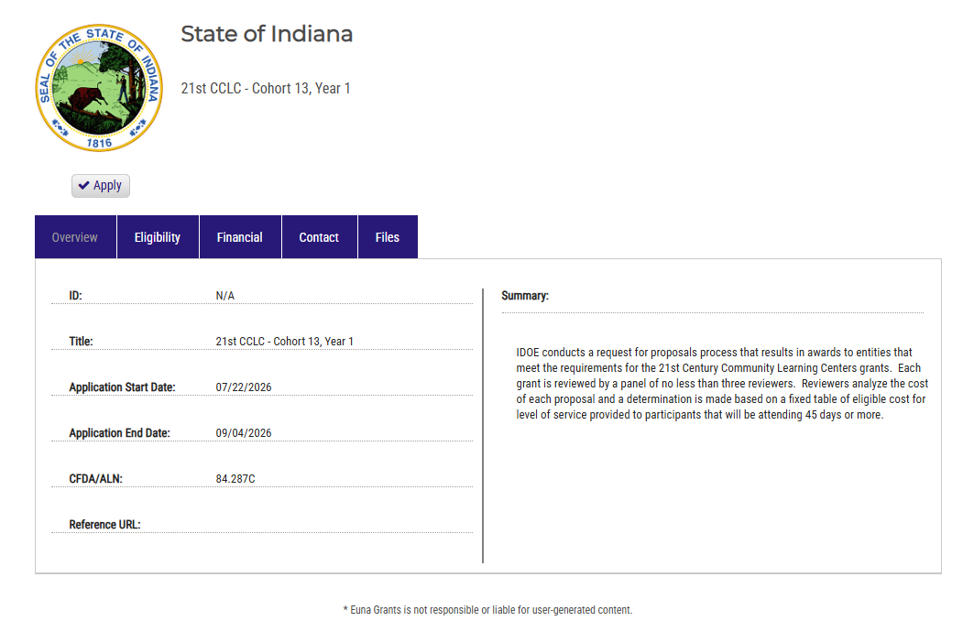
Application Page continued
Once the documents have been downloaded, click the “Apply” button to access the application.

Slide 32
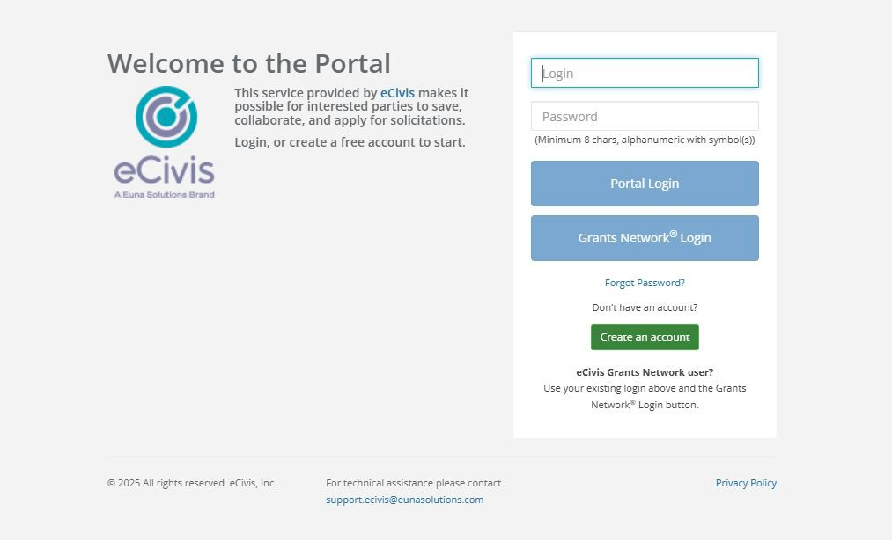
Portal Login
Once you click the apply button, you will be taken to the portal login. If you already have an account, use those credentials. Create an account if you do not have one (step to follow). Always use the Portal Login button.
Notes:
It may also appear without the option of Portal versus Grants Network login - that is okay! Same rules apply, create a login if you do not have one.

Slide 33
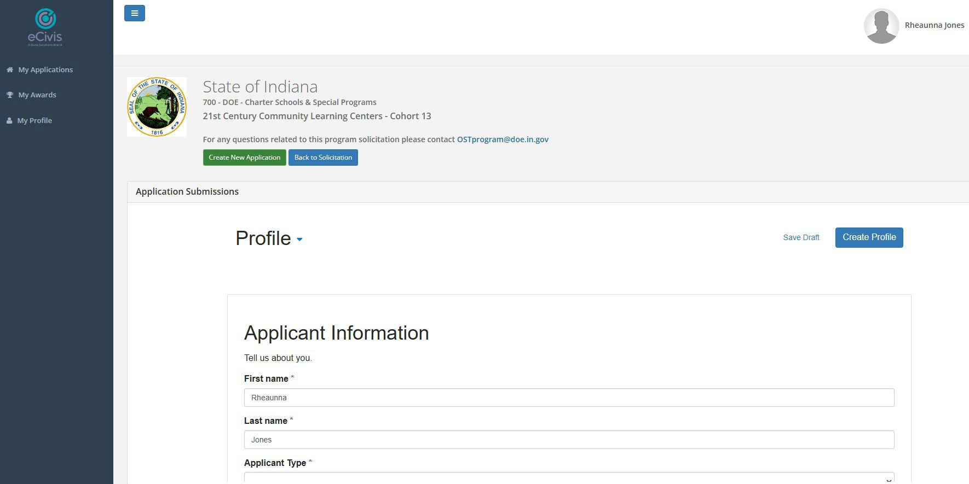
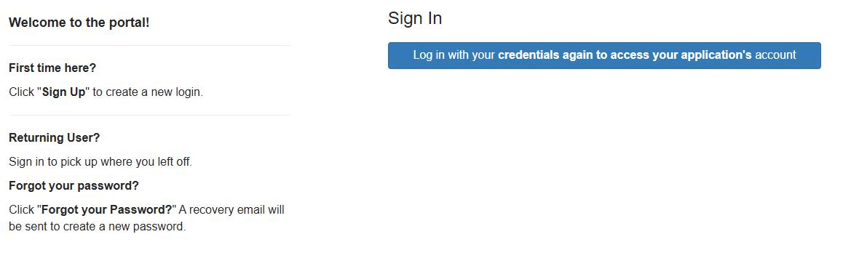
Profile Set Up
It may prompt you to sign in again. Click “Log in.” If you have not yet set up your proﬁle, please click on the “My Proﬁle” button and ﬁll out the information required.

Slide 34
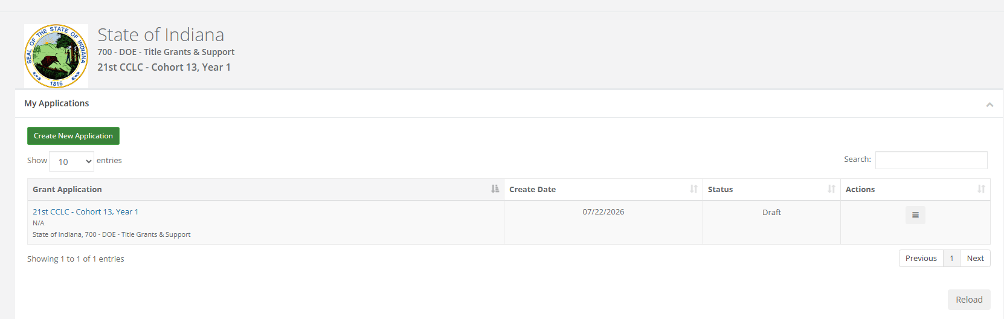
21st CCLC Cohort 13 Euna training
You should be automatically directed to the screen below. If you do not see the “Create New Application” button, then you may need to click on the original link on slide 2 and press “Apply” again. This will bring the 21st CCLC - Cohort 13, Year 1 application into your “My Applications” tab.

Slide 35
21st CCLC Cohort 13 Euna training continued
After clicking on the “Create New Application” button, you will be asked to log in to your account again.

Slide 36
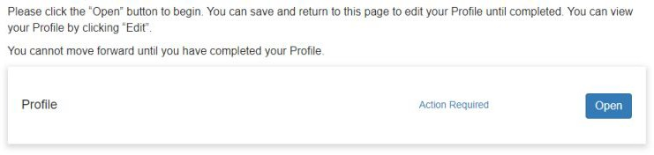
important Note
If you have not already set up your proﬁle, you will be asked to complete it before being able to access the application.
You will not be able to move forward to the application process if you do not complete a proﬁle.

Slide 37
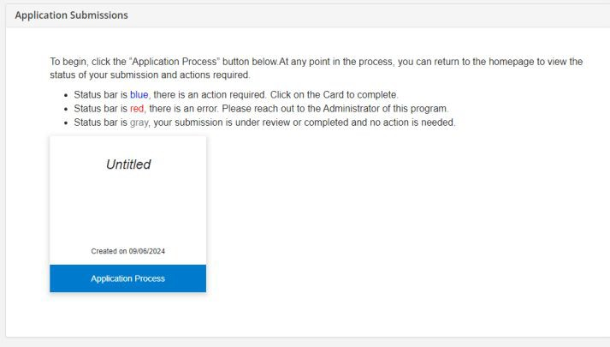
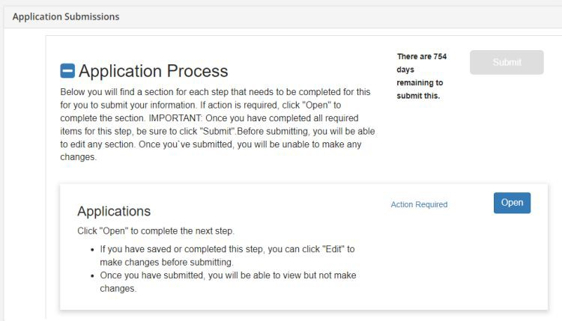
21st CCLC Cohort 13 Euna training
Next, you will click the blue “Application Process” button. Click the blue “Open” button to be taken into the application.

Slide 38
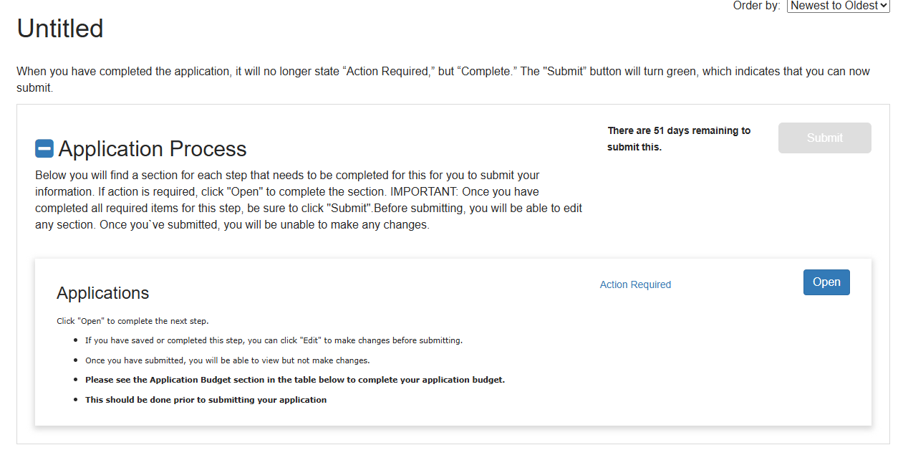
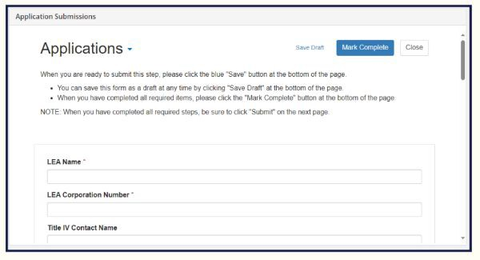
21st CCLC Cohort 13 Euna training continued
Click “Open” when the first screen appears which will direct you to the below page. Ensure that you ﬁll out each required question in the application. The application will not allow you to submit until all required questions have been answered and all required forms have been attached.
When attaching ﬁles, please use a naming convention with your application/organization name so that we know how to organize them for our own ﬁling records.

Slide 39
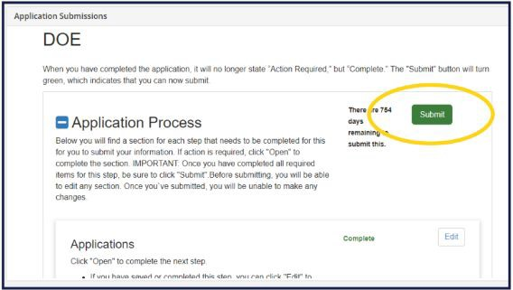
Euna submission
Once you have ﬁlled out all the required parts of the application and uploaded your required forms click the “Mark Complete” button.
The last required question within the application is in regard to the Euna Budget that is a needed step prior to submission. The following slides will walk you through completing the Euna Budget which is separate from the budget template you must upload.

Slide 40
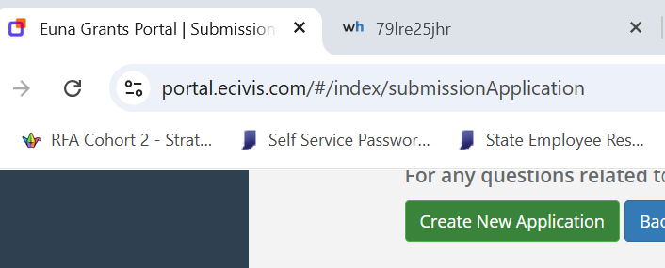
EUNA Budget
Before you mark your application as complete, you will need to ensure your Application Budget has a value attached (as seen below). To accurately click yes on the final question, use the following steps.
Instead of selecting “Mark as complete”, click "Save Draft" and return to the Euna Grants Portal tab located to the left of the portal tab you are on. Scroll down to the applications budget section.

Slide 41
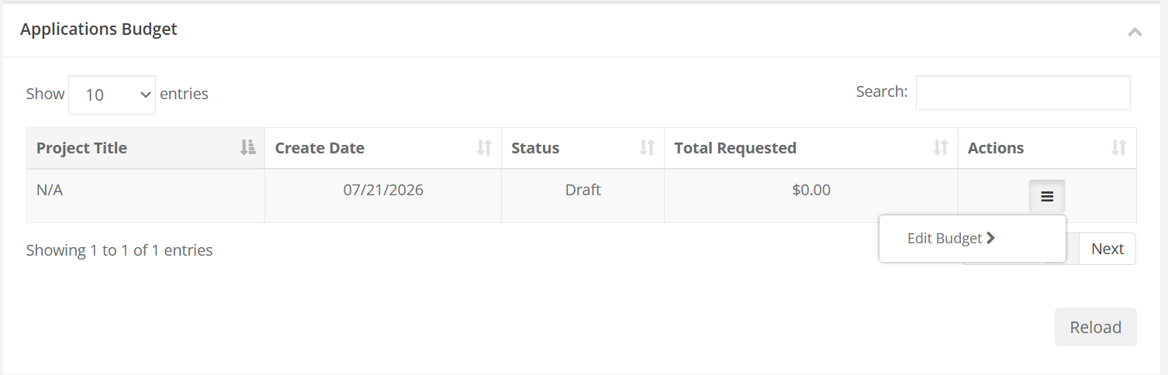
euna budget continued
2. Scroll to the applications budget section. Click the three lines under the "Actions" column heading. Select "Edit Budget."

Slide 42
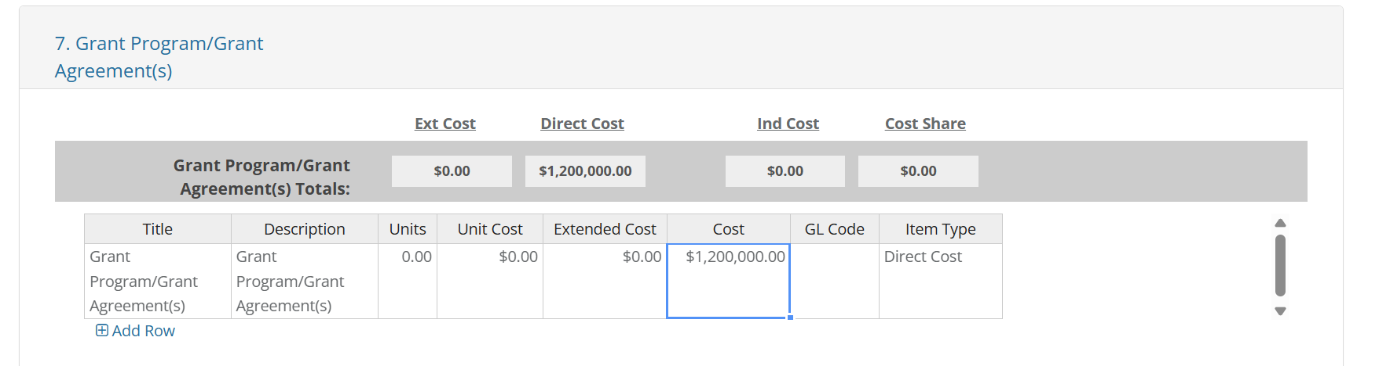
euna budget continued
3. Scroll down to Line 7 and click the blue "Grant Program/Grant Agreement(s)" text. Double click the "$0.00" under the "Cost" header. Input the total award amount you are requesting - the yearly value given the per-pupil allocation multiplied by 3 (for the three-year grant cycle). Scroll down and select "Save Changes."

Slide 43
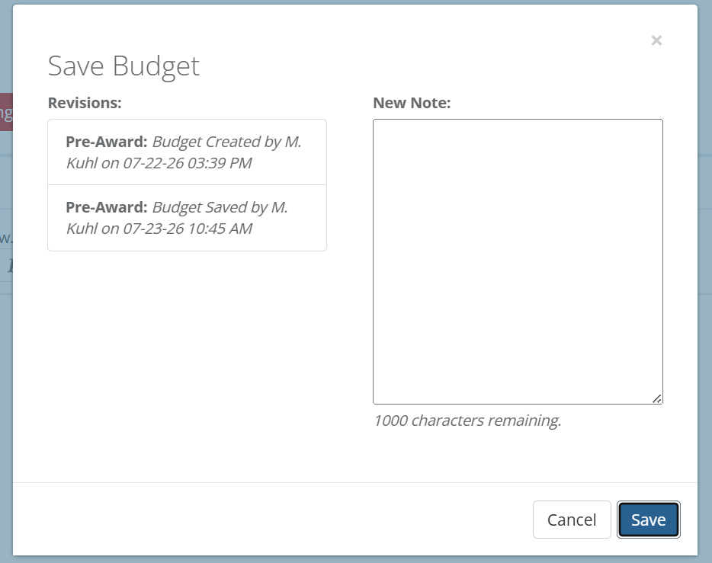
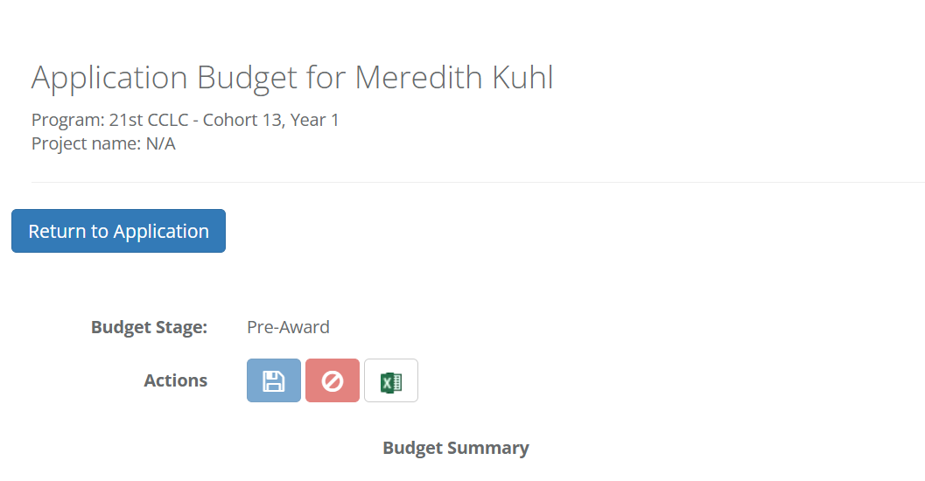
euna budget continued
4. Click "Save" in the pop-up box. No notes are needed. Scroll up and click "Return to Application."

Slide 44
euna budget continued
5. Log in again to view this application portal. Click "Application Process." Click "Open."

Slide 45
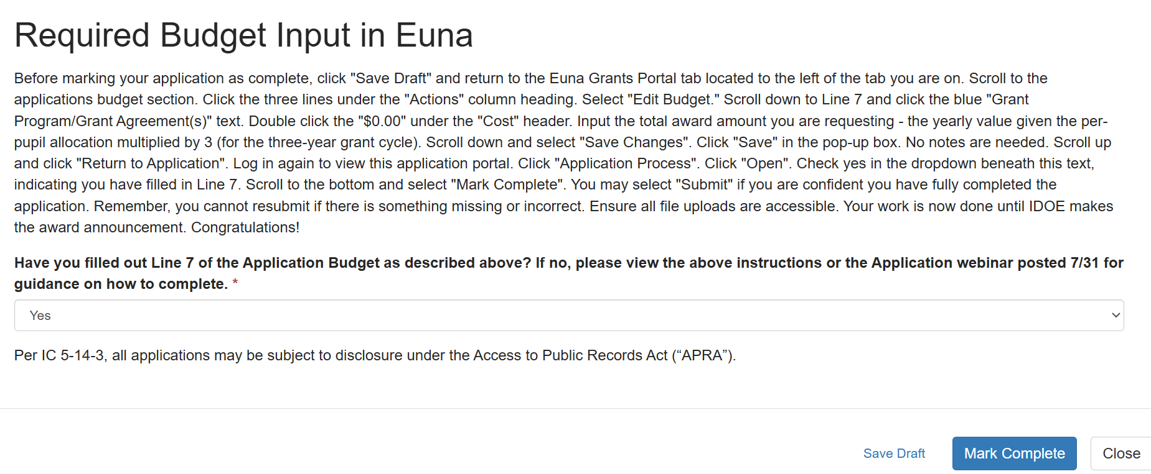
euna budget continued
6. Scroll to the bottom of your application. Check yes in the final required dropdown, indicating you have filled in Line 7. Select "Mark Complete". You may select "Submit" on the next page if you are confident you have fully completed the application.
Remember, you cannot resubmit if there is something missing or incorrect. Ensure all file uploads are accessible. Your work is now done until IDOE makes the award announcement. Congratulations!

Slide 46
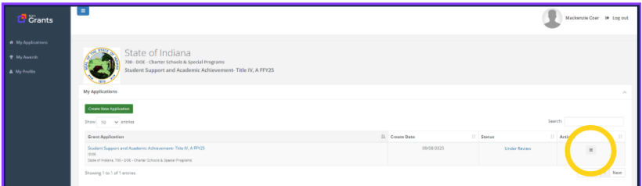
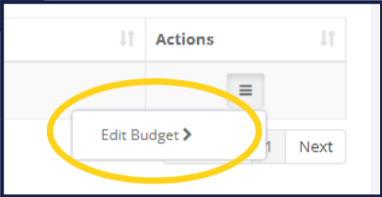
common issue: no budget
You will not be able to edit your budget once you successfully submit. Go to slide 40 for instructions on how to complete the Euna budget.

Slide 47

Video Demo
Transcript

Slide 48

Questions?
OSTprogram@doe.in.gov
For Euna concerns, please contact support.ecivis@eunasolutions.com for further assistance.

Slide 49
Thank you!

