Slide 1

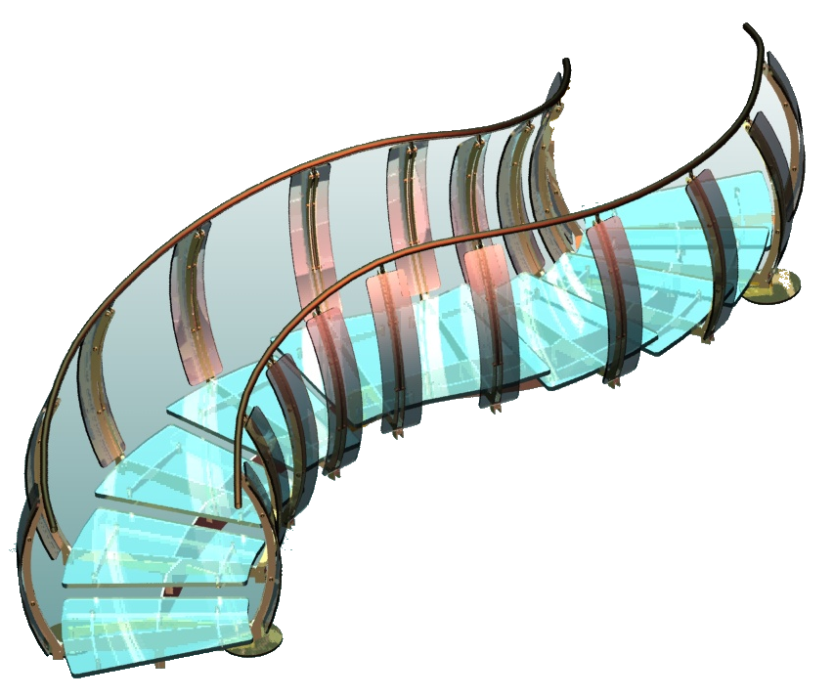



SolidWorks 鈑金學習與實務
20 min
2024/11/4
55-90-2 鈑金學習與應用實務

Slide 2
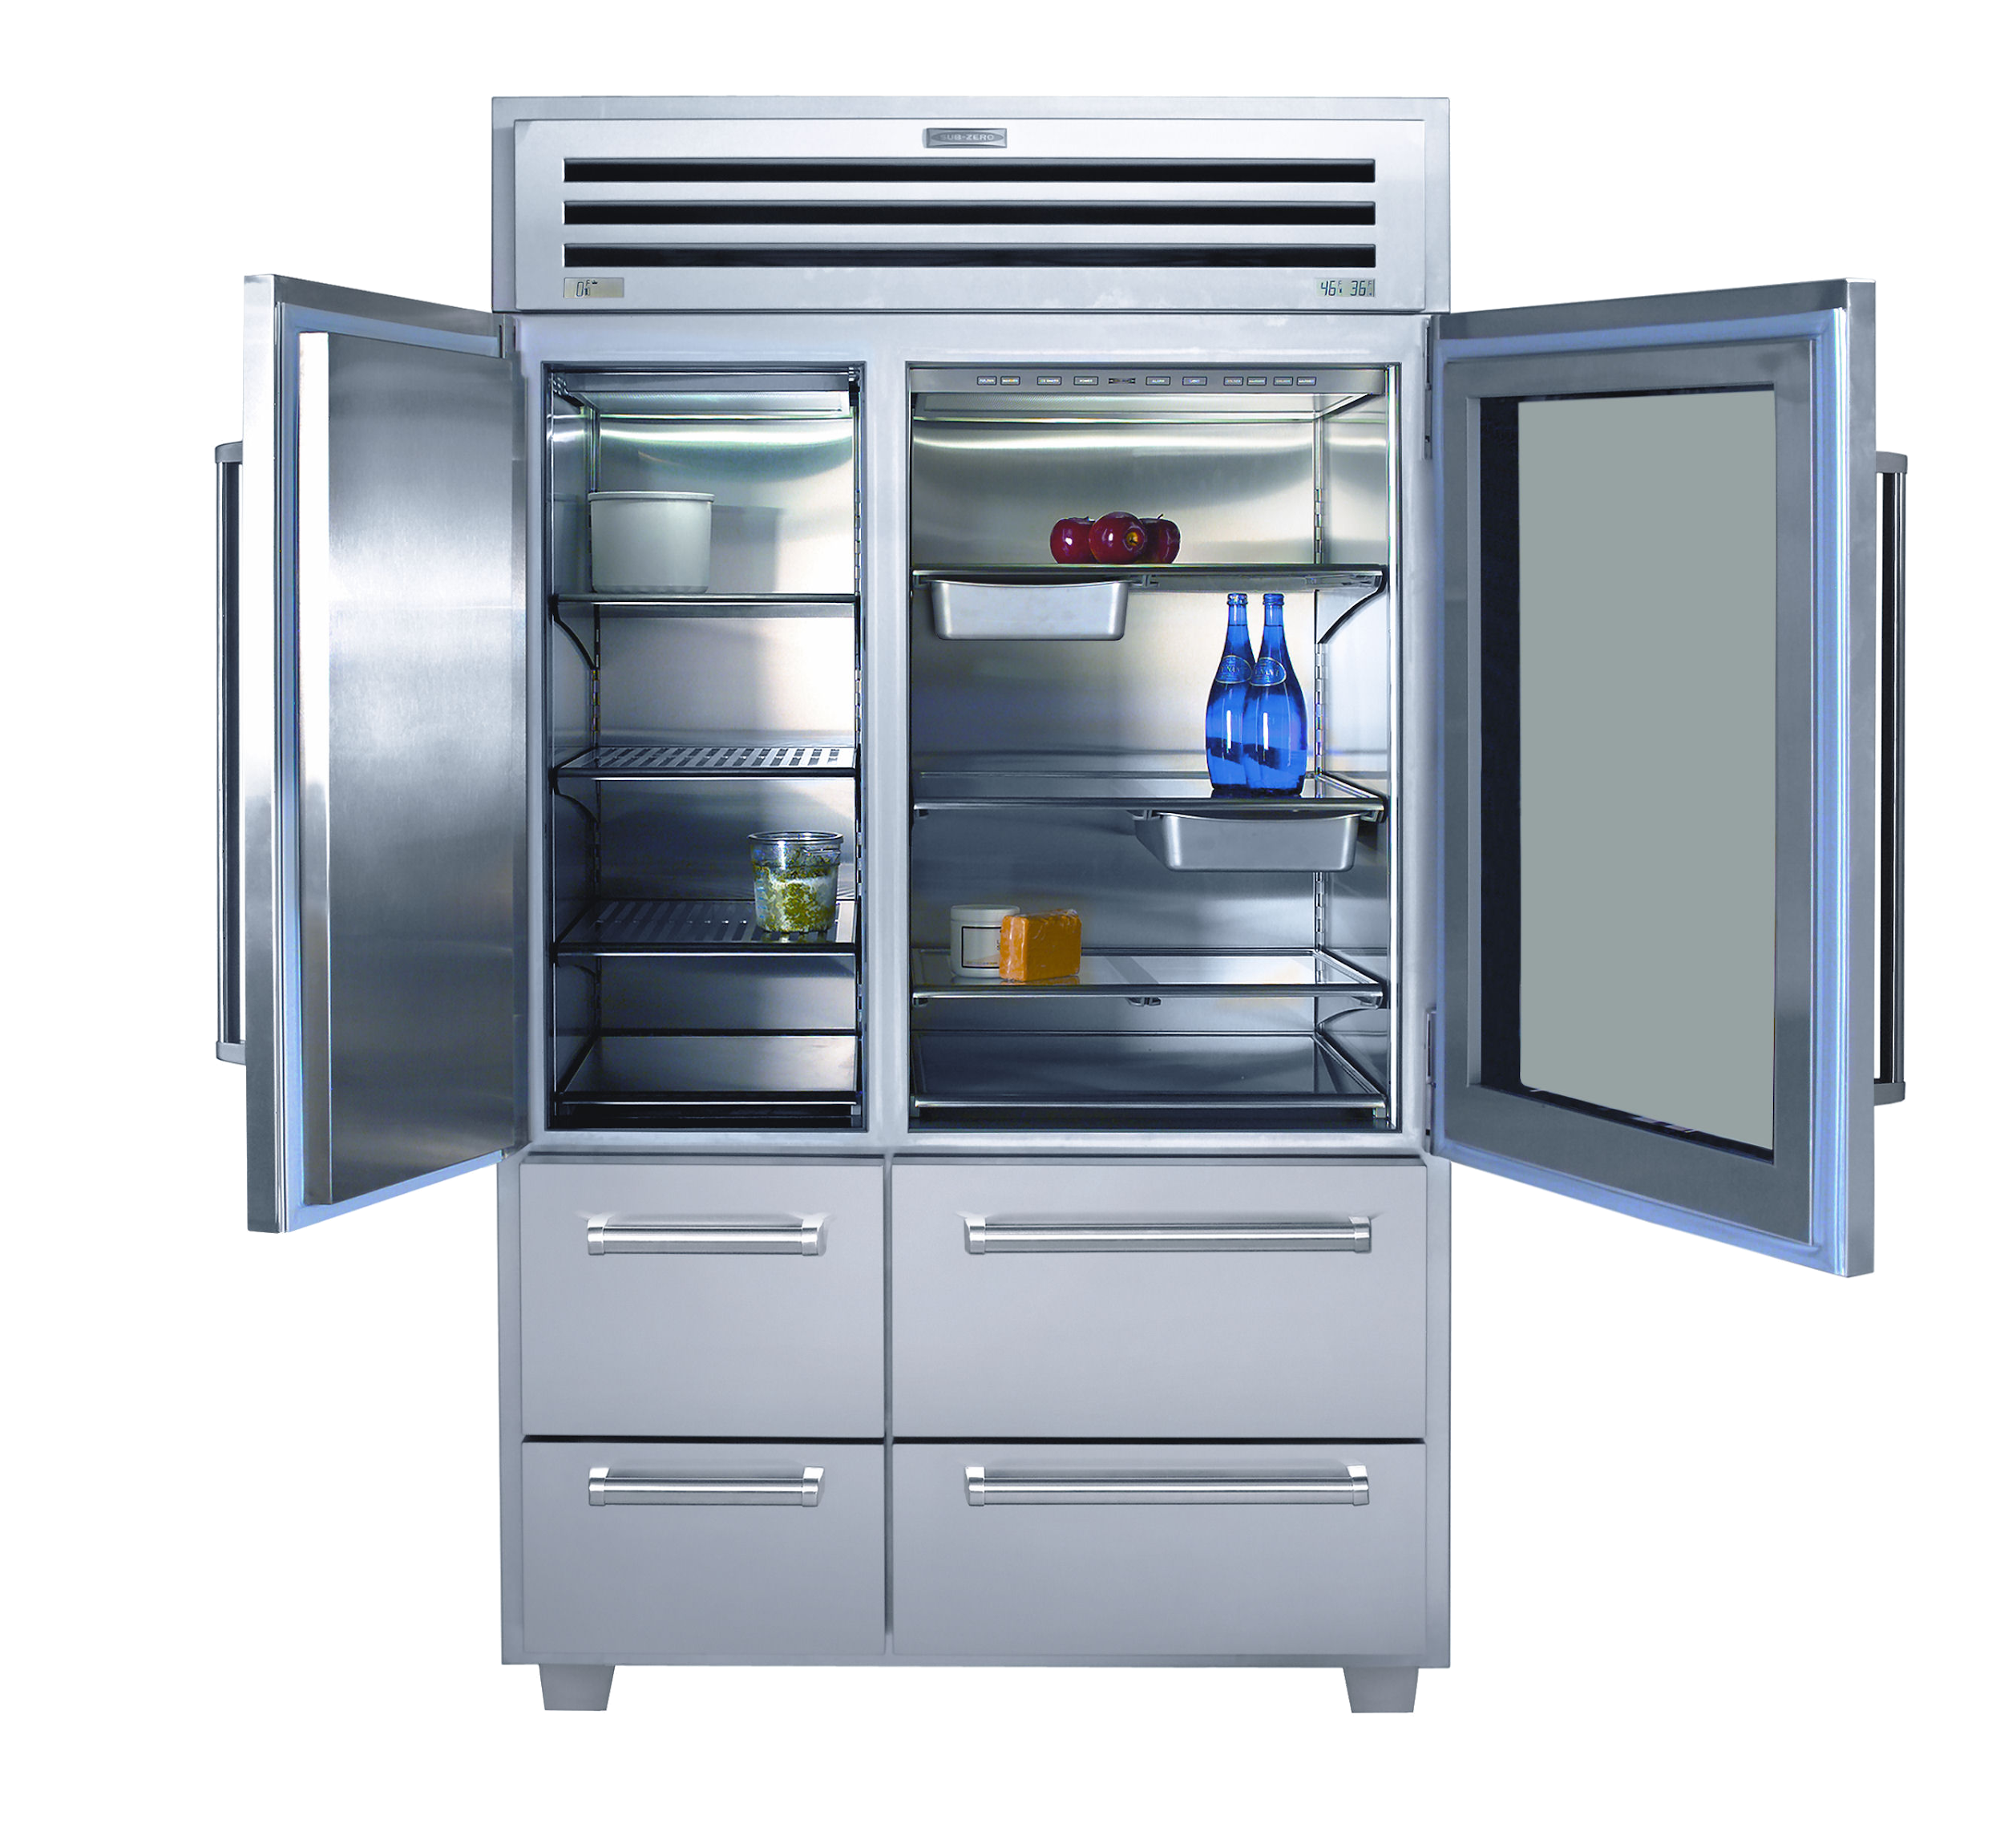
1 學鈑金好處
2 鈑金學習方向
3 鈑金實務討論

Slide 3
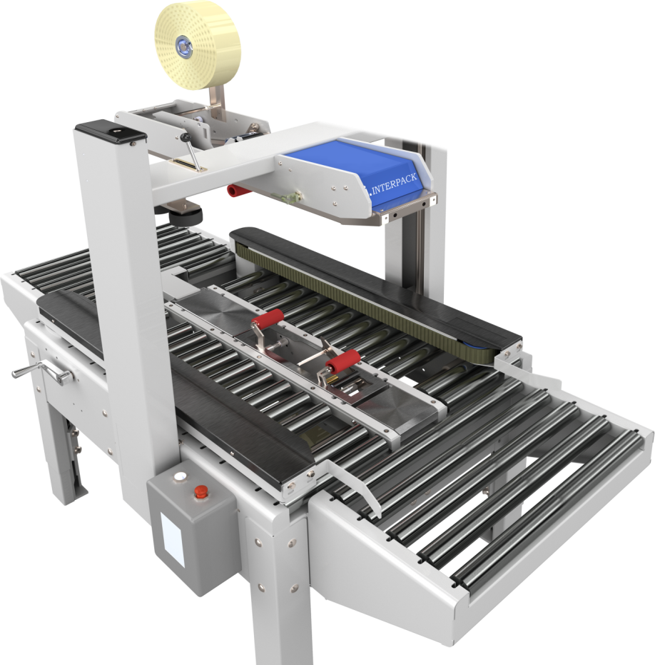
1 鈑金專業原理
1-1 提升自我
1-2 製造驗證
1-3 降低成本
1-4 結構分析
1-5 增加用途
Image courtesy of Intertape Polymer Group

Slide 4
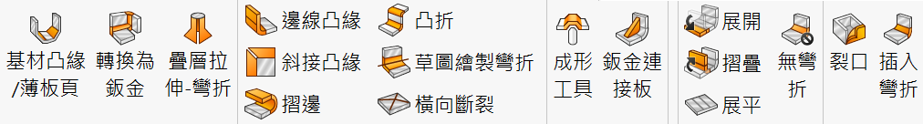
1-1 提升自我
好處1 認識鈑金加工術語
SW鈑金術語和業界相通

Slide 5
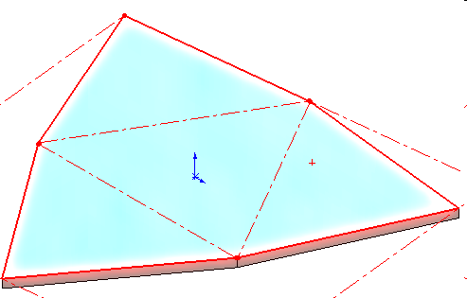
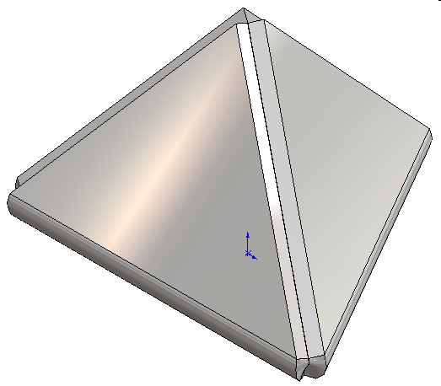
1-1 提升自我
好處2 多了建模思考（指令交互運用加速設計）
金字塔展開

Slide 6

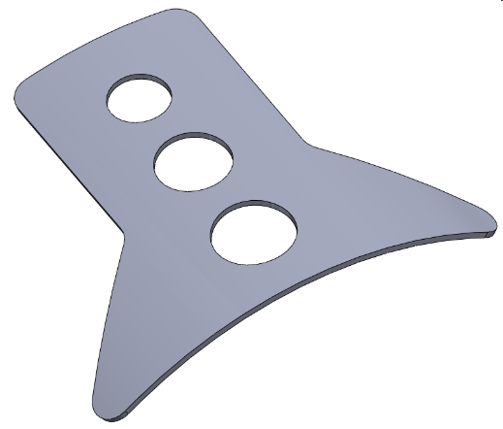
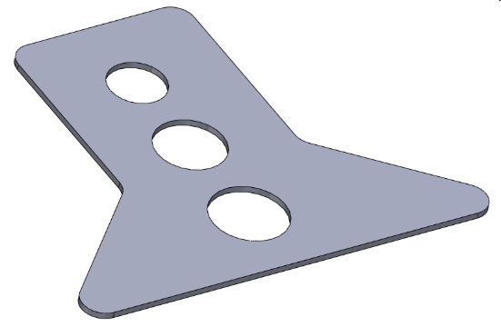
1-1 提升自我
好處3 多了建模思考（指令交互運用加速設計）
畫得出展不開呀?
還在用實體畫嗎?
大家都用3D展開
這種圖廠商要如何展開

Slide 7
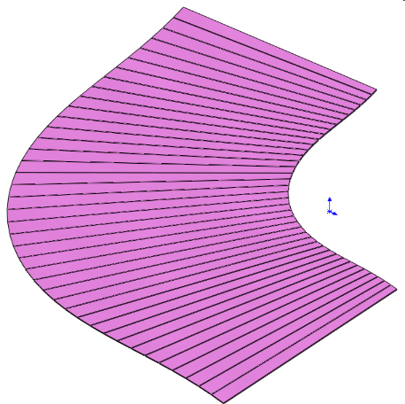
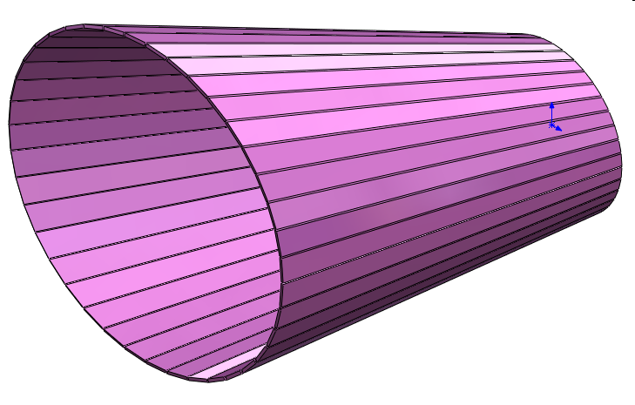
1-1 提升自我
好處4 突破特徵限制
這你當然會畫 可是不夠
別人已經進步到這樣

Slide 8
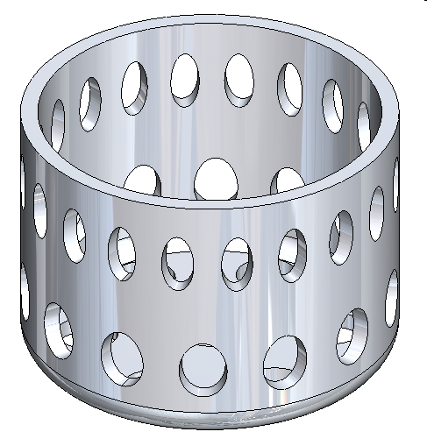
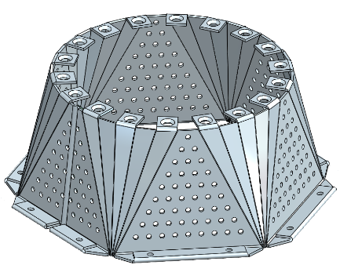
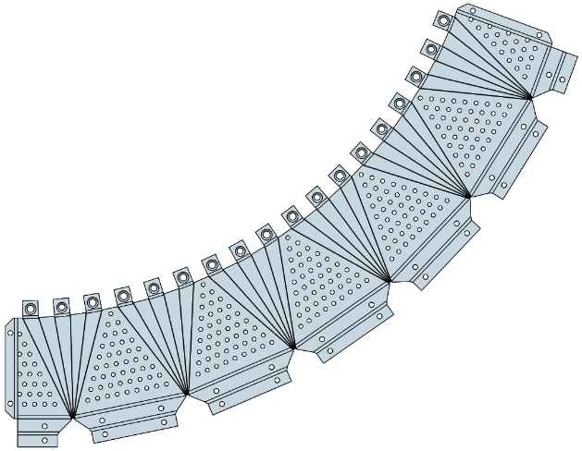
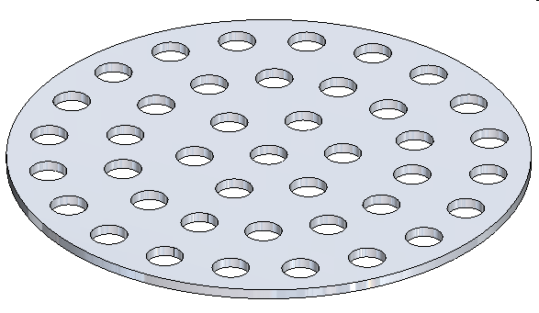
1-1 提升自我
好處4 突破特徵限制
50個孔平均在圓盤上
怎麼畫?
先畫展開圖囉!

Slide 9
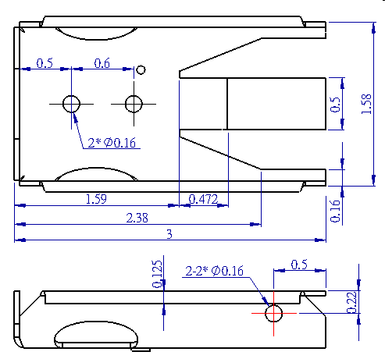
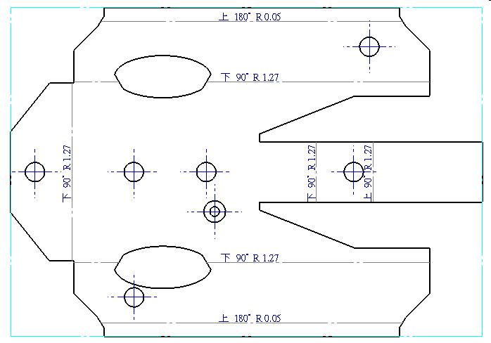
1-1 提升自我
好處5 會出鈑金工程圖
這就是區隔
展開圖 VS 三視圖

Slide 10
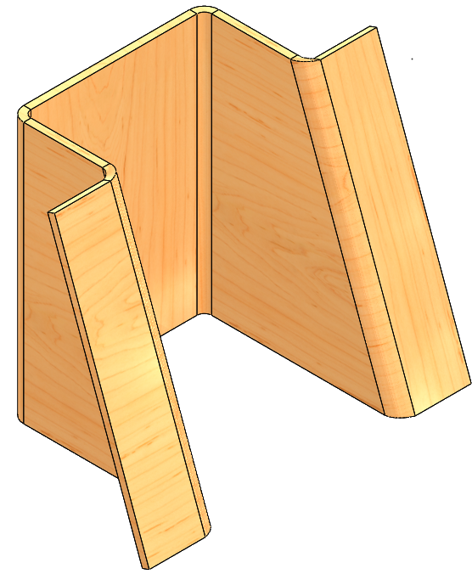
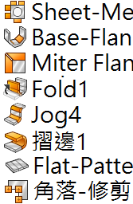
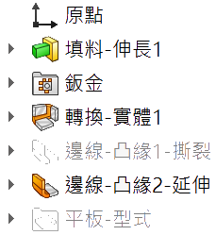
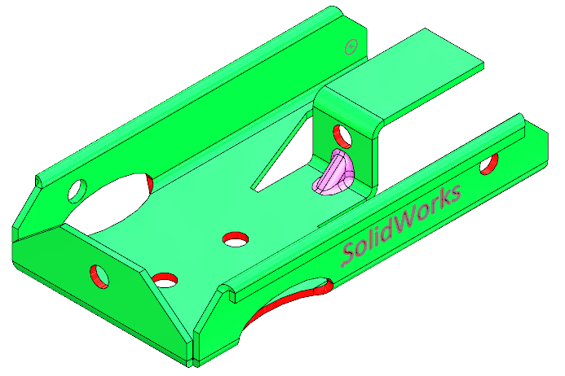
1-1 提升自我
好處6 增加自信
遇到鈑金不會徬徨 而是簡單的東西來了

Slide 11
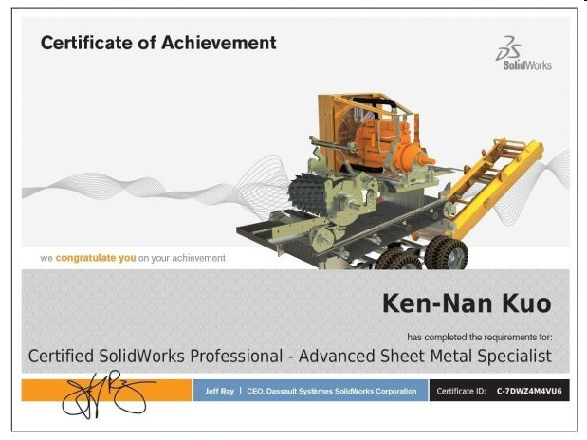
1-1 提升自我
好處8 鈑金國際認證
快來考一張吧

Slide 12

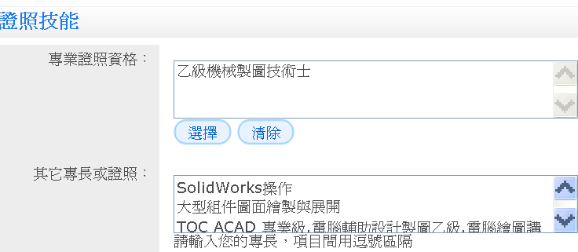
1-1 提升自我
好處10 多一項鈑金專業履歷
履歷直接寫上 不要客氣

Slide 13

1-1 提升自我
好處11 減少錯誤發生與反淘汰
鈑金一定要會
沒得選擇
趕快學會鈑金吧!!

Slide 14
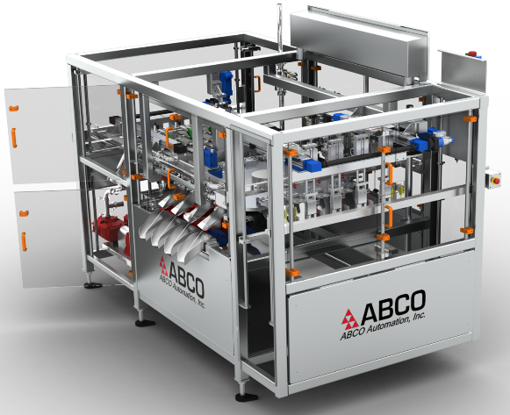

1-1 提升自我
好處12 鈑金在設備扮演重要角色
你不能不會

Slide 15
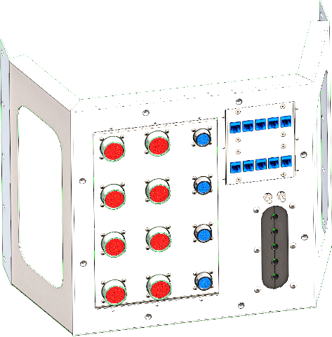
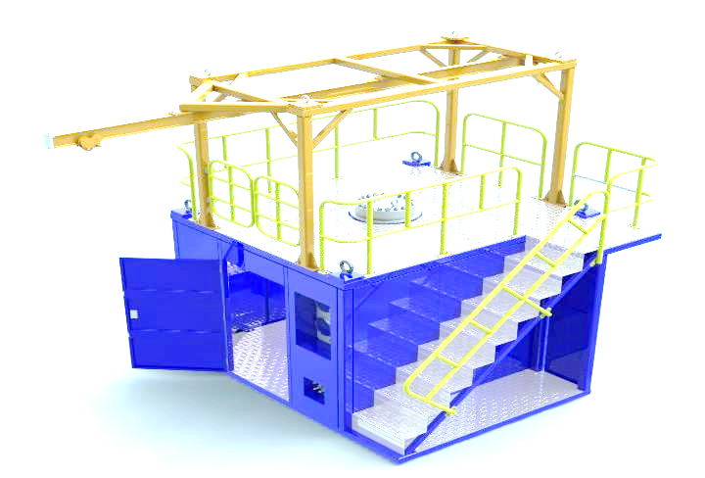
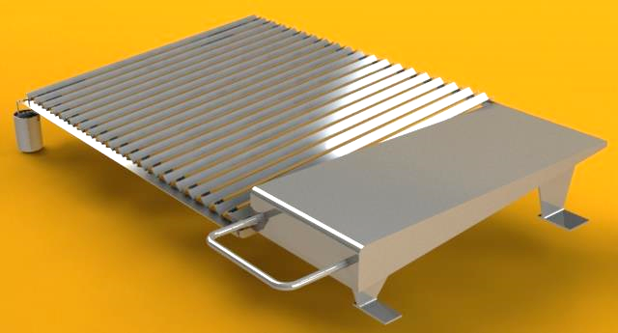
1-1 提升自我
好處13 鈑金與鋼構是相輔相成專業

Slide 16
1 鈑金專業原理
1-1 提升自我
1-2 製造驗證
1-3 降低成本
1-4 結構分析
1-5 增加用途
Image courtesy of Intertape Polymer Group

Slide 17
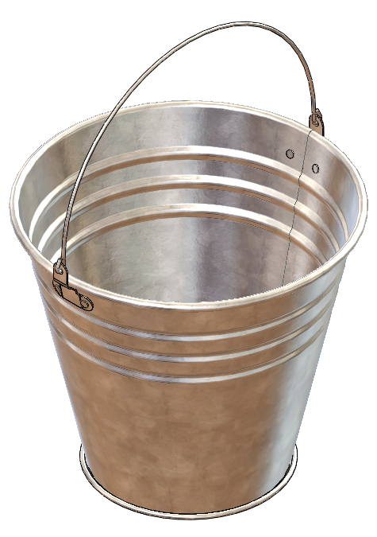
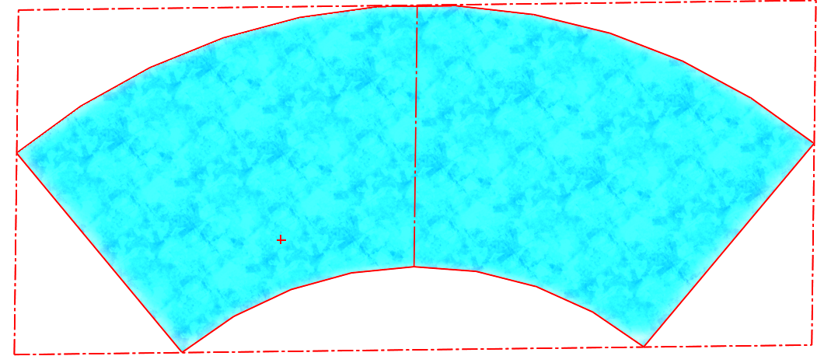
1-2 製造驗證
1 摺邊不行用掃出
透過展開驗證

Slide 18
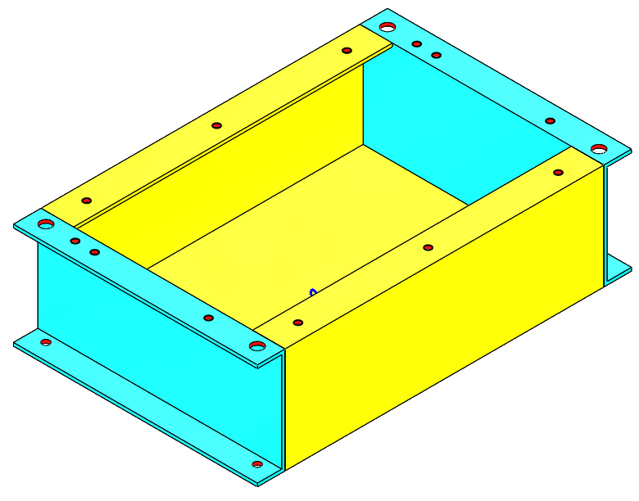
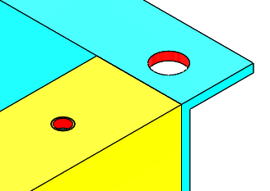
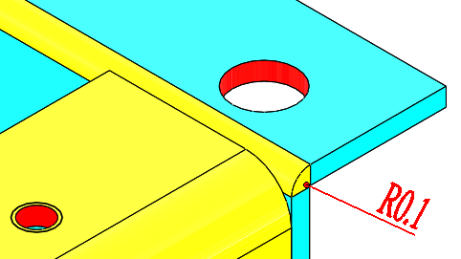
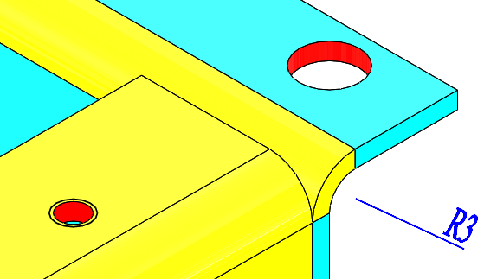
1-2 製造驗證
2 模擬實際彎折-改孔距
無彎折
不合理
彎折小
不合理
彎折合理，但…

Slide 19

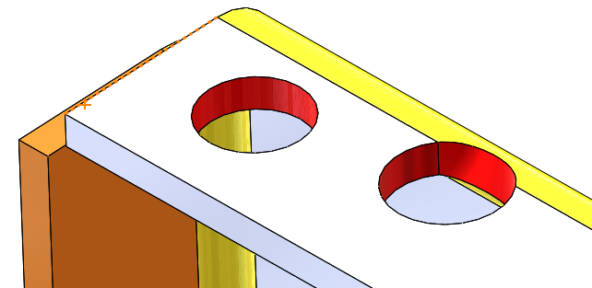

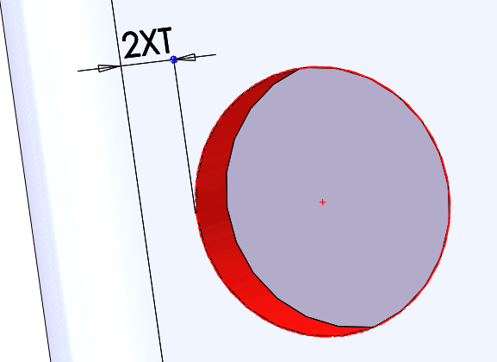
1-2 製造驗證
2 模擬實際彎折-改孔位
孔離彎折要2倍鈑厚
Notes:
There are some small fabrication shops in the industry today that still use manual hand operated equipment, but we are not going to focus on this. We want to utilize the power of SolidWorks so we will focus on CNC fabrication equipment.
The equipment operation is computer based and will let us import programs that were created from our SolidWorks models.
The key to utilizing the power of SolidWorks is to be able to use the electronic data that is created to process the design into the manufacturing of the parts.
That means that the SolidWorks models that you the designer create must be usable by the manufacturer.
When I say usable I mean it must unfold and contain all of the features that the 3D model contains.
Once the flat pattern is developed, a program can be written by the CAM software to cut out the shape of the part.
The program can be for one piece or a nest of many different parts that can be arraigned to fit on the sheet of material.
At this point we are ready to manufacture the parts.
If needed we use a shear to cut the raw material into more manageable sizes.
The program is downloaded into the punch press or laser and the part or parts are cut out.
We use a press brake to bend the cutout material into it’s 3d shape.
All of this can be achieved by using the SolidWorks model to get the information needed for manufacturing.
That means no drawing is required to make the part as long as all of the information needed such as material, finish and any special notes are specified in the properties.
In the case at Ometek, we create a simple drawing with bend dimensions, material finish and any special notes that might apply.
Ometek has installed the E-Drawings Viewer on computers on the manufacturing floor so parts can be viewed for clarification.
In the e planation of the manufacturing process there is one key component, the flat pattern, all sheet metal parts start from a flat pattern so it is imperative that the flat pattern be accurate.

Slide 20
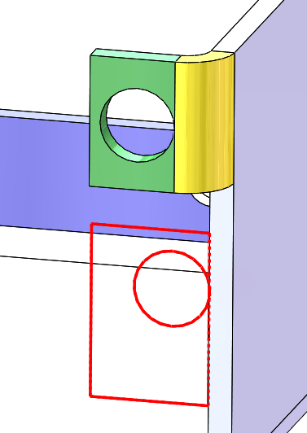
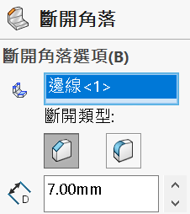
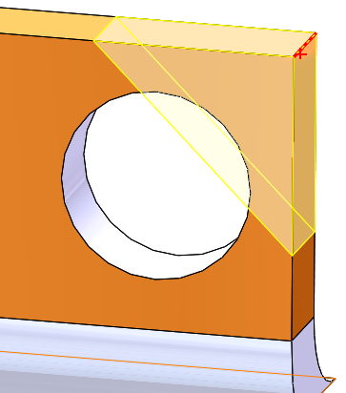
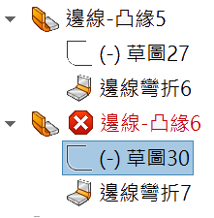
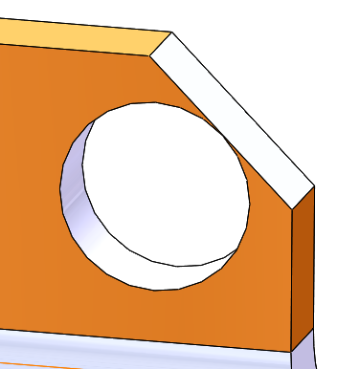
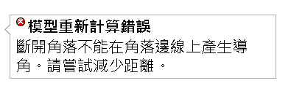
1-2 製造驗證
3 模擬實際彎折-改孔位
彎折處
圓離彎折太近

Slide 21
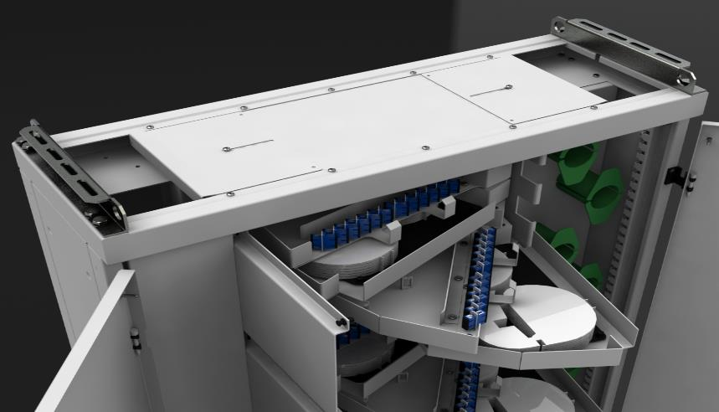
1-2 製造驗證
4 增加討論空間
鈑金架
鈑金盤
門
討論鈑金工法、成本、時間與設計

Slide 22
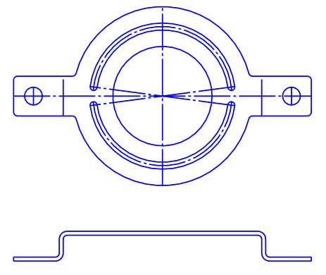
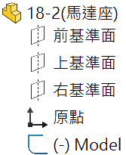
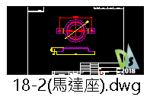
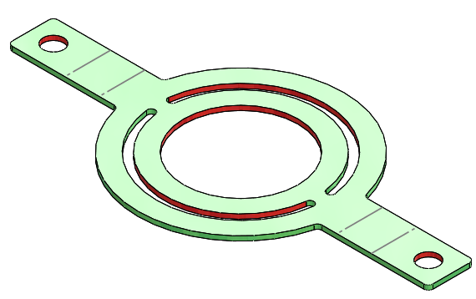
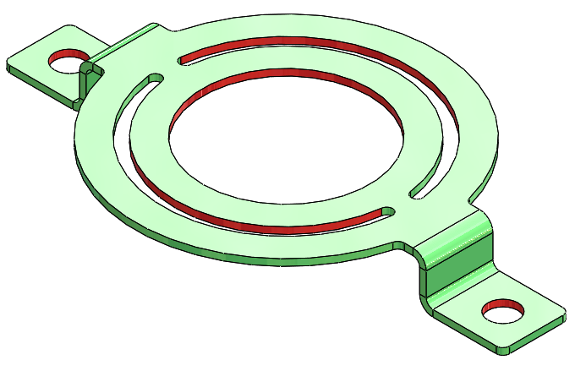
1-2 製造驗證
5 逆向工程作業與開發
你有主動在製作前
用3D向客戶確認服務嗎?
你有了這樣的服務還會生意不好?
用最簡單服務
卻得到很高服務滿意
2D 鈑金工程圖
2D 草圖

Slide 23
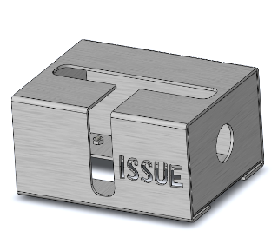
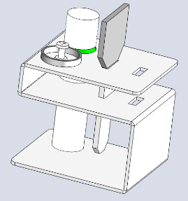
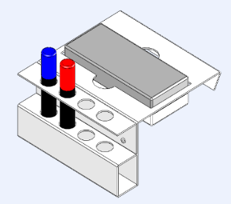
1-2 製造驗證
6 鈑金機構設計
鈑金機構設計
鈑金與機構設計
鈑金盒

Slide 24
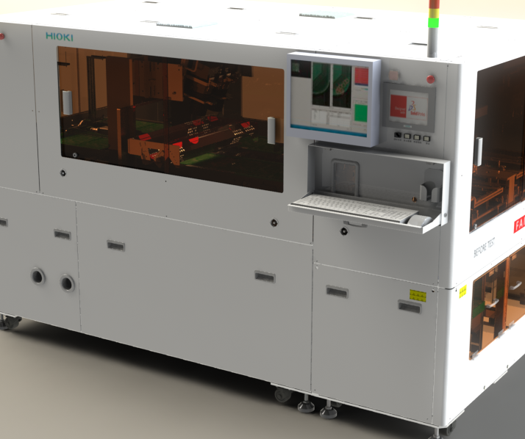

1-2 製造驗證
7 設備設計
裡面有什麼?
鑽孔目地是甚麼?
看你要不要嚴重使用鈑金

Slide 25
1 鈑金專業原理
1-1 提升自我
1-2 製造驗證
1-3 降低成本
1-4 結構分析
1-5 增加用途
Image courtesy of Intertape Polymer Group

Slide 26




1-3 降低製造成本
1 下料排版作業進行成本控制
4片 VS 6片

Slide 27



1-3 降低製造成本
2 降低．．．．成本
沒3D敢加工嗎?
有主動向對方要3D嗎?
逆向建構出來
願意主動
降成本給對方嗎?
廠商與客戶都渴望３Ｄ

Slide 28

1-3 降低製造成本
3 知道鈑金廠商要什麼
不能只考慮怎麼畫圖／設計
若加上製程會來得更貼切
廠商都很肯教

Slide 29





1-3 降低製造成本
4 製作鈑金加工順序動作
透過模型組態來完成

Slide 30
1 鈑金專業原理
1-1 提升自我
1-2 製造驗證
1-3 降低成本
1-4 結構分析
1-5 增加用途
Image courtesy of Intertape Polymer Group

Slide 31




1-4 鈑金結構分析
1 延伸鈑金產品分析
為何沒想到
鈑金+分析服務
間接賺很多錢
這樣就好??
不只這樣!!

Slide 32
1 鈑金專業原理
1-1 提升自我
1-2 製造驗證
1-3 降低成本
1-4 結構分析
1-5 增加用途
Image courtesy of Intertape Polymer Group

Slide 33

1-5 鈑金多用途
1 營造金屬

Slide 34

1-5 鈑金多用途
2 廚具設計
鈑金有自動殺菌(不鏽鋼)
好清理與低成本的優勢

Slide 35

1-5 鈑金多用途
3 鈑金加工兼設計
封 板
框 架
組合件封板+框架

Slide 36




1-5 鈑金多用途
4 藝術品
鈑金藝術品

Slide 37


1-5 鈑金多用途
5.景觀藝術
天花板 鈑金裝飾
大廳 鈑金裝飾
圖片來源 網路

Slide 38

1-5 鈑金多用途
6 鈑金與產業結合
鈑金
鋼構
管路
鈑金＋鋼構＋管路是好朋友

Slide 39
1 學鈑金好處
2 鈑金學習方向
3 鈑金實務討論

Slide 40
2 鈑金學習方向
2-1 不敢用鈑金
2-2 選項設定
2-3 文意感應
2-4 延伸學習
2-5
Image courtesy of Intertape Polymer Group

Slide 41

2-1 不敢用鈑金的理由X
理由1 完全不會用
上完課就會了

Slide 42

2-1 不敢用鈑金理由X
理由2 雖然會～沒自信上戰場
老師和論壇給你靠

Slide 43



2-1 不敢用鈑金理由X
理由3 不懂鈑金CAD結構
指令
不能用
1 三明治法則
2 熔接最後做

Slide 44


2-1 不敢用鈑金理由X
理由4 道聽塗說 好像沒人用SW畫 業界都用 Pro/e UG
看人用

Slide 45




2-1 不敢用鈑金理由X
理由5 這一行很少人用3D畫鈑金

Slide 46



2-1 不敢用鈑金理由
理由 6 被鈑厚害死
還敢用2D嗎?
有沒有錯覺?

Slide 47


2-1 不敢用鈑金理由X
理由 6 被鈑厚害死
不敢用鈑金的16種理由
理由 5 被2D鈑厚害死
沒時間思考了
這張圖還要想多久??

Slide 48


2-1 不敢用鈑金理由X
理由 7 被3D鈑厚害死
凸緣位置控制
指令選擇留意即可~至少不是2D用畫的

Slide 49


2-1 不敢用鈑金理由X
理由 8 畫出來無法加工
至少還未到
出圖作業
驗證鈑金可否展開

Slide 50



2-1 不敢用鈑金理由X
理由 8 畫出來無法加工
干 涉
驗證鈑金是否干涉

Slide 51




2-1 不敢用鈑金理由X
理由 9 不敢嘗試 怕有問題被罵
跨出第一步 先從簡單模型開始

Slide 52

2-1 不敢用鈑金理由X
理由 10 鈑金工程圖不會標(亂標）
都不用標
不知到怎麼標
要不要標
看別人的鈑金圖面就會有信心

Slide 53




2-1 不敢用鈑金理由X
理由 11 給展開圖要擔責任
什麼時代
還這種思維

Slide 54

2-1 不敢用鈑金理由X
理由 13 加工廠說”用AutoCAD就夠了”

Slide 55


2-1 不敢用鈑金理由X
理由14 不知道鈑金廠要的是什麼
問對方 學會都是你的

Slide 56

2-1 不敢用鈑金理由X
理由15 鈑金廠不要展開圖
你的應對什麼?
1 拿掉展開圖
2 想辦法問怎麼做廠商才要
展開圖繪製是你表達專業的手段
你被斷手腳都還不知道
放棄是最簡單的！

Slide 57

2-1 不敢用鈑金理由X
理由15 鈑金廠不要展開圖
常被廠商嫌
用不到嗎？
你的應對什麼?
1 拿掉展開圖
2 想辦法問怎麼做廠商才要
積極作為

Slide 58
2-1 不敢用鈑金理由X
理由15 鈑金廠不要展開圖
你的應對什麼?
2 想辦法問怎麼做廠商才要
。每個廠商說法不一樣 這是要面對的
。別試著要搞懂每個人做法
會很累!因為變數太多
除非你懂鈑金
積極作為之結論
Notes:
帶NB到工廠討論鈑金成形 並討論設計方向來滿足加工

Slide 59


2-1 不敢用鈑金理由X
理由16 自己排斥
誰說工程師一定要會鈑金…

Slide 60


2-1 不敢用鈑金理由X
理由16 自己排斥
別人會
你為何不會
你無法與
他人競爭
排斥很容易! 接受很難!

Slide 61

2-1 不敢用鈑金理由X
理由17 用傳統方法比SolidWorks快
因為這不需設變
某些地方 ～2D比較快

Slide 62



2-1 不敢用鈑金理由X
理由18 沒有設計能力
連畫都有問題
如何設計
夾持治具
設計
要製造件

Slide 63
2 鈑金學習方向
2-1 不敢用鈑金
2-2 選項設定
2-3 文意感應
2-4 延伸學習
2-5
Image courtesy of Intertape Polymer Group

Slide 64


2-2 鈑金選項設定
1.鈑金/平板型式選項
適用零件與組合件

Slide 65

2-2 鈑金選項設定
2 效能

Slide 66

2 鈑金學習方向
2-1 不敢用鈑金
2-2 選項設定
2-3 文意感應
2-4 延伸學習
2-5

Slide 67

2-3 鈑金文意感應
平版形式(使用率最高)
定義最快速的方法

Slide 68
2 鈑金學習方向
2-1 不敢用鈑金
2-2 選項設定
2-3 文意感應
2-4 延伸學習
2-5

Slide 69


2-4 鈑金延伸學習
1.鈑金學習管道
鈑金網站
sheetmetalguy.com/solidworks/
youtube.com – Search for SolidWorks Sheet Metal
engineersedge.com/sheet_metal_design.shtml
forum.solidworks.com/community/solidworks/sheet_meta
solidworks.org.tw (soldiworks專門論壇)
鈑金書籍
鈑金廠商

Slide 70




2-4 鈑金延伸學習
2.鈑金新功能
弦差
彎折數
面選項的提升

Slide 71



2-4 鈑金延伸學習
2.展平
模型轉檔

Slide 72




2-4 鈑金延伸學習
3.創造等厚條件
模型轉檔

Slide 73
1 學鈑金好處
2 鈑金學習方向
3 鈑金實務討論

Slide 74
3 鈑金實務討論
3-1 加工方式
3-2 鈑金設計
3-3 實際案例
3-4 廠商行銷
2-5
Image courtesy of Intertape Polymer Group

Slide 75

3-1 鈑金加工方式
第1關 沖孔和切割
Notes:
There are some small fabrication shops in the industry today that still use manual hand operated equipment, but we are not going to focus on this. We want to utilize the power of SolidWorks so we will focus on CNC fabrication equipment.
The equipment operation is computer based and will let us import programs that were created from our SolidWorks models.
The key to utilizing the power of SolidWorks is to be able to use the electronic data that is created to process the design into the manufacturing of the parts.
That means that the SolidWorks models that you the designer create must be usable by the manufacturer.
When I say usable I mean it must unfold and contain all of the features that the 3D model contains.
Once the flat pattern is developed, a program can be written by the CAM software to cut out the shape of the part.
The program can be for one piece or a nest of many different parts that can be arraigned to fit on the sheet of material.
At this point we are ready to manufacture the parts.
If needed we use a shear to cut the raw material into more manageable sizes.
The program is downloaded into the punch press or laser and the part or parts are cut out.
We use a press brake to bend the cutout material into it’s 3d shape.
All of this can be achieved by using the SolidWorks model to get the information needed for manufacturing.
That means no drawing is required to make the part as long as all of the information needed such as material, finish and any special notes are specified in the properties.
In the case at Ometek, we create a simple drawing with bend dimensions, material finish and any special notes that might apply.
Ometek has installed the E-Drawings Viewer on computers on the manufacturing floor so parts can be viewed for clarification.
In the e planation of the manufacturing process there is one key component, the flat pattern, all sheet metal parts start from a flat pattern so it is imperative that the flat pattern be accurate.

Slide 76

3-1 鈑金加工方式
第2關 孔加工
Notes:
There are some small fabrication shops in the industry today that still use manual hand operated equipment, but we are not going to focus on this. We want to utilize the power of SolidWorks so we will focus on CNC fabrication equipment.
The equipment operation is computer based and will let us import programs that were created from our SolidWorks models.
The key to utilizing the power of SolidWorks is to be able to use the electronic data that is created to process the design into the manufacturing of the parts.
That means that the SolidWorks models that you the designer create must be usable by the manufacturer.
When I say usable I mean it must unfold and contain all of the features that the 3D model contains.
Once the flat pattern is developed, a program can be written by the CAM software to cut out the shape of the part.
The program can be for one piece or a nest of many different parts that can be arraigned to fit on the sheet of material.
At this point we are ready to manufacture the parts.
If needed we use a shear to cut the raw material into more manageable sizes.
The program is downloaded into the punch press or laser and the part or parts are cut out.
We use a press brake to bend the cutout material into it’s 3d shape.
All of this can be achieved by using the SolidWorks model to get the information needed for manufacturing.
That means no drawing is required to make the part as long as all of the information needed such as material, finish and any special notes are specified in the properties.
In the case at Ometek, we create a simple drawing with bend dimensions, material finish and any special notes that might apply.
Ometek has installed the E-Drawings Viewer on computers on the manufacturing floor so parts can be viewed for clarification.
In the e planation of the manufacturing process there is one key component, the flat pattern, all sheet metal parts start from a flat pattern so it is imperative that the flat pattern be accurate.

Slide 77


3-1 鈑金加工方式
第3關 折床
沖床模座
成形
Notes:
There are some small fabrication shops in the industry today that still use manual hand operated equipment, but we are not going to focus on this. We want to utilize the power of SolidWorks so we will focus on CNC fabrication equipment.
The equipment operation is computer based and will let us import programs that were created from our SolidWorks models.
The key to utilizing the power of SolidWorks is to be able to use the electronic data that is created to process the design into the manufacturing of the parts.
That means that the SolidWorks models that you the designer create must be usable by the manufacturer.
When I say usable I mean it must unfold and contain all of the features that the 3D model contains.
Once the flat pattern is developed, a program can be written by the CAM software to cut out the shape of the part.
The program can be for one piece or a nest of many different parts that can be arraigned to fit on the sheet of material.
At this point we are ready to manufacture the parts.
If needed we use a shear to cut the raw material into more manageable sizes.
The program is downloaded into the punch press or laser and the part or parts are cut out.
We use a press brake to bend the cutout material into it’s 3d shape.
All of this can be achieved by using the SolidWorks model to get the information needed for manufacturing.
That means no drawing is required to make the part as long as all of the information needed such as material, finish and any special notes are specified in the properties.
In the case at Ometek, we create a simple drawing with bend dimensions, material finish and any special notes that might apply.
Ometek has installed the E-Drawings Viewer on computers on the manufacturing floor so parts can be viewed for clarification.
In the e planation of the manufacturing process there is one key component, the flat pattern, all sheet metal parts start from a flat pattern so it is imperative that the flat pattern be accurate.

Slide 78

3-1 鈑金加工方式
第4關 焊接
Notes:
There are some small fabrication shops in the industry today that still use manual hand operated equipment, but we are not going to focus on this. We want to utilize the power of SolidWorks so we will focus on CNC fabrication equipment.
The equipment operation is computer based and will let us import programs that were created from our SolidWorks models.
The key to utilizing the power of SolidWorks is to be able to use the electronic data that is created to process the design into the manufacturing of the parts.
That means that the SolidWorks models that you the designer create must be usable by the manufacturer.
When I say usable I mean it must unfold and contain all of the features that the 3D model contains.
Once the flat pattern is developed, a program can be written by the CAM software to cut out the shape of the part.
The program can be for one piece or a nest of many different parts that can be arraigned to fit on the sheet of material.
At this point we are ready to manufacture the parts.
If needed we use a shear to cut the raw material into more manageable sizes.
The program is downloaded into the punch press or laser and the part or parts are cut out.
We use a press brake to bend the cutout material into it’s 3d shape.
All of this can be achieved by using the SolidWorks model to get the information needed for manufacturing.
That means no drawing is required to make the part as long as all of the information needed such as material, finish and any special notes are specified in the properties.
In the case at Ometek, we create a simple drawing with bend dimensions, material finish and any special notes that might apply.
Ometek has installed the E-Drawings Viewer on computers on the manufacturing floor so parts can be viewed for clarification.
In the e planation of the manufacturing process there is one key component, the flat pattern, all sheet metal parts start from a flat pattern so it is imperative that the flat pattern be accurate.

Slide 79



3-1 鈑金加工方式
凸緣加工
2.短
2.長
1.長
1.短
標準刀具便宜 短的凸緣比較貴
Notes:
There are some small fabrication shops in the industry today that still use manual hand operated equipment, but we are not going to focus on this. We want to utilize the power of SolidWorks so we will focus on CNC fabrication equipment.
The equipment operation is computer based and will let us import programs that were created from our SolidWorks models.
The key to utilizing the power of SolidWorks is to be able to use the electronic data that is created to process the design into the manufacturing of the parts.
That means that the SolidWorks models that you the designer create must be usable by the manufacturer.
When I say usable I mean it must unfold and contain all of the features that the 3D model contains.
Once the flat pattern is developed, a program can be written by the CAM software to cut out the shape of the part.
The program can be for one piece or a nest of many different parts that can be arraigned to fit on the sheet of material.
At this point we are ready to manufacture the parts.
If needed we use a shear to cut the raw material into more manageable sizes.
The program is downloaded into the punch press or laser and the part or parts are cut out.
We use a press brake to bend the cutout material into it’s 3d shape.
All of this can be achieved by using the SolidWorks model to get the information needed for manufacturing.
That means no drawing is required to make the part as long as all of the information needed such as material, finish and any special notes are specified in the properties.
In the case at Ometek, we create a simple drawing with bend dimensions, material finish and any special notes that might apply.
Ometek has installed the E-Drawings Viewer on computers on the manufacturing floor so parts can be viewed for clarification.
In the e planation of the manufacturing process there is one key component, the flat pattern, all sheet metal parts start from a flat pattern so it is imperative that the flat pattern be accurate.

Slide 80


3-1 鈑金加工方式
成形刀模認知
Notes:
There are some small fabrication shops in the industry today that still use manual hand operated equipment, but we are not going to focus on this. We want to utilize the power of SolidWorks so we will focus on CNC fabrication equipment.
The equipment operation is computer based and will let us import programs that were created from our SolidWorks models.
The key to utilizing the power of SolidWorks is to be able to use the electronic data that is created to process the design into the manufacturing of the parts.
That means that the SolidWorks models that you the designer create must be usable by the manufacturer.
When I say usable I mean it must unfold and contain all of the features that the 3D model contains.
Once the flat pattern is developed, a program can be written by the CAM software to cut out the shape of the part.
The program can be for one piece or a nest of many different parts that can be arraigned to fit on the sheet of material.
At this point we are ready to manufacture the parts.
If needed we use a shear to cut the raw material into more manageable sizes.
The program is downloaded into the punch press or laser and the part or parts are cut out.
We use a press brake to bend the cutout material into it’s 3d shape.
All of this can be achieved by using the SolidWorks model to get the information needed for manufacturing.
That means no drawing is required to make the part as long as all of the information needed such as material, finish and any special notes are specified in the properties.
In the case at Ometek, we create a simple drawing with bend dimensions, material finish and any special notes that might apply.
Ometek has installed the E-Drawings Viewer on computers on the manufacturing floor so parts can be viewed for clarification.
In the e planation of the manufacturing process there is one key component, the flat pattern, all sheet metal parts start from a flat pattern so it is imperative that the flat pattern be accurate.

Slide 81


3-1 鈑金加工方式
滾圓
Notes:
There are some small fabrication shops in the industry today that still use manual hand operated equipment, but we are not going to focus on this. We want to utilize the power of SolidWorks so we will focus on CNC fabrication equipment.
The equipment operation is computer based and will let us import programs that were created from our SolidWorks models.
The key to utilizing the power of SolidWorks is to be able to use the electronic data that is created to process the design into the manufacturing of the parts.
That means that the SolidWorks models that you the designer create must be usable by the manufacturer.
When I say usable I mean it must unfold and contain all of the features that the 3D model contains.
Once the flat pattern is developed, a program can be written by the CAM software to cut out the shape of the part.
The program can be for one piece or a nest of many different parts that can be arraigned to fit on the sheet of material.
At this point we are ready to manufacture the parts.
If needed we use a shear to cut the raw material into more manageable sizes.
The program is downloaded into the punch press or laser and the part or parts are cut out.
We use a press brake to bend the cutout material into it’s 3d shape.
All of this can be achieved by using the SolidWorks model to get the information needed for manufacturing.
That means no drawing is required to make the part as long as all of the information needed such as material, finish and any special notes are specified in the properties.
In the case at Ometek, we create a simple drawing with bend dimensions, material finish and any special notes that might apply.
Ometek has installed the E-Drawings Viewer on computers on the manufacturing floor so parts can be viewed for clarification.
In the e planation of the manufacturing process there is one key component, the flat pattern, all sheet metal parts start from a flat pattern so it is imperative that the flat pattern be accurate.

Slide 82

3-1 鈑金加工方式
摺邊要兩道程序
Notes:
There are some small fabrication shops in the industry today that still use manual hand operated equipment, but we are not going to focus on this. We want to utilize the power of SolidWorks so we will focus on CNC fabrication equipment.
The equipment operation is computer based and will let us import programs that were created from our SolidWorks models.
The key to utilizing the power of SolidWorks is to be able to use the electronic data that is created to process the design into the manufacturing of the parts.
That means that the SolidWorks models that you the designer create must be usable by the manufacturer.
When I say usable I mean it must unfold and contain all of the features that the 3D model contains.
Once the flat pattern is developed, a program can be written by the CAM software to cut out the shape of the part.
The program can be for one piece or a nest of many different parts that can be arraigned to fit on the sheet of material.
At this point we are ready to manufacture the parts.
If needed we use a shear to cut the raw material into more manageable sizes.
The program is downloaded into the punch press or laser and the part or parts are cut out.
We use a press brake to bend the cutout material into it’s 3d shape.
All of this can be achieved by using the SolidWorks model to get the information needed for manufacturing.
That means no drawing is required to make the part as long as all of the information needed such as material, finish and any special notes are specified in the properties.
In the case at Ometek, we create a simple drawing with bend dimensions, material finish and any special notes that might apply.
Ometek has installed the E-Drawings Viewer on computers on the manufacturing floor so parts can be viewed for clarification.
In the e planation of the manufacturing process there is one key component, the flat pattern, all sheet metal parts start from a flat pattern so it is imperative that the flat pattern be accurate.

Slide 83


3-1 鈑金加工方式
打丁
Notes:
There are some small fabrication shops in the industry today that still use manual hand operated equipment, but we are not going to focus on this. We want to utilize the power of SolidWorks so we will focus on CNC fabrication equipment.
The equipment operation is computer based and will let us import programs that were created from our SolidWorks models.
The key to utilizing the power of SolidWorks is to be able to use the electronic data that is created to process the design into the manufacturing of the parts.
That means that the SolidWorks models that you the designer create must be usable by the manufacturer.
When I say usable I mean it must unfold and contain all of the features that the 3D model contains.
Once the flat pattern is developed, a program can be written by the CAM software to cut out the shape of the part.
The program can be for one piece or a nest of many different parts that can be arraigned to fit on the sheet of material.
At this point we are ready to manufacture the parts.
If needed we use a shear to cut the raw material into more manageable sizes.
The program is downloaded into the punch press or laser and the part or parts are cut out.
We use a press brake to bend the cutout material into it’s 3d shape.
All of this can be achieved by using the SolidWorks model to get the information needed for manufacturing.
That means no drawing is required to make the part as long as all of the information needed such as material, finish and any special notes are specified in the properties.
In the case at Ometek, we create a simple drawing with bend dimensions, material finish and any special notes that might apply.
Ometek has installed the E-Drawings Viewer on computers on the manufacturing floor so parts can be viewed for clarification.
In the e planation of the manufacturing process there is one key component, the flat pattern, all sheet metal parts start from a flat pattern so it is imperative that the flat pattern be accurate.

Slide 84


3-1 鈑金加工方式
認知
Notes:
There are some small fabrication shops in the industry today that still use manual hand operated equipment, but we are not going to focus on this. We want to utilize the power of SolidWorks so we will focus on CNC fabrication equipment.
The equipment operation is computer based and will let us import programs that were created from our SolidWorks models.
The key to utilizing the power of SolidWorks is to be able to use the electronic data that is created to process the design into the manufacturing of the parts.
That means that the SolidWorks models that you the designer create must be usable by the manufacturer.
When I say usable I mean it must unfold and contain all of the features that the 3D model contains.
Once the flat pattern is developed, a program can be written by the CAM software to cut out the shape of the part.
The program can be for one piece or a nest of many different parts that can be arraigned to fit on the sheet of material.
At this point we are ready to manufacture the parts.
If needed we use a shear to cut the raw material into more manageable sizes.
The program is downloaded into the punch press or laser and the part or parts are cut out.
We use a press brake to bend the cutout material into it’s 3d shape.
All of this can be achieved by using the SolidWorks model to get the information needed for manufacturing.
That means no drawing is required to make the part as long as all of the information needed such as material, finish and any special notes are specified in the properties.
In the case at Ometek, we create a simple drawing with bend dimensions, material finish and any special notes that might apply.
Ometek has installed the E-Drawings Viewer on computers on the manufacturing floor so parts can be viewed for clarification.
In the e planation of the manufacturing process there is one key component, the flat pattern, all sheet metal parts start from a flat pattern so it is imperative that the flat pattern be accurate.

Slide 85
3 鈑金實務討論
3-1 加工方式
3-2 鈑金設計
3-3 實際案例
3-4 廠商行銷
2-5
Image courtesy of Intertape Polymer Group

Slide 86



3-2 鈑金設計
思考1 封閉角落哪個比較好
A 開放
B 長包短
C 短包長
Notes:
There are some small fabrication shops in the industry today that still use manual hand operated equipment, but we are not going to focus on this. We want to utilize the power of SolidWorks so we will focus on CNC fabrication equipment.
The equipment operation is computer based and will let us import programs that were created from our SolidWorks models.
The key to utilizing the power of SolidWorks is to be able to use the electronic data that is created to process the design into the manufacturing of the parts.
That means that the SolidWorks models that you the designer create must be usable by the manufacturer.
When I say usable I mean it must unfold and contain all of the features that the 3D model contains.
Once the flat pattern is developed, a program can be written by the CAM software to cut out the shape of the part.
The program can be for one piece or a nest of many different parts that can be arraigned to fit on the sheet of material.
At this point we are ready to manufacture the parts.
If needed we use a shear to cut the raw material into more manageable sizes.
The program is downloaded into the punch press or laser and the part or parts are cut out.
We use a press brake to bend the cutout material into it’s 3d shape.
All of this can be achieved by using the SolidWorks model to get the information needed for manufacturing.
That means no drawing is required to make the part as long as all of the information needed such as material, finish and any special notes are specified in the properties.
In the case at Ometek, we create a simple drawing with bend dimensions, material finish and any special notes that might apply.
Ometek has installed the E-Drawings Viewer on computers on the manufacturing floor so parts can be viewed for clarification.
In the e planation of the manufacturing process there is one key component, the flat pattern, all sheet metal parts start from a flat pattern so it is imperative that the flat pattern be accurate.

Slide 87


3-2 鈑金設計
思考2 斜接凸緣(Miter)哪個比較好
BAD
BAD
A
B
Notes:
There are some small fabrication shops in the industry today that still use manual hand operated equipment, but we are not going to focus on this. We want to utilize the power of SolidWorks so we will focus on CNC fabrication equipment.
The equipment operation is computer based and will let us import programs that were created from our SolidWorks models.
The key to utilizing the power of SolidWorks is to be able to use the electronic data that is created to process the design into the manufacturing of the parts.
That means that the SolidWorks models that you the designer create must be usable by the manufacturer.
When I say usable I mean it must unfold and contain all of the features that the 3D model contains.
Once the flat pattern is developed, a program can be written by the CAM software to cut out the shape of the part.
The program can be for one piece or a nest of many different parts that can be arraigned to fit on the sheet of material.
At this point we are ready to manufacture the parts.
If needed we use a shear to cut the raw material into more manageable sizes.
The program is downloaded into the punch press or laser and the part or parts are cut out.
We use a press brake to bend the cutout material into it’s 3d shape.
All of this can be achieved by using the SolidWorks model to get the information needed for manufacturing.
That means no drawing is required to make the part as long as all of the information needed such as material, finish and any special notes are specified in the properties.
In the case at Ometek, we create a simple drawing with bend dimensions, material finish and any special notes that might apply.
Ometek has installed the E-Drawings Viewer on computers on the manufacturing floor so parts can be viewed for clarification.
In the e planation of the manufacturing process there is one key component, the flat pattern, all sheet metal parts start from a flat pattern so it is imperative that the flat pattern be accurate.

Slide 88




3-2 鈑金設計
思考3 20 單體還是多本體比較好
Notes:
There are some small fabrication shops in the industry today that still use manual hand operated equipment, but we are not going to focus on this. We want to utilize the power of SolidWorks so we will focus on CNC fabrication equipment.
The equipment operation is computer based and will let us import programs that were created from our SolidWorks models.
The key to utilizing the power of SolidWorks is to be able to use the electronic data that is created to process the design into the manufacturing of the parts.
That means that the SolidWorks models that you the designer create must be usable by the manufacturer.
When I say usable I mean it must unfold and contain all of the features that the 3D model contains.
Once the flat pattern is developed, a program can be written by the CAM software to cut out the shape of the part.
The program can be for one piece or a nest of many different parts that can be arraigned to fit on the sheet of material.
At this point we are ready to manufacture the parts.
If needed we use a shear to cut the raw material into more manageable sizes.
The program is downloaded into the punch press or laser and the part or parts are cut out.
We use a press brake to bend the cutout material into it’s 3d shape.
All of this can be achieved by using the SolidWorks model to get the information needed for manufacturing.
That means no drawing is required to make the part as long as all of the information needed such as material, finish and any special notes are specified in the properties.
In the case at Ometek, we create a simple drawing with bend dimensions, material finish and any special notes that might apply.
Ometek has installed the E-Drawings Viewer on computers on the manufacturing floor so parts can be viewed for clarification.
In the e planation of the manufacturing process there is one key component, the flat pattern, all sheet metal parts start from a flat pattern so it is imperative that the flat pattern be accurate.

Slide 89



3-2 鈑金設計
思考5 用哪個指令比較好
邊線/斜接凸緣
轉換鈑金/插入彎折
Notes:
There are some small fabrication shops in the industry today that still use manual hand operated equipment, but we are not going to focus on this. We want to utilize the power of SolidWorks so we will focus on CNC fabrication equipment.
The equipment operation is computer based and will let us import programs that were created from our SolidWorks models.
The key to utilizing the power of SolidWorks is to be able to use the electronic data that is created to process the design into the manufacturing of the parts.
That means that the SolidWorks models that you the designer create must be usable by the manufacturer.
When I say usable I mean it must unfold and contain all of the features that the 3D model contains.
Once the flat pattern is developed, a program can be written by the CAM software to cut out the shape of the part.
The program can be for one piece or a nest of many different parts that can be arraigned to fit on the sheet of material.
At this point we are ready to manufacture the parts.
If needed we use a shear to cut the raw material into more manageable sizes.
The program is downloaded into the punch press or laser and the part or parts are cut out.
We use a press brake to bend the cutout material into it’s 3d shape.
All of this can be achieved by using the SolidWorks model to get the information needed for manufacturing.
That means no drawing is required to make the part as long as all of the information needed such as material, finish and any special notes are specified in the properties.
In the case at Ometek, we create a simple drawing with bend dimensions, material finish and any special notes that might apply.
Ometek has installed the E-Drawings Viewer on computers on the manufacturing floor so parts can be viewed for clarification.
In the e planation of the manufacturing process there is one key component, the flat pattern, all sheet metal parts start from a flat pattern so it is imperative that the flat pattern be accurate.

Slide 90
3 鈑金實務討論
3-1 加工方式
3-2 鈑金設計
3-3 實際案例
3-4 廠商行銷
2-5
Image courtesy of Intertape Polymer Group

Slide 91





3-3 業界實際案例
1 河堤案
取樣

Slide 92



3-3 業界實際案例
1 河堤案
1 分 割
2 取 面
3 展 開

Slide 93


3-3 業界實際案例
2 監視器電控盒

Slide 94


3-3 業界實際案例
3 咖 啡 機

Slide 95


3-3 業界實際案例
6 沖壓案

Slide 96


3-3 業界實際案例
8 新竹六家高鐵

Slide 97


3-3 業界實際案例
9 公園藝術

Slide 98



3-3 業界實際案例
10 中華航廈景觀

Slide 99
3 鈑金實務討論
3-1 加工方式
3-2 鈑金設計
3-3 實際案例
3-4 廠商行銷
3-5
Image courtesy of Intertape Polymer Group

Slide 100

3-4 鈑金廠商行銷
1 揭露3D接圖能力與設備
http://motaccc.com/index.htm

Slide 101



3-3 鈑金廠商行銷
2 加工與設計結合
hwaguo.gt-marketing.com.tw/product-category-8.htm
看看對方是怎麼行銷的

Slide 102


幾何電腦原廠訓練中心
SolidWorks 專門論壇
www.solidworks.org.tw

