Slide 1


Slide 2
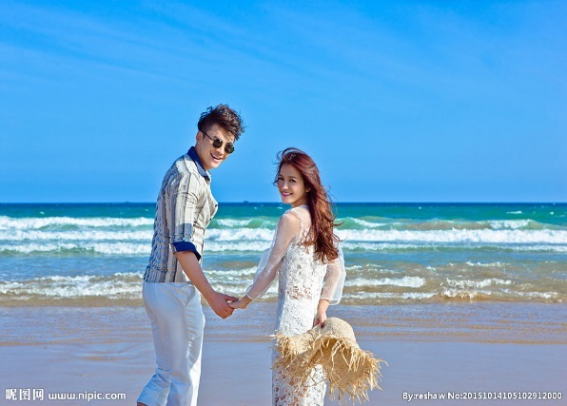
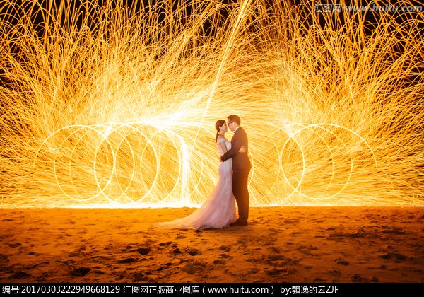
Meet
That year, we are 18 years.
Thank you for the embarrassment, let the two happy lifelines finally meet together...

Slide 3
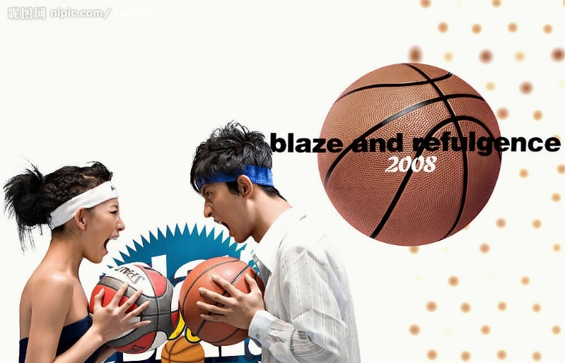
Love each other
That year, we were 19.
We don't understand love,
With a love for dreams and love,
You and I walked into the world of life

Slide 4
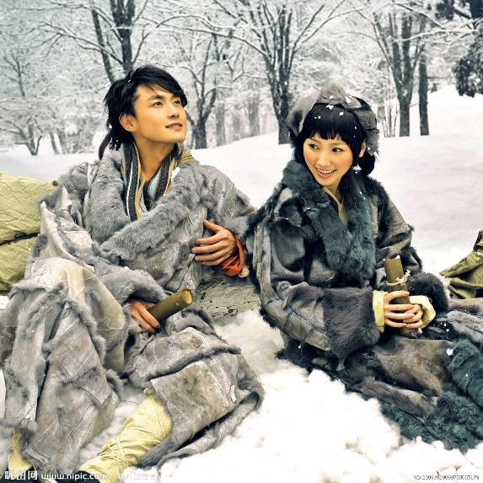
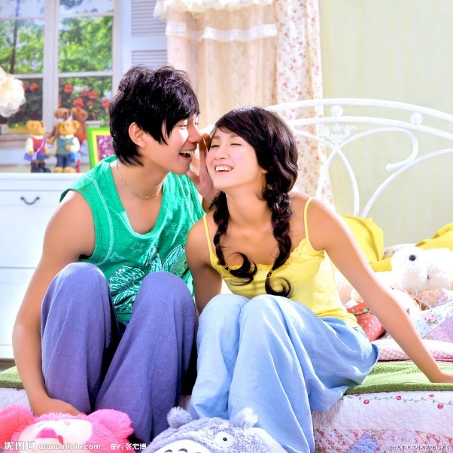
memory
That year, we are twenty.
all the time,
You are all tolerant, considerate, indulgent,
Every casual move of yours,
Are affecting my heart

Slide 5
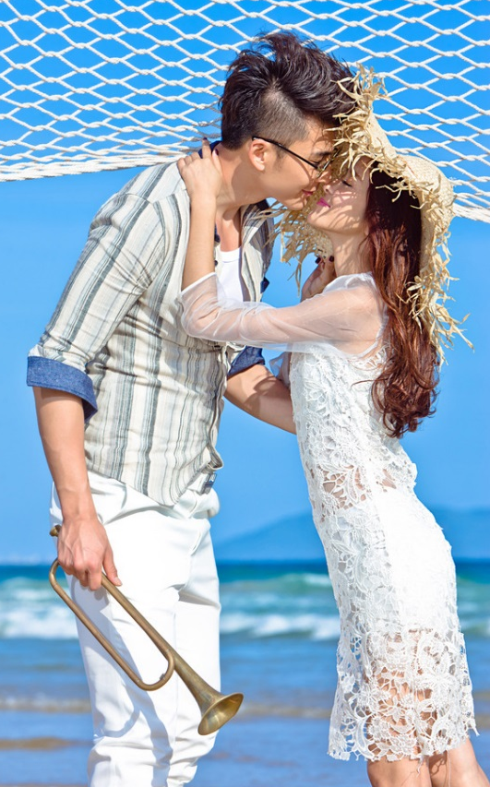
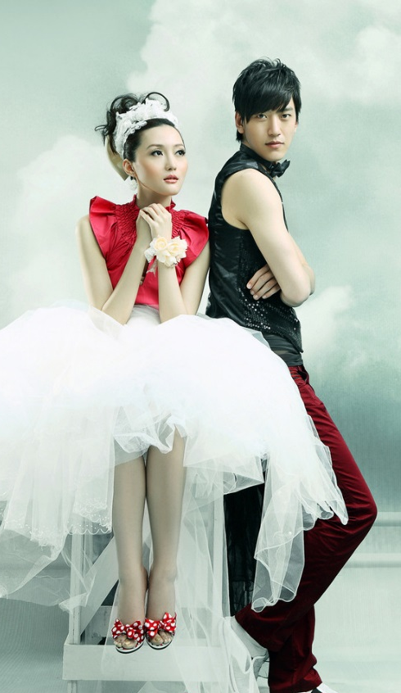
taste
That year,
We are 21 years old
We have experienced the sweetness
of love, It’s also a bitter,
Just to be able to be together,

Slide 6
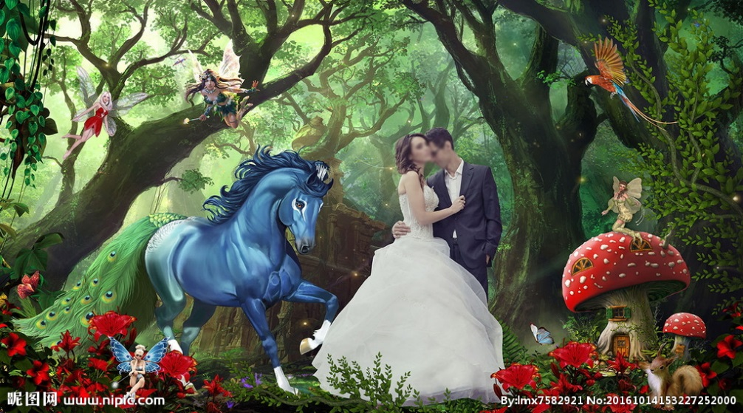

Carved bone
That year,
We are twenty-two years old
I know, in your heart,
I am used to my soft greetings.
And in my heart,
You have long been remembered.

Slide 7
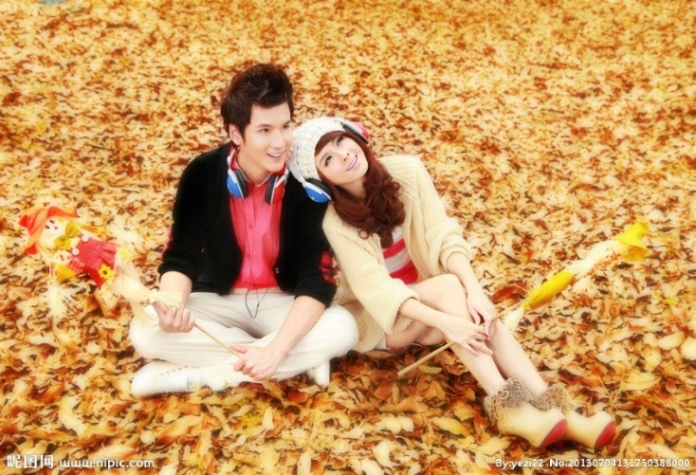
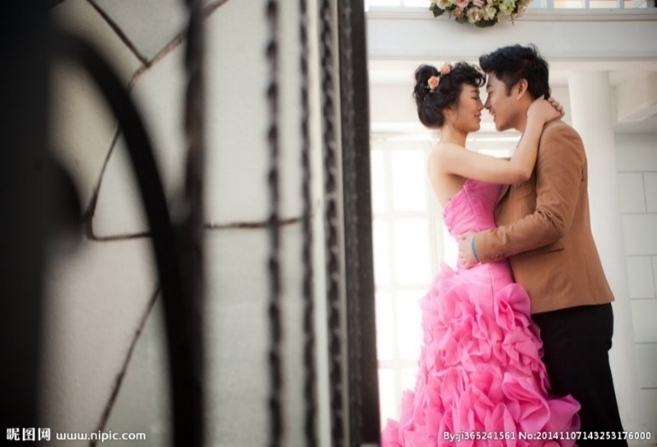
embrace
That year, we were twenty-three years old.
Sometimes it can be humble,
When you are small, you can
bow your head. Full of arms

Slide 8
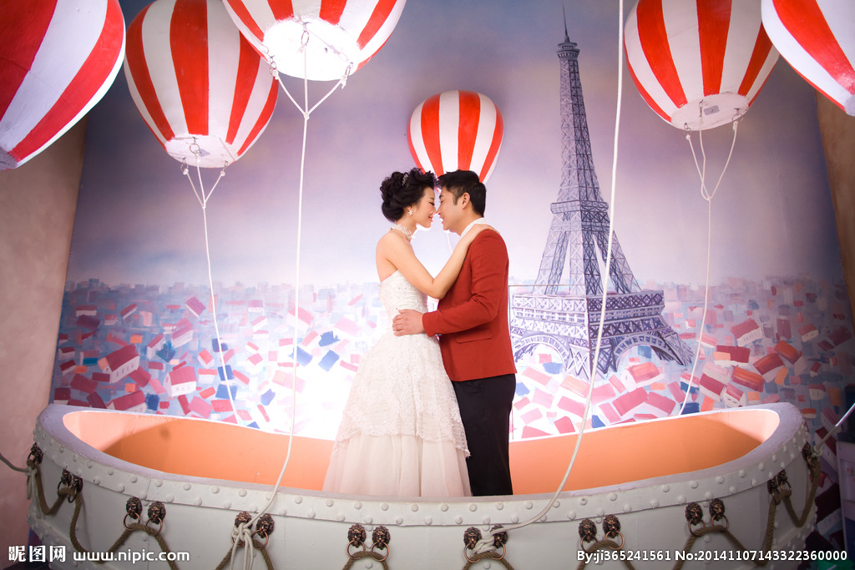
Together
That year,
We are twenty-four years old
Our love has spent seven years, and the years have witnessed our love.

Slide 9
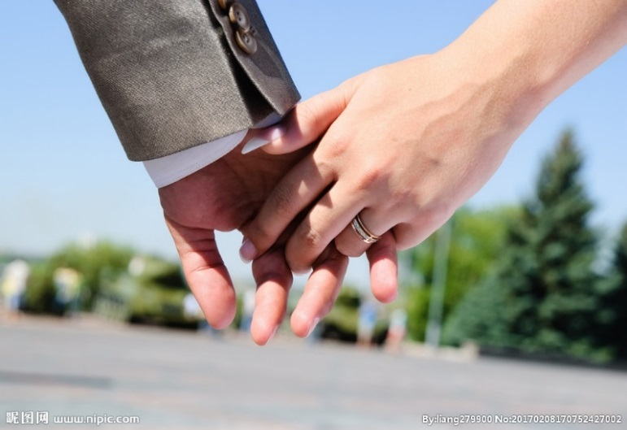
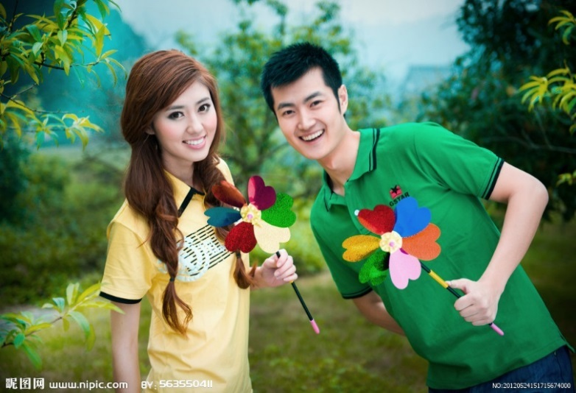
happy
That year, we were twenty-five years old.
I choose to deeply bury your love for you, that is deep inside.
A piece of pure land.

Slide 10
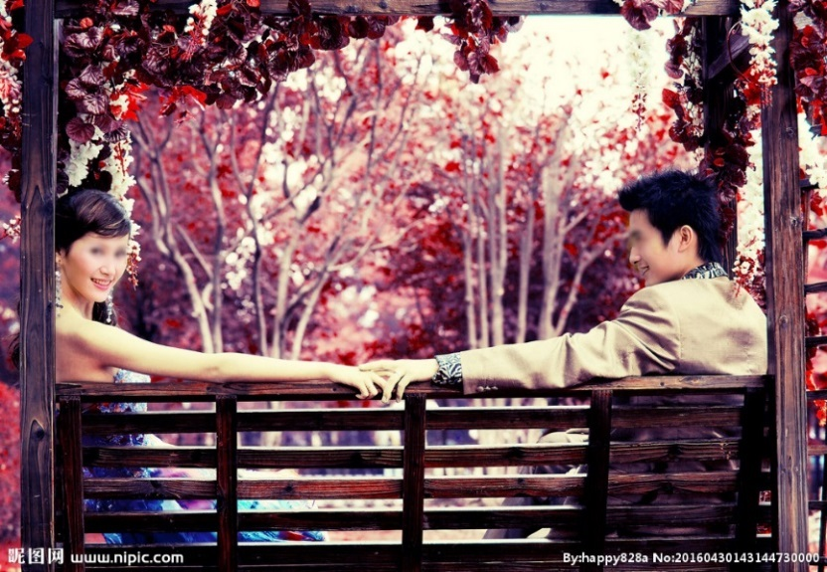
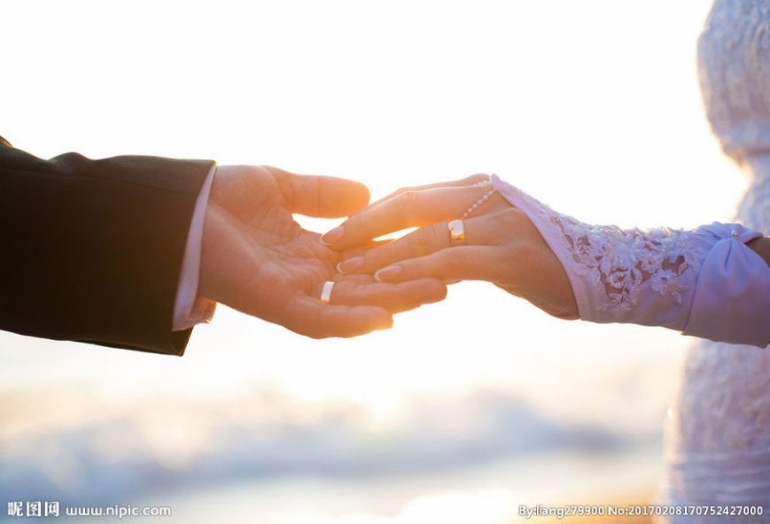
Accompanied
That year, we are twenty-six years old.
Holding hands, we need to spend all
Going to life

Slide 11


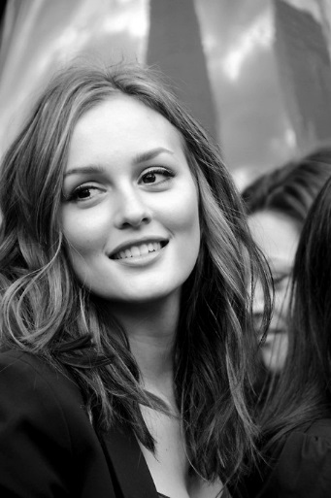
At the best age
Meet you Not to be disappointed Own

Slide 12
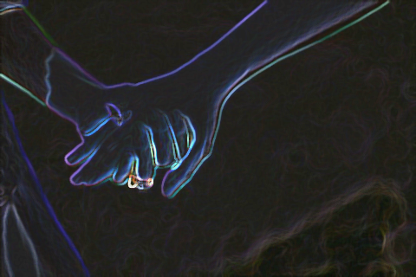
That night
I took your hand
I have never felt before
my partner

Slide 13
520 That day
I said ：
Want to be with you
Lifetime

Slide 14

with you Together
time flies
Looking at the back of each departure
I'm a little Give up

Slide 15
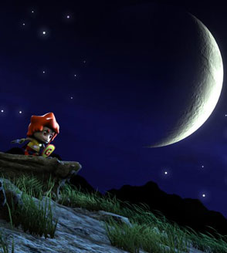
late at night
Tell the story of the egg
Princess and Prince Charming
Until you go to sleep
I have already thought about a lot of plots.
Ready to tell you
One thousand and one night stories

Slide 16
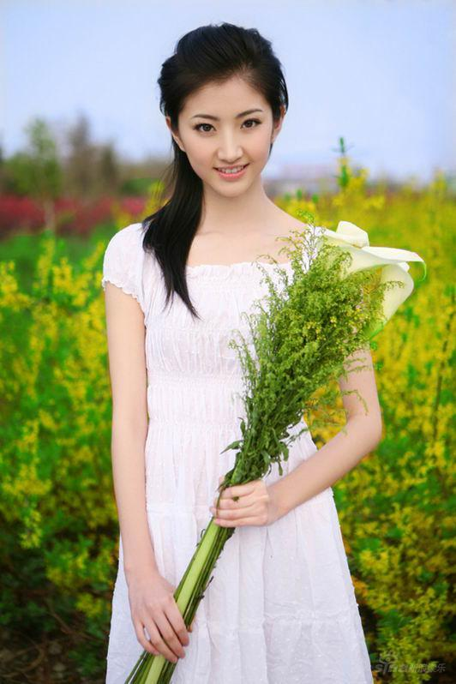
Low-key, low-key, then...
I have listened to the eggs.
Don't like to see you look angry

Slide 17

Everyone said that you can kiss
I do not know why either
With the egg
I always want to kiss you.
I won't say that I am hooligan.
~~~~(>_<)~~~~

Slide 18
Please allow me to declare:
1. I am dedicated and dedicated
2. I will not easily hurt the white
3. I only want you a girl, really eggs.
4. I really value you very much.

Slide 19

This is our first photo of shopping.
harmonious
General match
The first time I cooperated with this tacit understanding
Egg
FQ phase

Slide 20
Accompany you, from the very
Send clothes for you
Worried about you cold
Meet for the first time
Liu Jie Office
Say you can kiss
That night, holding hands successfully,
You said you are going to the Maldives
Go to the third factory to see you
Just to meet you
Walked with you a lot
Familiar road

Slide 21


Since my surname is Liu, I can keep your heart.

Slide 22
Fully Editable Icon Sets: A

Slide 23
Fully Editable Icon Sets: B

Slide 24
Fully Editable Icon Sets: C

