Slide 1

Hawaii International Conference on Education
Building a
Performance Feedback
School Culture
Randy Keyworth
Jack States

Slide 2
1978 - 2004
Operated a large non-profit organization in SF Bay Area
six spec. ed schools adult programs
residential programs employment supportive services
public school consultation teacher training campus
Implemented a comprehensive performance feedback culture
student performance
staff performance
system performance

Slide 3
“real world” challenges
Operating within direct service funding (no grants, research, university students)
Perpetual growth mode (services, programs, technology)
Serving extremely “high risk” kids w/ challenging behaviors
(requiring high treatment integrity implementing sophisticated programs)
High profile (regulatory oversight, parents, districts, community)
Constant shortage of trained staff (staff turnover, failure of Universities to train in effective teaching strategies)
Notes:
150 new staff

Slide 4
What is a School Culture?
elusive difficult to define nebulous
norms values beliefs traditions rituals
tacit expectations & assumptions
constantly evolving
culture shapes individuals’ behaviors
while individuals’ behaviors are shaping the culture

Slide 5
What is a School Culture?
The complex interaction of formal and informal contingencies governing the behavior of all stakeholders, embodied in:
Stakeholders
policy makers
parents
school administrators
classroom staff
students
External Contingencies
laws & regulations
funding
job market
training and ideology
Internal Contingencies
policies
practices
values
resource allocations
data systems
feedback systems
reporting requirements
program evaluation
recruitment & hiring
initiatives
job expectations
compensation
staff training
staff coaching
staff feedback
Notes:
Governance

Slide 6
Why is School Culture Important?
“Any type of change introduced to schools is often met with resistance and is doomed to failure as a result of the reform being counter to this nebulous, yet all-encompassing facet—school culture.” (Hinde 2003)
“Pit a good worker against a bad system and the system will win most every time.”
(Geary Rummler)

Slide 7
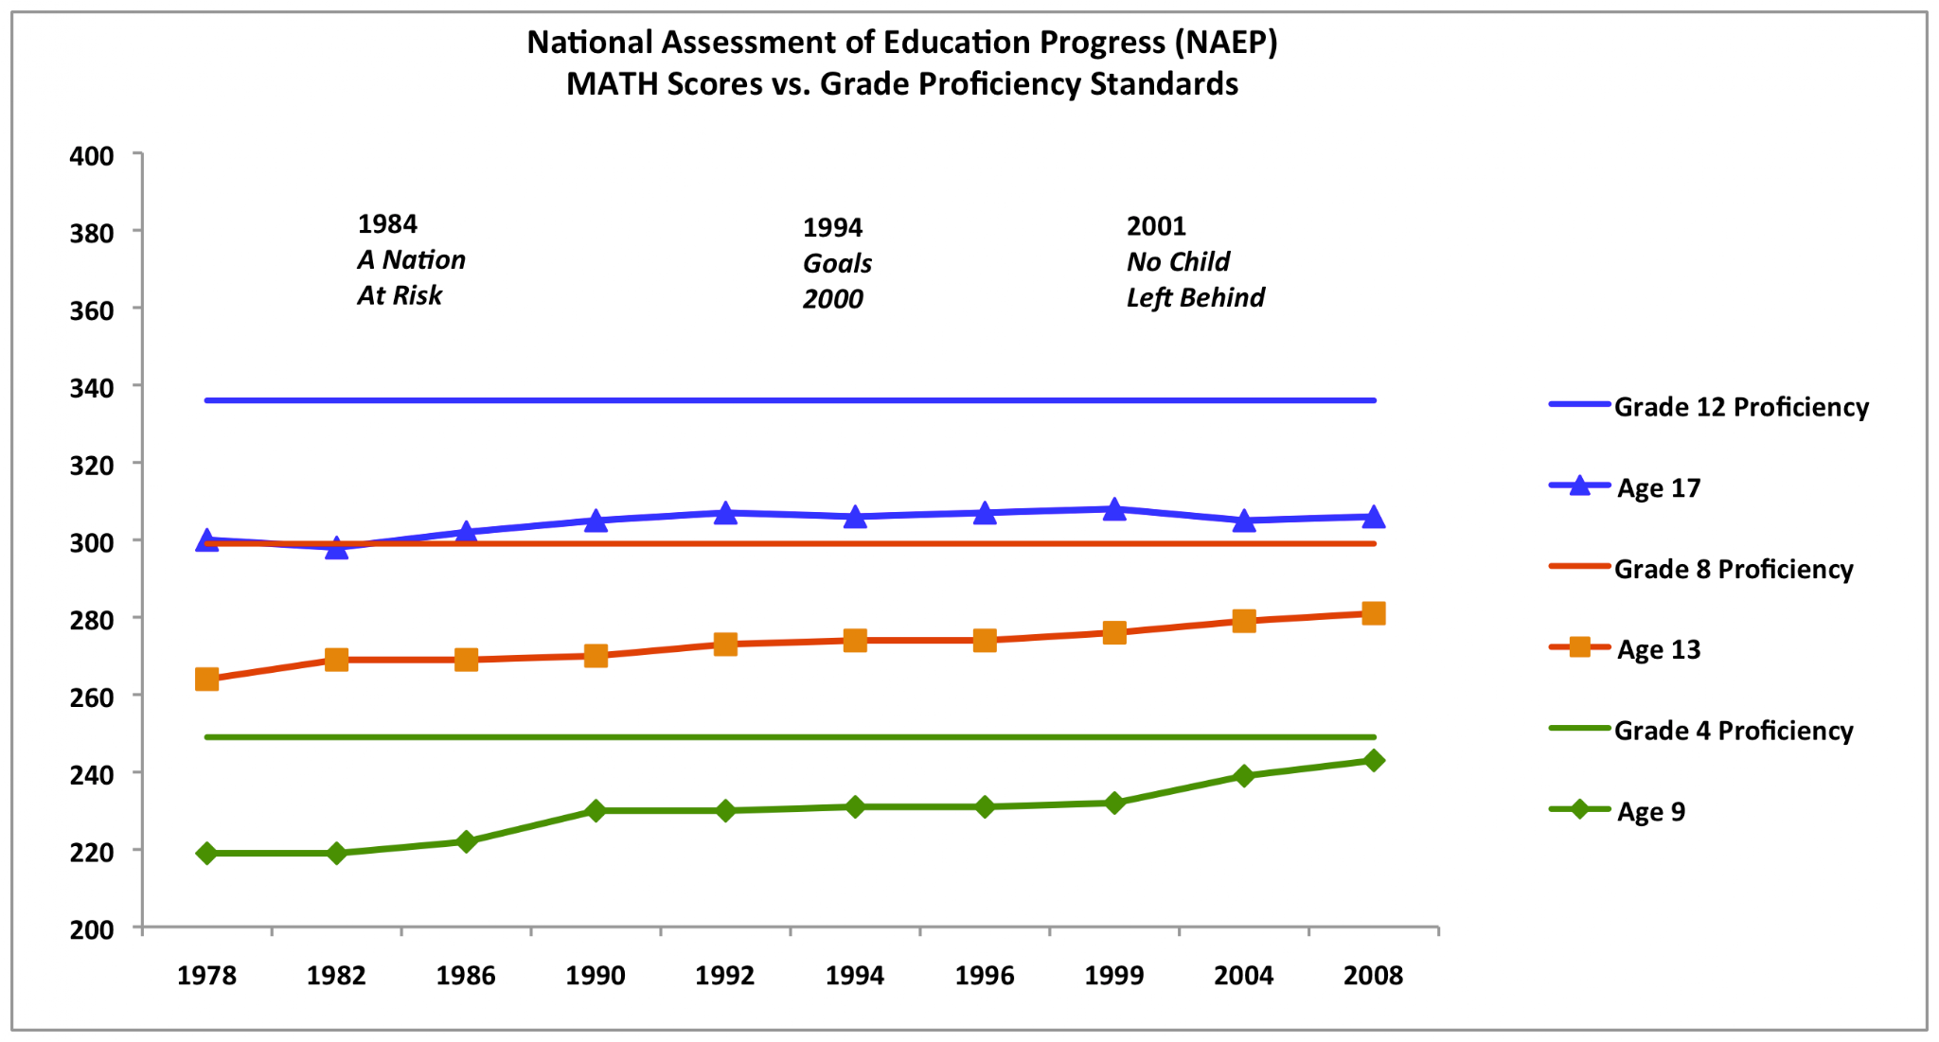
School Improvement is Failing

Slide 8
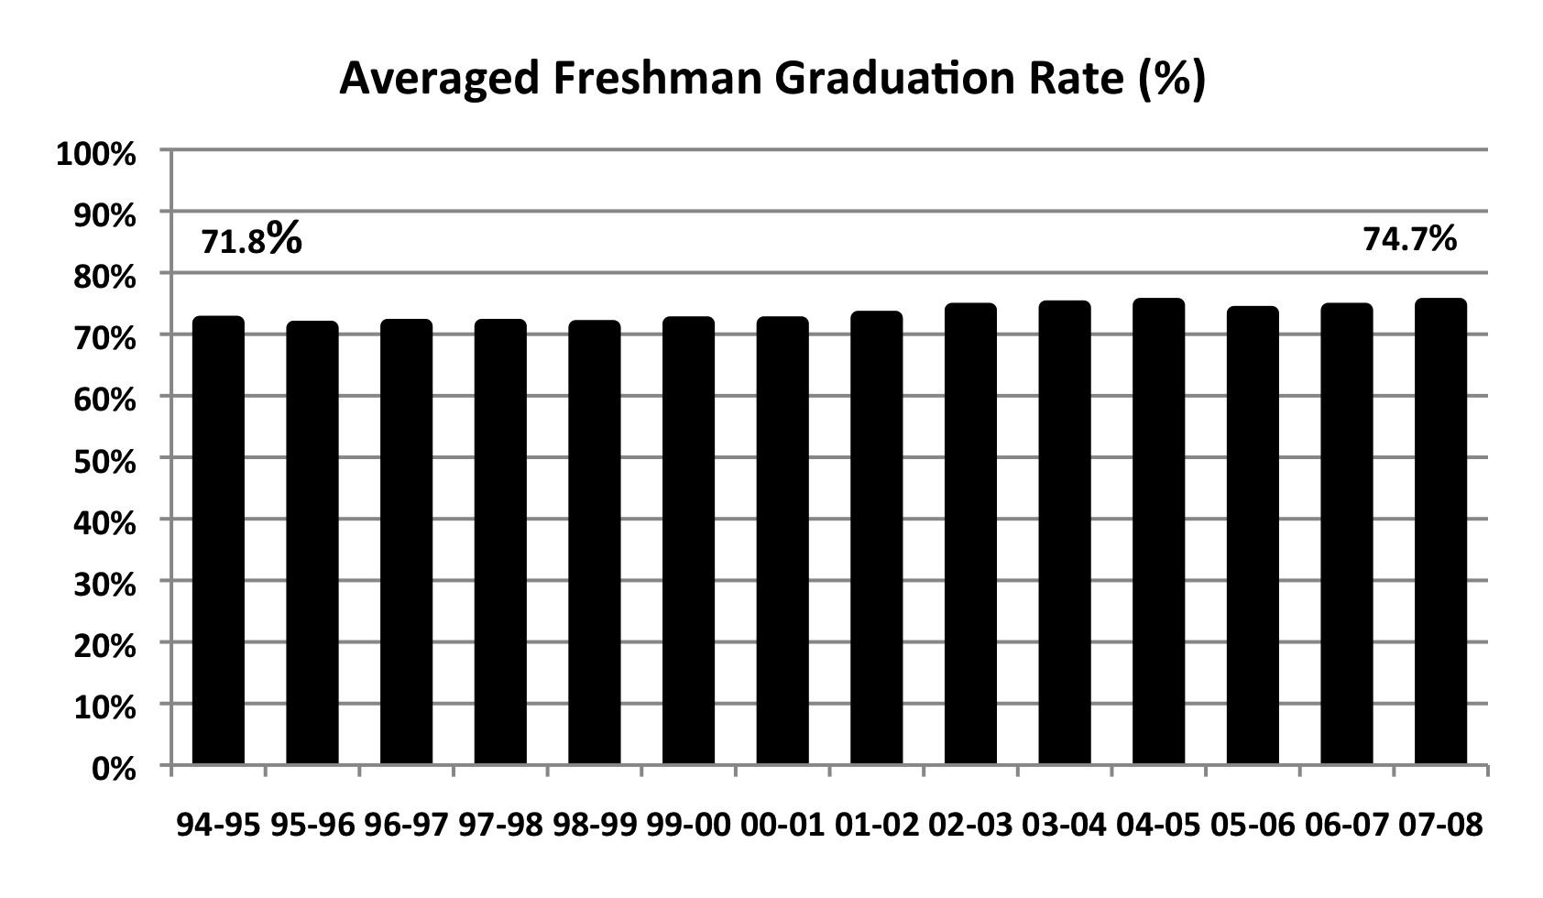
School Improvement is Failing

Slide 9
School Reform Track Record
average life of an education innovation is 18-48 months (Latham, 1988)
initial data on comprehensive school reform models initiated in 2000:
1 in 5 maintained reforms through 2002
1 in 10 maintained reforms through 2004
(American Institute for Research)

Slide 10
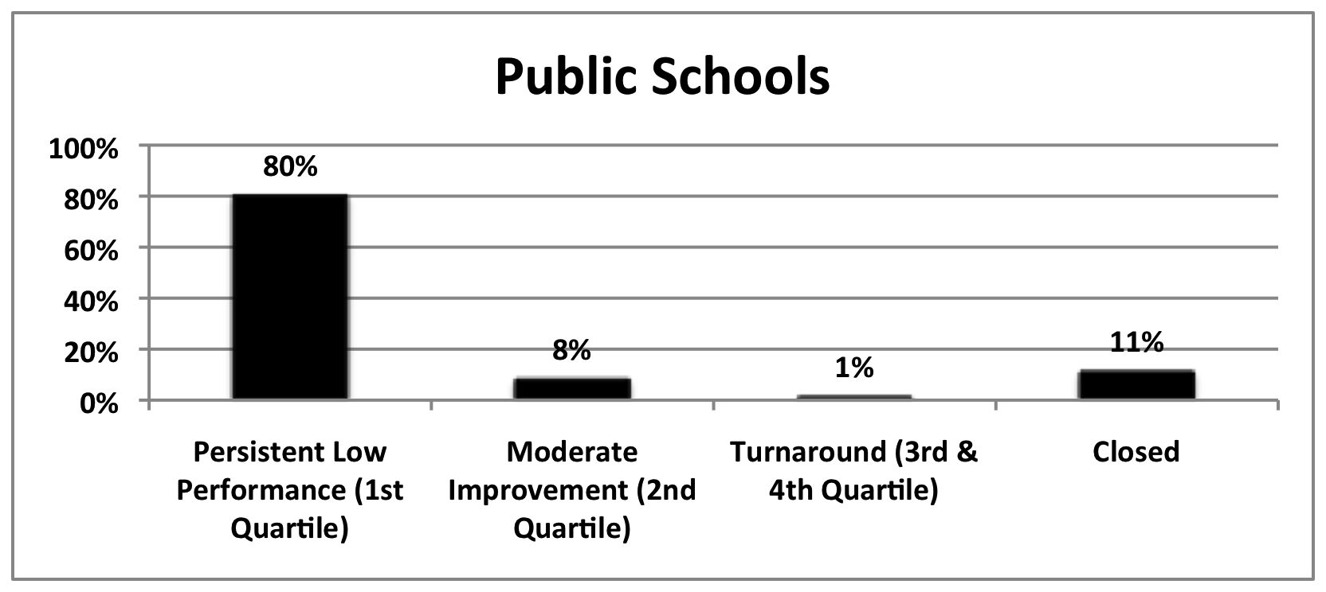
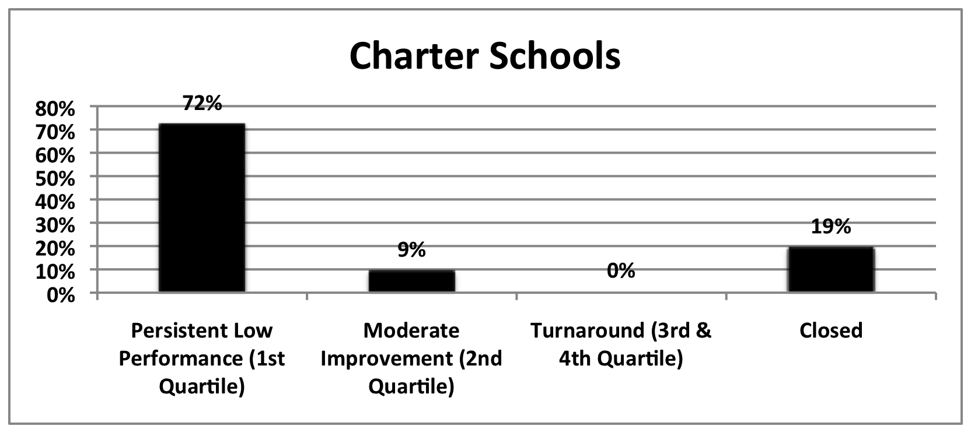
Status of 2003-04 Low Performing Schools in 2008-09
Tracked progress of 2,025 low-performing charter & district schools across 10 states
Thomas B. Fordham Institute, Are Bad Schools Immortal (2010)

Slide 11
Goals of a School Improvement
• implements services with procedural fidelity and desired outcomes (effectiveness) at the consumer level
maintains over time
maintains over generations of practitioners and decision-makers
operates within existing resources (financial, staff, materials) and existing mandates
becomes institutionalized, routine…
“the way we do business”
National Implementation Research Network (NIRN)

Slide 12
Keys to Sustainable School Improvement
Sustainable implementation requires a culture change across all levels of an organization:
changes in adult professional behavior (all stakeholders)
changes in organizational structures and cultures, both formal and informal (systems, policies, contingencies, values, procedures)
changes in relationships to consumers, stakeholders, and systems partners
National Implementation Research Network (NIRN)

Slide 13
School Turnaround Research: the Importance of Performance Feedback
Successful “turnaround” organizations:
identify a set of starting leading indicators based on known success factors in the industry
zealously monitor those indicators for signs of impending success or failure
act on what the indicators reveal
efficacy frequency action
Kowal & Ableidinger (2011)
Notes:
Education, for-profit, nonprofit, governmental

Slide 14


Slide 15
School Improvement Grant
School Improvement Models
$ 3.5 Billion $ 2 million per school 1,228 schools
Turnaround model: replace the principal and no less than 50% of the staff; and introduce significant instructional reforms, increase learning time, and provide flexibility and support
Restart model: reopen the school under management of a charter school operator, charter management organization, or an education management organization
School closure: close the school and reassign students to higher achieving schools
Transformational model: replace the principal, introduce significant instructional reforms, increase learning time, and provide flexibility and support
Hurlburt, et.al. 2011, Institute of Education Sciences

Slide 16
Review of multiple years of teacher evaluations from:
Large districts: Chicago, Denver, Cincinnati, Akron, Toledo
Smaller Districts: Jonesboro, Pueblo City, Springdale, Rockford
Out of 52,337 teacher evaluations,
only 233 were unsatisfactory or improvement needed,
99.6% of all teachers evaluated were satisfactory or above.
In the districts that gave “above satisfactory” ratings,
92.6% were rated as very good, distinguished, superior,
excellent, or outstanding.
Failure of Teacher Performance Feedback System
New Teacher Project: The Widget Effect (2009)

Slide 17
Failure of Teacher Performance Feedback System
Irrespective of school performance…
in Denver schools that did not make adequate yearly
progress (AYP), more than 98 percent of tenured
teachers received the highest rating—satisfactory.
in Chicago 87 Schools met criteria for being identified
as “failing schools”, 79% of these schools did not
issue a single “unsatisfactory rating”
New Teacher Project: The Widget Effect (2009)

Slide 18
Teacher Evaluation Effect on School Culture
School districts fail to acknowledge or act on differences in teacher performance almost entirely.
Failure to recognize excellence among top performers
Failure to identify and provide support to the broad plurality of hard working teachers who operate in the middle of the performance spectrum
Failure to identify and dismiss consistently poor performers
New Teacher Project: The Widget Effect (2009)

Slide 19
Impact on School Culture
staff resistance to a performance feedback culture:
strong expectation that they will receive outstanding evaluations
long standing mistrust of the purpose of data
educator autonomy, implicit power relationships
cynicism about fads, new ideas, education reform
resistance to performance feedback
data collection is too difficult
data collection causes too much change
desired outcomes take too long to materialize
perceived costs exceed perceived benefits

Slide 20

Kōan
A Kōan consists of a story, dialogue, question, or statement, the meaning of which cannot be understood by rational thinking but may be accessible through intuition.

Slide 21
Kōan of the Day
To implement and sustain a performance feedback culture….
you need a performance feedback culture.
Notes:
Not only outcome, but process to get to the outcome.

Slide 22

Will it make the boat go faster?
Will it help students learn?

Slide 23
Using Performance Feedback to Overcome Baseline Cultural Obstacles:
Calibration, Process, Engagement and Recognition
a “learner centered” culture (calibration)
focus on student learning and educational practices
establishing consensus on standards, definitions, goals
shifts away from ideologies, philosophies, fads
a culture of “inquiry” rather than “compliance” (process)
use of data to answer questions, problem solve
use of data-based decision making at all levels of the organization
not having all of the answers

Slide 24
Using Performance Feedback to Overcome Baseline Cultural Obstacles:
Calibration, Process, Engagement and Recognition
a culture of “universal participation” (engagement)
wide-spread involvement (ownership, pride, participation)
collaboration across disciplines
giving, receiving, and using feedback
data analysis as positive, non-threatening experience
a culture of “meritocracy” (recognition)
reinforcement for excellent teachers
support for middle range performing teachers
dismissal of consistently poor performing teachers
performance feedback for all staff

Slide 25
Overcoming Baseline Cultural Obstacles: Alignment
Alignment of all organizational cultural components so that contingencies consistently support data-based performance feedback and decision making
policies
practices
values
resource allocations
data systems
feedback systems
reporting requirements
program evaluation
recruitment & hiring
initiatives
job expectations
compensation
staff training
staff coaching
staff feedback

Slide 26
Using “cultural alignment” to increase performance feedback
Goals:
Definitions:
Outcomes:
Increase the number of staff using effective performance feedback
staff share common values about data, accountability, feedback and problem solving
staff have technical skills in instruction, data analysis, problem solving
staff positions filled by qualified staff
staff retention
performance feedback systems implemented

Slide 27
Using “cultural alignment” to increase performance feedback
Process Measures
Outcome Measures
Strategies
staff training
X
X
X
staff feedback
X
X
X
hiring
X
X
X
job expectations
X
X
X
recruitment
X
X
X
selection
X
X
X
policies
X
X
X
practices
X
X
X
resource allocations
X
X
X
staff evaluation
X
X
X
compensation
X
X
X
initiatives
X
X
X

Slide 28
Five-Step Implementation Process
1. Pinpoint
2. Measure
3. Feedback
4. Reinforce
5. Evaluate

Slide 29
1. Pinpoint
Technical skills: specialized skills required to be successful in a
specific position
teaching skills organization formative assessment
data collection reinforcement direct instruction
behavior analysis reading data writing reports
Core skills: foundation skills required to be successful in the organizational culture
assertiveness outcome oriented optimism
effective communication takes initiative motivation / buy-in
conflict resolution established priorities data driven
feedback (give & receive) leadership scientific
flexibility high tolerance for ambiguity nice

Slide 30
Keeper of the Organizational Culture:
HUMAN RESOURCES
job descriptions orientation
recruitment employee contracts
hiring orientation
offer sheets
employee contracts
1. Pinpoint

Slide 31
2. Measure
Teachers
Supervisors
treatment
fidelity
procedural
fidelity
Process
teacher
performance
Outcomes
student
direct observation, behavior products, checklists, etc.

Slide 32
Keeper of the Organizational Culture:
HUMAN RESOURCES
“incidental” feedback
“formative” feedback
“formal” evaluations
3. Feedback

Slide 33
Keeper of the Organizational Culture:
HUMAN RESOURCES
compensation
recognition
bonuses
promotions
n
4. Reinforce

Slide 34
Keeper of the Organizational Culture:
HUMAN RESOURCES
student measures
staff measures
system measures
n
5. Evaluate

Slide 35
Evolution is chaos with feedback.
John Ford, In Clifford A. Pickover, Computers, Pattern, Chaos, and Beauty (), 203.

