Slide 1
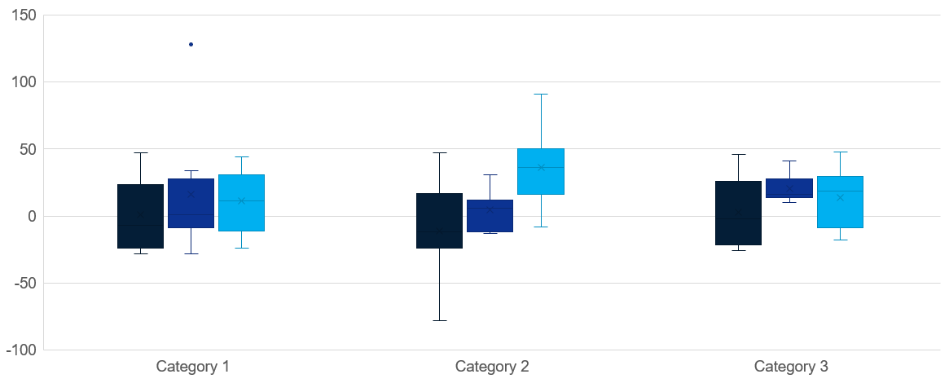
Box / Whisker
Click to edit Header text styles
Source: Complete if required

