Slide 1
DIVISION
Free Template
Here is where your presentation begins

Slide 2
BREAK OUT FREE TEMPLATE

Slide 3
Table of Contents
01
03
Here you could describe the topic of the section
Here you could describe the topic of the section
02
04
Here you could describe the topic of the section
Here you could describe the topic of the section
Overview
Assignment
Features
About the Topic

Slide 4

A Picture is Worth a Thousand Words

Slide 5
01
Overview
You could enter a subtitle here if you need it

Slide 6
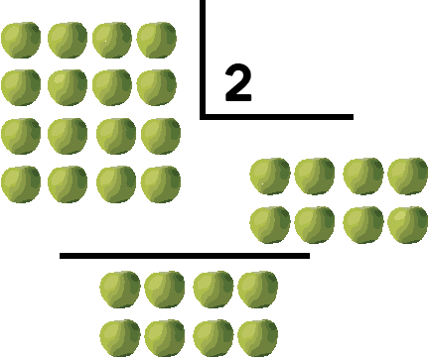
What Is This Topic About?
If you want to talk about Mercury, you could say that it’s the closest planet to the Sun and the smallest one in the Solar System
If you want to talk about Mercury, you could say that it’s the closest planet to the Sun and the smallest one in the Solar System

Slide 7
Introduction
Venus has a beautiful name and is the second planet from the Sun. It’s terribly hot. It’s the second-brightest natural object in the night sky after the Moon

Slide 8
— SOMEONE FAMOUS
“This is a quote. Words full of wisdom that someone important said and can make the reader get inspired.”

Slide 9
What Is This Topic About?
If you want to talk about Mercury, you could say that it’s the closest planet to the Sun and the smallest one in the Solar System

Slide 10
Definition of Concepts
Mars
Venus
Mercury
Despite being red, Mars is a cold place
Venus is the second planet from the Sun
Is the smallest one in the Solar System

Slide 11
Table

Slide 12
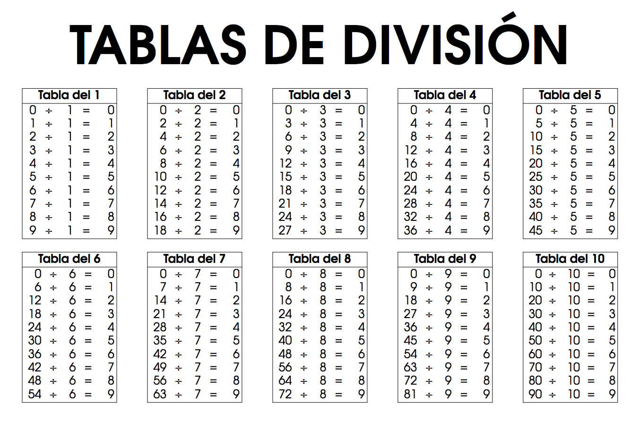
DIVISION TABLE 1-5

Slide 13
DIVISION TABLE 6-10

Slide 14
Features of the Topic
Mercury
Venus
Mercury is the closest planet to the Sun
Venus is the second planet from the Sun
Jupiter
Mars
It’s a gas giant and the biggest planet
Despite being red, Mars is a cold place, not hot

Slide 15
9,200,000 km2
15 mm
67,700 people
is the area covered by the Sahara
is the average rainfall per year in the Atacama Desert
live in the Kharga Oasis

Slide 16
This Is a Graph
Venus
Mercury
Venus is the second planet from the Sun
Mercury is the closest planet
Mars
Jupiter
Despite being red, Mars is a cold place
It’s a gas giant and the biggest planet
To modify this graph, click on it, follow the link, change the data and paste the new graph here

Slide 17
Practical Uses of This Subject
Venus
Mars
Mercury
Venus is the second planet from the Sun
Despite being red, Mars is a cold place
Mercury is the closest planet to the Sun
Saturn
Jupiter
Neptune
It’s the ringed one and a gas giant
It’s a gas giant and the biggest planet
Is the farthest planet from the Sun

Slide 18
A Picture Always Reinforces the Concept
Images reveal large amounts of data, so remember: use an image instead of a long texts

Slide 19
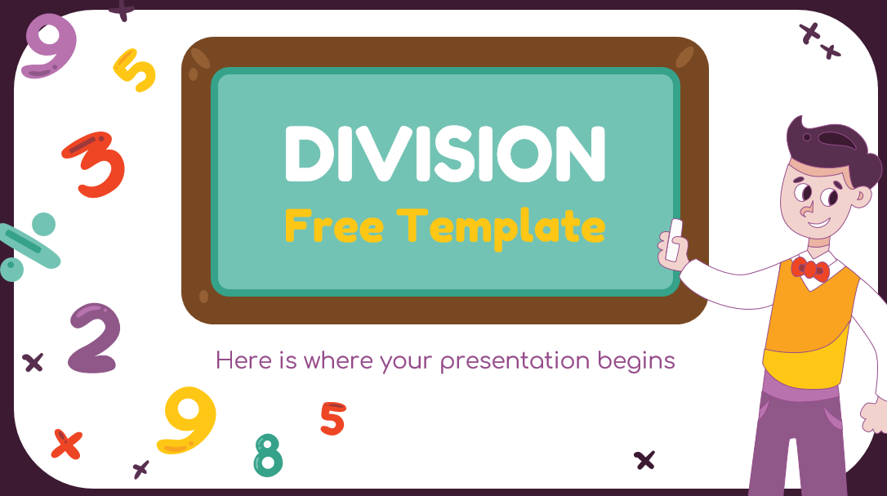
Multimedia
Despite being red, Mars is a cold place, not hot. It’s full of iron oxide dust, which gives the planet its reddish cast
Insert your multimedia content here

Slide 20
Did You Know This?
Venus
Venus is the second planet from the Sun
Saturn
It’s the ringed one and a gas giant
Jupiter
It’s a gas giant and the biggest planet

Slide 21
Process Timeline
Venus is terribly hot
Earth harbors life
Day 5
Day 1
Neptune is far away
Day 3
Day 4
Day 6
Saturn has rings
Day 2
The Sun is a star
Jupiter is a gas giant

Slide 22
1,000.000
Big numbers catch your audience’s attention

Slide 23
Problem VS. Solution
Problem
Solution
Venus has a beautiful name and is the second planet from the Sun
Despite being red, Mars is a cold place. It’s full of iron oxide dust

Slide 24
Overview Diagram
Jupiter
Mercury
Saturn
Jupiter is a gas giant
Saturn has rings
The Sun is a star

Slide 25

This Is a Graph
Venus
Mercury
Venus is the second planet from the Sun
25 %
20 %
Mercury is the closest planet
Mars
Jupiter
25 %
30 %
Despite being red, Mars is a cold place
It’s a gas giant and the biggest planet
To modify this graph, click on it, follow the link, change the data and paste the new graph here

Slide 26
You Could Use a Map
10,000
Despite being red, Mars is a cold place
25,000
Venus is the second planet from the Sun
Mars
Venus

Slide 27
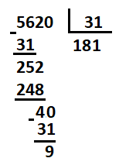
Exercise 1
Venus | 4+1= | 3-2=
Mars | 6+8= | 5-3=
Jupiter | 10+5= | 10-4=
Saturn | 14+3= | 13-5=

Slide 28
Exercise 2
You Could Write the Name of These Figures
____________________________
____________________________
____________________________

Slide 29
Assignments
Division
You could write you assignment here
You could write you assignment here
You could write you assignment here
You could write you assignment here
You could write you assignment here

Slide 30
This Is a Graph
Venus
Mercury
Venus is the second planet from the Sun
Mercury is the closest planet
Mars
Jupiter
Despite being red, Mars is a cold place
It’s a gas giant and the biggest planet
To modify this graph, click on it, follow the link, change the data and paste the new graph here

Slide 31
Thanks!
Venus has a beautiful name and is the second planet from the Sun
Please keep this slide You could write you assignment here for attribution

Slide 32
https://plantillaspowerpoint.org

Slide 33
Resources
PHOTO
Girl writing in class
Schoolgirl on math lesson
VECTOR
Cartoon kids math concept background 1
Cartoon kids math concept background 2
Cartoon kids math concept background 3
Cartoon kids math concept background

Slide 34
Editables VECTORES

Slide 35
Editables VECTORES

Slide 36
Alternative Resources

Slide 37
Editables VECTORES

Slide 38
Educational Icons
Medical Icons

