Slide 1

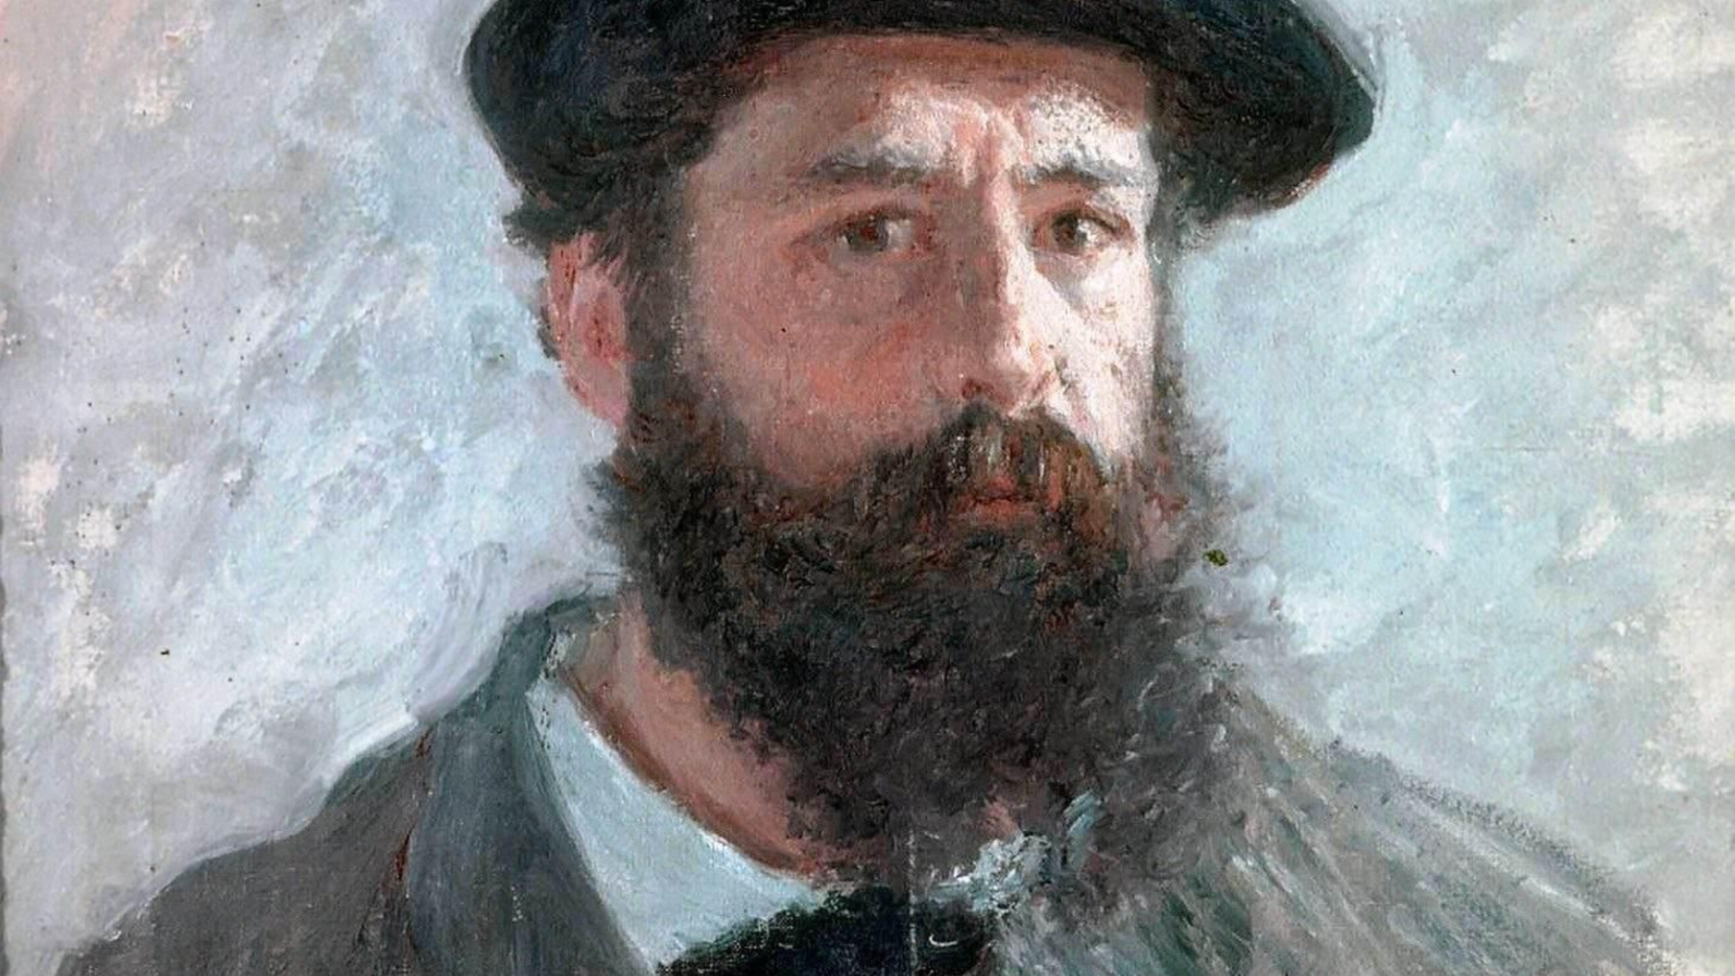

FREE PRESENTATION TEMPLATE BY EATEMP
Claude Monet

Slide 2


Welcome
Welcome to the world of fantasy! Join us on a journey to explore the mystical creatures, enchanted lands, and magical wonders that exist beyond our reality. Discover the wonders and secrets of this exciting realm and unlock the power of imagination.

Slide 3
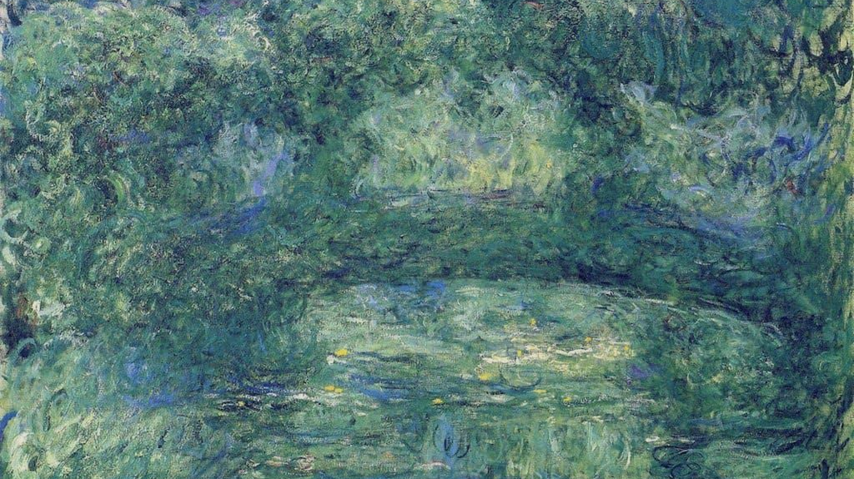
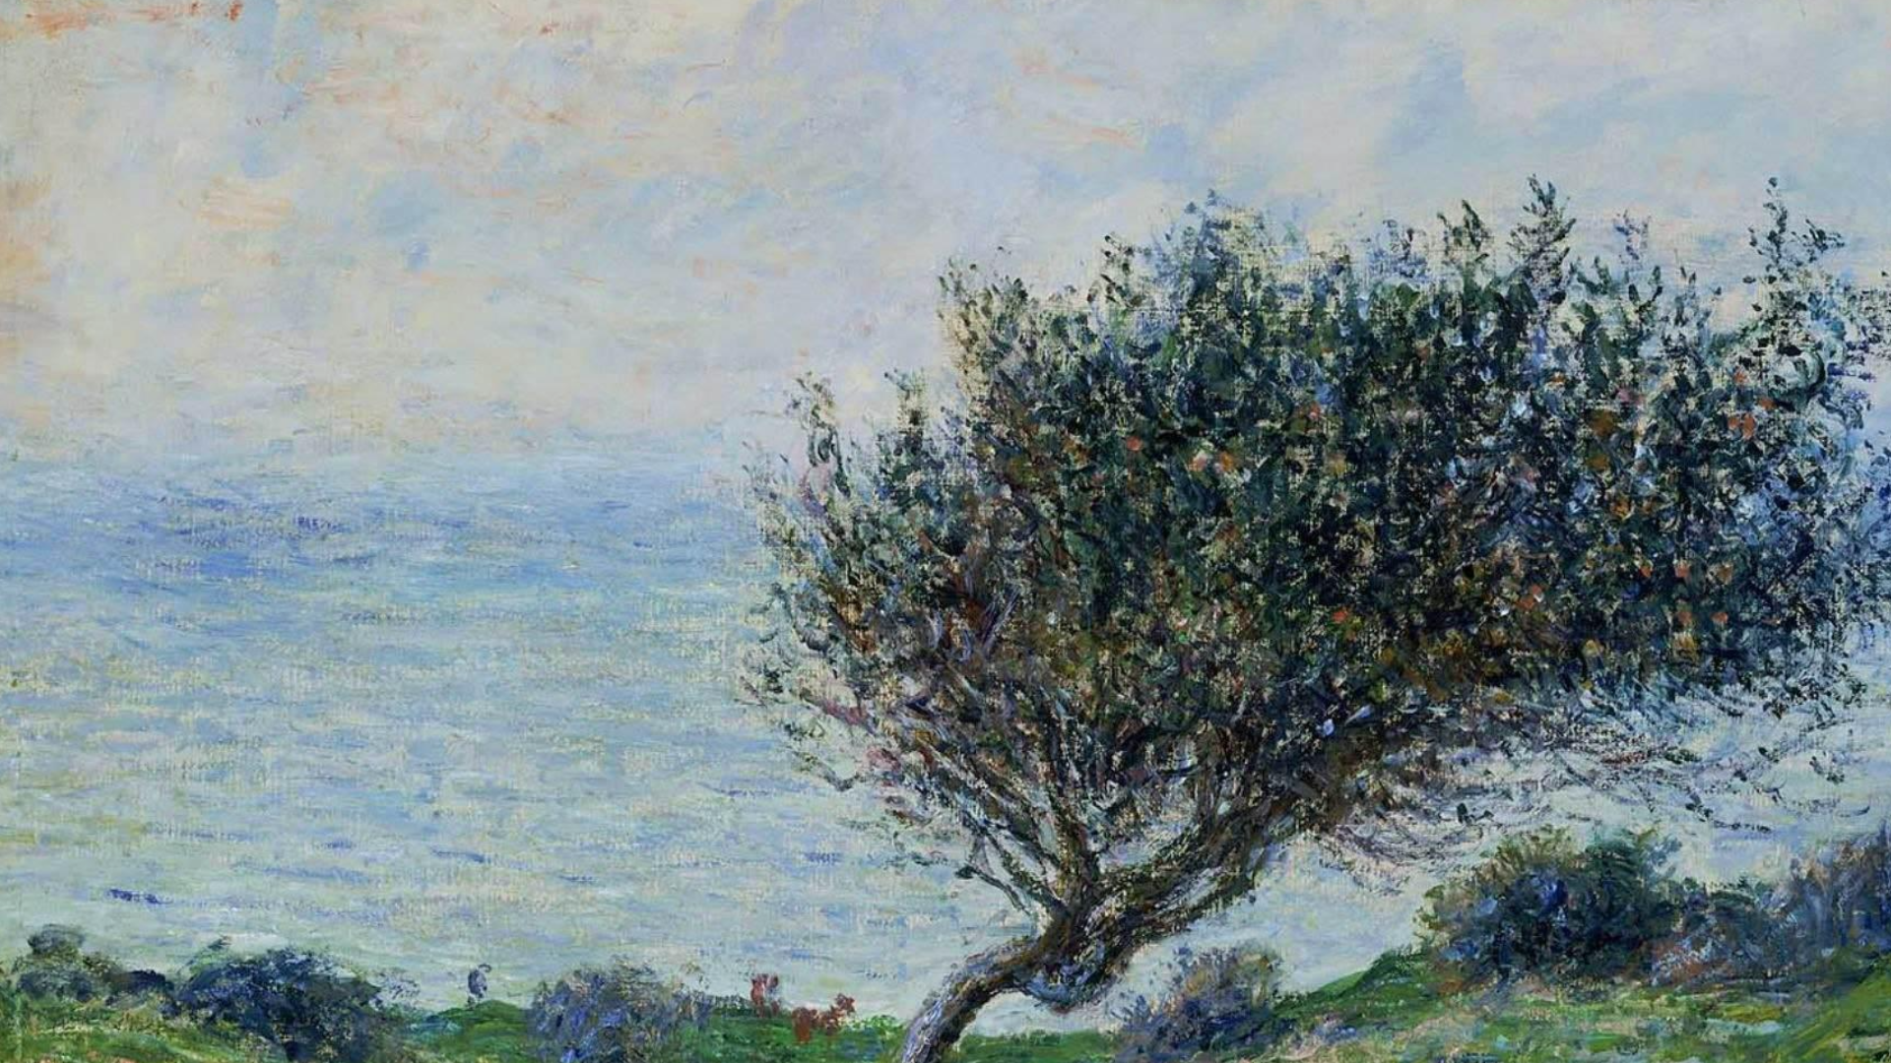
Table of Contents
01
Introduction
The Extraordinary Realm
02
Encounters
Unicorn Sightings
03
Wonders
Wishes Granted
04
Magic
Spellcasting

Slide 4
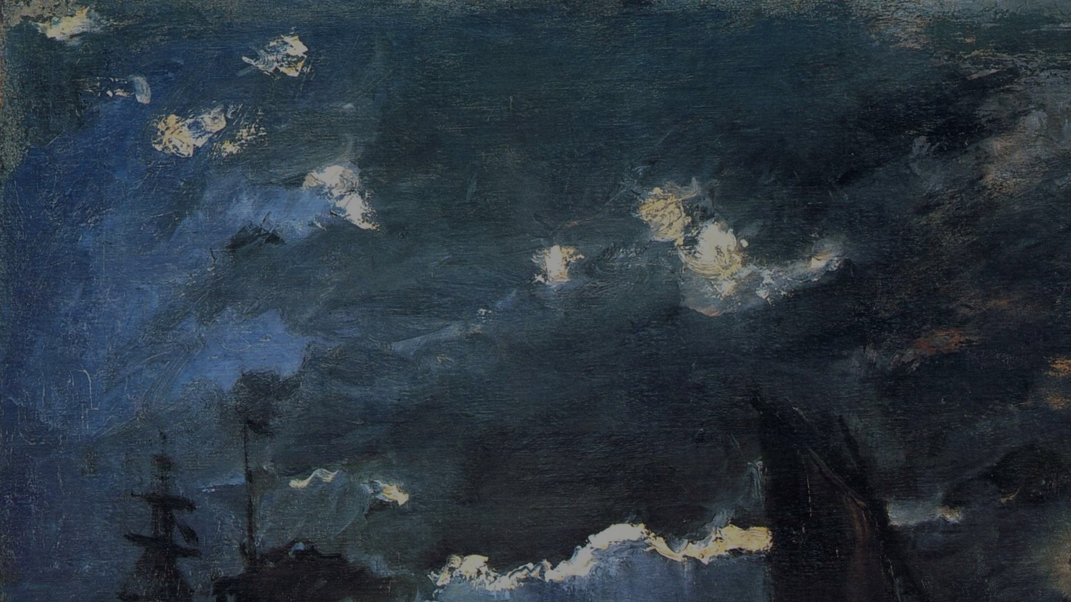
The Realm of the Extraordinary
Welcome to the Fantasy World, a realm of wonder and enchantment where anything is possible. Here, dragons breathe fire, unicorns prance through meadows, and rainbows shine brightly. This world is a place where wishes come true, where potions can be cursed and spells are cast. It's a place of treasure and adventure, where the impossible becomes possible. But the greatest treasure of all is the one that lies within.
The world of fantasy is a reflection of our deepest desires, our fondest dreams, and our wildest imaginations. It's a place where we can let go of the constraints of reality and explore the boundless possibilities of the human mind. In this introduction, we will delve into the mysteries of this realm, uncovering the magic and wonder that lies within. So come with us and let's embark on a journey through the Fantasy World.

Slide 5

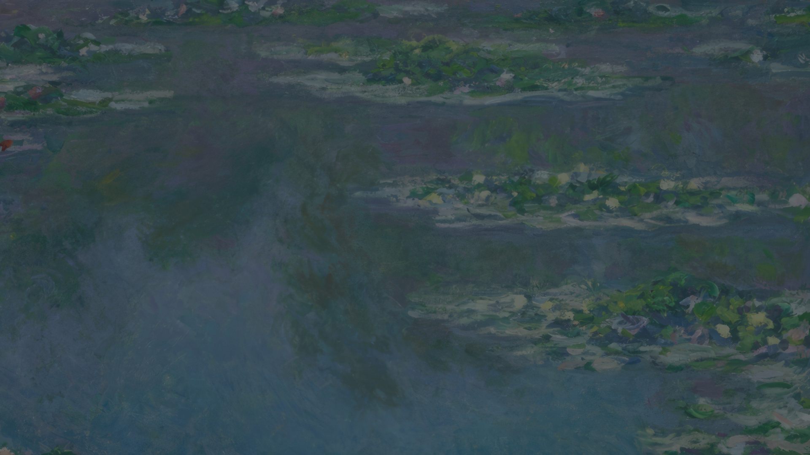
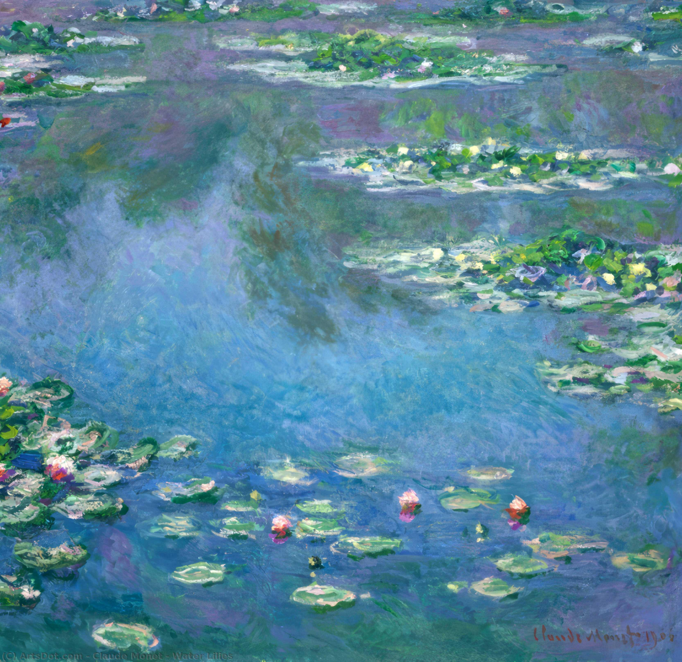
Unicorn Sightings
A record of the number of unicorns spotted in the fantasy realm and the beauty and mystery that surrounds these enchanting creatures.
Dragon Taming
A closer look at the art of taming dragons and the brave adventurers who dare to take on these fearsome creatures.

Slide 6
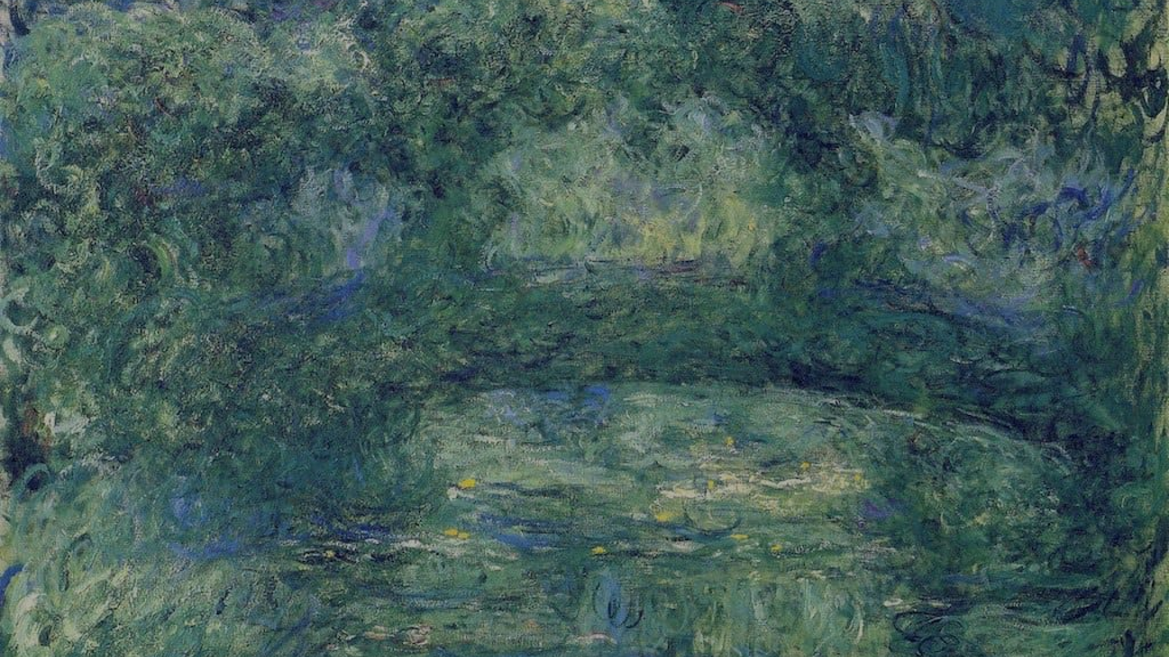
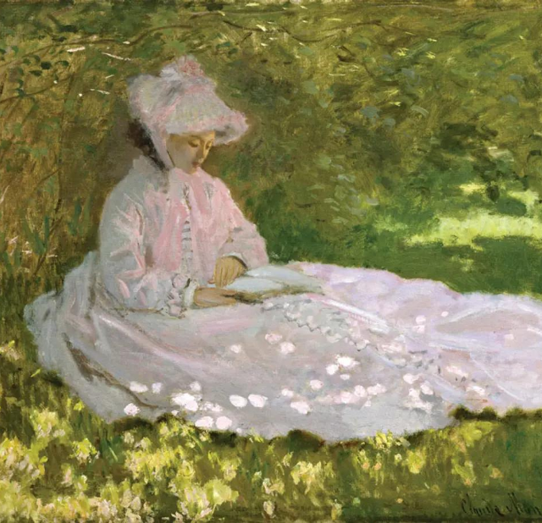
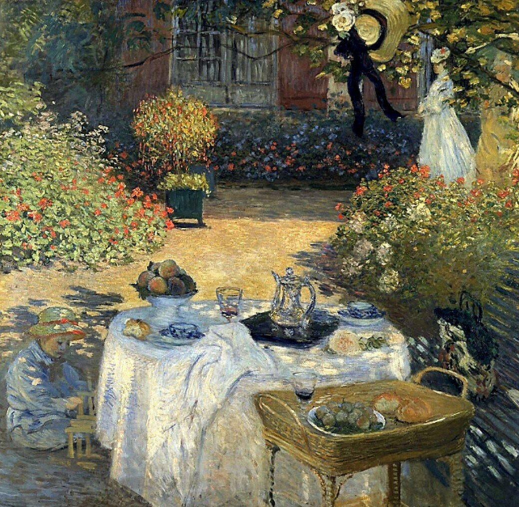
Unicorn Sightings
Dragon Taming
A record of the number of unicorns spotted in the fantasy realm and the beauty and mystery.
A closer look at the art of taming dragons and the adventurers who take on these creatures.

Slide 7

Fantasy is the gateway to the impossible, the land where the ordinary becomes extraordinary, and the impossible becomes possible. It is the realm of the imagination, where anything can happen and everything is possible.
The Dream Weaver

Slide 8
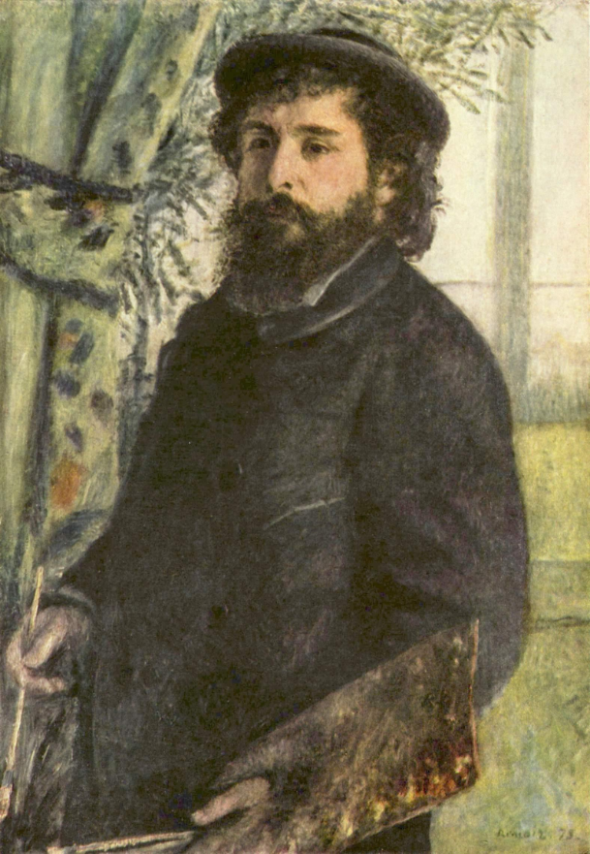
Dragon Taming Technique
A guide to taming and caring for dragons in the realm of magic.
The Art of Unicorn Sighting
Tips and tricks for spotting the elusive unicorns in their natural habitat.

Slide 9
Pricing Plan
Basic
Elite
Legendary
Access to the entry-level dungeons.
A limited number of quests and battles per month.
Ability to form a small party with fellow adventurers.
Access to the intermediate and advanced dungeons.
A greater number of quests and battles
Ability to form larger parties with fellow adventurers.
Access to the most challenging dungeons.
Unlimited quests and battles per month.
The ability to form the largest parties.
$10/month
$50/month
$100/month

Slide 10

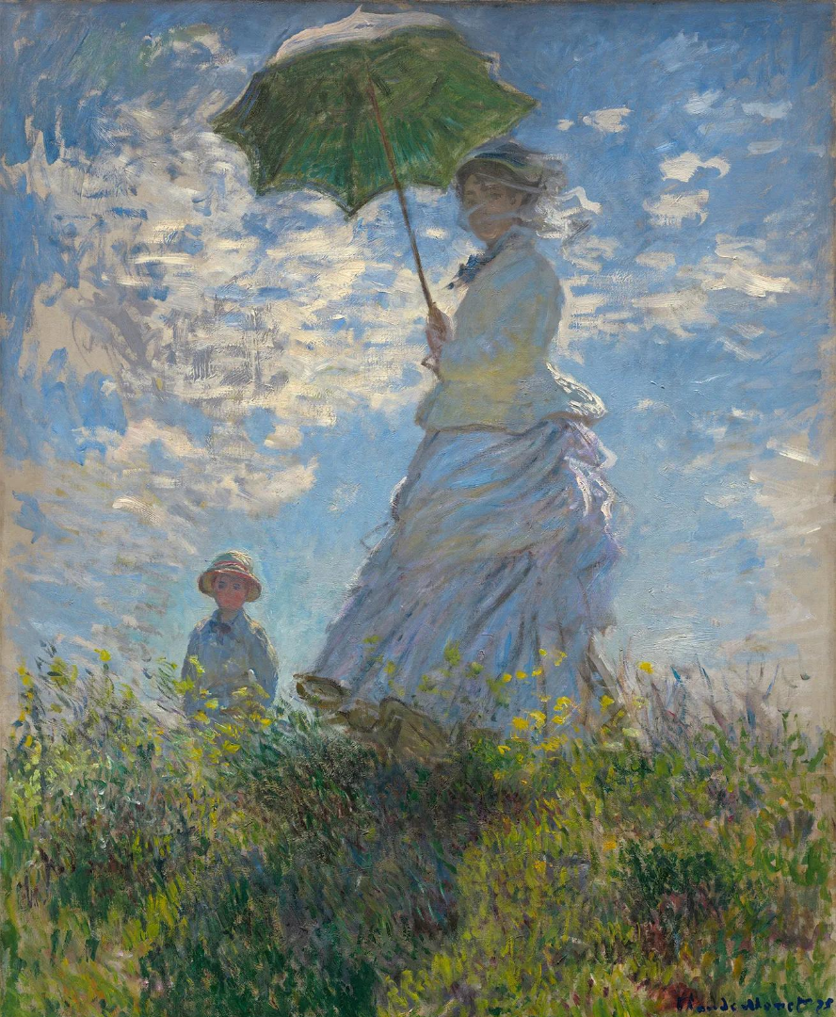
Some Data
75%
Enchanted Creatures
possess the ability to cast spells.
60%
Magic-Wielding Individuals
practice the art of illusions.
90%
Spells Cast
are dark magic, foretelling danger.

Slide 11
234,567
UNICORN SIGHTINGS
A tally of the number of unicorns spotted in the fantasy realm.

Slide 12
233 Coins
85%
Treasure Found
Wished Granted
456 Hours
765 Km
Duration of Spell Casting
Journey Distance

Slide 13



Portal to Adventure
A web application
A web application designed for discovering the world of fantasy

Slide 14
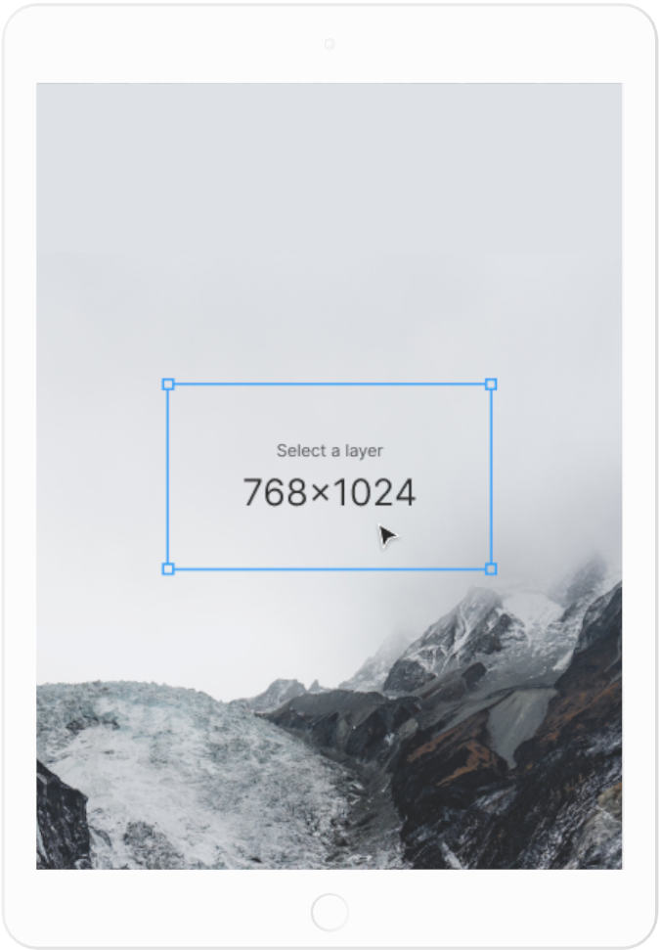
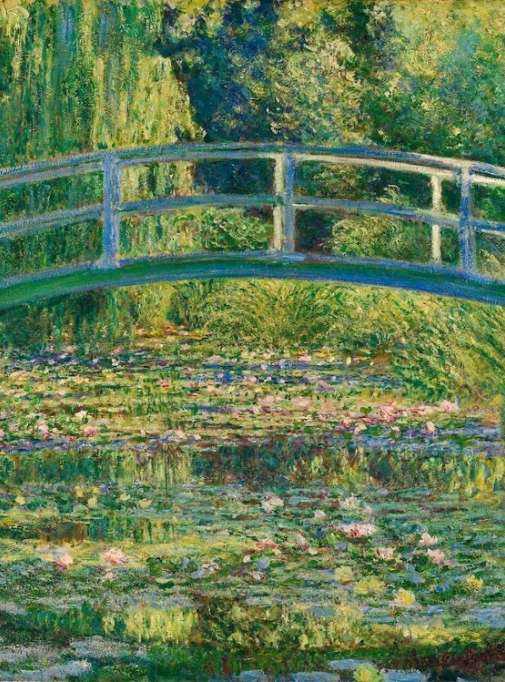
A Gateway to a World of Fantasy and Wonder
Immerse yourself in the world of magic and mystery
Explore uncharted territories and fantastical lands
Meet mythical creatures and legendary beings
Uncover hidden treasures and secret treasures
A web application
A web application designed for discovering the world of fantasy

Slide 15
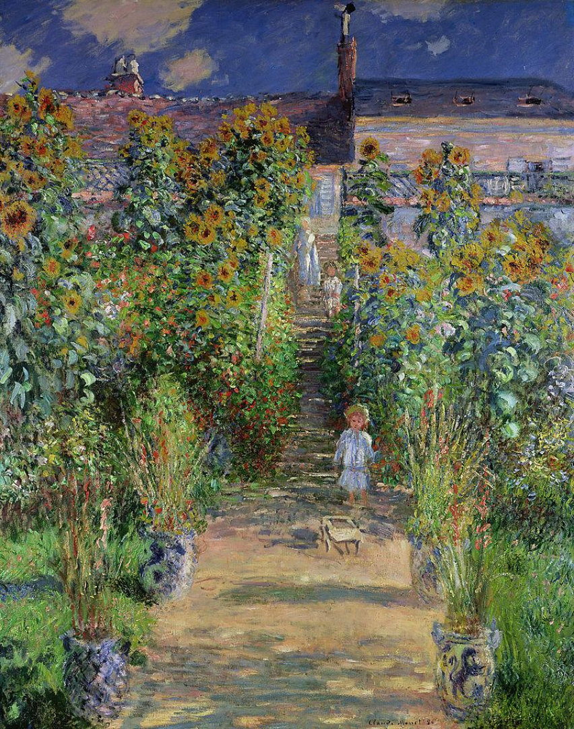
1
Discover the secrets
Explore the lush, vibrant forest and uncover the mysteries that lie within.
2
Find your own path
Choose your own path through the forest, and see where it takes you.
Meet the creatures
3
Encounter the mythical creatures that call the forest home, from talking animals to fairies.

Slide 16


The Forest
A magical forest filled with talking animals and creatures.
The Caves
A network of underground caves filled with gems.
The Lair
A dangerous place where dragons reside.
Fantasy Realm at a Glance

Slide 17


The Timeline
Dragon Taming
Unicorn Migration
First dragon was successfully tamed
Large herd of unicorns migrated to the realm
2022
2023
2024
2025
Enchanted Pool
Rainbow Sightings
A magical pool with power to grant wishes
Unusually large number of rainbows were sighted

Slide 18



The Information
Spellcasting Competition
Treasure
Hunt
Great
Adventure
A significant event in the history of the fantasy realm, in which the greatest spellcasters of the realm.
A significant event in the history of the fantasy realm, in which a massive and awesome treasure hunt was organized.
A notable year in the history of the fantasy realm, in which a large number of adventurers set out to explore.

Slide 19



Our Team
Eldruin
Elementalen
Lunaria
The Fire Mage
The Guardian
The Moon Priestess

Slide 20
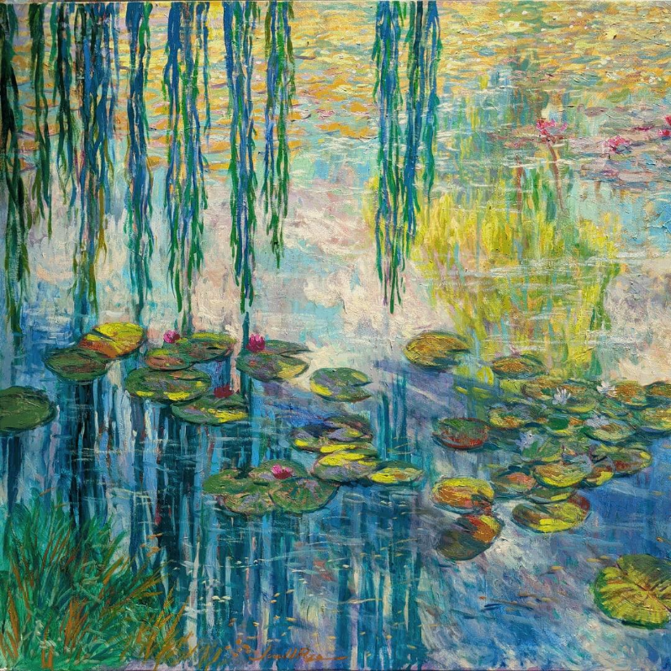
The Mystery
The Forbidden Forest: A place of mystery and wonder, where mystical creatures roam and flora flourishes.
The Crystal Caves: A network of glittering caves filled with precious gems and minerals, guarded by fierce beasts.
The Enchanted Garden: A place of pure beauty and tranquility, where the colors of the flowers are vibrant.

Slide 21

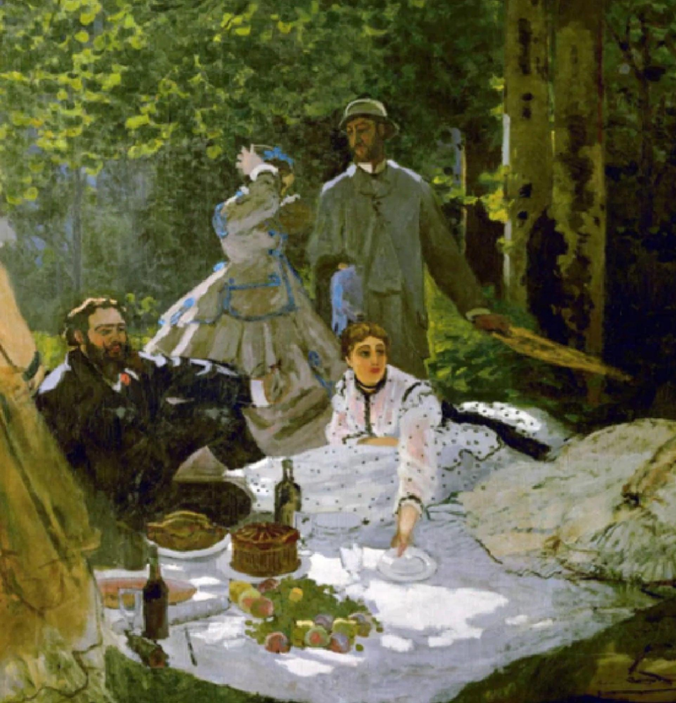
Thank you for choosing EaTemp
• Yes, you can use this for both personal and commercial projects.
• No, you don't have to credit us.
• No, you can't resell or redistribute it, including uploading this template online.
• And you can support us by sharing our site, EaTemp.com, with others.
Credit | Image: Unsplash

