Slide 1



Read words with s a t p i
Match the words, draw a line to connect the same words in each row.
Practise reading the word as you match them.
sat
at
pit
tip
pip
sat
at
tip
pit
pip
pip
tip
sat
at
pit
© State of New South Wales (Department of Education), 2023. Except for the Department of Education logo, other logos and trademark-protected material, this resource is licensed under the Creative Commons Attribution 4.0 International Licence

Slide 2

Read words with s a t p i
Say the three sounds in each word. Blend them together and read the word out loud.
Draw a picture that matches the word.
s
i
t
t
i
n
t
a
p
p
a
t
© State of New South Wales (Department of Education), 2023. Except for the Department of Education logo, other logos and trademark-protected material, this resource is licensed under the Creative Commons Attribution 4.0 International Licence

Slide 3





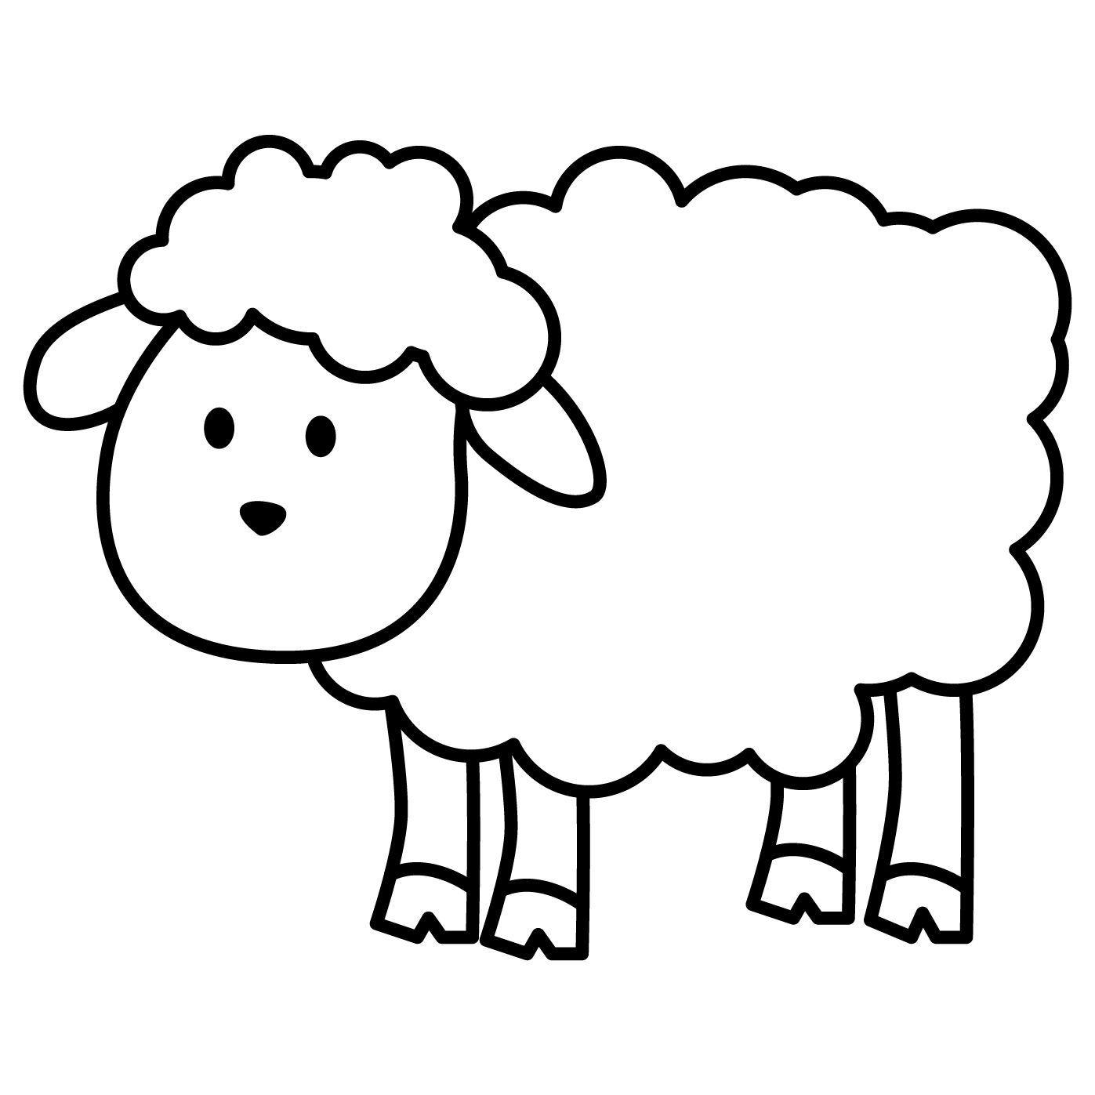



Read words with s a t p i
Say the three sounds in each word. Blend them together and read the word out loud.
Colour the picture that matches the word.
s | a | t
t | a | p
tin
© State of New South Wales (Department of Education), 2023. Except for the Department of Education logo, other logos and trademark-protected material, this resource is licensed under the Creative Commons Attribution 4.0 International Licence

