Slide 1


Mystery Science Alignment with Ohio Science Standards
Mystery Science is a hands-on curriculum that aligns with Ohio’s Learning Standards for Science (2018).
Mystery Science’s units of study contain:
Hands-on, easy-prep activities with EVERY lesson
Engaging, real-world investigative phenomena
Thoughtful discussions to build background knowledge
Lesson & unit assessments to evaluate comprehension
Curated, cross-curricular extensions
Mystery Science also offers the Anchor Layer, which enriches the unit with an anchor phenomenon, incorporates anchor connections after each lesson, & concludes the unit with a performance task.
Updated 06/14/2025

Slide 2
Ohio Standards Alignment
Table of Contents
Kindergarten
Life Science Animal Needs Plant Needs Earth & Space Science Severe Weather Weather Patterns Day Patterns Night Patterns Physical Science Light, Sound, & Communication | Page 3 Page 5 Page 9
1st Grade
Life Science Animal Traits & Survival Plant Traits & Survival Earth & Space Science Sunlight & Warmth States of Matter Physical Science Pushes & Pulls | Page 10 Page 12 Page 14
2nd Grade
Life Science Animal Biodiversity & Habitats Plant Growth & Interactions Earth & Space Science Weather & Climate Physical Science Forces, Motion, & Magnets | Page 15 Page 17 Page 18
3rd Grade
Life Science Life Cycles Heredity, Survival, & Selection Human Body, Vision, & The Brain Animal & Plant Adaptations Earth & Space Science Electricity, Light, & Heat Physical Science Material Properties | Page 19 Page 23 Page 25
4th Grade
Life Science Fossils & Changing Environments Earth & Space Science Erosion & Earth’s Surface Earth’s Features & Processes Water Cycle & Earth’s Systems Physical Science Chemical Reactions & Properties of Matter Electricity, LIght, & Heat | Page 27 Page 28 Page 32
5th Grade
Life Science Ecosystems & The Food Web Earth & Space Science Earth & Space Patterns Stars & Planets Physical Science Energy, & Energy Transfer Human Body, Vision, & The Brain Sound, Waves, & Communication | Page 34 Page 36 Page 38
www.mysteryscience.com/docs/ohio

Slide 3

Ohio Standards Alignment
Kindergarten - Life Science
Animal Needs (Animal Secrets)
 | Topic & Guiding Question | Student Objectives | Ohio’s Learning Standards for Science (2018)
Lesson 1 | Animal Needs: Food Why do woodpeckers peck wood? | Students obtain information through virtual observations of different animal behaviors. They use this evidence to explain that one of the basic needs of animals is food. | K.LS.1 Living things have specific characteristics and traits. K.LS.2 Living things have physical traits and behaviors, which influence their survival.
Lesson 2 | Animal Needs: Shelter Read-Along Where do animals live? | Students obtain information through media about how different animal homes are built. They use this evidence to explain that animals need shelter. | K.LS.2 Living things have physical traits and behaviors, which influence their survival.
Lesson 3 | Animal Needs: Safety How can you find animals in the woods? | Students obtain information through virtual observations of different animal behaviors. They use this evidence to explain that one of the basic needs of animals is shelter. | K.LS.2 Living things have physical traits and behaviors, which influence their survival.
Lesson 4 | Animals & Changing the Environment Read-Along How do animals make their homes in the forest? | Students take a nature walk to look for evidence of animal homes. | K.LS.2 Living things have physical traits and behaviors, which influence their survival.
Lesson 1
Lesson 2
Lesson 3
Lesson 4
www.mysteryscience.com/docs/ohio

Slide 4
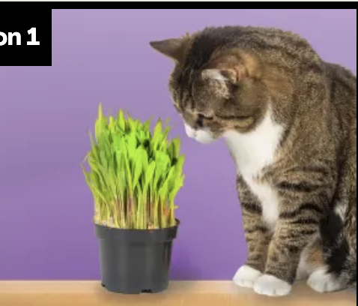
Ohio Standards Alignment
Kindergarten - Life Science
Plant Needs (Plant Secrets)
 | Topic & Guiding Question | Student Objectives | Ohio’s Learning Standards for Science (2018)
Lesson 5 | Living & Nonliving Are plants alive? | Students make observations of plants in order to identify their needs and that they are, in fact, living things. | K.LS.1 Living things have specific characteristics and traits.
Lesson 6 | Plant Needs: Water & Light How do plants and trees grow? | Students investigate to determine the basic needs of plants. They observe to identify ways young plants resemble the parent plant and how the plant changes as it proceeds through its life cycle. | K.LS.1 Living things have specific characteristics and traits. K.LS.2 Living things have physical traits and behaviors, which influence their survival.
Lesson 7 | Human Impacts on the Environment Read-Along Why would you want an old log in your backyard? | Students obtain evidence of living organisms by virtually keeping watch of a log and the living things that visit it. | K.LS.2 Living things have physical traits and behaviors, which influence their survival.
Lesson 1
Lesson 2
Lesson 3
www.mysteryscience.com/docs/ohio

Slide 5

Ohio Standards Alignment
Kindergarten - Earth & Space Science
Severe Weather (Wild Weather)
 | Topic & Guiding Question | Student Objectives | Ohio’s Learning Standards for Science (2018)
 | Severe Weather & Preparation Read-Along How can you get ready for a big storm? | Students obtain information of different types of severe weather to observe and describe how the weather changes during these events and what students can do to prepare and stay safe. | K.ESS.1 Weather changes are long-term and short term.
 | Wind & Storms Have you ever watched a storm? | Students create a simple tool that allows them to observe how hard the wind is blowing. They use this tool to observe weather changes and describe the pattern of faster wind speeds right before a storm. | K.ESS.1 Weather changes are long-term and short term.
 | Weather Conditions How many different kinds of weather are there? | Students obtain information through observations of the weather. They communicate the information by acting as weather watchers and creating drawings of the weather conditions. | K.ESS.1 Weather changes are long-term and short term.
Lesson 1
Lesson 2
Lesson 3
www.mysteryscience.com/docs/ohio

Slide 6

Ohio Standards Alignment
Kindergarten - Earth & Space Science
Weather Patterns (Circle of Seasons)
 | Topic & Guiding Question | Student Objectives | Ohio’s Learning Standards for Science (2018)
 | Daily Weather Patterns Read-Along How do you know what to wear for the weather? | Students track the weather daily and analyze the data by collecting, recording, and sharing their observations to observe patterns of weather changing throughout the day and from day-to-day. | K.ESS.1 Weather changes are long-term and short term.
 | Seasonal Weather Patterns What will the weather be like on your birthday? | Students evaluate information in a series of unnamed drawings of each season. They use these clues to identify characteristics of each season and describe the yearly cyclical pattern. | K.ESS.1 Weather changes are long-term and short term.
 | Animals Changing Their Environment Why do birds lay eggs in the spring? | Students identify the reasons why birds lay eggs in the spring. Then, they develop a bird nest model and use this model as evidence for how animals can change the environment to meet their needs. | K.ESS.1 Weather changes are long-term and short term. K.LS.2 Living things have physical traits and behaviors, which influence their survival.
Lesson 1
Lesson 2
Lesson 3
www.mysteryscience.com/docs/ohio

Slide 7

Ohio Standards Alignment
Kindergarten - Earth & Space Science
This unit is found under 1st grade on our site, but we recommend teaching all lessons in Kindergarten if you are following Ohio Standards.
Day Patterns (Sun & Shadows)
 | Topic & Guiding Question | Student Objectives | Ohio’s Learning Standards for Science (2018)
Lesson 1 | Sun, Shadows, & Daily Patterns Could a statue’s shadow move? | Students observe how shadows change as time passes, or as the Sun moves across the sky. They analyze how to move a light source to change the shape and direction of shadows, constructing an explanation of what causes a shadow to move. | K.ESS.2 The moon, sun, and stars can be observed at different times of the day or night.
Lesson 2 | Sun, Shadows, & Daily Patterns Read-Along What does your shadow do when you’re not looking? | Students conduct an investigation to gather information about how their shadow changes throughout the day. | K.ESS.2 The moon, sun, and stars can be observed at different times of the day or night.
Lesson 3 | Sun & Daily Patterns How can the Sun help you if you’re lost? | Students develop a Sun Finder, a model of the Sun’s movement across the sky. They use this model to reason about how the Sun can help guide them during the day. | K.ESS.2 The moon, sun, and stars can be observed at different times of the day or night.
Lesson 4 | Daylight & Seasonal Patterns Read-Along Why do you have to go to bed early in the summer? | Students obtain information about the seasonal patterns of sunrise and sunset. | K.ESS.2 The moon, sun, and stars can be observed at different times of the day or night.
Lesson 1
Lesson 2
Lesson 3
Lesson 4
www.mysteryscience.com/docs/ohio

Slide 8

Ohio Standards Alignment
Kindergarten - Earth & Space Science
This unit is found under 1st grade on our site, but we recommend teaching all lessons in Kindergarten if you are following Ohio Standards.
Night Patterns (Moon & Stars)
 | Topic & Guiding Question | Student Objectives | Ohio’s Learning Standards for Science (2018)
Lesson 1 | Moon Phases & Patterns When can you see the full moon? | Students record observations of the Moon’s shape using a series of photos collected over the course of four weeks. Using this information, students discover that the Moon follows a cyclical pattern, which they can use to predict when a full moon will appear. | K.ESS.2 The moon, sun, and stars can be observed at different times of the day or night.
Lesson 2 | Stars & Daily Patterns Why do stars come out at night? | Students develop and use a model of the Big Dipper in the night sky. After conducting a simple investigation, students construct an explanation for why stars are only visible in the night sky. | K.ESS.2 The moon, sun, and stars can be observed at different times of the day or night.
Lesson 3 | Stars & Seasonal Patterns Read-Along How can stars help you if you get lost? | Students observe that groups of stars in the sky form a pattern: constellations. Even though the Big Dipper changes its spot in the sky in different seasons, it always points to the North Star. | K.ESS.2 The moon, sun, and stars can be observed at different times of the day or night.
Lesson 1
Lesson 2
Lesson 3
www.mysteryscience.com/docs/ohio

Slide 9

Ohio Standards Alignment
Kindergarten - Physical Science
This unit is found under 1st grade on our site, but we recommend teaching all lessons in Kindergarten if you are following Ohio Standards.
Light, Sound, & Communication (Lights & Sounds)
 | Topic & Guiding Question | Student Objectives | Ohio’s Learning Standards for Science (2018)
 | Sounds & Vibrations How do they make silly sounds in cartoons? | Students explore how to make different sounds with everyday objects. They construct an explanation that objects vibrate when they make a sound, and if the vibration stops, the sound stops. | K.PS.2 Some objects and materials can be made to vibrate to produce sound.
 | Sounds & Vibrations Read-Along Where do sounds come from? | Students create three different sound makers and construct an explanation about where the vibrations are happening in each sound experiment. | K.PS.2 Some objects and materials can be made to vibrate to produce sound.
 | Light, Materials, Transparent & Opaque What if there were no windows? | Students investigate the properties of different materials that they can and cannot see through. Then they create a stained glass window using tissue paper to explore how materials interact with light. | K.PS.1 Objects and materials can be sorted and described by their properties.
 | Light & Illumination Read-Along Can you see in the dark? | Students look inside a completely dark box to determine if they can see the shape of the object inside. They allow more light into the box to illuminate the object and allow them to see it. Students use their observations explain that objects need light to be seen. | K.PS.1 Objects and materials can be sorted and described by their properties.
 | Light, Communication, & Engineering How could you send a secret message to someone far away? | Students are presented with the problem that they need to send a message at night, without using noise. They design a solution to create a color-coded message system and communicate with light signals. | K.PS.2 Some objects and materials can be made to vibrate to produce sound.
 | Lights, Sounds, & Communication Read-Along How do boats find their way in the fog? | Students obtain information about light and sound signals. They analyze different sounds with eyes closed to determine which type of sound they hear. | K.PS.2 Some objects and materials can be made to vibrate to produce sound.
Lesson 1
Lesson 2
Lesson 3
Lesson 4
Lesson 5
Lesson 6
www.mysteryscience.com/docs/ohio

Slide 10
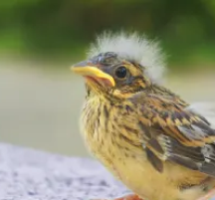


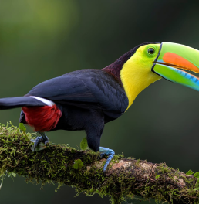
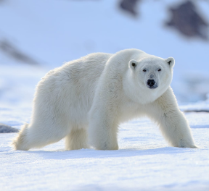
Ohio Standards Alignment
1st Grade - Life Science
✔ Animal Traits & Survival (Animal Superpowers)
 | Topic & Guiding Question | Student Objectives | Ohio’s Learning Standards for Science (2018)
 | Parent & Offspring Traits How can you help a lost baby animal find its parents? | Students observe the traits of adult and baby animals in order to construct an explanation that most young animals are like, but not exactly like, their parents. | 1.LS.2 Living things survive only in environments that meet their needs.
 | ✨New!✨ Offspring Trait Variation Can you predict what an animal’s babies will look like? | Students observe the traits of parent and baby animals to construct an explanation that offspring look similar to their parents, but can also vary in many ways. They predict what a puppy might look like based on the traits of the parent dogs. | 1.LS.2 Living things survive only in environments that meet their needs.
 | Animal Behavior & Offspring Survival Read-Along Why do baby ducks follow their mother? | Students obtain information about the behaviors of animal parents that help their offspring survive. | 1.LS.2 Living things survive only in environments that meet their needs.
 | Animal Structures & Survival Why do birds have beaks? | Students investigate how different bird beaks are well suited for eating different kinds of food. They explain which beak would help a particular bird survive in a particular environment. | 1.LS.1 Living things have basic needs, which are met by obtaining materials from the physical environment. 1.LS.2 Living things survive only in environments that meet their needs.
 | Camouflage & Animal Survival Why are polar bears white? | Students use observations of animal parents and their offspring to construct an explanation about young plants and animals being similar, but not identical, to their parents. | 1.LS.1 Living things have basic needs, which are met by obtaining materials from the physical environment. 1.LS.2 Living things survive only in environments that meet their needs.
Lesson 1
Lesson 2
Lesson 3
Lesson 4
Lesson 5
✨ New Lesson
✔ Unit Restructured for the 2025-2026 School Year
www.mysteryscience.com/docs/ohio

Slide 11

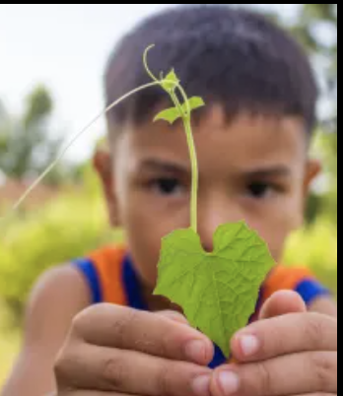
Ohio Standards Alignment
1st Grade - Life Science
Plant Traits & Survival (Plant Superpowers)
 | Topic & Guiding Question | Student Objectives | Ohio’s Learning Standards for Science (2018)
 | Plant Traits & Offspring What will a baby plant look like when it grows up? | Students observe seedlings and adult plants and use their observations to identify the pattern that young plants are similar to their parent plants. | 1.LS.2 Living things survive only in environments that meet their needs.
 | Plant Survival & Engineering Why don’t trees blow down in the wind? | Students learn how plants respond to light. They conduct an investigation to compare how the parts of a plant respond to light. | 1.LS.1 Living things have basic needs, which are met by obtaining materials from the physical environment. 1.LS.2 Living things survive only in environments that meet their needs.
 | Plant Movement & Survival Read-Along What do sunflowers do when you’re not looking? | Students learn how plants respond to light. They conduct an investigation to compare how the parts of a plant respond to light. | 1.LS.1 Living things have basic needs, which are met by obtaining materials from the physical environment.
Lesson 1
Lesson 2
Lesson 3
Lesson 1
Lesson 2
Lesson 3
www.mysteryscience.com/docs/ohio

Slide 12

Ohio Standards Alignment
1st Grade - Earth & Space Science
This unit is found under Kindergarten on our site, but we recommend teaching all lessons in 1st grade if you are following Ohio Standards.
Sunlight & Warmth (Sunny Skies)
 | Topic & Guiding Question | Student Objectives | Ohio’s Learning Standards for Science (2018)
 | Sunlight, Heat, & Earth’s Surface Read-Along How could you walk barefoot across hot pavement without burning your feet? | Students make observations of the pavement heating up after being warmed by the Sun. Then, they design a solution to build a shade structure that can reduce the warming effect of sunlight. | 1.ESS.1 The Sun is the principal source of energy. 1.PS.1 Properties of objects and materials can change.
 | Sunlight, Warming, & Engineering How could you warm up a frozen playground? | Students carry out an investigation to test which materials can redirect the light and heat of sunlight. (*This lesson has students increase the warming effect of sunlight on an area.) | 1.ESS.1 The Sun is the principal source of energy. 1.PS.1 Properties of objects and materials can change.
 | Sunlight & Warmth Why does it get cold in winter? | Students construct an explanation for why marshmallows melt in one car and not in another car. Then, they conduct a virtual investigation to determine that the warmth of the Sun is the cause of the melted marshmallows. | 1.ESS.1 The Sun is the principal source of energy. 1.PS.1 Properties of objects and materials can change.
Lesson 1
Lesson 2
Lesson 3
www.mysteryscience.com/docs/ohio

Slide 13
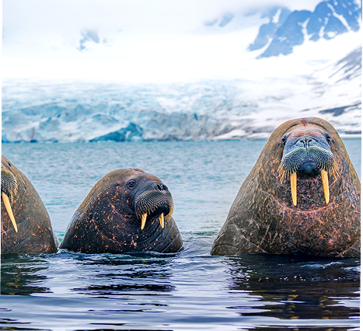

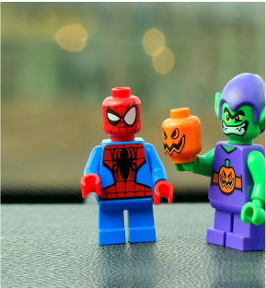
Ohio Standards Alignment
1st Grade - Earth & Space Science
This unit is found under 2nd grade on our site, but we recommend teaching Lesson 2 in 1st grade if you are following Ohio Standards.
⭐ States of Matter (States of Matter)
 | Topic & Guiding Question | Student Objectives | Ohio’s Learning Standards for Science (2018)
 | ✨New!✨ Liquid Water & Solid Ice Where do animals find the water they need? | Students obtain information about the liquid water and solid ice that different animals utilize for their survival in the Arctic. | 1.ESS.2 Water on Earth is present in many forms.
 | ✨New!✨ Reversible & Irreversible Changes How is an ice cube like a crayon? | Students observe the properties of different materials after being heated up and then cooled down. They use these observations to support the explanation that some changes are reversible and others are not. | 1.PS.1 Properties of objects and materials can change.
 | Heating, Cooling, & States of Matter Why are so many toys made out of plastic? | Student conduct an investigation of different materials in order to determine which are most and least easily melted. | 1.PS.1 Properties of objects and materials can change.
Lesson 1
Lesson 2
Lesson 3
✨ New Unit or Lesson
www.mysteryscience.com/docs/ohio

Slide 14

Ohio Standards Alignment
1st Grade - Physical Science
This unit is found under Kindergarten on our site, but we recommend teaching all lessons in 1st grade if you are following Ohio Standards.
Pushes & Pulls (Force Olympics)
 | Topic & Guiding Question | Student Objectives | Ohio’s Learning Standards for Science (2018)
 | Pushes & Pulls What’s the biggest excavator? | Students observe different machines and use those observations as evidence for why machines make work easier. | 1.PS.2 Objects can be moved in a variety of ways, such as straight, zigzag, circular, and back and forth.
 | Pushes, Pulls, & “Work Words” Read-Along Why do builders need so many big machines? | Students observe construction equipment being used in different ways to move objects. | 1.PS.2 Objects can be moved in a variety of ways, such as straight, zigzag, circular, and back and forth.
 | Motion, Speed, & Strength How can you knock down a wall made of concrete? | Students carry out an investigation to determine how far back they should pull a model wrecking ball to knock down a wall, but not the houses behind it. | 1.PS.2 Objects can be moved in a variety of ways, such as straight, zigzag, circular, and back and forth.
 | Speed & Direction of Force Read-Along How can you knock down the most bowling pins? | Students play a game of bumper bowling to observe the way that objects can move in straight lines, zigzags, and back and forth. | 1.PS.2 Objects can be moved in a variety of ways, such as straight, zigzag, circular, and back and forth.
 | Direction of Motion & Engineering How can we protect a mountain town from falling rocks? | Students conduct an investigation of how to protect a town from a falling boulder. They design a solution to safely guide the direction of the boulder away from the town. | 1.PS.2 Objects can be moved in a variety of ways, such as straight, zigzag, circular, and back and forth.
 | Forces & Engineering Read-Along How could you invent a trap? | Students define a problem they would like to solve and then design a solution using what they know about the locations of objects and how they can move. | 1.PS.2 Objects can be moved in a variety of ways, such as straight, zigzag, circular, and back and forth.
Lesson 1
Lesson 2
Lesson 3
Lesson 4
Lesson 5
Lesson 6
www.mysteryscience.com/docs/ohio

Slide 15

Ohio Standards Alignment
2nd Grade - Life Science
Animal Biodiversity & Habitats (Animal Adventures)
 | Topic & Guiding Question | Student Objectives | Ohio’s Learning Standards for Science (2018)
Lesson 1 | Biodiversity & Classification How many different kinds of animals are there? | Students observe the traits of different animals and use that information to organize them into groups based on their characteristics. | Foundational for 2.LS.1 Living things cause changes on Earth.
Lesson 2 | Habitat Diversity Why would a wild animal visit a playground? | Students observe animals, plants, and the physical characteristics of two different habitats. They collect and analyze data to compare the biodiversity between the two habitats. | Foundational for 2.LS.1 Living things cause changes on Earth.
Lesson 3 | Biodiversity, Habitats, & Species Why do frogs say “ribbit”? | Students identify frogs based on their unique calls and use that information to determine the level of frog species diversity within multiple habitats. | Foundational for 2.LS.1 Living things cause changes on Earth.
Lesson 4 | Biodiversity & Engineering How could you get more birds to visit a bird feeder? | Students investigate which kinds of birds are likely to visit a bird feeder based on what they eat and design and build a prototype bird feeder that attracts a specific type of bird. | Foundational for 2.LS.1 Living things cause changes on Earth.
Lesson 1
Lesson 2
Lesson 3
Lesson 4
Ohio Specific Standard: 2.LS.2 All organisms alive today result from their ancestors, some of which may be extinct. Not all kinds of organisms that lived in the past are represented by living organisms today.
www.mysteryscience.com/docs/ohio

Slide 16

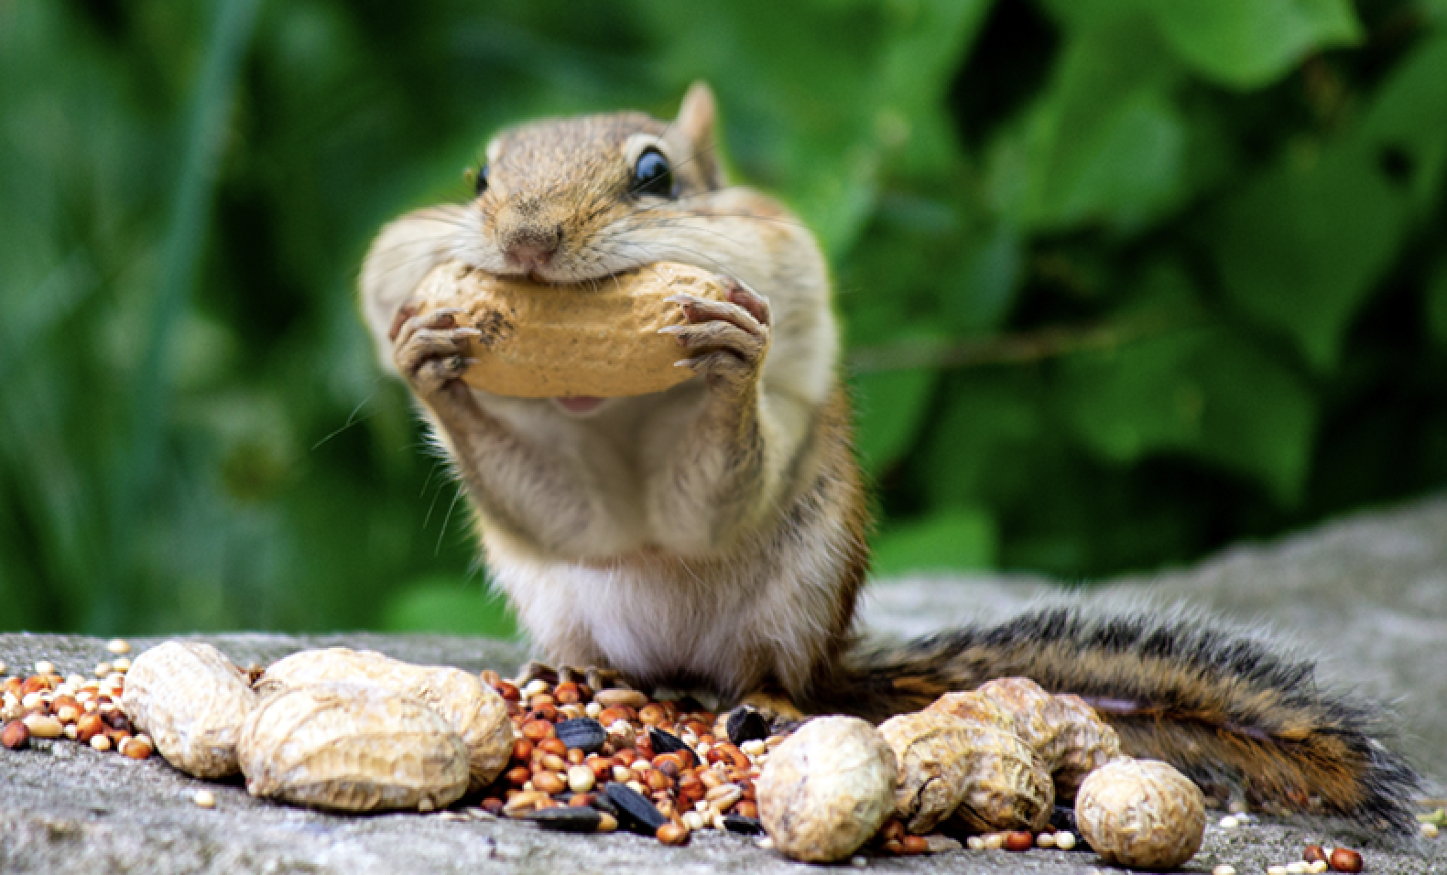
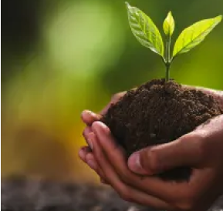

Ohio Standards Alignment
2nd Grade - Life Science
Plant Growth & Interactions (Plant Adventures)
 | Topic & Guiding Question | Student Objectives | Ohio’s Learning Standards for Science (2018)
 | Seed Dispersal How did a tree travel halfway around the world? | Students develop physical models of seed structures. They observe how structure affects the seed’s function in dispersing away from the tree. | Foundational for 2.LS.1 Living things cause changes on Earth.
 | Animal Seed Dispersal Why do seeds have so many different shapes? | Students develop a model of a furry animal and then use it to test how far seed models with different structures can travel. | Foundational for 2.LS.1 Living things cause changes on Earth.
 | Water, Sunlight, & Plant Growth Could a plant survive without light? | Students conduct an investigation to determine that plants need water and light to grow. | Foundational for 2.LS.1 Living things cause changes on Earth.
 | Plant Needs & Habitats How much water should you give a plant? | Students plan and conduct a series of virtual experiments in order to determine how much water and sunlight a set of mystery plants need in order to stay healthy and survive. | Foundational for 2.LS.1 Living things cause changes on Earth.
Lesson 1
Lesson 2
Lesson 3
Lesson 4
www.mysteryscience.com/docs/ohio

Slide 17

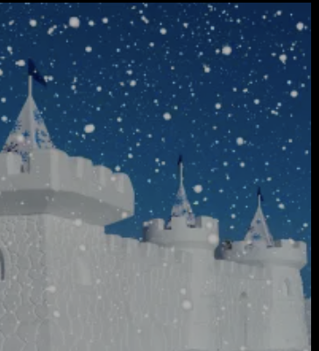
Ohio Standards Alignment
2nd Grade - Earth & Space Science
This unit is found under 3rd grade on our site, but we recommend teaching all lessons in 2nd grade if you are following Ohio Standards.
Weather & Climate (Stormy Skies)
 | Topic & Guiding Question | Student Objectives | Ohio’s Learning Standards for Science (2018)
Lesson 1 | Water Cycle & States of Matter Where do clouds come from? | Students obtain and combine information that water can change from liquid to gas, but that it is always made of tiny drops. Clouds are made of water that has evaporated. | 2.ESS.1 The atmosphere is primarily made up of air. 2.ESS.2 Water is present in the atmosphere. 2.ESS.3 Long- and short-term weather changes occur due to changes in energy.
Lesson 2 | Local Weather Patterns & Weather Prediction How can we predict when it’s going to storm? | Students make observations of clouds and develop a tool to make predictions about what kind of weather might happen next. | 2.ESS.3 Long- and short-term weather changes occur due to changes in energy.
Lesson 3 | Seasonal Weather Patterns Where’s the best place to build a snow fort? | Students gather winter temperature data from three different towns. They represent the data in a table to compare the weather and decide which town is the best candidate to host a snow fort festival in future years. | 2.ESS.3 Long- and short-term weather changes occur due to changes in energy.
Lesson 4 | Climate & Global Weather Patterns Why are some places always hot? | Students obtain and combine information to describe the different climate regions of the world. | 2.ESS.3 Long- and short-term weather changes occur due to changes in energy.
 | Natural Hazards & Engineering How can you keep a house from blowing away in a windstorm? | Students design and build solutions that reduce the hazards associated with strong winds that could damage buildings. | 2.ESS.1 The atmosphere is primarily made up of air. 2.ESS.3 Long- and short-term weather changes occur due to changes in energy.
Lesson 1
Lesson 2
Lesson 3
Lesson 4
Lesson 5
www.mysteryscience.com/docs/ohio

Slide 18

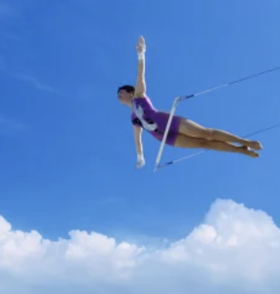
Ohio Standards Alignment
2nd Grade - Physical Science
This unit is found under 3rd grade on our site, but we recommend teaching all lessons in 2nd grade if you are following Ohio Standards.
Forces, Motion, & Magnets (Invisible Forces)
 | Topic & Guiding Question | Student Objectives | Ohio’s Learning Standards for Science (2018)
 | Balanced & Unbalanced Forces How could you win a tug-of-war against a bunch of adults? | Students develop a mental model of the nature of forces and motion and use that model to explain the behavior of an elastic jumper. | 2.PS.1 Forces change the motion of an object.
 | Balanced Forces & Engineering What makes bridges so strong? | Students develop and design a bridge to be as strong as possible while working with limited materials. | 2.PS.1 Forces change the motion of an object.
 | Patterns of Motion, Gravity, & Friction How high can you swing on a flying trapeze? | Students make observations and take measurements of the motion of that model and use that data to predict the motion of a real trapeze. | 2.PS.1 Forces change the motion of an object.
 | Magnets & Forces What can magnets do? | Students investigate the properties of magnets and the fact that they exert forces that act at a distance. | 2.PS.1 Forces change the motion of an object.
 | Magnets & Engineering How can you unlock a door using a magnet? | Students investigate magnetic attraction and repulsion, and design a magnetic lock in the hands-on activity. | 2.PS.1 Forces change the motion of an object.
Lesson 1
Lesson 2
Lesson 3
Lesson 4
Lesson 5
www.mysteryscience.com/docs/ohio

Slide 19
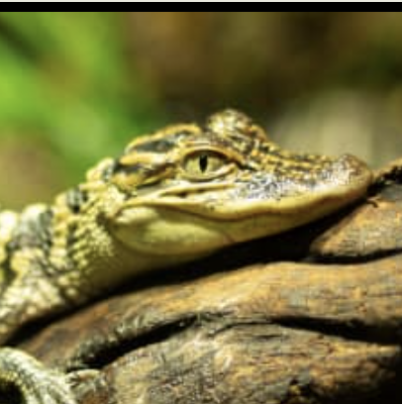



Ohio Standards Alignment
3rd Grade - Life Science
Life Cycles (Circle of Life)
 | Topic & Guiding Question | Student Objectives | Ohio’s Learning Standards for Science (2018)
 | Animal Life Cycles How is your life like an alligator’s life? | Students create models of several different animal life cycles and compare them to one another. They use these models to discover the pattern that all animals are born, grow, can have babies, and eventually die. | 3.LS.3 Plants and animals have life cycles that are part of their adaptations for survival in their natural environments.
 | Environmental Change & Engineering What’s the best way to get rid of mosquitoes? | Students obtain and evaluate information about mosquitoes from different sources. They analyze and interpret information about the mosquito life cycle to reduce the number of mosquitoes that live in a certain area. | 3.LS.3 Plants and animals have life cycles that are part of their adaptations for survival in their natural environments.
 | Pollination & Plant Reproduction Why do plants grow flowers? | Students model the structure and function of flower parts that are responsible for creating seeds. | 3.LS.3 Plants and animals have life cycles that are part of their adaptations for survival in their natural environments.
 | Fruit, Seeds, & Plant Reproduction Why do plants give us fruit? | Students explore the function of fruits in plants and practice classification. | 3.LS.3 Plants and animals have life cycles that are part of their adaptations for survival in their natural environments.
 | Plant Life Cycles Why are there so many different kinds of flowers? | Students play a game that models the stages of the plant life cycle. After playing the game students use the model to show how changes to one part of the life cycle affect all other stages. | 3.LS.3 Plants and animals have life cycles that are part of their adaptations for survival in their natural environments.
Lesson 1
Lesson 2
Lesson 3 Lesson 4 Lesson 5
www.mysteryscience.com/docs/ohio

Slide 20
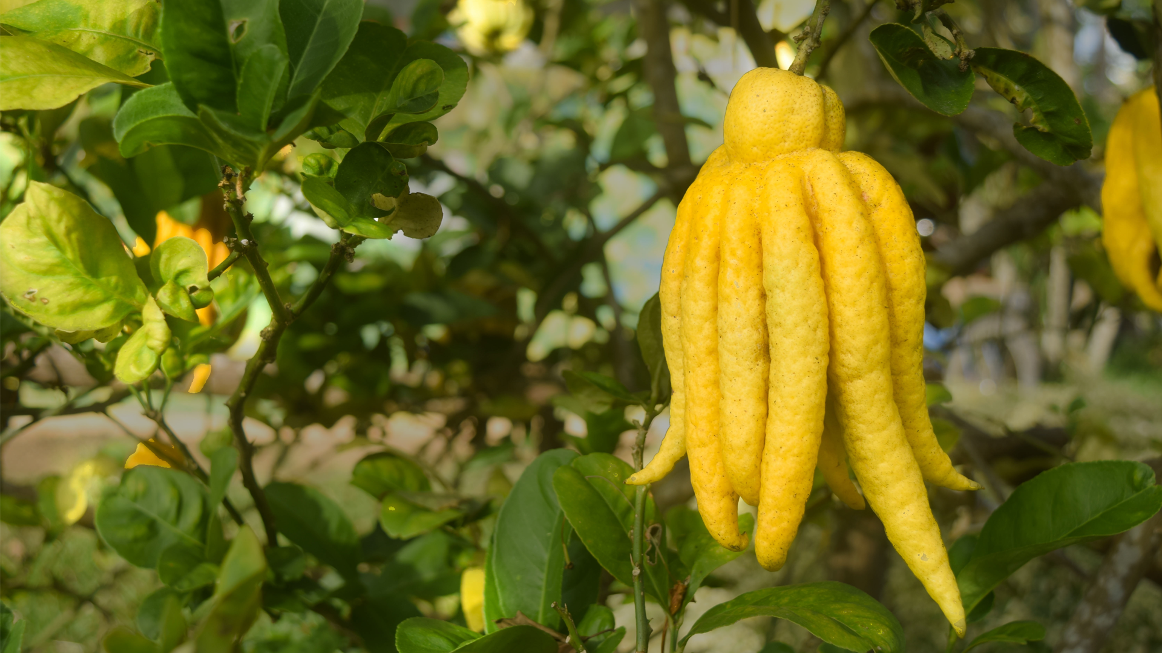
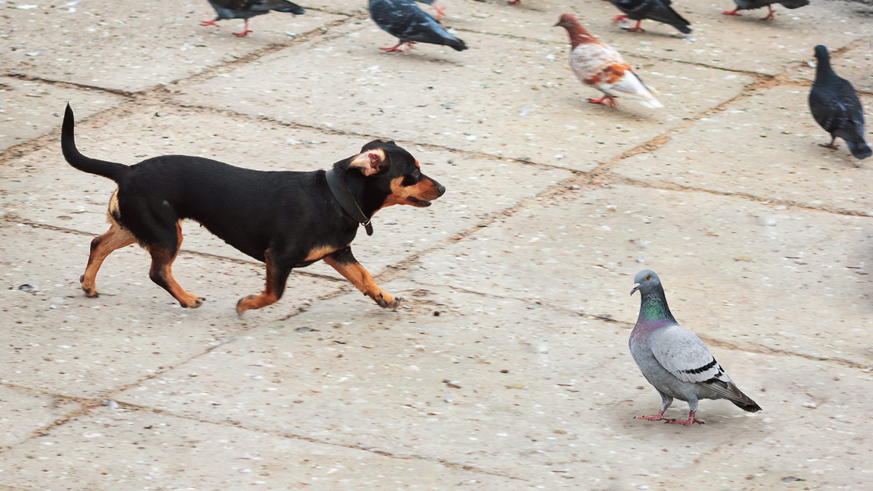
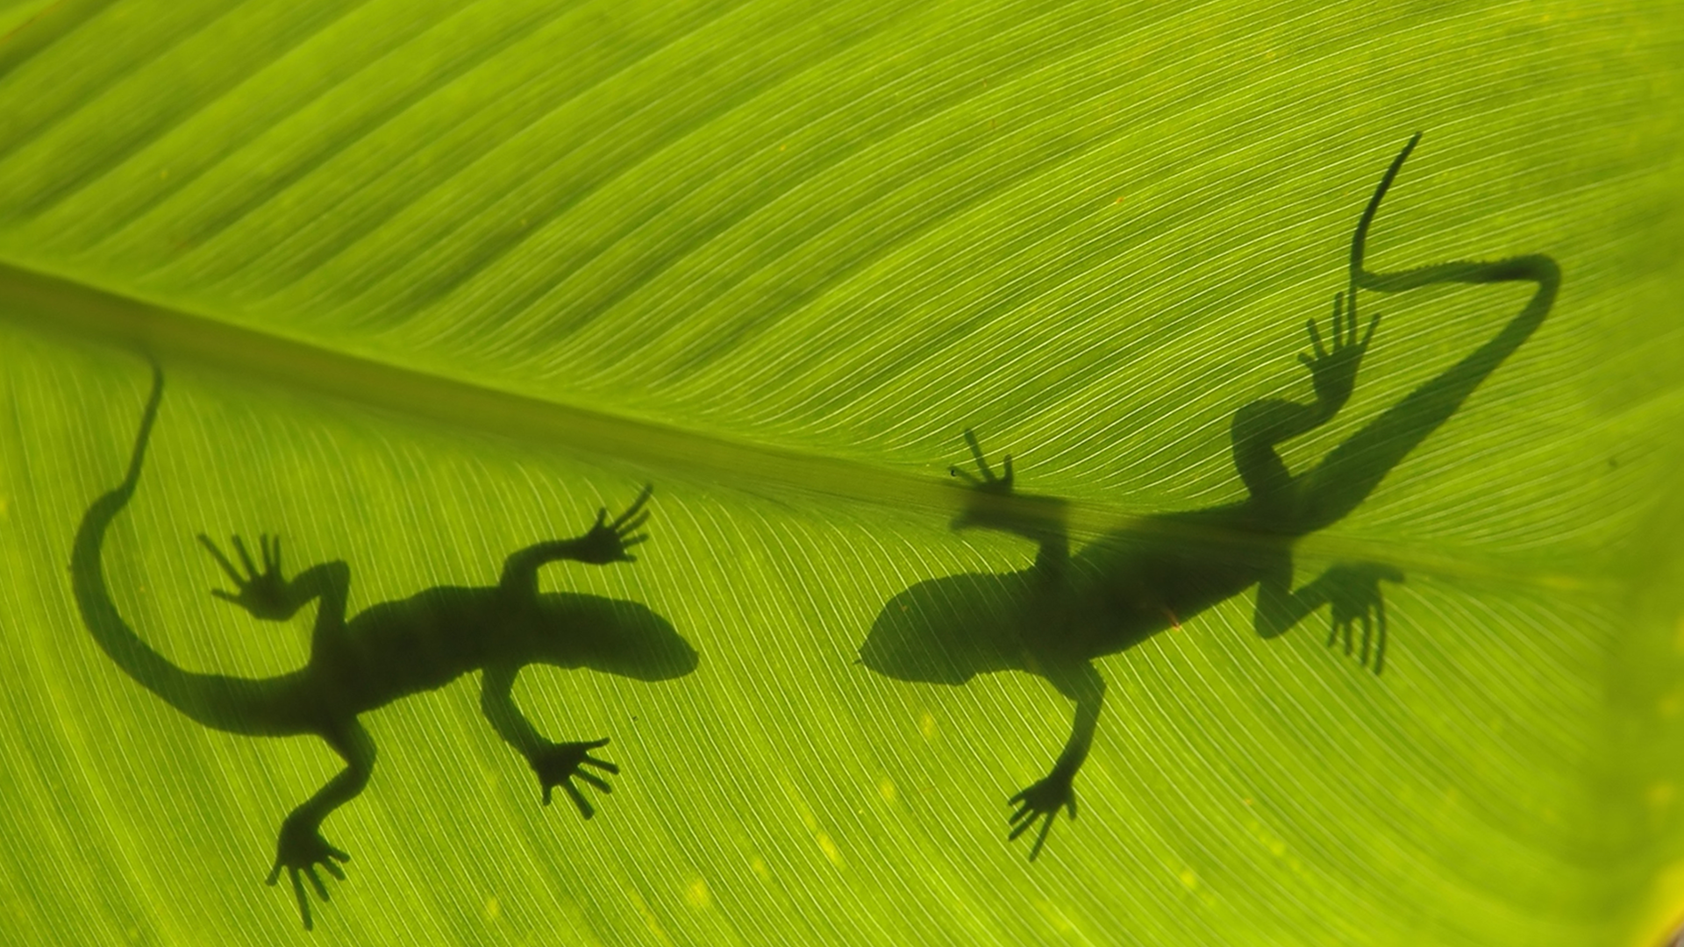
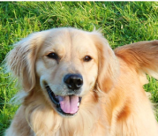

Ohio Standards Alignment
3rd Grade - Life Science
Heredity, Survival, & Selection (Fates of Traits)
 | Topic & Guiding Question | Student Objectives | Ohio’s Learning Standards for Science (2018)
 | Traits & Inheritance How do you identify a mysterious fruit? | Students examine plant traits and use that information as evidence to help them identify an unknown fruit. They look for similarities and differences in the leaves, flowers, and fruits of plants to sort them into groups and identify patterns of inheritance. | 3.LS.1 Offspring resemble their parents and each other.
 | Trait Variation, Inheritance, & Artificial Selection What do dogs and pigeons have in common? | Students analyze trait similarities and differences among parent, offspring, and sibling pigeons. They interpret this data to discover that the variation and inheritance of traits creates a pattern that explains why we see such extreme traits in artificially selected animal breeds. | 3.LS.1 Offspring resemble their parents and each other.
 | Trait Variation, Survival, & Natural Selection How could a lizard’s toes help it survive? | Students compare the structures of lizards that live on an island. They simulate multiple generations of these lizards, and analyze and interpret the data to understand how these structures aid in their survival. | 3.LS.1 Offspring resemble their parents and each other. 3.LS.2 Individuals of the same kind of organism differ in their inherited traits. These differences give some individuals an advantage in surviving and/or reproducing.
 | Animal Groups & Survival Why do dogs wag their tails? | Students observe animals that live in groups in order to obtain, evaluate, and communicate information about animal social behavior. Students use evidence to show how animals form groups to help them survive. | 3.LS.2 Individuals of the same kind of organism differ in their inherited traits. These differences give some individuals an advantage in surviving and/or reproducing.
 | Traits & Environmental Variation How long can people (and animals) survive in outer space? | Students measure and compare their own physical traits (arm strength, balance, and height) and analyze the information to construct an explanation for how the environment can influence traits. | 3.LS.2 Individuals of the same kind of organism differ in their inherited traits. These differences give some individuals an advantage in surviving and/or reproducing.
Lesson 1
Lesson 2
Lesson 3
Lesson 4
Lesson 5
www.mysteryscience.com/docs/ohio

Slide 21

Ohio Standards Alignment
3rd Grade - Life Science
This unit is found under 4th grade on our site, but we recommend teaching lessons in 3rd grade if you are following Ohio Standards.
Human Body, Vision, & The Brain (Human Machine)
 | Topic & Guiding Question | Student Objectives | Ohio’s Learning Standards for Science (2018)
 | Muscles & Skeleton Why do your biceps bulge? | Students construct a model of the human hand to explain how muscles pull on bones to create movement. | 3.LS.2 Individuals of the same kind of organism differ in their inherited traits. These differences give some individuals an advantage in surviving and/or reproducing.
 | Light, Eyes, & Vision What do people who are blind see? | Students develop a working model of an eye. They use the model to reason about how light reflects off an object and into the eye, helping an organism process information from the environment. | 5.PS.2 Light and sound are forms of energy that behave in predictable ways.
 | Structure & Function of Eyes How can some animals see in the dark? | Students use their eye model to discover that the pupil controls the amount of light let into the eye. In the dark, pupils get larger to let in more light. | 5.PS.2 Light and sound are forms of energy that behave in predictable ways.
 | Brain, Nerves, & Information Processing How does your brain control your body? | Students investigate how their own brain works by testing their reflexes. They discover that the brain receives information from the senses, processes the information, and sends signals to the muscles to enable movement. | 3.LS.2 Individuals of the same kind of organism differ in their inherited traits. These differences give some individuals an advantage in surviving and/or reproducing.
Lesson 1
Lesson 2
Lesson 3
Lesson 4
Although this appears on our site, we recommend teaching this in 5th grade if following Ohio Standards.
Although this appears on our site, we recommend teaching this in 5th grade if following Ohio Standards.
www.mysteryscience.com/docs/ohio

Slide 22
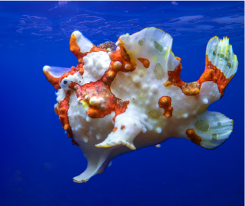
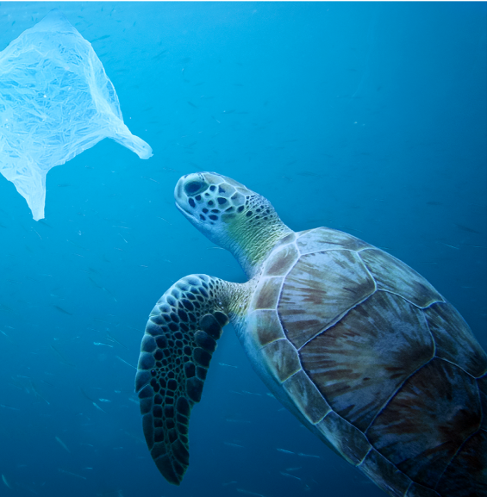
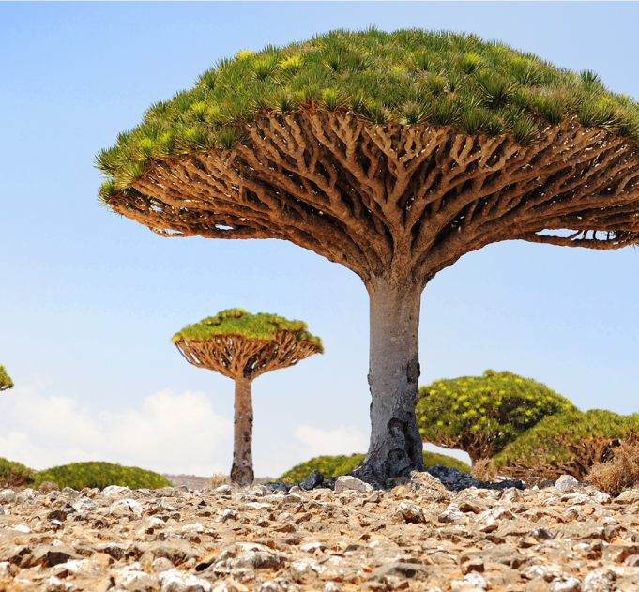
Ohio Standards Alignment
3rd Grade - Life Science
This unit is found under 4th grade on our site, but we recommend teaching lessons in 3rd grade if you are following Ohio Standards.
Animal & Plant Adaptations (Animal & Plant Adaptations)
 | Topic & Guiding Question | Student Objectives | Ohio’s Learning Standards for Science (2018)
 | Animal Adaptations Why do some sea creatures look so strange? | Students make observations of underwater animals in order to collect evidence that external structures serve specific functions. They use their observations to construct an argument that an animal’s structures work together as part of a system to support their growth and survival. | 3.LS.2 Individuals of the same kind of organism differ in their inherited traits. These differences give some individuals an advantage in surviving and/or reproducing.
 | Learned Behavior & Instinct Why would a sea turtle eat a plastic bag? | Students use models to understand how an animal’s senses, brain, and memories all work together as a system to influence their behavior and support their survival. | 3.LS.2 Individuals of the same kind of organism differ in their inherited traits. These differences give some individuals an advantage in surviving and/or reproducing.
 | Plant Adaptations Why don’t the same trees grow everywhere? | Students use models of roots and branches to explore their functions and then construct an argument about how these structures must work together in order to support the survival of trees in the unique environment of the frozen taiga. | 3.LS.2 Individuals of the same kind of organism differ in their inherited traits. These differences give some individuals an advantage in surviving and/or reproducing.
Lesson 1
Lesson 2
Lesson 3
www.mysteryscience.com/docs/ohio

Slide 23


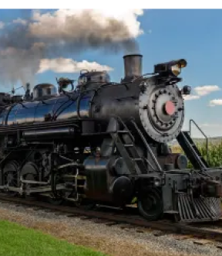
Ohio Standards Alignment
3rd Grade - Earth & Space Science
This unit is found under 4th grade on our site, but we recommend teaching Lesson 1 in 3rd grade if you are following Ohio Standards.
Electricity, Light, & Heat (Electricity, Light & Heat)
 | Topic & Guiding Question | Student Objectives | Ohio’s Learning Standards for Science
 | Renewable Energy & Natural Resources What’s the best way to light up a city? | Students evaluate the advantages and disadvantages of wind, water, and solar energy to power a town. Students obtain and evaluate information about the needs of each source of energy and analyze and interpret data about the town’s resources. | 3.ESS.2 Earth’s resources can be used for energy. 3.ESS.3 Some of Earth’s resources are limited.
 | Electrical Energy What if there were no electricity? | Students design a flashlight with an on/off switch, using batteries, flights, and tin foil. Students figure out that electricity can be transformed to other forms of energy, such as movement, light, and heat. | 4.PS.2 Energy can be transferred from one location to another or can be transformed from one form to another.
 | Heat Energy & Energy Transfer How long did it take to travel across the country before cars and planes? | Students build a paper spinner and conduct an investigation to explain how heat makes things move. Students realize that heat energy can be transformed into motion energy using a turbine. | 4.PS.2 Energy can be transferred from one location to another or can be transformed from one form to another.
Lesson 1
Lesson 2
Although this appears on our site, we recommend teaching this in 4th grade if following Ohio Standards.
Lesson 3
Although this appears on our site, we recommend teaching this in 4th grade if following Ohio Standards.
www.mysteryscience.com/docs/ohio

Slide 24
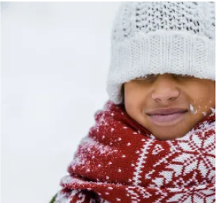
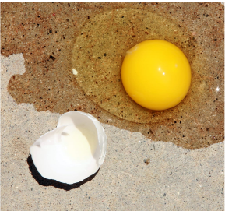


Ohio Standards Alignment
3rd Grade - Physical Science
This unit is found under 2nd grade on our site, but we recommend teaching all lessons in 3rd grade if you are following Ohio Standards.
✔ Material Properties (Material Magic)
 | Topic & Guiding Question | Student Objectives | Ohio’s Learning Standards for Science (2018)
 | Material Properties & Engineering Why do we wear clothes? | Students investigate different material properties, such as flexibility and absorbency, and use those properties to design and build a hat that protects them from the sun. | 3.PS.1 All objects and substances in the natural world are composed of matter. 3.PS.2 Matter exists in different states, each of which has different properties.
 | Classify Materials: Insulators & Conductors Can you really fry an egg on a hot sidewalk? | Students conduct an investigation of conductors and insulators in order to determine which are best suited for allowing people to handle hot items. | 3.PS.1 All objects and substances in the natural world are composed of matter. 3.PS.2 Matter exists in different states, each of which has different properties.
 | Material Building Blocks & Engineering Could you build a house out of paper? | Students construct an evidence- based account of how a structure built of paper can be disassembled and rebuilt in new ways. | 3.PS.1 All objects and substances in the natural world are composed of matter. 3.PS.2 Matter exists in different states, each of which has different properties.
 | Soil Properties How do you build a city out of mud? | Students conduct an investigation where they examine three different soil models. They use this information to determine which type of soil has the properties that will result in the best mud that can be used to build a house. | 3.ESS.1 Earth’s nonliving resources have specific properties
Lesson 1
Lesson 2
Lesson 3
Lesson 4
✔ Unit Restructured for the 2025-2026 School Year
www.mysteryscience.com/docs/ohio

Slide 25

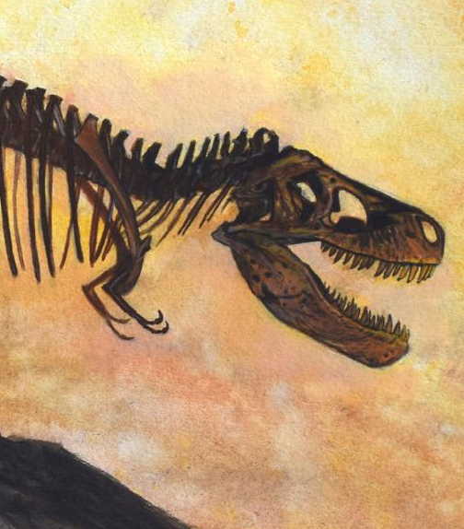
Ohio Standards Alignment
4th Grade - Life Science
This unit is found under 3rd grade on our site, but we recommend teaching lessons in 4th grade if you are following Ohio Standards.
Fossils & Changing Environments (Animals Through Time)
 | Topic & Guiding Question | Student Objectives | Ohio’s Learning Standards for Science (2018)
 | Habitats, Fossils, & Environments Over Time Where can you find whales in a desert? | Students explore the idea that the rock under our feet sometimes contains fossils, and investigate how these fossils reveal changes in habitats through time. | 4.LS.1 Changes in an organism’s environment are sometimes beneficial to its survival and sometimes harmful. 4.LS.2 Fossils can be compared to one another and to present-day organisms according to their similarities and differences.
 | Fossil Evidence & Classification How do we know what dinosaurs looked like? | Students learn how we can infer what the outside of an animal looked like by using clues about their skeleton. | 4.LS.2 Fossils can be compared to one another and to present-day organisms according to their similarities and differences.
 | Trace Fossil Evidence & Animal Movement Can you outrun a dinosaur? | Students learn how fossilized animal tracks can tell us a great deal about the animals that left them. | 4.LS.2 Fossils can be compared to one another and to present-day organisms according to their similarities and differences.
Lesson 1
Lesson 2
Lesson 3
www.mysteryscience.com/docs/ohio

Slide 26
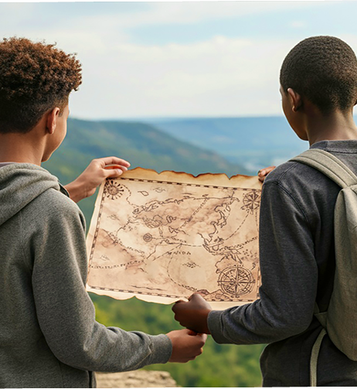
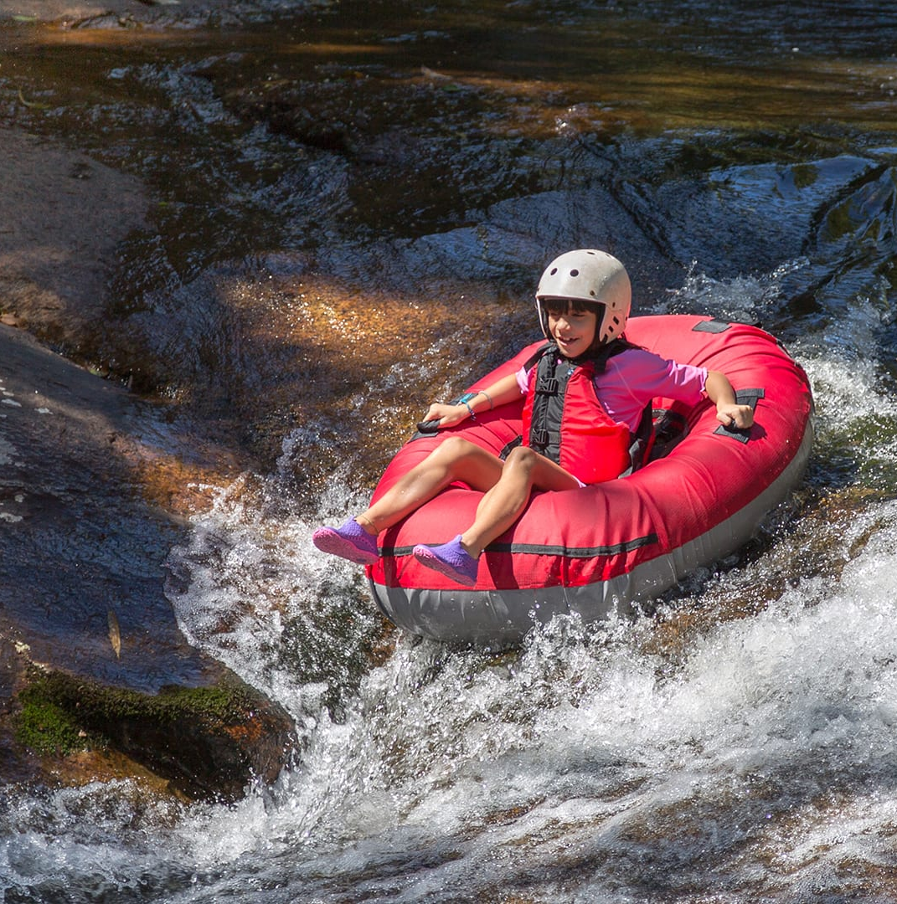

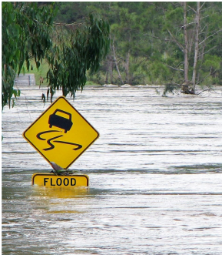
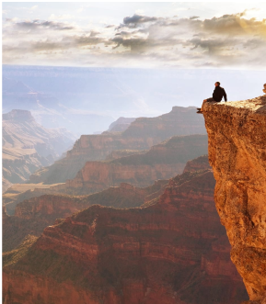
Ohio Standards Alignment
4th Grade - Earth & Space Science
This unit is found under 2nd grade on our site, but we recommend teaching lessons in 4th grade if you are following Ohio Standards.
Erosion & Earth’s Surface (Work of Water) • Page 1 of 2
 | Topic & Guiding Question | Student Objectives | Ohio’s Learning Standards for Science (2018)
 | ✨New!✨ Mapping Landforms & Bodies of Water Where’s the best place to hide a treasure? | Students develop a model of the Earth’s surface and use it to discover an important principle about how rivers work: rivers flow downhill, from high places to low places. | 4.ESS.1 Earth’s surface has specific characteristics and landforms that can be identified.
 | Mapping: Mountains & Rivers If you floated down a river, where would you end up? | Students develop a model of the Earth’s surface and use it to discover an important principle about how rivers work: rivers flow downhill, from high places to low places. | 4.ESS.1 Earth’s surface has specific characteristics and landforms that can be identified.
 | Rocks, Sand, & Erosion Why is there sand at the beach? | Students investigate the effects of rocks tumbling in a river. Based on their observations, they construct an explanation for why rocks on the top of mountains are much bigger than the sand at the beach. | 4.ESS.1 Earth’s surface has specific characteristics and landforms that can be identified. 4.ESS.2: The surface of Earth changes due to weathering.
 | Mapping & Severe Weather Where do flash floods happen? | Students use a model (i.e. a map) to examine the different factors, including the shapes and kinds of land, that contribute to flash floods. They use this to predict where flash floods are most likely to happen. | 4.ESS.1 Earth’s surface has specific characteristics and landforms that can be identified.
 | Erosion, Earth’s Surface, & Landforms What’s strong enough to make a canyon? | Students create a model landform and investigate how some Earth events can occur quickly, while others occur slowly. | 4.ESS.1 Earth’s surface has specific characteristics and landforms that can be identified. 4.ESS.3 The surface of Earth changes due to erosion and deposition.
Continued on next page
Lesson 1
Lesson 2
Lesson 3
Lesson 4
Lesson 5
✨ New Lesson
www.mysteryscience.com/docs/ohio

Slide 27
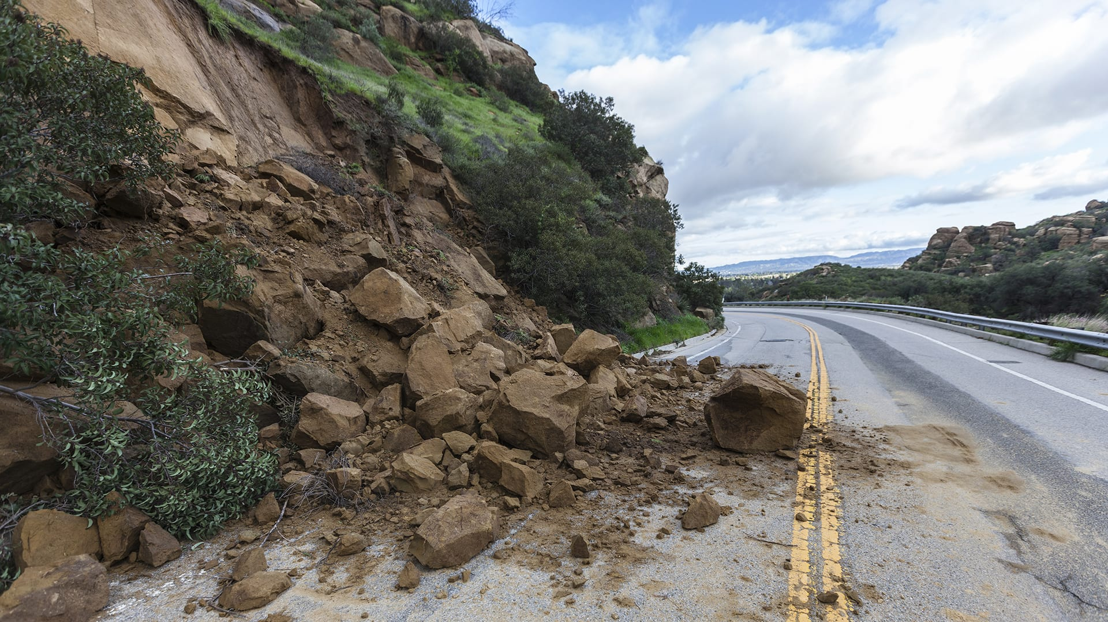
Ohio Standards Alignment
4th Grade - Earth & Space Science
Erosion & Earth’s Surface (Work of Water) • Page 2 of 2
 | Topic & Guiding Question | Student Objectives | Ohio’s Learning Standards for Science (2018)
 | Erosion & Engineering How can you stop a landslide? | Students compare multiple solutions for preventing erosion. | 4.ESS.3 The surface of Earth changes due to erosion and deposition.
Lesson 6
www.mysteryscience.com/docs/ohio

Slide 28

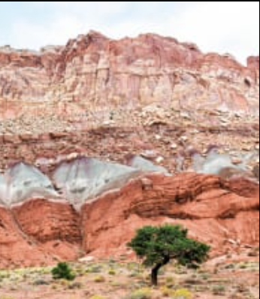
Ohio Standards Alignment
4th Grade - Earth & Space Science
Earth’s Features & Processes (The Birth of Rocks)
 | Topic & Guiding Question | Student Objectives | Ohio’s Learning Standards for Science (2018)
Lesson 1 | Volcanoes & Patterns of Earth’s Features Could a volcano pop up where you live? | Students use coordinates to develop a map of volcanoes to discover a pattern of where volcanoes exist on Earth. Students identify the pattern of volcanoes in the “Ring of Fire.” | 4.ESS.1 Earth’s surface has specific characteristics and landforms that can be identified.
Lesson 2 | Volcanoes & Rock Cycle Why do some volcanoes explode? | Students investigate the properties of thin and thick lava by attempting to create air bubbles. Students realize that thick lava will cause a volcano to explode, while thin lava will not. | 4.ESS.1 Earth’s surface has specific characteristics and landforms that can be identified.
Lesson 3 | Weathering & Erosion Will a mountain last forever? | Students make observations of the effects of weathering to discover that rocks will become rounded and break into small pieces when they tumble down a mountain. | 4.ESS.2 The surface of Earth changes due to weathering. 4.ESS.3 The surface of Earth changes due to erosion and deposition.
Lesson 4 | Sedimentary Rock & Fossils What did your town look like 100 million years ago? | Students create a model canyon and use the pattern of fossils found in each rock layer to support the explanation that the landscape has changed many times over millions of years. | 4.ESS.3 The surface of Earth changes due to erosion and deposition. 4.LS.2 Fossils can be compared to one another and to present-day organisms according to their similarities and differences.
 | Erosion, Natural Hazards, & Engineering How could you survive a landslide? | Students generate multiple possible solutions to protect homes from a landslide. Students realize that there are many causes for the erosion that causes rocks to fall in landslides. | 4.ESS.1 Earth’s surface has specific characteristics and landforms that can be identified.
Lesson 1
Lesson 2
Lesson 3
Lesson 4
Lesson 5
www.mysteryscience.com/docs/ohio

Slide 29

Ohio Standards Alignment
4th Grade - Earth & Space Science
This unit is found under 5th grade on our site, but we recommend teaching all lessons in 4th grade if you are following Ohio Standards.
Water Cycle & Earth’s Systems (Watery Planet)
 | Topic & Guiding Question | Student Objectives | Ohio’s Learning Standards for Science (2018)
Lesson 1 | Hydrosphere & Water Distribution How much water is in the world? | Students analyze and interpret data from world maps to determine the relative amounts of fresh, salt, and frozen water. Students figure out that while the Earth has a lot of water, most of Earth’s water is not fresh or accessible. | 4.ESS.1 Earth’s surface has specific characteristics and landforms that can be identified.
Lesson 2 | Mixtures & Solutions How much salt is in the ocean? | Students create a model ocean to observe how salt seems to completely vanish when dissolved in water. Students measure and graph quantities to provide evidence that the salt is still in the solution, even though we can’t see it. | 4.PS.1 When objects break into smaller pieces, dissolve, or change state, the total amount of matter is conserved.
Lesson 3 | Groundwater as a Natural Resource When you turn on the faucet, where does the water come from? | Students learn most people get fresh water from underground sources. Students determine the best place to settle a town by considering features of the landscape & the characteristics of the plants that thrive there. | 4.ESS.1 Earth’s surface has specific characteristics and landforms that can be identified.
Lesson 4 | Water Cycle Can we make it rain? | Students create a model of the ocean and sky to investigate how temperature influences evaporation and condensation. Students figure out that higher ocean temperatures lead to more evaporation, thus leading to more rain. | 4.ESS.1 Earth’s surface has specific characteristics and landforms that can be identified.
 | Natural Disasters & Engineering How can you save a town from a hurricane? | Students define the problem that a town needs protection from flooding. They design solutions using different types of flood protection. They realize flooding is caused by severe rainfall generated by hurricanes. Hurricanes are created where ocean temperatures are warm. | 4.ESS.1 Earth’s surface has specific characteristics and landforms that can be identified.
Lesson 1
Lesson 2
Lesson 3
Lesson 4
Lesson 5
www.mysteryscience.com/docs/ohio

Slide 30

Ohio Standards Alignment
4th Grade - Physical Science
This unit is found under 5th grade on our site, but we recommend teaching all lessons in 4th grade if you are following Ohio Standards.
Chemical Reactions & Properties of Matter (Chemical Magic)
 | Topic & Guiding Question | Student Objectives | Ohio’s Learning Standards for Science (2018)
 | Conservation of Matter Are magic potions real? | Students observe that a salt and vinegar solution will turn a dull penny shiny again indicating that substances can change other substances. | 4.PS.1 When objects break into smaller pieces, dissolve, or change state, the total amount of matter is conserved.
 | Dissolving & Particulate Nature of Matter Could you transform something worthless into gold? | Students coat a steel nail in copper by placing it into the solution that dissolved bits of the penny. Students realize that substances can change to become particles too small to be seen, but they still exist. | 4.PS.1 When objects break into smaller pieces, dissolve, or change state, the total amount of matter is conserved.
 | Properties of Matter: Acids What would happen if you drank a glass of acid? | Students figure out that acids are very reactive substances. Students investigate reactions between different substances to determine how known acids react with other materials. | 4.PS.1 When objects break into smaller pieces, dissolve, or change state, the total amount of matter is conserved.
 | Chemical Reactions What do fireworks, rubber, and Silly Putty have in common? | Students combine different substances together to discover that chemical reactions can create new substances. | 4.PS.1 When objects break into smaller pieces, dissolve, or change state, the total amount of matter is conserved.
 | Gases & Particle Models Why do some things explode? | Students investigate and model the reaction between baking soda and vinegar. They figure out that gases are made of particles too small to be seen. | 4.PS.1 When objects break into smaller pieces, dissolve, or change state, the total amount of matter is conserved.
Lesson 1
Lesson 2
Lesson 3
Lesson 4
Lesson 5
www.mysteryscience.com/docs/ohio

Slide 31
Ohio Standards Alignment
4th Grade - Physical Science
Electricity, Light, & Heat (Electricity, Light & Heat)
 | Topic & Guiding Question | Student Objectives | Ohio’s Learning Standards for Science
 | ✨New!✨ Renewable Energy & Natural Resources What’s the best way to light up a city? | Students evaluate the advantages and disadvantages of wind, water, and solar energy to power a town. Students obtain and evaluate information about the needs of each source of energy and analyze and interpret data about the town’s resources. | 3.ESS.2 Earth’s resources can be used for energy. 3.ESS.3 Some of Earth’s resources are limited.
 | Electrical Energy What if there were no electricity? | Students design a flashlight with an on/off switch, using batteries, flights, and tin foil. Students figure out that electricity can be transformed to other forms of energy, such as movement, light, and heat. | 4.PS.2 Energy can be transferred from one location to another or can be transformed from one form to another.
 | Heat Energy & Energy Transfer How long did it take to travel across the country before cars and planes? | Students build a paper spinner and conduct an investigation to explain how heat makes things move. Students realize that heat energy can be transformed into motion energy using a turbine. | 4.PS.2 Energy can be transferred from one location to another or can be transformed from one form to another.
Lesson 1
Although this appears on our site, we recommend teaching this in 3rd grade if following Ohio Standards.
Lesson 2
Lesson 3
www.mysteryscience.com/docs/ohio

Slide 32
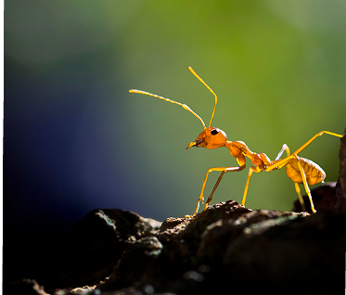
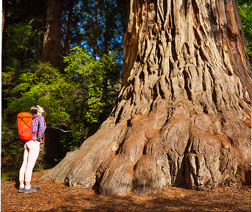
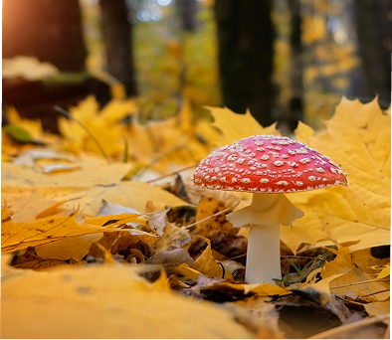
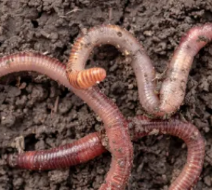
Ohio Standards Alignment
5th Grade - Life Science
Ecosystems & The Food Web (Web of Life)• Page 1 of 2
 | Topic & Guiding Question | Student Objectives | Ohio’s Learning Standards for Science (2018)
 | ✨New!✨ Food Chains & Matter Flow What if all the ants disappeared? | Students construct models of food chains by linking cards discovering that different interrelationships exist between organisms. | 5.LS.1 Organisms perform a variety of roles in an ecosystem.
 | ✨New!✨ Plant Growth & Matter How does a tiny seed become one of the heaviest trees on Earth? | Students gather evidence through a series of virtual experiments to construct an argument that plants use mostly air and water as the materials for their growth. | 5.LS.1 Organisms perform a variety of roles in an ecosystem.
 | ✨New!✨ Decomposers & Matter Flow Where do fallen leaves go? | Students conduct an investigation to gain an understanding of the important role that decomposers play in recycling matter from dead leaves back into the environment. | 5.LS.1 Organisms perform a variety of roles in an ecosystem.
 | Decomposers & Soil Nutrients Do worms really eat dirt? | Students make observations of worms to realize that worms act as decomposers to eat dead matter in an ecosystem and cycle nutrients into the soil. | 5.LS.1 Organisms perform a variety of roles in an ecosystem. 5.LS.2 All of the processes that take place within organisms require energy.
Lesson 1
Lesson 2
Lesson 3
Lesson 4
Continued on next page
✨ New Lesson
www.mysteryscience.com/docs/ohio

Slide 33

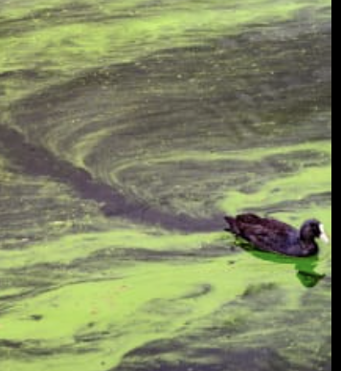
Ohio Standards Alignment
5th Grade - Life Science
Ecosystems & The Food Web (Web of Life)• Page 2 of 2
 | Topic & Guiding Question | Student Objectives | Ohio’s Learning Standards for Science (2018)
 | Ecosystems & Matter Cycle Why do you have to clean a fish tank but not a pond? | Students develop a model of a pond ecosystem and realize that interrelationships exist between decomposers, plants, and animals. Students discover that each organism must be in balance for the pond ecosystem to function. | 5.LS.1 Organisms perform a variety of roles in an ecosystem. 5.LS.2 All of the processes that take place within organisms require energy.
 | Protecting Environments How can we protect Earth’s environments? | In this lesson, students learn about what happens in unbalanced ecosystems and how that can lead to an overabundance of algae and harmful algal blooms. In the activity, Bloom Busters, students play a game in which they obtain and combine science ideas in order to help a community respond to and prevent harmful algal blooms. | 5.LS.1 Organisms perform a variety of roles in an ecosystem.
 | Food Webs & Flow of Energy Why did the dinosaurs go extinct? | Students develop a model of a dinosaur food web. Students realize that blocking the sun’s energy would have disastrous effects on the organisms that rely on this energy in the food web and cause the extinction of some entire species. | 5.LS.1 Organisms perform a variety of roles in an ecosystem. 5.LS.2 All of the processes that take place within organisms require energy.
Lesson 5 Lesson 6
Lesson 7
www.mysteryscience.com/docs/ohio

Slide 34


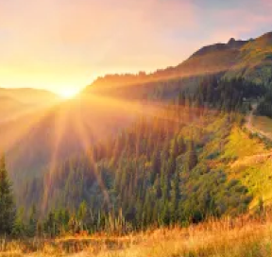

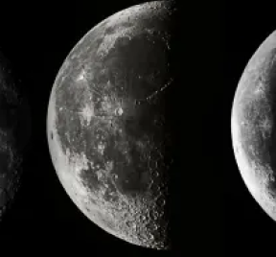
Ohio Standards Alignment
5th Grade - Earth & Space Science
Earth & Space Patterns (Spaceship Earth)
 | Topic & Guiding Question | Student Objectives | Ohio’s Learning Standards for Science (2018)
 | Day, Night, & Earth’s Rotation How fast does the Earth spin? | Students model the rotation of the Earth and investigate why the Sun looks like it’s moving across the sky. Using evidence they gathered in the investigation, students build a model that explains how the Earth’s rotation around its own axis causes the Sun to appear to rise and set. | 5.ESS.3 Most of the cycles and patterns of motion between the Earth and Sun are predictable.
 | Earth’s Rotation & Daily Shadow Patterns Who set the first clock? | Students make a shadow clock (sundial) and investigate how the direction and length of shadows change with the position of the light shining on the sundial. Students realize that the Sun’s position in the sky can be used to tell the time of day. | 5.ESS.3 Most of the cycles and patterns of motion between the Earth and Sun are predictable.
 | Seasonal Changes & Shadow Length How can the Sun tell you the season? | Students examine photos taken at different times of year and figure out the time of year that each photo was taken. Students discover that the Sun’s path changes with the seasons, as does the time of sunrise and sunset. The Sun is always highest in the sky at noon, but that height changes with the season. | 5.ESS.3 Most of the cycles and patterns of motion between the Earth and Sun are predictable.
 | Seasonal Patterns & Earth’s Orbit Why do the stars change with the seasons? | Students build a model of the universe and use it to explain why different stars are visible at different times of year. Using evidence from this model, students make an argument that supports the claim that the Earth orbits the Sun. | 5.ESS.3 Most of the cycles and patterns of motion between the Earth and Sun are predictable.
 | Moon Phases, Lunar Cycle Why does the Moon change shape? | Students use a physical model of the Sun and Moon to investigate how the Moon’s phase relates to its position relative to the Sun. Students notice that the Moon’s phases repeat in a predictable pattern. | 5.ESS.3 Most of the cycles and patterns of motion between the Earth and Sun are predictable.
Lesson 1
Lesson 2
Lesson 3
Lesson 4
Lesson 5
www.mysteryscience.com/docs/ohio

Slide 35

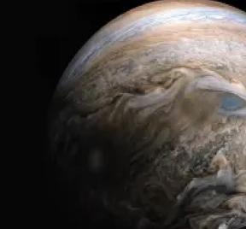
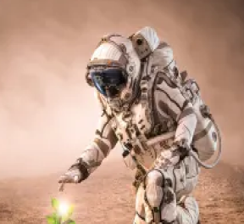
Ohio Standards Alignment
5th Grade - Earth & Space Science
Stars & Planets (Stars & Planets)
 | Topic & Guiding Question | Student Objectives | Ohio’s Learning Standards for Science (2018)
 | Solar System & Sun Brightness How can the Sun help us explore other planets? | Students gather evidence to support an argument that the apparent brightness of the Sun is dependent upon an observer’s distance from the Sun. They construct a model of the solar system and gather observations of the Sun’s apparent brightness from each planet within their model. | 5.ESS.1 The solar system includes the Sun and all celestial bodies that orbit the Sun. Each planet in the solar system has unique characteristics. 5.ESS.2 The Sun is one of many stars that exist in the universe.
 | Gravity Why is gravity different on other planets? | Using mathematics and computational thinking, students calculate how high they could jump on planets and moons that have stronger or weaker gravity than Earth. Students analyze and interpret this data to construct an explanation for why the amount of gravity is different on other planets. | 5.ESS.1 The solar system includes the Sun and all celestial bodies that orbit the Sun. Each planet in the solar system has unique characteristics. 5.PS.1 The amount of change in movement of an object is based on the mass of the object and the amount of force exerted.
 | Star Brightness & Habitable Planets Could there be life on other planets? | Sun with the right amount of light and heat for life to exist. Students evaluate other solar systems, comparing their stars to our Sun. Based on their analysis, students plan a space mission to a planet with conditions similar to those on Earth. | 5.ESS.2 The Sun is one of many stars that exist in the universe.
Lesson 1
Lesson 2
Lesson 3
www.mysteryscience.com/docs/ohio

Slide 36


Ohio Standards Alignment
5th Grade - Physical Science
This unit is found under 4th grade on our site, but we recommend teaching lessons in 5th grade if you are following Ohio Standards.
Energy & Energy Transfer (Energizing Everything)
 | Topic & Guiding Question | Student Objectives | Ohio’s Learning Standards for Science (2018)
 | Speed & Energy How is your body similar to a car? | Students learn about stored energy and about the relationship between motion and energy. Students build models of an amusement park ride and discover how energy can be stored in materials. Stored energy can be converted to speed. | 5.PS.1 The amount of change in movement of an object is based on the mass of the object and the amount of force exerted.
 | Gravitational Energy, Speed, & Collisions What makes roller coasters go so fast? | Students build a model of a roller coaster and carry out an investigation using marbles. Students learn that lifting an object up stores energy in the object. When the object falls, that stored energy is released. They realize that energy is transferred when objects collide. | 5.PS.1 The amount of change in movement of an object is based on the mass of the object and the amount of force exerted.
 | Collisions & Energy Transfer How can marbles save the world? | Students investigate how energy transfers when objects collide. In the activity, Bumper Jumper, students ask questions and make predictions about how far a marble will launch over a jump after colliding with other objects. | 5.PS.1 The amount of change in movement of an object is based on the mass of the object and the amount of force exerted.
 | Energy Transfer & Engineering Could you knock down a building using only dominoes? | Students experiment with ways to store and release energy, creating the beginning of a chain reaction machine with a lever and a ramp. Students figure out that a domino standing on end is storing energy, only requiring a small amount of energy (a tiny push) to release the stored energy. | 5.PS.1 The amount of change in movement of an object is based on the mass of the object and the amount of force exerted.
 | Energy Transfer & Engineering Can you build a chain reaction machine? | Students continue to build a chain reaction machine — identifying a goal, brainstorming and testing multiple ideas, and determining an optimal solution. The chain reaction machine uses multiple components to transfer energy from one part to the next. | 5.PS.1 The amount of change in movement of an object is based on the mass of the object and the amount of force exerted.
Lesson 1
Lesson 2
Lesson 3
Lesson 4 Lesson 5
www.mysteryscience.com/docs/ohio

Slide 37
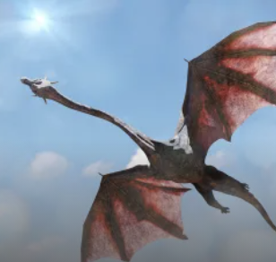
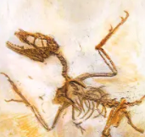
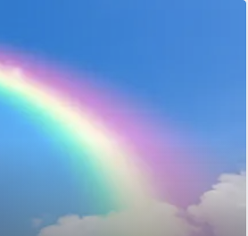
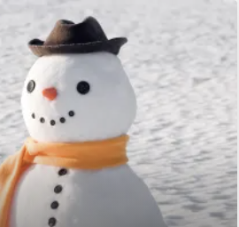
Ohio Standards Alignment
5th Grade - Physical Science
This unit is found under 4th grade on our site, but we recommend teaching several lessons in 5th grade if you are following Ohio Standards.
Human Body, Vision, & The Brain (Human Machine)
 | Topic & Guiding Question | Student Objectives | Ohio’s Learning Standards for Science
 | Muscles & Skeleton Why do your biceps bulge? | Students construct a model of the human hand to explain how muscles pull on bones to create movement. | 3.LS.2 Individuals of the same kind of organism differ in their inherited traits. These differences give some individuals an advantage in surviving and/or reproducing.
 | Light, Eyes, & Vision What do people who are blind see? | Students develop a working model of an eye. They use the model to reason about how light reflects off an object and into the eye, helping an organism process information from the environment. | 5.PS.2 Light and sound are forms of energy that behave in predictable ways.
 | Structure & Function of Eyes How can some animals see in the dark? | Students use their eye model to discover that the pupil controls the amount of light let into the eye. In the dark, pupils get larger to let in more light. | 5.PS.2 Light and sound are forms of energy that behave in predictable ways.
 | Brain, Nerves, & Information Processing How does your brain control your body? | Students investigate how their own brain works by testing their reflexes. They discover that the brain receives information from the senses, processes the information, and sends signals to the muscles to enable movement. | 3.LS.2 Individuals of the same kind of organism differ in their inherited traits. These differences give some individuals an advantage in surviving and/or reproducing.
Lesson 1
Lesson 2
Lesson 3
Lesson 4
Although this appears on our site, we recommend teaching this in 3rd grade if following Ohio Standards.
Although this appears on our site, we recommend teaching this in 3rd grade if following Ohio Standards.
The following mini-lessons can be used to support Ohio Science Standards.
Mini-lesson
Mini-lesson
5.PS.2 How is a rainbow made?
5.PS.2 Why is snow white?
www.mysteryscience.com/docs/ohio

Slide 38


Ohio Standards Alignment
5th Grade - Physical Science
This unit is found under 4th grade on our site, but we recommend teaching all lessons in 5th grade if you are following Ohio Standards.
Sound, Waves, & Communication (Waves of Sound)
 | Topic & Guiding Question | Student Objectives | Ohio’s Learning Standards for Science (2018)
 | Pattern Transfer & Technology How do you send a secret code? | Students explore how digital devices encode complex information. Students generate their own codes in order to transfer information across the classroom. Then, they compare their codes and evaluate which worked best given the criteria and constraints. | 5.PS.2 Light and sound are forms of energy that behave in predictable ways.
 | Sound, Vibration, & Engineering How far can a whisper travel? | Students investigate sound energy using paper cup telephones. Students figure out that sound is a vibration that can travel through a medium. | 5.PS.2 Light and sound are forms of energy that behave in predictable ways.
 | Sound & Vibrations What would happen if you screamed in outer space? | Students construct a model of sound vibrations to explain how air is a medium that sound vibrations travel through. | 5.PS.2 Light and sound are forms of energy that behave in predictable ways.
 | Sound Waves & Wavelength Why are some sounds high and some sounds low? | Students make observations of vibrations and sound waves to discover that high pitch sounds vibrate faster and have short wavelengths and low pitch sounds vibrate slower and have long wavelengths. | 5.PS.2 Light and sound are forms of energy that behave in predictable ways.
Lesson 1
Lesson 2
Lesson 3 Lesson 4
www.mysteryscience.com/docs/ohio

