Slide 1


Scratch Challenge
Template de Slides Carnival
Advanced
RÉCIT document made available, with exception, according to the terms of the Creative Commons 4.0 License.

Slide 2

Scratch Challenge
Present at least one concrete action you can take to reach a sustainable development goal.

Slide 3
Get informed !
01

Slide 4
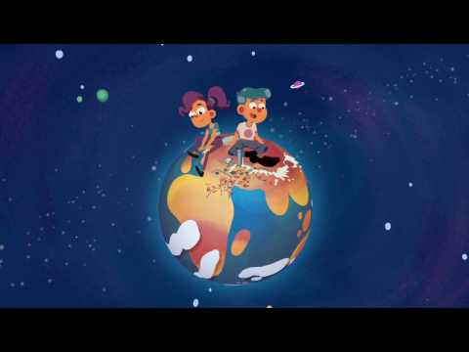

What is sustainable development?
What is sustainable development? - (3 min. 40 s.)

Slide 5
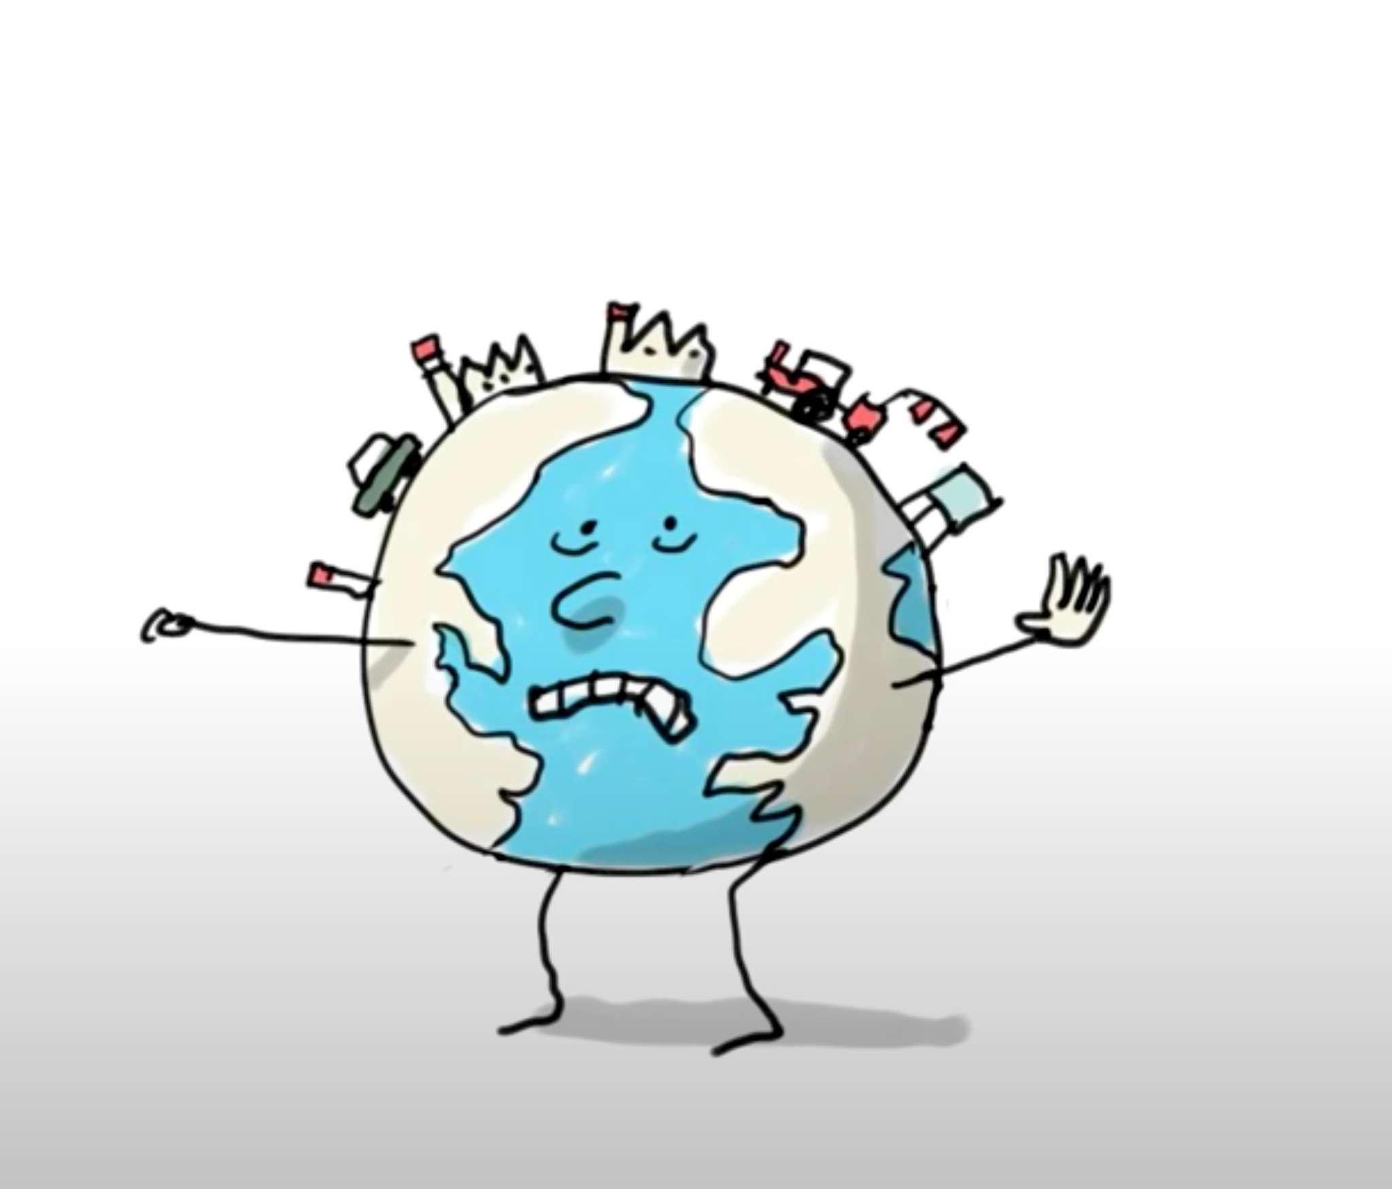
Respectful interactions between humans and the Earth
What suggestions were presented in the video?
Can you think of anymore ?

Slide 6

What is sustainable development?
1
Meet current needs without harming future generations.
Reflect on the consequences of all of our our daily actions.
Make choices with great respect for humans and the Earth.
2
3

Slide 7





Sustainable Development
Environmental Protection
Economic
Viability
Social
Equity

Slide 8

Sustainable Development Goals
Notes:
https://en.wikipedia.org/wiki/Sustainable_Development_Goals#/media/File:Sustainable_Development_Goals.svg

Slide 9
Get inspired !
02

Slide 10
Scratch Challenge
Present at least one concrete action you can take to achieve a sustainable development goal.

Slide 11

Sustainable goal #12 :
Notes:
Sustainable goal chosen for this challenge: Responsible Consumption and Production
Note to teacher: A video explaining the 17 sustainable development goals defined by the UN.

Slide 12
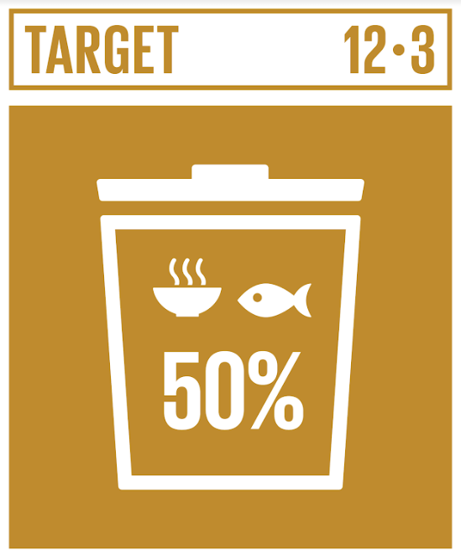


Observe and discuss the LOGOS
Reduce food waste by half
Reduce waste :
reduce, recyclage et reuse
Raise awareness of sustainable development goals and lifestyle in harmony with nature
Notes:
These logos represent issues. Describe what you see on the different logos.
Have students discuss what actions that could be taken or that they are already taking.

Slide 13
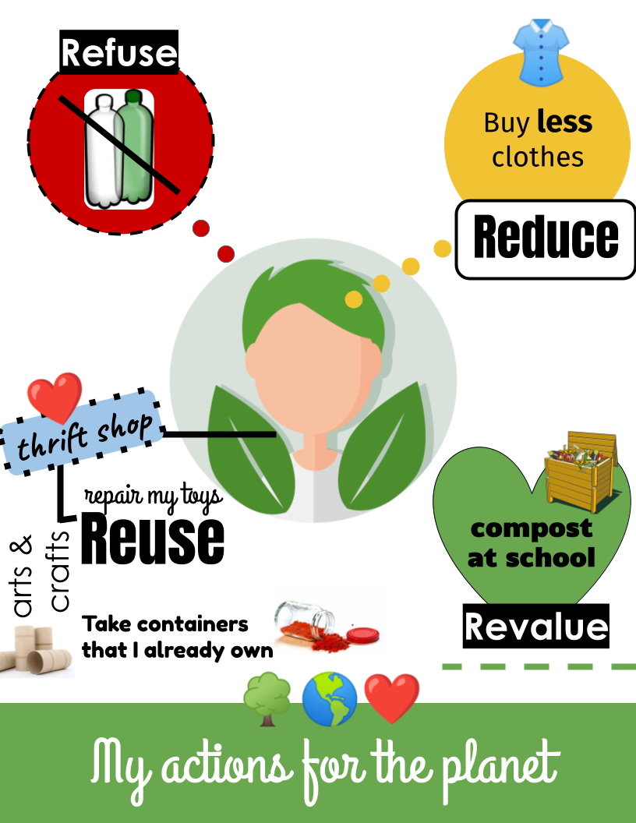
Actions to reduce waste
What actions are you already taking?
What actions can you take?

Slide 14
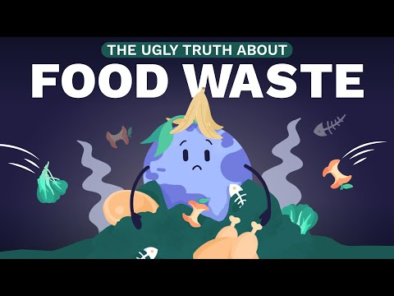
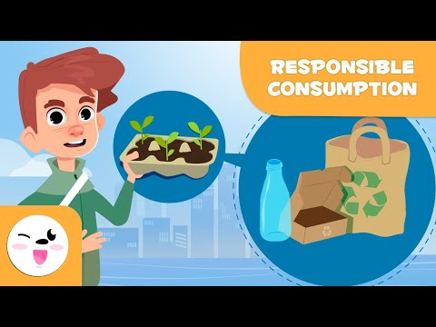
Other video suggestions
What is
food waste ?
How to
reduce waste ?
Notes:
Suggestions
Food waste https://youtu.be/ishA6kry8nc or https://www.youtube.com/watch?v=0eqxgvZNn0I
Waste reduction: https://youtu.be/TPG6E4nxtSw or https://www.youtube.com/watch?v=EGzg77rx7Uo

Slide 15
Planning my work !
03

Slide 16
Scratch Challenge
Present at least one concrete action you can take to achieve a sustainable development goal.

Slide 17
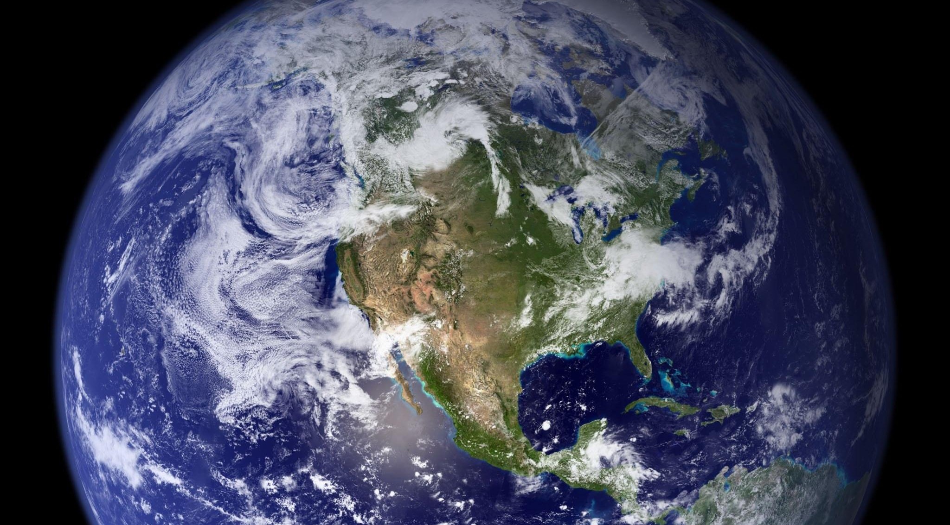
My scenario: What subject will you address?
-
O
X
Reduce
Refuse
Recycle
Repurpose
Composting
Food waste
Other?

Slide 18
Coding my animation
04

Slide 19
Criteria
💡 Content of the animation or interactive game
Your animation or your game should include:
at least one concrete action you can do;
at least two backdrops;
at least two sprites;
at least one sound or one audio recording.
at least one dialogue between two sprites;
an interaction (e.g.: a question) with the user.

Slide 20
Criteria
💡 Content of the Scratch program
Your program should include:
motion blocks to animate your sprites;
at least one sensing block (e.g.: to ask a question to the user);
at least one conditional statement;
at least one programming loop;
at least two different starting blocks (Events);
an animation between 2 and 4 minutes.

Slide 21
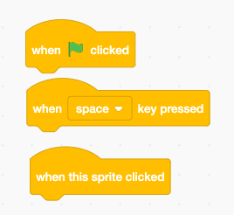
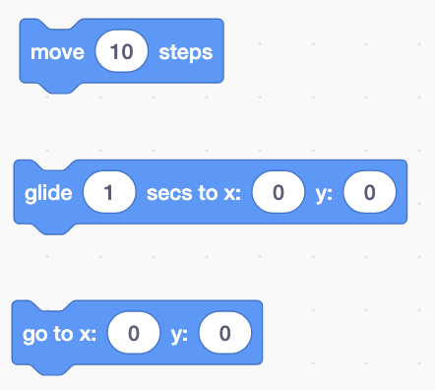

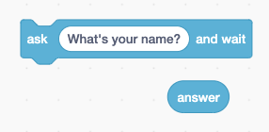
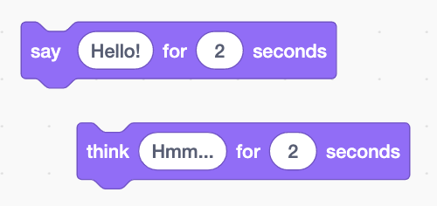
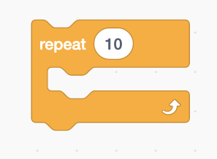
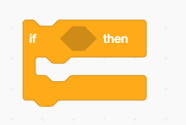
Blocks used in the program

Slide 22
Sharing my animation
05

Slide 23
Criteria (continued)
💡 Elements related to the publication
To publish your project, you should:
have a meaningful title followed by Kreocode 20XX
(e.g. : I recycle - Kreocode 20XX);
use images, photos or sounds that are copyright-free; (no photo or personal information of students)
cite any sources used in the Notes and Credits space;
pay close attention to your use of language;
indicate how to start your program in the Instructions section (if it does not start with the green flag);
share the project when it is completed.

