Slide 1

GRADE 4
Distance Learning Guide
Our recommendations for adapting Mystery Science lessons for socially distant classrooms and online distance learning.
We’ve assigned each lesson one of these labels:
Ready to Teach
These lessons have activities that only need minor modifications to eliminate partner work or shared supplies. For these activities, you can have students work solo without preparing extra supplies.
Adjust Supplies
Jump to a section:
Human Machine
4 lessons
Birth of Rocks
4 lessons
Waves of Sound
3 lessons
Energizing Everything
8 lessons
Guide FAQs
Using Your Mystery Pack
These lessons also have activities that need small changes so students can work solo, but you’ll need to adjust the supply quantities. We suggest how to adjust the supplies.
Demo Activity
These lessons have activities that require coordinated partner work or messy materials, so we recommend demonstrating the activity for students. Students can make detailed observations.
Substitute Activity
These lessons have activities that require specialized materials or adult help. We suggest an alternative activity to do instead.
1

Slide 2

GRADE 4
UNIT Human Machine
View this unit here. | Teaching in the classroom | Teaching online
Lesson 1 Why do your biceps bulge? | Have students do the activity solo. No supply adjustments. | Have students do the activity at home. Send each student home with: 1 index card, 2 paper clips, 1 dot sticker, 18” of string and the Robot Finger template (a digital version will not work).
Lesson 2 What do people who are blind see? | Have students do the activity solo. No supply adjustments. | Have students do the activity at home. Send each student home with: 1 index card, 2 dot stickers, 1 credit card-sized magnifier and the Front of the Eye template (a digital version will not work).
Lesson 3 How can some animals see in the dark? | Students can do the first part of the activity with a mirror in a dark room, observing their eyes as they turn the lights on and off. (Step 7 shows what happens.) Students can do Steps 8 - 15 solo. Send students home with their eye model to complete the remaining steps with a partner. | Students need their eye model and the Pupil Card template. Students can do the first part of the activity with a mirror in a dark room. Students should observe their eyes as they turn the lights on and off. (Step 7 shows what happens.) Students can do Steps 8 - 15 solo but need a partner for the final steps.
Lesson 4 How does your brain control your body? | Have students do the lesson’s 2 short activities during class. The reflex test activity requires two people, so you can assign this for students to complete at home with a partner. | Have students do the lesson’s 2 short activities at home. The reflex test activity requires two people. Send each student home with the Think Fast! worksheet (or assign the digital copy).
Ready to Teach
Ready to Teach
Adjust Supplies
Ready to Teach
2

Slide 3
GRADE 4
UNIT Birth of Rocks
View this unit here. | Teaching in the classroom | Teaching online
Lesson 1 Could a volcano pop up where you live? | Have each student complete one portion of the Volcano Mapping on their own. You will need 2x as many Volcano Mapping printouts. Collect the maps and assemble them as described in the step-by-step activity instructions. | Send each student home with the Volcano Mapping and Volcano Discoveries printouts (or assign the digital versions). Students can complete a portion of the map on their own and then share what the maps look like over video conference.
Lesson 2 Why do some volcanoes explode? | Set up a cup with thick lava and a cup with thin lava and have your students make observations as you demo the activity. Provide students with the Lava Experiments worksheet so they can record their observations. | Set up the activity and demo over video conference. Send each student home with the Lava Experiments worksheet (or assign the digital version) so they can record their observations.
Lesson 3 Will a mountain last forever? | Set up containers with sugar cubes and have your students make observations as you demo the activity. Provide students with the Sugar Shake Data worksheet so they can record their observations. | Set up the activity and demo over video conference. Send each student home with the Sugar Shake Data worksheet (or assign the digital version) so they can record their observations.
Lesson 4 How could you survive a landslide? | Have students do the activity solo. No supply adjustments. | Send each student home with 10 Post-Its and the Saving My Slide-City Home worksheet (or assign the digital version). This activity includes a group brainstorm. If possible, have students brainstorm together virtually.
Adjust Supplies
Demo Activity
Demo Activity
Ready to Teach
3

Slide 4
GRADE 4
UNIT Waves of Sound
View this unit here. | Teaching in the classroom | Teaching online
Lesson 1 How far can a whisper travel? | Students can do the first part of the activity on their own (Step 1 - 8). Partner steps can be completed at a distance if the teacher is able to help tie the two phone strings together (Step 10). | Send each student home with 1 paper cup, 1 paper clip and 6 feet of string. Students can do the first part of the activity solo (Step 1 - 8). They will need a partner and extra supplies for the remaining steps.
Lesson 2 What would happen if you screamed in outer space? | This lesson has two activities. For the first, you need 1 balloon and 1 binder clip per student. Have students do the activity solo, holding their own balloon while they make sounds. For the second activity, watch Steps 4 - 6 of the step-by-step instructions. | This lesson has two activities. For the first, you need 1 balloon and 1 binder clip per student. Have students do the activity solo, holding their own balloon while they make sounds. For the second activity, watch Steps 4 - 6 of the step-by-step instructions.
Lesson 3 Why are some sounds high and some sounds low? | An oscilloscope draws a picture of a sound. Students can explore this online oscilloscope and follow instructions for the 3 experiments. Challenge students to make a sound that makes skinny waves and one that makes wide waves. Ask them to describe what’s different about the sounds that make different waves. | An oscilloscope draws a picture of a sound. Students can explore this online oscilloscope and follow instructions for the 3 experiments. Challenge students to make a sound that makes skinny waves and one that makes wide waves. Ask them to describe what’s different about the sounds that make different waves.
Ready to Teach
Adjust Supplies
Substitute Activity
4

Slide 5
GRADE 4
UNIT Energizing Everything
View this unit here. | Teaching in the classroom | Teaching online
Lesson 1 How is your body similar to a car? | Print and set up two Twist-o-matics for the class to observe during a demo. Give each student the Twist-o-matic Challenges worksheet so they can record their ideas and observations. | Print and set up two Twist-o-matics for the class to observe over video conference. Send each student home with the Twist-o-matic Challenges worksheet(or assign a digital version) so they can record their ideas and observations.
Lesson 2 What makes roller coasters go so fast? | Set up Bumper Coasters I (with foam tubing or paper) for a demo. This video shows how to make a paper bumper coaster in about 10 minutes. Provide students with the Distance & Height Experiments and Collision Experiments worksheets to record their observations. | Set up Bumper Coasters I (with foam tubing or paper) for a demo. This video shows how to make a paper bumper coaster in about 10 minutes. Send students home with Distance & Height Experiments and Collision Experiments worksheets (or assign a digital version) so they can record their observations.
Lesson 3 Why is the first hill of a roller coaster always the highest? | Set up Bumper Coasters II with ramps (foam tubing or paper) as a class demo. Provide students with the Bumper Coaster with Hills worksheet so they can record their observations. | Set up Bumper Coasters II with ramps (foam tubing or paper) as a demo over video conference. Send each student home with the Bumper Coaster with Hills worksheet (or assign a digital version) so they can record their observations.
Lesson 4 Could you knock down a building only using dominoes? | Students can build their chain reaction machine while working solo. But there are a few partner steps in the activity. To make solo work easy, we’ve created new versions of Step 8b and Step 9b in the activity. | Send each student home with a Dixie cup, 8oz paper cup, a paper clip, 3 stickers (or pieces of tape), a rubber band, and a marble. They also need a marker, ruler, and scissors. To make solo work easy, we’ve created new versions of Step 8b and Step 9b in the activity.
Demo Activity
Demo Activity
Demo Activity
Ready to Teach
5

Slide 6
GRADE 4
UNIT Energizing Everything
View this unit here. | Teaching in the classroom | Teaching online
Lesson 5 Can you build a chain reaction machine? | Have students build their own chain reaction machines at home (for even more fun!). You’ll need 2x the number of Dixie cups, stickers, index cards, paper clips and pop-up signs. Watch this video with students to get started, and encourage them to watch our inspiration videos. | Have students build their own chain reaction machines at home (for even more fun!). You’ll need 2x the number of Dixie cups, stickers, index cards, paper clips and pop-up signs. Watch this video with students to get started, and encourage them to watch our inspiration videos.
Lesson 6 What if there were no electricity? | Have students do the activity solo. No supply adjustments. | Send each student home with a battery, LED, index card, aluminum foil (4”x12”), and stickers. Each student will also need a Flashlight Maker worksheet (or assign a digital version).
Lesson 7 How long did it take to travel across the country before cars and planes? | Set up Heat Spinners yourself (Part 1 of the activity) and have your students make observations as you demo (Part 2). Students can complete the Inventing a Heat Engine worksheet as they make observations about the demo. | Set up Heat Spinners yourself (Part 1 of the activity). Have students make observations as you demo (Part 2) over video conference. Send each student home with the Inventing a Heat Engine worksheet (or assign a digital version).
Lesson 8 Where does energy come from? | Have students do the activity solo. No supply adjustments. | Have students do the activity at home. Send each student home with a copy of the printout or assign a digital version.
Adjust Supplies
Ready to Teach
Demo Activity
Ready to Teach
6

Slide 7
GRADE 4
Guide FAQs
Additional recommendations for using this guide to adapt Mystery Science for socially distant classrooms and online distance learning.
Where should I start?
Human Machine is the easiest Grade 4 unit to adapt for distance learning, so we recommend starting with that unit.
What does it mean when the guide says students can work “solo”?
Our lessons are designed to get students talking and working together, but group work and sharing supplies is not advised at present. So, when we mention students working “solo,” we mean that students can work independently at home or in the classroom, without partners or sharing supplies.
Where can I find all of the printouts for the Grade 4 units?
To easily make packets of printouts for students, you can find all the printouts for each grade level here.
What if I skip some of the lessons in a unit?
If you omit lessons, we recommend reviewing the Grade 4 Planning Guide to see the concepts and standards covered in those lessons.
Will students need any additional supplies for the activities?
This guide lists the specialized supplies students need for each activity, but general classroom supplies (such as pencils, scissors, crayons, markers, and rulers) are not listed. We suggest checking the lesson supply lists to know which general supplies students will need.
7

Slide 8
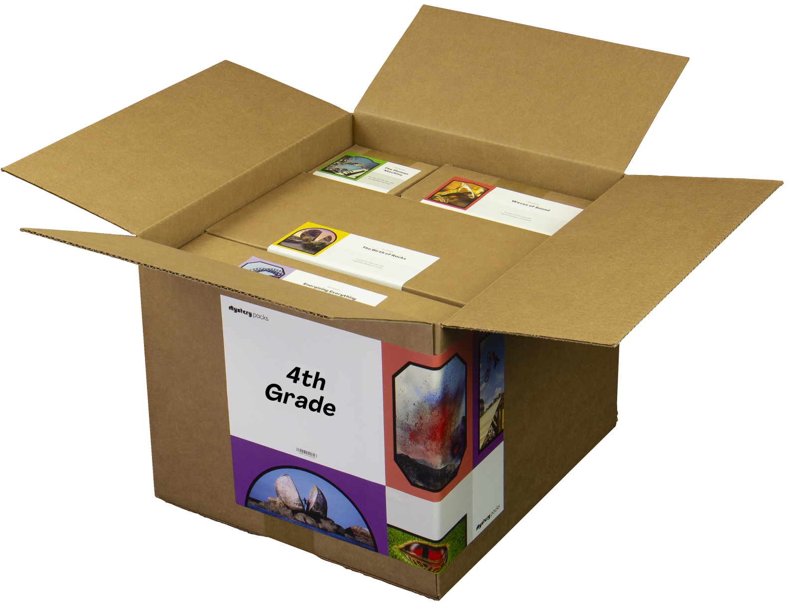
GRADE 4
Using Your Mystery Pack
Mystery Packs are supply kits that contain all the materials needed to teach Mystery Science for the entire year. Each box contains supplies for a class of 30 students.
Does my Mystery Pack contain enough supplies to send home?
For activities labeled Ready to Teach, there are enough supplies in your box for each student to have their own materials. For activities labeled Adjust Supplies, you’ll need some extra materials so that students can work on their own without sharing supplies.
What if I can’t send supplies home to students?
If students don’t have access to supplies, you can turn some activities into demonstrations and share via video conference. Students can participate by recording their observations.
What if I don’t use all of my supplies this year?
Don’t worry! You can still use your Mystery Pack next school year. You’ll just need to refill any supplies that you do use this year.
I don’t have a Mystery Pack. Can I still order one?
Yes! Packs are still available for purchase. You can learn more about Mystery Packs and how to get them here.
8

