Slide 1
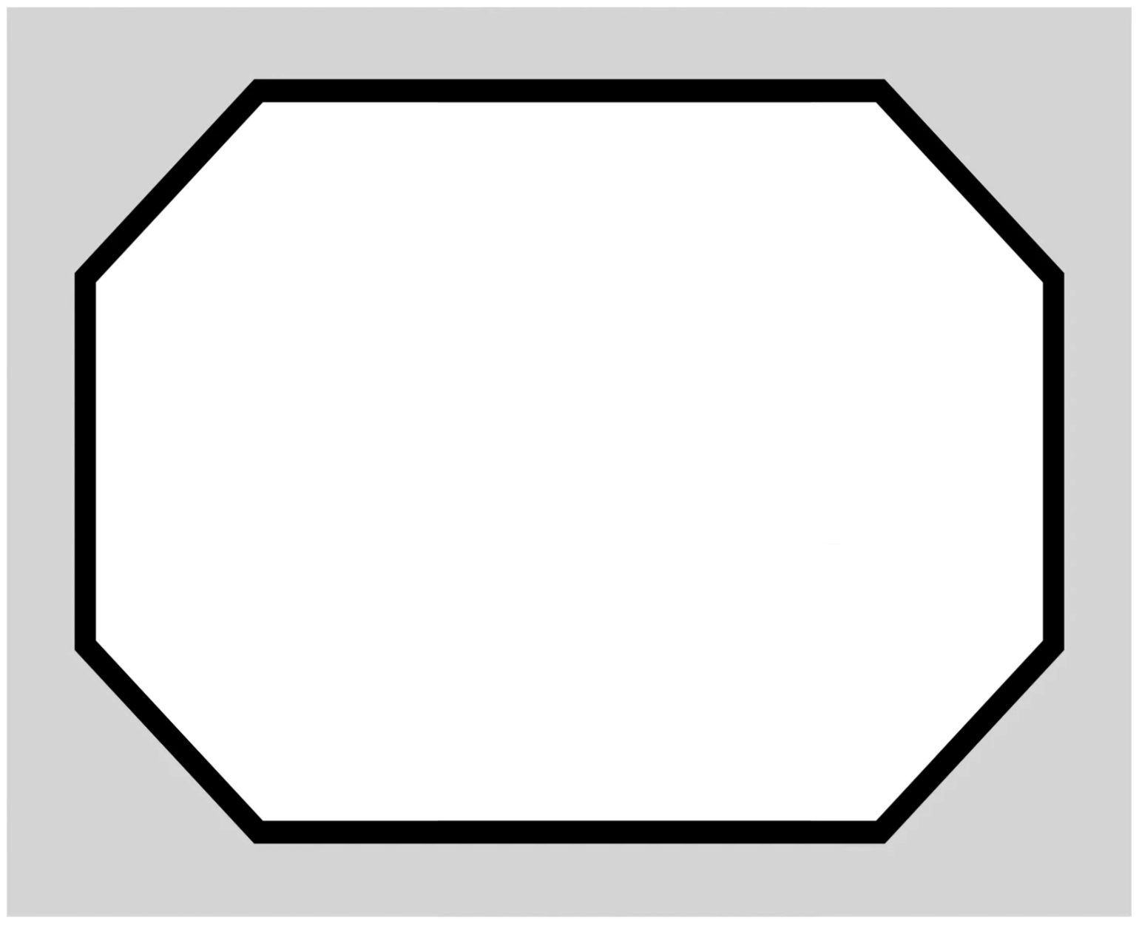
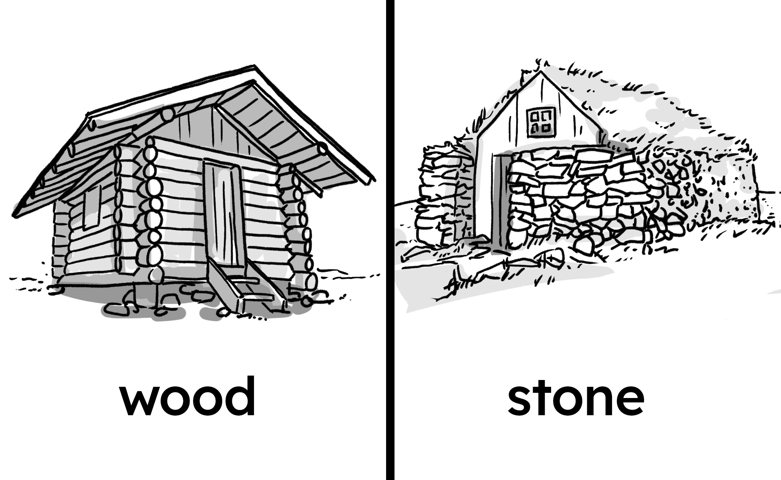

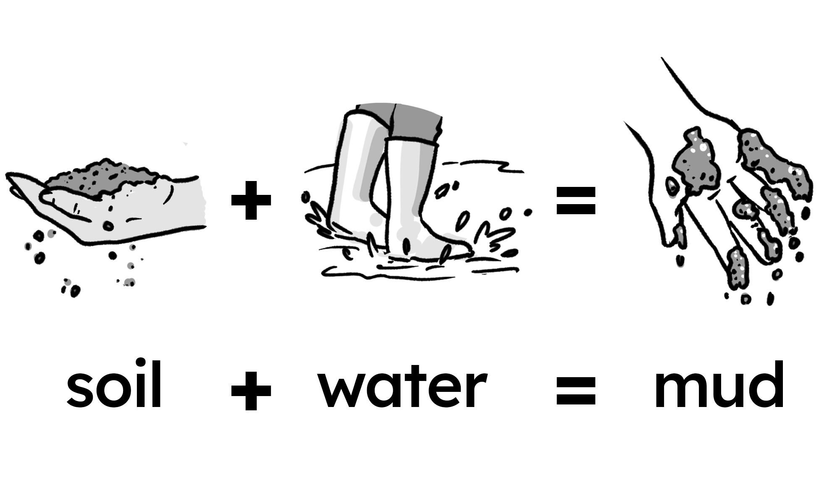
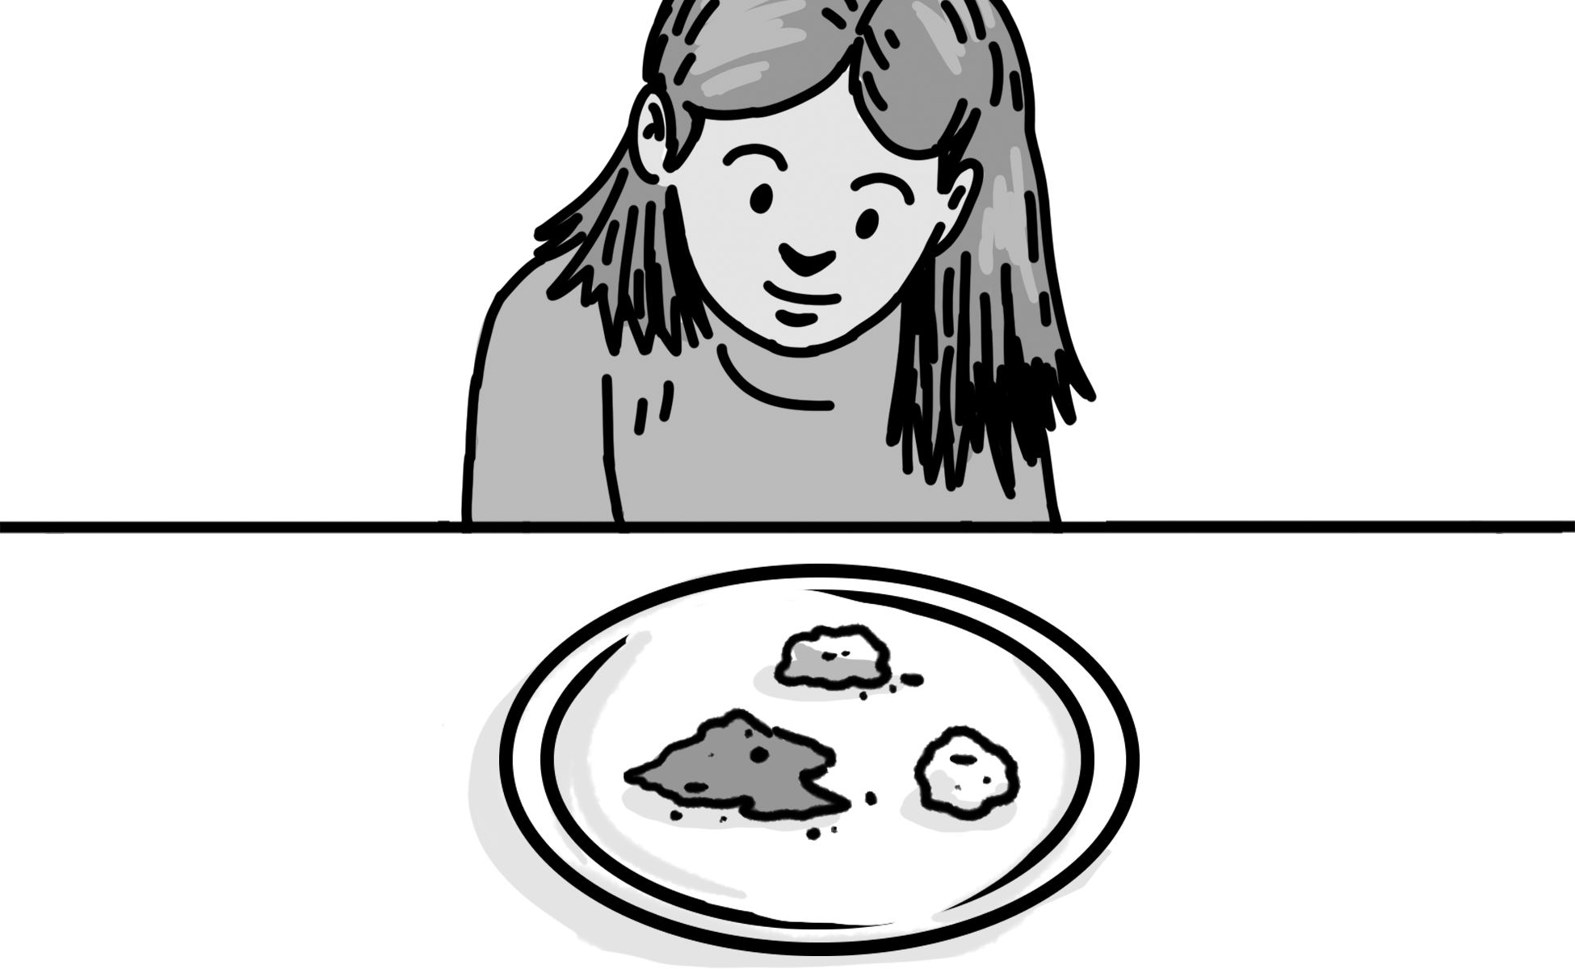
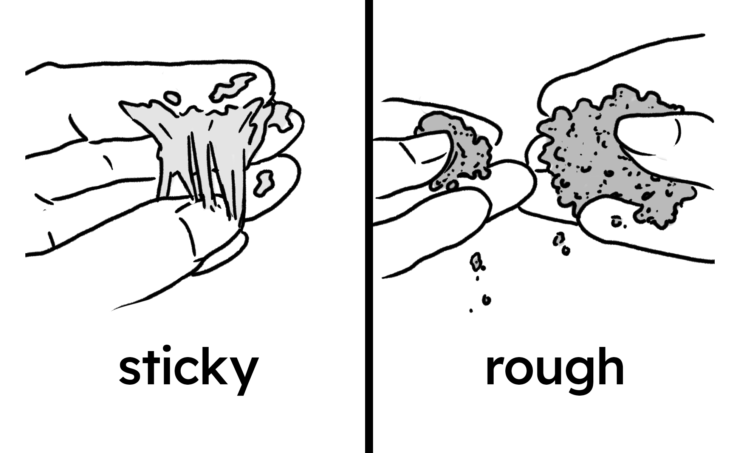
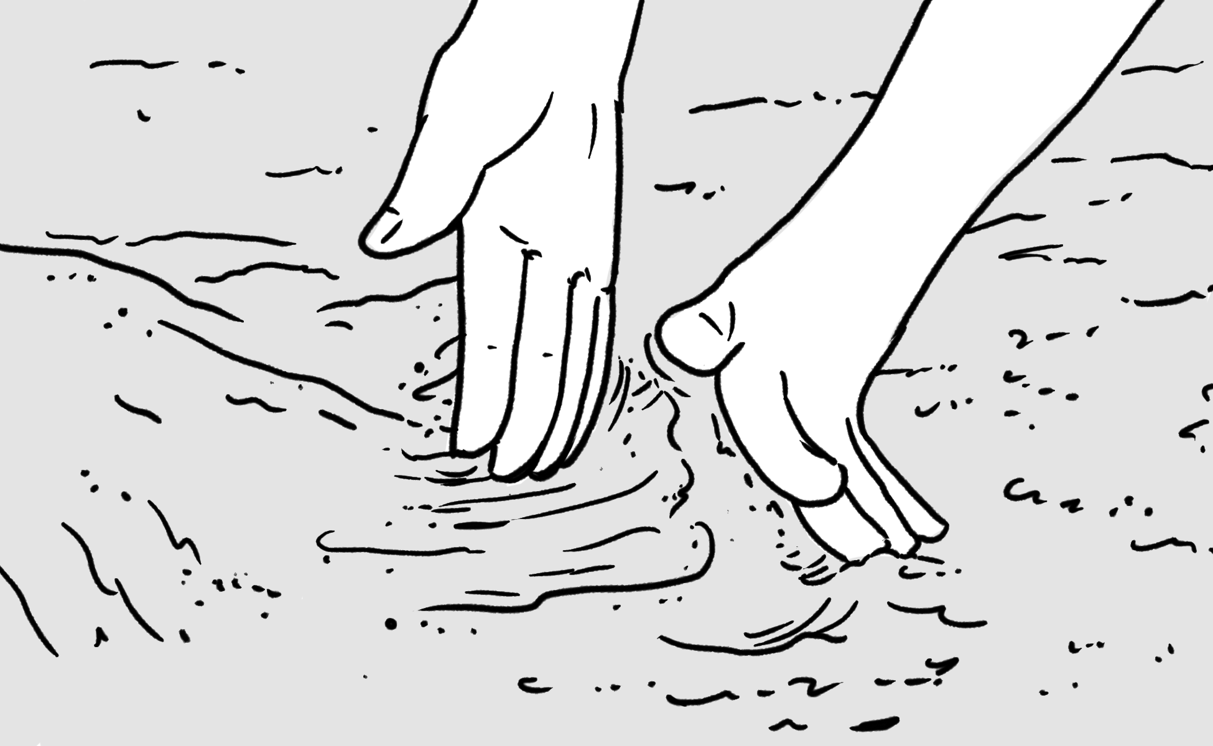
material
Vocabulary
Lesson: How do you build a city out of mud?
what something is made of, like wood or stone
mixture
observe
a combination of two or more things
to pay close attention to something
property
texture
something you can observe about an object or material
how something feels to touch, such as rough or smooth

Slide 2
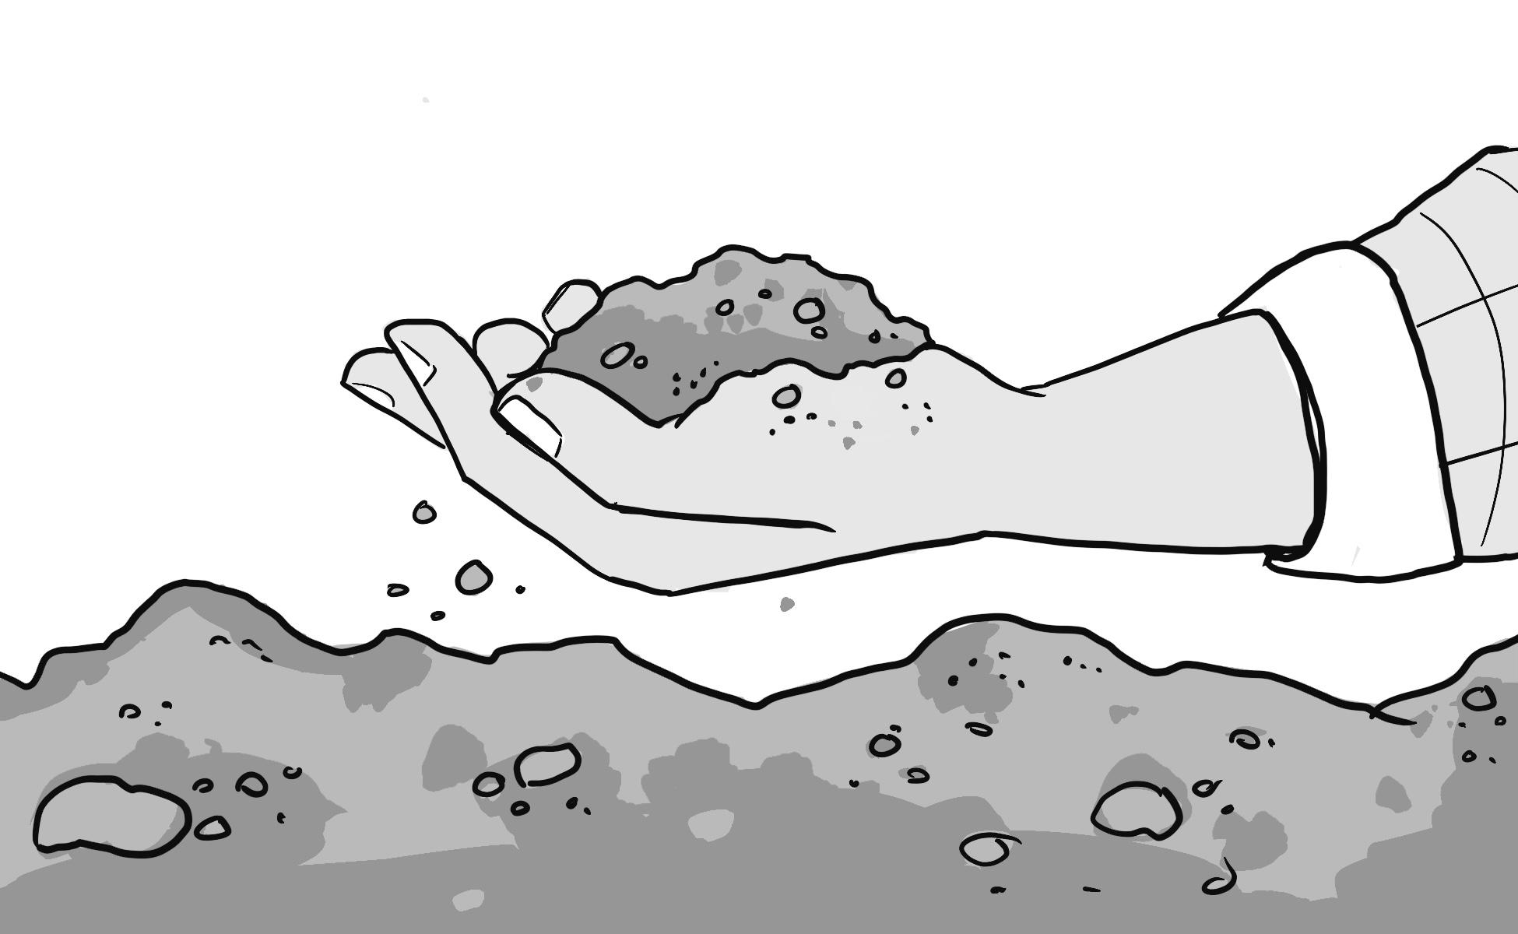
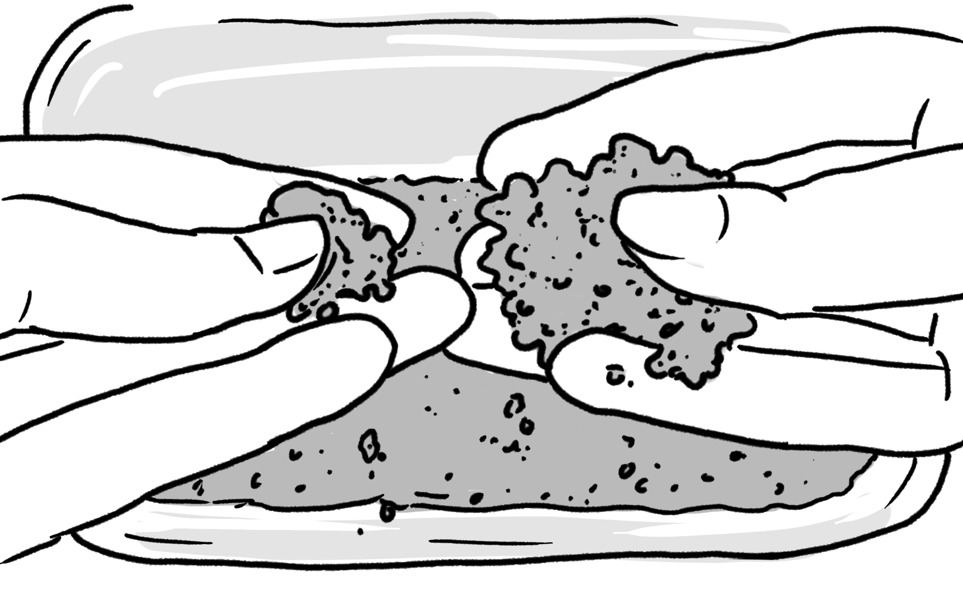
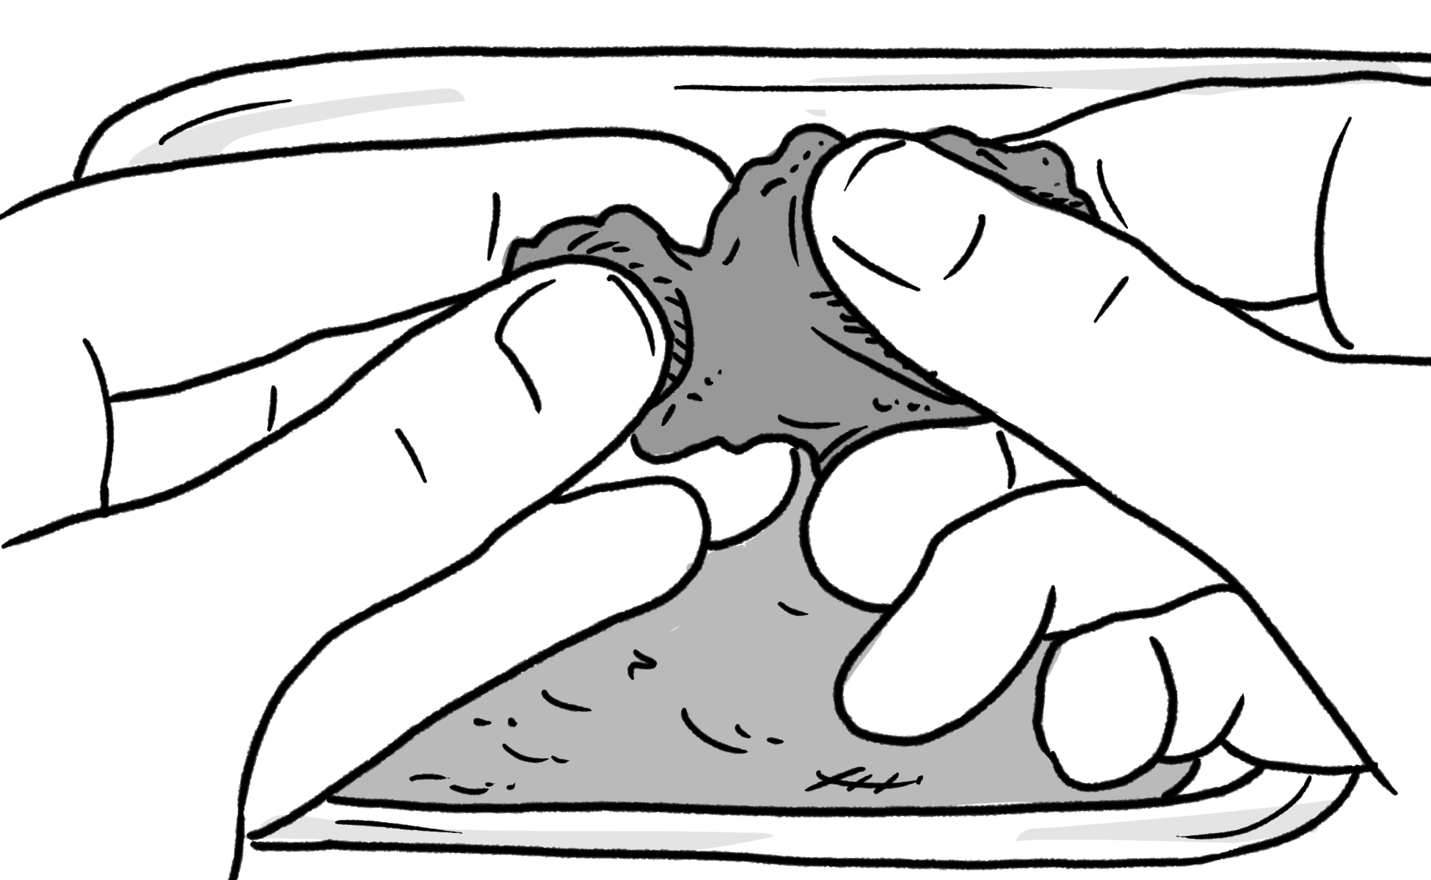
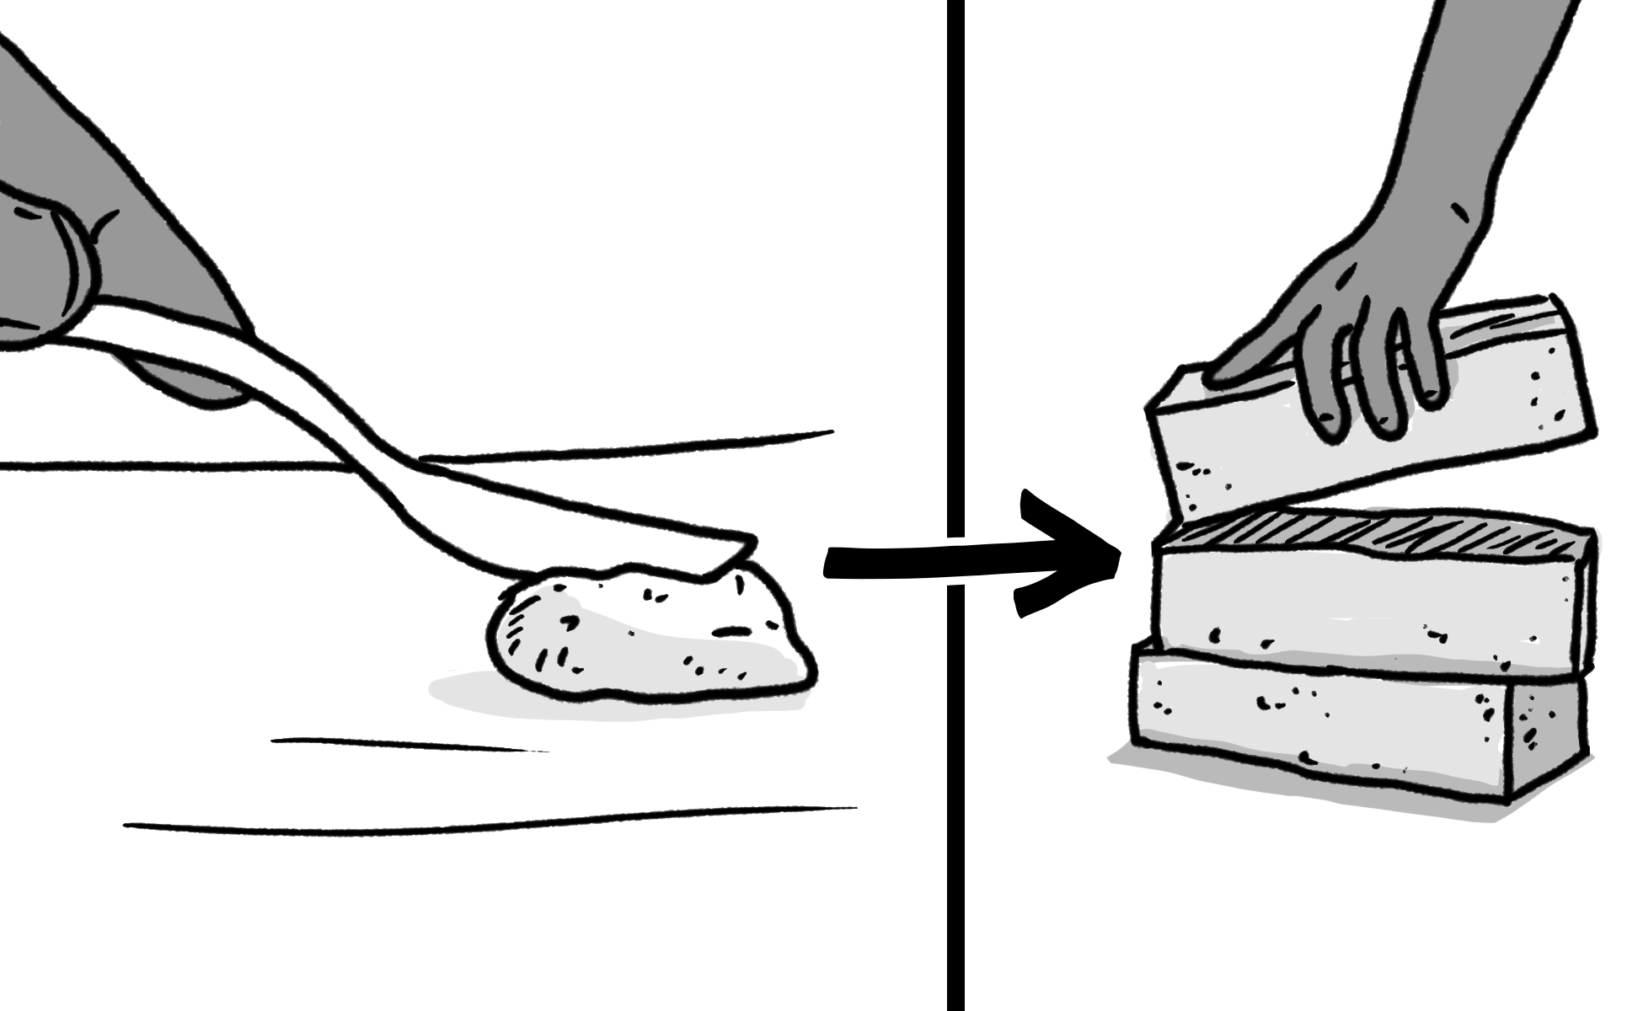
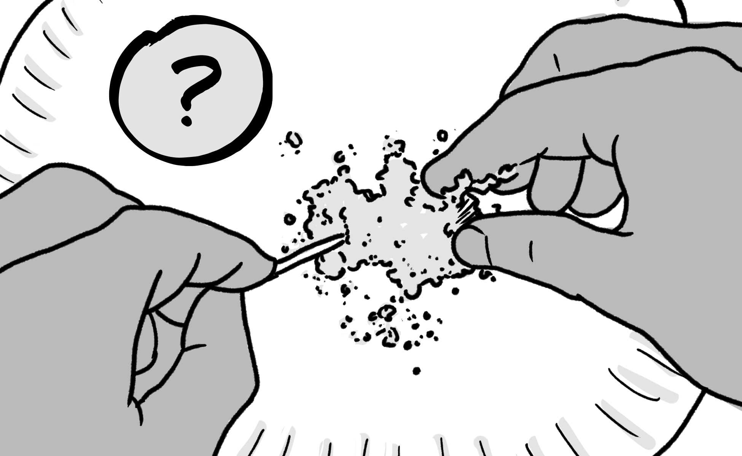
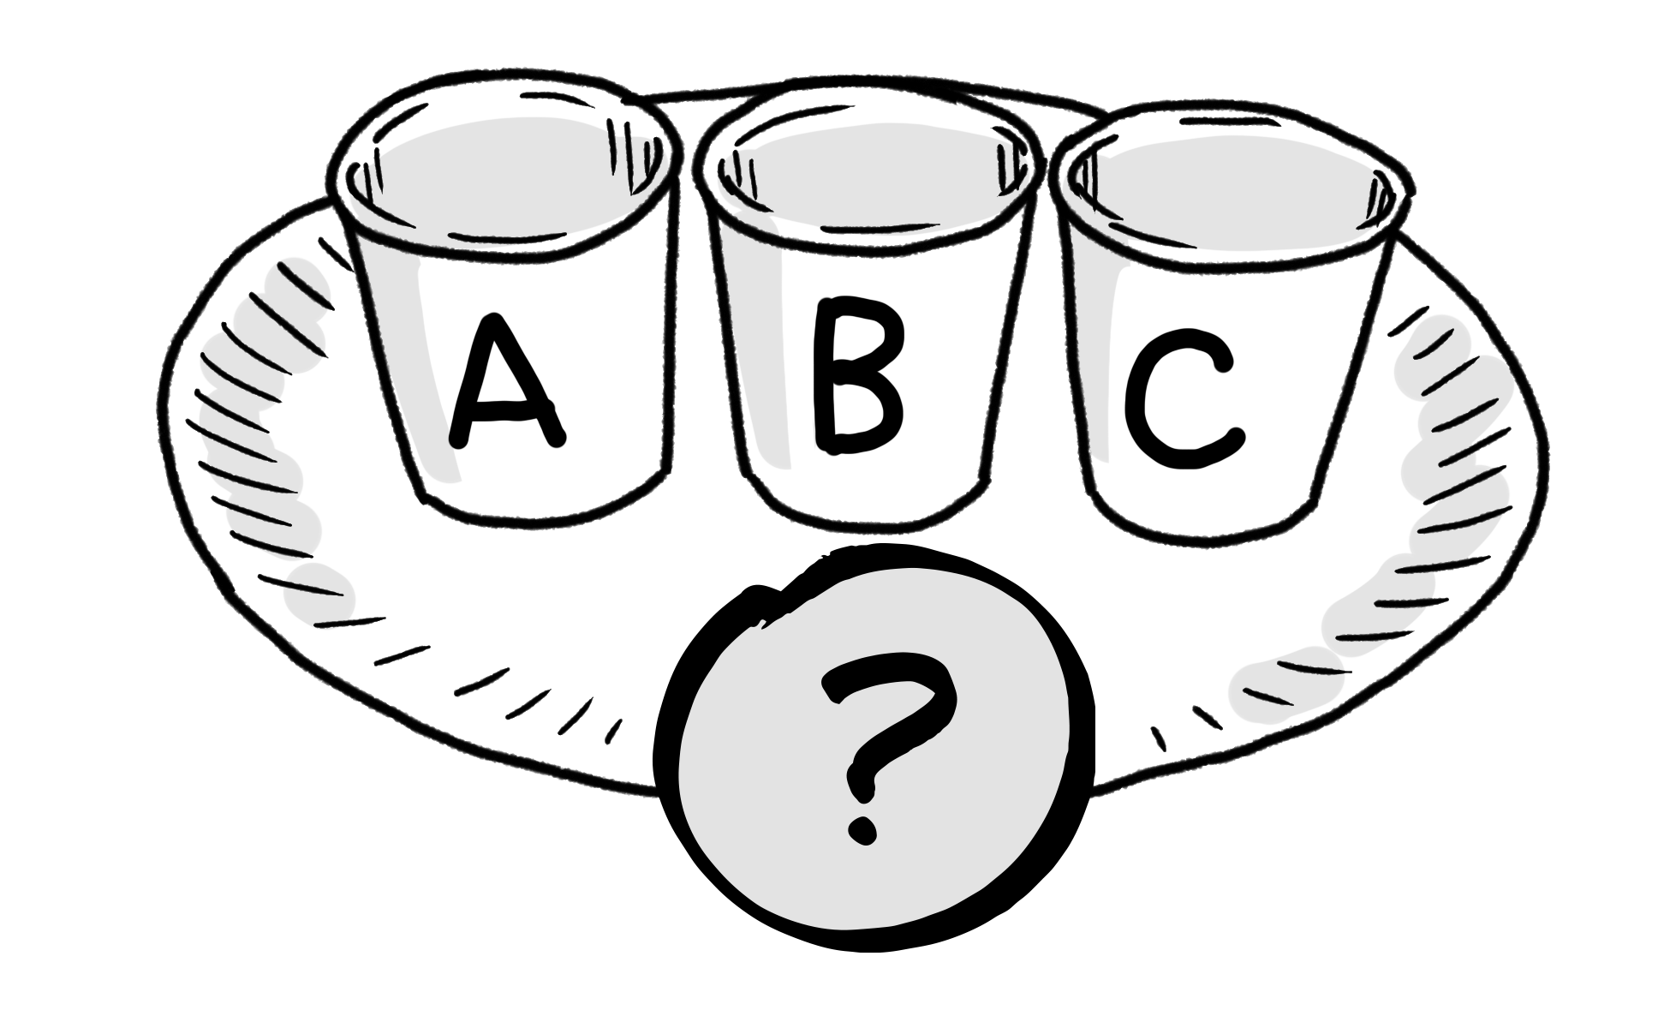
soil
sandy soil
tiny pieces of rock and other materials that cover the ground
a type of soil that has a rough texture; water easily flows through it
clay soil
model
a type of soil that has a smooth texture; water does not easily flow through it
a pretend version of something that scientists use when the real thing is too big, small, or complicated to work with
investigate
experiment
to figure out the answer to a question or to understand how something works
a test used to discover new information about a question

