Slide 1

Tenth Annual Summit
on Evidence-Based Education
Effective School Leadership:
A Cornerstone for Improving
Student Performance

Slide 2
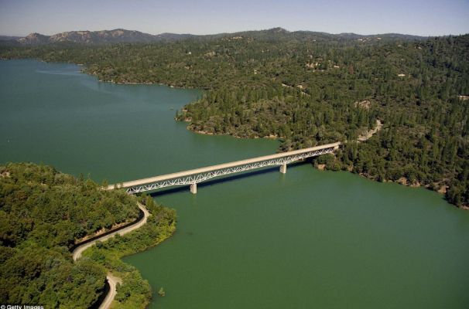
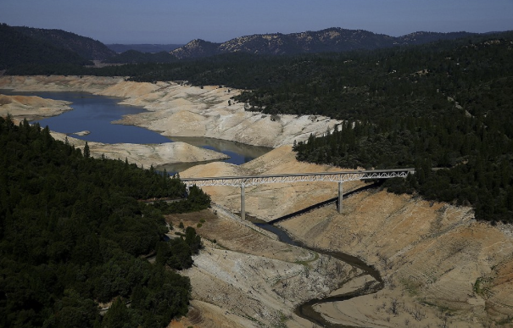
Welcome to sunny, sunny, sunny, sunny California!
Most severe drought (2012–2014) in the last 1200 years.
Griffin & Anchukaitis (2014)

Slide 3
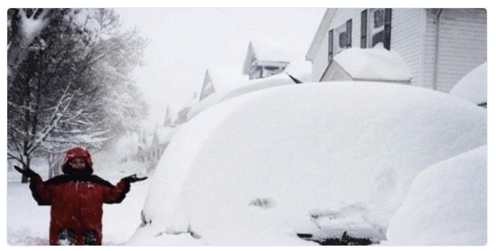
Buffalo, NY (2014)

Slide 4
40 years studying “research to practice” issues…
30 years from the “practice” side
10 years from the “research” side

Slide 5
1978 - 2004
Operated a large non-profit organization in SF Bay Area
six spec. ed schools adult programs
residential programs employment supportive services
public school consultation teacher training campus
Implemented an organizational culture based on:
Evidence-based Clinical problem solving
research to practice data-based decision making
Performance feedback Positive reinforcement
student, staff, organization student, staff, organization
Notes:
How many worked for us ?

Slide 6
2004 - present
independent, non-profit operating foundation
promote evidence-based education policies and practices
act as a catalyst to facilitate communication, cooperation and collaboration between individuals and organizations currently engaged in evidence based education
engage in data-mining, gathering, analyzing and disseminating data

Slide 7
Summit Model
Posit a “wicked” problem
Assemble people who are much smarter than we are
Create an environment that is structured, intellectually stimulating, informal, and above all, reinforcing
4. Have participants do the “heavy lifting”

Slide 8
Wicked problems have…
high level of complexity and thus inherent “trickiness” of the problem
multiple stakeholders with radically different “frames” for understanding the problem …what one side finds satisfactory the other finds abhorrent
complex interdependencies, the effort to solve one aspect
of a wicked problem may reveal or create other problems
there are no good or bad solutions, just better or worse
Notes:
TAME: CLEARLY DEFINABLE, DEMARCATED OR SEPARABLE FROM OTHER PROBLEMS, HAVE SOLUTIONS THAT ARE “FINDABLE”, EVEN IF THEY ARE TECHNICALLY DIFFICULT.
WICKED: ILL-DEFINED OR DEFINED IN MULTIPLE WAYS, RELY ON POLITICAL JUDGMENT.

Slide 9
Summit Model
Posit a “wicked” problem
Assemble people who are much smarter than we are
Create an environment that is structured, intellectually stimulating, informal, and above all, reinforcing
4. Have participants do the “heavy lifting”
MORATORIUM

Slide 10
What kind of word is “posit” anyway?
Synonyms
hypothesize a “wicked” problem
hypothesize
presume
postulate
conclude
consider
suspect
feel
fancy
have a hunch
have sneaking suspicion
reckon
postulate a “wicked” problem
consider a “wicked” problem
fancy a “wicked” problem
suspect a “wicked” problem
have a hunch about a “wicked” problem
have a sneaking suspicion about a “wicked” problem

Slide 11
What kind of word is “posit” anyway?
Antonyms
be honest about a “wicked” problem
abstain
be honest
disbelieve
know
leave
misunderstand
disregard
forget
ignore
neglect
not believe
reject
misunderstand a “wicked” problem
consider a “wicked” problem
ignore a “wicked” problem
forget a “wicked” problem
disregard a “wicked” problem
reject a “wicked” problem

Slide 12
What if we DIDN’T POSIT a wicked problem??
What if we NEVER POSITED a wicked problem
ever again??

Slide 13
Summit Model
Posit a “wicked” problem
Assemble people who are much smarter than we are
Create an environment that is structured, intellectually stimulating, informal, and above all, reinforcing
4. Have participants do the “heavy lifting”
MORATORIUM

Slide 14
Participant Criteria
Assemble people who are much smarter than we are:
Defining characteristics:
• extremely bright, talented and quick
• successful and accomplished
• practice-based, applied
• science, evidence, research world view
• “walk the walk” in the real world
• shared values
• clever & witty (no pressure)
• nice

Slide 15
Participant Criteria
Assemble people who are much smarter than we are:
folie à deux
a rare disorder where delusional beliefs or ideas are shared by 2 or more people

Slide 16
Summit Participants
1st Summit: Tom Bellamy, Lucille Eber, Betsy Fernandez, Andrew Kim, Michelle Massar, Brian McNulty, Marilyn Murphy
2nd Summit: Bryan Cook, Sheila Alber Morgan, Bill Redmon, Mary Sawyer
3rd Summit: Paul Hippolitus, George Sugai, Susan Wilczynski
4rd Summit: Sam Redding
6th Summit: Ken Denny, David Forbush, Kent Johnson, Larry Maheady, Trina Spencer
7th Summit:
8th Summit: Janet Twyman
9th Summit: Suzy Fitch, Ken Traupmann
10th Summit: Karen Hager, Teri Lewis, Tim Slocum

Slide 17
CYPE Index
(Cumulative Years of Professional Experience)
of Summit Participants
FY 2013: 824
FY 2014: 915
FY 2015: 1026

Slide 18
SPEAKERS
Tom Bellamy, Ph.D
Lucille Eber, Ed.D
Brian McNulty, Ph.D

Slide 19
SPEAKERS
Observations
They are not felons
They are all overachievers.
They seem to have difficulty holding a job.
They have managed to accomplish a feat that is very rare in our field…bridging the research to practice gap
They have dedicated their careers to the improvement of public education
They are very nice

Slide 20
Report Outs
Brian Cook
David Forbush
Sam Redding
George Sugai
Susan Wilczynski

Slide 21
Summit Model
Posit a “wicked” problem
Assemble people who are much smarter than we are
Create an environment that is structured, intellectually stimulating, informal, and above all, reinforcing
4. Have participants do the “heavy lifting”
MORATORIUM
✔

Slide 22
Presentations
Work Activities
Flash Drives
Commentaries
Papers
Proceedings
Dissemination

Slide 23
Summit Model
Posit a “wicked” problem
Assemble people who are much smarter than we are
Create an environment that is structured, intellectually stimulating, informal, and above all, reinforcing
4. Have participants do the “heavy lifting”
MORATORIUM
✔
✔

Slide 24

Today’s Warm Up Exercise:
Common Core gets blamed for everything these days, so it only makes sense to keep a running record of all the trouble it's causing.
A new twitter account sent its first tweet on July 25, 2014

Slide 25
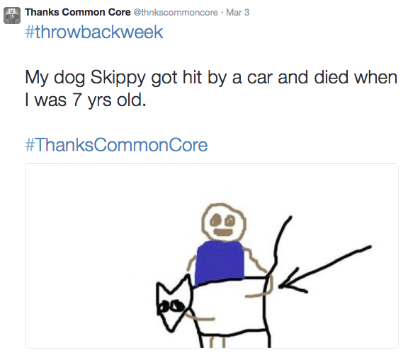

Slide 26
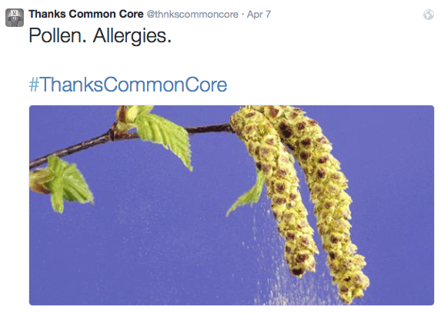

Slide 27
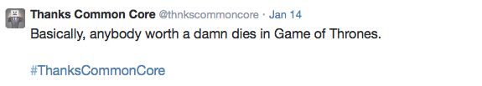
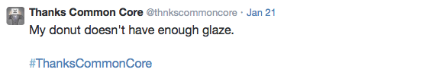
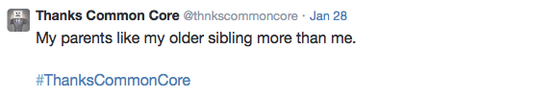
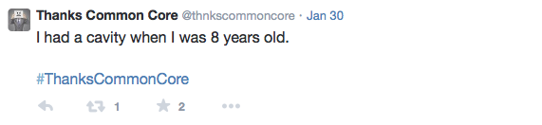

Slide 28
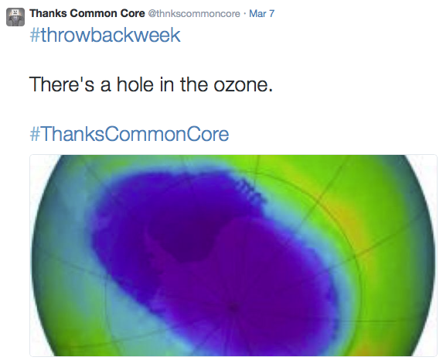

Slide 29
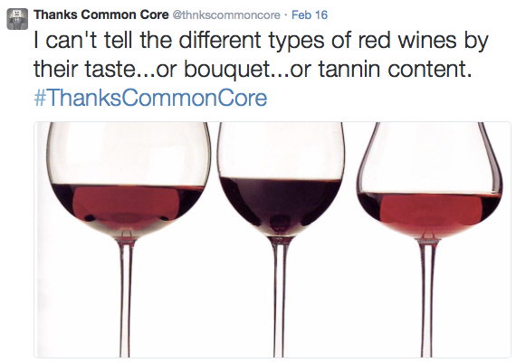

Slide 30
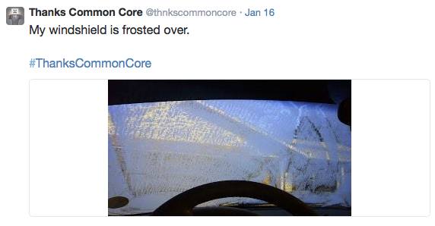

Slide 31
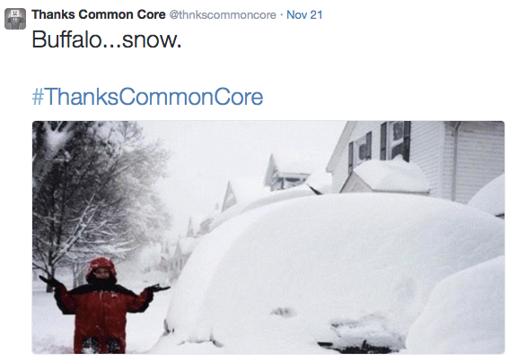

Slide 32
MORATORIUM
Posit a “wicked” problem…..
How can we improve student performance through more effective school leadership?
1. What are the critical components of effective school leadership?
What are the obstacles to building effective school leadership?
3. How do we build school leadership anyway?
PART 1

Slide 33
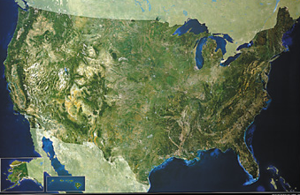
Context
What is the environment in which school leaders must navigate?
Notes:
By way of introduction on why this is so important
we are extremely bad at school reform
one of the reasons is or failure to address the issue of culture
there are strategies we can use

Slide 34
Obstacles to Building Effective School Leadership in Education: Part I
INERTIA
INEQUITY
POLITICS
CULTURE
PREPARATION
TURNOVER
SUSTAINABILITY

Slide 35
1. INERTIA
in·er·tia
The tendency of a body at rest to remain at rest
or of a body in straight line motion to stay in motion
in a straight line…unless acted on

Slide 36
Federal School Reform Actions
Elementary and Secondary Education Act (ESEA)
designed to direct federal education dollars to the most disadvantaged children living in poverty.
2001 No Child Left Behind (NCLB)
• required states set targets for Adequate Yearly Progress (AYP) • sanctions for low performing schools
• an increased policy emphasis on scientific research
• target of 100% proficiency in reading and math by the end of the 2014 school year
Obama / Duncan
• ARRA ($ 100 billion) and NCLB Waivers
• Race to the Top
• School Improvement Grants
• standards, effective teachers & principals, accountability, data systems, improving low performing schools

Slide 37
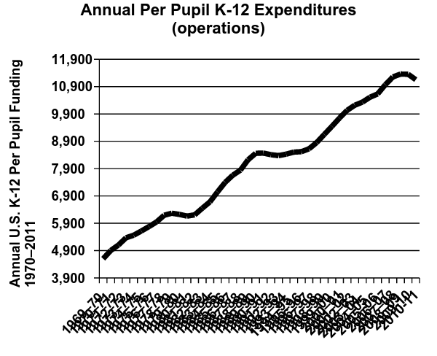
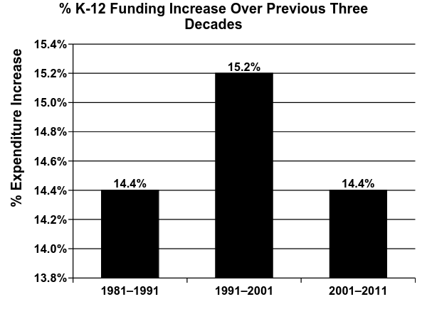
Public School Annual Expenditures per Student (1969–70 to 2010–11)
Funding Increase by Decade (1981–2011)
2013 Digest of Educational Statistics, National Center for Education Statistics

Slide 38
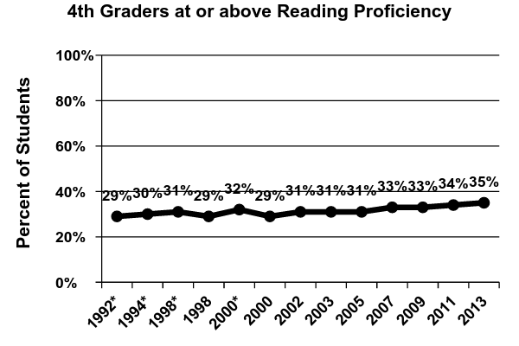
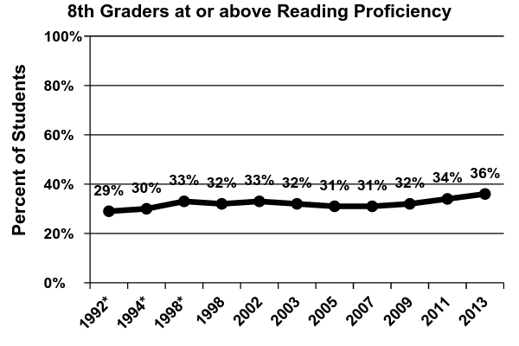
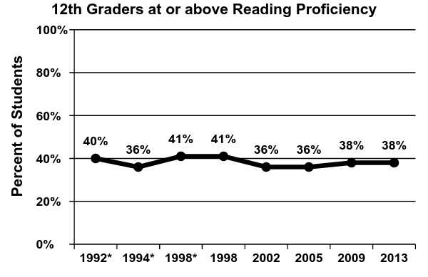
NAEP Reading Proficiency

Slide 39
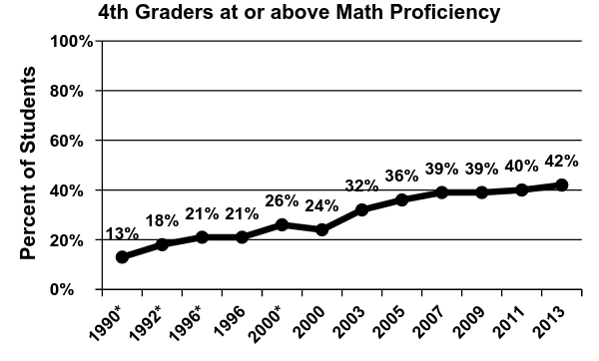
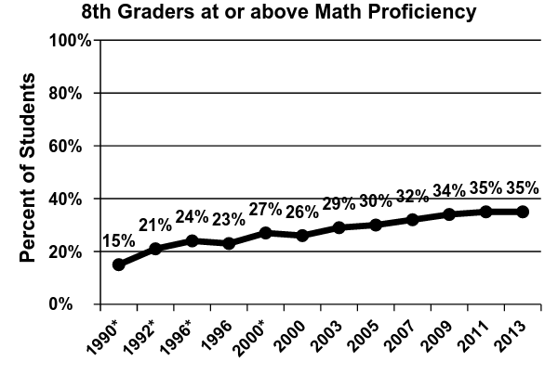
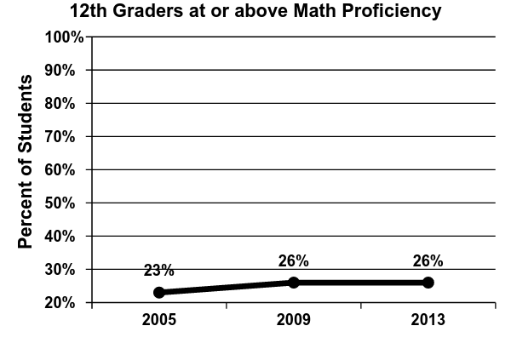
NAEP Math Proficiency

Slide 40
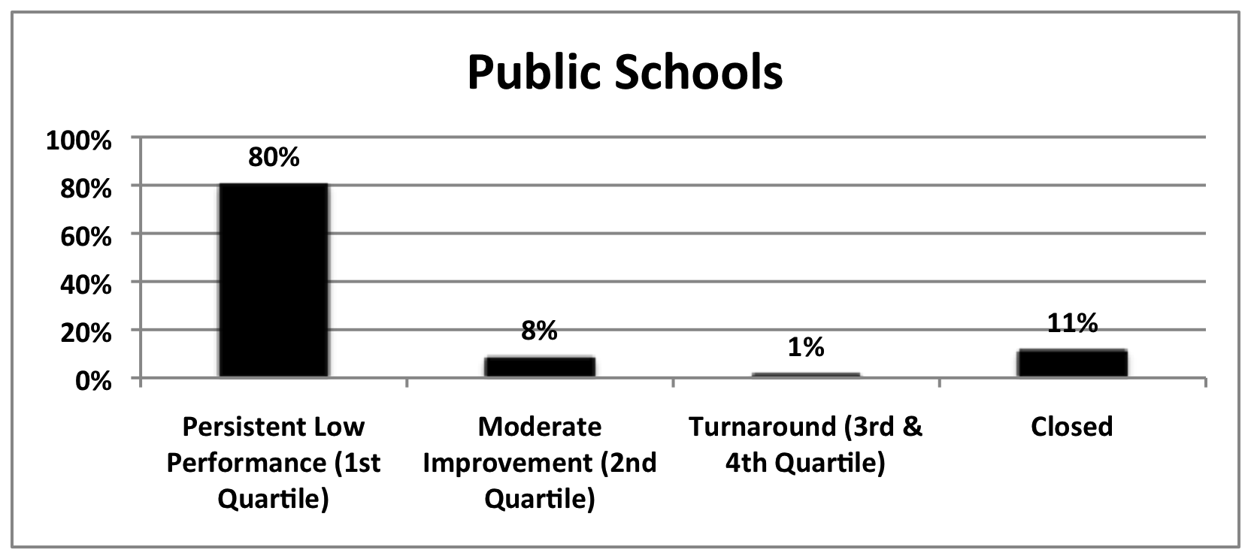
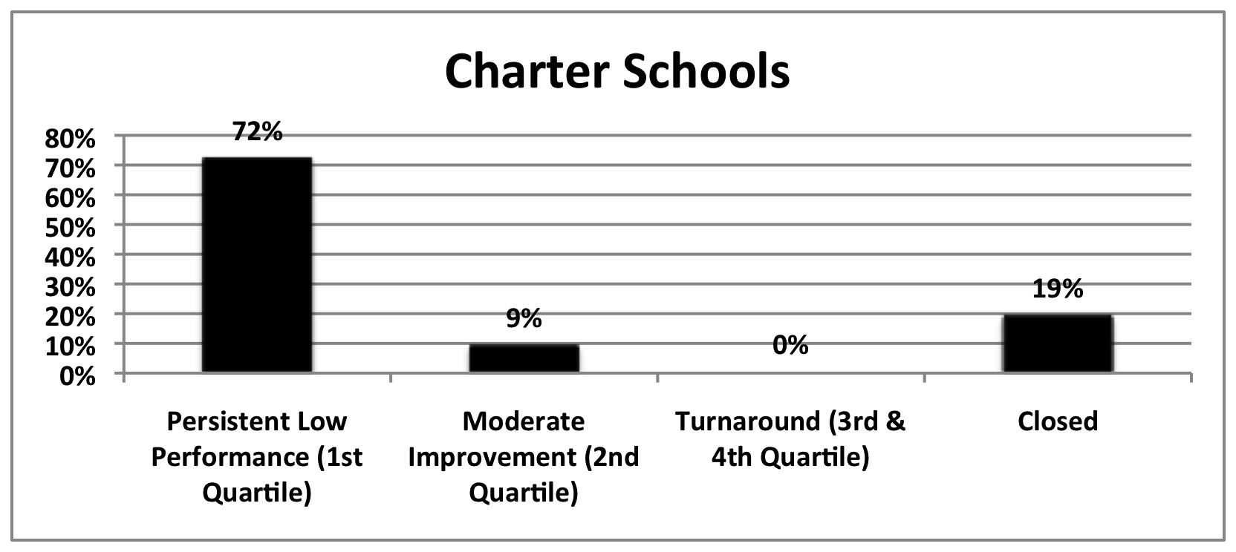
Education Structural Interventions
No Child Left Behind
Tracked progress of
2,025 low-performing
charter & district schools
across 10 states
(2003-04 TO 2008-09)
Thomas B. Fordham Institute,
Are Bad Schools Immortal? (2010)
Notes:
Low performing schools = avg. combined 02/03, 03/04 reading and math proficiency in lowest 10%
= schools failed to meet AYP proficiency targets two years in a row
Turnaround = test scores above 50th percentile in last two years 07/08, 08/09

Slide 41
2. INEQUITY
equity vs. equality
Equity in education aims at fairness in the distribution of educational resources; it is distribution based on need.
Equality is distribution of the same for all. (Erakovich, 2011)
Equity goes beyond educational equality of opportunity.
Equity involves both opportunity as well as results.
opportunity = resources
results = outcomes

Slide 42
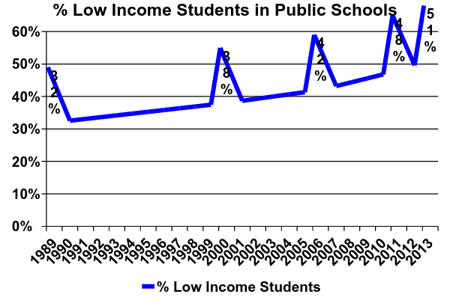
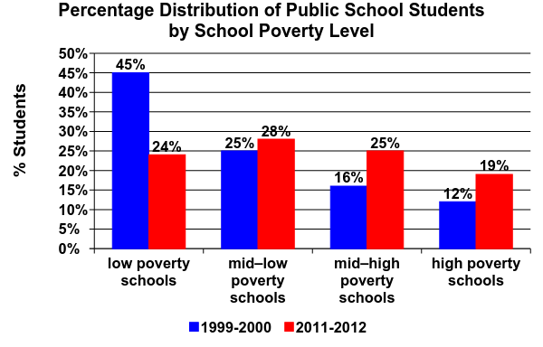
Low Income Students in Public Education
A New Majority,
Southern Education Foundation,
NCES (2015)
The Condition of Education 2014, National Center for Education Statistics
Notes:
19% of public school students attend a high poverty school
National School Lunch Program (NSLP), Free and Reduced-price Lunch Program (FRLP).
Low poverty = 25% or less of students quality
High poverty = 75% of students who qualify

Slide 43
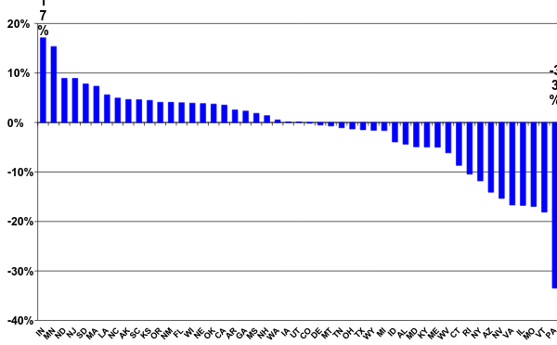
EQUALITY: District Funding by Student Poverty by State
U.S. Avg.: Highest poverty districts receive $ 1,451 (15.6%) less per student than the lowest poverty districts
$ 725,000 for a school of 500 students

Slide 44
Funding Equity Issues for Students from Low-income Families
It costs more to educate low-income children, many of whom start school academically behind their more affluent peers.
Title I of the ESEA: Purpose is to level the educational playing field for poor children. The assumption was that all states had comparable funding between districts. The objective was to supplement, not supplant funding. The Title I formula assumes it costs a district 40% more to educate a student in poverty than a student not in poverty.
Funding Gaps 2015, Education Trust (2015)
Reviewed statistical based methods for estimating the extra costs of educating disadvantaged students and devised a method to estimate pupil weights directly. Concluded that the weighted formula should be between 111% and 215%.
Dumcombe & Yinger (2004)

Slide 45
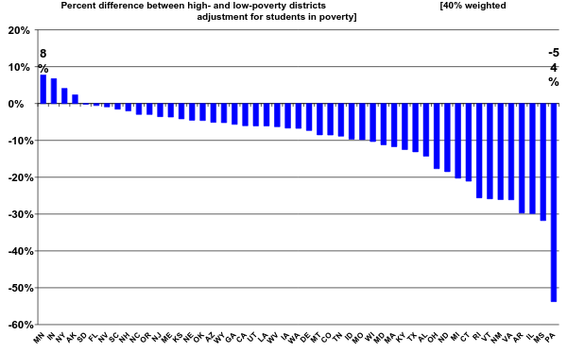
EQUITY: District Funding by Student Poverty by State
(w/ 40% Weighted Adjustment)
U.S. Avg.: Highest poverty districts receive $ 2,327 (29%) less per student than the lowest poverty districts
$ 1.1 million for a school of 500 students

Slide 46
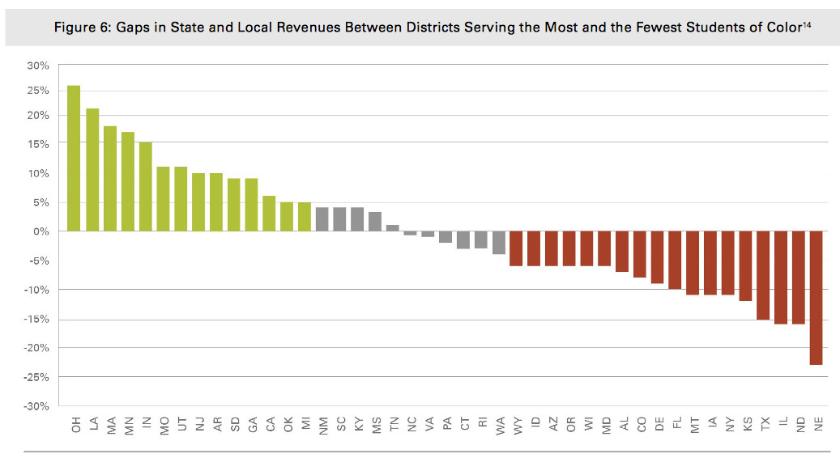
District Funding by Student of Color by State
Districts serving the most students of color receive $ 2,000 (15%) less per student than districts serving the fewest students of color
$ 1,000,000 for a school of 500 students

Slide 47
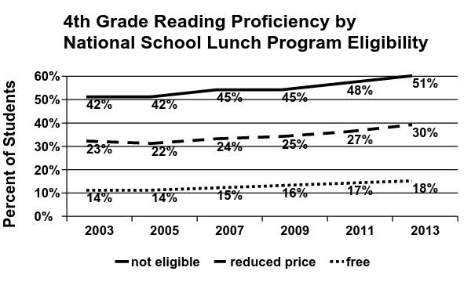
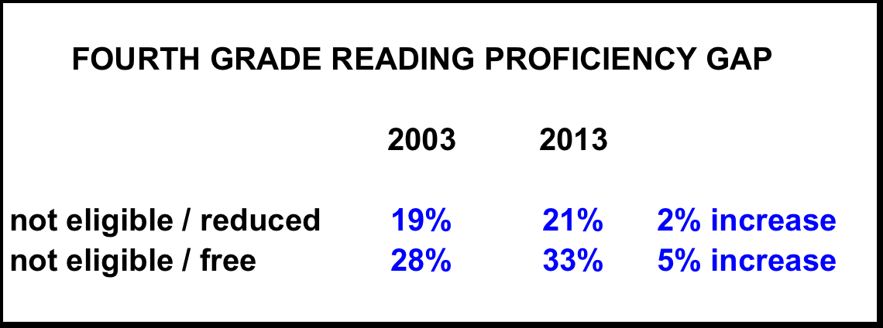
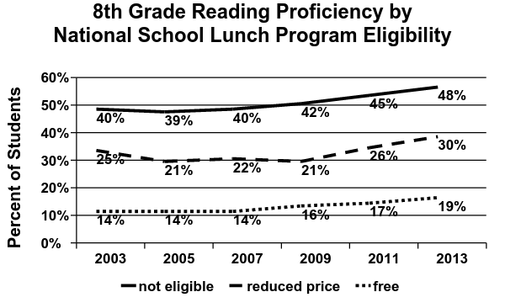
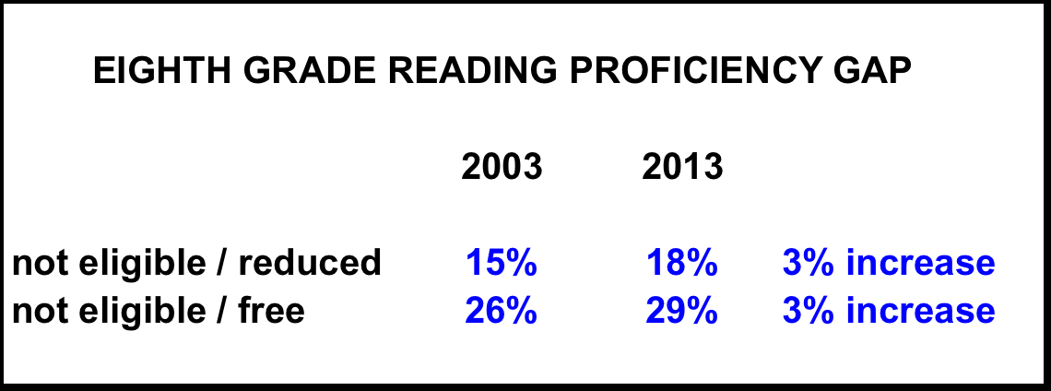
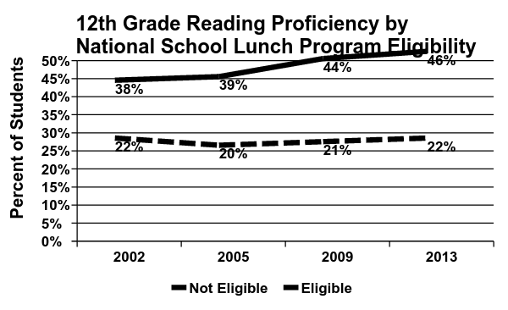
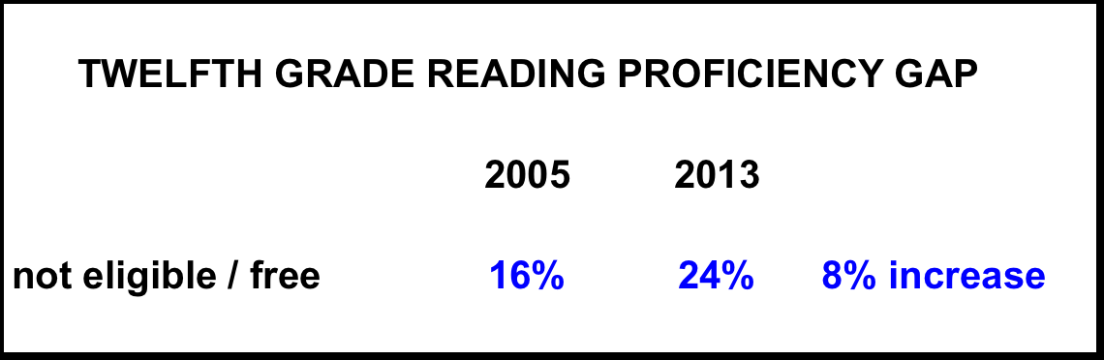
NAEP Reading Proficiency by Student Income

Slide 48
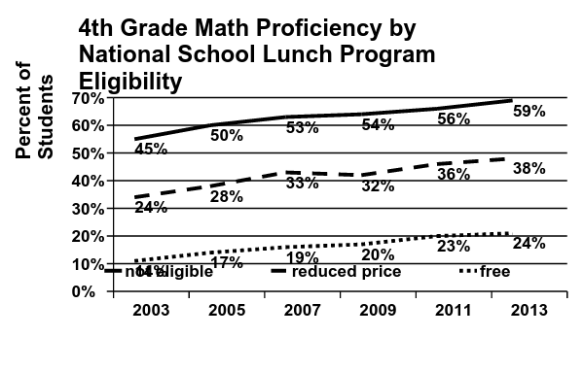
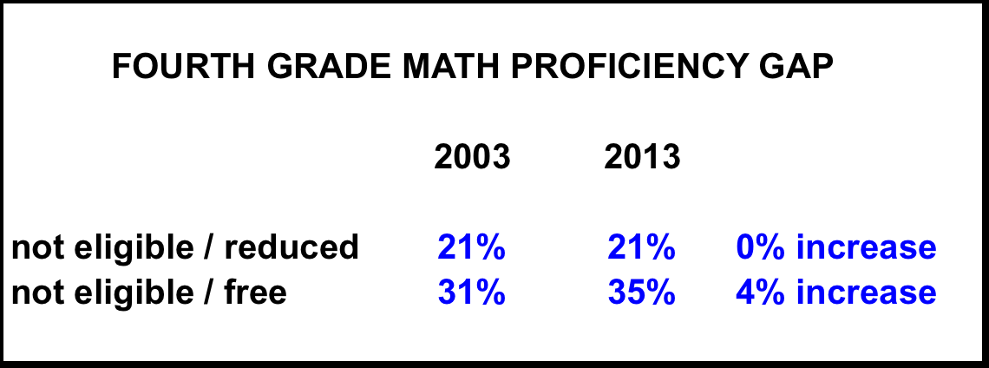
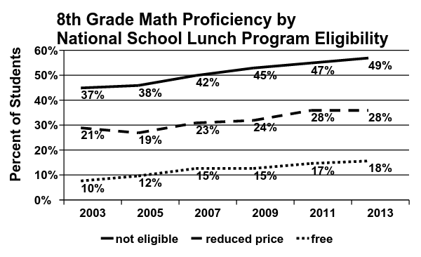
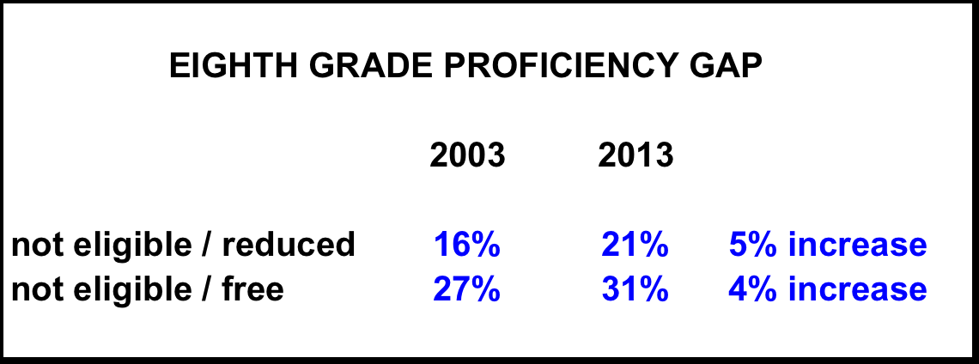
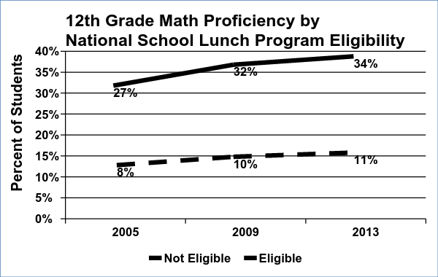
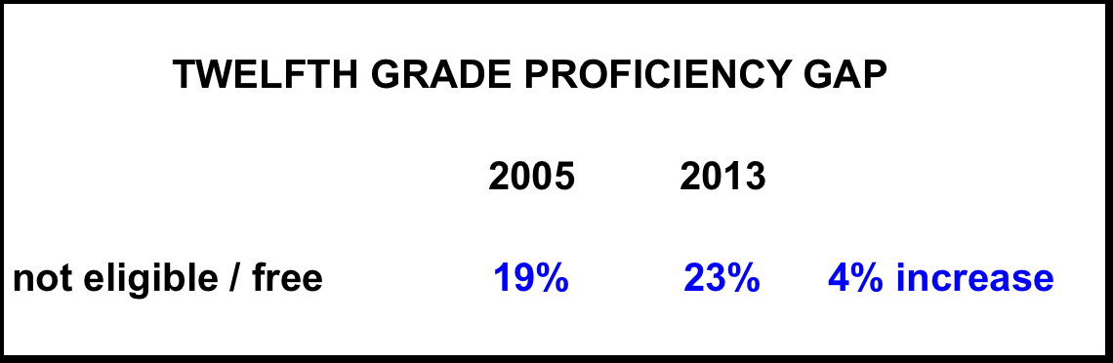
NAEP Math Proficiency by Student Income

Slide 49
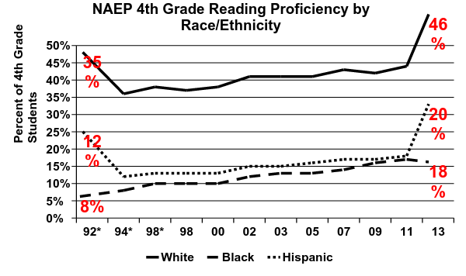
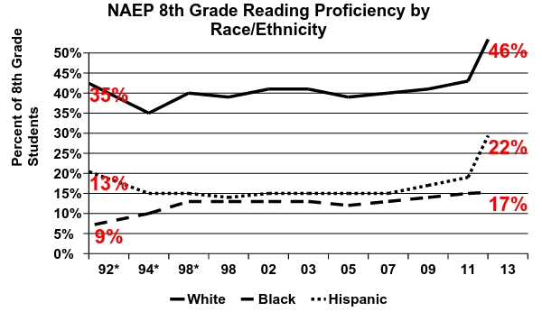
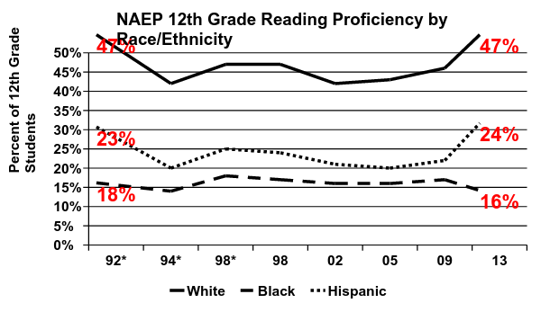
NAEP Reading Proficiency
by Race/Ethnicity

Slide 50
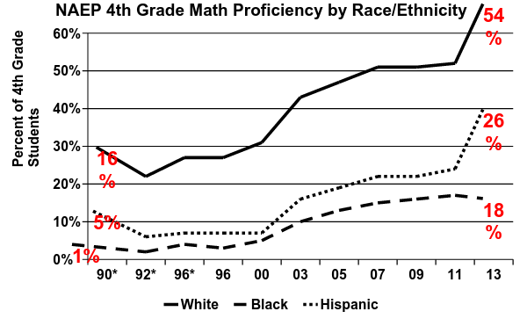
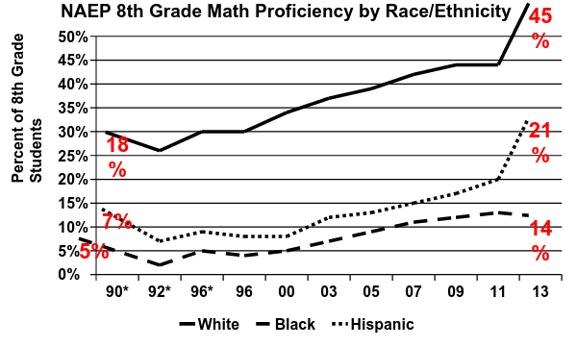
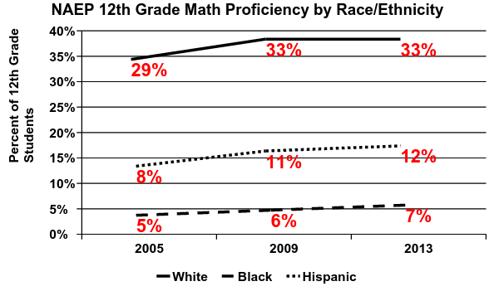
NAEP Math Proficiency
by Race/Ethnicity

Slide 51
3. POLITICS
FEDERAL GOVERNMENT
Executive Branch (President)
Legislative Branch
Judicial Branch
Secretary of Education
Department of Education
Various Departments
STATE GOVERNMENT
Executive Branch (Governors)
Legislative Branch
Secretary of Education
Department of Education
State Superintendent
State School Board
Teacher Credentialing Board
LOCAL GOVERNMENT
Executive Branch (Mayors)
City Councils
School Superintendents
School Boards of Education
District Administration
School Principals
Notes:
Fragmented, complex, inconsistent Multiple actors and institutions Rube-Goldberg like contraption
Private – Public Federalized - local

Slide 52
POLITICS
EDUCATION INDUSTRY
universities
“experts”
alternative credential programs
continuing education industry
PRIVATE
unions
professional organizations
“think tanks”
foundations
corporations
curriculum publishers
education management
charter schools
special issue groups
consumer organizations
advocacy groups
lobbyists
GENERAL PUBLIC
general citizenry
media
internet
FRONT LINE
school principals
teachers
parents
students
Notes:
Fragmented, complex, inconsistent Multiple actors and institutions Rube-Goldberg like contraption
Private – Public Federalized - local

Slide 53
Annual Spending (2012-13)
Department of Defense $ 632 billion
K-12 (private and public) $ 669 billion
Colleges & universities $ 496 billion
= $ 1.165 trillion
Notes:
50 million students

Slide 54
POLITICS
standards curriculum teacher development student evaluation
outcomes pedagogy teacher evaluation resource allocation
Federal Activism
No Child Left Behind
Race to the Top
School Improvement Grants
NCLB Waivers
Common Core
State Re-Activism
anti-union activities
anti-federal “overreach”
teacher evaluation
curriculum
charter schools
Privatization
Private schools
Charter schools
Vouchers
Management
Tuition Tax Credits
Curriculum
Technology

Slide 55
4. Culture
FRAMES
Individual Frame Private Sector Frame
Blame Frame Back to Basics Frame
Visionary Leader Frame More Funding Frame
Magic Bullet Frame Computers Frame
Local Solutions Frame
O’Neil & Haydon, (2013)

Slide 56
Culture
child centered vs. teacher directed
anti-science
long standing mistrust of the purpose of data
educator autonomy, implicit power relationships
cynicism about fads, new ideas, education reform
resistance to performance feedback

Slide 57
5. PREPARATION
0%
15%
24%
25%
21%
15%
39%
61%
0%
2%
22%
54%
14%
8%
24%
76%
Strong design
Meets standard
Nearly meets standard
Partly meets standard
Meets a small part of standard
Does not meet standard
Nearly meets to strong design
Does not meet to partly meets
0%
16%
19%
11%
22%
32%
35%
65%
0%
32%
0%
26%
0%
42%
32%
68%
 | Early Reading | Elementary Mathematics | Classroom Management | Lesson Planning | Assessment and Data | Student Teaching
0%
5%
16%
6%
20%
54%
21%
80%
0%
1%
14%
27%
23%
35%
15%
85%
2014 Teacher Prep Review, National Council on Teacher Quality

Slide 58
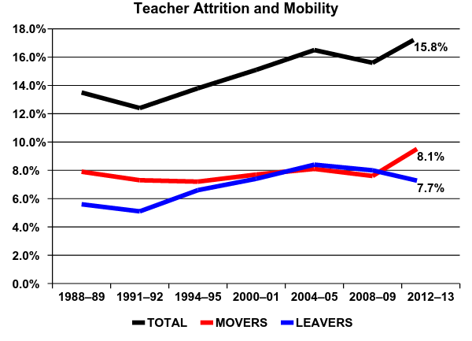
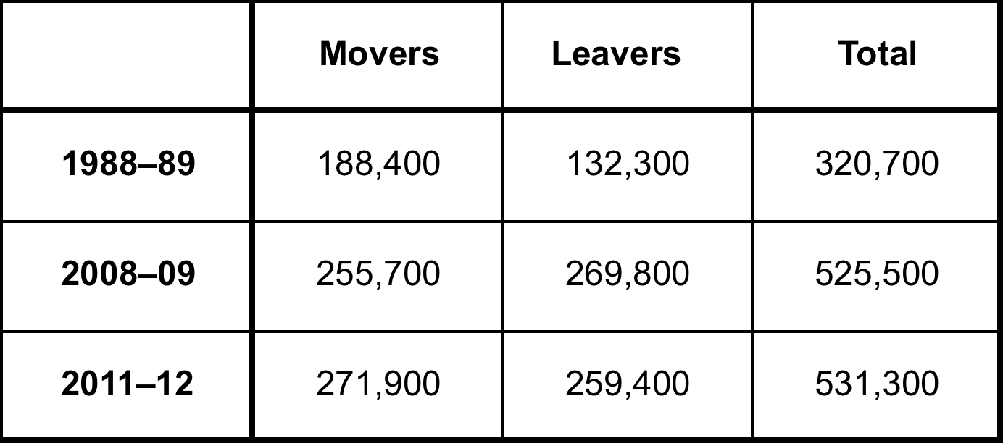
6. TURNOVER
Teacher Attrition and Mobility: Results from the 2012–13 Teacher Follow-up Survey, National Center for Education Statistics (2014)

Slide 59
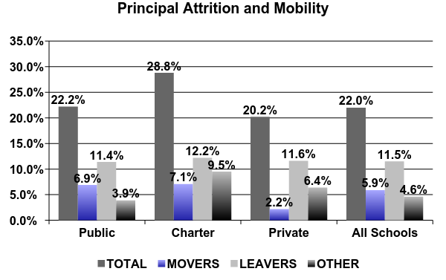

6. TURNOVER
Principal Attrition and Mobility: Results from the 2012–13 Principal Follow-up Survey, National Center for Education Statistics (2014)

Slide 60


School Superintendents
Average tenure of superintendents = 3.3 yrs
79% of CGCS Superintendents have 5 or less years experience
Council of the Great City Schools, Urban School Superintendents: Characteristics, Tenure and Salary (2014)

Slide 61
7. SUSTAINABILITY
• implemented with procedural fidelity and desired outcomes (effectiveness) at the consumer level
maintains over time
maintains over generations of practitioners and decision-makers
operates within existing resources (financial, staff, materials) and existing mandates
becomes institutionalized, routine…
“the way we do business”
National Implementation Research Network (NIRN)

Slide 62
Why do we care about “sustainability”?
average life of an education innovation is 18-48 months (Latham, 1988)
evidence-based and effective practices often fail due to ineffective implementation strategies (National Implementation Research Network)
major gaps exist between what is known as effective practices (i.e. theory and science) and what is actually done (i.e. policy and practice)
(National Implementation Research Network)
initial data on comprehensive school reform models initiated in 2000:
1 in 5 maintained reforms through 2002
1 in 10 maintained reforms through 2004
(American Institute for Research)

Slide 63
A Case Study: New York City Public Schools
Scale: 1.1 million students, 135,000 employees, 1,800 schools
Leadership 2001 – 2013: Michael Bloomberg, Joel Klein, Dennis Walcott
• decentralized control and accountability to school level (more authority / responsibility for learning), school grades, expanded use of test scores
• dismantled much of system wide-administrative bureaucracy
• established principal support networks focused on coaching
• focus on data guided practice (collects and publishes enormous quantity of school and student data)
• significantly increased school choice (more charter schools, small High Schools, more transparency for public schools)
• expansion of school choice and school competition

Slide 64
A Case Study: New York City Public Schools
Leadership 2014 forward: Bill de Blasio, Carmen Farina
• a methodological dismantling of the Bloomberg era policies and practices
• dissolved most principal networks, recreating a centralized hierarchy
• rejected use of data to evaluate school performance
“I know a good quality school when I am in the building.”
when presented a multi-year study showing that students who attended the small high schools started by the Bloomberg administration were more likely to graduate and attend college than their peers at larger schools she dismissed the conclusions. “It’s one view of things,” she said. “There are many views about everything”.
• abolished letter-grade ratings for schools
• reduced reliance on test scores

Slide 65
What are the obstacles to building effective school leadership?
To be continued…

