Slide 1


FLOWER FRAME
Presentation Template
www.freepptbackgrounds.net

Slide 2
CONTENTS
1. Powerpoint
3. Keynote
2.Web Design
4. Development

Slide 3
ONE
POWERPOINT

Slide 4


TITLE HERE
We use well-known development methodologies to create a customized approach for each of the projects. This allows us to achieve high quality outcomes and full transparency towards.
TEMPLATE
TEMPLATE
TEMPLATE
TEMPLATE
A complex idea can be conveyed with just a single still
image, namely making it possible to absorb large
amounts of data quickly.

Slide 5

TITLE HERE
We use well-known development methodologies to create a customized approach for each of the projects. This allows us to achieve high quality outcomes and full transparency towards.
We use well-known development methodologies to create a customized approach for each of the projects. This allows us to achieve high quality outcomes and full transparency towards.
We use well-known development methodologies to create a customized approach for each of the projects. This allows us to achieve high quality outcomes and full transparency towards.
We use well-known development methodologies to create a customized approach for each of the projects. This allows us to achieve high quality outcomes and full transparency towards.
We use well-known development methodologies to create a customized approach for each of the projects. This allows us to achieve high quality outcomes and full transparency towards.
A complex idea can be conveyed with just a single still image, namely making it possible to absorb large amounts of data quickly.

Slide 6
TITLE HERE
1
We hope that this template will return to you as a time, money and reputation.
2
We hope that this template will return to you as a time, money and reputation.
3
KEYWORD
KEYWORD
We hope that this template will return to you as a time, money and reputation.
4
We hope that this template will return to you as a time, money and reputation.
5
We hope that this template will return to you as a time, money and reputation.
6
We hope that this template will return to you as a time, money and reputation.
KEYWORD
KEYWORD

Slide 7
TITLE HERE
OPTION HERE
A complex idea can be conveyed with just a single still image, namely making it possible to absorb large amounts of data quickly.
OPTION HERE
A complex idea can be conveyed with just a single still image, namely making it possible to absorb large amounts of data quickly.
OPTION HERE
A complex idea can be conveyed with just a single still image, namely making it possible to absorb large amounts of data quickly.
OPTION HERE
A complex idea can be conveyed with just a single still image, namely making it possible to absorb large amounts of data quickly.

Slide 8
TITLE HERE
02
Option here
NOTE HERE
A complex idea can be conveyed with just a single still image, namely making it possible to absorb large amounts of data quickly.
01
03
Option here
01
Option here
NOTE HERE
A complex idea can be conveyed with just a single still image, namely making it possible to absorb large amounts of data quickly.
02
04
Option here
NOTE HERE
A complex idea can be conveyed with just a single still image, namely making it possible to absorb large amounts of data quickly.
03
NOTE HERE
A complex idea can be conveyed with just a single still image, namely making it possible to absorb large amounts of data quickly.
04

Slide 9
TWO
WEB DESIGN

Slide 10

TITLE HERE
NOTE HERE
NOTE HERE
A complex idea can be conveyed with just a single still image, namely making it possible to absorb large amounts of data quickly.
A complex idea can be conveyed with just a single still image, namely making it possible to absorb large amounts of data quickly.
NOTE HERE
NOTE HERE
A complex idea can be conveyed with just a single still image, namely making it possible to absorb large amounts of data
A complex idea can be conveyed with just a single still image, namely making it possible to absorb large

Slide 11
TITLE HERE
Mobile
Phone
Skype
A complex idea can be conveyed with just a single still image, namely making it possible to absorb large amounts of data quickly.
A complex idea can be conveyed with just a single still image, namely making it possible to absorb large amounts of data quickly.
A complex idea can be conveyed with just a single still image, namely making it possible to absorb large amounts of data quickly.

Slide 12
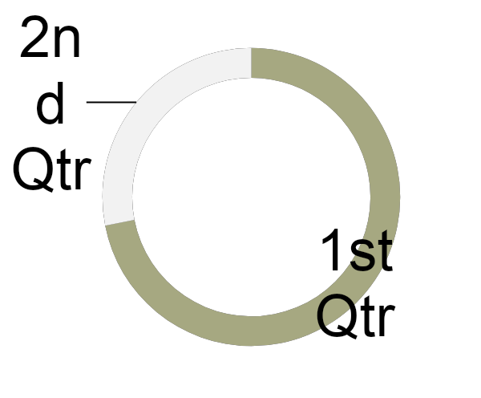


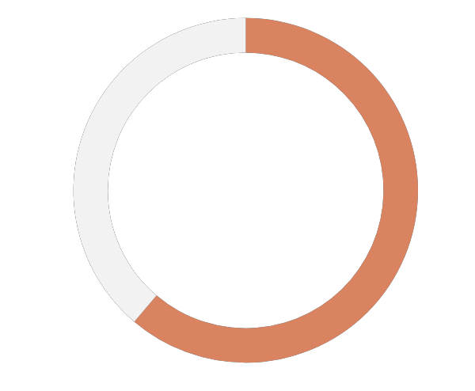
TITLE HERE
20%
80%
30%
40%
STAGE HERE
STAGE HERE
STAGE HERE
STAGE HERE
70%
We hope that this template will return to you
STAGE HERE
76%
STAGE HERE
76%

Slide 13

TITLE HERE
We use well-known development methodologies to create a customized approach for each of the projects. This allows us to achieve high quality outcomes and full transparency towards.
We use well-known development methodologies to create a customized approach for each of the projects. This allows us to achieve high quality outcomes and full transparency towards.
We use well-known development methodologies to create a customized approach for each of the projects. This allows us to achieve high quality outcomes and full transparency towards. We use well-known development methodologies to create a customized approach for each of the projects. This allows us to achieve high quality outcomes and full transparency towards. We use well-known development methodologies to create a customized approach for each of the projects. This allows us to achieve high quality outcomes and full transparency towards.
Reworking
We hope that this template will return to you as a time, money and reputation.

Slide 14




TITLE HERE
ASEP SUNARYA
EUIS KOMARIAH
DADANG PERMANA
PUTRI TERTUKAR
Creative Director
Chief Excutive Officer
General Manager
HR manager
We hope that this template will return to you as a time, money and reputation.
We hope that this template will return to you as a time, money and reputation.
We hope that this template will return to you as a time, money and reputation.
We hope that this template will return to you as a time, money and reputation.

Slide 15
THREE
KEYNOTE

Slide 16

TITLE HERE
MORE THAN TEMPLATE
Click here to add you to the
Center of the narrative thought
01
NOTE HERE
A complex idea can be conveyed with just a single still image, namely making it possible to absorb large amounts of data quickly.
02
NOTE HERE
A complex idea can be conveyed with just a single still image, namely making it possible to absorb large amounts of data quickly.
03
NOTE HERE
A complex idea can be conveyed with just a single still image, namely making it possible to absorb large amounts of data quickly.

Slide 17
TITLE HERE
DESCRIPTION HERE
A complex idea can be conveyed with just a single still image, namely making it possible to absorb large amounts of data quickly.
DESCRIPTION HERE
A complex idea can be conveyed with just a single still image, namely making it possible to absorb large amounts of data quickly.
DESCRIPTION HERE
A complex idea can be conveyed with just a single still image, namely making it possible to absorb large amounts of data quickly.

Slide 18
TITLE HERE
ADVERTISING
SEO ANALYSIS
A complex idea can be conveyed with just a single still image, namely making it possible to absorb large amounts of data quickly.
A complex idea can be conveyed with just a single still image, namely making it possible to absorb large amounts of data quickly.
DELIVERY
PUBLIC RELATIONS
A complex idea can be conveyed with just a single still image, namely making it possible to absorb large amounts of data quickly.
A complex idea can be conveyed with just a single still image, namely making it possible to absorb large amounts of data quickly.

Slide 19
TITLE HERE
Determination
Competing Competitor
Personal Class Action
Good Performance
Durability and Energy
Advanced Level Clash Action
Third Party
We hope that this template will return to you as a time, money and reputation.
Quite Technology
We hope that this template will return to you as a time, money and reputation.

Slide 20
TITLE HERE
TITLE HERE
A
We hope that this template will return to you as a time, money and reputation.
TITLE HERE
We hope that this template will return to you as a time, money and reputation.
B
TITLE HERE
C
We hope that this template will return to you as a time, money and reputation.

Slide 21
FOUR
DEVELOPMENT

Slide 22

TITLE HERE
DESCRIPTION HERE
We use well-known development methodologies to create a customized approach for each of the projects. This allows us to achieve high quality outcomes and full transparency towards.
We use well-known development methodologies to create a customized approach for each of the projects. This allows us to achieve high quality outcomes and full transparency towards.
We have many We use well-known development methodologies to create a customized approach for each of the projects. This allows us to achieve high quality outcomes and full transparency towards.
We have many We use well-known development methodologies to create a customized approach for each of the projects. This allows us to achieve We use well-known development methodologies to create a customized approach for each of the projects. This allows us to achieve high quality outcomes and full transparency towards.
We have many We use well-known development methodologies to create a customized approach for each of the projects. This allows us to achieve high quality outcomes and full transparency towards.
We have many PowerPoint templates that has been specifically designed.
We have many PowerPoint templates that has been specifically designed.

Slide 23
TITLE HERE
DESCRIPTION HERE
Go ahead and replace it with your own text.
DESCRIPTION HERE
Go ahead and replace it with your own text.
DESCRIPTION HERE
Go ahead and replace it with your own text.
DESCRIPTION HERE
Go ahead and replace it with your own text.
DESCRIPTION HERE
Go ahead and replace it with your own text.
DESCRIPTION HERE
Go ahead and replace it with your own text.

Slide 24

TITLE HERE
Technology
We hope that this template will return to you as a time, money and reputation.
New Idea
We hope that this template will return to you as a time, money and reputation.
Deadline
We hope that this template will return to you as a time, money and reputation.
Good Capacity
We hope that this template will return to you as a time, money and reputation.

Slide 25
TITLE HERE
MORE THAN TEMPLATE
A complex idea can be conveyed with just a single still image, namely making it possible to absorb large amounts of data quickly.
MORE THAN TEMPLATE
A complex idea can be conveyed with just a single still image, namely making it possible to absorb large amounts of data quickly.
MORE THAN TEMPLATE
A complex idea can be conveyed with just a single still image, namely making it possible to absorb large amounts of data quickly.
01
02
03

Slide 26

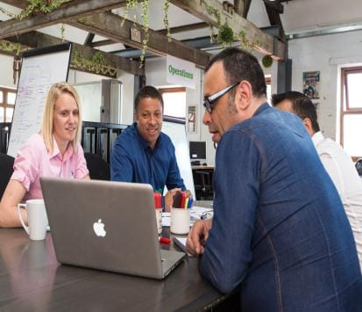


TITLE HERE
OPTION HERE
A complex idea can be
conveyed with just a single
still image, namely making it
possible to absorb large
amounts of data quickly.
OPTION HERE
A complex idea can be
conveyed with just a single
still image, namely making it
possible to absorb large
amounts of data quickly.
OPTION HERE
A complex idea can be
conveyed with just a single
still image, namely making it
possible to absorb large
amounts of data quickly.
OPTION HERE
A complex idea can be
conveyed with just a single
still image, namely making it
possible to absorb large
amounts of data quickly.

Slide 27
THANK YOU !
Flower Frame
Google Slides
www.freepptbackgrounds.net

